Slide 1
Impacts of SEEs
LHC Performance Workshop
Chamonix 2009
R2E Taskforce
B. Bellesia, M. Brugger, A. Ferrari, D. Kramer, R. Losito,
S. Myers, M. Pojer, S. Roesler, M. Solfaroli, A. Vergara,
S. Weisz, T. Wijnands
with input from:
R. Assmann, A. Ballarino, J.C. Billy, S. Claudet, B. Dehning,
R. Denz, Q. King, M. Lamont, J. Lendaro, M. Moll, D. Perrin,
R. Schmidt, H. Thiesen, Y. Thurel, J. Uythoven, M. Zerlauth

Slide 2
Overview
R2E 2008 Activities and Conclusions
Example of UJ76/RR73,77 to illustrate the chosen analysis & evaluation approach
Underground Areas – Expected Radiation & Prioritization
Suggested Priority Classification of Equipment
1st Iteration on Machine Protection related Systems
Performed Radiation Tests
Implications for 2009
What is needed for the mid/long-term

Slide 3
R2E 2008 Activities and Conclusions
Review of available simulation data and respective iteration
Split of priorities in short/mid/long-term
Loss assumptions and scaling for coming years
FLUKA simulations for most critical areas
Shielding studies for most critical areas, discussion of possible solution
Study of possible temporary move of the betatron cleaning to P3
Prioritization of underground radiation areas containing electronics
Monitoring during start-up, successful comparison with simulations
Radiation Tests and implications
SEE related shutdown activities
(UJ76/TZ76, RR73/77, UA63/67, UX85)
http://ab-div.web.cern.ch/ab-div/Meetings/r2e

Slide 4
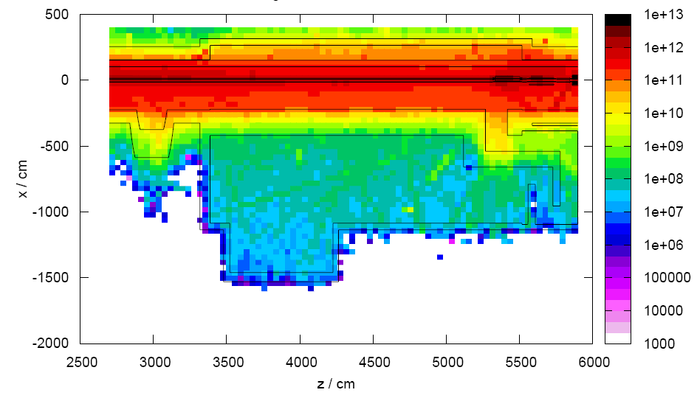
UJ76/RR73/77 Approach
Early awareness of radiation levels
Detailed analysis based on tracking studies (SIXTRACK) and cascade simulations (FLUKA) to estimate the distribution and maximum radiation doses and fluences
Analysis of related uncertainties
(assumptions, models, statistics, limitations)
Inventory and location of installed electronics
Study of consequences in case of failure
Study of different solutions
(shielding, relocation, combinations)
Proposed solution outlined and discussed in respective ECR (LHC-EC-UJ76)
Staged implementation approach to allow for additional measurements during operation

Slide 5
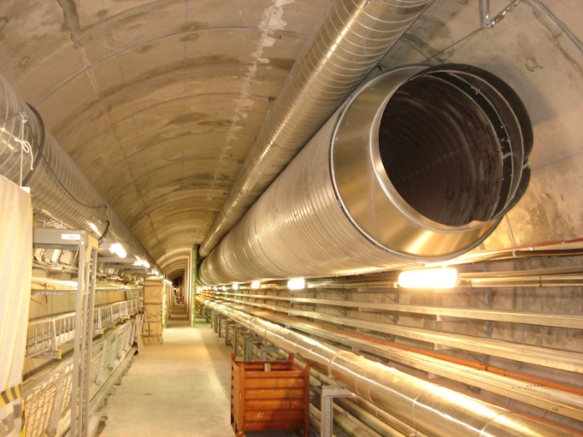
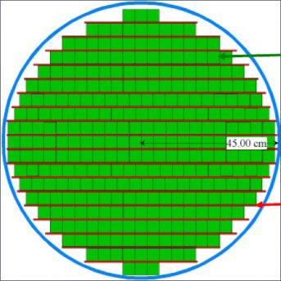
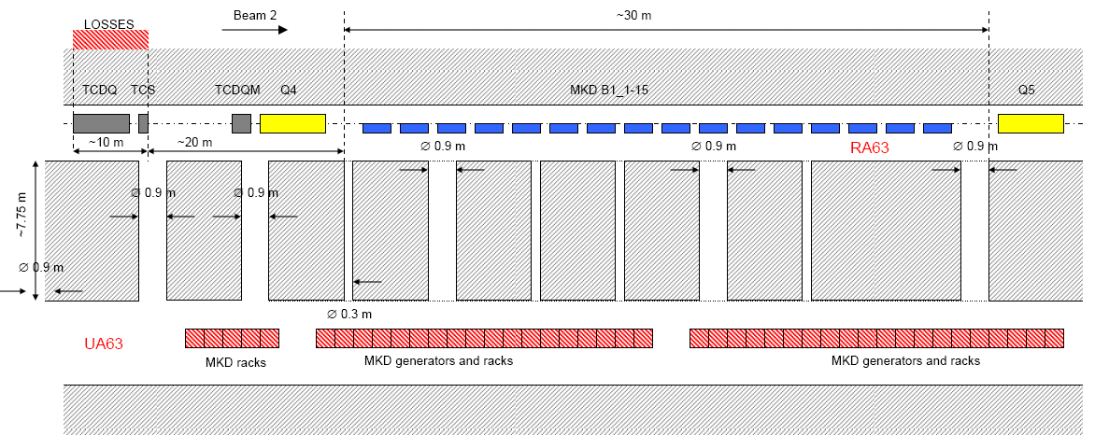
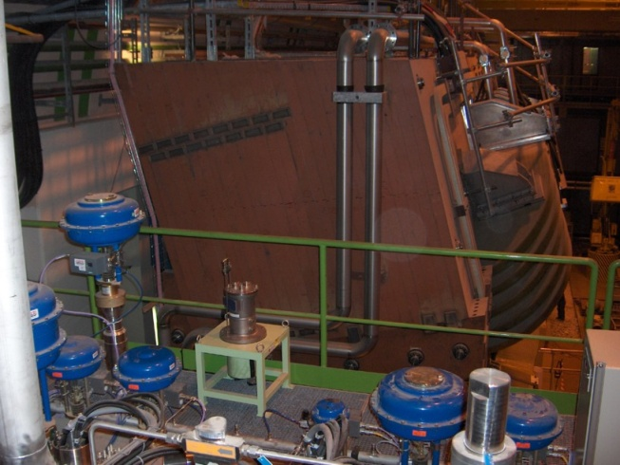
SEEs related 2008/9 Shutdown’s Activities
IR7
  RR73/77 installation of final shielding
  TZ76 preparation
  UJ76
    UPS removal (from UJ76 into TZ76)
    additional shielding wall to increase
    protection of safe room
IR6
  Shielding of ducts between tunnel and UA63/67
IR8
  UX85b installation of remote controllers
Additional identified holes in shielding were already mostly closed before first start-up (e.g., geometer holes)
Critical Areas: check for additional monitoring, iterations

Slide 6
Radiation Levels- Summary - Prioritized
Current knowledge based on simulations only, thus detailed analysis and iteration required during early operation
Important uncertainties due to assumptions going into loss terms (real integrated luminosity, distribution of losses, …)
Priorities assigned during 2008 according to
  system sensitivity and criticality
  uncertainty of loss assumptions (e.g., UJ76)
  possible short-term measures (e.g., UA63/67)
Continuous evaluation – Prioritization (colour coding)
  Ongoing work during this shutdown
  Highest priority for upcoming iterations/evaluations
  Second priority, cross-check with measurements
  Lowest priority, layout check and evaluation
Other color codes:
  areas which require additional calculations analysis to be done

Slide 7
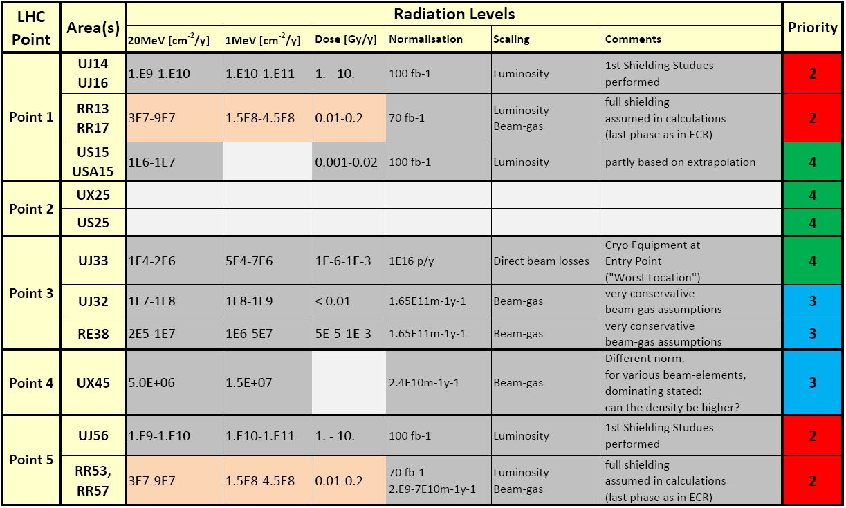
Radiation Levels - Summary - Prioritized
!!! Simulations Only !!!
!!! Loss Assumptions !!!

Slide 8
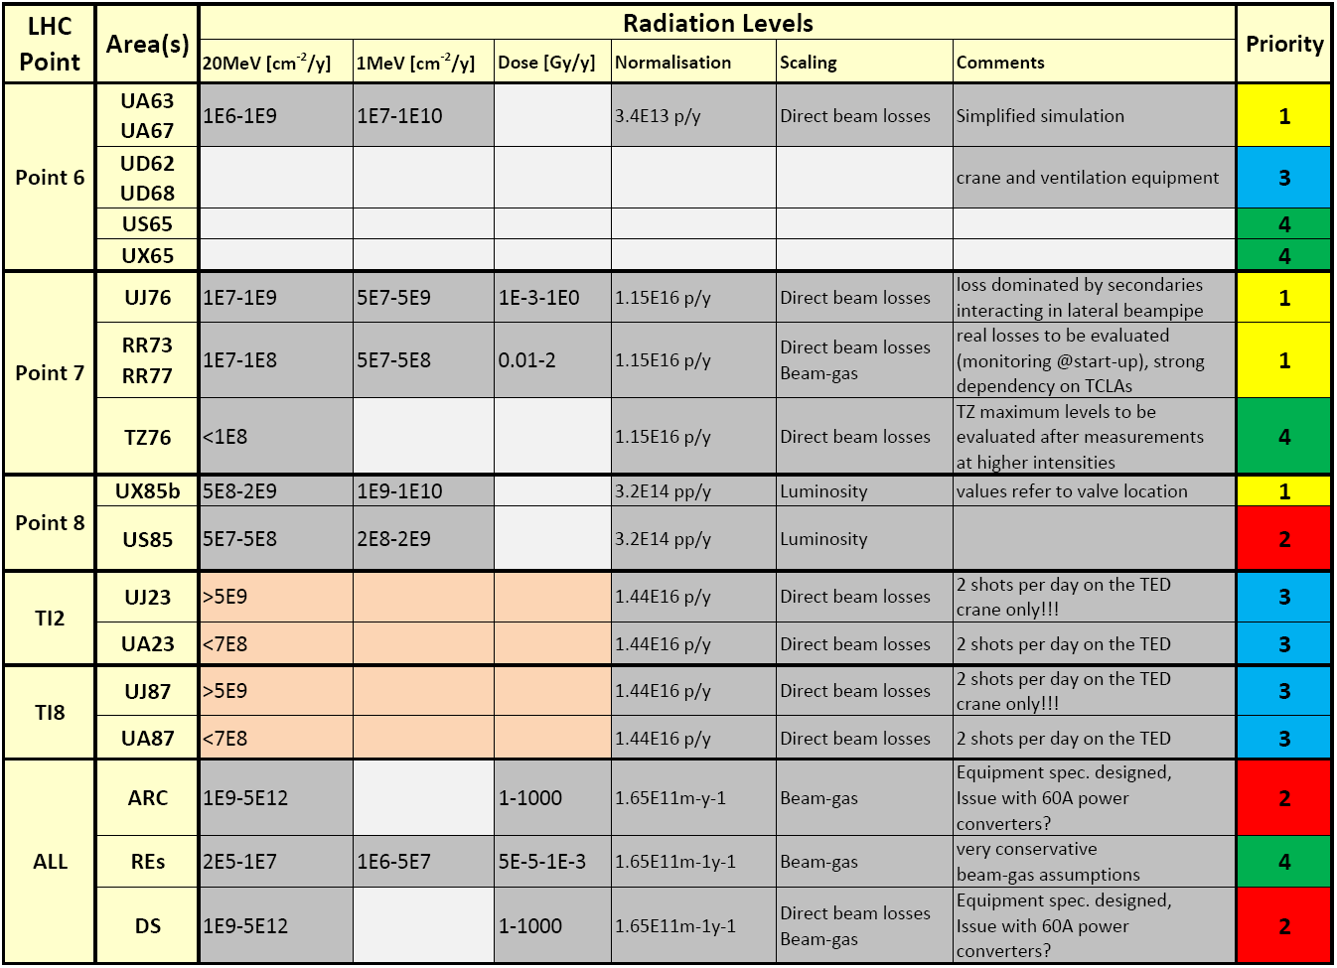
Radiation Levels- Summary - Prioritized
!!! Simulations Only !!!
!!! Loss Assumptions !!!

Slide 9
Radiation Levels – Evolution
!!! Simulations Only !!!
!!! Loss Assumptions !!!
[ Loss/Intensity-Scaling: M. Lamont]

Slide 10
Equipment Criticality Levels
Suggested colour coding according to equipment classes and respective implications:
1. Machine Safety Control
  Beam Interlock System (BIC)
  Damage related sub-systems (PIC, WIC, FMCM, BDS,…)
1.b. Systems whose input is important to assure machine protection
  e.g., BLM
2. Systems whose dis-functionality leads to downtime or localized damage only
  e.g., Power Converters, BTV
3. Impact on Beam Quality
  e.g., Vacuum
4. Monitoring mainly
  e.g., RAMSES (tunnel monitors)

Slide 11
Application to Machine Protection
LHC
Devices
Movable Detectors
Beam Loss
Monitors
BCM
Experimental Magnets
Collimator
Positions
Environmental
parameters
Safe Beam Parameter Distribution
LHC
Devices
LHC
Devices
Special-
BLMs
Safe
LHC
Parameter
Software
Interlocks
Sequencer
Operator Buttons
CCC
LHC
Experiments
Transverse Feedback
Beam
Aperture
Kickers
Collimation
System
Beam Interlock System
Beam
Dumping
System
Safe
Beam
Flag
Powering
Interlocks
sc magnets
Powering
Interlocks
nc magnets
Magnet Current Monitor
Beam loss monitors
BLM
Beam
Lifetime
FBCM
Access
System
Vacuum
System
Screens / Mirrors
BTV
Injection Interlock
RF
System
Timing System
(Post Mortem Trigger)
Magnets
Power Converters
Monitors
aperture limits
(some 100)
Monitors in arcs
(several 1000)
QPS
(several 1000)
Power
Converters
~1500
AUG
UPS
Cryo
OK
Doors
EIS
Vacuum
valves
Access
Safety
Blocks
RF Stoppers
© R. Schmidt

Slide 12
Machine Protection Overview
LHC
Devices
Movable Detectors
Beam Loss
Monitors
BCM
Experimental Magnets
Collimator
Positions
Environmental
parameters
Safe Beam Parameter Distribution
LHC
Devices
LHC
Devices
Special-
BLMs
Safe
LHC
Parameter
Software
Interlocks
Sequencer
Operator Buttons
CCC
LHC
Experiments
Transverse Feedback
Beam
Aperture
Kickers
Collimation
System
Beam Interlock System
Beam
Dumping
System
Safe
Beam
Flag
Powering
Interlocks
sc magnets
Powering
Interlocks
nc magnets
Magnet Current Monitor
Beam loss monitors
BLM
Beam
Lifetime
FBCM
Access
System
Vacuum
System
Screens / Mirrors
BTV
Injection Interlock
RF
System
Timing System
(Post Mortem Trigger)
Magnets
Power Converters
Monitors
aperture limits
(some 100)
Monitors in arcs
(several 1000)
QPS
(several 1000)
Power
Converters
~1500
AUG
UPS
Cryo
OK
Doors
EIS
Vacuum
valves
Access
Safety
Blocks
RF Stoppers
© R. Schmidt

Slide 13
What Sits Where – Critical?
LHC
Devices
Movable Detectors
Beam Loss
Monitors
BCM
Experimental Magnets
Collimator
Positions
Environmental
parameters
Safe Beam Parameter Distribution
LHC
Devices
LHC
Devices
Special-
BLMs
Safe
LHC
Parameter
Software
Interlocks
Sequencer
Operator Buttons
CCC
LHC
Experiments
Transverse Feedback
Beam
Aperture
Kickers
Collimation
System
[J. Uythoven]
- UA63 & UA67
- Ducts will be filled
Beam Interlock System
Beam
Dumping
System
Safe
Beam
Flag
Powering
Interlocks
sc magnets
Powering
Interlocks
nc magnets
Magnet Current Monitor
Beam loss monitors
BLM
Beam
Lifetime
FBCM
Access
System
Vacuum
System
Screens / Mirrors
BTV
Injection Interlock
RF
System
Timing System
(Post Mortem Trigger)
Magnets
Power Converters
Monitors
aperture limits
(some 100)
Monitors in arcs
(several 1000)
QPS
(several 1000)
Power
Converters
~1500
AUG
UPS
Cryo
OK
Doors
EIS
Vacuum
valves
Access
Safety
Blocks
RF Stoppers
© R. Schmidt

Slide 14
What Sits Where – Critical?
LHC
Devices
Movable Detectors
Beam Loss
Monitors
BCM
Experimental Magnets
Collimator
Positions
Environmental
parameters
Safe Beam Parameter Distribution
LHC
Devices
LHC
Devices
[J. Lendaro]
- TZ76, UJ33 -> ok
- UA23, 87 -> to be checked
- UJ14, UJ16, UJ56 -> problematic!
Special-
BLMs
Safe
LHC
Parameter
Software
Interlocks
Sequencer
Operator Buttons
CCC
LHC
Experiments
Transverse Feedback
Beam
Aperture
Kickers
Collimation
System
Beam Interlock System
Beam
Dumping
System
Safe
Beam
Flag
Powering
Interlocks
sc magnets
Powering
Interlocks
nc magnets
Magnet Current Monitor
Beam loss monitors
BLM
Beam
Lifetime
FBCM
Access
System
Vacuum
System
Screens / Mirrors
BTV
Injection Interlock
RF
System
Timing System
(Post Mortem Trigger)
Magnets
Power Converters
Monitors
aperture limits
(some 100)
Monitors in arcs
(several 1000)
QPS
(several 1000)
Power
Converters
~1500
AUG
UPS
Cryo
OK
Doors
EIS
Vacuum
valves
Access
Safety
Blocks
RF Stoppers
© R. Schmidt

Slide 15
What Sits Where – Critical?
LHC
Devices
Movable Detectors
Beam Loss
Monitors
BCM
Experimental Magnets
Collimator
Positions
Environmental
parameters
Safe Beam Parameter Distribution
LHC
Devices
LHC
Devices
Special-
BLMs
Safe
LHC
Parameter
Software
Interlocks
Sequencer
Operator Buttons
CCC
LHC
Experiments
Transverse Feedback
Beam
Aperture
Kickers
Collimation
System
Beam Interlock System
Beam
Dumping
System
Safe
Beam
Flag
Powering
Interlocks
sc magnets
Powering
Interlocks
nc magnets
Magnet Current Monitor
[M. Zerlauth]
- Surface, UAs, TZ76 -> ok
- UJ56 -> system redundancy ok, to be reviewed in terms of relocation
Injection Interlock
RF
System
Beam loss monitors
BLM
Beam
Lifetime
FBCM
Access
System
Vacuum
System
Screens / Mirrors
BTV
Timing System
(Post Mortem Trigger)
Magnets
Power Converters
Monitors
aperture limits
(some 100)
Monitors in arcs
(several 1000)
QPS
(several 1000)
Power
Converters
~1500
AUG
UPS
Cryo
OK
Doors
EIS
Vacuum
valves
Access
Safety
Blocks
RF Stoppers
© R. Schmidt

Slide 16
What Sits Where – Critical?
LHC
Devices
Movable Detectors
Beam Loss
Monitors
BCM
Experimental Magnets
Collimator
Positions
Environmental
parameters
Safe Beam Parameter Distribution
LHC
Devices
LHC
Devices
Special-
BLMs
Safe
LHC
Parameter
Software
Interlocks
Sequencer
Operator Buttons
CCC
LHC
Experiments
Transverse Feedback
Beam
Aperture
Kickers
Collimation
System
Beam Interlock System
Beam
Dumping
System
Safe
Beam
Flag
Powering
Interlocks
sc magnets
Powering
Interlocks
nc magnets
Magnet Current Monitor
Beam loss monitors
BLM
Beam
Lifetime
FBCM
Access
System
Vacuum
System
Screens / Mirrors
BTV
Injection Interlock
RF
System
[J. C. Billy]
- all REs -> ok
- even points: UAs -> ok
- odd points: US15, UJ33, USC151 -> ok
- UJ76 -> solution foreseen
Timing System
(Post Mortem Trigger)
Magnets
Power Converters
Monitors
aperture limits
(some 100)
Monitors in arcs
(several 1000)
QPS
(several 1000)
Power
Converters
~1500
AUG
UPS
Cryo
OK
Doors
EIS
Vacuum
valves
Access
Safety
Blocks
RF Stoppers
© R. Schmidt

Slide 17
Machine Protection
[ R. Schmidt, M. Zerlauth]
Machine protection control equipment doesn’t rely on standard communication – hard links used where required
Electronics racks (controllers) are installed in surface areas and certain underground areas (UAs, USs, TZ76 and UJ56)
One current concern is the BIC rack located in the UJ56 (BIC, FMCM,…) where important radiation levels are expected (luminosity driven)
  the design is redundant (fail safe except both units would fail at the same time), thus no direct impact on machine safety (dump would occur)
The others are considered as radiation safe, with two ‘reminders’
  UA63/67: ducts to be filled (this shutdown) thus maximum radiation levels substantially reduced
  UJ-UA23/87: equipment close to UJs (e.g., access control rack), no early problem expected, possible impact due to injections on TED to be verified
protection control equipment installed in the tunnel (e.g., interfaces) were tested and showed high radiation resistance

Slide 18
Machine Protection
Further concern: collimation racks (for TCTs, TCLPs) in UJ14/16 and UJ56: options to be studied
A closer look to what is in the UA:
  control of TCDQ position: additional redundancy added, will work similar as the BETS [see talk J. Uythoven]
  BETS: problem with beam energy would lead to possible worst case accident, sufficient redundancy
  Extraction kicker switches will be checked during operation, no problem expected for the UAs
Energy extraction 13kA switches
  Located at some points, RRs, UAs (1st floor)
  radiation levels in the RRs of IP1 and IP5 to be reviewed
  more detailed analysis required
Transfer line dump on downstream TED
  UJ23/UA23, UJ87/UA87 radiation levels to be checked
  general issue (not SEE): circulating LHC beam and affected BLM monitor
Additional iterations ongoing through R2E/RadWG linked with MPWG
[ J. Uythoven]
[ A. Vergara]
[ J. Uythoven]

Slide 19
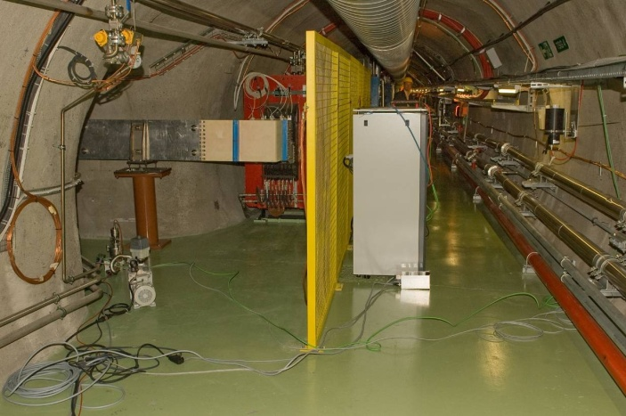
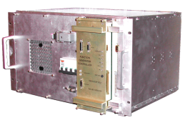
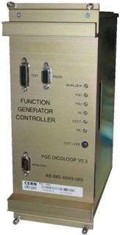
Recent Radiation Tests & Problems
Power Converters [Y. Thurel, Q. King]
  LHC60A-08V power part tests during 2008
  were successful
  SEUs counted on FGC generic, auto-recovery
  worked
  FGC (special design) of the 60kA (network interface) failure is linked to the Xilinx CPLD, so far it can not be excluded that failure could also be non-radiation caused
  If radiation sensitivity is confirmed then ‘extended MicroFIP’ or similar solution possible for the LHC60A (within one year)
  For all designs, significant additional hardening possible already on software level
  Situation significantly more complicated (time required, costs) in case full redesign of convertors needed
  Ok for 2009
  Additional radiation tests (1 month) required at CNGS

Slide 20
Recent Radiation Tests & Problems
New QPS devices to be installed in the tunnel (mid dipole only) [Reiner Denz]
  tests with the presently installed QPS system were promising (no hardware failure, only software)
  the new extended QPS device will be further modified
    increased hardening concerning firmware (triple voting etc.)
    power supplies (linear regulators etc.) including remote power cycle features
  link to Field-bus: communication loss clears the ‘Power Permit’ condition for the corresponding circuit, i.e., an alarm is created, the run can continue but re-start is not possible anymore.
  detection systems do not depend on the Field-bus communication with respect to detection/ protection
  additional tests (March PSI, Summer CNGS)
  Ok for 2009
Solid state relays used for the HTS current lead heating system
[Amalia Ballarino]
  two different types were tested at CNGS and both failed after some days of operation -> analysis ongoing, no details yet
  located in UJs, RRs (1st floor)
  additional radiation tests foreseen in 2009
  Ok for 2009

Slide 21
Implications on 2009 Operation
Based on current knowledge: no showstopper for 2009 restart
BIC (and collimation crates) in UJ56 (also in UJ14/16) to be kept in mind
Equipment and radiation levels in US85 to be checked
Monitoring of radiation levels, evaluation of loss assumptions and comparison with respective simulations
Iterations of areas/systems to continue
  Machine Protection related systems
  R2E iterations scheduled for all areas (following the assigned priorities) before startup
  Additional analysis required in case it’s decided to run through winter (possible short-term measures to be investigated)
Additional radiation tests required (CNGS and elsewhere)

Slide 22
What we should do…
Review of areas
  scheduled Iterations: 1 every 4 weeks (R2E)
  followed by a RadWG collecting detailed
  information of equipment/status/links/etc…
  visits to be scheduled as from now
  point owners collect/check global system information
  integration drawings (racks, monitors,…)
  review of monitor locations & settings
  assignment of maximum fluence/dose values
  (based on simulations, scaling, applying uncertainties)
Data collection
  general document database [existing]
  radiation levels & classifications (critical areas) [ongoing]
  inventory of concerned equipment systems [missing]
    Class
    Racks
  equipment details and inter-dependencies to be collected
    general problem not only for SEE [missing]
  consequences of equipment failure/malfunctioning [missing]
  repair (replacement) implications [missing]
Challenging
but Possible
Realistic
Currently
not Possible

Slide 23
What else is needed…
Early ‘Learning’
  efficient Monitoring tool allowing for quick analysis during early operation
  (monitor locations, settings to be reviewed now!)
  during start-up: concentrating on most important areas
  (UJ76, RRs, US85, UJ56,…)
  Continued/additional simulation studies
Knowledge & Development
  improve exchange between experiments & machine
  ‘SchoolDay’ to be organised
Radiation Tests & Facilities
  Coordinated radiation test campaigns (RadWG)
  External facilities
  New CERN facility?
Structure
  Organisational
  Procedures
  Supported (requested) by all concerned department & group leaders

Slide 24
Structure: R2E Suggestion
LHC Machine Committee
Policy for Electronics installed in areas with elevated radiation levels (R2E)
Evaluation of Radiation Levels: simulations, monitoring, proposal of measures (R2E)
Structure to implement the Policy (RadWG)
Radiation Tests (RadWG)
Control (Point Owners)
Point-Owners
R2E
Monitoring
RadWG
Testing
Equipment Owners
Installations
Electronics Policy

Slide 25
Conclusions
No imminent SEE related machine protection problems expected (identified so far!) during 2009 operation
Concerns discovered for early operation - BIC and collimation racks installed in UJ56 (UJ14, 16)
Further important impacts on operation to be expected
(as soon as intensity/losses go up)
Continuously updated priority list presented
Weak links & Redundancy: information difficult to access
  more detailed inventory needed on the mid/long-term
  equipment classes, evaluations to be added first
Related short & medium term actions discussed
R2E approach presented:
  iterations to tackle existing installations
  evaluation/selection of implementations
  mid/long-term structure proposed

Slide 26
Conclusions
R2E objectives for 2009
  Detailed review of areas
  (one by one, bi-weekly/monthly schedule)
  Monitoring tool
  (required for efficient analysis of early operation)
  Review of monitor locations and setting
  Definition of Maximum Radiation Levels
  (per area, and ‘operational year’)
  Additional simulation studies of areas
  Organization of ‘SchoolDay’ for electronics installed in radiation areas
  Definition of electronics policy for underground areas with radiation
  Evaluation/Monitoring during start-up
  Proposal of 2009/2010 shutdown activities

Slide 27
Backup

Slide 28
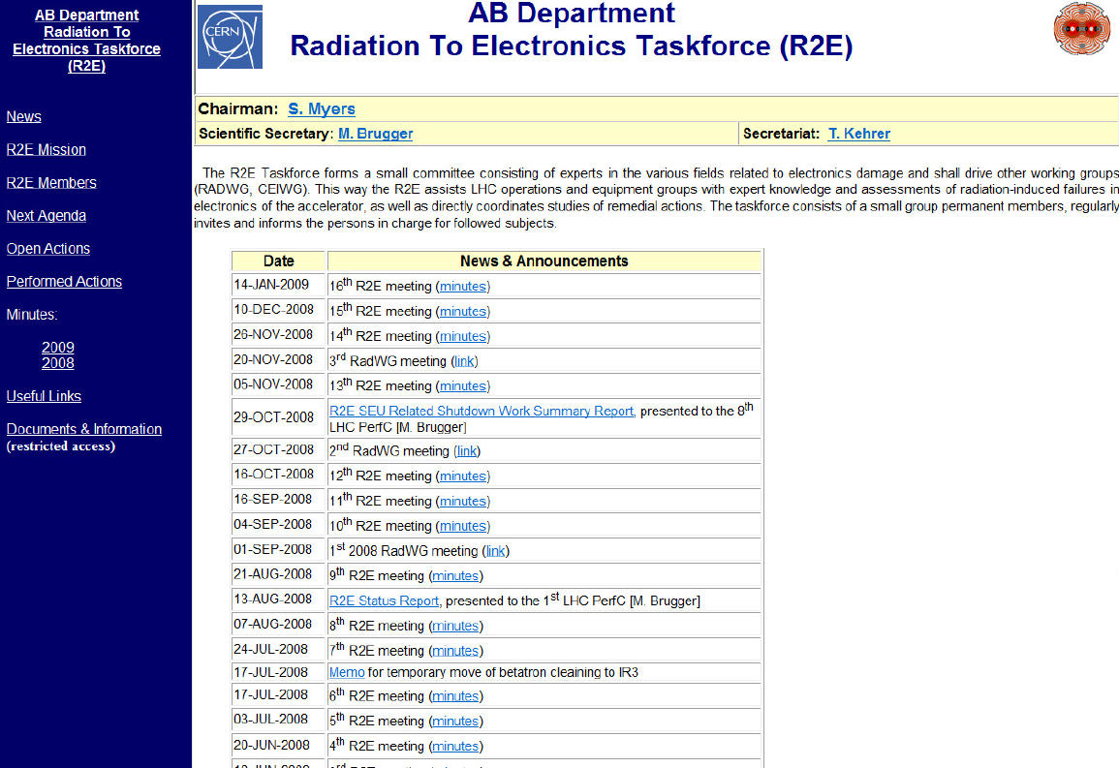
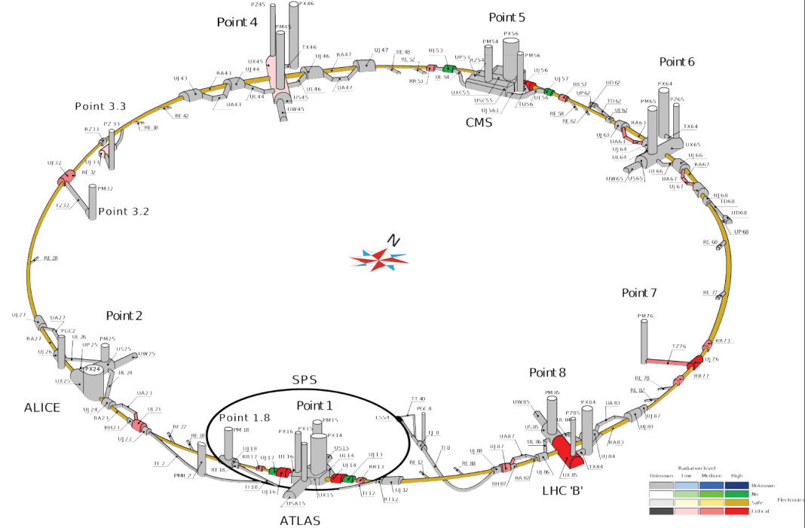
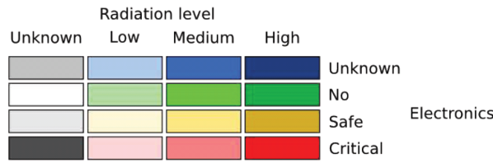
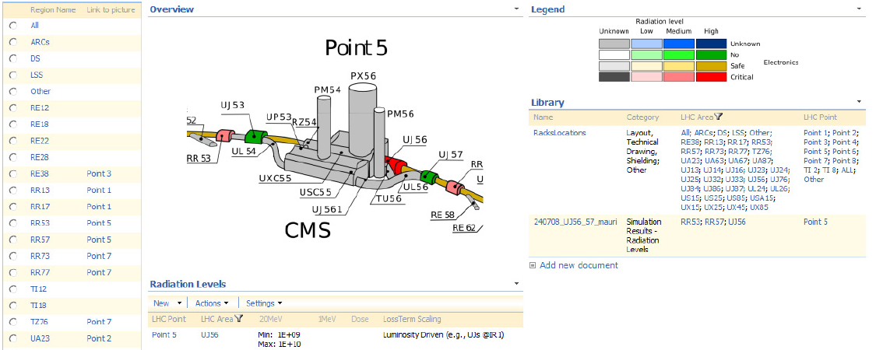
R2E Website & Related Database
https://ab-div.web.cern.ch/ab-div/Meetings/r2e/

Slide 29
Monitoring Tool
Important to efficiently understand radiation levels during early operation
Collection of available monitor data, units, storage & access details
  prepared ‘Definition Document’
A staged implementation is followed starting from the simple and core objectives
  post-mortem analysis
  selection of available monitor data by area(s)
  interface to existing logging tool (Timber, and other DBs not accessible through Timber) in order to obtain relevant data-files
  unit conversion when available/needed
  link to technical drawings for visualized monitor locations (where available)
Important ingredients & first implementation
  monitor inventory & locations updated/entered into LHC Reference Database
    http://layout.web.cern.ch/layout/search.aspx
    Radmon, BLM, RAMSES, BCM, …
  detector locations further put into technical drawings

Slide 30
Policy & Procedures
What Experiments Where Doing
Radiation Tolerance Documents kept in dedicated Data Base
Policy for Electronics Design to be installed in Radiation Areas
All electronic systems are required to provide detailed information
  General Information
  Technical Data Sheet
  Radiation Test Report
  For COTS components data sheet from the manufacturer, as well as chosen approach (e.g., redundancy)
  For ASICs, FPGAs datasheets/details from the collaboration author are required
To be installed components go through a coordinator and/or respective working group
Installation in underground areas only with approved permit (‘plaquette could be a nice idea’)
Has to be top-down, department/groups to agree on procedure

Slide 31
Knowledge & Development
R2E ‘SchoolDay’
  jointly organised: PH/ESE – EN/STI – BE - …
  Combined Experiments/Machine lectures based on radiation to electronics related experience, development and solutions
  Organised on 1-Day Basis outside CERN (no WiFi!)
  Focused on one central subject
  Participants: electronic developers, equipment designers (owners),… [restricted group]
  1st Scheduled for
    Theme: Design of electronics for radiation levels in the machine
    Date: to be scheduled before summer
  Possible repetition on various subjects

Slide 32
Radiation Test Requirements
Need of irradiation facilities summarized in memo of ‘Working Group on Future Irradiation Facilities at CERN’ [15.12.2008]
  http://www.cern.ch/irradiation-facilities
Test facility for electronics is important part of it
Partly required for existing equipment as amount of tests ideally to be performed would be both:
  very costly if through external institutions
  limited in terms of radiation field (mixed-field requirements)
  too time consuming
Certainly required for replacements and new developments
Indispensible for all LHC upgrade related activities

