Slide 1
LHC Performance Workshop Chamonix 2009
Summary of Session 02
Safety
Ralf Trant
Laurette Ponce

Slide 2
Program
Task Force on Safety of Personnel
in LHC underground areas following the accident
in sector 3-4 on 19-09-2008 (Ghislain Roy on behalf of the Task Force)
Safety Organisation (John Etheridge & Ruediger Schmidt)
Access & LACS/LASS (Laurette Ponce)
Safety systems (AL3) and systems relevant to Safety (Steve Hutchins)
Possible scenarios for a safety upgrade of the ventilation system (J. Inigo-Golfin)
Emergency preparedness (Enrico Cennini)

Slide 3
Task Force on Safety of Personnel in LHC underground areas following the accident in sector 3-4 on 19-09-2008 (G. Roy)
Between the accident and today
  Access conditions defined in the repowering procedure
  WG defined the working and transport conditions in the LHC tunnel during 08/09 shutdown based on risks of cryogenic nature
Taskforce mandate
  Establish the sequence of facts related to safety of personnel, based on e.g. AL3 data and FB emergency intervention records.
  Analyse the LHC underground environmental conditions with respect to Safety of personnel and explain their development, in relation with original risk analyses (incl. tests) performed.
  Recommend preventive and corrective measures for the Safety of Personnel in the LHC underground.
  Note : Scope limited to cryogenic accidents with release of cryofluids, caused by any sources.
Interim conclusion
  We still have more questions than answers…
  Work has started in gathering all info necessary to come to meaningful conclusions.

Slide 4
Safety Organisation
(J. Etheridge)
Evolving Safety culture at CERN
  CERN is building safety in from the conception stage of nearly all new projects.
  Avoiding the after thought syndrome
  For any operation to retain integrity scheduling, Safety and related documentation must be built in from the pre planning stage.
  Safety can save us time, improve working condition, the quality of the work, and if we look at the global picture for the life time of the installation it can save us a lot of money…
Special Situations
  There are none! All work tests, interventions must be planned, prepared, authorized and all documentation respected

Slide 5
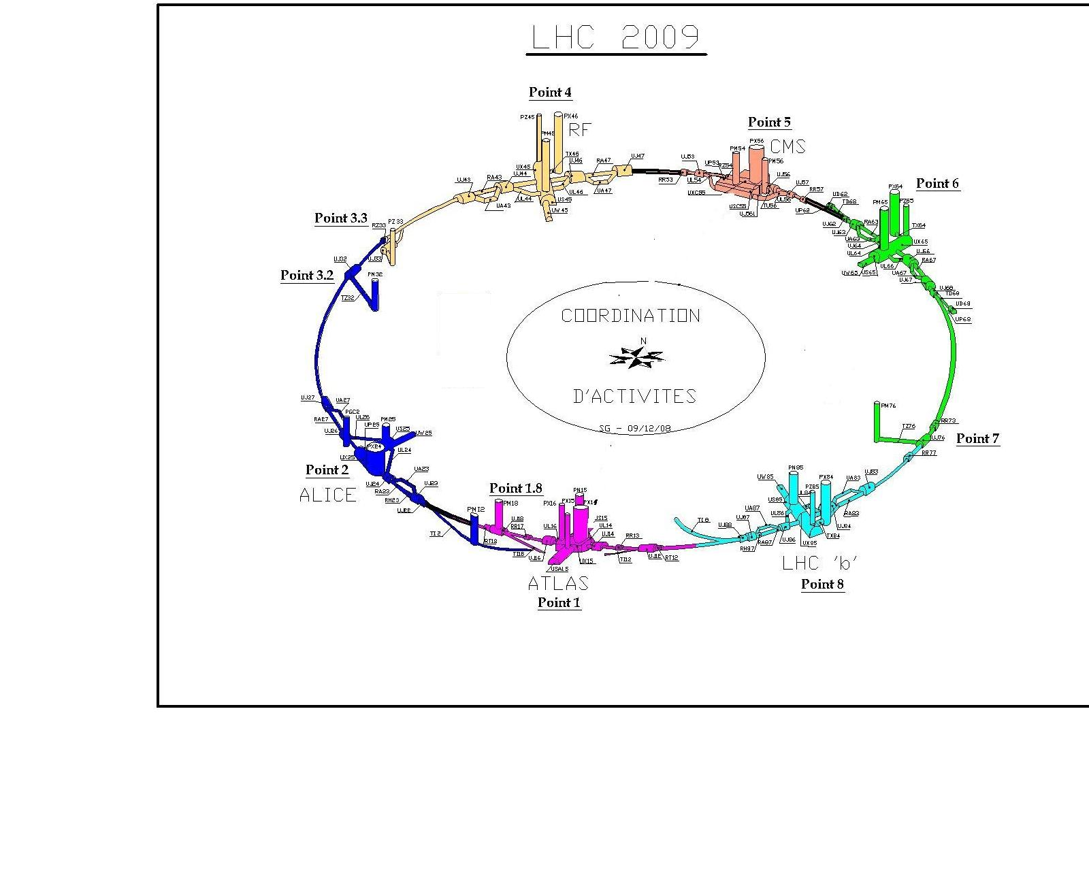

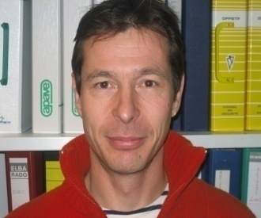
Planning & General coordination
(J. Etheridge)
Katy.Foraz@cern.ch EN/MEF 16-05-40
Serge.Grillot@cern.ch EN/MEF 16-06-15

Slide 6
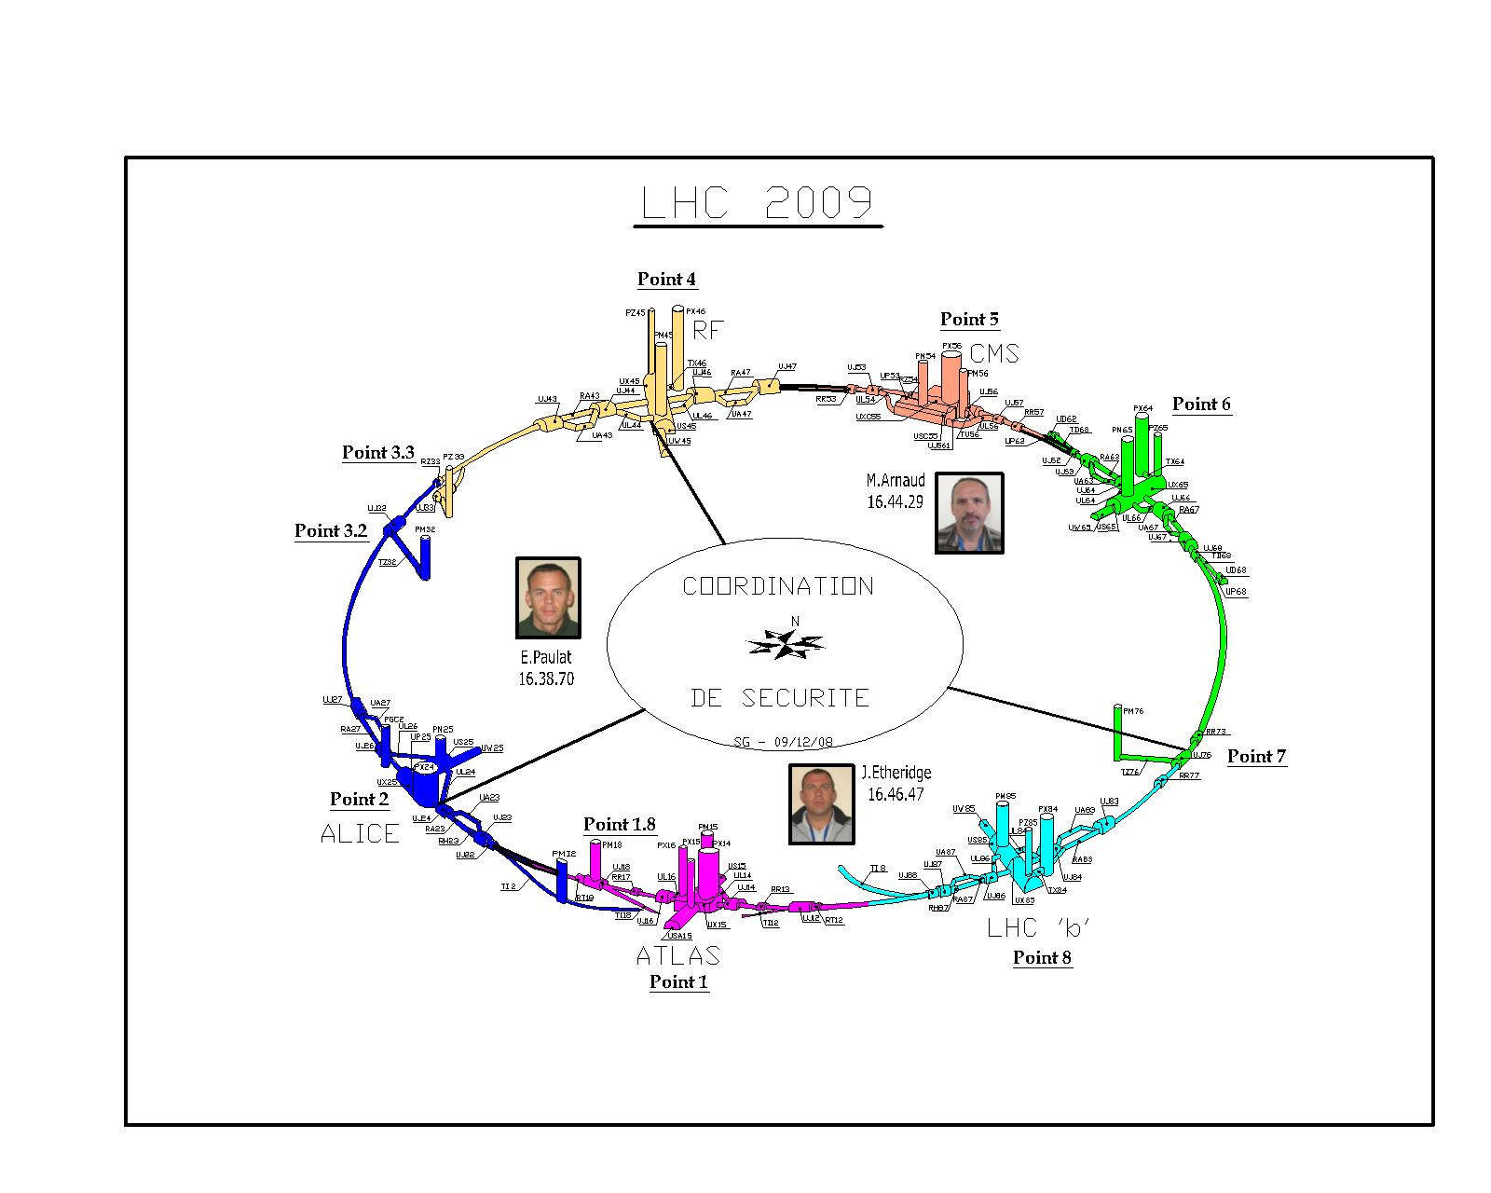
Health & Safety Coordinators
(J. Etheridge)
Emmanuel.Paulat@cern.ch BE/ASR 16-3870
Michel.Arnaud@cern.ch PH/DI 16-44-29
John.Etheridge@cern.ch EN/GMS 16-46-47

Slide 7
Safety Organisation
(J. Etheridge)
Take into account the information contained in the PGC Shut Down 2008/2009 No EDMS 978710
Certain documentation needs to be made more user friendly
(e.g. AOC or one EDH documents for all tests [pressure, electrical or X-ray])
Improve verification of materials coming out of the tunnel in relation to RP
Wearing of individual protection
Improve reaction time in producing the safety related documents
Ensure the same rules are applied CERN wide i.e. no difference between PS, SPS, LHC
Clean up after ourselves ….

Slide 8
Safety during powering tests (Ruediger Schmidt)
Many safety issues were discussed during the LHC Safety Day on 18 October 2007:
=>http://indico.cern.ch/conferenceTimeTable.py?confId=22150
In particular, the procedures that were used to ensure electrical safety when working on equipment remain in place (locking-off circuits etc.)
What is new?
How can we perform the powering tests in the future?
Lessons learned from 19/9/2008

Slide 9
Safety during powering tests (Ruediger Schmidt)
PHASE I - Low current powering tests: current limited to a value to be defined, taking the risks into account
  Underground access is in restricted mode
  Limitations for access to tunnel to be discussed (closed or restricted)
  No limitations for access to experiment
  No limitations for access to adjacent sectors
PHASE II - High current powering tests: the current in the circuits is not limited
  Access is closed & all necessary areas patrolled
  Access to experiments to be defined
For each circuit type, it is required to define “High Current”
For each circuit powered with “High Current” is required to define what areas need to be closed and patrolled (Task Force chaired by R.Trant)
  Adjacent tunnel areas ? Service areas ? Experiments ?

Slide 10
Safety during powering tests (Ruediger Schmidt)
If there is an agreement on the two phases of powering, work to define and implement tools for operation can go ahead
  there are several open questions to be addressed
Most urgent: matrix between maximum current for circuits and access conditions needs to be defined
Circuits with normal conducting magnets are not considered as no risk for helium release and electrical protection is done according to IP regulations

Slide 11
Access System – LASS/LACS
(Laurette Ponce)
LHC Access Safety System (LASS):
  End of the contract phase
  non conformities fixed in the last release, but DSO tests to be done
  Main issue is the sorting out of SPS interlock signals to avoid wrong BIW alarms at points 2/8
‏ LHC Access Control System (LACS):
  Treatment of well known non-conformities pending,
  The two main issues for operational efficiency seems to be solved in the last version, but only partial deployment and need testing
  Most of the changes cannot be tested before switching back to RESTRICTED mode
  Delay in software delivery from the contractors makes the improvements slow.
Notes:
MAD problem is missing

Slide 12
Access System – LASS/LACS
(Laurette Ponce)
Major challenge is the period before beam operation (short term):
  MAD problem : compensatory measures to be put in place to avoid intrusion (local or remote human control of the opening?)
  During shut-down: tracking of people in the underground area
  During powering tests: how to guarantee that the proper zone is empty when dangerous conditions are given
Most of the problems are linked to the use of the access system for more than the specified protection against radiation hazard:
for adequate and safe use of the Access System during powering phase, specifications (and implementation) have to be revisited
As the LACS/LASS projects are reaching the end, what about future developments, maintenance, manpower?
Notes:
MAD problem is missing

Slide 13
Safety systems (AL3) and systems relevant to Safety (Steve Hutchins)
AL3 are those system which require immediate intervention from rescue team.
Safety systems are those that are relevant to prevent or reduce risks.
LHC AL3 systems: Automatic fire detection, oxygen deficiency monitoring, flood alarms, flammable gas alarms, emergency phones (“red phones”) and lift alerts, evacuation alarms and emergency stops.
LHC AL3 systems are spread over 8 of the 33 geographical CSAM zones.
20000 detectors at CERN, covering surface building and underground areas.
The CSAM system monitors the status of every alarm and communicates the information over two separate communications systems to the CCC and SCR.
The information is also redistributed to local display terminals for use in an intervention, replacing the local hardwired synoptic panels that the pompiers had relied on for years.

Slide 14
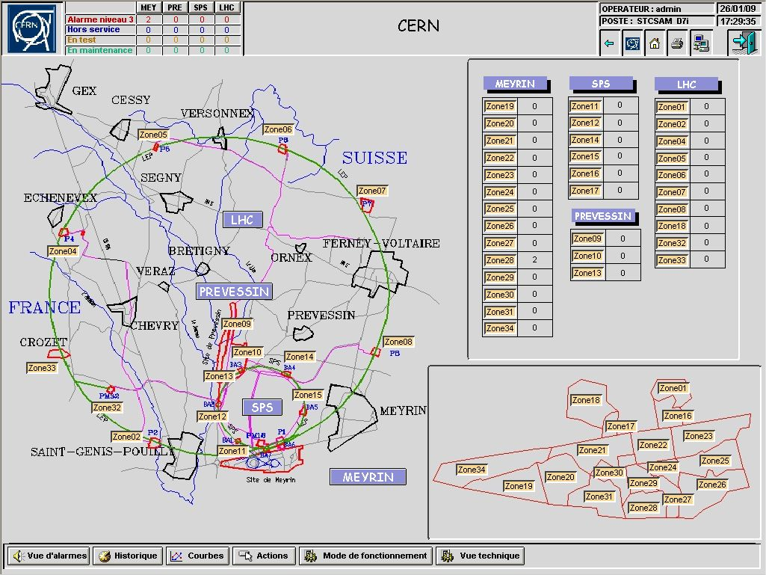

Slide 15
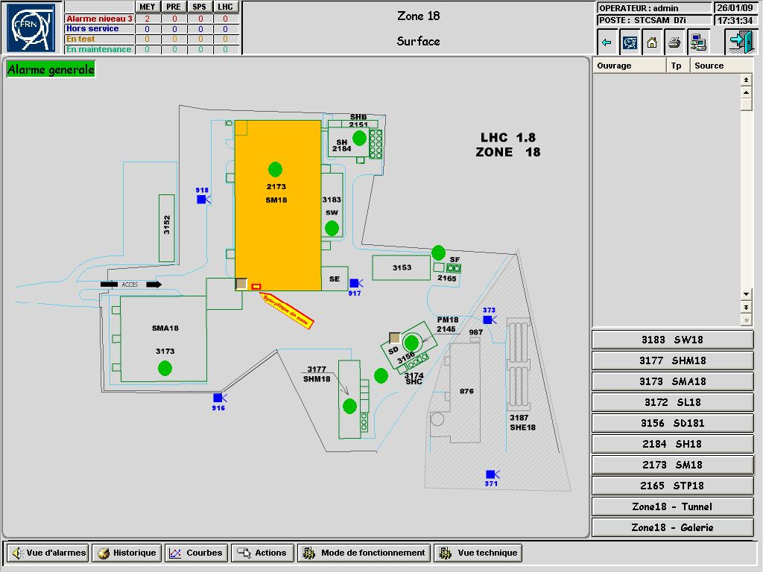

Slide 16
Safety systems (AL3) and systems relevant to Safety (Steve Hutchins)
Overall, the required LHC safety systems are in place and perform well, despite some shortcomings.
CSAM single failure points will be eliminated with the introduction of the new network.
The “CSAM - test mode” should be used as soon as possible.
The few missing ODH detectors are to be installed.
The TaskForce results might entail more actions on safety and safety related systems.
Safety information panels would make it possible to inform users of any local alarms, the status of adjoining sectors etc. (cryo conditions, transport restrictions, power testing plans, the need to evacuate an area at a certain time, x-ray tests…)

Slide 17
The LHC HVAC system
(Joaquin Inigo-Golfin)
Different volumes should remain distinct in all operation conditions,
Confinement of experimental caverns important for fire/ODH reasons.

Slide 18
The LHC HVAC system
(Joaquin Inigo-Golfin)
The existing LHC HVAC system is inherited from LEP. It has undergone no upgrade to conform to new regulations.
2. Recent ISO standards provide a relevant referential for possible improvements. The major improvement axes would be:
    Confinement and filtration,
    Availability and reliability,
    Monitoring,
    Procedures,
However full adherence to the ISO impractical and costly for the LHC.
Improvement of some aspects very affordable (door contacts, independent alarms).
5. Some modifications (filtration of smoke, back-up electrical supply) very costly and require careful consideration.

Slide 19
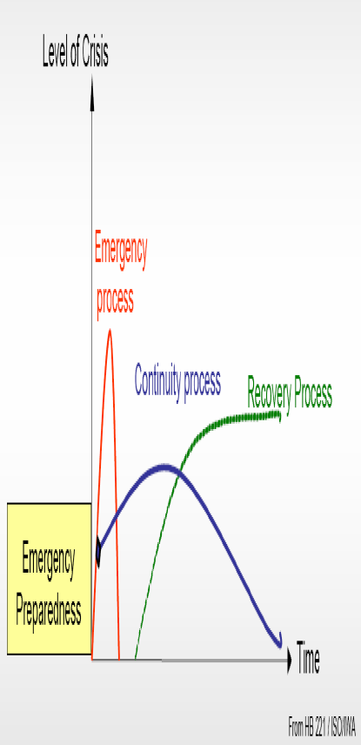
Emergency Preparedness
(Enrico Cennini)
Situations
NORMAL
INCIDENT
ACCIDENT
ACCIDENT
MAJOR ACCIDENT
CRISIS
Requiring external assistance
NORMAL OPERATION
- Situation under control
- Limited and « short » downtimes
EMERGENCY MANAGEMENT
- Unexpected and unknown situations, threat for people, environment, equipment
- Operation interrupted, long downtimes
Continuous risk assessment
Preventive/protective improvements
Reviews (audits)
Safety procedures/instructions
Safety training
Equipment and system maintenance
Equipment and system test
Equipment and system monitoring
Management of technical alarms
...
A serious incident/accident/crisis includes three different processes:
Emergency response
Continuity
Recovery
Each must be planned and organised in advance in the emergency preparedness process.

Slide 20
Sector 3-4 accident
Sector 3-4 opportunity?
Threats / Hazard Identification
Risk assessment - Probability - Impact/ Consequences
Prevention Define preventive measures
Residual risk acceptance
Preparedness
Emergency response mitigation of effects
Continuity
Recovery
exhaustive?
Re-assess the risks of damage to equipment
Check the risk assessment at the interfaces
Tackle the Safety File production process
Elaborate a centralised accident logging and analysis tool
Compare CERNs current situation on Emergency management
with ISO 31000 and ISO PAS 22399
incomplete?
availability/reliability
to be assured
Define a list of critical/sensitive systems
Implement a quality assurance plan for these systems
Evaluate the residual risk impact also on downtimes
awareness of the
residual risk
Define the consequences related to the residual risk
Search for potential improvements
(Fire Brigade)
Review/clarify Safety Rules on Emergency Management
Update Safety Plans/Procedures, Internal Emergency Plan
Ask/help for the elaboration of an External Emergency Plan
Organisation/documentation
external support?
Elaborate “modus operandi” with external Emergency services
Perform regular training and exercises
immediate response
Define a Emergency Management Method
Elaborate Continuity/Recovery Plans (guidelines)
framework

Slide 21
Summary of summary
Safety Task force following 19th of Sept. is running full speed.
Safety culture during shut-down is evolving: to be continued & supporting tools to be improved/supplemented.
Risk assessment of proposed two phases of powering tests (“access conditions”) is being detailed.
Further improvements and (DSO) test(s) of the access system for the period before beam operation are underway or identified.
Safety systems in place and performing well; further improvements are set-up & additions are identified.
Identified development potential of the HVAC system, inherited from LEP, shall be analyzed.
While the emergency intervention process is developed, the continuity & recovery part of the emergency preparedness process needs to be elaborated.

