Slide 1
  Computer Virtualization
  from a network perspective
  Jose Carlos Luna Duran - IT/CS/CT

Slide 2
Agenda
Introduction to Data Center networking
Impact of virtualization on networks
VM machine network management

Slide 3
Part I
Introduction to Data Center Networking

Slide 4
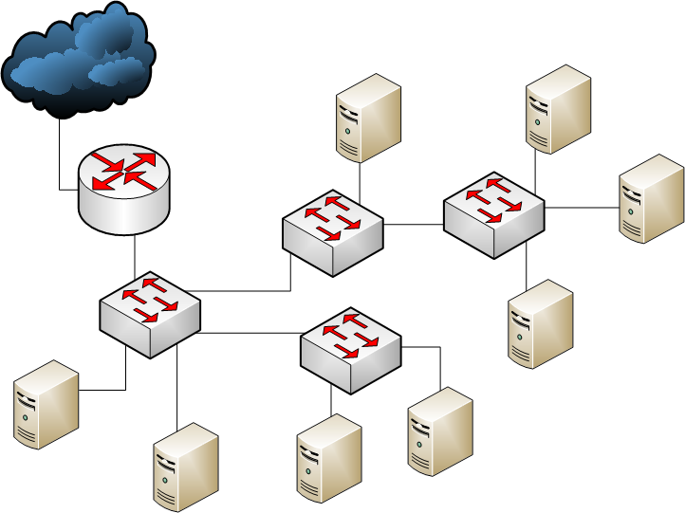
Data Centers
Typical small data center: Layer 2 based

Slide 5
Layer 2 Data Center
Flat layer two Ethernet network: same broadcast domain.
Appropriate when:
  Network traffic is very localized.
  Same responsible for the whole infrastructure
But…
  Uplink shared with a big number of host.
  Noise from other nodes (broadcast): problems may affect the whole infrastructure.

Slide 6
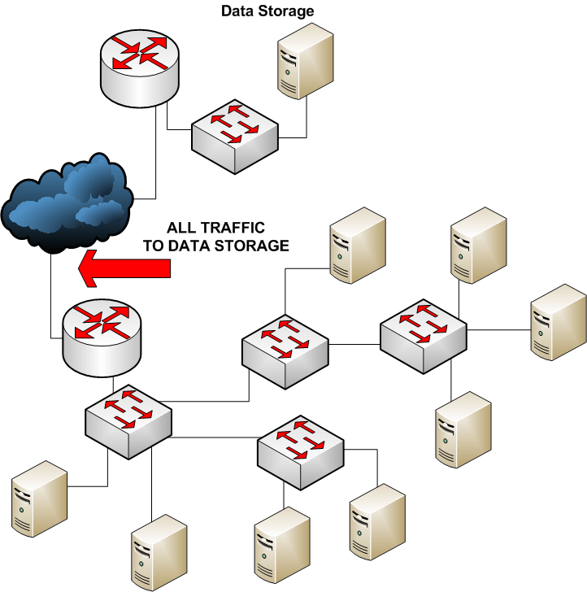
Data Center L2: Limitations

Slide 7
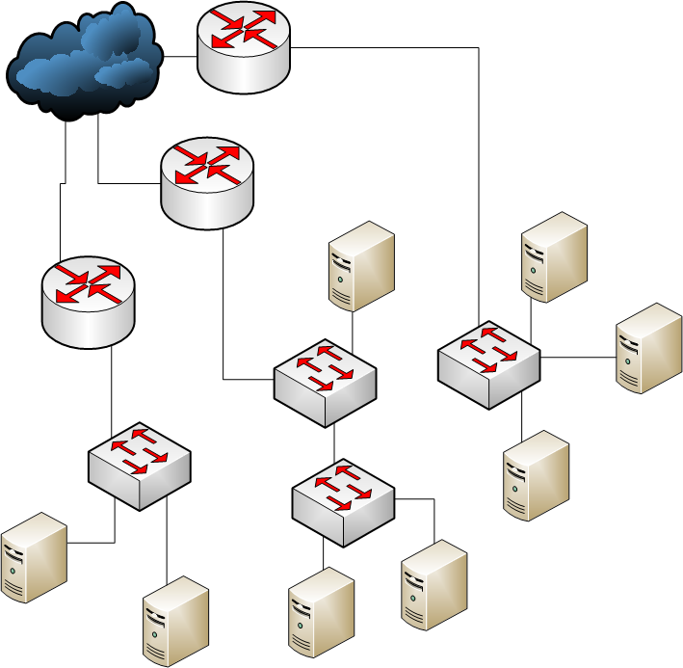
Data Center L3
Layer 3 Data Center

Slide 8
Data Center L3
Advantages:
  Broadcasts are contained in small area (subnet)
  Easier management and network debugging.
  Promotes “fair” networking (all services point-to-point are equally important).
But…
  Fragmentation of the IP space.
  Move from one area (subnet) to another requires IP change.
  Needs a performing backbone.

Slide 9













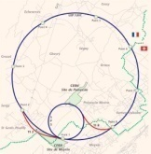
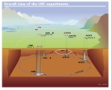













Network Backbone Topology
Gigabit
10 Gigabit
Multi Gigabit
Multi 10 Gigabit
Computer Center
Vault
Computer Center
Vault
EXT
LCG
GPN
Farms
230x
BB20
Firewall
PL1
SL1
RB20
PG1
SG1
BL7
RL7
40x
BB16
BB17
IB1
Internet
50x
RB16
RB17
PG2
SG2
IB2
Monitoring
BB51
ZB51
BB52
ZB52
BB53
ZB53
ZB54
BB54
ZB50
BB50
ZB55
BB55
BB56
ZB56
AB51
AB52
AB53
RB54
AB54
RB50
RB51
RB52
RB53
AB50
RB55
AB55
AB56
Meyrin area
Prevessin area
TN
RB56
BL5
2-S
10-1
40-S2
376-R
513-C
874-R
887-R
513-CCR
212
BT2
354
BT3
376
BT13
513
BT12
BT1
874
BT16
RL5
RT3
RT4
RT14
RT13
874
RT2
RT17
BL4
513-CCR
RL4
100x
BT15
513
874
or
874-CCC
LHC area
BL3
RL3
BL2
RL2
1000x
RT16
BT4
RT5
BT5
RT6
BT6
RT7
BT7
BL1
RT8
BT8
RT9
BT9
RT10
BT10
RT11
BT11
RT12
RL1
Minor Starpoints 100x
TT1
TT2
TT3
TT4
TT5
TT6
TT7
2175
2275
2375
2475
2575
2675
2775
2875
CERN sites
21x
TT8
433x
AG
AG
AG
ATCN
15x
15x
TN
Control
15x
15x
Control
10x
Control
10x
TN
10x
TN
10x
TN
AG
AG
CDR
AG
AG
8x
AG
CDR
AG
AG
CDR
CDR
HLT
Tiers'1
ATLAS
DAQ
ALICE
DAQ
CMS
DAQ
LHCB
90x
DAQ
25x
90x
Original document : 2007/M.C.
Latest update : 19-Feb-2009 -O.v.d.V.
MS3634-version 13-Mar-2009 O.v.d.V.

Slide 10
CERN Network
Highly Routed (L3 centred)
  In the past several studies where done for localizing services -> Very heterogeneous behaviour: did not work out.
  Promote small subnets (typical size: 64)
  Switch to Router: 10 Gb uplink
Numbers:
  150+ Routers
  1000+ 10Gb ports
  2500+ Switches
  70000+ 1Gb user ports
  40000+ End nodes (physical user devices)
  140 Gbps WAN connectivity (Tier 0 to Tier 1) + 20 Gbps General Internet
  4.8 Tbps at the LCG backbone CORE

Slide 11
Part II
Impact of virtualization on networks

Slide 12
Types of VM Connectivity
Virtual Machine hypervisors offer different connectivity solutions:
Bridged
  Virtual machine has its own address (IP and MAC).
  Seen from the network as a different machine.
  Needed when incoming IP connectivity is necessary.
NAT
  Uses the address of the HOST system (invisible for us).
  Provides offsite connectivity using the IP of the hypervisor.
  NAT is currently not allowed at CERN (for debugging and traceability reasons).
Host-Only
  VM has no connectivity with the outside world

Slide 13
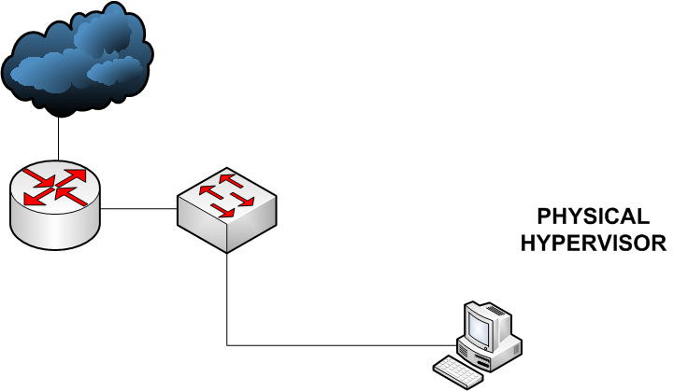
Bridged and IPv4
For bridged reality is this:

Slide 14
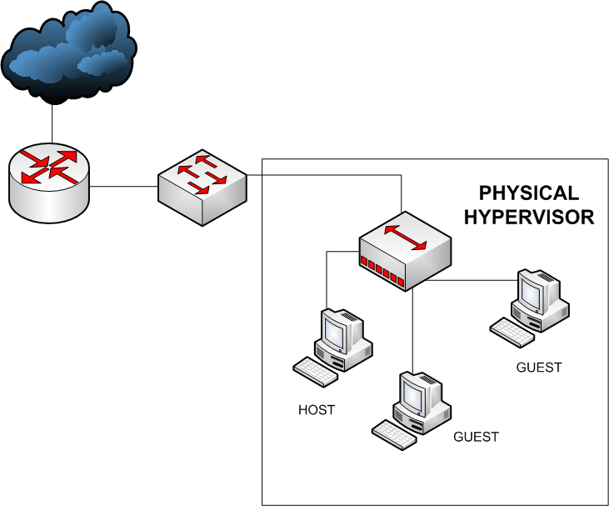
Bridged and IPv4
Observed by us as this:

Slide 15
Bridged and IPv4 (II)
It’s just the same as a physical machine, therefore should be considered as such!
Two possibilities for addressing:
  Private addressing
    Only on-site connectivity
    No direct off-site (NO INTERNET) connectivity
  Public addressing: best option, but…
    Needs a public IPv4 address
    IPv4 address is limited.
    IPv4 address allocation: IPv4 address are given in form of subnets (no single IPv4 addresses around the infrastructure)-> Fragmentation -> Use wisely and fully.

Slide 16
Why not IPv6?
No address space problem, but:
  ALL computers that the guest wants to contact would have to use IPv6 to have connectivity.
  IPv6 “island” would not solve the problem
    If these machines need IPv4 connectivity IPv6 to IPv4 conversion is necessary.
    If you have to map each IPv6 address to one IPv4 address we are hitting the same limitations as IPv4.
  All applications running in the VM should be IPv6 compatible.

Slide 17
Private Addressing
Go for it whenever possible! (space not as limited as if we use public addresses).
But… no direct off-site connectivity (perfect for the hypervisors!)
Depends on the use case for the VM

Slide 18
NAT
Currently not allowed at CERN:traceability...
NAT where?
  In the Hypervisor
    No network ports in the VM would be reachable from outside.
    Debugging network problems for VMs impossible
  Private addressing in the VM and NAT in the Internet Gate:
    Would allow incoming in-site connectivity
    No box capable of handling 10Gb+ bandwidth
  Distribution Layer (access to the core)
    Same as above plus more number of high speed NAT engines required.
No path redundancy possible with NAT!

Slide 19
Recommendations
Everything depends on the behavior of the VM and its intended usage.
Public addresses are a scarce resource. Can be provided if limited in number.
Use private addressing if there is no other special need besides the use of local on-site resources.

Slide 20
Part III
VM machine network management.

Slide 21
CS proposed solutions
For desktops:
  Desktops are not servers, therefore…
  NAT in the hypervisor proposed:
    Responsible of the hypervisor is the same as responsible of VMs
VM as a service (servers, batch, etc…):
  For large number of VMs (farms)
  Private addressing preferred
  VMs should not be scattered around the physical infrastructure.
  Creation of the “VM Cluster” concept.

Slide 22
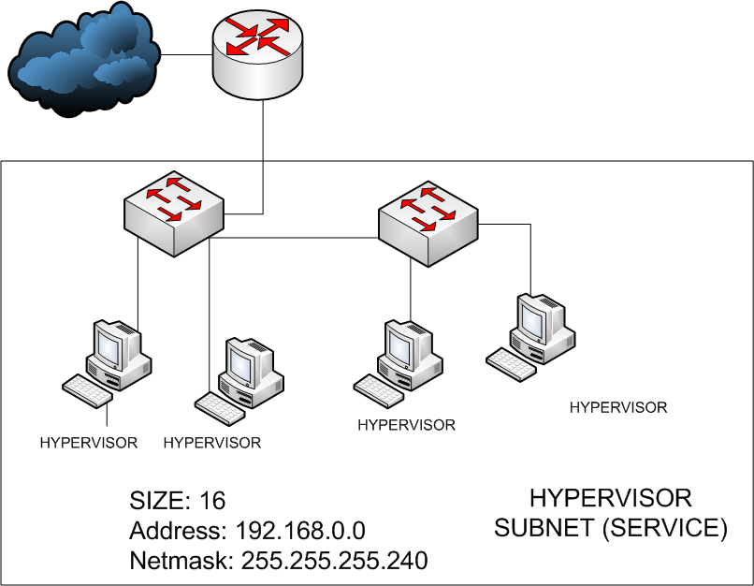
VM Clusters
VM Cluster: separate set of subnets running in the SAME contiguous physical infrastructure:

Slide 23
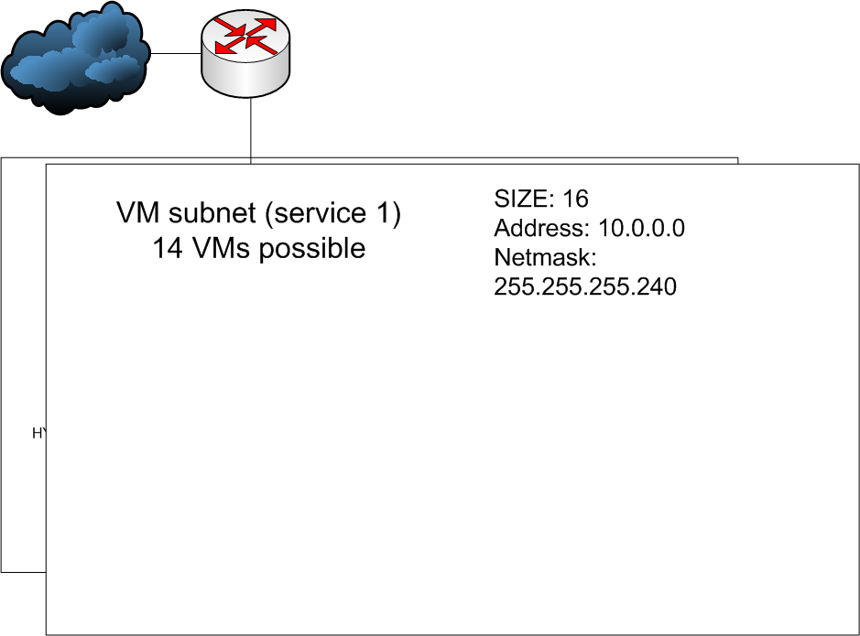
VM Clusters

Slide 24
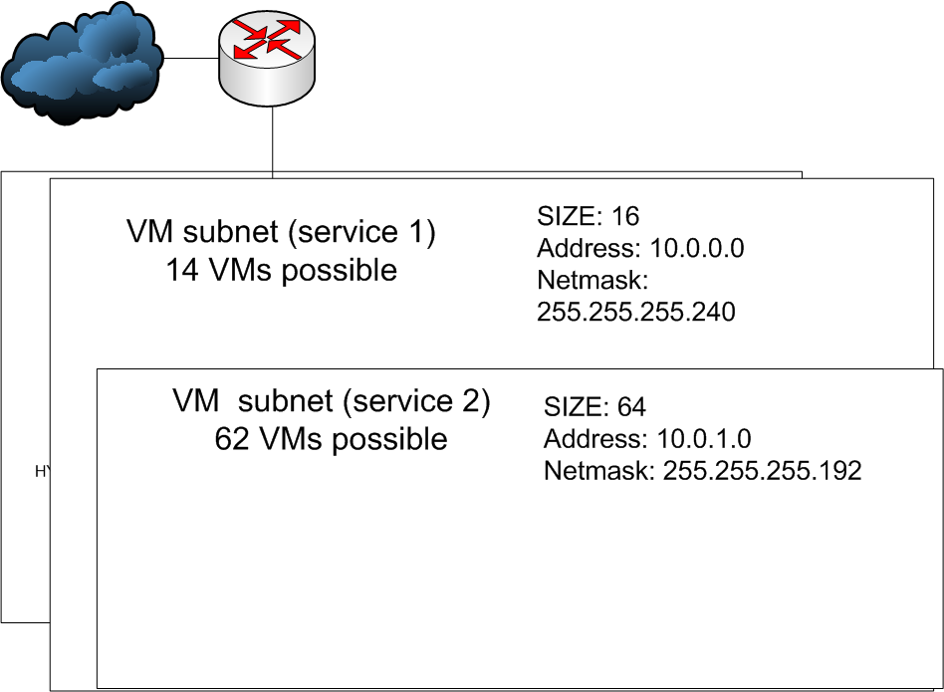
VM Clusters

Slide 25
VM Cluster advantages
Allows us to move the full virtualized infrastructure (without changing IP addresses for the VMs) in case of need.
Delegate to the VM Cluster owner full allocation of network resources.
All combinations possible:
  Hypervisor in public address/private (preferred)
  VM subnet1 public/private
  VM subnet2 public/private
Migration within the same VM subnet to any host in the same VM cluster possible.

Slide 26
VM Clusters
How this service is offered to service providers: SOAP
Is flexible: can represent the actual VM or a VM Slot.
VM Cluster is requested directly to us
  Adding a VM subnet also has to be requested.
What can be done programmatically?

Slide 27
VM representation in LANDB
Several use cases for VMs: we need flexibility
They are still machines, responsible may differ from hypervisor. Should be registered as such:
  Added a flag that indicates this is a Virtual Machine.
  Pointer to the HOST machine using it at this moment.

Slide 28
Operations allowed for service providers in LANDB
Allows to document the VM infrastructure in LANDB:
  Create a VM (creates device, IP allocation in the cluster)
  Destroy a VM
  Migrate a VM (inside the same VM subnet)
  Move a VM (inside the same cluster or other cluster -> VM will change IP)
  Query information on Clusters, hypervisors, and VMs
    What hypervisor is my VM-IP on?
    What VM-IPs are running in this hypervisor?

Slide 29
Conclusions
Is not obvious how to manage virtualization on large networks.
We are already exploring possible solutions
When the requirements are defined we are confident to find the appropriate networking solutions.

Slide 30
Questions?
THANK YOU!

