Slide 1
Protection of underground areas and
He release to surface
Review of present situation;
Shortfalls of the present situation;
Strategy to consolidate/upgrade He release.
LHC Performance workshop – Chamonix 2010 Sylvain Weisz – DG/PRG

Slide 2
Present situation: Protection of experimental areas
Experimental premises at Pt 1,2,5 & 6 have been sealed and are protected in case of overpressure from the tunnel
(See Olga and Mauro’s presentations in this session)
Visits to assess the readiness for powering phase II made systematic controls of these protections, their minutes are available in:
    ATLAS ➔ EDMS N° 1027686
    ALICE ➔ EDMS N° 1027705
    CMS ➔ EDMS N° 1027714
    LHCb ➔ EDMS N° 1027632
Crucial participation
and thanks to
Experiments,
EN/HE, EN/MEF,
GS/ASE,
DGS/GS, DGS/RP,
BE/ASR, BE/OP
LHC Performance workshop – Chamonix 2010 Sylvain Weisz – DG/PRG

Slide 3
Present situation: He Release to surface
Ventilation doors and partitions have been modified or added to control the He release to the surface through the PM shafts, taking account of the pressure build up in case of a MCI.
Doors between the LHC tunnel and the UA service galleries have been temporary removed to ease the passage of large He flows.
The He release paths to surface are:
    RA➔UA➔UL➔US➔PM➔SD at points 2,4,6 & 8
    RA➔UL➔US15➔PM15➔SD1 at point 1
    with doors acting as pressure release valves both at the UL-US interfaces and on the surface buildings.
LHC Performance workshop – Chamonix 2010 Sylvain Weisz – DG/PRG

Slide 4
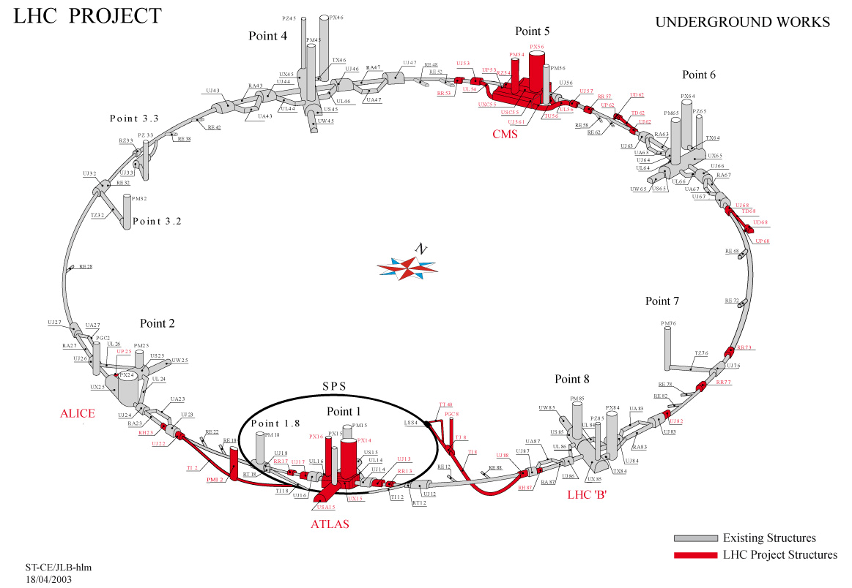
Shortfalls of the present situation
Free flow from tunnel straight sections (RA’s) to service galleries (UA’s)
  Does not meet the confinement requirements for RP ,
  fire protection and ventilation control
  Derogation from RP valid for first beam period only, with beam intensities limited to 10% of nominal and beam energy below 5TeV
  (See Memo EDMS N°1035364)
PM shafts on the release paths implies no access in adjacent sectors during powering phase II
Shafts used for
He release
Sylvain Weisz – DG/PRG

Slide 5
Consolidation of Safety in underground areas
The consolidation and upgrade of the He release to surface will follow a 2 steps strategy:
Fulfill RP, fire & ventilation requirements concerning the separation of underground ventilation sectors;
Study and implement new He release paths to remove constraints on the access matrix.
LHC Performance workshop – Chamonix 2010 Sylvain Weisz – DG/PRG

Slide 6
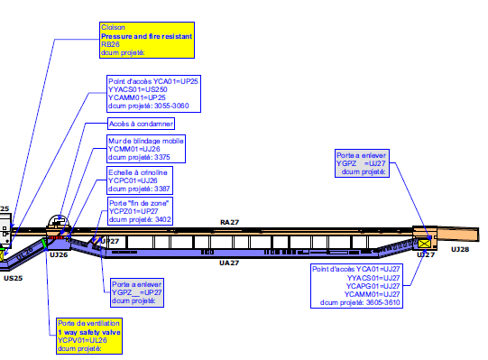
Separation of underground ventilation sectors
Generic case – Pt 2
Need to seal all ducts
Need to re-install ventilation
doors in UP27 and UJ27

Slide 7
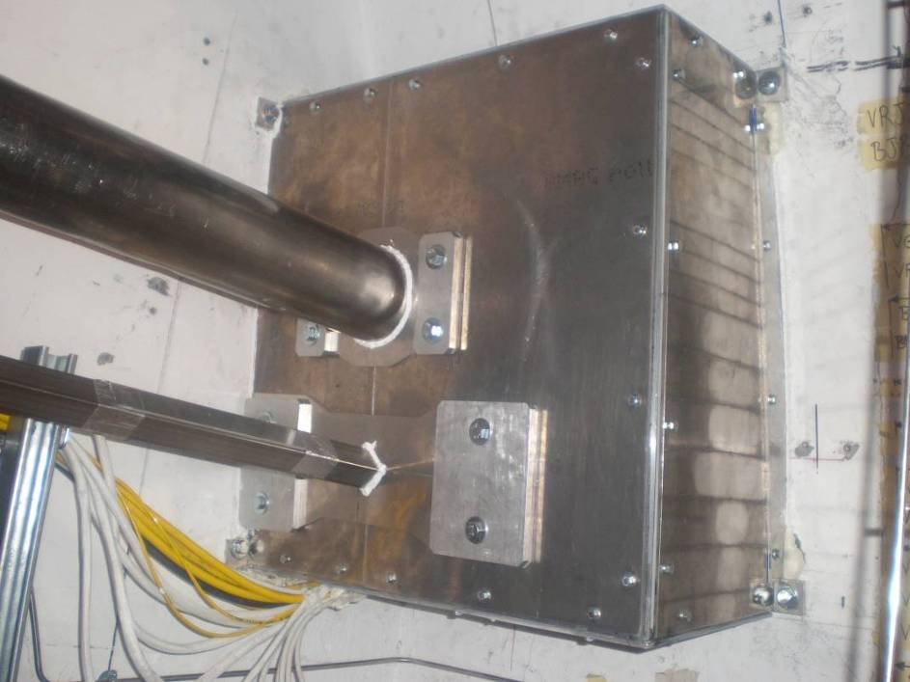
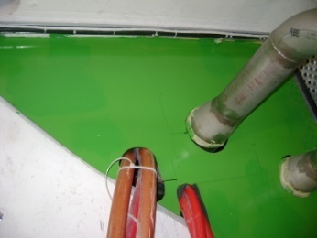
Separation of underground ventilation sectors
Sealing of all ducts:
Many options were developed to seal the experimental caverns:
Need full inventory of all ducts to be sealed
Need to define sealing technique most adequate for each cases (presence of cable or tubes, type of cable, need for cooling, etc…)
Re-installation of doors in UP’s and UJ’s:
Doors need to act as pressure release valves (open with ~10mb overpressure) : opening mechanism and position monitoring required
LHC Performance workshop – Chamonix 2010 Sylvain Weisz – DG/PRG

Slide 8
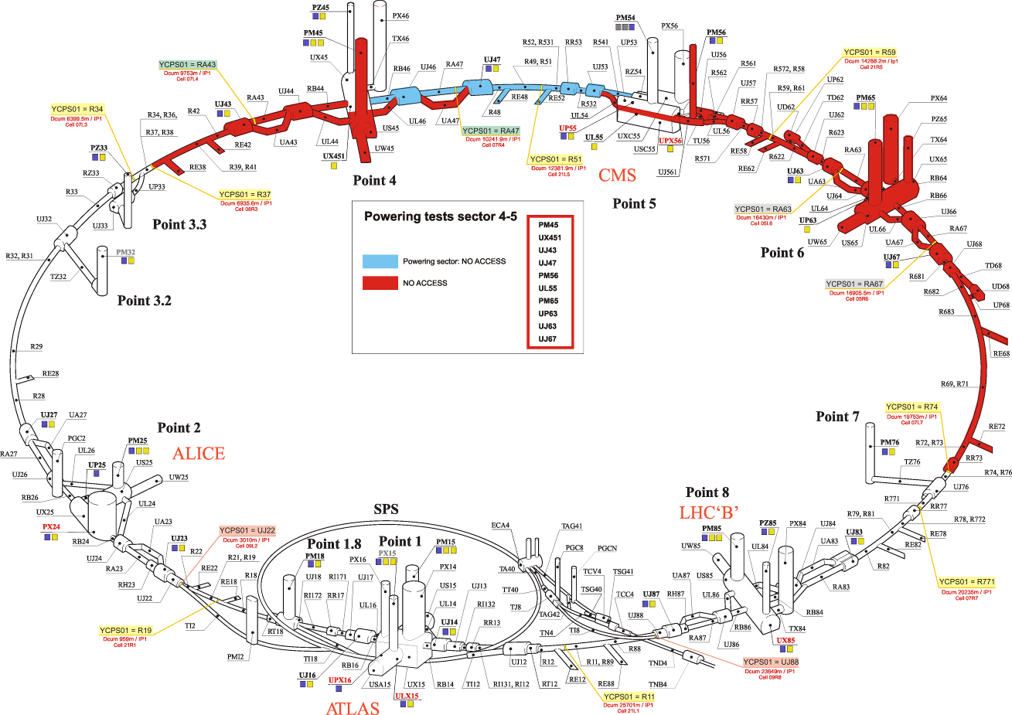
Access matrix in LHC
Access restriction in LHC will not be modified by the first set of measures
Use of US and PM shafts to evacuate He flow condemn access to adjacent sector.
In case of sectors linked with saloon doors (6/8), ~half of LHC is closed …
Example of restriction when powering sector 4-5 ➔
➔ Need to implement alternative He release path to surface to get more access flexibility during tests
LHC Performance workshop – Chamonix 2010 Sylvain Weisz – DG/PRG

Slide 9
List of alternate He release path to consider:
1) Without heavy CE, could become available in the “short term”:
UJ18 ➔ PM18 for Sector 1-2
TI2 (~1.5km long, Ø 3m) ➔ PMI2 for Sector 1-2
UJ32 ➔ TZ32 (900m long, Ø 3m) ➔ PM32 for Sector 2-3 and Sector 3-4
RUX45 ➔ UX45 ➔ PX46 for Sector 3-4 and Sector 4-5
UP56 ➔ UJ76 ➔ PM56 for Sector 4-5 and 5-6
RUX65 ➔ UX65 ➔ PX64 for Sector 5-6 and Sector 6-7
RA83 ➔ UGC1 (access of TBM) ➔ PX84 for Sector 7-8
TI8 (~2.5km long, Ø 3m) ➔ PGC8 for Sector 8-1
2) With heavy CE, could be envisaged for the long term (≥ 3 years):
Shafts close to RR13, RR17, RR53 & RR57
PGC2, to be emptied from rubble
Cryo equipment
RF equipment
Low-β upgrade
LHCb
LHC Performance workshop – Chamonix 2010 Sylvain Weisz – DG/PRG

Slide 10
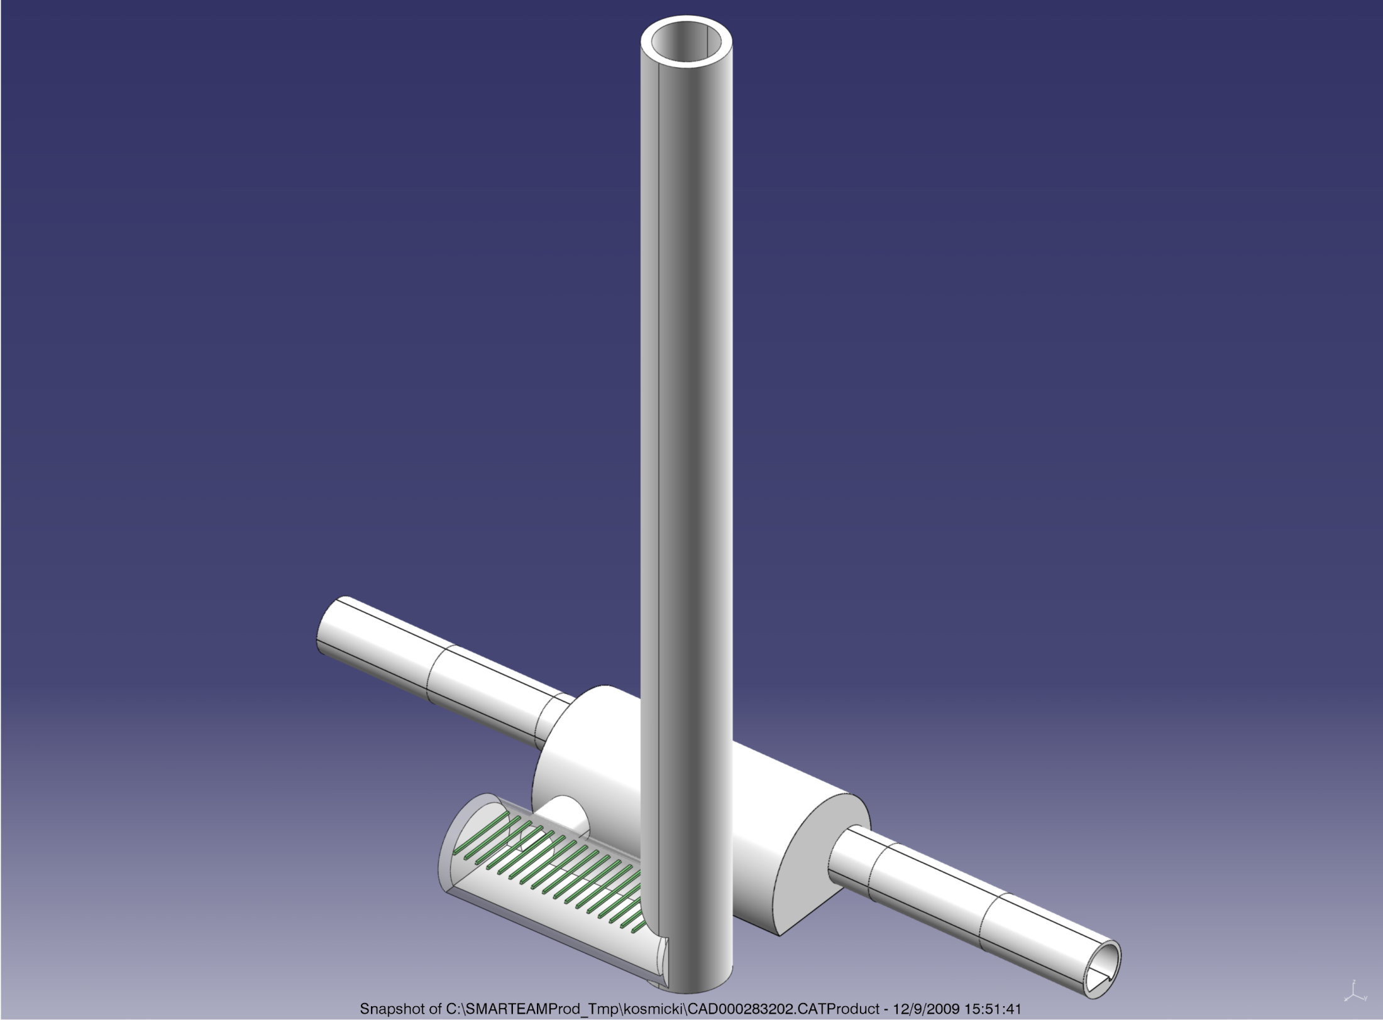
RR’s + shafts
Point 1 & 5
John Osborne GS-SEM
New Shaft ∅5m
Existing
LHC tunnel
Existing RR
New Access ∅3m
Existing
LHC tunnel
New cavern ∅7m

Slide 11
Preliminary Cost Estimate ➔ 37.8 MCHF
For site preparation, 4 shafts, 4 caverns + galleries
Incl. Consultant, Drawings, Supervision &10% contingency

Slide 12
Summary
Experimental areas are sealed and safe with respect to the pressure rise in case of an MCI event.
Ventilation doors and partitions have been modified or added, and some temporary removed, to control the He release to the surface through the PM shafts.
Stringent access restrictions are in force during powering phase II to insure personnel safety in case of a large He release.
The first priority for the next long shut down is to restore the separation of the underground ventilation sectors to fulfill the RP and fire protection requirements.
Alternate paths for He release to surface will be studied and implemented to progressively improve the access conditions during powering tests. Full flexibility between LHC sectors will take several years since heavy Civil Engineering work is probably required.
LHC Performance workshop – Chamonix 2010 Sylvain Weisz – DG/PRG

