Slide 1
Overview of the
LHC IR Upgrade Phase-1
  Project goals and constraints
  Milestones, collaborations, budget
  Status of studies:
    Layout and sLHC optics
    Magnets and cryogenics
    Equipment integration
  Conclusions

Slide 2
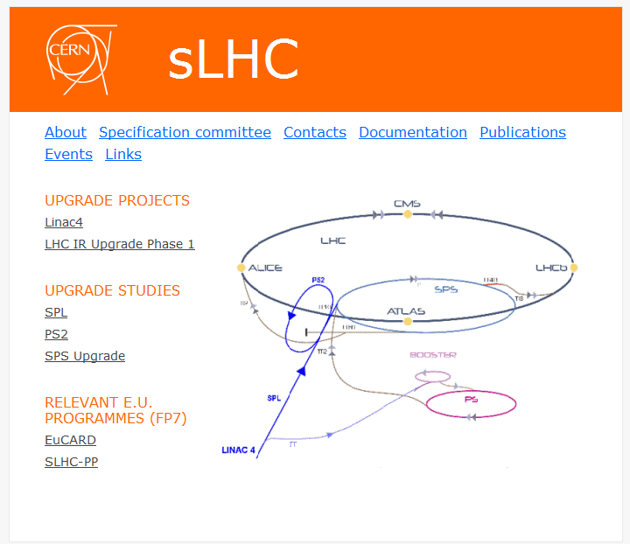
sLHC projects and design studies
Strategy based on:
Steadily increasing operational performance of the LHC year to year;
Preparation of long-lead time hardware for known bottlenecks;
Coordinated shutdowns with the goal of ensuring continuously increasing performance on a longer term.
“sLHC Phase-1” readiness for installation end 2014.
CMS/ATLAS Upgrade Phase-1

Slide 3
The ATLAS and CMS interaction regions
Dispersion suppressor
Matching section
Separation dipoles
Final focus
LHC low-β triplet
Position L* = 23 m
Quad gradient 205 T/m
Coil aperture 70 mm
β*, L 55 cm, 10³⁴cm⁻²s⁻¹
Dissipated power 180 W @ 1.9 K

Slide 4
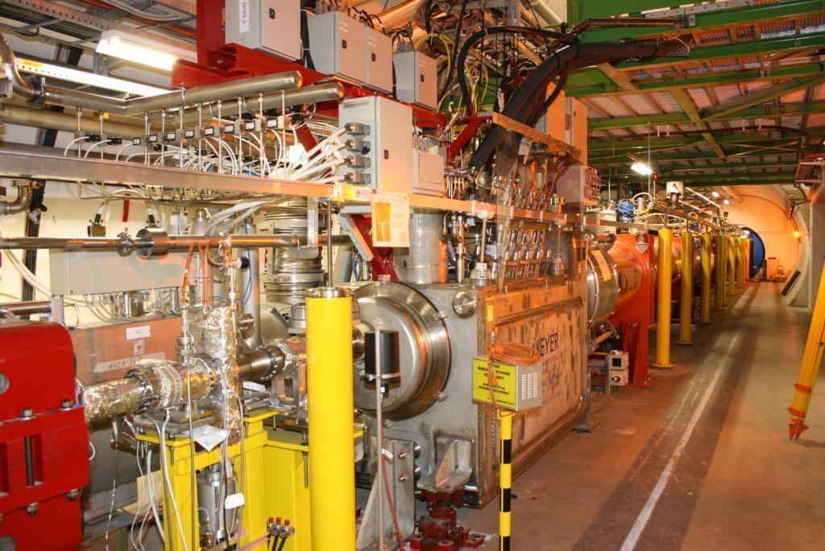
The low-β triplet in IP1

Slide 5
LHC IR Upgrade – Phase-1
  Goal of the Project:
  Provide more flexibility for focusing of the LHC beams in the ATLAS and CMS insertions, and enable reliable operation of the LHC at 2 10³⁴ cm⁻²s⁻¹.
  Scope of the Project:
    Upgrade of ATLAS and CMS interaction regions. The interfaces between the LHC and the experiments remain unchanged.
    The cryogenic cooling capacity and other infrastructure in IR1 and IR5 remain unchanged and will be used to the full potential.
    Replace the present triplets with wide aperture quadrupoles based on the LHC dipole (Nb-Ti) cables cooled at 1.9 K.
    Upgrade the D1 separation dipoles, TAS, TAN and other beam-line equipment so as to be compatible with the inner triplets.
    Upgrade the LHC optics, ensure optics flexibility and machine protection with appropriate layout and additional protection equipment.

Slide 6
Constraints (1)
Interfaces with the experiments: Very tight interfaces between the triplet and the experiments; there is no possibility of reducing L* (23m) in ATLAS and CMS insertions.
Cryogenics: Ultimate cooling capacity is 500 W@1.9K per triplet (design capacity of sub-cooler at triplet entry).
  Operational experience will show if ultimate cooling power is available.
  The triplet in 5L will have less cooling capacity (cryogenic sector feeding RF in IR4).
  Due to the distance to the cold refrigerators (3.3 km), the temperature of the superfluid bath in the triplets is close to 2 K.
  The replacement of triplets in IR1 and IR5 requires warm-up of two adjacent sectors (in total at least four sectors of the LHC).
A local cryo-system for RF in IR4 should be included as part of LHC consolidation.
Plan for new cryogenics, dedicated to the triplets in IP1 and IP5, useful for Phase-1 triplet and later upgrades.

Slide 7
Constraints (2)
LHC Optics: Reduction of β* drives aberrations all around the ring. A new optics solution for all arcs and insertions is necessary.
Accessibility and maintenance: all electronics equipment for the triplets and the DFBX should be located in “low-radiation” areas. Severe space constraints around IP1 and IP5 for any new equipment.
Tunnel transport: access from the surface to IR1/5 requires that the overall dimensions of the new magnets are similar to the LHC main dipole.
Upgrade implementation: Must be compatible with CERN-wide planning requiring medium-duration shutdown.
New underground areas in IR1 and IR5 may be needed. They should cover all the requirements of consolidation and upgrade projects (including Phase-1 triplets).

Slide 8
Project milestones
Project Start Jan 2008
CD Report Nov 2008
TD Report end 2010
Model magnets end 2010
Pre-series quadrupole mid 2011
Series magnets 2011-2014
Triplet string test 2014
Readiness for installation end 2014

Slide 9
Collaborations
SLHC-PP
(CEA, CERN, CIEMAT, CNRS, STFC)
CERN
Quadrupole production
Cryostating and testing
Power converters
Protection
String test
Tunnel integration
Design and construction of quadrupole and corrector model magnets
Design of cryostats
LHC IR Upgrade Phase-1
Special French contribution
(CEA, CNRS)
US-APUL
(BNL, Fermilab)
Quadrupole components
Cryostat components
Production of correctors
D1 separation dipoles
Feedboxes and SC links

Slide 10
Budget
The project was approved by Council as part of “New initiatives” with a CERN materials budget of 33 MCHF (exclusive of the available SC cable, other materials and tooling remaining from the LHC production).
The project relies on a strong international effort and brings together all presently available expertise and resources in accelerator superconducting magnet systems. Contributions from EU, US and a special French contribution have been secured for a considerable part of new equipment.
Nevertheless, the present MTP materials budget falls short by about 10 MCHF.

Slide 11
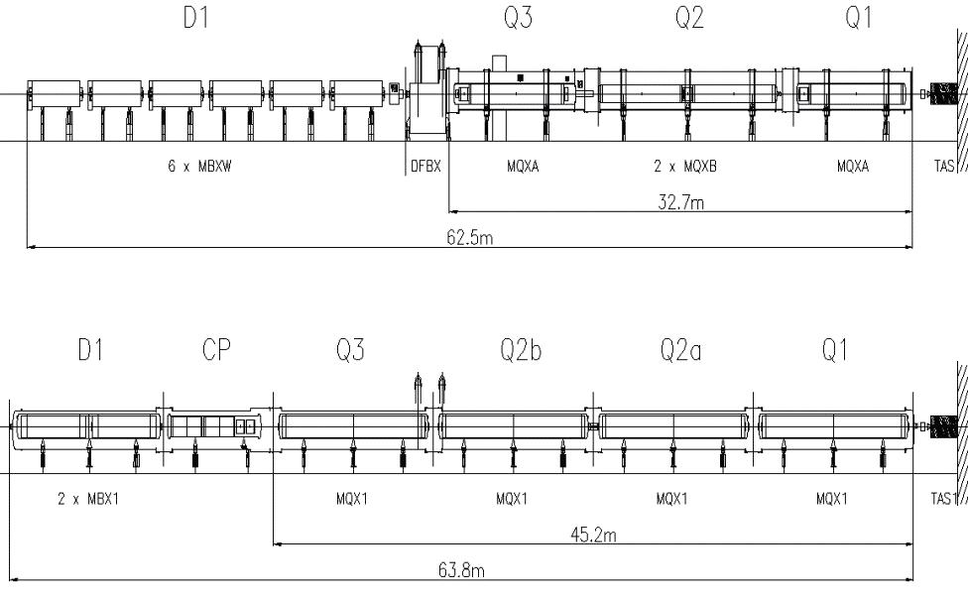
Triplet layout
Issues:
Quadrupole length and powering
Orbit correctors
BPMS position
CP and QDXS length and D1 position
LHC triplet
Phase-1 triplet

Slide 12
Matching Sections
Reduction of β* inevitably reduces the flexibility of the matching sections.
Improvements of the matching section are limited to repositioning of the existing magnets (and eventually modification of their beam screens).
At present, the Phase-1 Upgrade assumes that:
  the matching section magnets (D2-Q6) remain unchanged.
  TAN vacuum chamber to be replaced.
  Protection against beam halo (tertiary collimators) extended to all insertion magnets (Q4-D2, Q5 and Q6).
  Interventions on warm equipment can be done in normal shutdowns.
If redesigned, the matching sections should be preferably optimized to satisfy also the optics and equipment requirements of “Phase-2”.
The time and effort to complete these studies may delay the completion of the technical design.

Slide 13
Optics issues
Insertions. The strength and aperture of the magnets are the limiting factors for reducing β*.
Arcs. Correction of aberrations requires re-phasing of all the arcs and insertions for β* < 0.5 m.
Triplets. Parasitic dispersion in the triplets due to large crossing angle has to be controlled. Beam crossing schemes in IP1 and IP5 need to be flexible.
A complete solution for the new LHC optics has been developed.

Slide 14
Magnet cooling
Quadrupoles and correctors:
  Pressurised static superfluid He bath at 1.3 bar, cooled by two-phase flow of saturated superfluid helium in a bayonet heat exchanger.
  Heat exchanger dimensioned for the ultimate power of 500 W/1.9 K and ultimate vapour velocity of 7 m/s.
  Due to the distance of the QRL (3.3 km), the temperature at high heat load increases from the outlet of the refrigerator (1.776 K) to 1.97 K on the outer surface of the heater exchanger.
D1 dipole:
  Pressurised static superfluid He bath at 1.3 bar, cooled by heat conduction to the triplet.
Beam screen:
  Cooled with supercritical helium, 5-20 K.

Slide 15
Triplet cooling scheme
Main features:
Control and safety valves integrated in the new service module QDXS.
Warm-up of the triplet independent of the arc.
Warm-up of the SC link/DFX independent of the triplet.

Slide 16
MQXC low-β quadrupole
Coil aperture 120 mm
Gradient 127 T/m
Operating temp 1.9 K
Current 13.8 kA
Inductance 5.2 mH/m
Yoke ID 260 mm
Yoke OD 550 mm
LHC cables 01 and 02
Enhanced cable polyimide insulation
Self-supporting collars
Single piece yoke
Welded-shell cold mass

Slide 17
MCXB, MQSX correctors
Coil aperture 140 mm
Operating temp 1.9 K
Current 2.4 kA
Yoke OD 550 mm
New 4 mm cable design
Cable polyimide insulation
Self-supporting collars
Single piece yoke
Welded-shell cold mass
MCXB field strength 1.5 Tm
MCXB inductance 10 mH
MQSX field strength 0.65 T
MQSX inductance 3 mH

Slide 18
D1 separation dipole
Two optimised BNL DX magnets assembled in one helium vessel
Coil aperture 180 mm
Field 4.1 T
Magnetic length 7.4 m
Operating temp 1.9 K
Current 6.35 kA
Inductance 98 mH
Yoke OD 620/550 mm

Slide 19
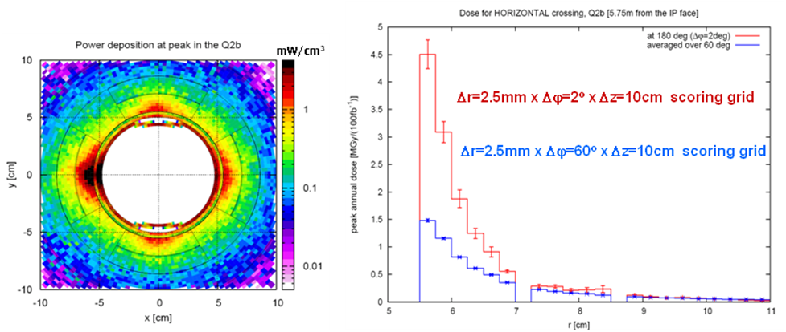
Protection against particle debris
Protection against particle debris is the single most serious issue of the upgrade.
Energy deposition in the coils and magnet lifetime.
Equipment protection around the beamline (TAS, TAN).
Protection of electronic equipment in underground areas.
Maintenance and interventions …
Triplet shielding efficiency:
Phase-1 = 2.5 LHC
Average dose 1.5 MGy/100 fb⁻¹
All equipment built for a lifetime of 1000 fb⁻¹,
compatible with the lifetime of ATLAS and
CMS before their “Phase-2” upgrade.

Slide 20
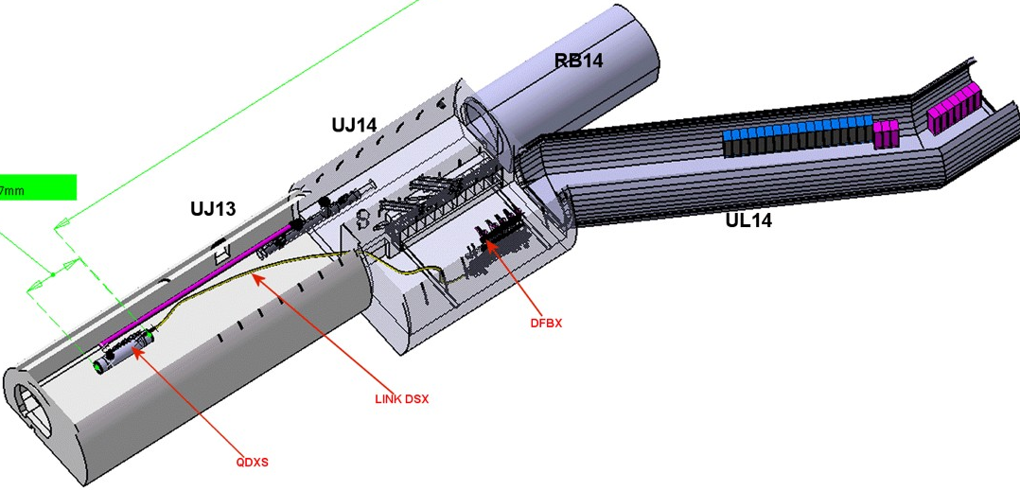
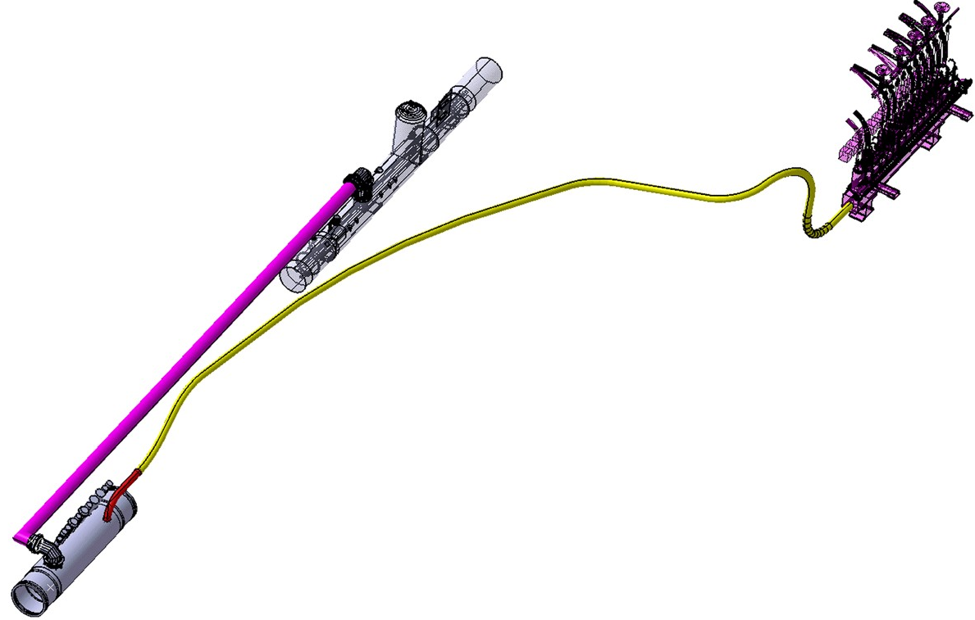
Powering equipment in IR1
Split powering chosen as a compromise between volume and complexity.
  Protection of the magnets ensured by the energy extraction system and by the quench heaters.
  DFX, converters and switches located in low-radiation areas. DFX connected to the QDXS service module via a SC link (~30-100 m.)
DFX
DFX
Link Cryo
Link DSX
Length ~28 m
3 sharp (~ 1.5 m radius) bends plus some curves
Service
Module
(QDXS)

Slide 21
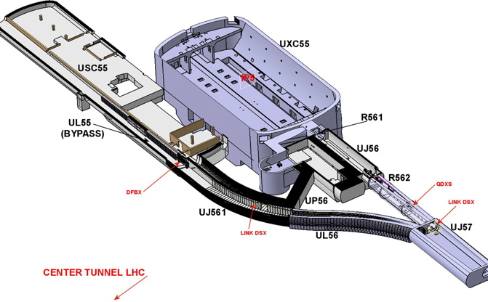
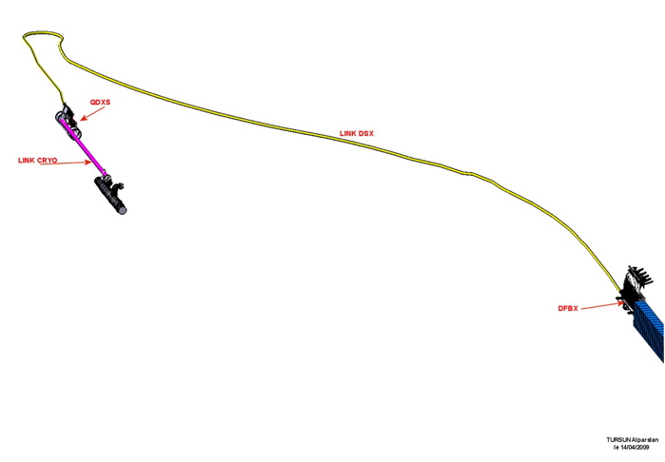
Equipment in IR5
DFX
Service
Module
(QDXS)
Length ~95 m
One 180 degree curve plus some longer curves
Link Cryo
DSX

Slide 22
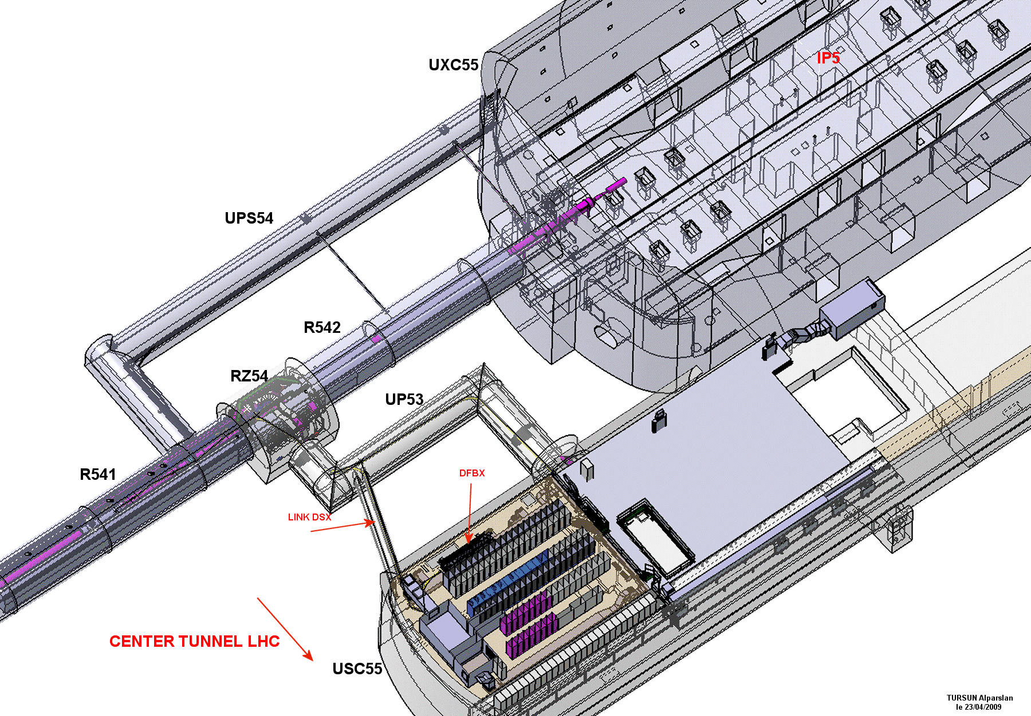
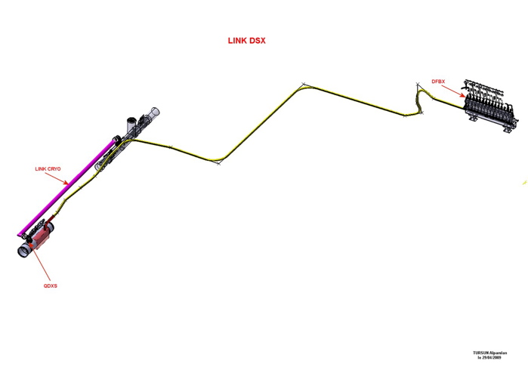
Equipment in IR5
New underground areas in IR1 and IR5 would considerably ease equipment installation and maintenance.
Length ~50m
5 sharp bends
DSX
DFX
Service
Module
(QDXS)

Slide 23
Comparison of LHC and Phase-1 triplets

Slide 24
In conclusion
  A conceptual design for the Phase-1 Upgrade, in line with the general constraints, is at hand. The technical design, the limited R&D and tooling preparations for magnet construction, are advancing. Due to the fact that the LHC dipole cable is readily available, the magnets and other equipment can be built, under reasonable assumptions, by the end of 2014.
  The available resources at CERN and worldwide for the construction of the magnets and other equipment for the Phase-1 Upgrade are limited. The collaborations with European and US laboratories, which bring in their expertise and resources, have been formalised and are in effect.
  Separate cryogenic systems for the triplets in IR1 and IR5, together with new underground areas, if available around 2015-16, would considerably ease the installation and improve the performance of the new triplets. Such investment is necessary for further IR upgrades.
  The new triplets provide considerable flexibility for beam collisions in ATLAS and CMS insertions. Several ways are open to reach stable operation at a luminosity of 2 10³⁴ cm⁻²s⁻¹.

Slide 25
Acknowledgments
Members of the Technical Design Group
R.Assmann
M.Bajko
A.Ballarino
C.Boccard
F.Butin
F.Cerutti
R.Denz
D.Duarte Ramos
O.Dunkel
S.Fartoukh
S.Feher
P.Fessia
B.Holzer
M.Kaducak
M.Karppinen
G.Kirby
N.Kos
H.Mainaud Durand
S.Maridor
J.Miles
Y.Muttoni
T.Peterson
S.Plate
H.Prin
S.Roesler
S.Russenschuck
H.Thiesen
J-P.Tock
A.Vande Craen
R.Van Weelderen
R.Veness
B.Vullierme
S.Weisz
P.Wanderer
L.Williams
K.C.Wu

