Slide 1
What do the experiments want?
prepared by N. Hessey, J. Nash, M.Nessi, W.Rieger, W. Witzeling
LHC Performance Workshop, Session 9 - Chamonix 2010

Slide 2
sLHC as a luminosity upgrade
The physics potential will be better tuned once the LHC reaches its discovery phase
Today’s forecast is that the requirements on the detectors will remain the same or will even increase. The detector environment will become more complex
√(sx₁x₂) = √(sx)
[ “Hard scattering partons” ]
proton
x₁p
x₂p
proton
proton beams

Slide 3
3000 fb⁻¹ on tape
/ experiment (ATLAS, CMS)
100 fb⁻¹ on tape
/ LHCb
10 nb⁻¹ PbPb (+pA, light ions)
/ Alice
a programme which lasts out to 2030 !

Slide 4
Luminosity evolution ?
~ 3000 fb⁻¹
Phase 2
L= 4-5 * 10³⁴ ?
Phase 1
~ 600 fb⁻¹
LINAC 4
L= 2 * 10³⁴ ?
~ 100 fb⁻¹
L= 1 * 10³⁴
Years ~20

Slide 5
Detector limitations
Some detectors will age at a given integrated Luminosity (different case by case)
      ATLAS b-layer PIXEL ~ L_{int} = 200-300 fb⁻¹
      ATLAS Silicon Tracker (SCT + PIXEL) ~ L_{int} = 600-700 fb⁻¹
      ATLAS LAr Hadron Calorimeter FE Electronics ~ L_{int} = 1000 fb⁻¹
      CMS PIXEL ~ L_{int} = 300 fb⁻¹
      CMS Silicon Tracker ~ L_{int} = 600-700 fb⁻¹
      ….
Some detectors will become inefficient or problematic at a given peak Luminosity
      ATLAS TRT (transition radiation tracker) ~ L = 2-3 10³⁴
      ATLAS FCAL (forward calorimeters) ~ L = 2-3 10³⁴
      ATLAS SS external beam pipes (activation) ~ L = 1 10³⁴
      ATLAS&CMS Silicon trackers ~ L = 2-3 10³⁴
      ……

Slide 6
ATLAS and CMS strategy
Use efficiently the next 4-5 years shutdowns to fix problems, consolidate infrastructure, anticipate issues related to rate effects at nominal Luminosity and restore the original full detector layout (un-staging)
Make efficient use of the long shutdown (9 months? foreseen in 2015) for the LINAC 4 installation. ATLAS, for example, is making plans to insert a 4th Pixel layer around the beam pipe
Anticipate all possible upgrade activities towards sLHC that can be factorized out of the main sLHC detector upgrade plans. Make use of all shutdowns before 2020 for installation …. If not we will need later a very long shutdown!
Request a long shutdown (>18 months), just after ~600-700 fb⁻¹ of good data have been collected, to install the new Inner Detectors of ATLAS and CMS (plan today for end 2020 ?)

Slide 7
CMS upgrade overview
Similar picture for ATLAS !

Slide 8
A few examples
ATLAS LAr forward calorimeters
ATLAS innermost Pixel layer
CMS low-mass Pixel detector
CMS and ATLAS inner detectors
First level trigger considerations

Slide 9
ATLAS LAr forward calorimeters
Currently FCal1 will work properly up to peak luminosities of 1*10³⁴cm⁻²s⁻¹
• The FCal1 will however not work efficiently above 2-3*10³⁴cm⁻²s⁻¹
- positive Ar ions build-up leads to field distortion and to signal loss
- high HV currents lead to voltage drop
- heating of Ar and boiling (only at very high luminosities)

Slide 10
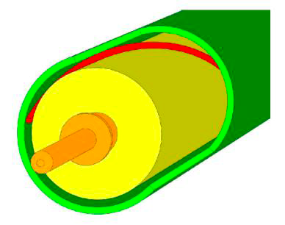
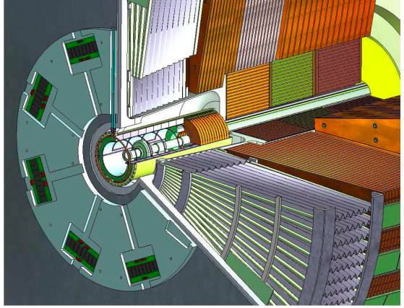
ATLAS LAr forward calorimeters
LAr read out rod
LAr end cap calorimeter
Two options:
• new cold FCal1 with smaller gaps: 250 μm → 100 μm : this will require a major shutdown of ~ 15 months (2020 ?)
• new warm Mini-Fcal in front of current FCAL : this can be ready in phase I and will need a 8-9 months shutdown for installation

Slide 11
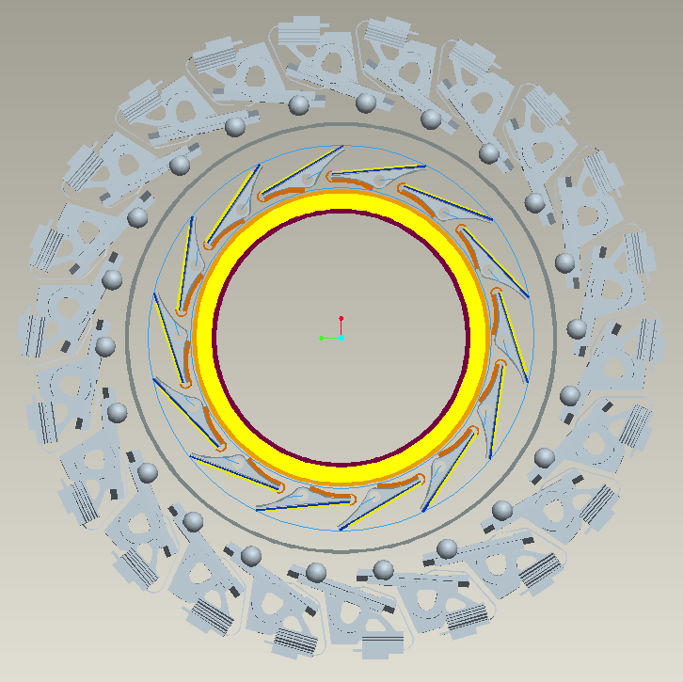
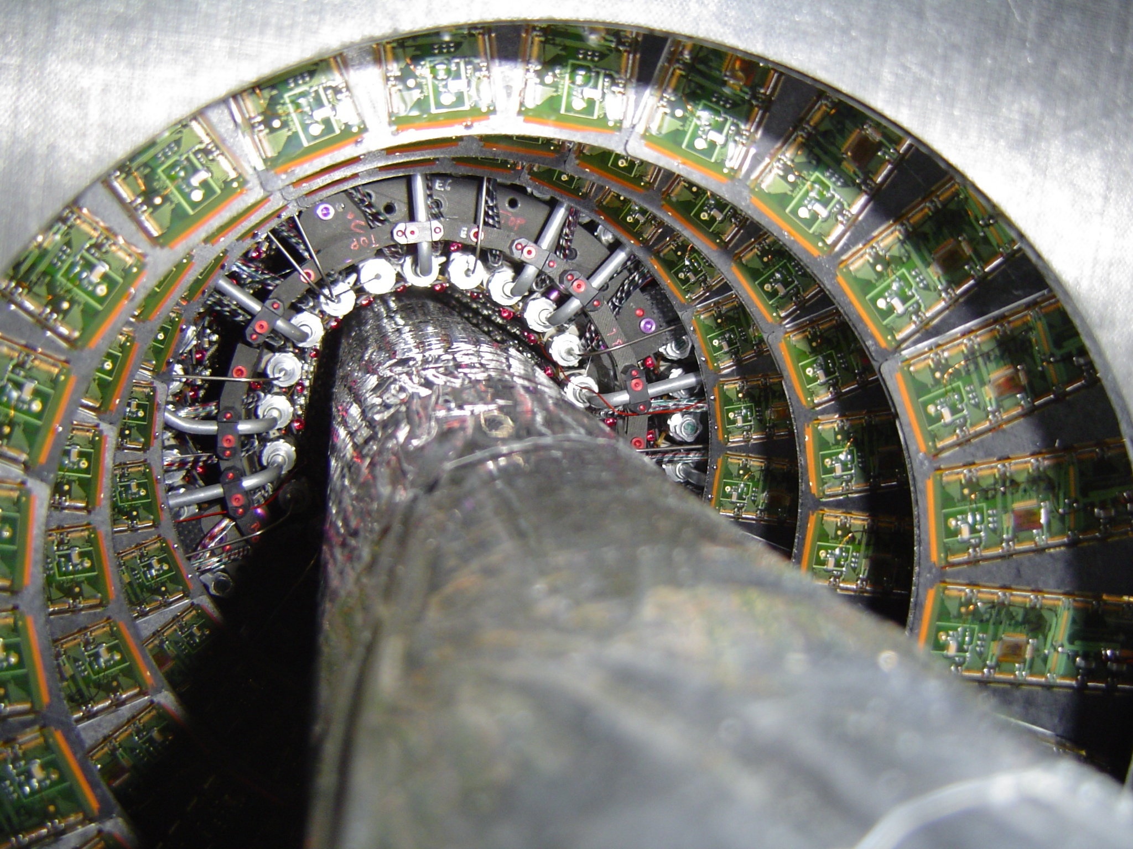
ATLAS innermost PIXEL layer (b-layer)
Present Pixel detector, in particular the innermost layer (out of 3) will become inefficient (100-300 fb⁻¹, L ~2-3 10³⁴ cm⁻² s⁻¹)
ATLAS has officially approved this project. TDR & MOU expected soon
Ready for 2014
Existing b-layer
New b-layer
ATLAS
Add a new b-layer around a smaller beam pipe (in radius), stave structure, 160 MHz readout, CO₂ cooling

Slide 12
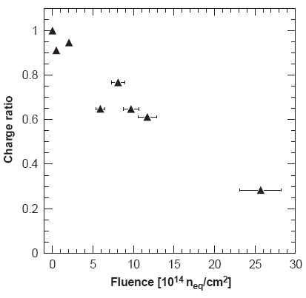
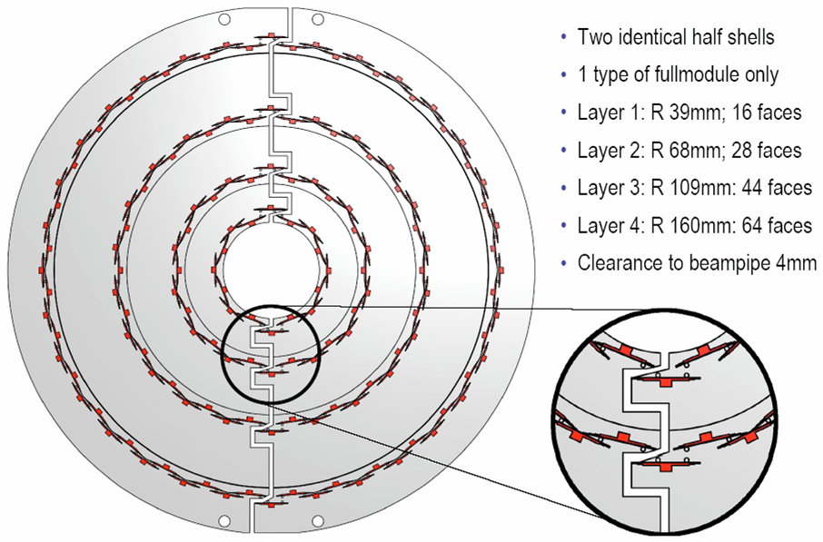
CMS low-mass PIXEL detector
Radiation damage due to integrated luminosity
  Today sensors designed to survive 6×10¹⁴n_{eq}/cm² (∼ 300 fb⁻¹ )
  n-on-n sensors degrade gradually at large fluences
New design adds a fourth pixel layer, is capable of higher rate running, and total material is substantially reduced from current 3 layer Pixel detector. In addition inner layer modules can be replaced during shutdown
Aim to be ready by 2014

Slide 13
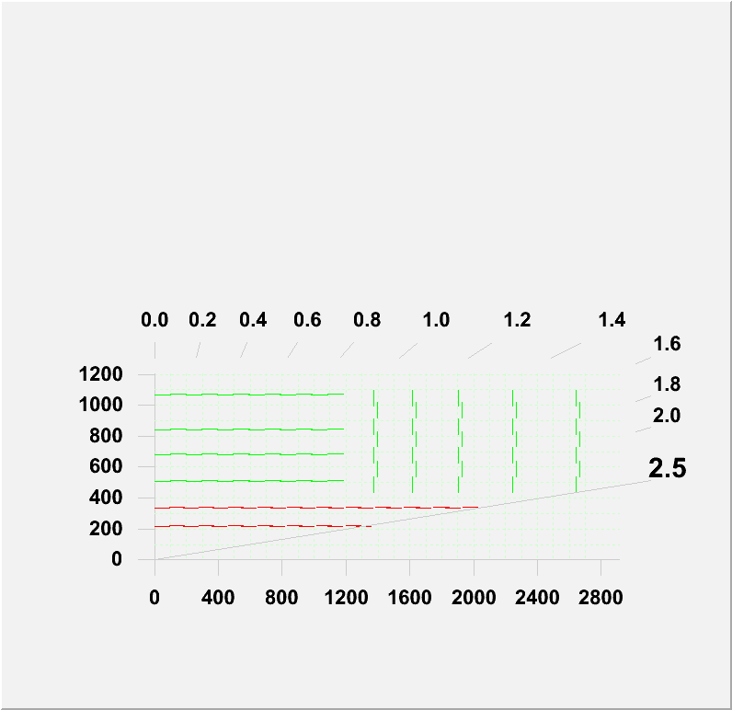
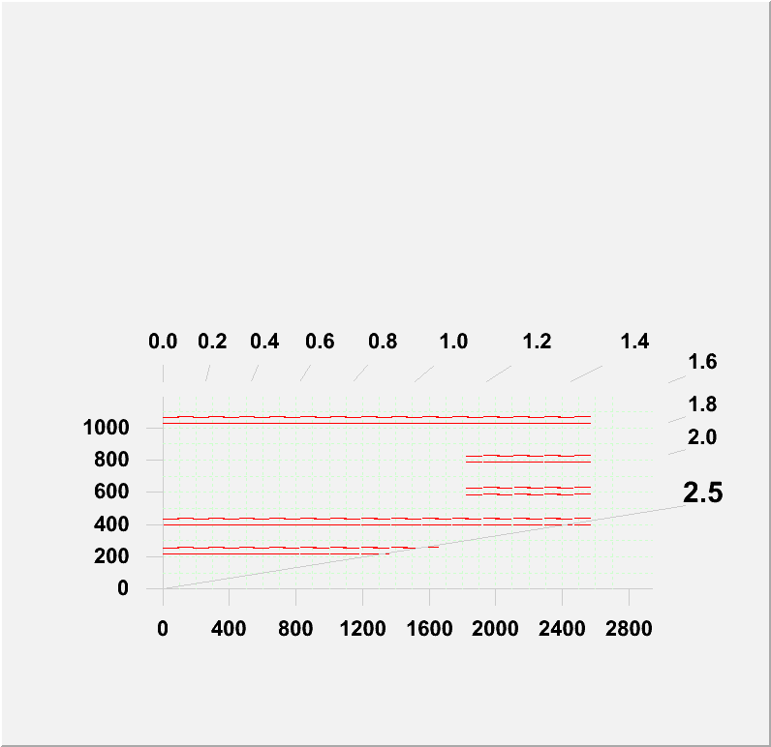
CMS Inner Detector (1)
  Studying several potential layouts for a new outer tracker
  Want to increase granularity as well as minimize material in future tracker
  Need to understand how many triggering layers (in red at left), and where they need to be located in order to provide adequate triggering capability
  No final decision on layout of tracker until final requirements determined

Slide 14
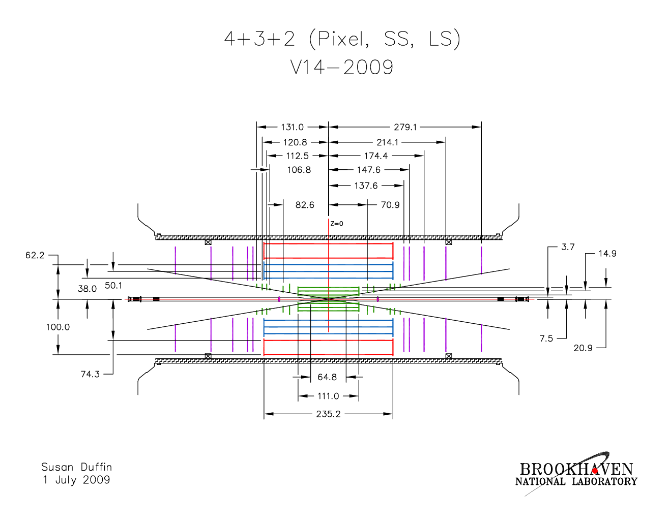
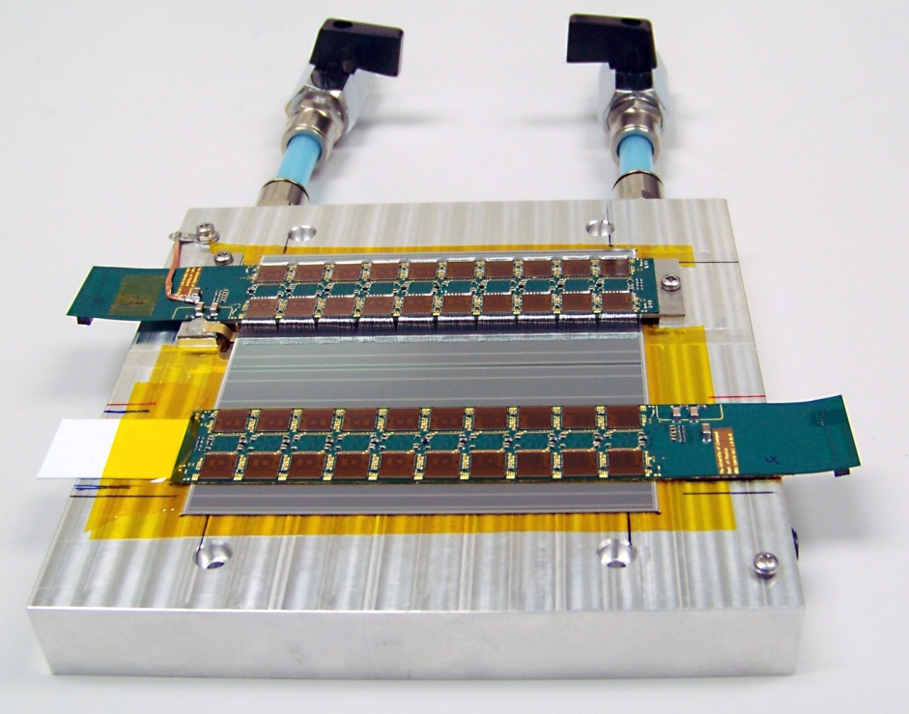
ATLAS Inner Detector (1)
4 layers of pixels
3 double-layers of short strips
2 double-layers of long strips
Approx. 400 Million pixels (cf 80 Million now)‏
Approx. 45 Million strips (cf 6.3 Million now)‏
Prototype strip sensors (ATLAS07), read-out chips (ABCNext) and hybrids built into modules with excellent performance

Slide 15

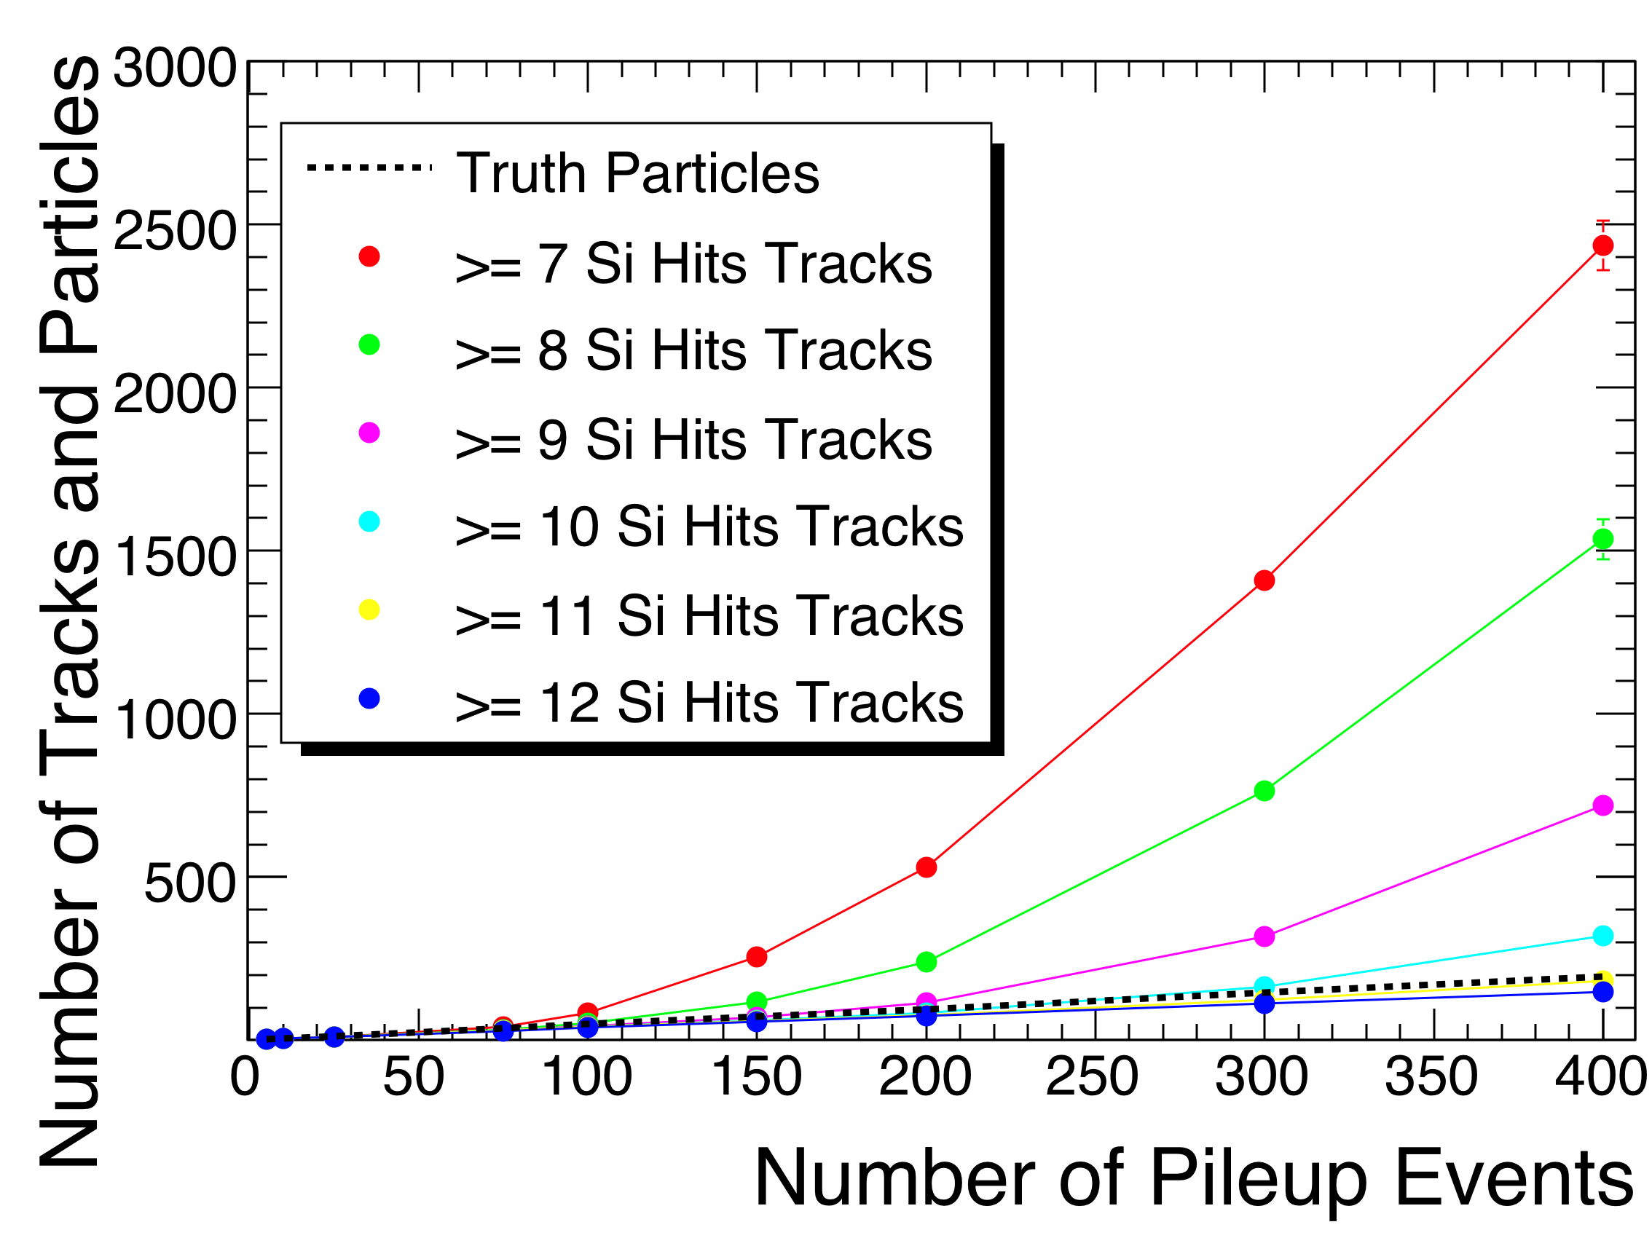
ATLAS Inner Detector (2)
Very high track density
Picture shows hits in inner tracker from one bunch crossing with 400 pile up events; only tracks in forward half of detector were generated.
The inner tracker gets about 15,000 tracks per bunch crossing (and a similar number of photons which can produce e⁺e⁻ pairs)‏
The challenge is to find all the tracks, without also finding many fake tracks from random combinations of hits.
Work in progress; we can cope with 400 events, but it requires a tight cut of at least 11 hits on a track (yellow line) to control the fake rate. Then the number of tracks found follows the black dotted line of actual number generated, but with some inefficiency.

Slide 16
LVL1 trigger considerations
We need to keep the stored event rate roughly the same as now : ~200 events per bunch crossing. The events are much bigger at high luminosity, so this is quite a challenge.
It means rejecting 10 to 20 times as many events as now, each of which is about 10 times as big.
To meet this challenge, we can increase the latency at level-1 and move some of what is done in software at high level, such as combining trigger objects, into LVL1.
We consider introducing new elements at LVL1, including a track-trigger.
Full granularity of the calorimeters at trigger level will allow better particle id.
The muon trigger needs better resolution to allow higher momentum thresholds to reduce the muon trigger rate. Adding some new chambers can achieve this.
It is not known how the very important forward calorimeter trigger will perform at these sLHC high rates.

Slide 17
Detectors limitations
In general some detector components will need to be replaced, upgraded or just consolidated. A large fraction of the front-end electronics and trigger electronics will need to be upgraded before going to sLHC Luminosity
In the early half of the last decade, some detector components necessary to run at nominal Luminosity have been staged and need now to be restored
we do not yet know how the various detector components will react once we stress them by operation nearer to design rates. Special corrective interventions and consolidation programmes may prove to be necessary
The experiments feel now it is very important to have a basic scenario for all what concerns beam periods and shutdown periods over the next 5-6 years, at least until the LINAC 4 is installed and is operational. Actions on the detectors need to be anticipated with enough time for preparation.

Slide 18
Detector Activities
Phase 2
L= 4-5 * 10³⁴
Phase 1
new Inner Detectors
ATLAS open endcap LAr?
Upgrade front end electronics
and upgrade triggers
ATLAS installs 4th Pixel layer
CMS new low mass Pixel ?
Modification of the TAS regions?
Install new shielding elements
ATLAS new warm FCAl
ATLAS new muon forward det.
……..
New forward beam pipes
Consolidate infrastructure
Solve single points of failure
Fix detectors problems
Restore nominal design
~ 600 fb⁻¹
L= 2 * 10³⁴
~ 100 fb⁻¹
L= 1 * 10³⁴

Slide 19
LHCb upgrade strategy
Strategy
  First collect ~10 fb⁻¹
  Upgrade LHCb to 40MHz read-out (requires ~8-10 month shutdown)
  Then collect ~100 fb⁻¹
This requires running LHC at a Luminosity of 5*10³³ at Point 8
LHC and sLHC operation schemes must be designed to allow
running of LHCb after 2020 with L=5*10³³
  Need to ensure full compatibility with LHCb requirements in IP8, in particular:
  Compatibility of triplets in IP8 with higher luminosity (at present no TAS in P8)
  Optics and crossing scheme (displaced collision point, de-focussed beams)
  R2E of electronics in UX85, US85…
  Coordination of the Phase-1 shutdown/upgrade activities such to include LHCb upgrade
This needs to be clarified a.s.a.p.

Slide 20
ALICE upgrade strategy (>2017)
For the ‘Phase II’ operation one assumes the typical scheme of a yearly Ion run together with a (short) period of p+p running (data comparison+detector startup) .
For pp, the luminosity has to stay below few 10³¹ (displaced beams and/or short dedicated low Lum runs).
Detector upgrades:
- 2nd generation vertex detector (using a smaller beam pipe)
- Detectors for forward physics (in particular, forward calorimetry)
- Particle ID for p_{T} 5 – 20 GeV
- Increased rate capability of TPC (faster gas, increased R/O speed)
- Upgraded DAQ & HLT
LHC upgrade:
- increase PbPb by factor five to 5*10²⁷ (still compatible with TPC operation)
LHC and sLHC operation schemes must be designed to allow heavy ion operation and short periods (few weeks/year) of pp with L<5*10³¹ in IP2

Slide 21
Summary (1)
The experiments urgently need a plan for shutdowns over the next 5-6 years (LINAC 4) to organize the first stage of upgrade work
We need a credible programme of long-term LHC operation in order to be able to justify planning and resources for the phase II upgrades
Preparing new trackers is a 10 year programme. They are very challenging, and we have to push ahead with the R&D now in order to be able to consider building these devices. Signals that this is not going to happen will be deadly.
  We should not be planning that the LHC will reach its end of life (~ 2030) with a few 100 fb⁻¹/year

Slide 22
Summary (2)
Today the experiments have not yet demonstrated to be able to run efficiently, with an upgraded detector, at a peak Luminosity of 10³⁵ cm⁻² s⁻¹. Occupancy and Track density are still major concerns. Any solution which will allow to minimize pileup while reaching the goal of 3000 fb⁻¹ is strongly preferred (see luminosity leveling)
The compatibility between running CMS and ATLAS at sLHC and at the same time colliding at point 2 and 8 should be urgently clarified
  All plans to modify, upgrade the interface regions between experiment and machine (TAS, triplets, …) need a new and a proper level of organization and visibility

