Slide 1
the LHC is back

Slide 2
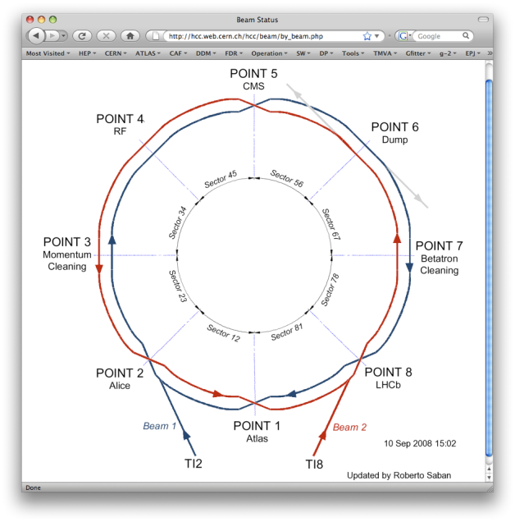
Friday November 20
18:30 Beam 1
  19.00 beam through CMS (23, 34, 45)
    beam1 through to IP6 19.55 Starting again injection of Beam1
    corrected beam to IP6, 7, 8, 1
  20.40 Beam 1 makes 2 turns
    Working on tune measurement, orbit, dump and RF
    Beam makes several hundred turns (not captured)
      Integers 64 59, fractional around .3 (Qv trimmed up .1)
  20.50 Beam 1 on beam dump at point 6
  21.50 Beam 1 captured
22:15 Beam2
  23.10 Start threading Beam2
    Round to 7 6 5 2 1
  23.40 First Turn Beam2
    Working on tune measurement, orbit, dump and RF
    Beam makes several hundred turns (not captured)
      Integers 64 59, fractional around .3 (Qv trimmed up .05)
  24.10 Beam 2 captured
2h10 for 27km: 12.5km/h average speed
1h25 for 27km: a bit faster

Slide 3
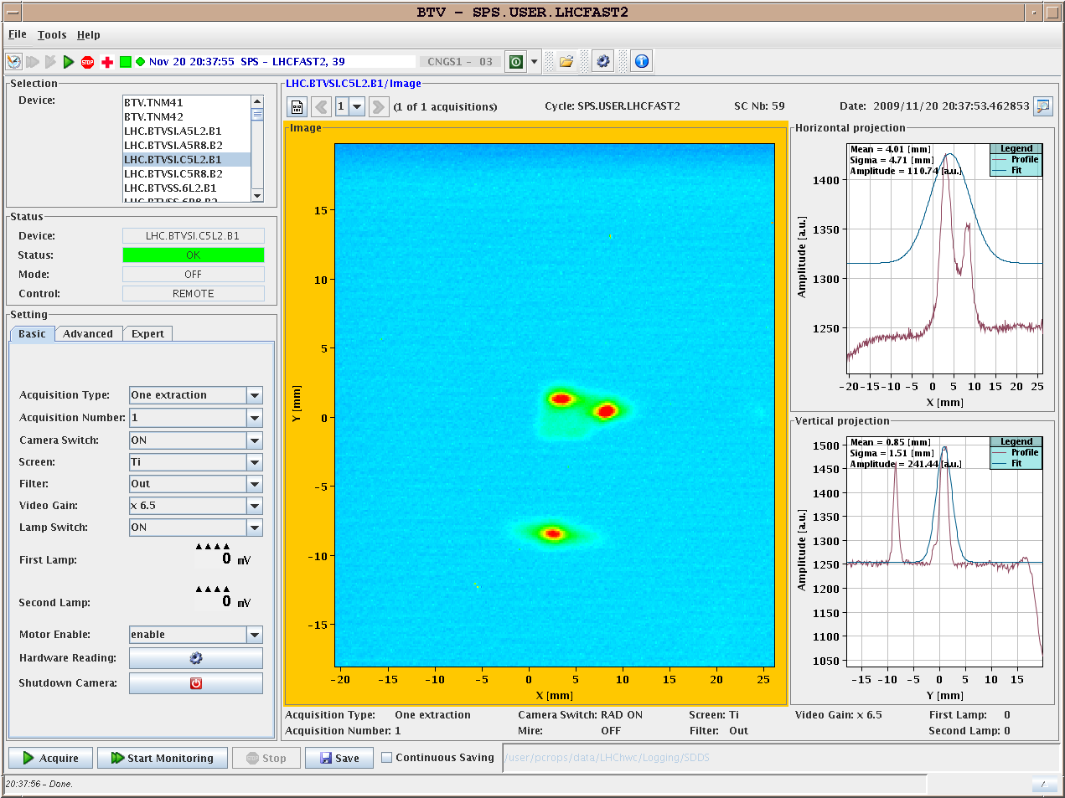
Friday: 8:15pm: Beam 1 First 2 turns

Slide 4
Monday, 23rd afternoon
Recorded collision events in ATLAS and CMS
From 16:00
  Two beams in LHC at buckets 1 and 8911
  Quiet beams for ALICE
  Then 2 beams in LHC at buckets 1 and 26701
  Quiet beams for LHCb
Recorded collision events in ALICE and LHCb
Both beams at 1.18 TeV
Monday, 30th at 0:42

Slide 5
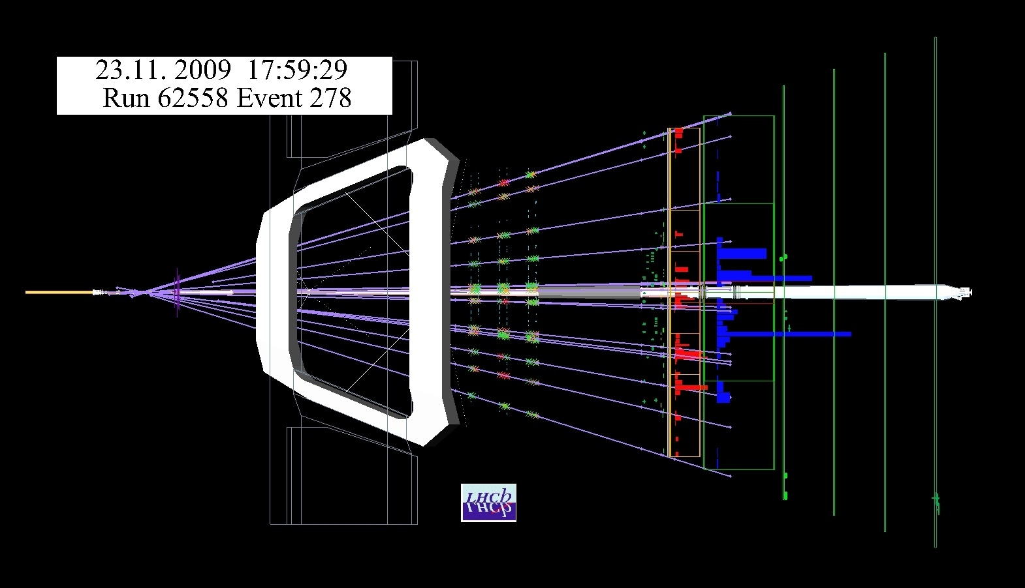
Events have nice vertices (extrapolating OT tracks)

Slide 6
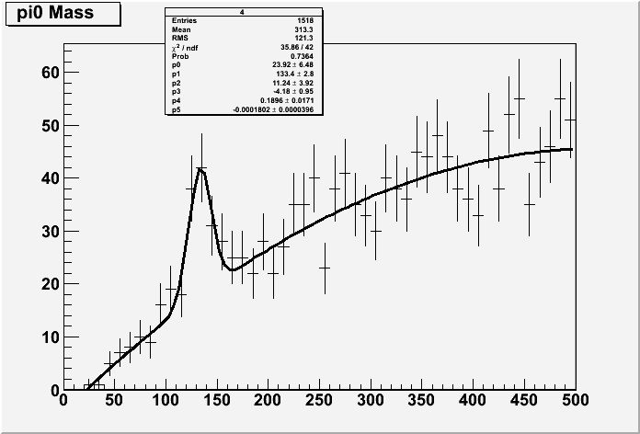
π⁰ have been reconstructed in the calorimeter

Slide 7
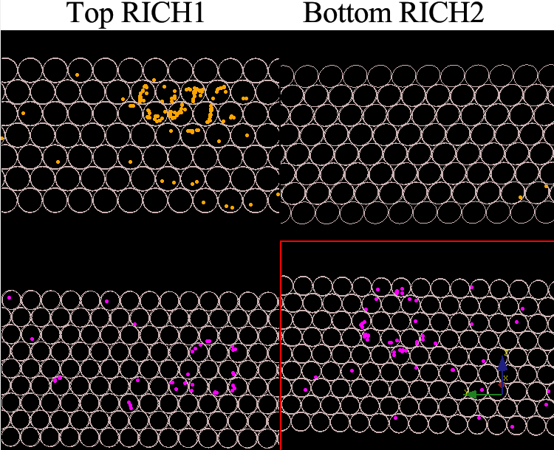
Towards collisions
Monday 23 November afternoon was fantastic
  First some “quiet” beam while beams were colliding in Atlas and CMS, then when colliding in Alice
  The RICH got its first rings due to beam-induced particles

Slide 8
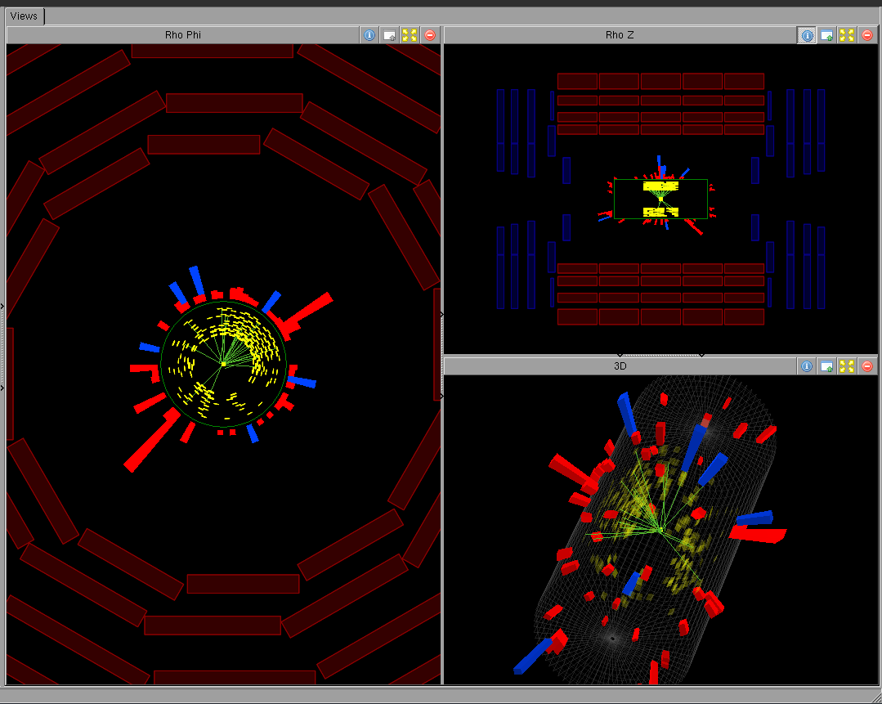

An event from the Evening Fill
Mon 23 Nov 19:21
Run 122314 Evt 1514552
First candidate collision

Slide 9
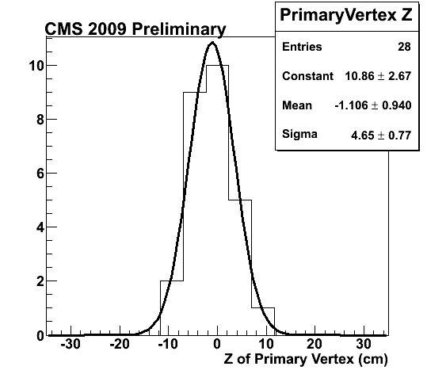
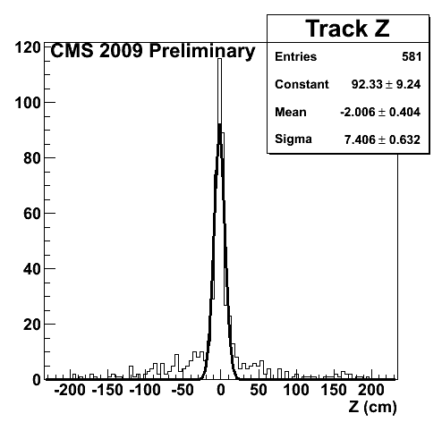
Reconstructed vertices using TOB
Evening Fill
CMS 2009 Preliminary
Uncorrected Distributions
Mean z = -1.1 ± 0.9 cm
All tracks with > 6 hits
and χ² < 10
Clean vertices (≥ 3 tracks)

Slide 10
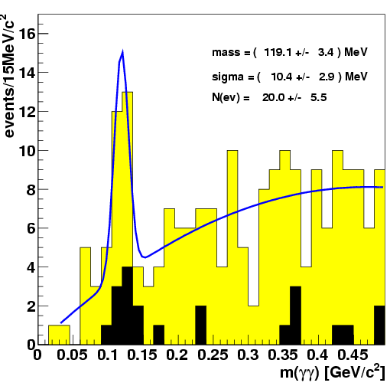
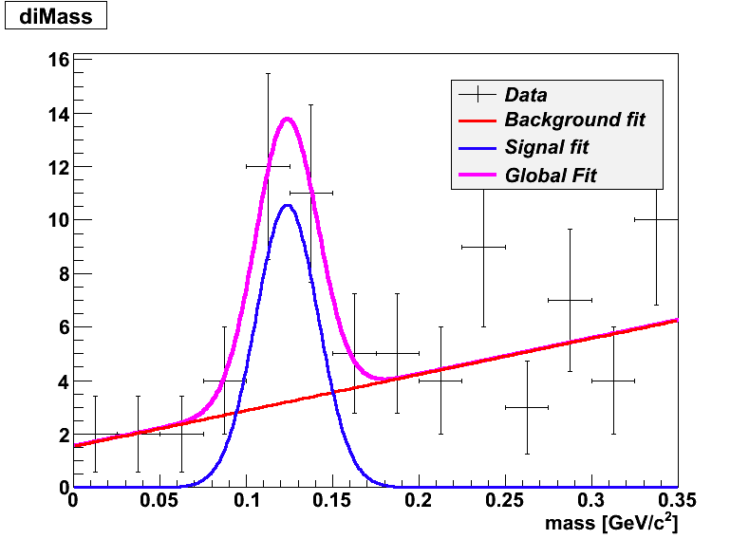
First Di-photon Distribution in CMS
Evening Fill
CMS 2009 Preliminary
Uncorrected Distribution
CMS 2009 preliminary
Events/25 MeV/c²
M(π⁰) is lower in both data and MC
Mostly due to the readout threshold (100 MeV/Crystal).
Conversions: part of the energy is deposited upstream of ECAL.
Event timing is consistent
Analysis 1: based on E_{T} selections (tighter cuts in black)
Analysis 2: based on E selections

Slide 11
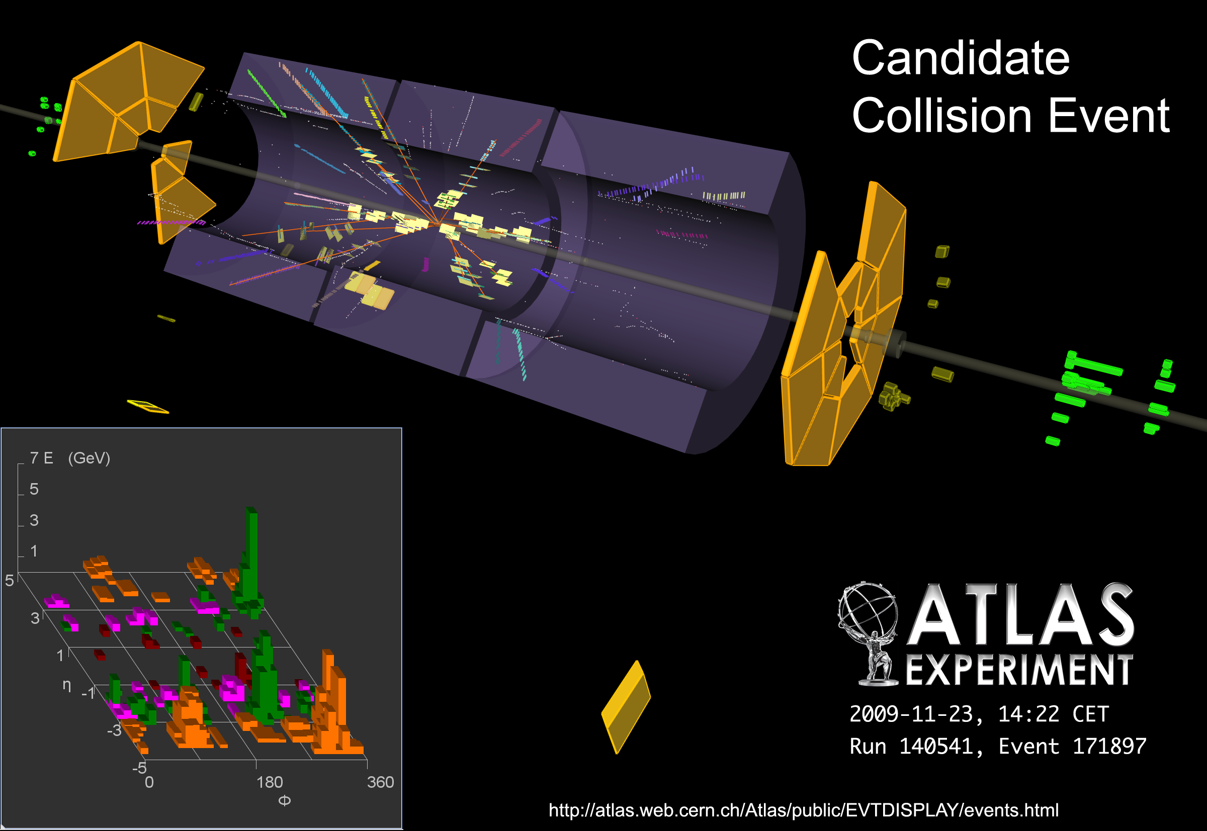

Slide 12
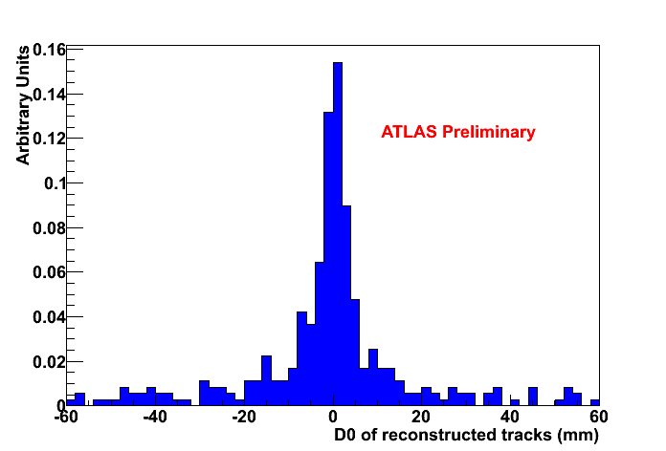
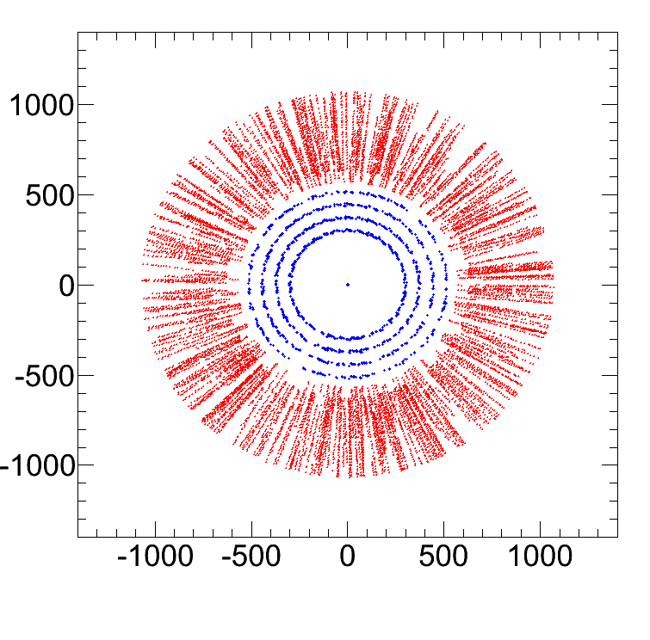
Tracking (challenging w/o Pixel, limited SCT and solenoid field off!)
Without solenoid field no separation of tracks by momenta
Fit impact parameter in a “silver-plated” sample with SCT >= 20 V and number of SCT hits >= 6 (46 events)
Scatter plot of hits on tracks (barrel, 46 events)
ATLAS preliminary
The impact point is well centred in ATLAS!
mm
ATLAS preliminary
TRT
SCT
mm

Slide 13
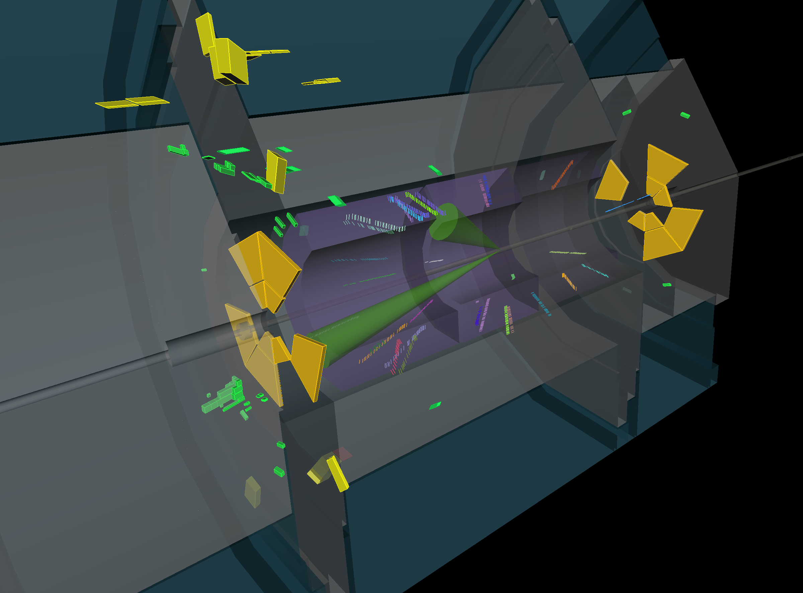
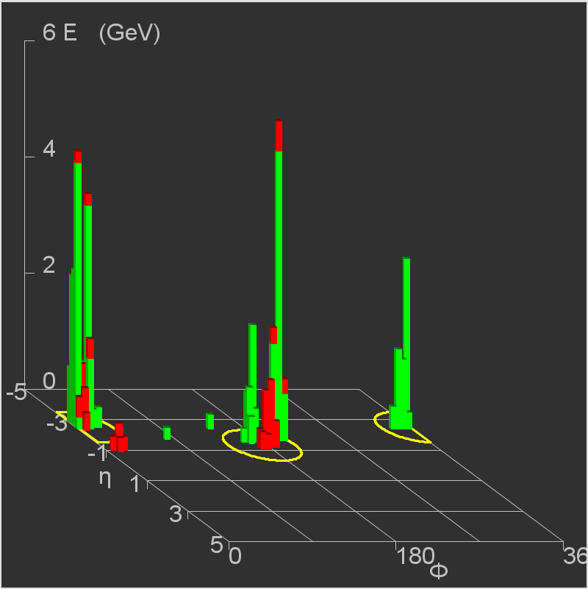
A di-jet candidate
Run 140541 Event 416712
ATLAS preliminary
Two jets back-to-back in φ, both with (uncalibrated) E_{T} ~ 10 GeV,
η of −1.3 and −2.5,
~ no missing E_{T}
Triggered by MBTS A/B in time, several hits
Also triggered by L1Calo EM3

Slide 14
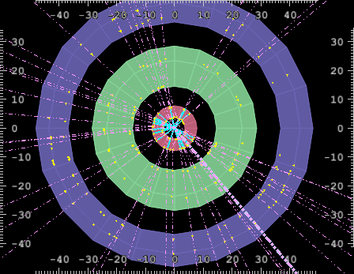
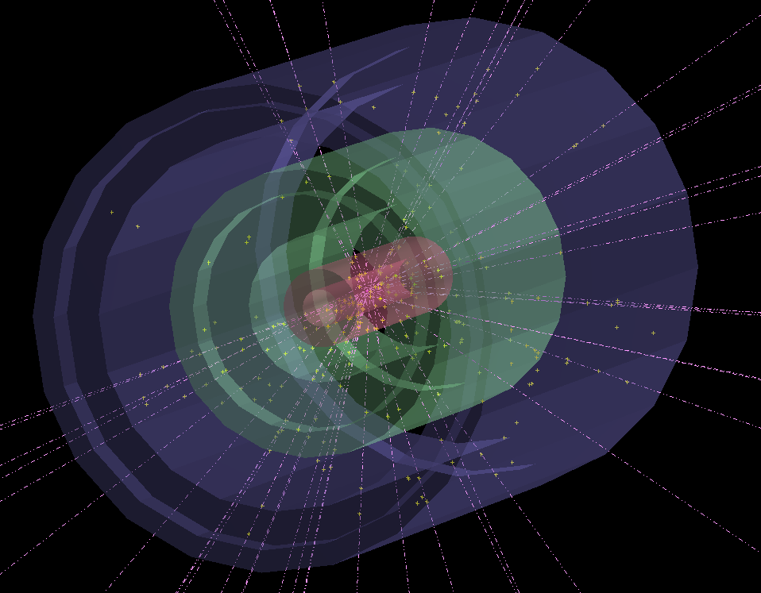
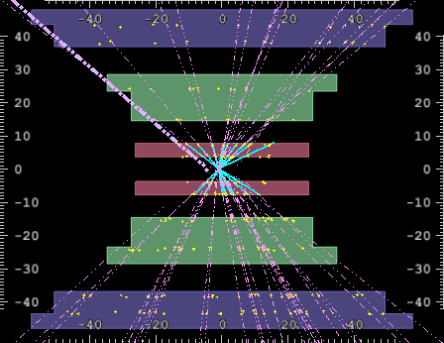
A high multiplicity event…

Slide 15
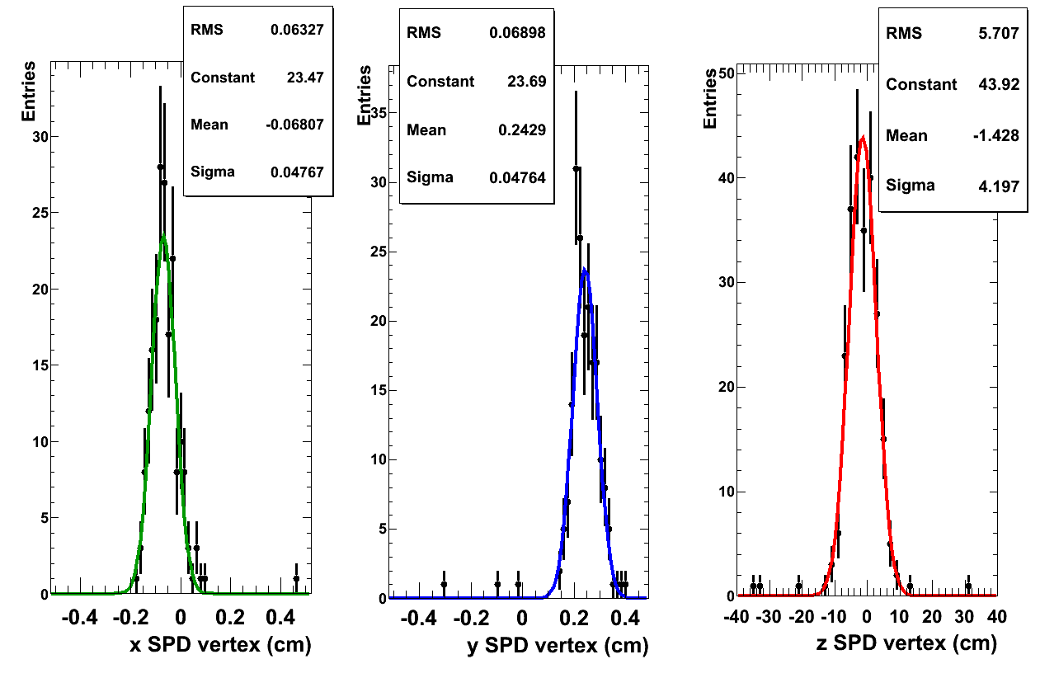
Vertex distributions (offline)
Calculated in Offline from tracklets in Silicon Pixel Detector:
σ_{x} ~ 475 µm
σ_{y} ~ 475 µm
σ_{z} ~ 4.2 cm

Slide 16
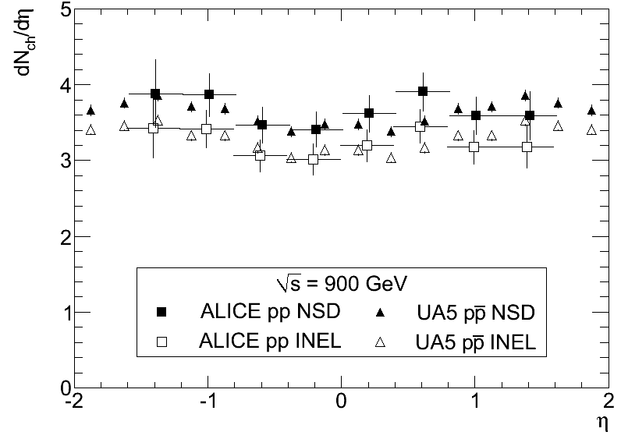
First publication, accepted by EPJ
Pseudorapidity distribution

Slide 17
LHC physics is starting now
PS started 50 years ago. . .

