Slide 1
Super B Factories:
Motivation and Realization
David Hitlin
Aspen Winter Conference
January 22, 2010

Slide 2
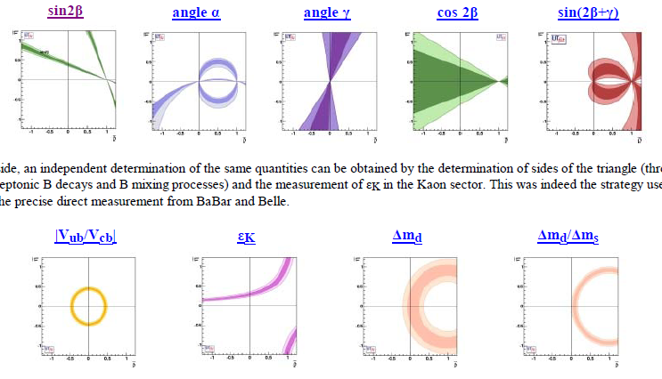
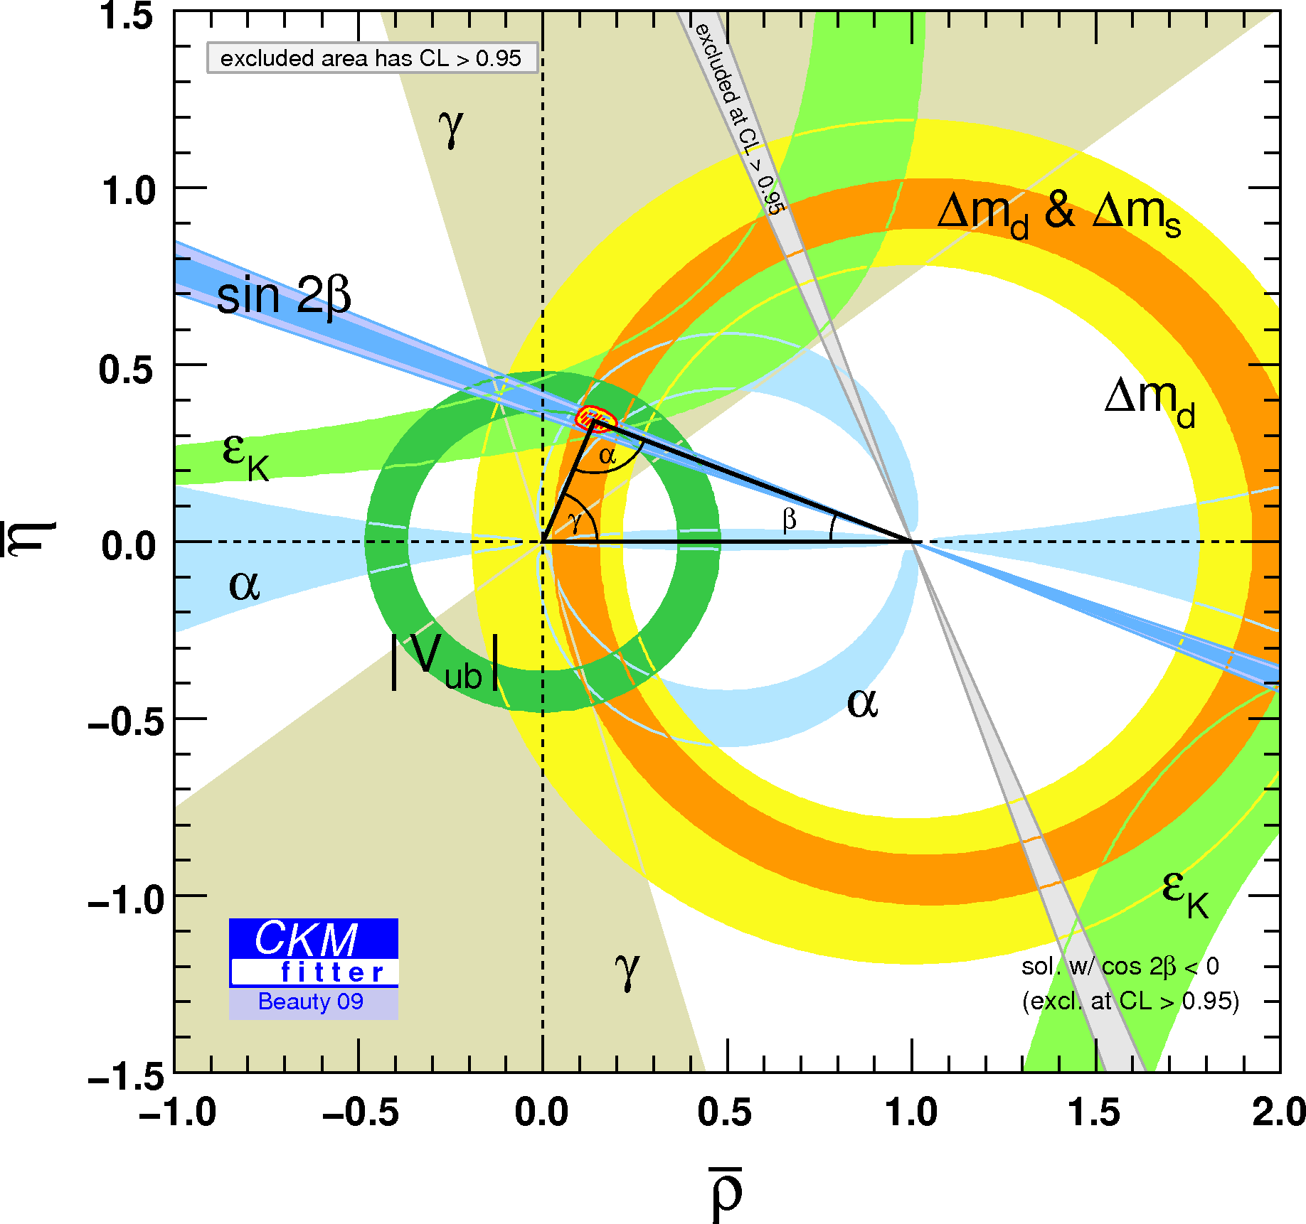
CKM Fitter results as of Beauty 2009
The BABAR and Belle CP asymmetry measurements
together with improved precision in other
measurements
have produced a set of highly
overconstrained tests, which
grosso modo, are well-satisfied
A closer look, however, reveals some issues, which warrant more
precise measurements, but which I will not discuss further

Slide 3
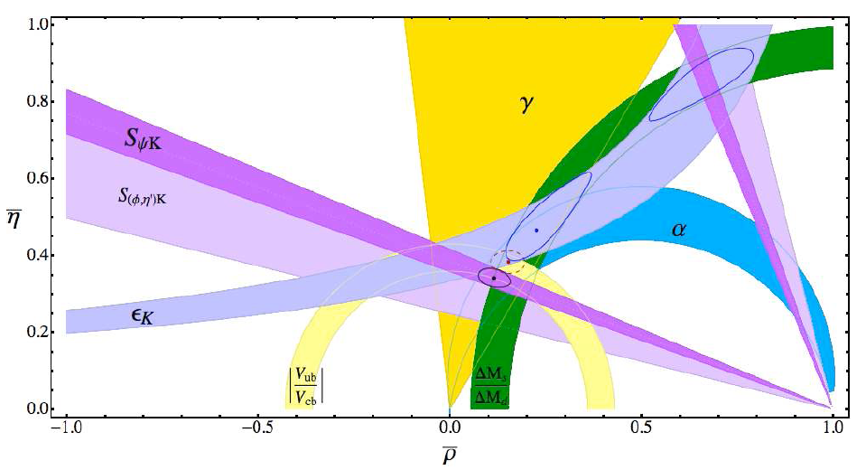
Does the agreement of the overconstrained tests stand up to detailed scrutiny ?
There is actually some tension,
and there are enough constraints
to explore these issues
  Caveats:
    There may be Standard Model
    explanations for some effects
    All issues are at the <3σ level
  Inclusive and exclusive V_{ub} determinations are not in good agreement
    There are also issues with inclusive/exclusive V_{cb}
  The B(B→τν) conflict in V_{ub}
  The agreement of the fitted, i.e., SM-predicted, value of sin 2β vs the directly measured value using tree decays and loop decays is not perfect
  The B_{s} → ψϕ phase
  The Kπ problem
Lunghi and Soni

Slide 4
Motivation beyond the Unitarity Triangle
High p_{T} LHC physics and precision flavor physics are complementary
The consistency of all measurements of flavor-changing neutral current (FCNC) processes with the Standard Model predictions requires that the flavor structure of new physics at theTeV scale is highly nontrivial
  The extreme case is minimal flavor violation (MFV):
    In MFV the only source of flavor violation, even for new particles, are the Yukawa matrices of the Standard Model
    Some people are sure this is the answer, in which case searches for New Physics effects in high precision heavy flavor experiments would be futile
Are there non-MFV effects in b,c and τ decays?
  What experimental sensitivity is required to see such effects?
    A Super B Factory (better, Super Flavor Factory) has this sensitivity
The pattern of observed effects provides unique information on New Physics
  Patterns can distinguish
    SUSY and specific modes of symmetry breaking
    Extra Dimension models
    Little Higgs (LHT) models

Slide 5
What is a Super B Factory and why do we need one?
The motivation to continue e⁺e⁻ flavor physics studies with a Super B factory beyond the BABAR/Belle/(LHCb) era lies in its ability to make measurements
in b, c and τ decay that have sensitivity to physics beyond the Standard Model
A data sample of 50-75 ab⁻¹ is required to provide this sensitivity
  BABAR +Belle total sample is <2 ab⁻¹
  A luminosity in the range of 10³⁶ cm⁻²s⁻¹ is required to integrate a sample
  of this size in a reasonable time: 10³⁶ ⇒ 15 ab⁻¹/Snowmass Year
The are two proposed Super B Factories
  SuperB at LNF or on the campus of Rome II Univ (Tor Vergata)
  SuperKEKB at KEK
  These machines use a novel design to produce high luminosity with currents
  comparable to those in the current generation of colliders
    Asymmetric energy rings ( ~4x7 GeV) with very low emittance, similar to those developed for the ILC damping rings and high brightness light sources
      New type of final focus – a “crabbed waist”
      Longitudinally polarized (~80%) LER beam
      Luminosity of ~10³⁵ in the 4 GeV region
Design of an appropriate detector as an upgrade of BABAR is a fairly
straightforward problem
  Luminosity-related backgrounds present the biggest issues
SuperB
only

Slide 6
What’s the killer app?
  Is it the ability to discover lepton flavor-violating τ decays and determine the chirality of the LFV coupling ?
    Neutrino oscillations demonstrate the existence of
    neutral LFV couplings
    Charged LFV are very small in the Standard Model, but measureable at SuperB
  Is it the unique sensitivity to new CP phases beyond CKM in
  B and D decay through studies of direct and indirect CP
  asymmetries?
  Is it the sensitivity to the existence of a fourth quark generation ?
  Is it the sensitivity to right-handed currents ?
  Is it the sensitive tests of CPT invariance at the highest available q²
  made possible by exploiting quantum coherence ?
  Is it the whole panoply of measurements and the pattern of effects uncovered that can serve as a “DNA chip” for New Physics found at LHC ?

Slide 7
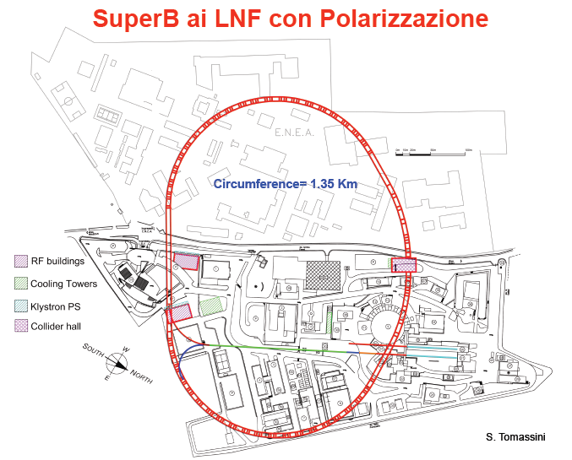
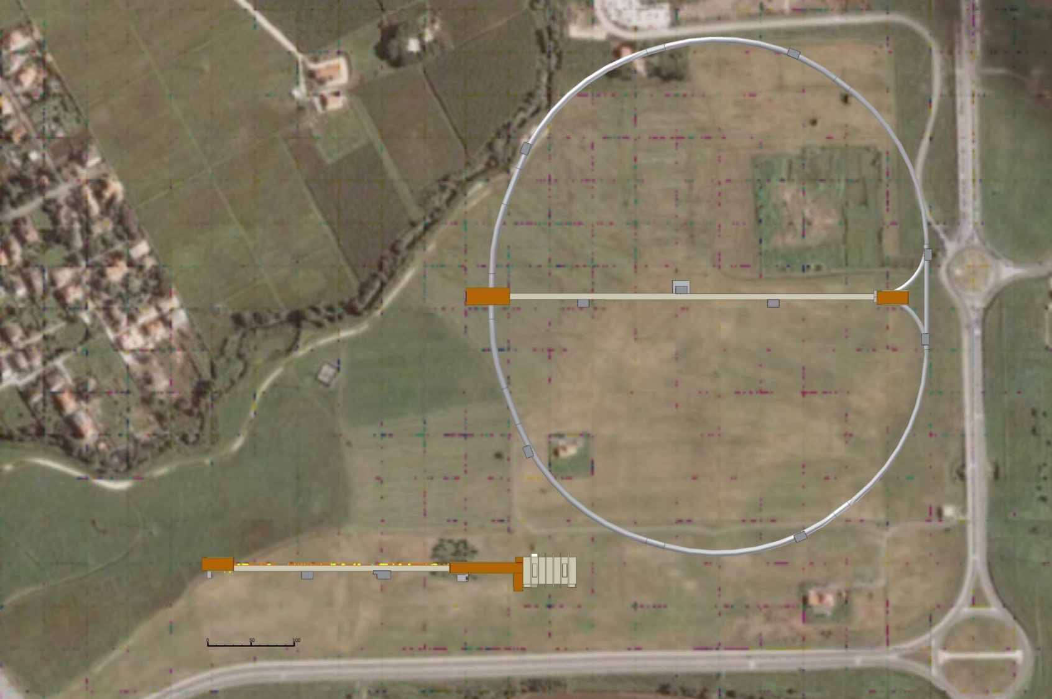
Two locations are under study for SuperB
Roman Villa
LNF+ENEA
Tor Vergata
Collider Hall
Circumference
1.8 km
SuperB LINAC
SPARX

Slide 8
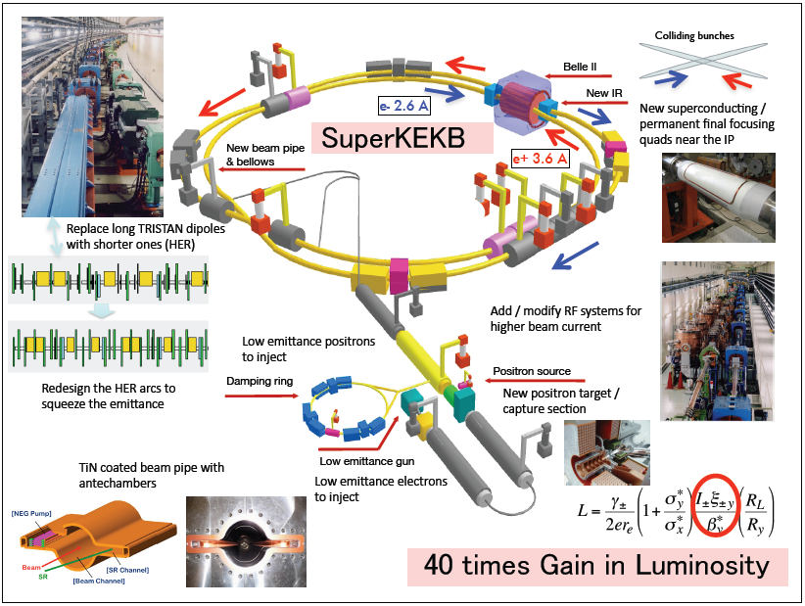

Slide 9
Brief chronology of design evolution
2001: Initial efforts at SLAC to design a collider at ~10³⁶
  Based on PEP-II with more bunches, higher currents,
  higher beam-beam tune shifts
    wall-plug power very high
    detector backgrounds very difficult
  Similar effort to upgrade KEKB began soon thereafter
Explore alternative ideas (INFN Frascati, SLAC, BINP, ….)
  2005: Colliding linacs: lower backgrounds, but high power
  and large ΔE_{CM}
  2006: Low emittance rings (à la ILC), crab waist, using PEP-II components
  2008/9 Crab waist successfully implemented at DAΦNE
  2009: Low emittance concept adopted at KEK
2010: Both Italian and Japanese projects await approval
Technical issues
  Dynamic aperture
  Luminosity lifetime
  Seismic stability of the collision point
  Emittance control at the level on latest synchrotron light sources
  More sophisticated RF system feedback control systems

Slide 10
Super B Factory parameter lists
LER/HER |  | SuperB LNF Site | SuperKEKB High Current | SuperKEKB Nanobeam
E+/E- | GeV | 4/7 | 3.5/8 | 4/7
Luminosity | cm⁻²s⁻¹ | 1 x 10³⁶ | 5.3 x 10³⁶ | 8 x 10³⁵
I+/I- | A | 2.7/2.7 | 9.4/4.1 | 3.6/2.6
Polarized electrons |  | 80% | No | No
N particles | x 10¹⁰ | 4.5/4.5 | 12/5.3 | 9.2/6.7
N bunches |  | 1740 | 5000 | 2500
Collision geometry |  | Crab waist | Crab crossing | Not determined
θ /2 | mrad | 30 | 0 | 41.3
β_{x}* | mm | 35/20 | 200/200 | 32/25
β_{y}* | mm | 0.21/0.37 | 3/6 | 0.27/0.42
ε_{x} | nm | 2.8/1.6 | 24/18 | 3.2/1.7
ε_{y} | pm | 7/4 | 240/90 | 12.8/8.2
σ_{x} | μm | 9.9/5.7 | 69/60 | 10.1/6.5
σ_{y} | nm | 38/38 | 850/730 | 59/59
σ_{z} | mm | 5/5 | 5/3 | 6/5
ξ_{y} | y tune shift | 0.094/0.095 | 0.30/0.51 | 0.09/0.09
RF wall plug power | MW | 17 | 83
Circumference | m | 1400 | 3016 | 3016

Slide 11
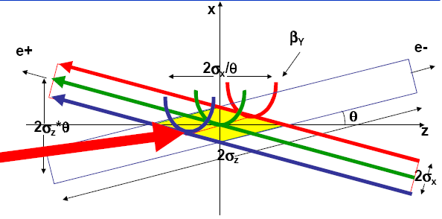
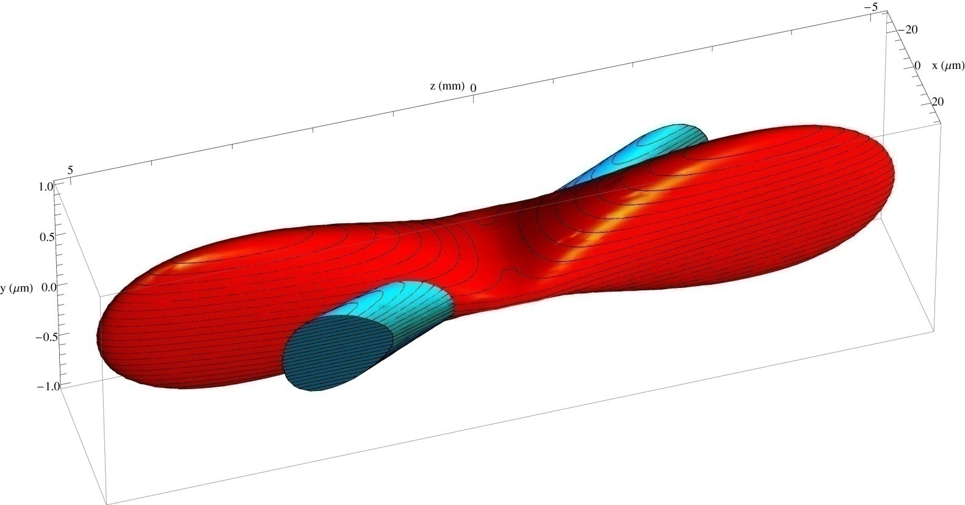
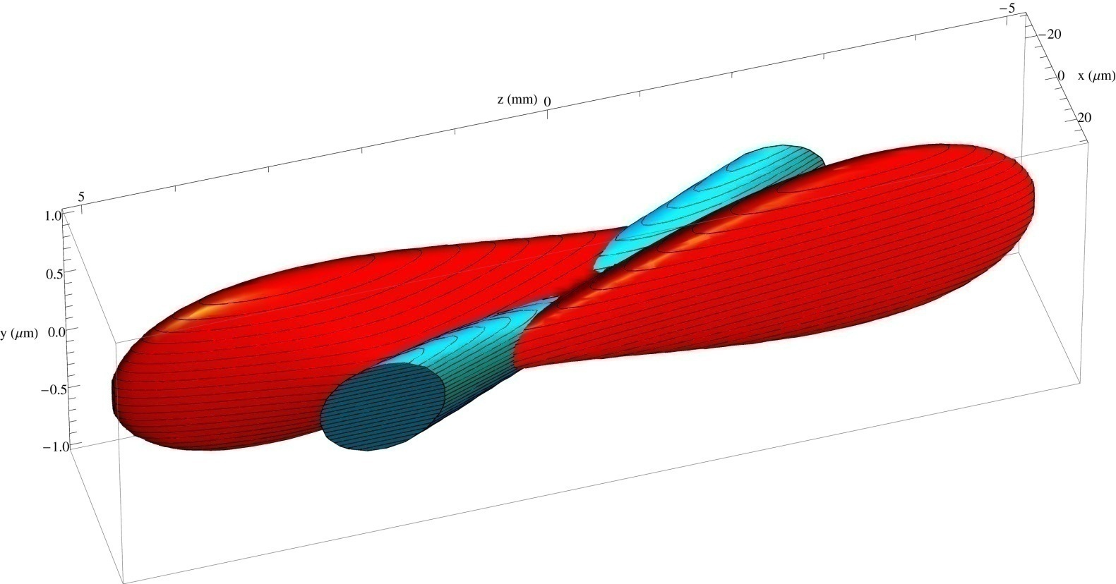
Crabbed waist beam distribution at the IP
waist line is orthogonal
to the axis of bunch
Crab sextupoles
OFF
waist moves to the
axis of other beam
Crab sextupoles
ON
All particles from both beams collide in the minimum β_{y} region,
with a net luminosity gain
E. Paoloni

Slide 12
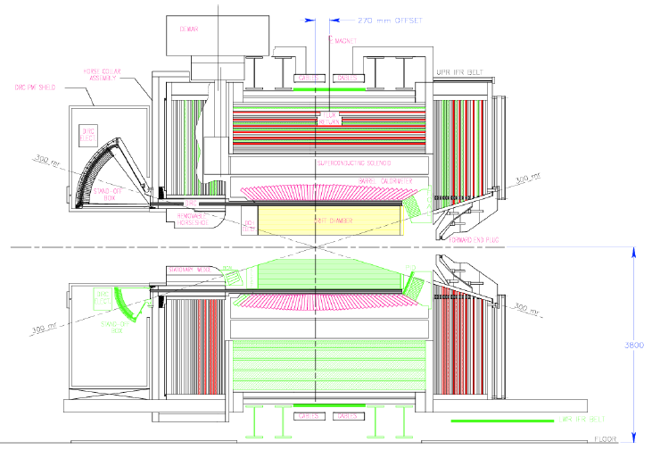
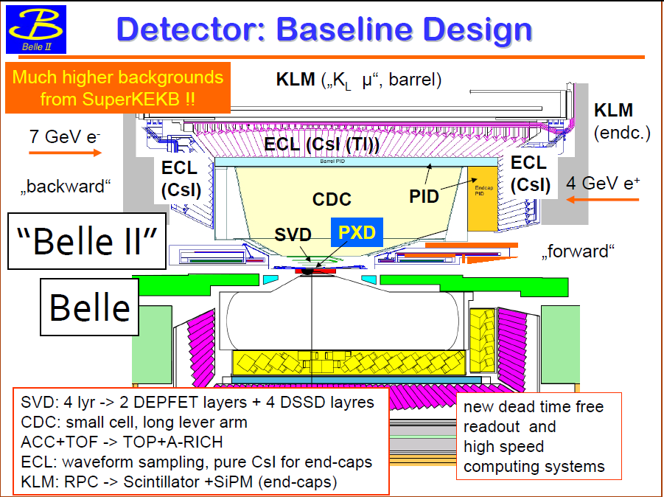
The SuperB and Belle II detectors are upgrades of BABAR and Belle – must deal with substantial luminosity-related backgrounds
BABAR
SuperB
New SVT with pixel Layer 0
New DCH
Smaller DIRC SOB
Possible forward PID
New EMC forward & rear endcap calorimeters
Improved muon ID

Slide 13
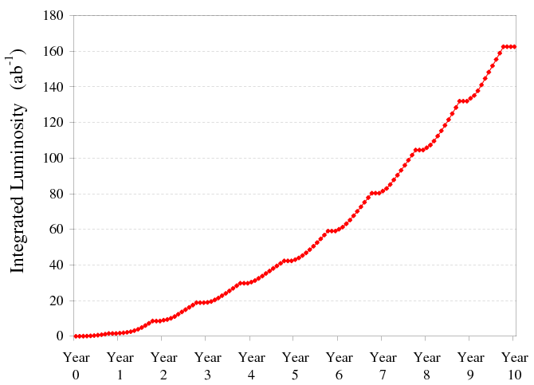
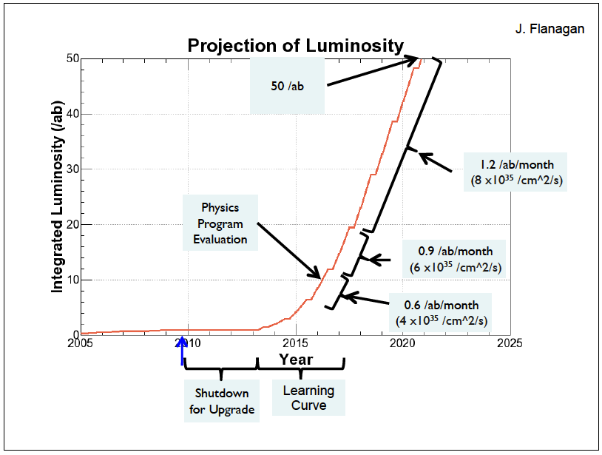

Luminosity integration rate
SuperB
50/ab in year 6
+ 5 year construction
SuperKEKB
50/ab in year 11
including 3 year
construction

Slide 14
Many SM extensions yield measurable effects in flavor physics
Little Higgs w/
MFV UV fix
Generic Little Higgs
Extra dim w/
SM on brane
Generic extra dim w SM in bulk
SUSY GUTs
Supersoft
SUSY breaking
Dirac gauginos
MSSM
MFV
low tanβ
MSSM
MFV
large tanβ
Effective SUSY
SM-like flavor physics Observable effects of New Physics
after G. Hiller

Slide 15

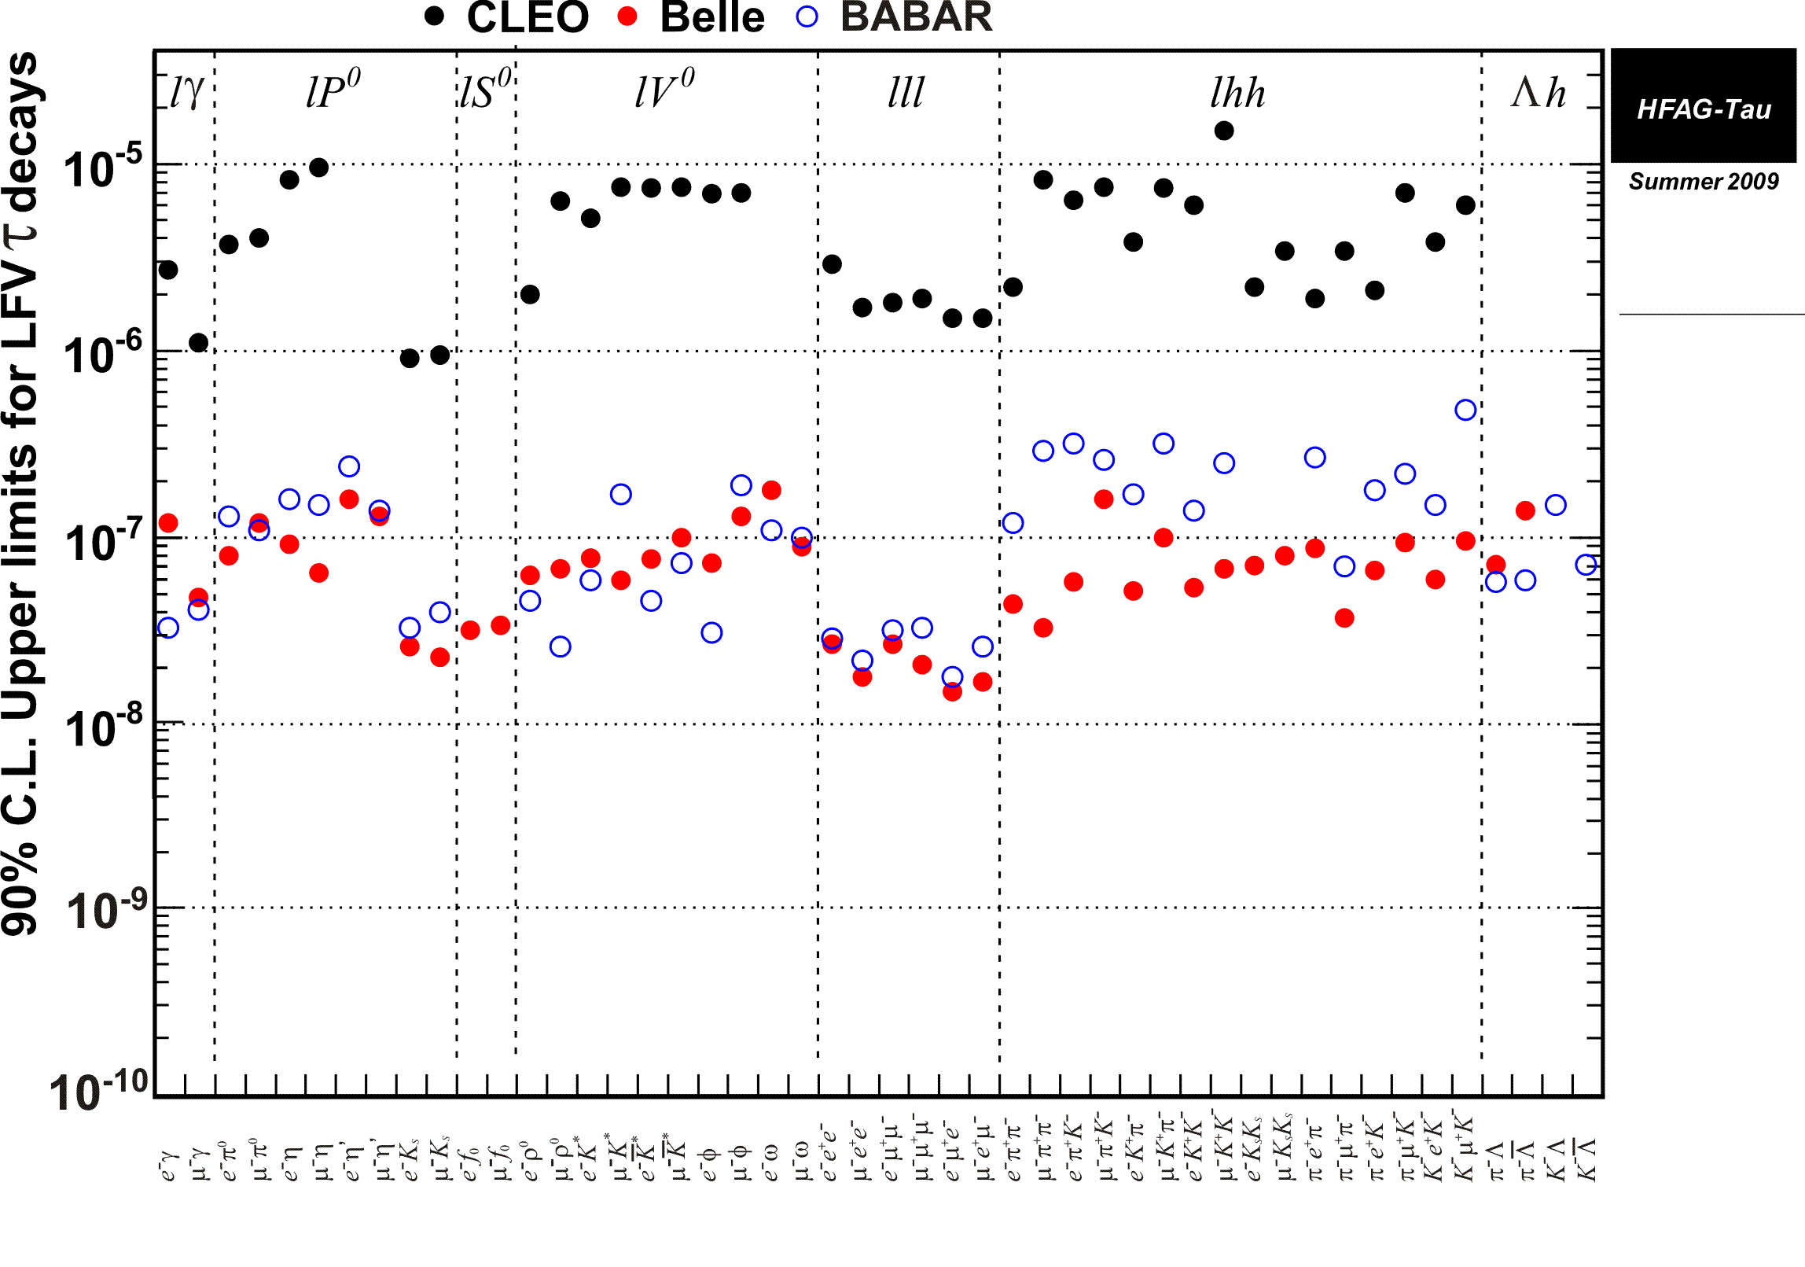
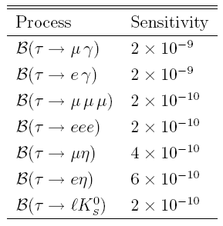
Lepton Flavor Violation in τ decays
Super B Factory sensitivity directly confronts New Physics models
SuperB
sensitivity
For 75 ab⁻¹
We expect to see LFV events, not just improve limits

Slide 16
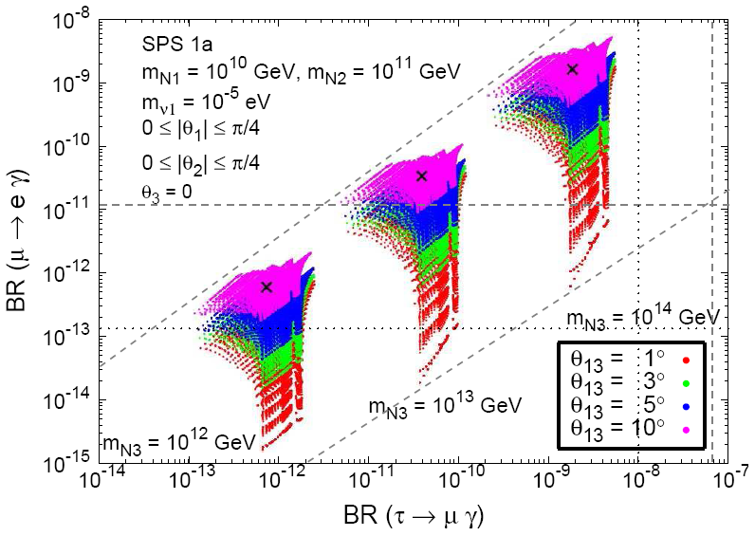
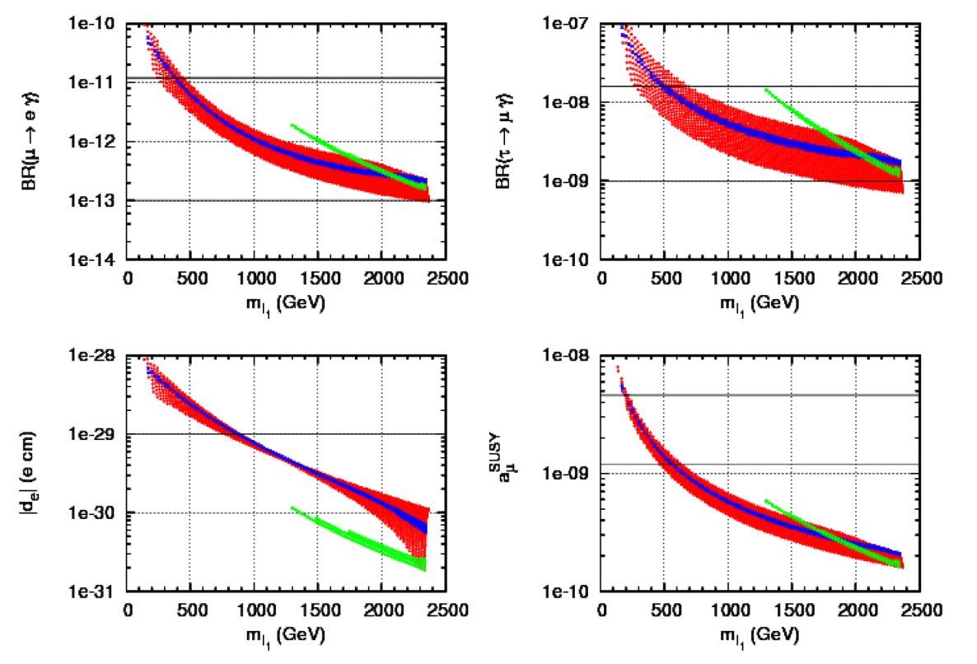

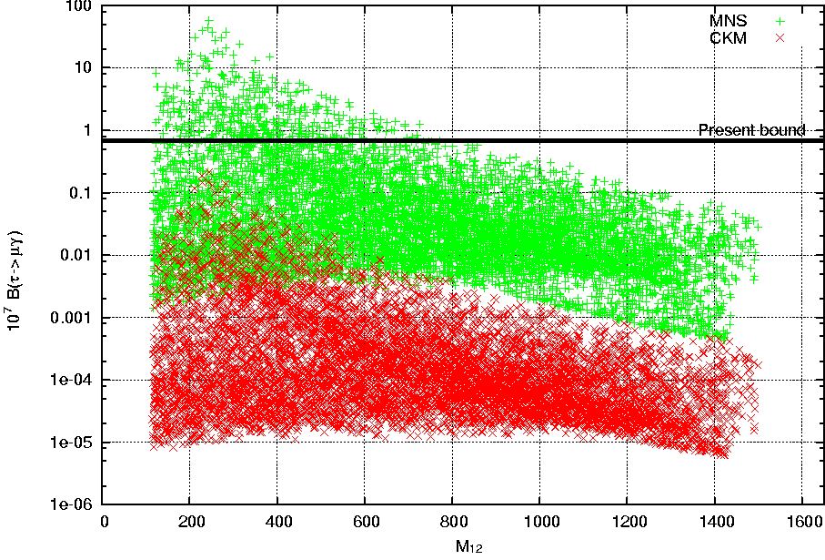
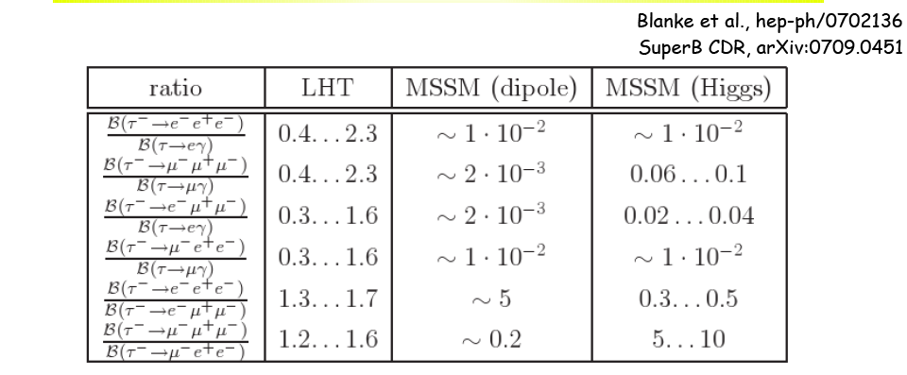
Lepton Flavor Violation in τ decays
Lepton sector constraints in an
SU(3)-flavored MSSM
Impact of θ₁₃ in a SUSY seesaw model
Calibbi,
Jones
Perez,
Masiero,
Park,
Porod &
Vives
arXiv
0907.
4069v2
Lightest
slepton mass
SO(10) GUT
Discrimination between SUSY and LHT
SO(10) MSSM
10⁷ BR (τ→μγ)
LFV from PMNS
SuperB
LFV from CKM
M_{1/2}
Antusch, Arganda, Herrero, Teixeira, JHEP 0611:090,2006
The ratio τ→ lll / τ→ μγ is not suppressed in LHT
by a_{e} as in MSSM

Slide 17

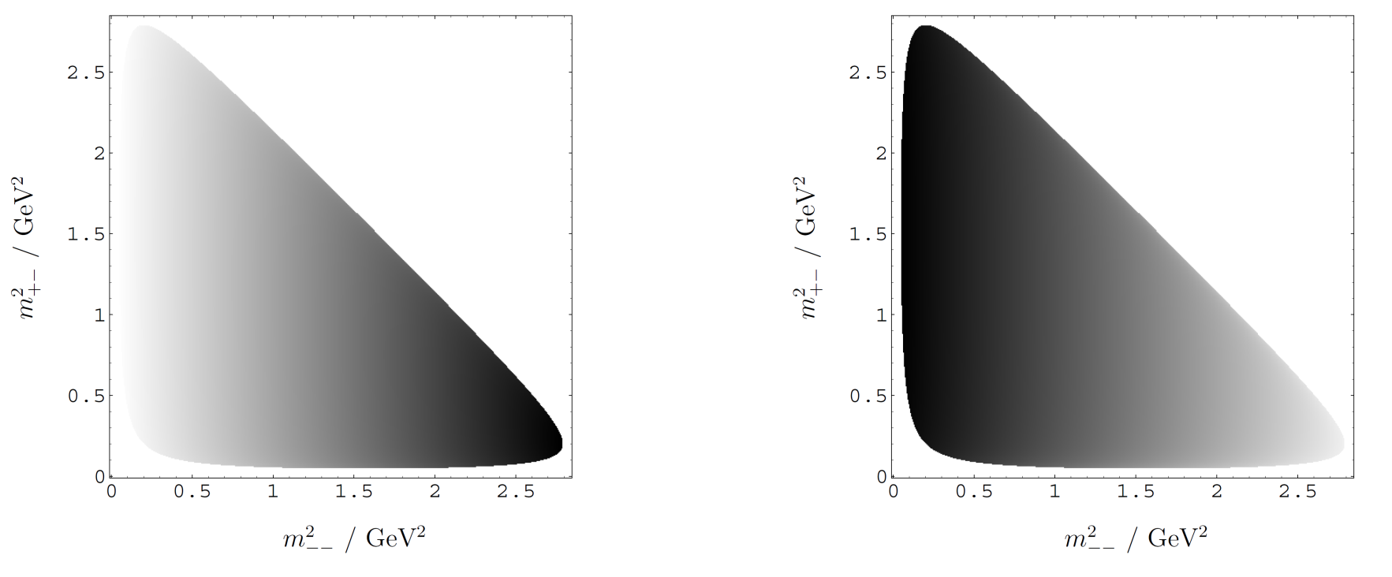

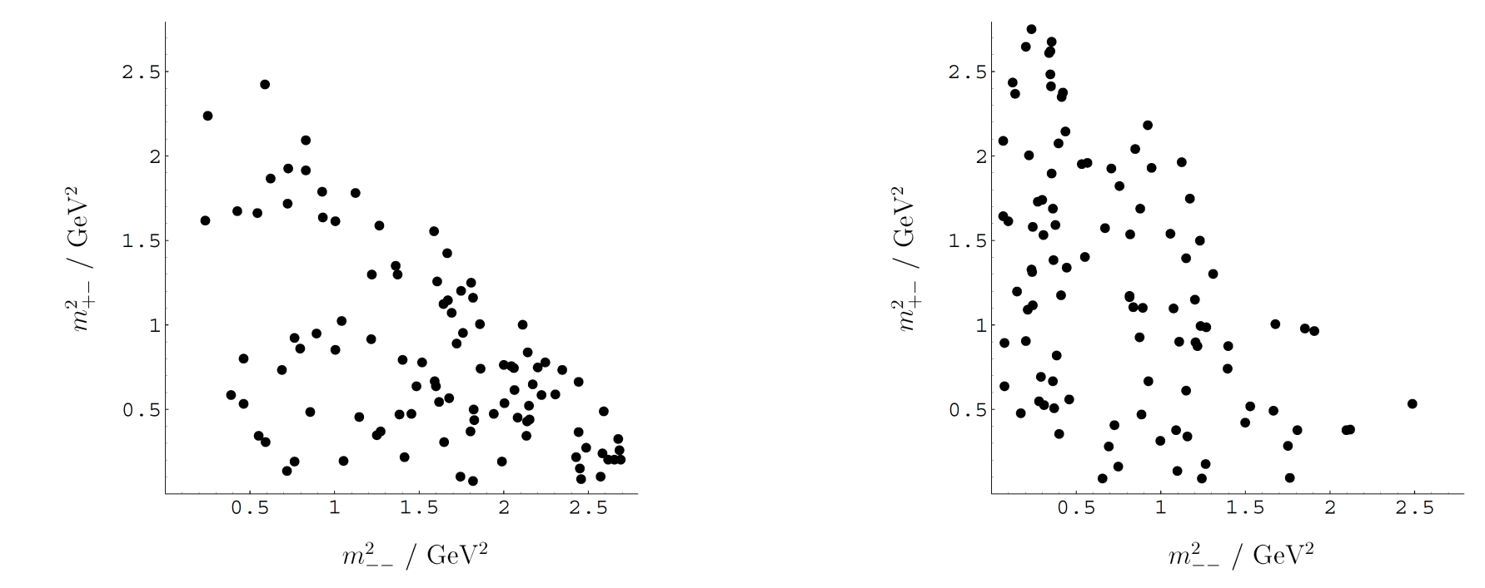
Polarized τ’s can probe the chiral structure of LFV
in a model-independent manner
A longitudinally polarized electron beam, producing polarized τ’s,
can determinate the chiral
structure of lepton flavor-violating interactions
Dassinger, Feldmann, Mannel, and Turczyk
JHEP 0710:039,2007;
[See also Matsuzaki and Sanda
Phys.Rev.D77:073003,2008 ]
Also:
Reduction in backgrounds for rare τ decays
Measurement of τ anamolous magnetic moment
Search for CP or T violation in τ production and decay

Slide 18
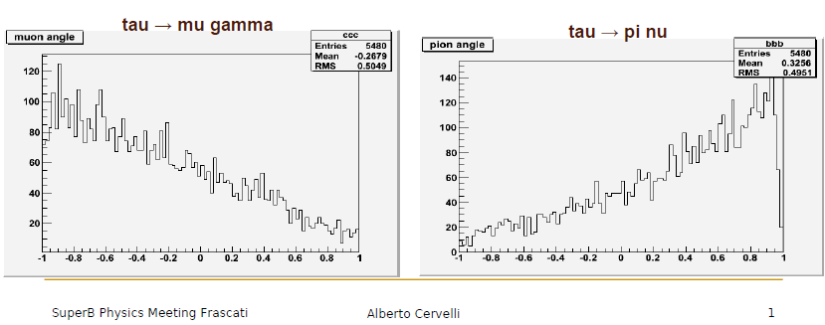
Background suppression with polarized τ’s

Slide 19
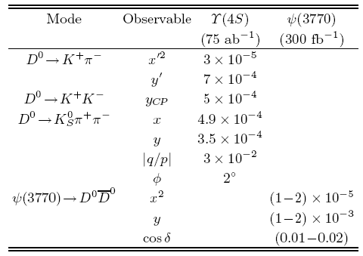
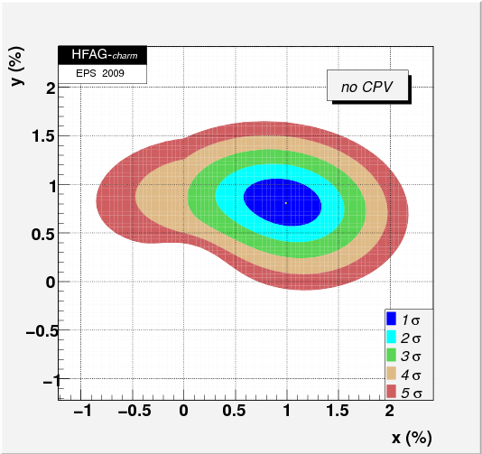
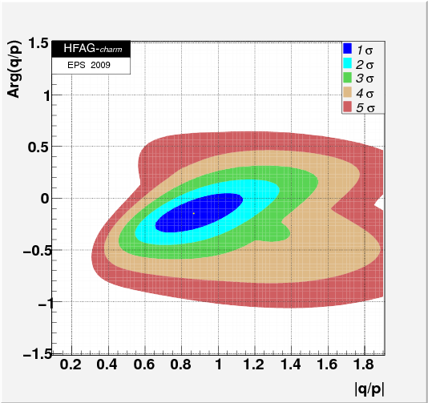
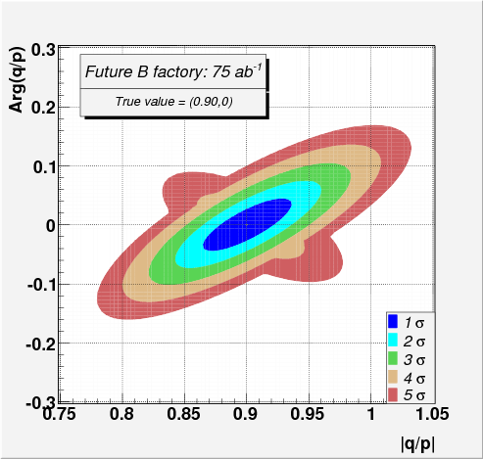
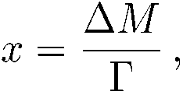
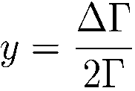
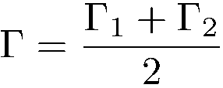
mixing is now well-established and large
D⁰→ K⁺π ⁻ decay time analysis | BABAR: PRL 98 211802 (2007) | 3.9σ
D⁰→ K ⁺K ⁻, π ⁺π ⁻ vs K⁺π ⁻ lifetime difference analysis | Belle: PRL 98 211803 (2007) | 3.2σ
D⁰→ K_{s}π ⁺π ⁻ time dependent amplitude analysis | Belle: PRL 99 131803 (2007) | 2.2σ
D⁰→ K ⁺π ⁻ decay time analysis | CDF: PRL 100, 121802 (2008) | 3.8σ
D⁰→ K ⁺K ⁻, π ⁺π ⁻ vs K ⁺π ⁻ lifetime difference analysis | BABAR: PRD 78, 011105 R (2008) | 3.0σ
D⁰→ K ⁺π ⁻π ⁰ time dependent amplitude analysis | BABAR: arXiv:0807, 4544 (2008) | 3.1σ
D⁰→ K ⁺π ⁻ relative strong phase using quantum-correlated measurements in e⁺e⁻→ | CLEO-c: PRD 78, 012001, (2008)
D⁰→ K⁻π⁺ and K⁺K⁻ lifetime ratios | BABAR: EPS 2009 | 4.1σ
Significance of all mixing results (HFAG Preliminary– EPS2009): |  | 10.2σ
This raises the exciting possibility of searching for CP violation
Super B Factory
@ 75 ab⁻¹
+
+

Slide 20
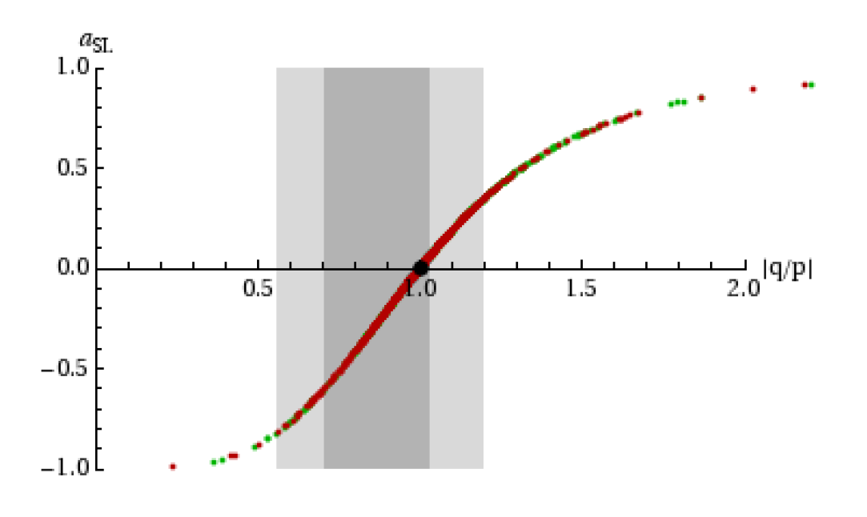
CP violation in ΔC=2 mixing in an LHT model
|q/p| from
D→Kπ, Kππ..
75 ab⁻¹
LHT model
Little Higgs w T parity
Bigi, Blanke, Buras & Recksiegel
arXiv:0904.1545v3 [hep-ph]

Slide 21
Projecting B→τν to SuperB
(Assuming SM branching fraction is measured)
2HDM-II
MSSM
75ab⁻¹
2ab⁻¹
LEP m_{H}>79.3 GeV
ATLAS 30fb⁻¹
SuperB excludes
SuperB excludes
Excluded by
Br(b→ s γ)
B-factories exclude
B-factories exclude
ATLAS 30fb⁻¹
ATLAS 30fb⁻¹
SuperB will substantially extend the search for NP in these models
Marco Ciuchini

Slide 22
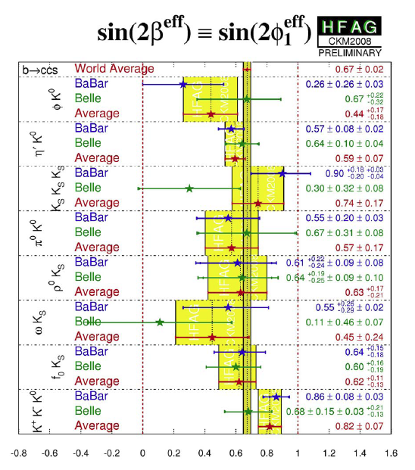
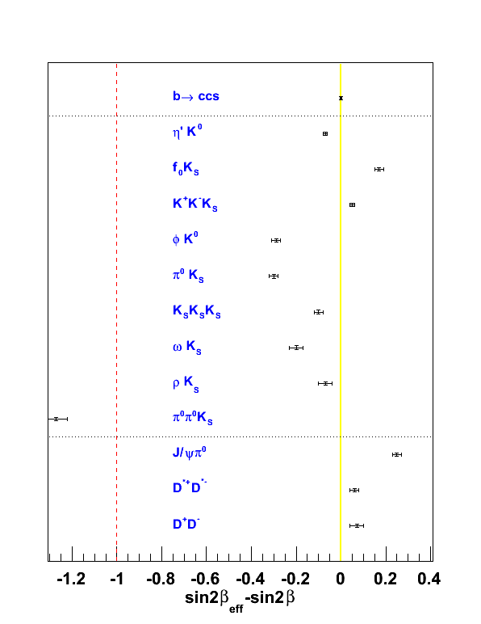
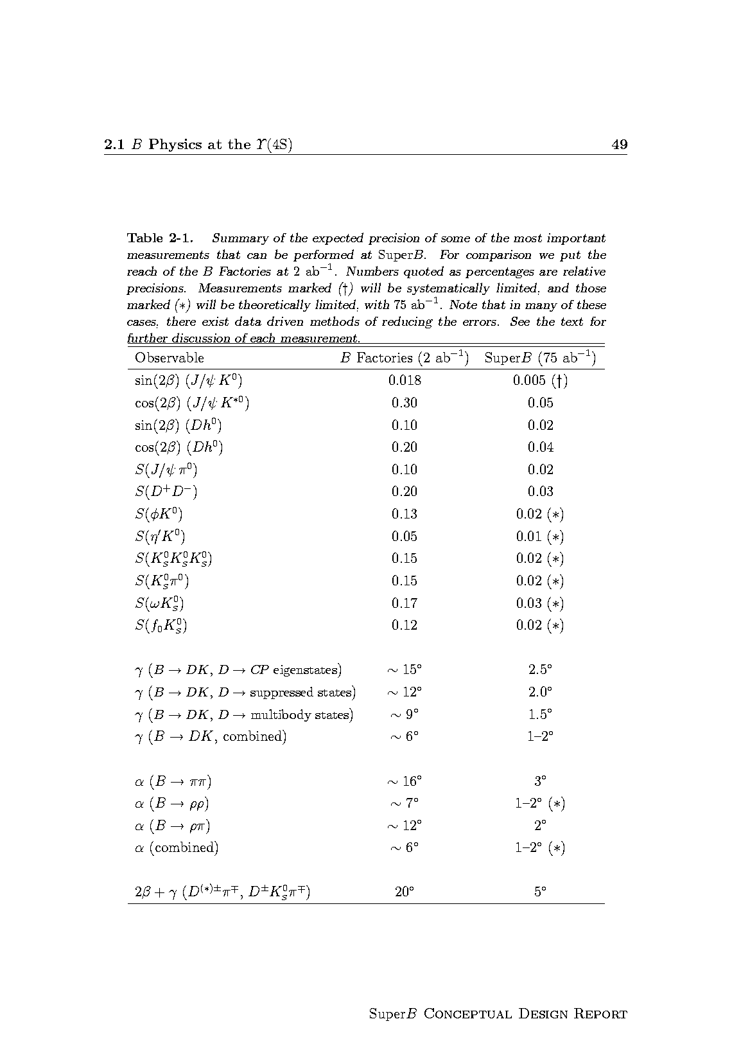
New Physics in CPV: sin2β from s Penguins…
75 ab⁻¹
b→s penguin processes b→d
sin2β_{eff} – sin2β
W⁻
Many channels can show effects in the range ΔS~(0.01-0.04)
b
s
φ
t
s
SuperB 75 ab⁻¹
B⁰_{d}
s
d
d
K⁰
~
g
b
~
~
s
b
X
s
(*) theory limited

Slide 23
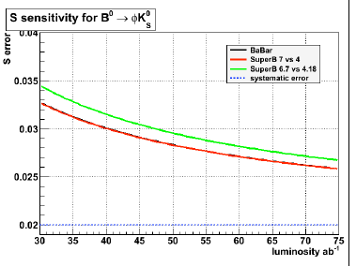
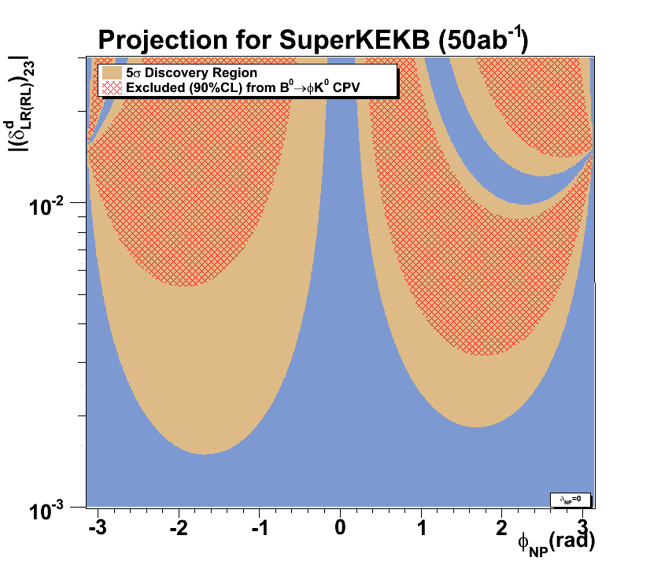
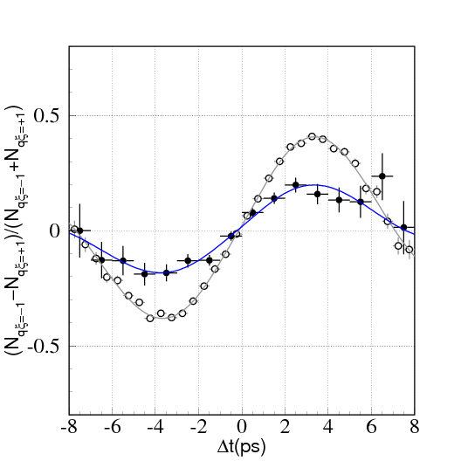
Precision of “sin2β” measurement in B g φK⁰
J/ψK⁰
φK⁰

Slide 24
Determination of SUSY mass insertion parameter (δ₁₃)_{LL} with 10 ab⁻¹ and 75 ab⁻¹
10ab⁻¹
75ab⁻¹

Slide 25
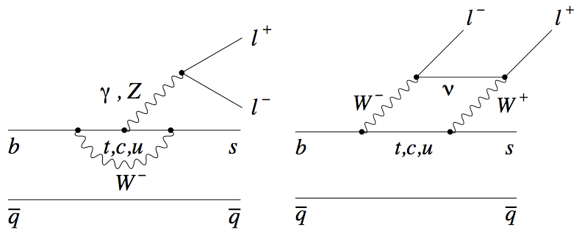
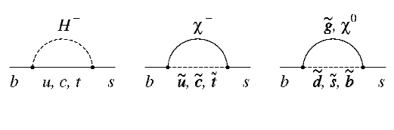


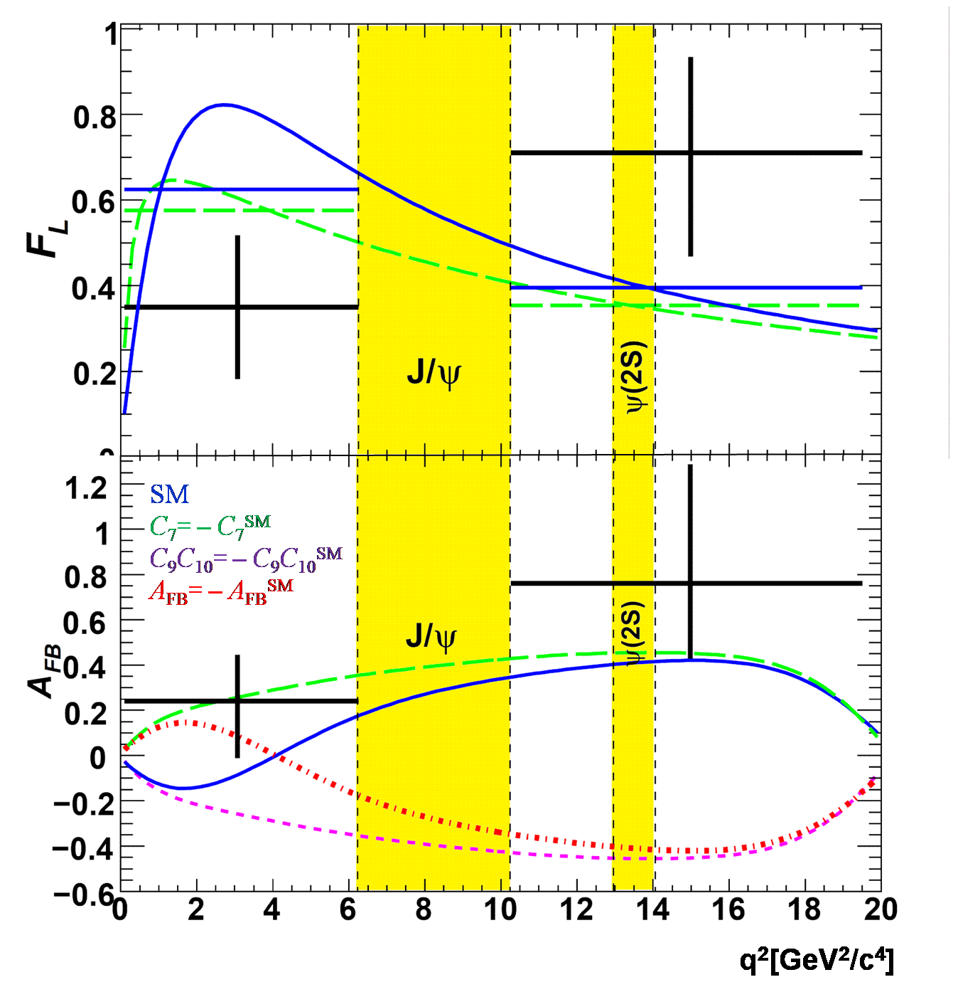
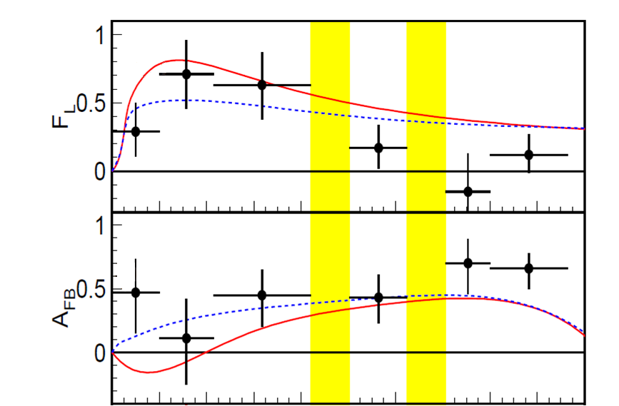
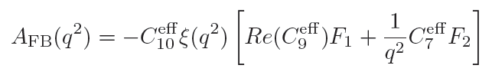
Kinematic distributions in
1
F_{L}
0.5
0
1
SM
C₇= – C₇SM
A_{FB}
0.5
0

Slide 26
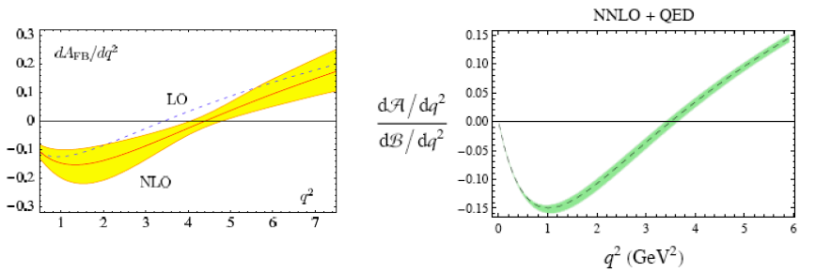
Much more data is required for a definitive result
Can be pursued with exclusive or inclusive reconstruction
A measure of the relative merits is the precision in determination of the zero
Exclusive Inclusive
Theory error: 9% + O(Λ/m_{b}) uncertainty
Egede, Hurth, Matias, Ramon, Reece
arxiv:0807.2589
Experimental error (SHLC): 2.1%
Theory error: ~5%
Huber, Hurth, Lunghi
arxiv:0712.3009
Experimental error (Super B Factory): 4-6%

Slide 27
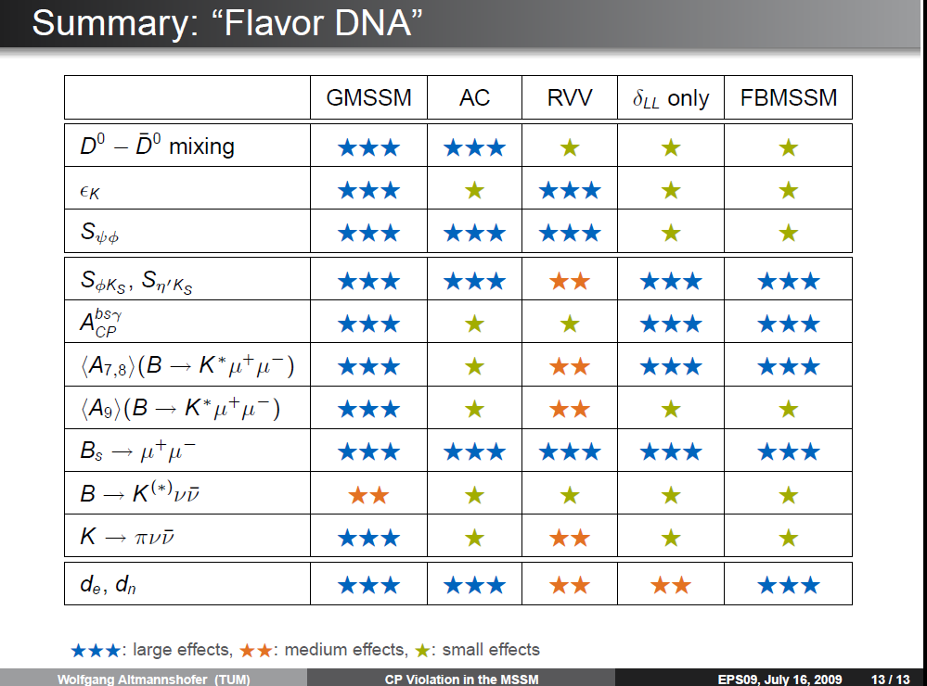

Slide 28
A Super B Factory is a DNA chip for New Physics

Slide 29

Approval status of the projects
SuperB
  INFN provided R&D funds in FY09
  The project has been recommended for funding by the Ministry of
  Science and Education
  A decision on project approval by the Economics Ministry is anticipated
  within the next few months
SuperKEKB
  The new government has been re-examining all large research projects
  Funding has been provided for the Damping Ring in FY10
  MEXT is seeking full approval of the project
It’s Big Louie. He says forget about the horses –
he’s putting 10G’s on SuperB

Slide 30
Conclusions
A new generation of flavor physics experiments will play a vital role in understanding new physics found at LHC
  A full set of constraints requires studies of EDMs, (g-2)_{μ},
  rare μ and τ decays, μe conversion and rare K, D and B decays
High statistics (50-75 ab⁻¹ ) data samples at e⁺e⁻ Super B Factories are a crucial component of such studies, providing both
  Discovery potential
    Charged lepton flavor violation in τ decays
    New sources of CP violation in the B meson system
    CPV in mixing, and
  A DNA chip to discriminate between model of New Physics
    The achievable levels of sensitivity in rare b, c and τ decays
    provide substantial coverage in the parameter space
The Super B Factory programs, of course, overlap with the programs of LHC flavor experiments such as LHCb, but the e⁺e⁻ environment makes possible a substantial number of unique and important physics measurements in areas sensitive to New Physics

