Slide 1
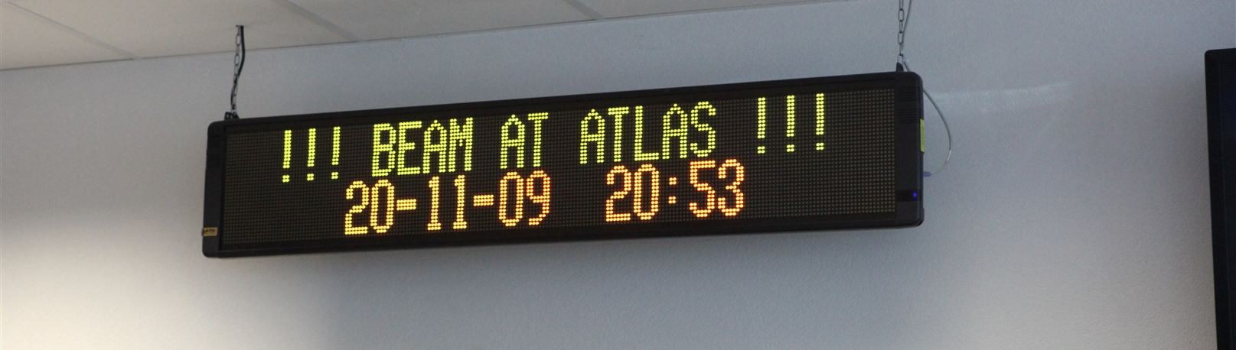


ATLAS
Beams and first collisions
Andreas Hoecker (CERN) on behalf of the ATLAS Collaboration
CERN seminar “LHC, week 1”, Nov 26, 2009

Slide 2
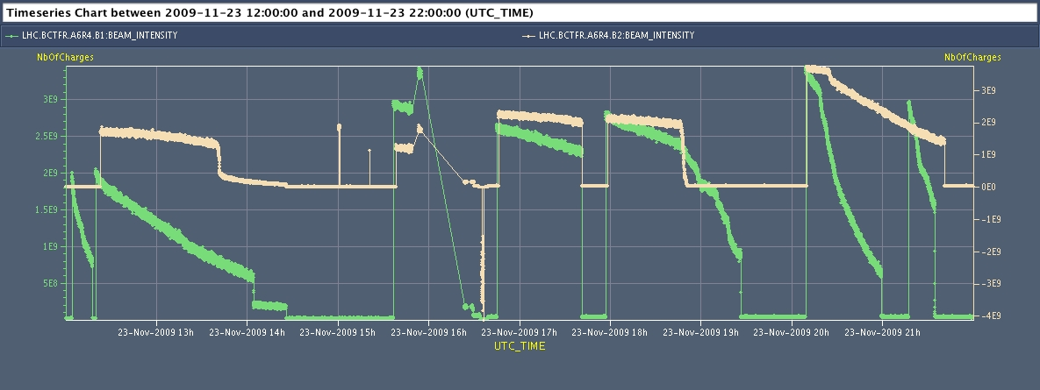
Big thanks to the machine team for a spectacular performance, and the excellent communication between ATLAS and CCC

Slide 3
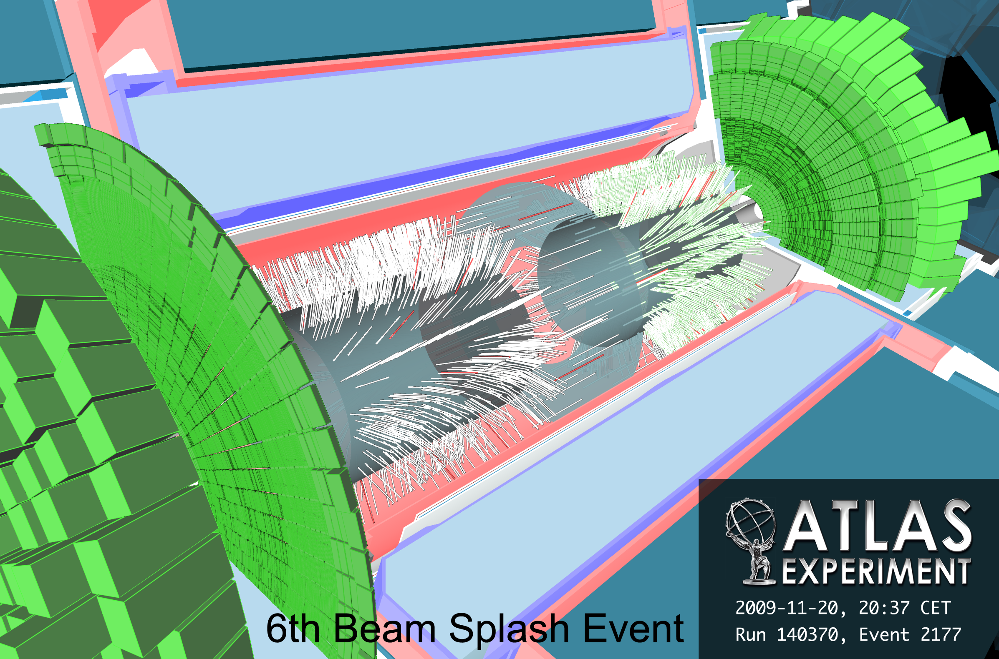
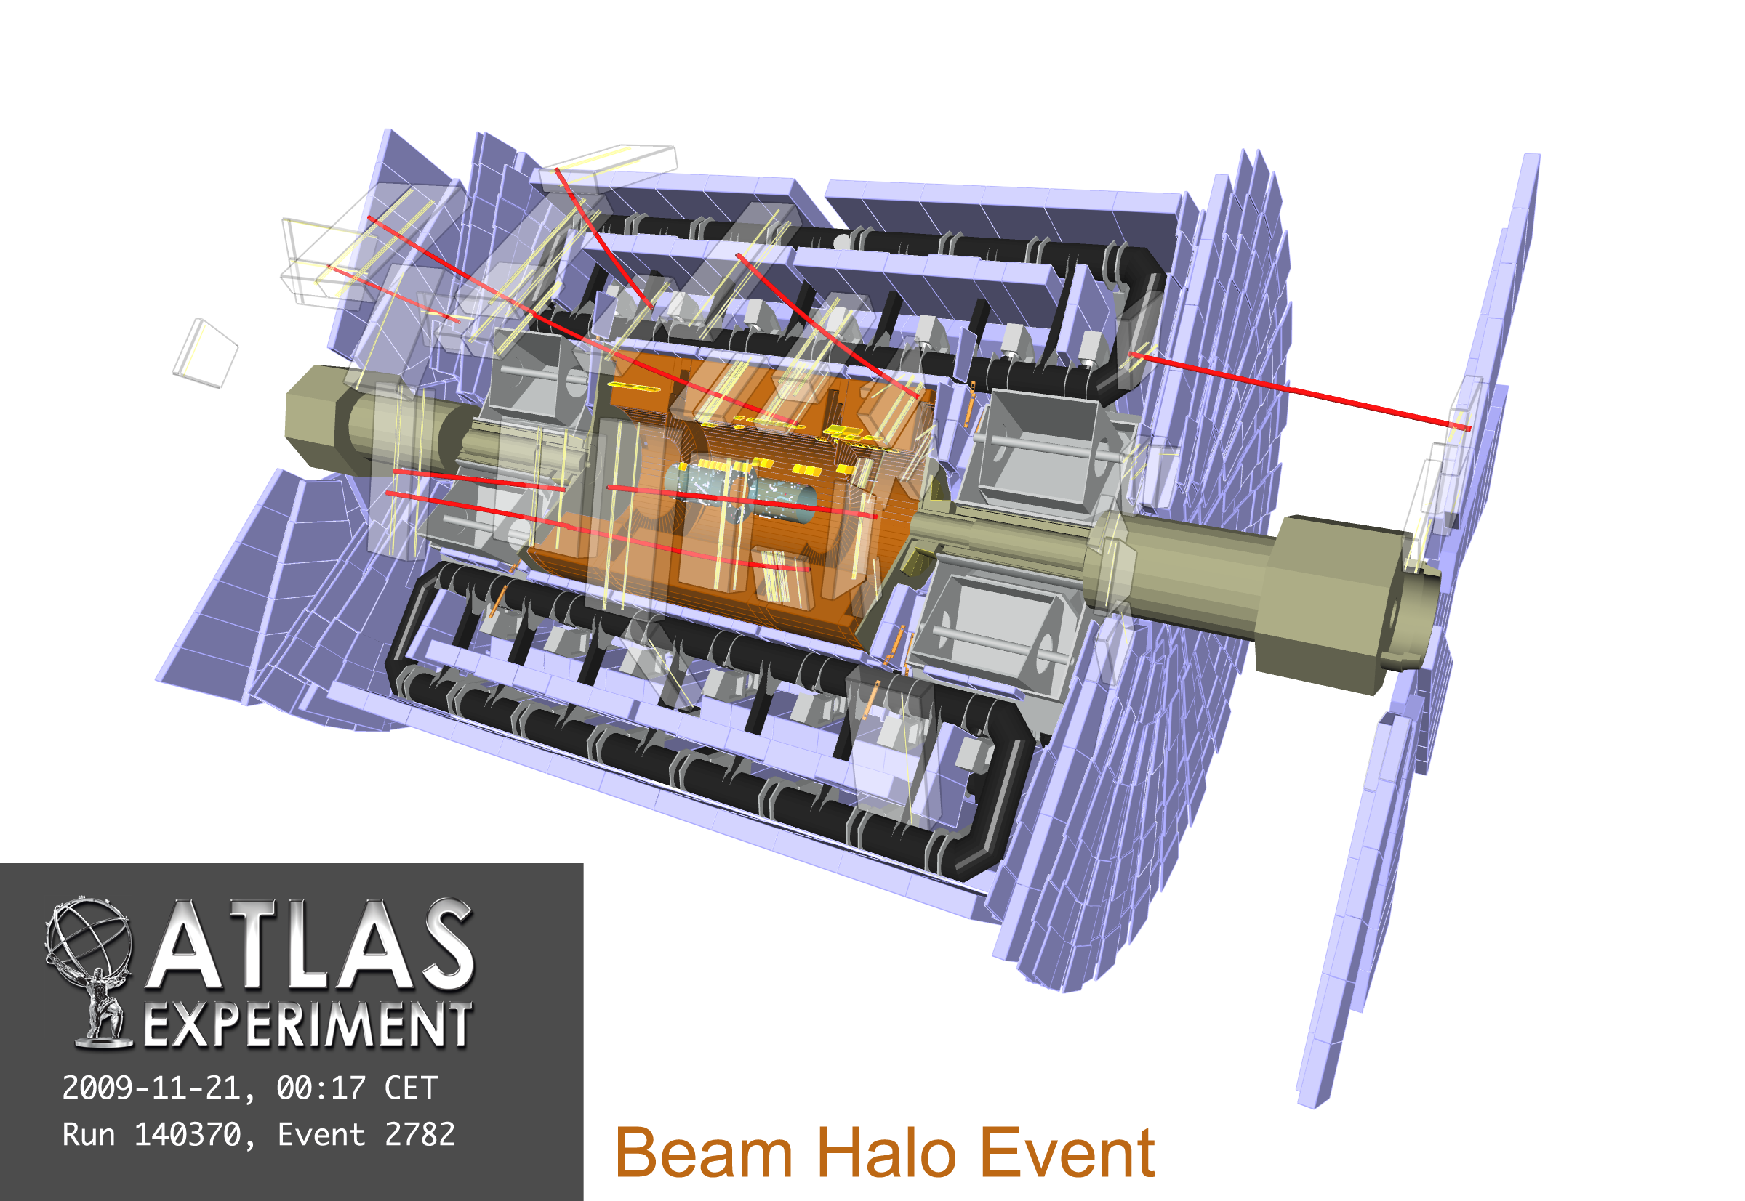
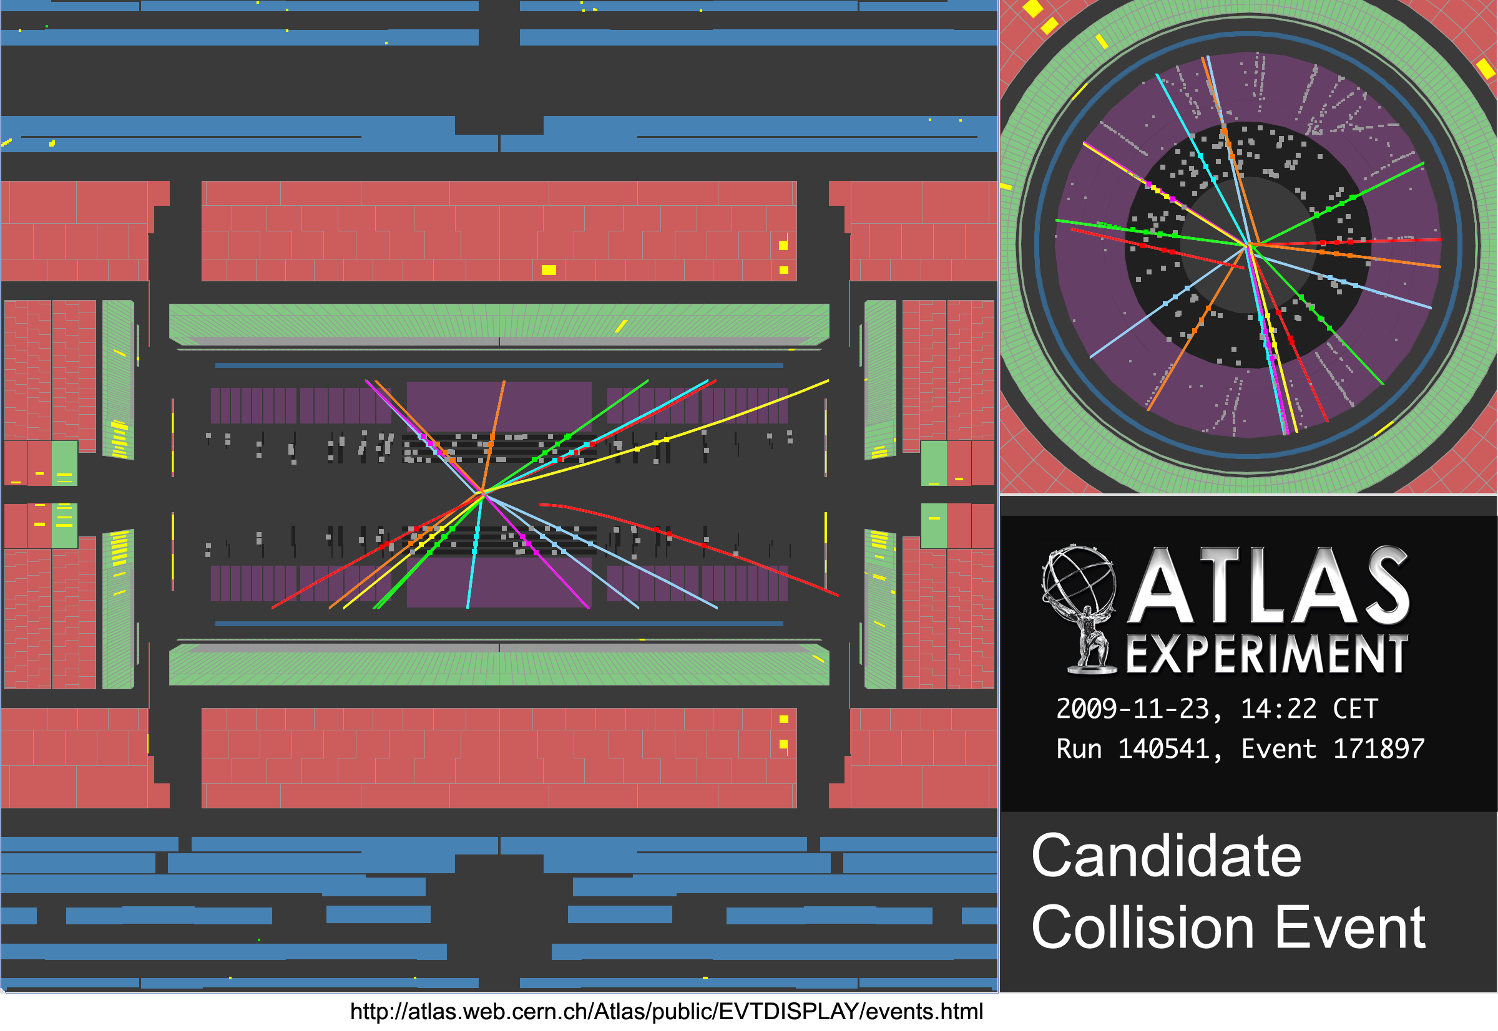
Nov 20 – 23: beam history from ATLAS perspective
Friday, November 20:
~ 20:30h: beam-1 threading → 6 beam splashes to ATLAS
~ 22:30h: beam-2 threading → 7 beam splashes to ATLAS
Saturday, 21 November:
~ 1h: beam-2 splashes to ATLAS → 27 events (side C)
~ 4h: beam-1 splashes to ATLAS → 26 events (side A)
Sunday, 22 November:
~ 6h: 15 splash events to test beam abort by BCM → successful
Monday 23 November:
~ 6:30: last series of splashes to ATLAS→ 25 events (side C)
~ 13:30: two beams injected for collisions at IP1 and IP5
~ 14:22: first ATLAS collision event seen

Slide 4
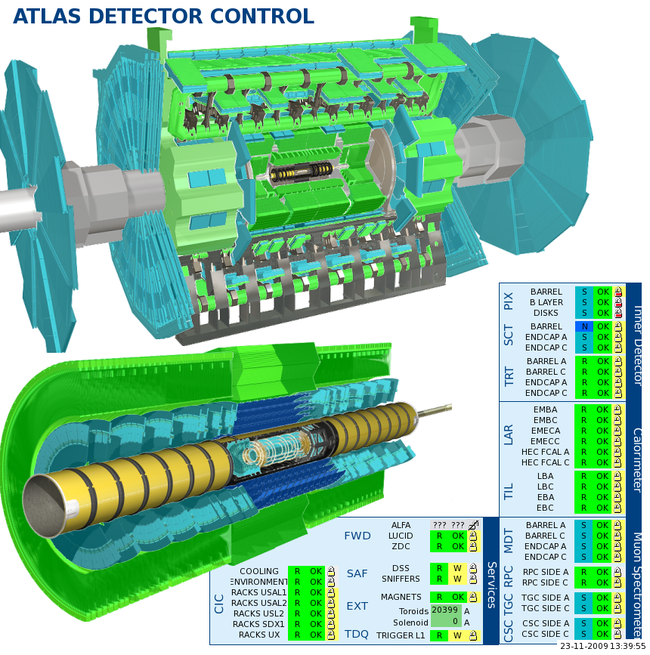
Detector fully operational
  Setup for beam commissioning
  Pixel off
  SCT (standard bias voltage 150 V)
    Standby V is 20 V → ~50% hit efficiency (increases with incidence angle)
    Barrel and endcap increased to 50V for short stable beam periods during collisions
    Barrel voltage sometimes lower than 20V for beam set up (eg. splash events)
  All other systems ON
  No solenoid field, toroids ON
  CSC running in separate DAQ partition for rate tests

Slide 5
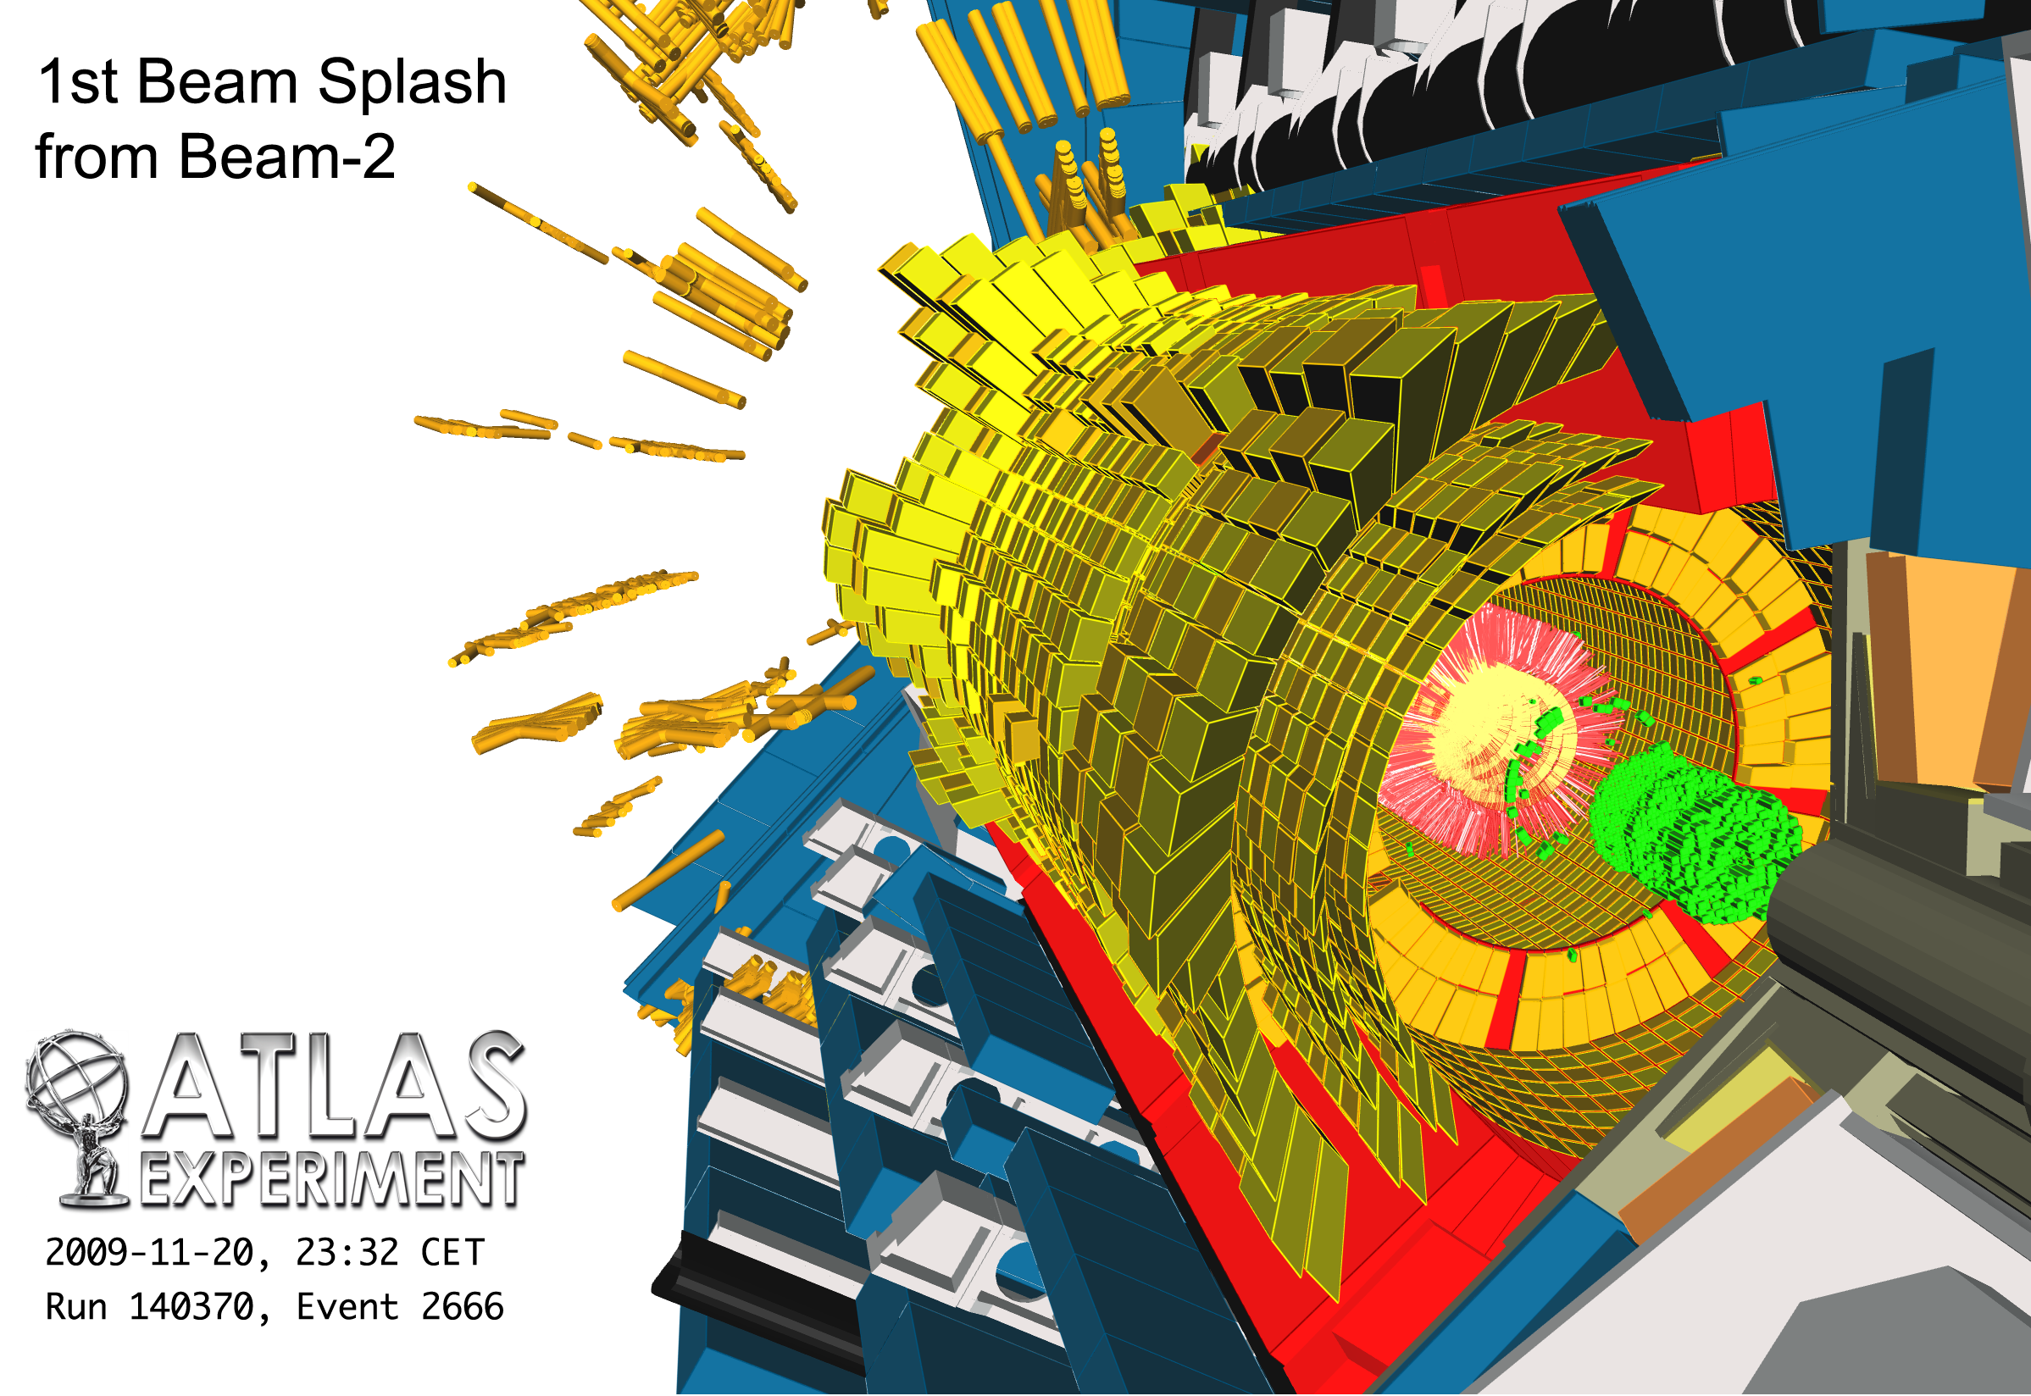
Beam-splash events
Avalanche of scattered particles from beam-on-collimator hits
Detectors fully lit, typically
300,000 SCT hits
350,000 TRT hits
(~all passing high-threshold)
3000 TeV calo energy sum
490,000 MDT hits
320,000 RPC hits
65,000 TGC hits

Slide 6
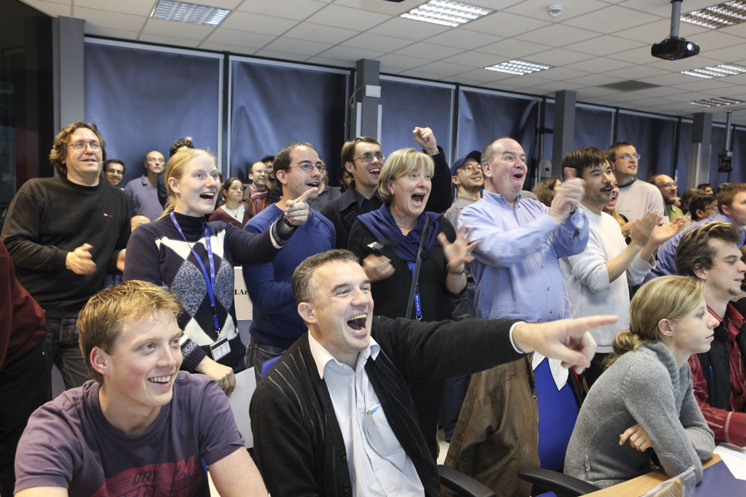
We were very excited…
Beam-splash events

Slide 7
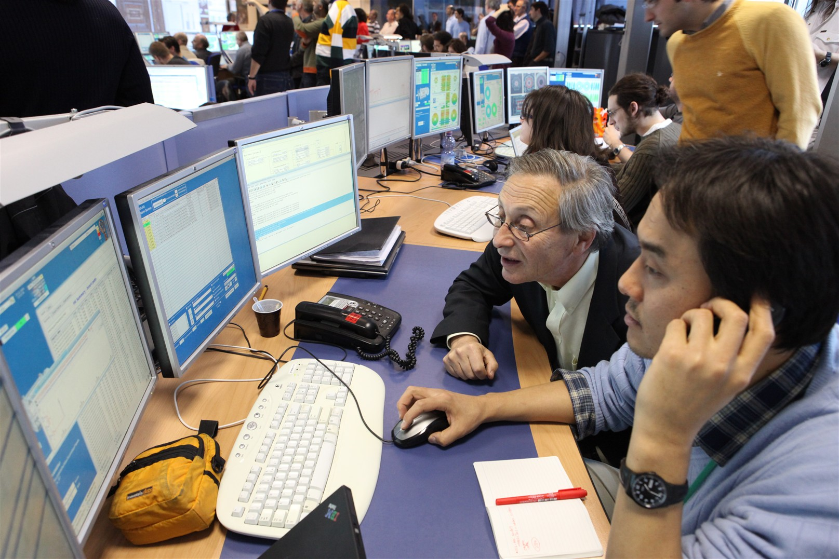
But some stayed cool and concentrated …

Slide 8
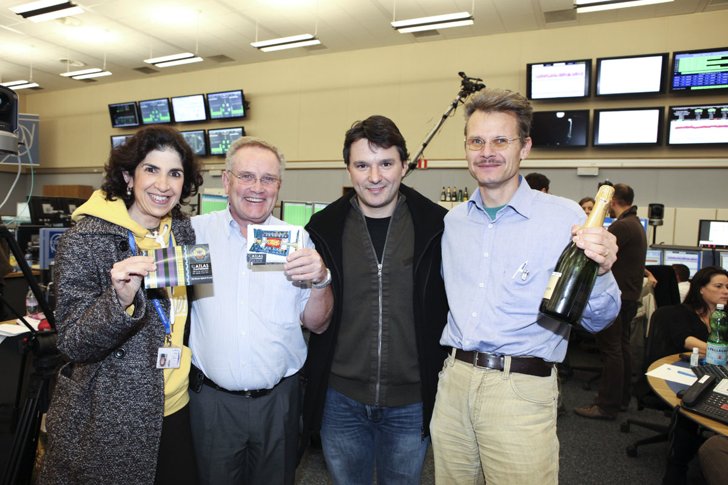
Proudly presents …

Slide 9
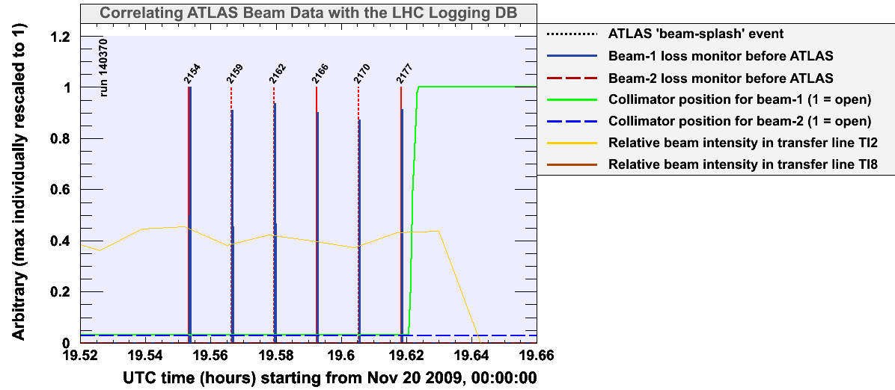
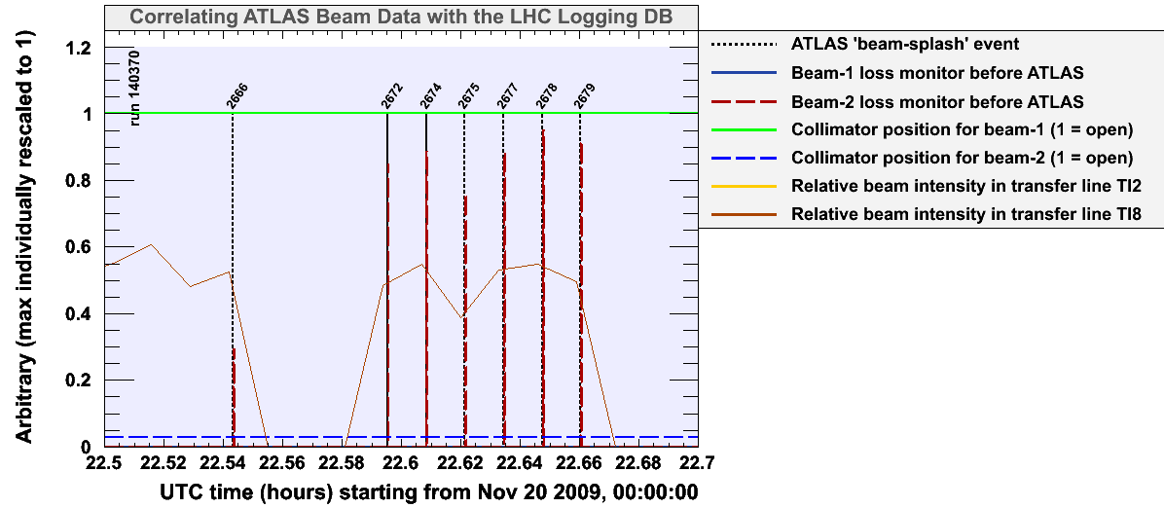
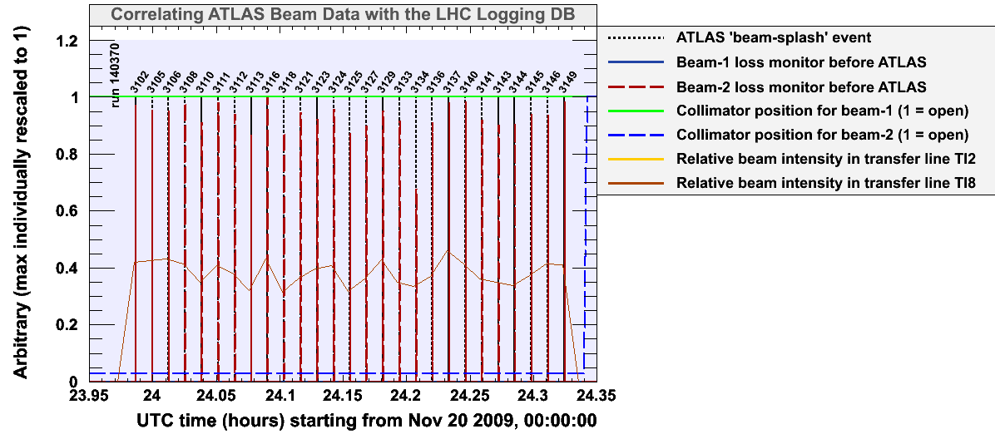
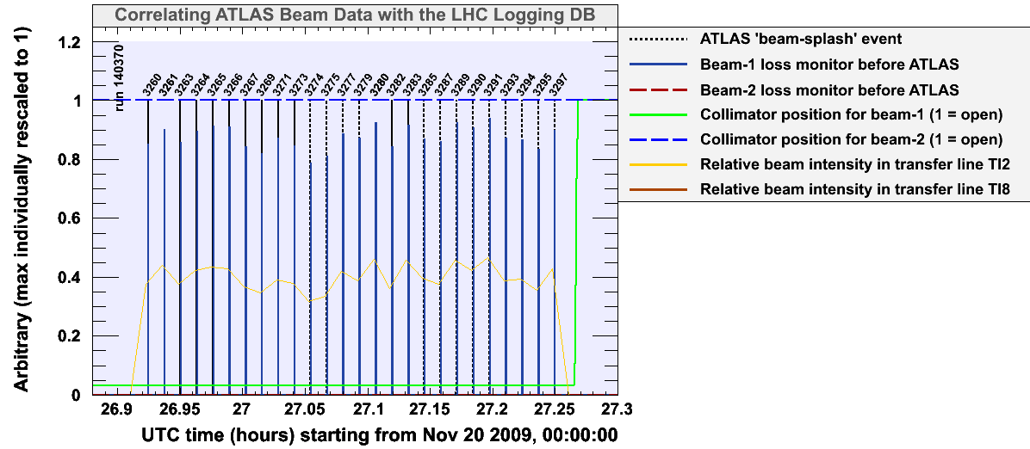
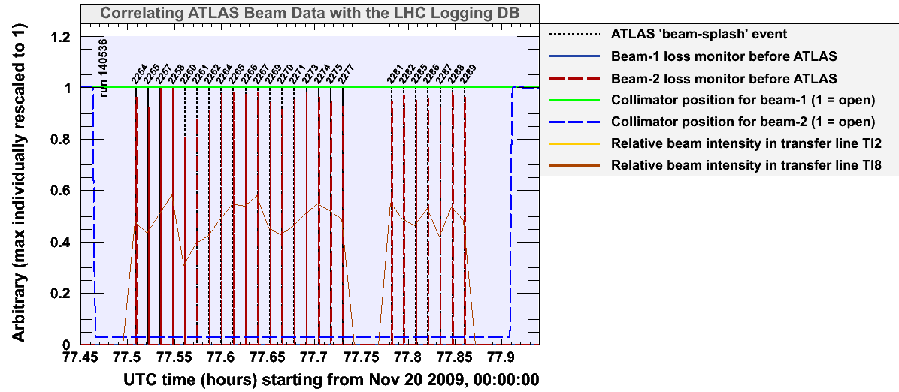
Indeed … why do it again ? Timing and beam-abort tests!
Triggering on splashes: ATLAS received and triggered on 106 splashes
Thank you LHC – we’ve taken them all !
Δt = 47 sec

Slide 10
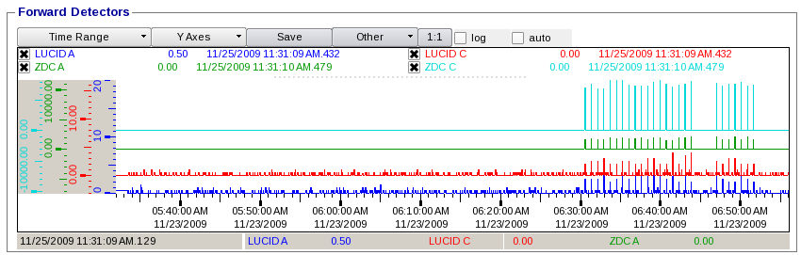
Indeed … why do it again ? Timing and beam-abort tests!
Beam splash events also measured by ATLAS very forward detectors (LUCID z = ±17 m and ZDC z = ±140 m)
ZDC C
ZDC A
LUCID A
LUCID C

Slide 11
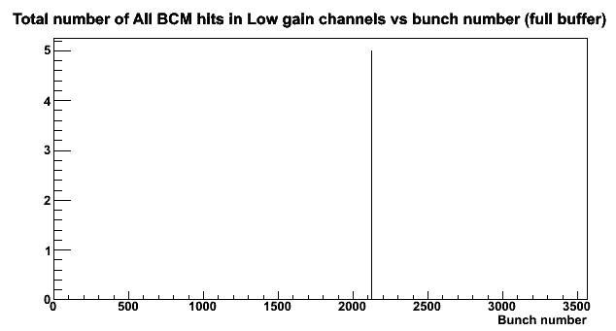
Indeed … why do it again ? Timing and beam-abort tests!
Beam abort test using dedicated diamond Beam Condition Monitors was successfully conducted on Sun, 22 Nov at 6:34, and no fake abort!
Lowered threshold:
~2-2.5 MIPs
6:34:30
Thank you LHC – we’ve taken them all !
Δt = 47 sec

Slide 12
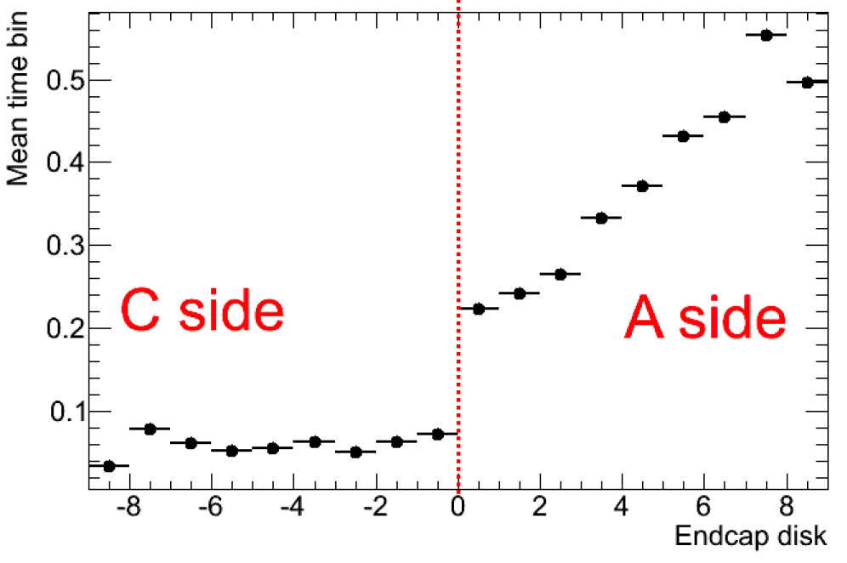
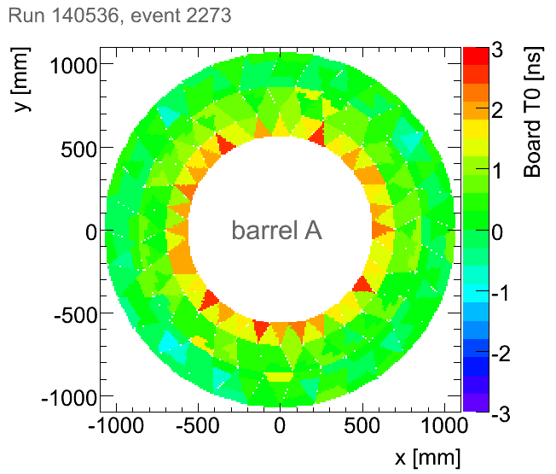
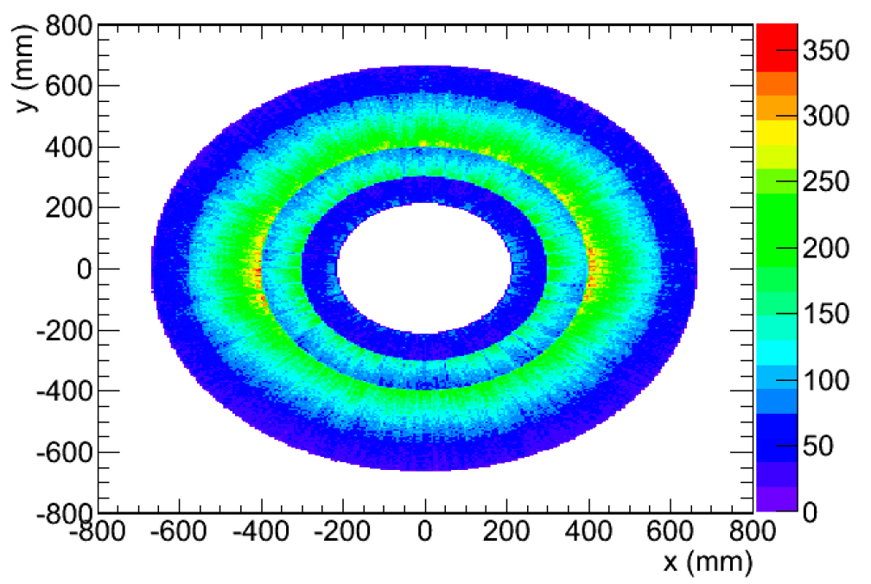
Timing studies with beam-splash events (Inner Detector)
Inner tracking systems:
  SCT already well timed-in from cosmics and known cable lengths (better than 2 ns)
  TRT boards timed-in to better than 2 ns
Beam-1 arriving from A-side: timing as collisions for C-side, but wrong for A-side
TRT Barrel: plot made with collision timing → sensitive to ToF effect on Inner Boards !
15 ns
C-side
A-side
ATLAS preliminary
ATLAS preliminary

Slide 13
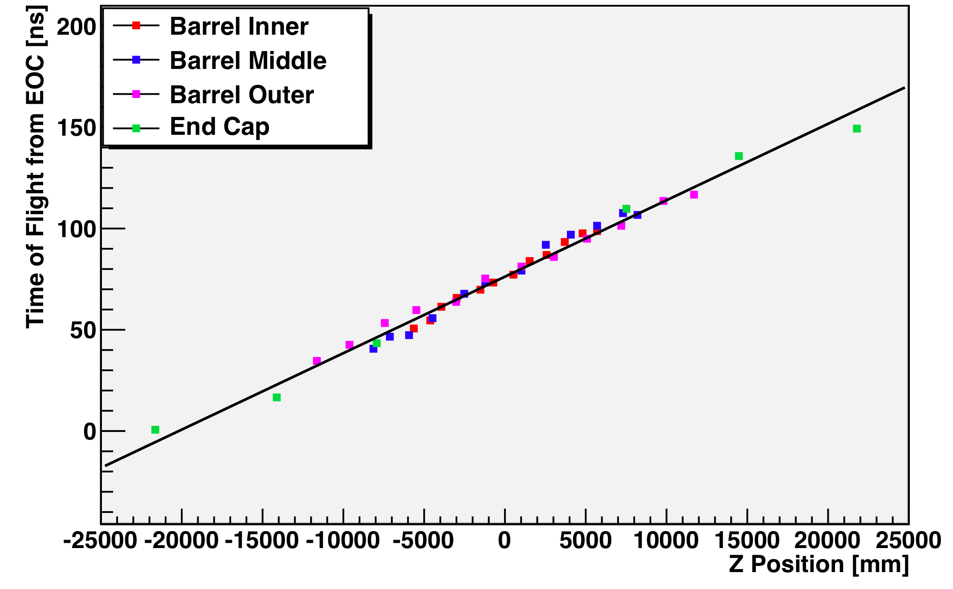
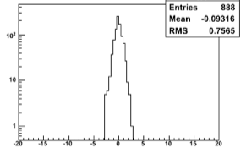
Timing studies with beam-splash events (Calorimeter & Muons)
LAr Timing:
After 2008 beam-splash data taking and analysis of many millions of cosmics events, timing good within a few ns
MDT Timing:
Synchronize all chambers at a given z using the synchronous front of splash particles and the very large particle flux
ATLAS now well timed in for collisions
EM barrel
ATLAS preliminary
ATLAS preliminary
ns

Slide 14
Single beam, two beams, two synchronised beams, colliding beams, collisions ?

Slide 15
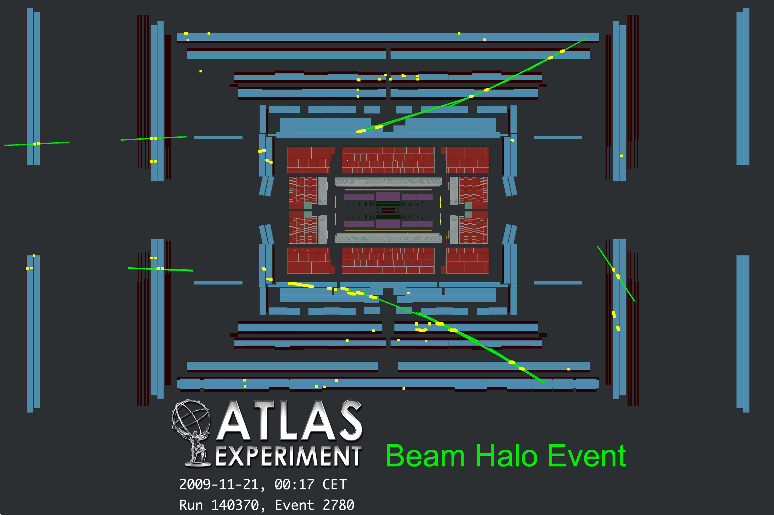

Slide 16
We were lucky – shortly after colliding beams were announced, at 14:22 an interesting event appeared on our screens

Slide 17
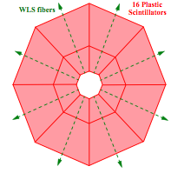
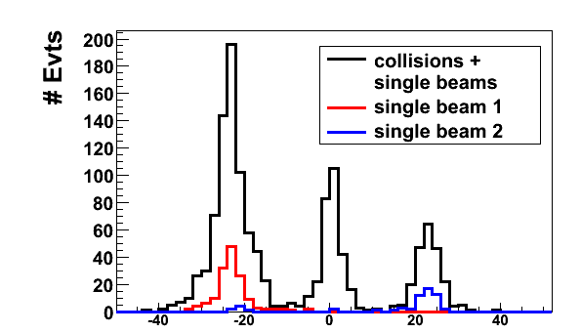
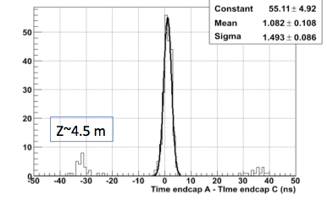
Two beams in the machine, how to detect a collision event?
Trigger synchronized with beam pickup signals (suppresses cosmics)
Separation of beam-related backgrounds and collisions via timing measurements on A and C sides of ATLAS (ToF)
  Use minimum bias scintillators (MBTS) in forward regions
  (use also multiplicity)
  Use precise Liquid-argon endcap calorimeter timing
LAr calorimeter: Δt(A – C)
MBTS: Δt(A – C)
ATLAS preliminary
two beams
ATLAS preliminary
Mean: 1.1 ± 0.1 ns
Sigma: 1.5 ± 0.1 ns
Δz ~ 7m
Δz ~ 9m
ns

Slide 18
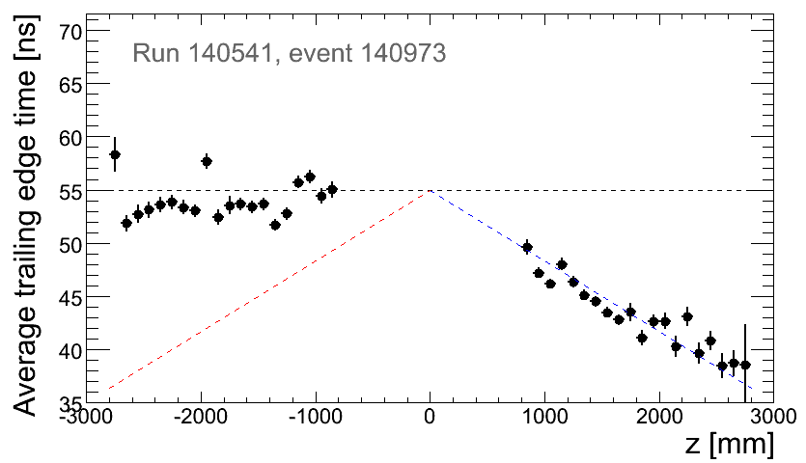
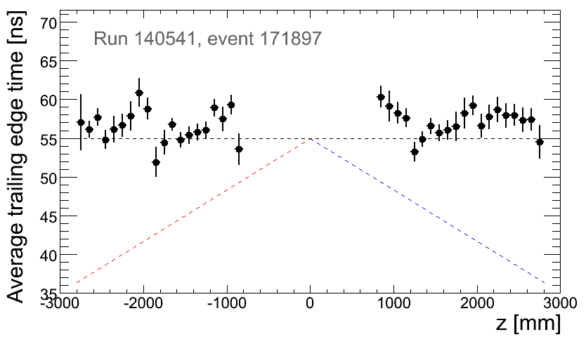
Two beams in the machine, how to detect a collision event?
Can also use TRT timing
C-side
A-side
beam
A beam-related background event coming from beam-1 (A-side)
→ timing is “wrong” for A-side
ATLAS preliminary
A collision event
→ timing is collision-like on both sides
ATLAS preliminary

Slide 19
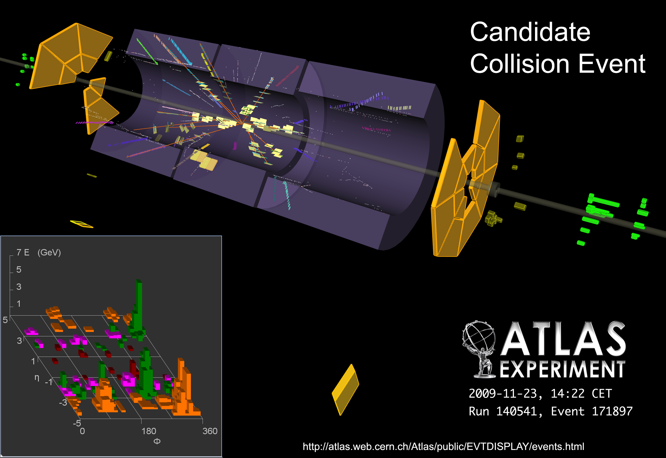

Slide 20
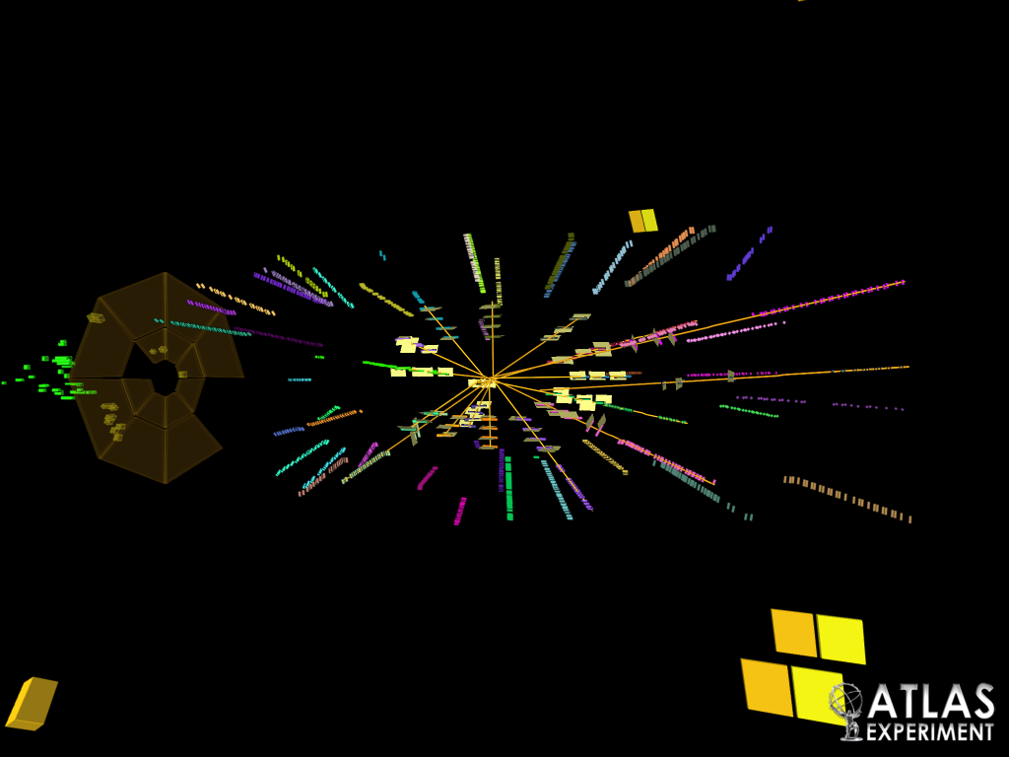

Slide 21
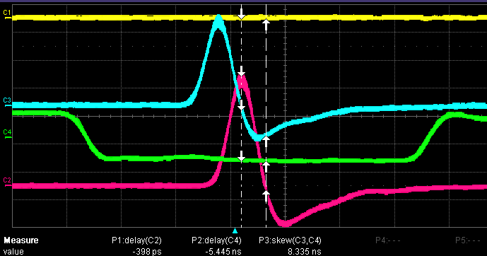
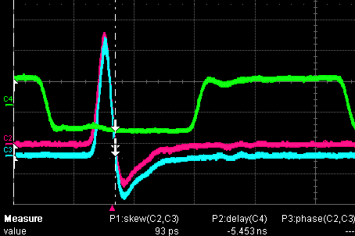
Can we prove that our background separation works?
The ATLAS beam pickups showed a phase inconsistency of 900 ps causing the primary vertex to be shifted by −13.5 cm in z
Based on this information, at around 14:50, the LHC operators performed an RF cogging to correct the z positioning of the beam spot at IP1
Before RF cogging
After RF cogging
Applied shift of 900 ps
providing vertex shift of +13.5 cm
Beam pickup scope shots, beam 1 & 2
Bunches stable within 20 ps (RMS) !

Slide 22
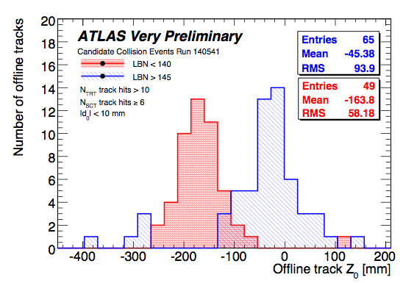
Can we prove that our background separation works?
ATLAS has taken data before and after the RF cogging
Must observe shift in z₀ of tracks if indeed we select collision events!
Track z₀ distribution of collision candidate events taken before and after RF cogging
Observed shift: +12 cm
ATLAS preliminary

Slide 23
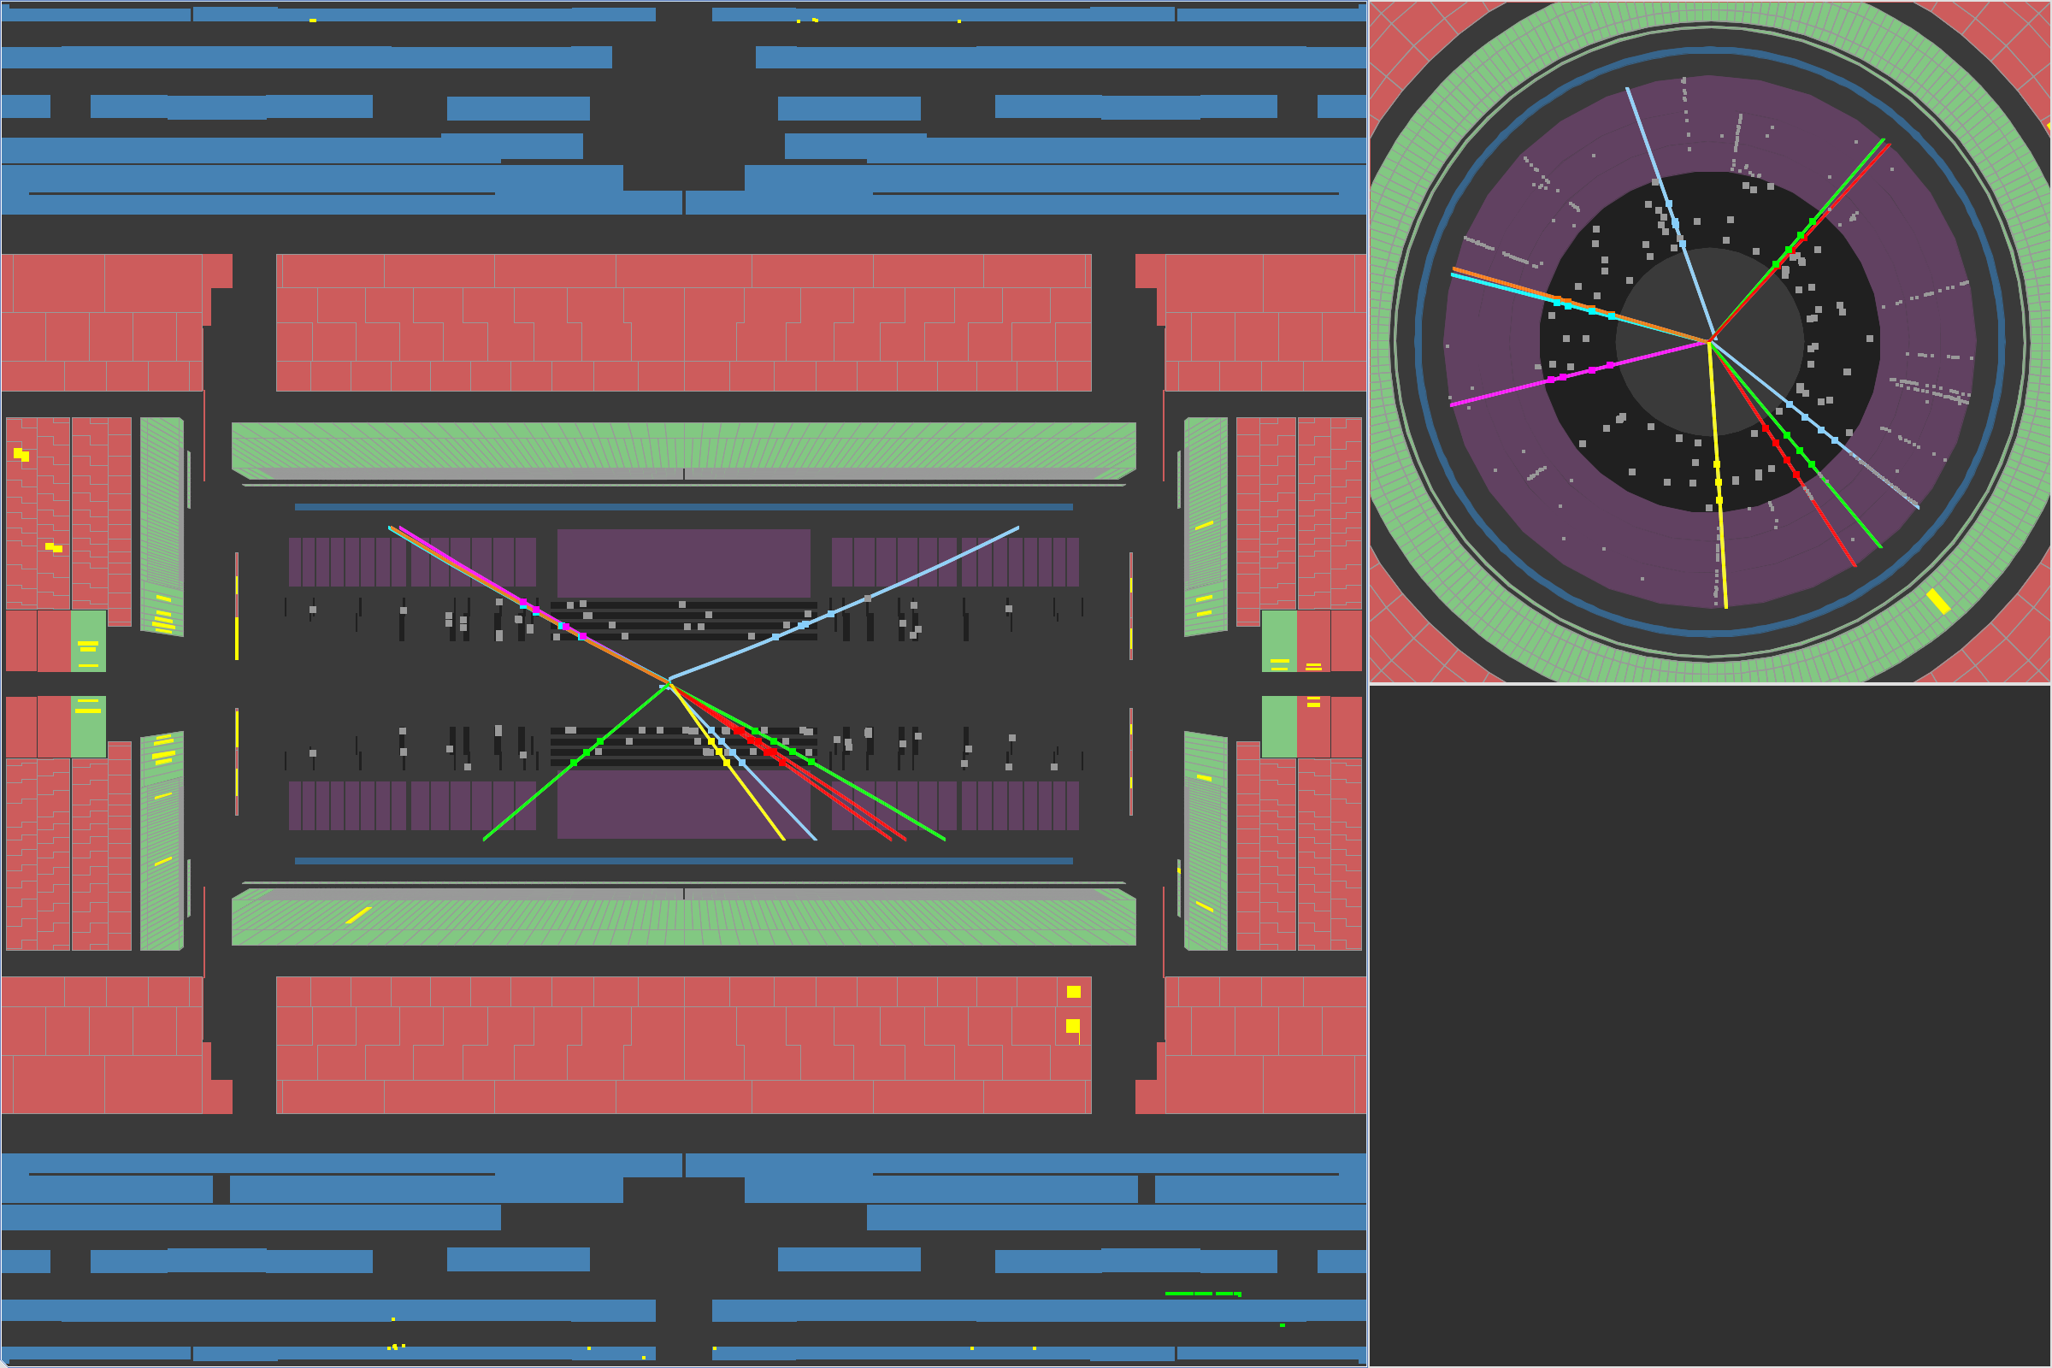
Run 140541 Event 184417
Looking at properties of collision events

Slide 24
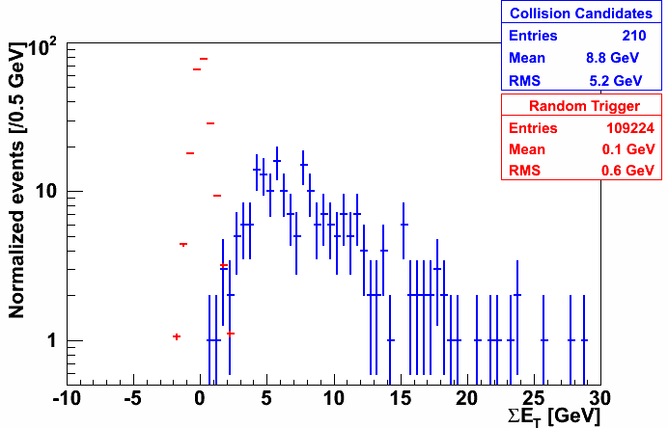
Properties of collision events
Sum of calorimeter transverse energy compared to random events
Total energy in calorimeters (clusters)
ATLAS preliminary
noise

Slide 25
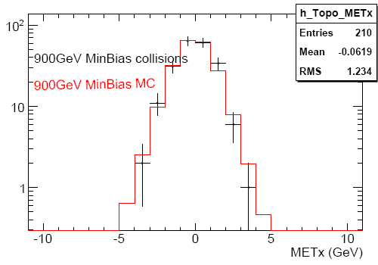
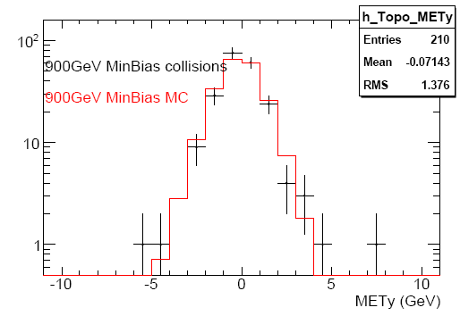
Properties of collision events
Missing transverse energy components compared to 900 GeV minimum bias Monte Carlo (solenoid field ON)
ATLAS preliminary
ATLAS preliminary
noise

Slide 26
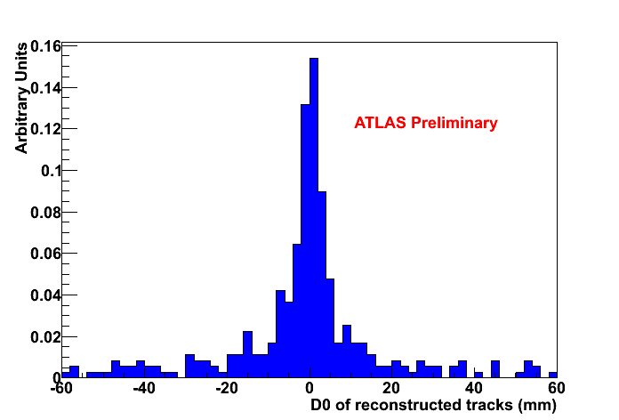
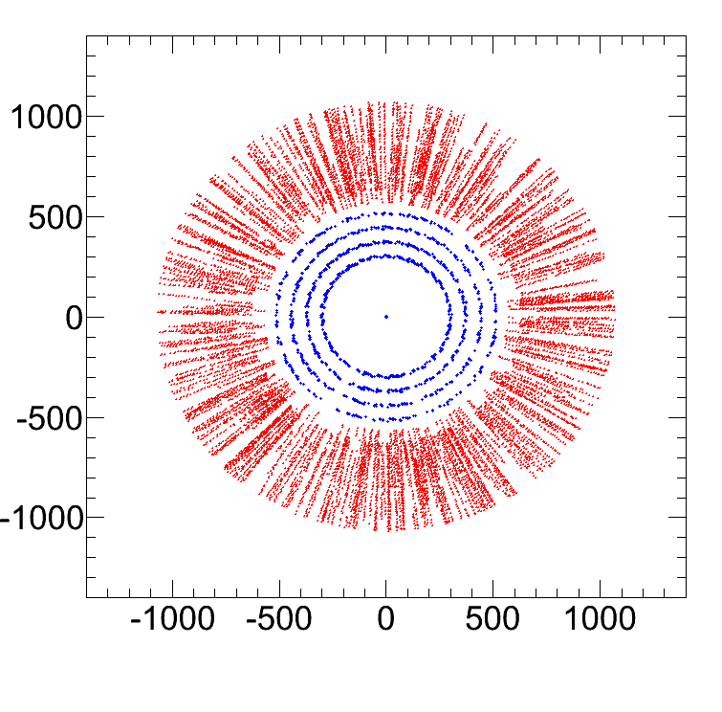
Tracking (challenging w/o Pixel, limited SCT and solenoid field off!)
Without solenoid field no separation of tracks by momenta
Fit impact parameter in a “silver-plated” sample with SCT >= 20 V and number of SCT hits >= 6 (46 events)
Scatter plot of hits on tracks (barrel, 46 events)
ATLAS preliminary
The impact point is well centred in ATLAS!
mm
ATLAS preliminary
TRT
SCT
mm

Slide 27
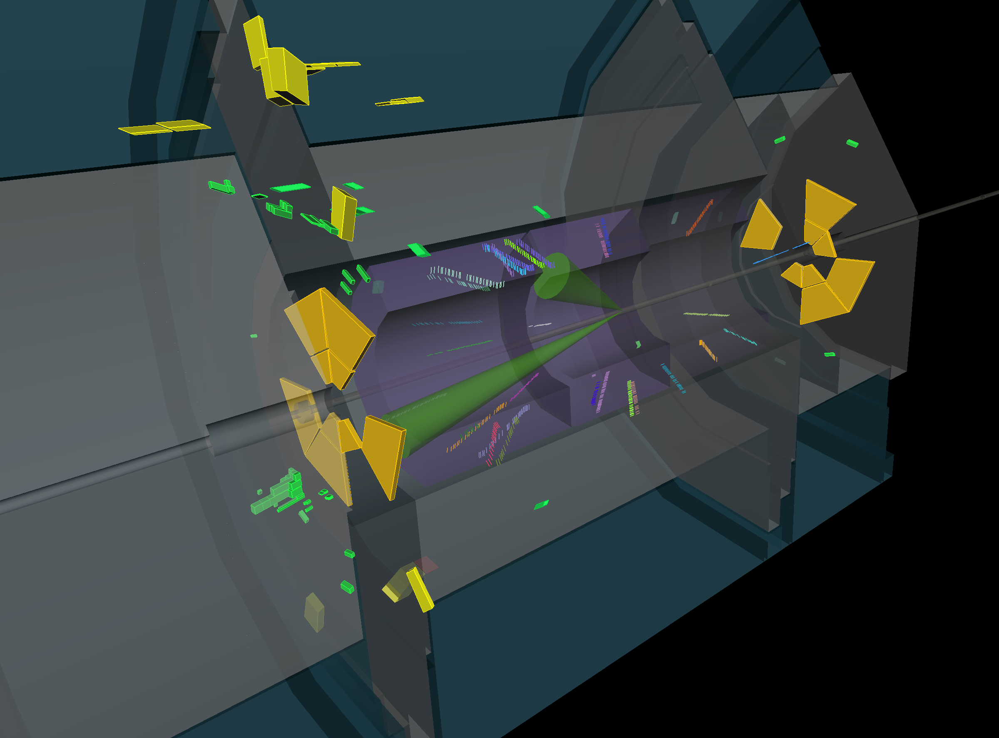
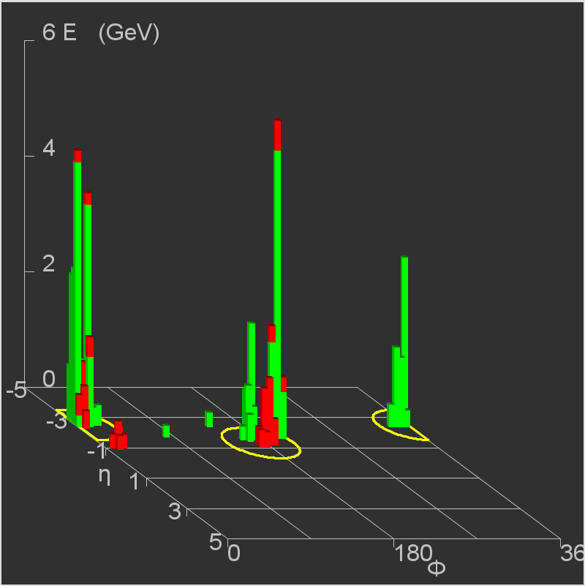
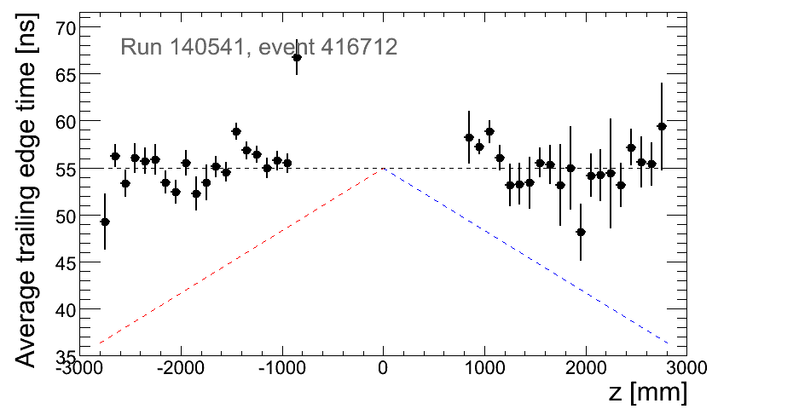
A di-jet candidate
Run 140541 Event 416712
ATLAS preliminary
Two jets back-to-back in φ, both with (uncalibrated) E_{T} ~ 10 GeV,
η of −1.3 and −2.5,
~ no missing E_{T}
Triggered by MBTS A/B in time, several hits
Also triggered by L1Calo EM3
Verify that TRT timing consistent with collision

Slide 28
How much luminosity did we collect? Naïve estimate
With a tight calorimeter-based timing selection, cross-checked by the MBTS and TRT ToF measurements, we have identified 197 golden collision candidates from run 140541 of Nov 23
We separate this sample into 2 parts (afternoon=A, evening=B) of different beam conditions
From Monte Carlo (solenoid field on) we find that the selection efficiency, including trigger, for inelastic and diffractive minimum bias events is about 70%
Using as total minimum bias cross section of 58 mb (40 mb inelastic, 12/6 mb SD/DD):
Sample | Number of events | DAQ duration | Average rate | Average inst. luminosity | Integrated luminosity
A | 61 | 54 mins | 0.03 Hz | 0.5 × 10²⁴ cm⁻² s⁻¹ | 1.5 mb⁻¹
B | 136 | 46 mins | 0.07 Hz | 1.2 × 10²⁴ cm⁻² s⁻¹ | 3.4 mb⁻¹
Cross checks:
Assuming that ε=0% for SD and DD → increases luminosity by 10%
change inelastic cross section to 34 mb → increases luminosity by 15%

Slide 29
Final words …
ATLAS welcomes the beams – experiment and collaboration are ready for physics!
What I did not mention: the data acquisition system, prompt reconstruction and the worldwide data distribution worked smoothly with collision and the huge beam splash events.
First collisions at 900 GeV have been recorded, and were a phase transition for ATLAS.
We are looking forward to lots more data, with the solenoid field on.
Again, thanks to the LHC team for a spectacular restart !

Slide 30
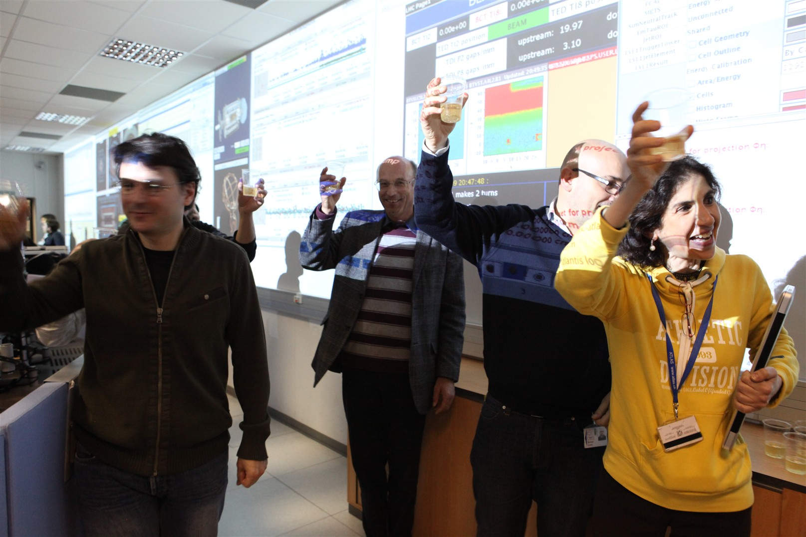
… and a final toast !

Slide 31
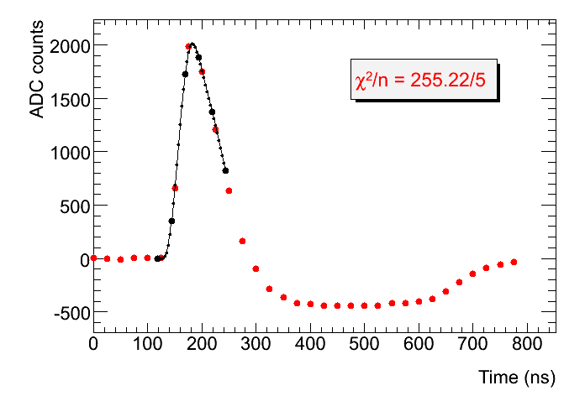
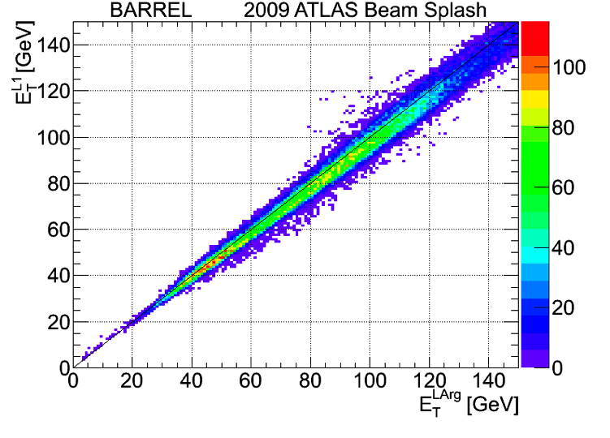
Other studies with beam-splash events (Calorimeters)
Liquid-Argon calorimeter bipolar pulse shape
E_{T} Level-1 trigger versus offline reconstruction
Prediction
ATLAS preliminary
Data
EM barrel layer 2
ATLAS preliminary

Slide 32
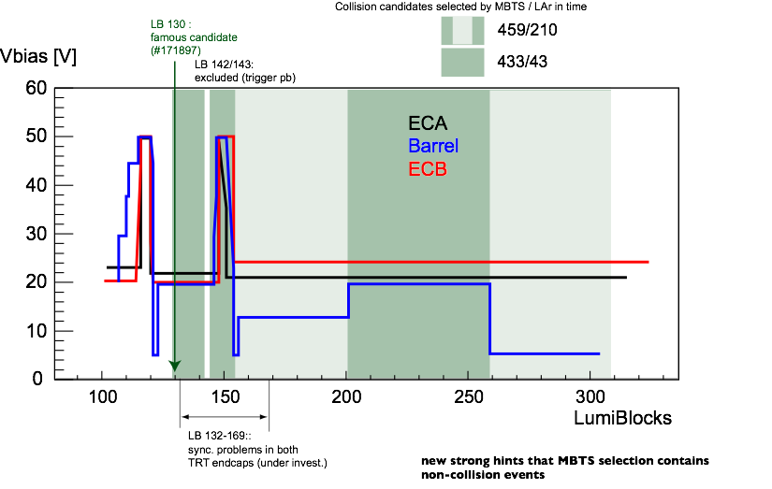
Tracking – very challenging w/o Pixel, limited SCT and B=0
Large number of low-momentum tracks because of no B field
Varying SCT bias voltage throughout run:

