Slide 1
Persistency Framework News for ATLAS
Andrea Valassi (IT-ES)
For the Persistency Framework team
ATLAS Database Meeting, 2nd December 2010

Slide 2
Outline and summary
Recent developments and releases
  POOL, CORAL, COOL (news since my July 15 talk at ATLAS sw week)
  ORA-07445 (already covered in my August 23 talk at ATLAS DB meeting)
Work in progress
  CORAL network glitches
  Consolidate CORAL test infrastructure (CppUnit & qmtest)
  Change date/time type used internally in COOL (task #5112)
  Joint review of POOL usage in ATLAS & LHCb (yesterday)

Slide 3
LCG 59^{(new!)} for ATLAS (July 2010)
LCG59 for ATLAS was built on July 7 and rebuilt on July 28
  Difference between the builds: disable gssapi in XercesC
    Upgrade XercesC 3.1.1 to 3.1.1p1 (without ‘network’ features)
    Main motivation also of LCG 58e release for LHCb (rebuild of 58d)
This is a workaround for a bug in the Globus client library
  Globus redefines gssapi symbols that already exist in the OpenSSL system libraries, loaded by XercesC 3.1.1 (bug #70641)
  Applications may crash depending on the order of library loading
    If OpenSSL version is loaded first (e.g. through XercesC 3.1.1), then any linked Grid middleware (e.g. LFCReplicaSvc for LHCb) fails
  Fix has been identified: use gssapi ‘versioned symbols’ in Globus
    This will be included in the first EMI middleware release (~April 2011)
A similar bug affects Oracle client 11.2.0.1.0p2
  Oracle defines a third, different, implementation of gssapi symbols
    This was reported to Oracle Support proposing the use of versioned symbols for the Oracle client too – an Enhancement Request is open
  Note also that frontier client loads the OpenSSL gssapi symbols

Slide 4
LCG 59a for ATLAS (August 2010)
Main motivation: ROOT and POOL/CORAL/COOL patches
  ROOT 5.26.00d includes genreflex fix (bug #70660)
POOL 2.9.10
  Many fixes and enhancements for ATLAS in collection packages
  Fix conflicts between simultaneous nightly tests on different slots
CORAL 2.3.11
  FrontierAccess fixes to read ATLAS geometry (bug #70208)
  FrontierAccess fixes to read CMS timestamps (bug #69605)
  Other fixes (e.g. memory leaks), some suggested by Coverity
COOL 2.8.7
  New vector payload mode for ATLAS (task #10335)
    Disabled (#ifdef COOL290) as it breaks binary compatibility: is it ok?
For full details see the release notes on TWiki
  Also: upgrade Grid clients (python 2.6 support, new voms features)

Slide 5
Tags for CMS (Sep. & Nov. 2010)
CORAL 2.3.12 (September 2010)
  Fix segfault in OracleAccess with gcc43 optimization (bug #71853)
  Fix SQLiteAccess file leak in ATLAS CherryPyCOOL (bug #71449)
CORAL 2.3.12a (November 2010)
  Port to gcc451 with -std=c++0x
For full details see the release notes on Twiki
  CMS was previously using a one-year old version of CORAL
  Now all of ATLAS, LHCb and CMS rapidly adopt the ~last version

Slide 6
LCG 59b in preparation for SPI
Main motivation: review the release build process in SPI
  Only POOL/CORAL/COOL patches (on top of CMS CORAL patch)
    Seize the opportunity to freeze recent changes in PF packages
    Could be used by ATLAS if needed (same externals as 59a)?
POOL 2.9.11
  Many fixes and enhancements for ATLAS in collection packages
  Patches in RootStorageSvc (e.g. prepare for ROOT I/O changes)
CORAL 2.3.13
  Start consolidation of C++ tests (goal: use CppUnit)
  Start cleanup of qmtest (goal: fixed #tests in all platforms/slots)
  Minor fixes, start code cleanup to prepare network glitch changes
COOL 2.8.8
  Improve handling of NaN floats and doubles (bug #72147)
For full details see the release notes on TWiki

Slide 7
ORA-07445 (1/3)
Signature: ORA-07445 server process crash
  “core dump [ksxpmprp()+267] [SIGSEGV]” in trace files
  Effect on end users: high load spikes, DB server ‘freezes’
Observed in COOL (ATLAS & LHCb) after April PSU in June
  Rolled back the April PSU until problem better understood
  Tried to reproduce it on test DB to validate possible patches
Used COOL nightly tests to try and reproduce it
  June PSU was not rolled back on test1 (lcg_cool_nightly)
  “ORA-07445 [ksxpmprp()+267]” seen 15x in 2 months (June-July)
    Always associated to “update sys.aud$” on disconnecting
    Always the same test “test_RelationalCool_RelationalFolder”
    Client apps succeed: crash is on server side when disconnecting
  Developed a script to maximize chances of reproducing the issue
    Successfully managed to reproduce ORA-07445 (~25 per hour)
    Also observed freezing of DB server (and of client at the same time)

Slide 8
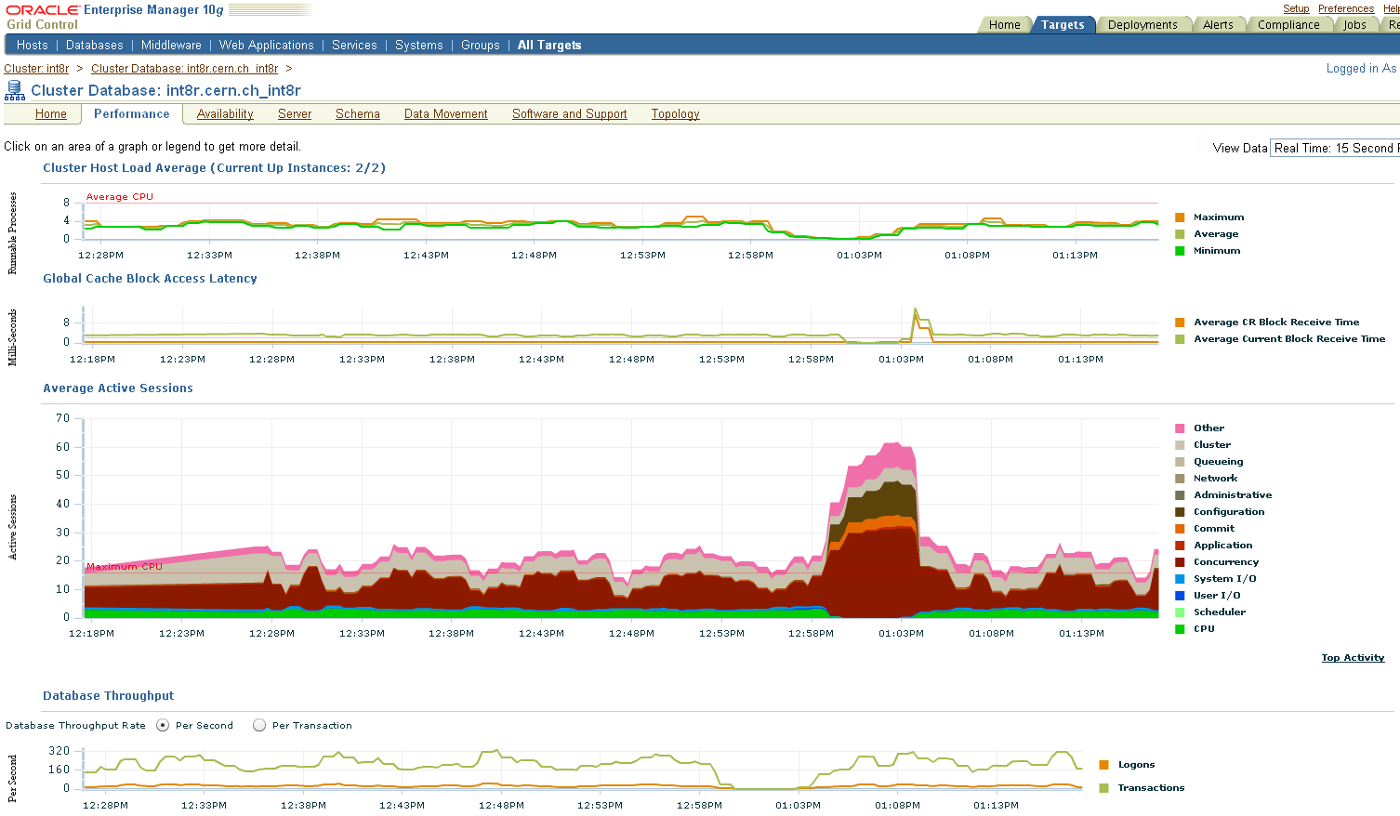
ORA-07445 (2/3)
Observed freezing of database server during COOL tests
Observed freezing of client CPU at same time…

Slide 9
ORA-07445 (3/3)
Which applications are hit by ORA-07445?
  COOL applications with connection sharing
    Clearly demonstrated using the COOL based test script
    No errors observed if connection sharing is disabled
  Issue was also observed in applications other than COOL
    e.g. on int8r: ATLAS tags (CORAL-based POOL collections)
Validation of patches on int8r (thanks to Marcin!)
  No April PSU: OK… (no ORA-07445)
  April PSU: NOT OK (~90 ORA-07445 on 900 COOL tests)
  April + July PSU: NOT OK (ORA-07445 still there)
  April + July PSU + 6196748 patch: OK! (no ORA-07445 on 300 tests)
COOL test script can now be used by PDB team
  Further tests of ORA-07445 and similar issues
  Generate some COOL load with/without connection sharing
  Warning: not fully representative of production-like activities
    Much more DDL (create/drop tables) than in production!

Slide 10
CORAL “network glitch” issues
Reported by all experiments in various cases
  “A transaction is not active” in CORAL server (bug #65597)
  ORA-24327 “need explicit attach” in ATLAS/CMS (bug #24327)
  OracleAccess crash after losing session in LHCb (bug #73334)
What should CORAL do? Many different scenarios
  e.g. non serializable R/O transaction: should reconnect and restart it
  e.g. DDL not committed in update transaction: cannot do anything
What is CORAL doing now?
  Correctly reconnecting in some cases (existing useful features)
  Not doing anything in other cases (missing useful features)
  Reconnecting in the wrong way in other cases (bugs!)
Work in progress (A. Kalkhof, R. Trentadue, A.V.)
  Catalog the different scenarios and prepare tests for each of them
  Prototype the implementation changes (ConnectionSvc and plugins)

