Slide 1
I/O in the multicore era a ROOT perspective
2nd Workshop on adapting applications and computing services to multi-core and virtualization
21-22 June 2010
René Brun/CERN

Slide 2
Memory <--> Tree
Each Node is a branch in the Tree
Memory
0
T.GetEntry(6)
1
2
3
4
5
6
7
8
9
10
11
12
13
14
15
16
17
T.Fill()
18
T
tr

Slide 3
Automatic branch creation from object model
branch buffers
float a;
int b;
double c[5];
int N;
float* x; //[N]
float* y; //[N]
Class1 c1;
Class2 c2; //!
Class3 *c3;
std::vector<T>;
std::vector<T*>;
TClonesArray *tc;

Slide 4
ObjectWise/MemberWise Streaming
member-wise streaming of collections is now the default in 5.27
3 modes to stream
an object
a
b
c
d
a1b1c1d1a2b2c2d2…anbncndn
object-wise to a buffer
member-wise to a buffer
a1a2..anb1b2..bnc1c2..cnd1d2..dn
a1a2…an
each member to a buffer
member-wise gives better compression
b1b2…bn
c1c2…cn
d1d2…dn

Slide 5
Important factors
Objects
in memory
Unzipped buffer
Unzipped buffer
Zipped buffer
Zipped buffer
Zipped buffer
Remote
Disk file
network
Local
Disk file

Slide 6
Buffering effects
Branch buffers are not full at the same time.
A branch containing one integer/event and with a buffer size of 32Kbytes will be written to disk every 8000 events, while a branch containing a non-split collection may be written at each event.
This may give serious problems when reading if the file is not read sequentially.

Slide 7
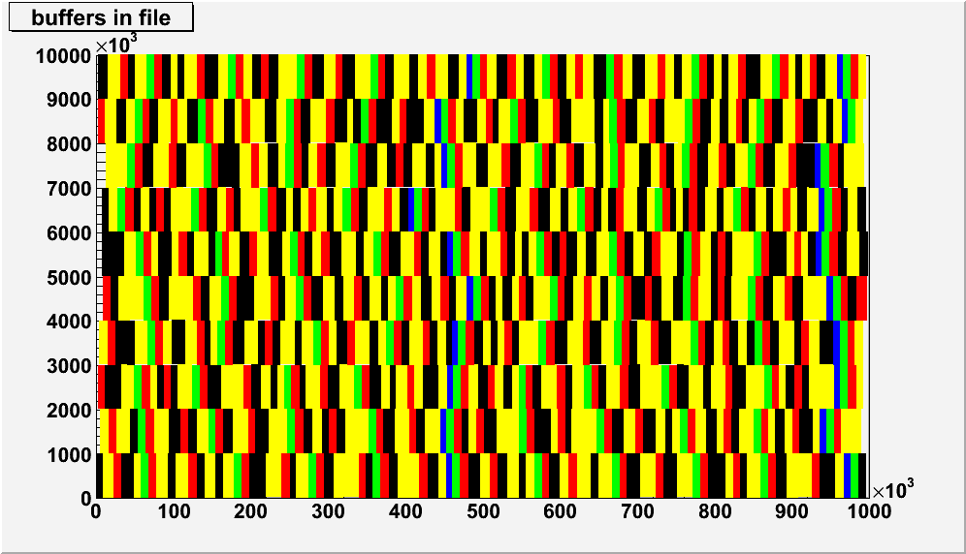
Tree Buffers layout
Example of a Tree with 5 branches
  b1 : 400 bytes/event
  b2: 2500 ± 50 bytes/ev
  b3: 5000 ± 500 bytes/ev
  b4: 7500 ± 2500 bytes/ev
  b5: 10000 ± 5000 bytes/ev
10 rows of 1 MByte
in this 10 MBytes file
each branch has its own buffer
(8000 bytes)
(< 3000 zipped)
typical Trees have several hundred branches

Slide 8
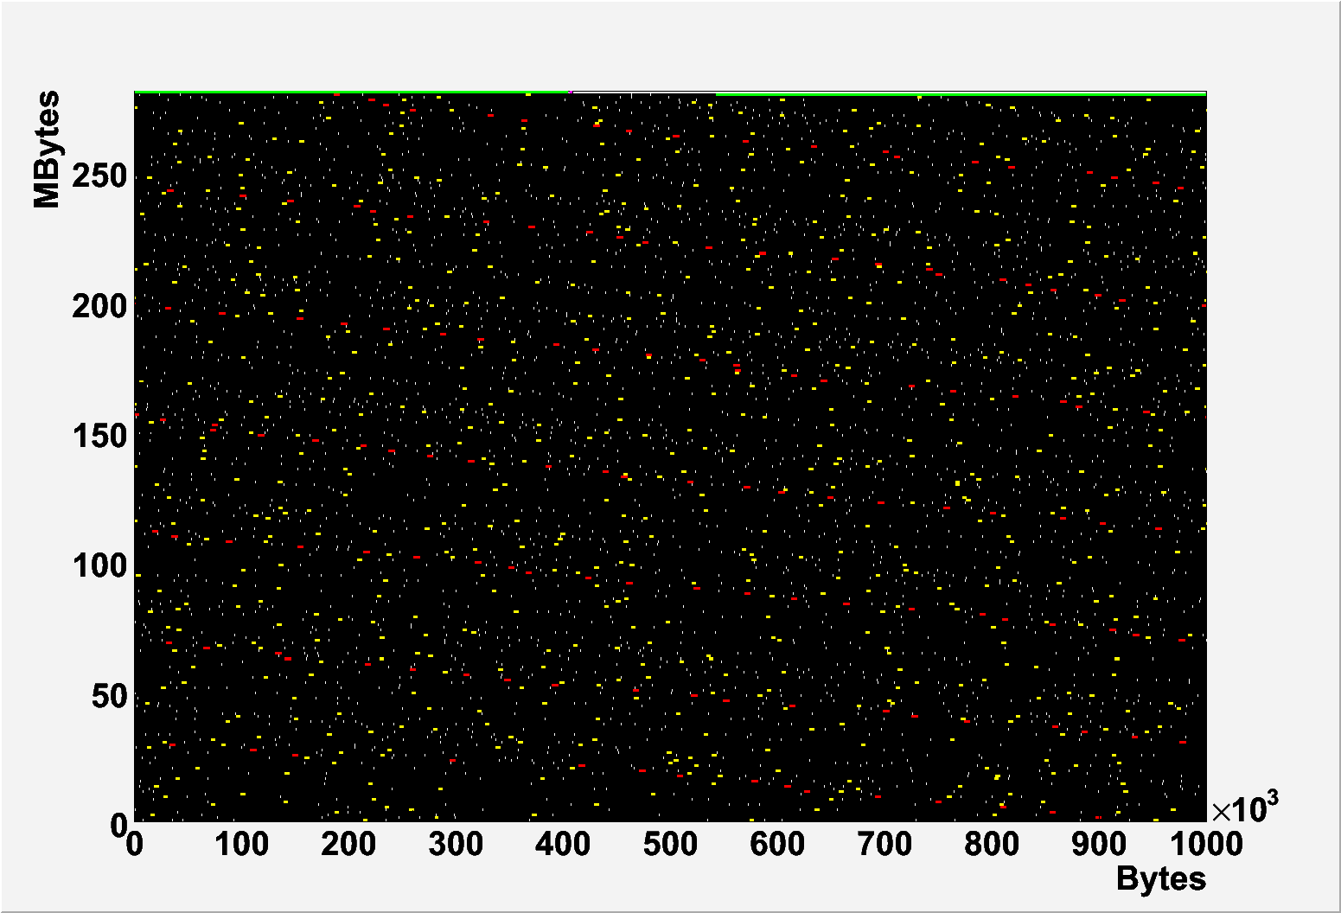
Looking inside a ROOT Tree
3 branches
have been
colored
TFile f("h1big.root");
f.DrawMap();
283813 entries
280 Mbytes
152 branches

Slide 9
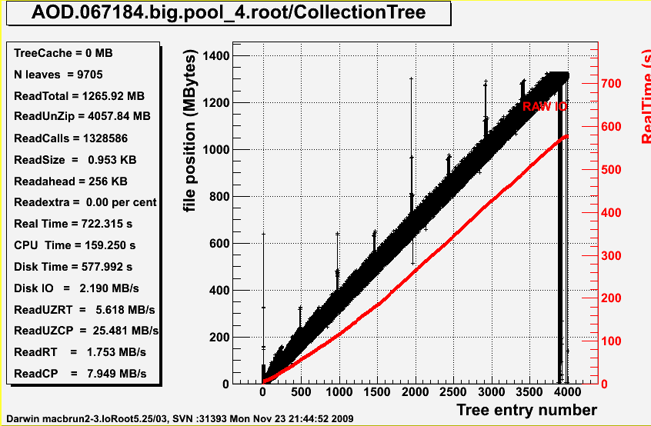
See Doctor

Slide 10
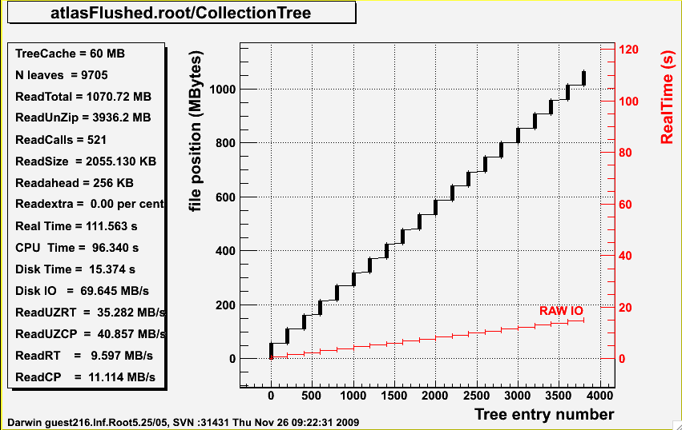
After doctor
gain a factor 6.5 !!
Old Real Time = 722s
New Real Time = 111s
The limitation is now cpu time

Slide 11
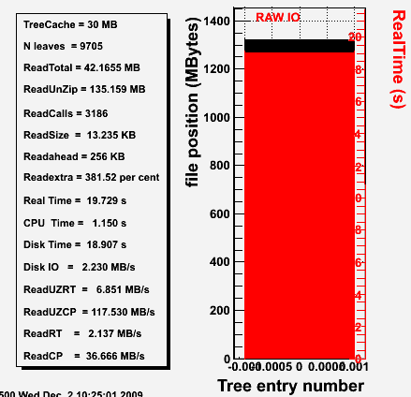
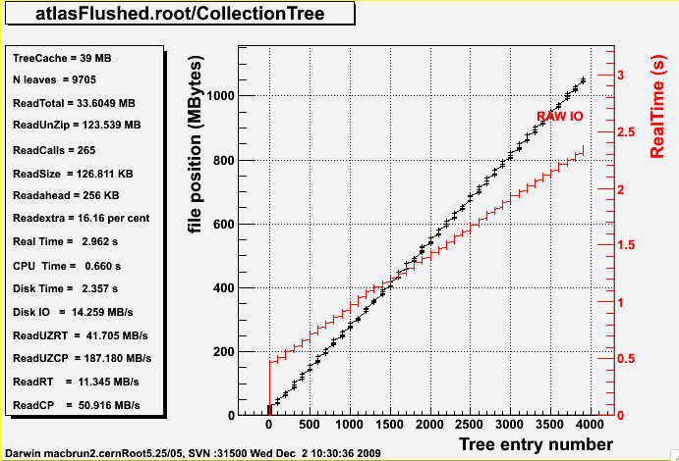
Use Case reading 33 Mbytes out of 1100 MBytes
Seek time = 3186*5ms = 15.9s
Seek time = 265*5ms = 1.3s
Old ATLAS file
New ATLAS file

Slide 12
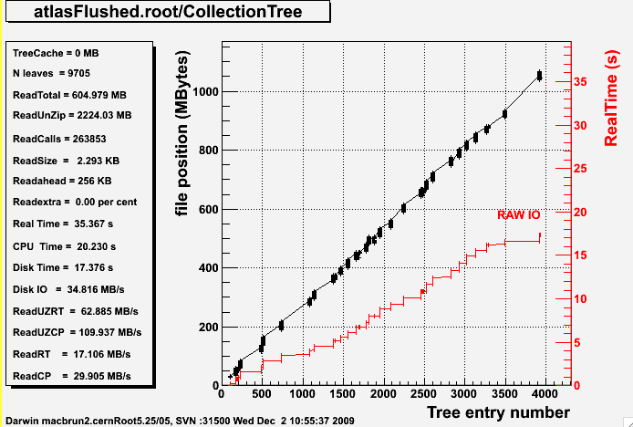
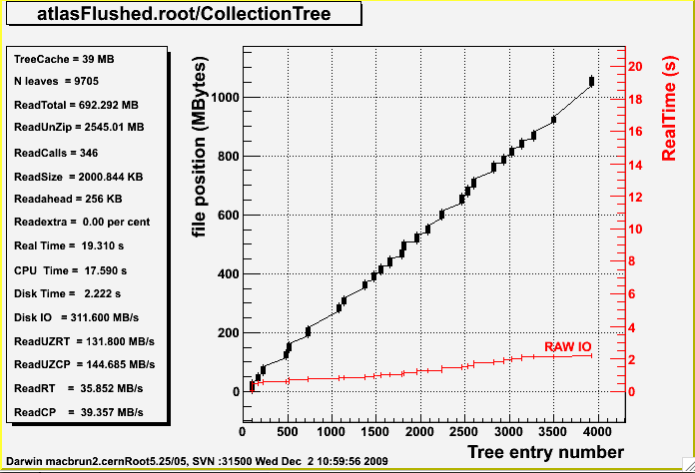
Use Case reading 20% of the events
Even in this difficult case cache is better

Slide 13
What is the TreeCache
It groups into one buffer all blocks from the used branches.
The blocks are sorted in ascending order and consecutive blocks merged such that the file is read sequentially.
It reduces typically by a factor 10000 the number of transactions with the disk and in particular the network with servers like httpd, xrootd or dCache.
The typical size of the TreeCache is 30 Mbytes, but higher values will always give better results
readv
readv
readv
readv
readv

Slide 14
TTreeCache with LANs and WANs
client | latency (ms) | cachesize 0 | cachesize 64k | cachesize 10 MB
A: local pcbrun.cern.ch | 0 | 3.4 s | 3.4 | 3.3
B: 100Mb.s CERN LAN | 0.3 | 8.0 s | 6.0 | 4.0
C: 10 Mb/s CERN wireless | 2 | 11.6 s | 5.6 | 4.9
D: 100 Mb/s Orsay | 11 | 124.7 s | 12.3 | 9.0
E: 100 Mb/s Amsterdam | 22 | 230.9 s | 11.7 | 8.4
F: 8 Mb/s ADSL home | 72 | 743.7 s | 48.3 | 28.0
G: 10 Gb/s Caltech | 240 | 2800 s | 125.4 | 4.6
old slide
from 2005
One query to a 280 MB Tree
I/O = 6.6 MB

Slide 15
TreeCache results table
Original Atlas file (1266 MB), 9705 branches split=99
Cache size (MB) | readcalls | RT pcbrun4 (s) | CP pcbrun4 (s) | RT macbrun (s) | CP macbrun (s)
0 | 1328586 | 734.6 | 270.5 | 618.6 | 169.8
LAN 1ms 0 | 1328586 | 734.6+1300 | 270.5 | 618.6+1300 | 169.8
10 | 24842 | 298.5 | 228.5 | 229.7 | 130.1
30 | 13885 | 272.1 | 215.9 | 183.0 | 126.9
200 | 6211 | 217.2 | 191.5 | 149.8 | 125.4
Reclust: OptimizeBaskets 30 MB (1147 MB), 203 branches split=0
Cache size (MB) | readcalls | RT pcbrun4 (s) | CP pcbrun4 (s) | RT macbrun (s) | CP macbrun (s)
0 | 15869 | 148.1 | 141.4 | 81.6 | 80.7
LAN 1ms 0 | 15869 | 148.1 + 16 | 141.4 | 81.6 + 16 | 80.7
10 | 714 | 157.9 | 142.4 | 93.4 | 82.5
30 | 600 | 165.7 | 148.8 | 97.0 | 82.5
200 | 552 | 154.0 | 137.6 | 98.1 | 82.0
Reclust: OptimizeBaskets 30 MB (1086 MB), 9705 branches split=99
Cache size (MB) | readcalls | RT pcbrun4 (s) | CP pcbrun4 (s) | RT macbrun (s) | CP macbrun (s)
0 | 515350 | 381.8 | 216.3 | 326.2 | 127.0
LAN 1ms 0 | 515350 | 381.8 + 515 | 216.3 | 326.2 +515 | 127.0
10 | 15595 | 234.0 | 185.6 | 175.0 | 106.2
30 | 8717 | 216.5 | 182.6 | 144.4 | 104.5
200 | 2096 | 182.5 | 163.3 | 122.3 | 103.4

Slide 16
OptimizeBaskets
Facts: Users do not tune the branch buffer size
Effect: branches for the same event are scattered in the file.
TTree::OptimizeBaskets is a new function that will optimize the buffer sizes taking into account the population in each branch.
You can call this function on an existing read only Tree file to see the diagnostics.

Slide 17
FlushBaskets
TTree::FlushBaskets was introduced in 5.22 but called only once at the end of the filling process to disconnect the buffers from the tree header.
In version 5.25/04 this function is called automatically when a reasonable amount of data (default is 30 Mbytes) has been written to the file.
The frequency to call TTree::FlushBaskets can be changed by calling TTree::SetAutoFlush.
The first time that FlushBaskets is called, we also call OptimizeBaskets.

Slide 18
FlushBaskets 2
The frequency at which FlushBaskets is called is saved in the Tree (new member fAutoFlush).
This very important parameter is used when reading to compute the best value for the TreeCache.
The TreeCache is set to a multiple of fAutoFlush.
Thanks to FlushBaskets there is no backward seeks on the file for files written with 5.25/04. This makes a dramatic improvement in the raw disk IO speed.

Slide 19
Caching a remote file
ROOT can write a local cache on demand of a remote file. This feature is extensively used by the ROOT stress suite that read many files from root.cern.ch
  TFile f(http://root.cern.ch/files/CMS.root”,”cacheread”);
The CACHEREAD option opens an existing file for reading through the file cache. If the download fails, it will be opened remotely. The file will be downloaded to the directory specified by SetCacheFileDir().

Slide 20
Caching the TreeCache
The TreeCache is mandatory when reading files in a LAN and of course a WAN. It reduces by a factor 10000 the number of network transactions.
One could think of a further optimization by keeping locally the TreeCache for reuse in a following session.
A prototype implementation (by A.Peters) is currently being tested and looks very promising.
A generalisation of this prototype to pick treecache buffers on proxy servers would be a huge step forward.

Slide 21
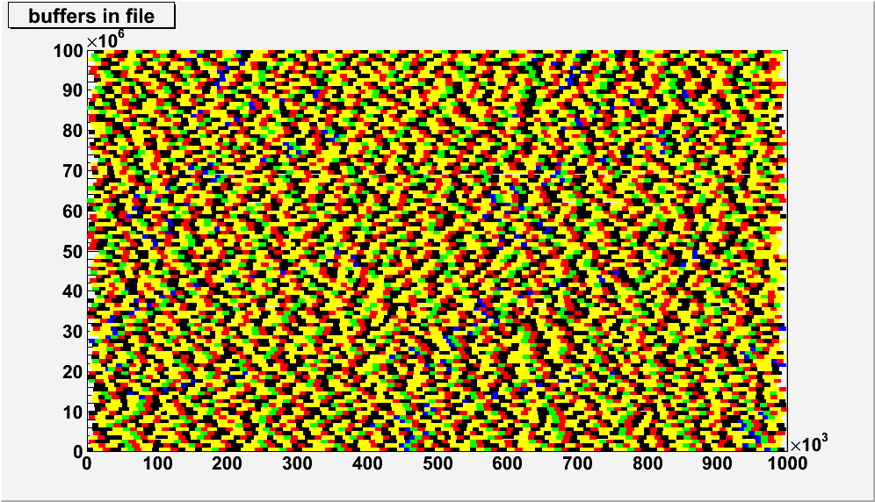
Caching the TreeCache
Remote
disk file
10 MB zip
network
30 MB unzip
Local
disk file

Slide 22
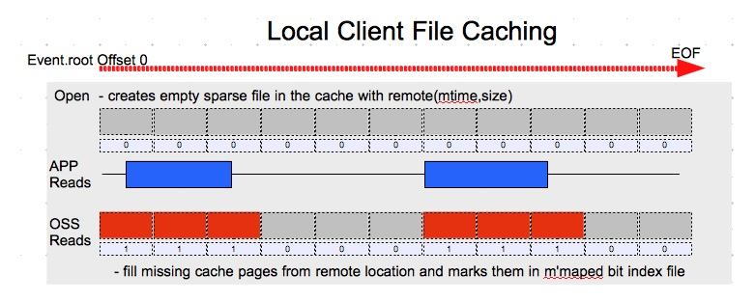
A.Peters cache prototype

Slide 23
caching the TreeCache
Preliminary results
results on an Atlas AOD 1 GB file
with preliminary cache
from Andreas Peters
very encouraging results
session | Real Time(s) | Cpu Time (s)
local | 116 | 110
remote xrootd | 123.7 | 117.1
with cache (1st time) | 142.4 | 120.1
with cache (2nd time) | 118.7 | 117.9

Slide 24

Parallel buffers merge
parallel job with 8 cores
each core produces a 1 GB file in 100 seconds.
Then assuming that one can read each file at 50MB/s and write at 50 MB/s, merging will take 8*20+160 = 320s !!
One can do the job in <160s
8 GB
1 GB
F1
F
2
F3
F
4
F
5
F
6
F
7
F
8
10 KB

Slide 25

Parallel buffers merge
8 GB
8 GB
1 GB
10 MB
F1
F
2
F3
F
4
F
5
F
6
F
7
F
8
B1
B
2
B
3
B
4
B
5
B
6
B
7
B
8
10 KB
10 KB

Slide 26
Parallel buffers/file merge
in 5.26 the default for fAutoFlush is to write the tree buffers after 30 MBytes. When using the parallel buffers merge, the user will have to specify fAutoFlush as the number of events in the buffers to force the autoFlush.
We still have to fix a minor problem with 5.26 when merging files to take into account the fact that the last buffers are <= fAutoFlush

Slide 27
I/O CPU improvements
We are currently working on 2 major improvements that will reduce substantially the cputime for I/O.
We are replacing a huge static switch/case logic in TStreamerInfo::ReadBuffer by a more dynamic algorithm using direct pointers to static functions or functions dynamically compiled with the JIT to implement a more efficient schema evolution.
We are introducing memory pools to reduce the number of new/delete and the memory fragmentation.

Slide 28
switch/case → longjump
The code generated by a long switch/case is not very efficient in C++. We are introducing new functions instead of the inline code in the switch/case.
It is better to have more short functions because the code can be optimized and many ifs statement removed.
This work in 5.27/03 is half-done and preliminary results indicate a gain in cpu of a factor 2 ! (after unzipping)

Slide 29
memory pools
Reading one event requires
  reading the zipped buffer in a dynamic buffer
  unzipping this buffer into another dynamic buffer
  fill the user final structures with the creation in turn of many new objects.
We are introducing a memory pool per branch where the buffer allocation will be inside the pool and possibly the user objects too when the object ownership is delegated to ROOT.
Memory pools per branch requires more memory but also save memory by minimizing memory fragmentation.

Slide 30
Memory Pools (2)
Phase 1: The unzipped buffer is in a pool per branch
Phase 2: The user objects are created in the branch pool if root has ownership of the objects in the branch
  Myclass1 *p1 =0;
  tree.SetBranchAddress(“b1”,&p1);
  Myclass2 *p2 = new Myclass2(…);
  tree.SetBranchAddress(“b2”,&p2);
p1 will be created by ROOT in the branch pool
}
}
p2 is managed by user
if ROOT has ownership in dedicated branch pools
branch IO could be in parallel

Slide 31
Summary
Version 5.26 include several features that improve drastically the IO speed, in particular in LANs and WANs. To take advantage of these improvements files must be written with 5.26.
We are currently making new improvements in 5.27/5.28 that will reduce the CPU overhead or optimize the IO (input and output) when running in multi-core mode.

Slide 32
Summary 2
The combination of the TreeCache with local caching is a fantastic alternative to the current inefficient and bureaucratic push model where thousands of files are pushed to T2, T3 and then jobs send to the data.
It is very unfortunate that no grid tools exist to simulate the push and pull behaviors. Only gradual prototyping at a small scale in T3, then in T2 can tell us if this is the right direction. I am convinced that it is the right direction.

