Slide 1
Create a movie into CATIA
5th CERN CATIA Users Forum
Jean-Pierre Corso EN-MEF

Slide 2
Outline
Workbench and basic settings
Create a Camera
Create Track(s)
Create Sequence
Visualize the tracks or sequences
Generate the video File
A.O.B.
Jean-Pierre Corso EN-MEF-INT / 17.06.2010

Slide 3
Workbench and Basic Settings
Open the Product & Check-Out
Start the DMU Navigator workbench
Set the view to perspective
  View → Render Style → Perspective
Jean-Pierre Corso EN-MEF-INT / 17.06.2010

Slide 4
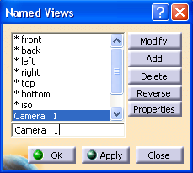
Create a Camera
Choose the position and zoom !
Insert a camera
  View → Named Views
Add, and type the name chosen
Jean-Pierre Corso EN-MEF-INT / 17.06.2010

Slide 5
Create a Camera
In the Window menu, go into Camera Window and select the Camera 1
Arrange the 2 windows
  Window → Tile Horizontally
Note...
In the 1st window, you see what the camera see.
In the 2nd, you have a global view and visualize camera’s position.
Jean-Pierre Corso EN-MEF-INT / 17.06.2010

Slide 6

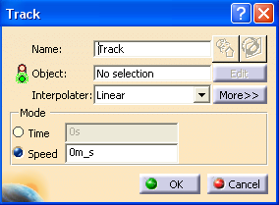
Create a Track
Select the command
Select the Camera 1 as object
Choose Linear or Spline
  Linear recommended
Choose the Speed
  Examples:
    0.5 for detailed area
    4 for large room
Jean-Pierre Corso EN-MEF-INT / 17.06.2010

Slide 7

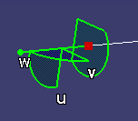
Create a Track
Create 1st point with record
Move the camera with the compass using axes for translation or arcs for rotations
Record intermediate points with record
End the Track with a last Record.
Note...
Before creating a new point, you can change Linear to Spline, or increase or decrease the Speed.
Jean-Pierre Corso EN-MEF-INT / 17.06.2010

Slide 8
Single Track or Multi tracks ???
You can make your Sequence Plan in one single track.
You can slice your Sequence Plan in several tracks.
  Therefore, Create as many Tracks as needed.
Note...
To locate the camera for the following track, select the previous track and skip to the end.
The compass will be positionned on the last point.
Jean-Pierre Corso EN-MEF-INT / 17.06.2010

Slide 9
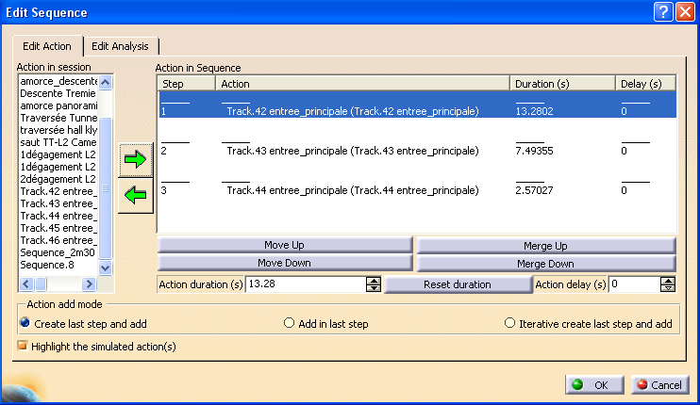
Create a Sequence
To assemble your tracks, you have to create a Sequence
Select the tracks in the order with the right arrow to load them in the sequence.
Jean-Pierre Corso EN-MEF-INT / 17.06.2010

Slide 10

Visualize the work
Select a track or a sequence
Select parameters
Change the sampling to 0.04s
Put the cursor at the beginning with the mentioned button
Run
Jean-Pierre Corso EN-MEF-INT / 17.06.2010

Slide 11
Customization
You can modify the tracks as needed
  delete, move points, change speed…
To move the points, select modify and then use the compass to change the position.
Note...
When the Tracks are modified, the sequence is not update !
You must recreate a new sequence.
Jean-Pierre Corso EN-MEF-INT / 17.06.2010

Slide 12
Generate the video file
Select the camera
Increase the Camera Window
  The size on the screen will be the size of the video !
Reduce the global window to minimum needed
  You have to select the sequence on it !
Hide the Tracks and Sequences ! (F2)
Jean-Pierre Corso EN-MEF-INT / 17.06.2010

Slide 13
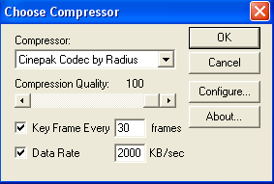
Generate the video file
Select the track or the sequence
Select the command
    Tools → Simulation → Generate Video
  Change the Setup
    Values recommended…
  Name the file & RUN
Note...
The Camera Window must be ACTIVE !
Select it before run the generation…
Jean-Pierre Corso EN-MEF-INT / 17.06.2010

Slide 14
A.O.B.
An ‘avi’ file is created
Generally, they are huge !
You can compress them and/or add texts, but that’s another story, out of CATIA.
Note...
Don’t forget to Check-in your CATIA file to keep your work…
Jean-Pierre Corso EN-MEF-INT / 17.06.2010

