Slide 1

Generic Catia Tools
- User case -
3D curve length optimization

Slide 2
Summary
Context
Preparing environment
Instantiate the tool & Launch the optimization

Slide 3
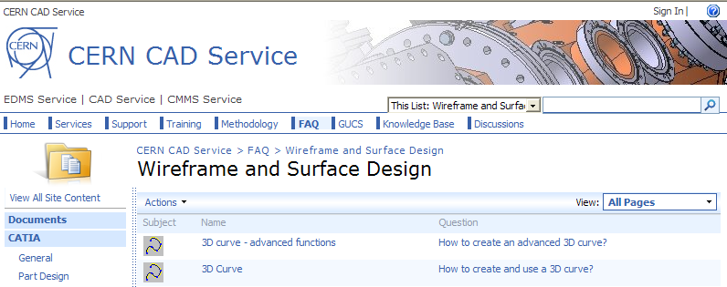
Context
Last Catia Forum, we have seen that it was possible to easily create a 3D curve througth existing points or "on the fly".
2 FAQs have been created
about this :
During the forum, one question was : "Is it possible to specify the curve length?"

Slide 4
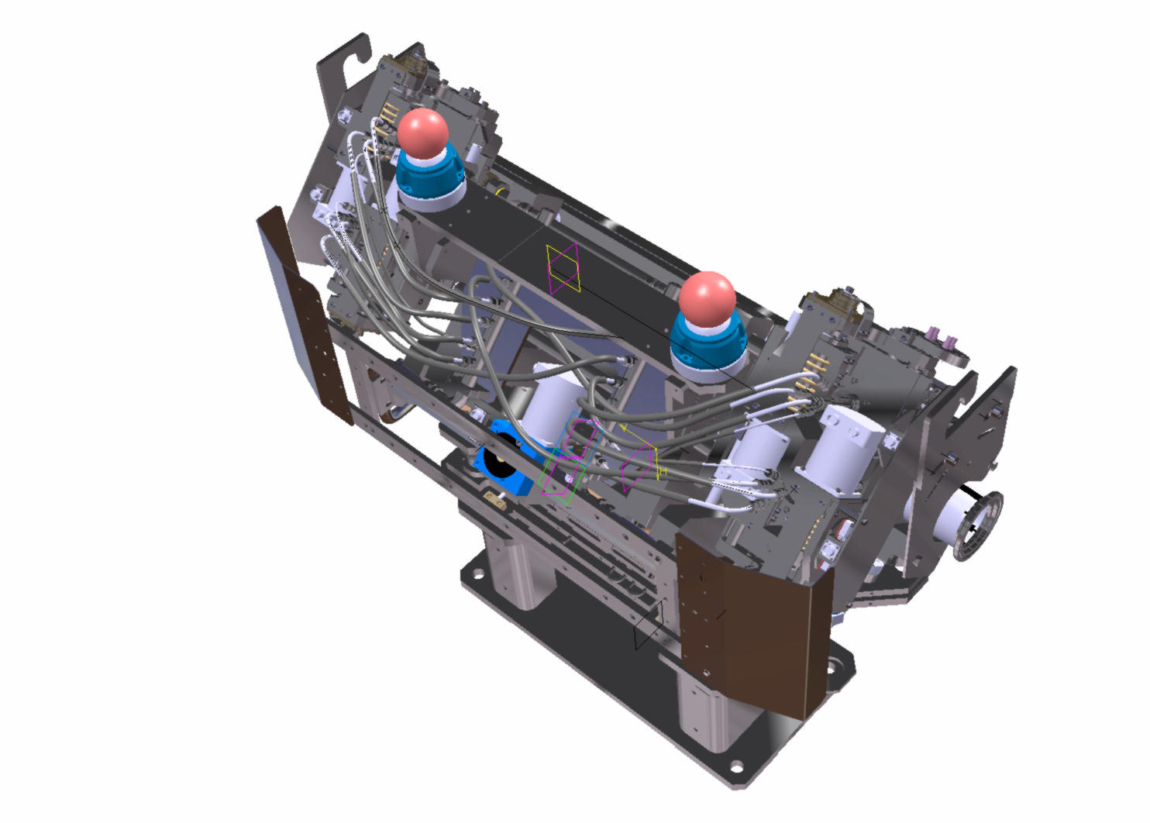
Context
We will see in this presentation that an internal CERN tool can help you to modify an existing curve to obtain a specific length.
This demonstration is based on an user case, about flexible on a 135° collimateur.
The purpose is to obtain a 700mm
long flexible.
The current value is about 690mm.
Notes:
Cela sert dans l’accélérateur à particules, a densifier/diriger/corriger le faisceau,
Il y en a plusieurs de ces machines disposés dans le tunnel a différent endroit.
Il existe 4 positions angulaire différente de collimateur, d’où le nom collimateur 0° 45° 90° et 135°
Car le tunnel n’est pas orienté forcement dans un plan horizontal mais possède un angle, donc ces 4 différents collimateurs avec ??? servent a compenser les différences angulaires (chaque collimateur possède différents réglages angulaires/linéaires en plus pour le réglage du faisceau).

Slide 5
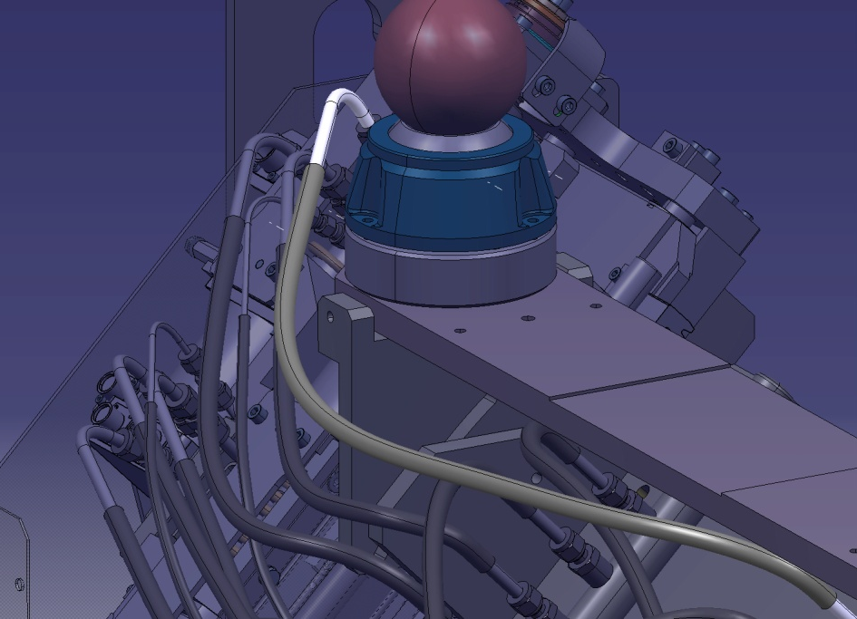
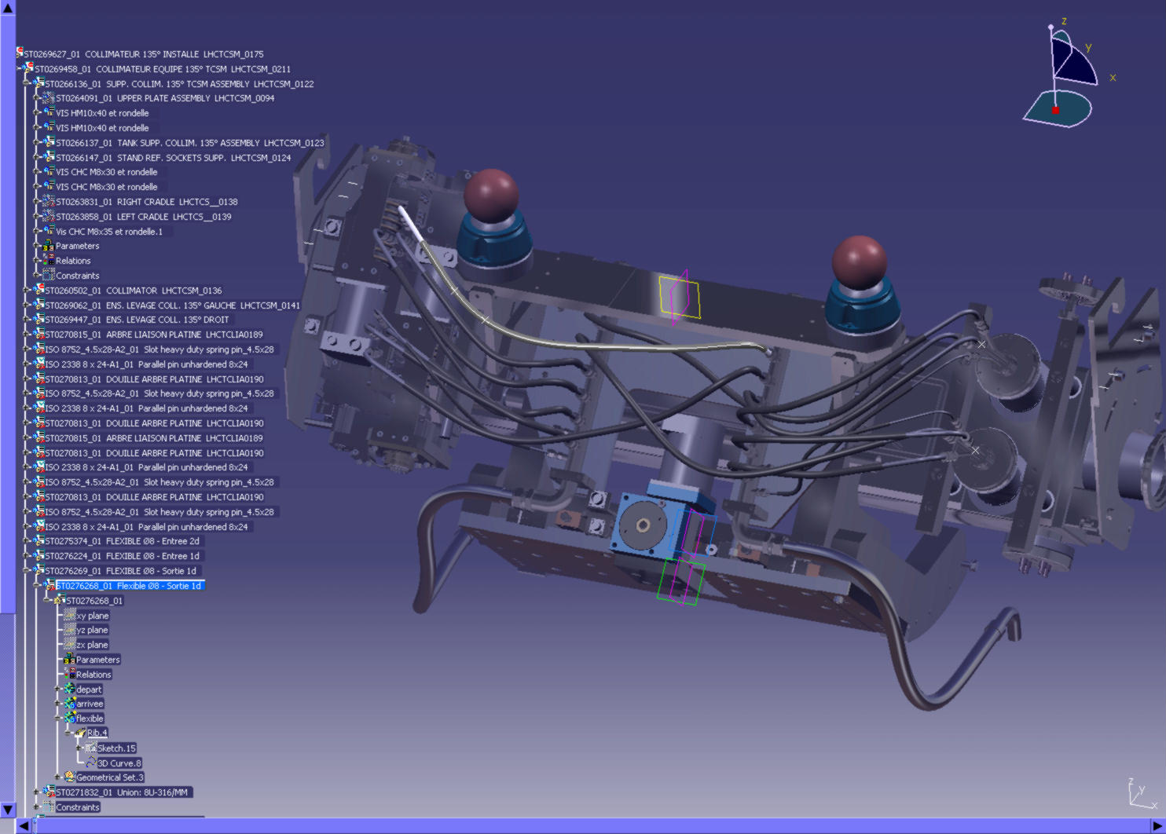
Preparing environment?
As we will work with this flexible, we can remove / hide all the useless environment.

Slide 6
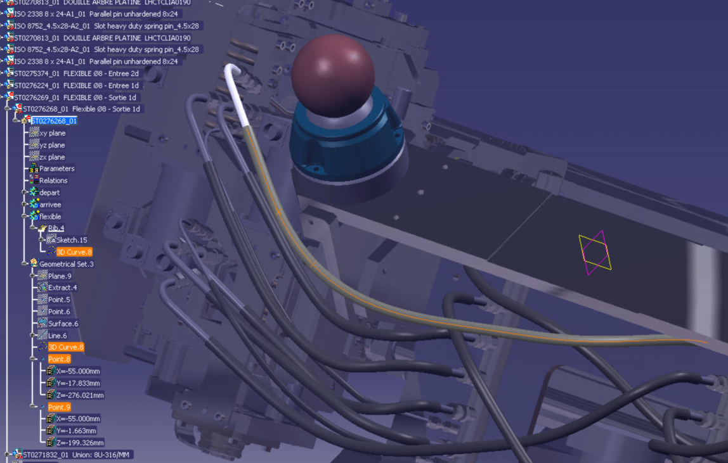
Preparing environment?
Check that the curve is based on point(s) that have some degrees of freedom.
The tool is a
Powercopy.
It means that it will be
instantiated in the
active Part.

Slide 7
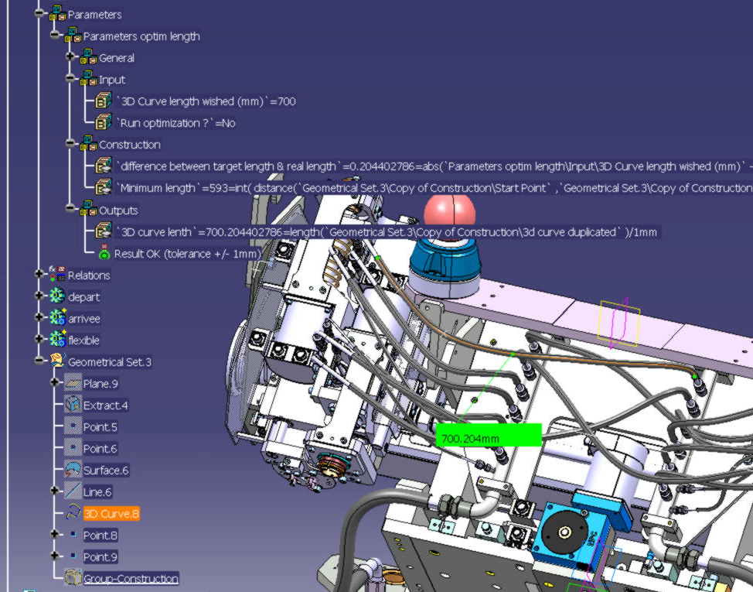
Instantiate the tool & Launch the optimization
Call the tool from the catalog browser and select the inputs (3D curve + 3 parameters)
The tool is instantiated in the tree.
You have to set the targeted length then run the optimization.

Slide 8

Thank you / Merci

