Slide 1
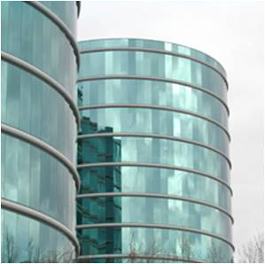
Introducing
Oracle Data Integrator and
Oracle GoldenGate
Marco Ragogna
EMEA Principal Sales Consultant
Data integration Solutions

Slide 2
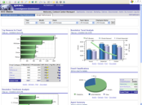







IT Obstacles to Unifying Information
What is it costing you to unify your data?
Analytics
Business
Intelligence
Custom Reporting
Packaged
Applications
Enterprise Performance
Data
Replication
Data
Migration
Data
Warehousing
Data Silos
Data Marts
Data
Federation
Data Hubs
Data Access
Batch Scripts
SQL
Custom
Java
OLTP & ODS
Systems
Oracle
PeopleSoft, Siebel, SAP
Custom Apps
Files
Excel
XML
OLAP
Data
Warehouse, Data Mart
Fragmented
Data Silos
Slow
Performance
Out of sync
Poor
Data Quality
What’s the
cost?
2
Notes:
2
2
2
The challenge many companies face today is that they expect their SOA or their BI or their Data Warehousing to solve many of their integration issues automatically. Worse yet, they simply sweep a lot of these issues under the rug and leverage custom code, scripts or even SQL. They overlook their architecture requirements for how data spans heterogeneous sources, and they need to not only be integrated, but considerations about keeping data in sync, timely, and with the right quality are of key importance. Instead they are left with an architecture like this one where the approach to solve the problem was admirable, but ultimately the fragmented approach leads to little tangible benefit. Here’s why:
Fragmented approaches - lead to a lack of control, inconsistent data, no common visibility of how information is being used
Doesn’t perform – inefficient in how it operates and doesn’t help you achieve the benefits of your business.
Out of sync- Integration is complex, costly, requires custom code, development or silo’d, impacts performance and speed of implementation
Lack of Trusted Data - Ambiguous sources of data and multiple sources of truth which aren’t matching, lack of integrations, inability to consolidate
Finally what’s the cost of this approach? It’s possible to solve some of these challenges by hand using custom coding and custom approaches – typically this is what many organizations are forced to do.

Slide 3
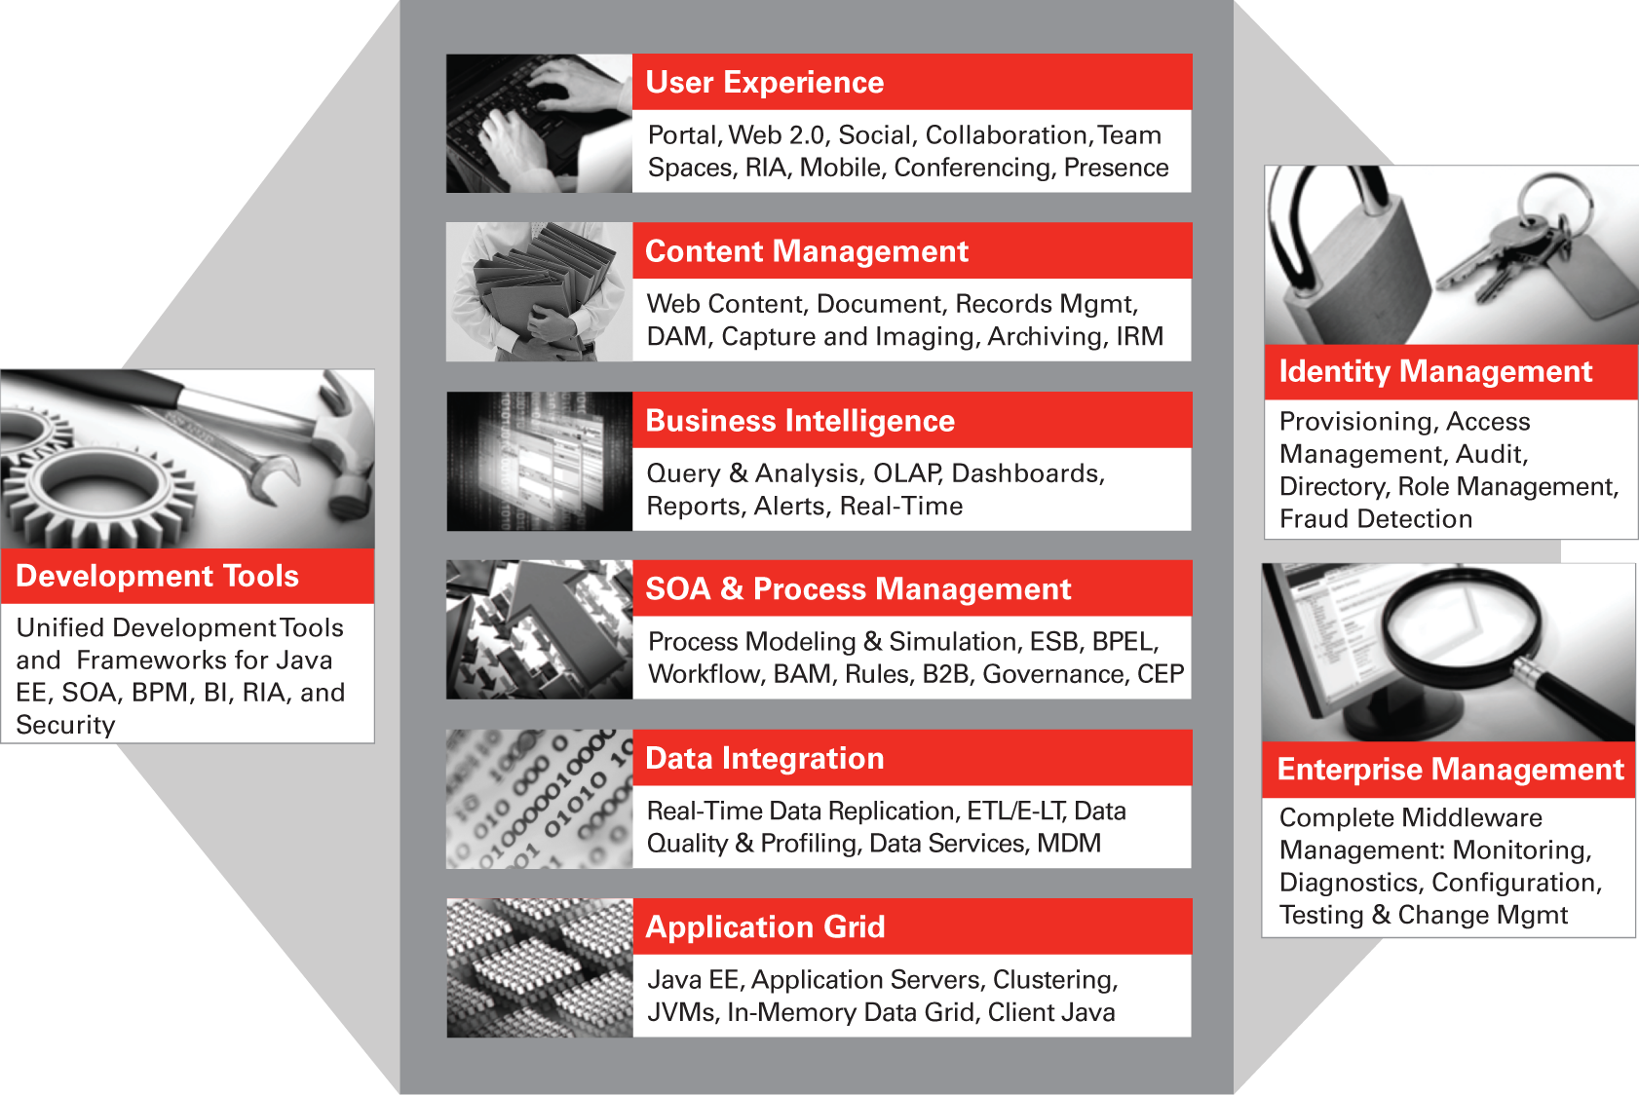

Data Integration
Key Component of Oracle Fusion Middleware
Applications
Middleware
Database
Infrastructure & Management

Slide 4


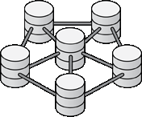




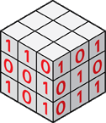


Oracle Data Integration
The solution for enterprise-wide real-time data
Databases
Mission critical systems and data
Distributed systems
Real-time Data
Business Intelligence, Performance Management
Legacy systems
Data Access
Web Services
Data Warehouses,
MDM
OLAP systems
Data Quality
OLTP systems
SOA
Dramatically improve the accessibility, reliability, and
quality of critical data across enterprise systems
Notes:
At Oracle we have taken the three requirements for access, real-time and quality and made them a cornerstone of our data integration strategy. It’s important to be able to manage information across these multiple paradigms (databases, distributed systems, legacy, OLAP, and OLTP) and get them to where they need to go: the mission critical systems that rely on the data, the business intelligence and performance Management systems that need the data for insight and finally for customers, partners that need this information either for reporting or other purposes.
By consolidating these three factors into an integrated solution we can dramatically improve the accessibility, reliability and quality of not just data, but the data you rely on for your business.
4
11/15/2012 11:22 AM
Hasan Rizvi

Slide 5

Oracle Data Integration
The solution for enterprise-wide real-time data
Databases
Mission critical systems and data
Distributed systems
Oracle Golden Gate
Business Intelligence, Performance Management
Legacy systems
ODI EE
Data Warehouses,
MDM
OLAP systems
Enterprise Data Quality
OLTP systems
SOA
Dramatically improve the accessibility, reliability, and
quality of critical data across enterprise systems
Notes:
At Oracle we have taken the three requirements for access, real-time and quality and made them a cornerstone of our data integration strategy. It’s important to be able to manage information across these multiple paradigms (databases, distributed systems, legacy, OLAP, and OLTP) and get them to where they need to go: the mission critical systems that rely on the data, the business intelligence and performance Management systems that need the data for insight and finally for customers, partners that need this information either for reporting or other purposes.
By consolidating these three factors into an integrated solution we can dramatically improve the accessibility, reliability and quality of not just data, but the data you rely on for your business.
5
11/15/2012 11:22 AM
Hasan Rizvi

Slide 6
Oracle Data Integration
The solution for enterprise-wide real-time data
Databases
Mission critical systems and data
Distributed systems
Oracle Golden Gate
Business Intelligence, Performance Management
Legacy systems
ODI EE
Data Warehouses,
MDM
OLAP systems
Enterprise Data Quality
OLTP systems
SOA
Dramatically improve the accessibility, reliability, and
quality of critical data across enterprise systems
Notes:
At Oracle we have taken the three requirements for access, real-time and quality and made them a cornerstone of our data integration strategy. It’s important to be able to manage information across these multiple paradigms (databases, distributed systems, legacy, OLAP, and OLTP) and get them to where they need to go: the mission critical systems that rely on the data, the business intelligence and performance Management systems that need the data for insight and finally for customers, partners that need this information either for reporting or other purposes.
By consolidating these three factors into an integrated solution we can dramatically improve the accessibility, reliability and quality of not just data, but the data you rely on for your business.
6
11/15/2012 11:22 AM
Hasan Rizvi

Slide 7
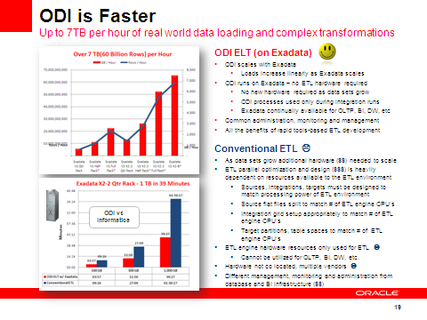
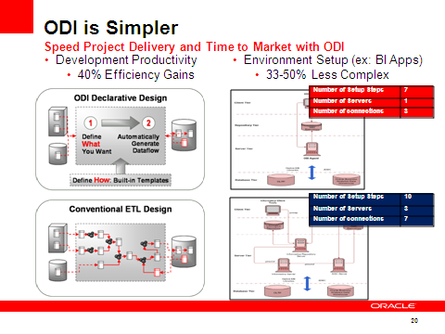
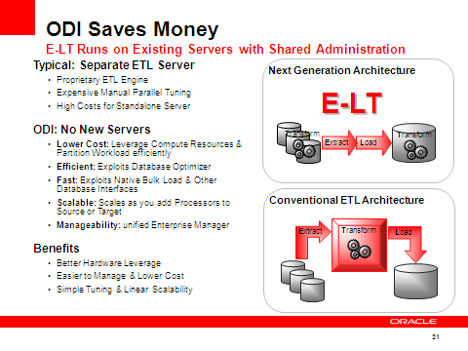
Why Does ODI Win?
ODI is Faster
Fastest E-LT Bulk/Batch Performance
Faster Real Time integration (sub-second trickle) with CDC, Replication, and SOA infrastructure
Faster Project Setup, Design and Delivery
ODI is Simpler
Simpler Setup, Configuration, Management, and Monitoring
Simpler way to do Mapping using Declarative SQL Interfaces
Simpler Deployment with Fewer Hardware Devices
Simpler extensibility with Knowledge Module code templates
ODI is Saves Money (Lower TCO, Higher ROI)
Less Hardware & Energy Costs with E-LT Architecture
Less Time Wasted on Unnecessary ETL Mappings, Scripting, and Complex Training
Less Integration Overhead Integrating with Applications, SOA, and Management Software
Notes:
Time and time again we work with customers that have prior investments in ETL tools or experience with manually scripting bulk data integration routines. For most customers, their awareness of ODI, and the key concepts of ODI, are brand new. So, naturally, people want to know how ODI is different than what they are familiar with.
First of all, ODI is the fastest ETL tool on the planet. For most typical data warehouse use cases, with modern data warehouse infrastructure, the scale and performance of ODI cannot be matched. ODI is the only data integration tool capable of a pure declarative, set-based data transformation technique – which yields the fastest results in the vast majority of use cases.
Secondly, ODI is the simplest product to get working with high performance straight out of the box. There are no expensive and time consuming optimizations that must be made for complex parallel processing in the middle tier servers. ODI doesn’t need a middle tier, and is vastly simpler because of that.
Finally and most importantly, ODI saves money. By getting warehouse projects done faster, customers get faster return on investment. By eliminating unnecessary hardware, capital costs are reduced. By simplifying the administration and maintenance, cost of ownership is reduced.
So why do customers choose ODI? Because it is faster, simpler and saves more money than any other alternatives…let’s see more.

Slide 8
ODI Saves Money
E-LT Runs on Existing Servers with Shared Administration
Typical: Separate ETL Server
  Proprietary ETL Engine
  Expensive Manual Parallel Tuning
  High Costs for Standalone Server
ODI: No New Servers
  Lower Cost: Leverage Compute Resources & Partition Workload efficiently
  Efficient: Exploits Database Optimizer
  Fast: Exploits Native Bulk Load & Other Database Interfaces
  Scalable: Scales as you add Processors to Source or Target
  Manageability: unified Enterprise Manager
Benefits
  Better Hardware Leverage
  Easier to Manage & Lower Cost
  Simple Tuning & Linear Scalability
Next Generation Architecture
E-LT
Transform
Transform
Extract
Load
Conventional ETL Architecture
Extract
Transform
Load
Notes:
We believe that ODI is the most cost-effective ETL tool on the planet.
ODI can save hardware costs on ETL servers. For large data warehouses requiring mission critical service levels, ETL servers can sometimes cost millions to procure, lease and maintain. Factor in additional incremental costs with systems administration and energy costs and the actual costs of ETL servers are even higher.
ODI can save manpower costs on tuning and optimization. While entry-level developers for conventional ETL tools are very easy to find, that is not true for expert level resources that can define end-to-end parallelism for demanding ETL deployments. Splitting source feeds, engine optimization, load optimization, push-down optimization etc can cost time and lots of money to get right with conventional ETL tools.
From the time a project is started with ODI, our customers are saving money. They get to production faster, using fewer resources, supplying better solution performance and lower long-term maintenance costs. What isn’t to like about that equation?

Slide 9
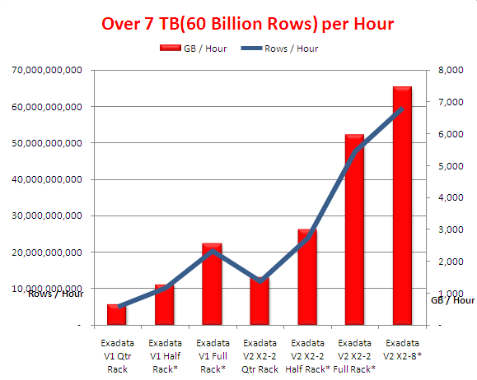
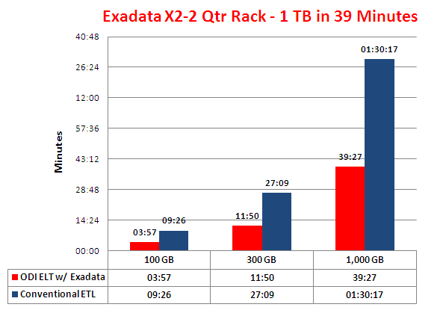
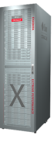
ODI is Faster
Up to 7TB per hour of real world data loading and complex transformations
ODI ELT (on Exadata/any DW)
ODI scales with the Database
  Loads increase linearly as DW scales
ODI runs on relational technologies – no ETL hardware required
  No new hardware required as data sets grow
  ODI processes used only during integration runs
  Databases continually available for OLTP, BI, DW, etc
Common administration, monitoring and management
All the benefits of rapid tools-based ETL development
Conventional ETL
As data sets grow, more hardware ($$) needed to scale
ETL parallel optimization and design ($$$) is heavily dependent on resources available to the ETL environment
  Sources, integrations, targets must be designed to match processing power of ETL environment
  Source flat files split to match # of ETL engine CPU’s
  Integration grid setup appropriately to match # of ETL engine CPU’s
  Target partitions, table spaces to match # of ETL engine CPU’s
ETL engine hardware resources only used for ETL
  Cannot be utilized for OLTP, BI, DW, etc.
Hardware not co located, multiple vendors
Different management, monitoring and administration from database and BI infrastructure ($$)
Notes:
We believe ODI is the fastest ETL tool on the planet.
For most typical data warehouse use cases, with modern data warehouse infrastructure, the scale and performance of ODI cannot be matched. ODI is the only data integration tool capable of a pure declarative, set-based data transformation technique – which yields the fastest results in the vast majority of use cases.
Oracle has benchmarked ODI running on Exadata systems, and we see up to 7 terabytes per hour using real-world TPC-H data and complex data transformations. No other ETL tools can even come close. For most conventional ETL tools to even scale into the 100’s of gigabytes range, they required massive hardware investments whereas ODI requires none.
A recent benchmark from a conventional ETL vendor using the same TPC-H data sets yielded only 750GB in an hour, this is an order of magnitude difference in favor of ODI.
Clearly ODI is better at high performance, but ODI is also much easier to setup to achieve high performance. Conventional ETL tools require laborious tuning of Source extracts and parallel threaded processing to achieve their scalability. ODI just works with the out-of-box knowledge modules and very little special tuning is required whether ODI is running on a 4 CPU Oracle Database or the high-end Oracle Exadata X2-8 system.

Slide 10
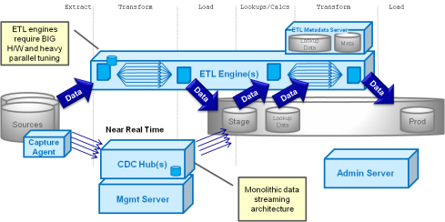
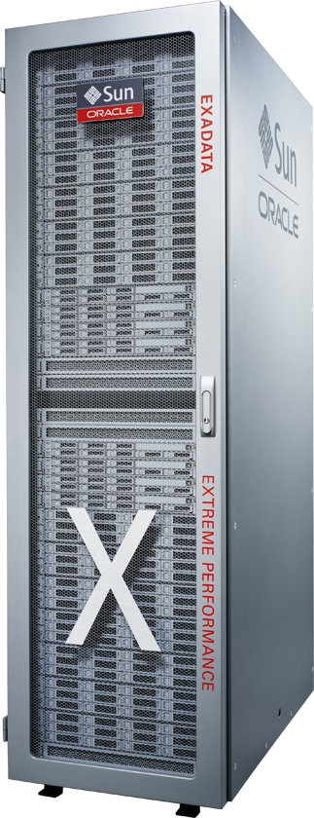
“Old Style” ETL
Monolithic & Expensive Environments
Fragile, Hard to Manage
Difficult to Tune or Optimize
Development, QA, System (etc) Environments
Extract Transform Load Lookups/Calcs Transform Load
ETL engines require BIG H/W and heavy parallel tuning
ETL Metadata Server
Lookup Data
Meta
ETL Engine(s)
Data
Data
Data
Data
Data
Sources
Stage
Lookup Data
Prod
Near Real Time
Capture Agent
CDC Hub(s)
Admin Server
Monolithic data streaming architecture
Mgmt Server

Slide 11
Modern Data Integration
Lightweight, Inexpensive Environments – Agents
Resilient, Easy to Manage – Non-Invasive
Easy to Optimize and Tune – uses DBMS power
Extract Transform Load Lookups/Calcs Transform Load
Set-based SQL transforms typically faster
SQL Load inside DB is always faster
ODI
Sources
Bulk Data Movement
Stage
Lookup Data
Data Transformation
Prod
Near Real Time
OGG
OGG
Flexible options for real time data streams
True Real Time
Set-based SQL transforms typically faster

Slide 12
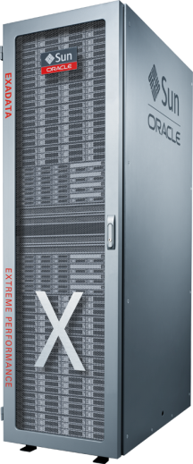
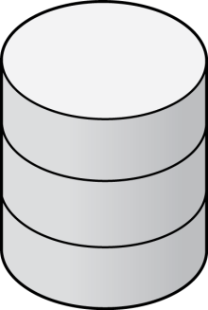
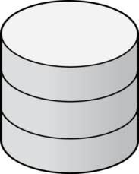
Best Data Integration for Exadata
Top Performance, Smallest Footprint
Run ODI, EDQ & OGG Directly on Exadata
Support Any Latency Data Feeds
Non-Invasive Source Capture
Most Cost-Effective and High-Performance Exadata Data Loading
Oracle
GoldenGate
Oracle
Data Integrator
Oracle
Enterprise DQ
tx4
tx3
tx2
tx1
Non-Invasive Real Time Transaction Feeds
DIM
DIM
EMP
DEPT
Batch Feeds, Incremental Updates and in-DB transformations via ELT
FACT
EMP
12
DEPT
DIM
DIM
Notes:
Oracle data integration products are designed and engineered to work with Exadata. Only Oracle supplies best-of-breed data integration tools that install on exadata, are certified and benchmarked with exadata, and are engineered to take advantage of the powerful innovations that Exadata brings to bear.
For the full data integration solution, Oracle Data Integrator and Oracle GoldenGate can be combined with Oracle Data Quality, Oracle Data Profiling, and Oracle Active Data Guard to ensure that the Exadata solution is fully future-proof, optimized for the best performance, and simplified for the most cost-efficient operations.

Slide 13
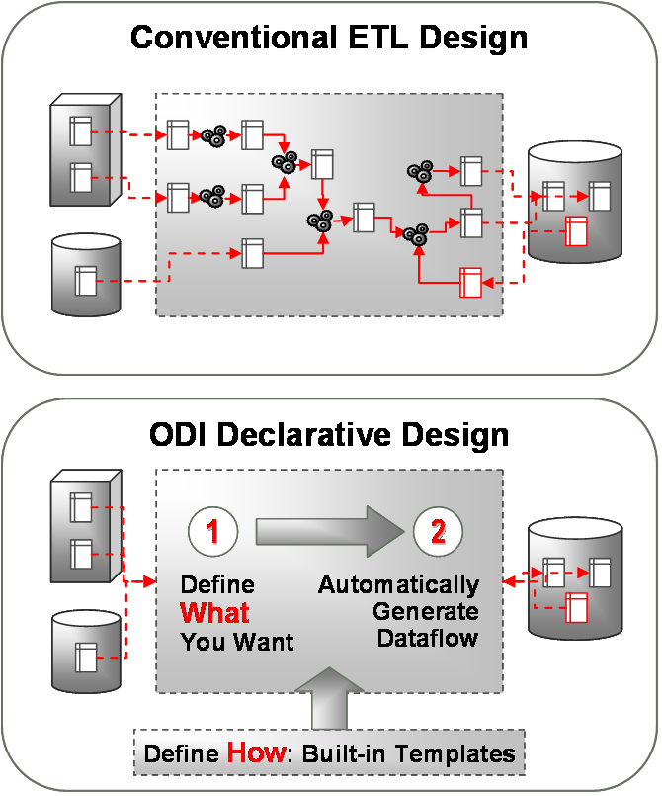
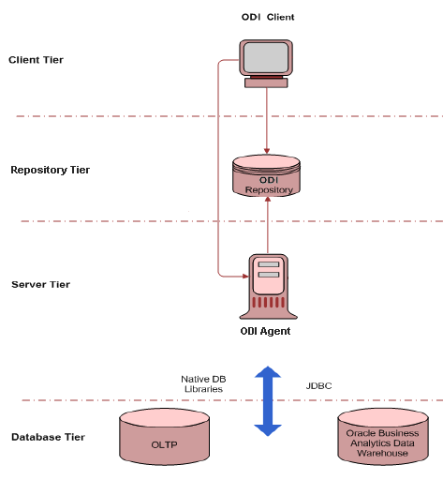
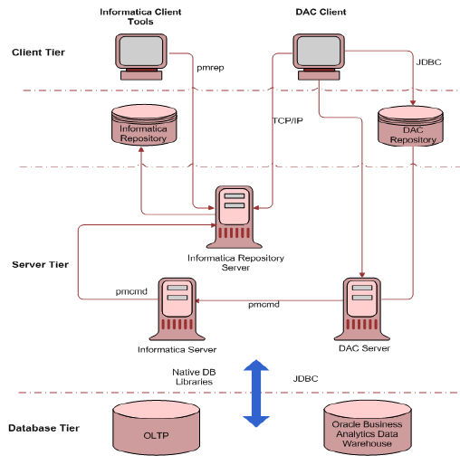
ODI is Simpler
Speed Project Delivery and Time to Market with ODI
Development Productivity
  40% Efficiency Gains
Environment Setup (ex: BI Apps)
  33-50% Less Complex
Number of Setup Steps | 7
Number of Servers | 1
Number of connections | 3
Number of Setup Steps | 10
Number of Servers | 3
Number of connections | 7
Notes:
We believe ODI is the easiest to use ETL tool on the planet.
ODI enables ETL developers to be much more efficient in their ETL projects. Because ODI uses set-based SQL (for the performance benefits), the mapping and transformation design can be defined more declaratively than conventional ETL tools that use procedural transformation logic – after all, SQL itself is the quintessential declarative programming language.
But beyond the theory for why it works, ODI is just easier to do development with. Oracle customers, industry analysts and independent reviews of ODI all confirm that it is very easy to get started with even the most complicated data warehouse ETL jobs.
Likewise, ODI gives the simplest production deployment architecture of any ETL tool.
Since ODI doesn’t require dedicated servers or complex architectures for scaling out, ODI can give the highest performance with the smallest footprint in the datacenter. In Oracle’s own replacement of Informatica in the Oracle Business Intelligence Analytic Applications, we have reduced the setup steps and deployment complexity by 50% These savings are passed directly to Oracle customers, and any ODI customer can experience the same results compared to conventional ETL tools like Informatica or IBM DataStage.

Slide 14
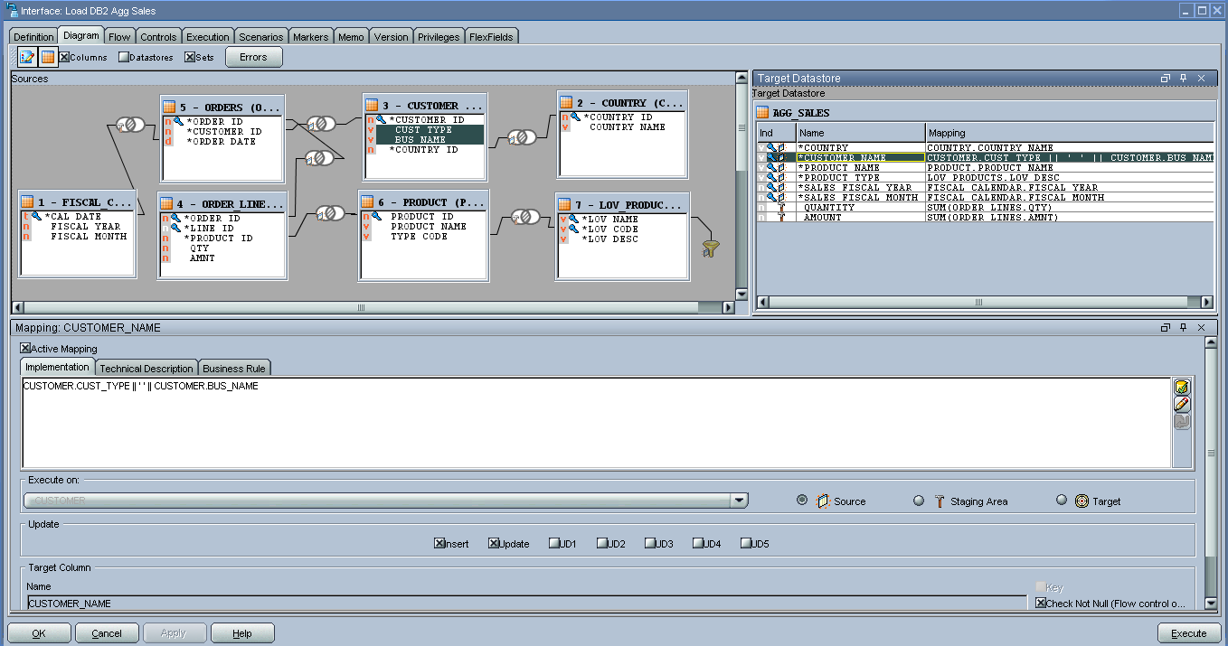
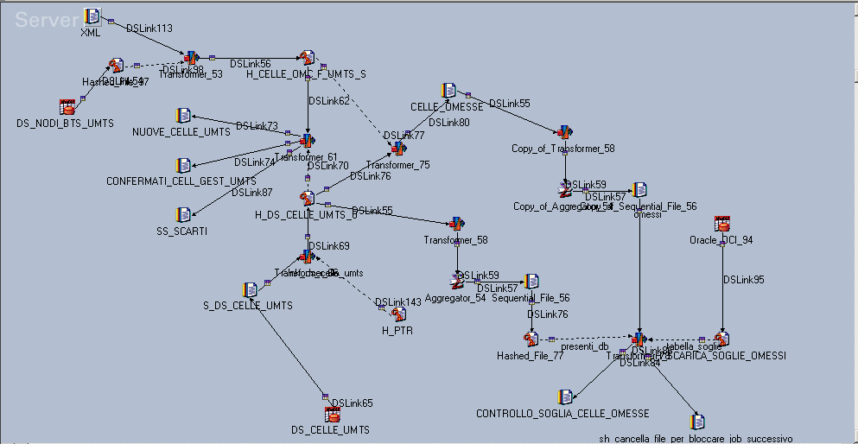
Traditional procedural ETL
Traditional ETL row to row complexity
One or a related group
of flow-based procedural ETL
Mappings – first sample
One declarative ODI interface plus
selection among existing Knowledge Modules
One or a related group
of flow-based procedural ETL
Mappings - second sample

Slide 15
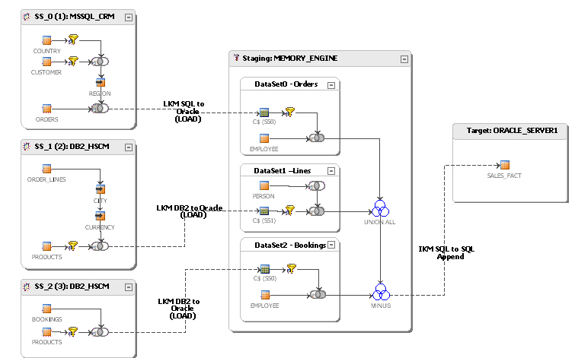
Traditional procedural ETL
Traditional ETL row to row complexity
One or a related group
of flow-based procedural ETL
Mappings – first sample
Flow Generation is AUTOMATIC, written by ODI directly!

Slide 16
Topology Module on ODI
You describe how the relational infrastructure where ODI works is done
ODI builds the flow for a specific loading automatically!
Topology module allows to describe all the information on the technology where the ELT projects work, starting from specific definition on the technologies that are used, going to physical description on how to access a server, wich user and password to enter, which schema users or database are involved in the jobs. The final developer will have only a logical reference to the servers

Slide 17
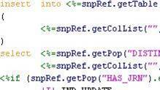
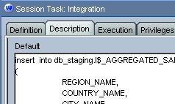
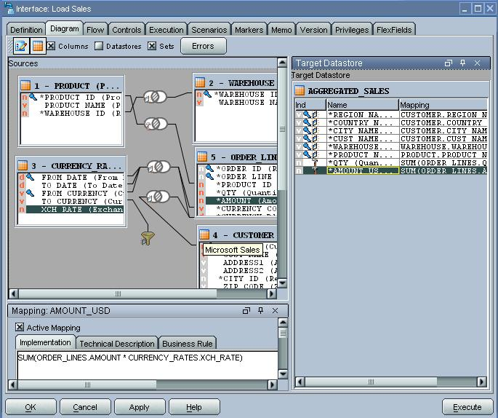
Declarative mapping + Knowledge Modules = Generated Code
KM’s Meta Code
120+ KMs out-of-the-box
  Tailor to existing best practices
  Ease administration work
  Reduce cost of ownership
Customizable and extensible
Executed Code
KM
Interpreter
Metadata
Siebel
Oracle SQL*Loader
Type II SCD
Oracle Merge
DB2 Exp/Imp
JMS Queues
SAP/R3
TPump/ Multiload
Oracle Web Services
Pluggable Knowledge Modules Architecture
Reverse
Engineer Metadata
Journalize
Read from CDC Source
Load
From Sources to Staging
Check
Constraints before Load
Integrate
Transform and Move to Targets
Service
Expose Data and Transformation Services
Reverse
WS
WS
WS
Load
Staging Tables
Integrate
CDC
Services
Journalize
Check
Target Tables
Sources
Error Tables

Slide 18
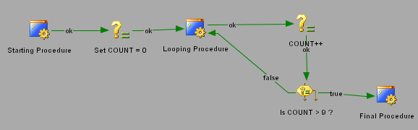
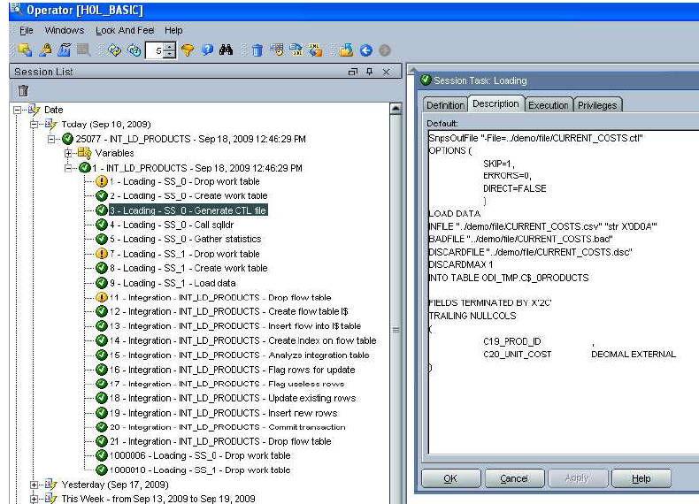
Jobs, auditing
Technical and business metadata: ability to manage in a unique and centralized way jobs, their transformation, schedulings, data definition language etc.
Central Monitoring and Logging: verifying the execution of jobs
Graphical environment allows to describe job complex as needed, created putting together simple steps like the declarative design
ELT Agent writes back on the repository the auditing offor the job executions, giving information on generated code, warnings and database errors that can eventually occur

Slide 19
Oracle Data Integration
The solution for enterprise-wide real-time data
Databases
Mission critical systems and data
Distributed systems
Oracle Golden Gate
Business Intelligence, Performance Management
Legacy systems
ODI EE
Data Warehouses,
MDM
OLAP systems
Enterprise Data Quality
OLTP systems
SOA
Dramatically improve the accessibility, reliability, and
quality of critical data across enterprise systems
Notes:
At Oracle we have taken the three requirements for access, real-time and quality and made them a cornerstone of our data integration strategy. It’s important to be able to manage information across these multiple paradigms (databases, distributed systems, legacy, OLAP, and OLTP) and get them to where they need to go: the mission critical systems that rely on the data, the business intelligence and performance Management systems that need the data for insight and finally for customers, partners that need this information either for reporting or other purposes.
By consolidating these three factors into an integrated solution we can dramatically improve the accessibility, reliability and quality of not just data, but the data you rely on for your business.
19
11/15/2012 11:22 AM
Hasan Rizvi

Slide 20
Oracle GoldenGate Overview
Oracle GoldenGate provides low-impact capture, routing, transformation, and delivery of transactional data across heterogeneous environments in real time
Key Differentiators:
Performance
Non-intrusive, low-impact, sub-second latency
Flexible and Extensible
Open, modular architecture - Supports heterogeneous sources and targets
Reliable
Maintains transactional integrity - Resilient against interruptions and failures
Notes:
20
We discussed Oracle GoldenGate in previous sessions. Oracle GoldenGate offers a heterogeneous data replication solution that is transaction aware. It moves committed transactions from redo logs and maintains transaction integrity. Just as a reminder GoldenGate is built for moving data non-intrusively between heterogeneous systems in sub-seconds. Its reliability is especially critical for enabling continuous availability solutions. As we mentioned earlier this software is used to keep mission critical systems of leading Fortune 500 companies and it is designed for reliable data delivery.

Slide 21


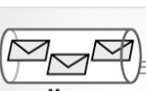


Oracle GoldenGate Use Cases
Enterprise-wide Solution for Real Time Data Needs
Zero Downtime Migration and Upgrades
New DB/
OS/HW/App
Active-Active High
Availability
Fully Active
Distributed Database
Reduce Costs
Lower Risks
Achieve Operational Excellence
Log Based, Real-Time Change Data Capture
Query Offloading
Reporting
Database
Oracle
GoldenGate
ETL
ODS
EDW
ETL
Heterogeneous Source Systems
Real-time BI
EDW
Data Distribution
Global Data Centers
SOA/EDA
Notes:
Oracle GoldenGate is a very multipurpose technology as you can see here. It can be deployed for feeding analytical systems with real time change data but also offer continuous data availability by synchronizing standby systems or new hardware/db/os environments companies want to migrate to. It can synchronize data across distributed systems in different continents for real-time data sharing and has the ability to publish changed data to JMS based messaging systems with its non invasive log based change data capture . With version 11g it can also capture real time data from messaging systems.
You can capture once from the source system and move to multiple targets for different needs without impacting the performance of the source system.
Companies can standardize on Oracle GoldenGate for any real-time data movement needs. With its fast and easy deployment and low impact on the IT infrastrcuture it certainly brings savings in cost of ownership
21

Slide 22
Advantages of Oracle GoldenGate Architecture
Reduced Overhead and TCO
Captures once, delivers to many targets for different uses
High Performance with Reliability
Subsecond latency even with high data volumes
Non-invasive, log-based capture
Moves only committed data, reduces bandwidth needs
Preserves transaction integrity
Flexibility and Ease of Use
Provides decoupled, modular architecture
Supports heterogeneous sources and targets, and different latency needs
Coexists and integrates with ELT/ETL and messaging solutions
Ensures data recoverability
Notes:
22
22
22
We covered various benefits of RTBI with Oracle. Let me summarize them here
One major and popular benefit we see from our customers is cost reduction. By moving only change data without burdening the source systems it frees up CPU resources and reduces network overhead
GoldenGate's ease of use and ODI EE packaged integration to wellknown applications helps shorten implementation times
Eliminating performance impact, improving data recoverability and integrating data quality helps with reducing risks and ensuring optimal performance and business continuity.
And as mentioned with several examples before, realtime BI enables near real time decision making, Oracle also allows to combine real-time data with historical information for better business insights and decision making.
Move only the changed data from redo logs and reduce source and network overhead
Shorten implementation times from months to weeks using pre-packaged integrations to well-known applications, sources and targets.
Eliminate performance impact on source systems
Reduce the risk of missed orders, poor customer interactions, missed opportunities through improved recoverability, data quality

Slide 23


How Oracle GoldenGate Works
Capture: committed transactions are captured (and can be filtered) as they occur by reading the transaction logs.
Capture
LAN/WAN
Internet
Source
Oracle & Non-Oracle
Database(s)
Target
Oracle & Non-Oracle
Database(s)
Notes:
23
Let’s take a deeper look how GG works. As I mentioned, GG moves data between heterogeneous databases, as shown here. It does not have to Oracle. The software operates at the database level and the capture component is typically installed on the source database server outside of the DBMS. GoldenGate’s CAPTURE reads native transaction logs and captures transactions as soon as they commit and takes outside of the database system to be queued. It only moves changed, committed transactional data– therefore operates with extremely high performance and very low impact .
It allows filtering at table, column and/or row level and row-level transformations can be applied at this capture stage or later when delivering.

Slide 24
How Oracle GoldenGate Works
Capture: committed transactions are captured (and can be filtered) as they occur by reading the transaction logs.
Trail: stages and queues data for routing.
Trail
Capture
LAN/WAN
Internet
Source
Oracle & Non-Oracle
Database(s)
Target
Oracle & Non-Oracle
Database(s)
Notes:
24
After the capture GoldenGate converts the committed transactions into a universal data format in “trail” files. Using source and target trail files, it eliminates any single point of failure and ensures data integrity is maintained – even in the event of a system error or outage.

Slide 25
How Oracle GoldenGate Works
Capture: committed transactions are captured (and can be filtered) as they occur by reading the transaction logs.
Trail: stages and queues data for routing.
Pump: distributes data for routing to target(s).
Trail
Capture
Pump
LAN/WAN
Internet
Source
Oracle & Non-Oracle
Database(s)
Target
Oracle & Non-Oracle
Database(s)
Notes:
25
Another Capture component can be use to pump the data to multiple targets and for better recoverability. This configuration enhances the fault tolerance and reliability of the overall GoldenGate environment. In the event of a network failure (between the source and the target systems), the GoldenGate Capture component can continue to capture transactions since the data can be queued up locally in the Trail Files on the source, enhancing the recoverability in case of database failures.
This is NOT the database feature called Data Pump.

Slide 26
How Oracle GoldenGate Works
Capture: committed transactions are captured (and can be filtered) as they occur by reading the transaction logs.
Trail: stages and queues data for routing.
Pump: distributes data for routing to target(s).
Route: data is compressed, encrypted for routing to target(s).
Trail
Trail
Capture
Pump
LAN/WAN
Internet
TCP/IP
Source
Oracle & Non-Oracle
Database(s)
Target
Oracle & Non-Oracle
Database(s)
Notes:
26
From the trail files the data is routed via TCP/IP to the target systems. During routing Data compression and encryption can be applied and thousands of transactions can be moved per second, without any distance limitations.

Slide 27
How Oracle GoldenGate Works
Capture: committed transactions are captured (and can be filtered) as they occur by reading the transaction logs.
Trail: stages and queues data for routing.
Pump: distributes data for routing to target(s).
Route: data is compressed, encrypted for routing to target(s).
Delivery: applies data with transaction integrity, transforming the data as required.
Trail
Trail
Capture
Pump
Delivery
LAN/WAN
Internet
TCP/IP
Source
Oracle & Non-Oracle
Database(s)
Target
Oracle & Non-Oracle
Database(s)
Notes:
27
The other key component of GoldenGate is the Delivery module that is installed on the target database server. Qeued Transactions that are stored in the trail files are applied to target using native SQL calls
Basic transformations at the row level can be applied if desired at delivery or capture.

Slide 28
How Oracle GoldenGate Works
Capture: committed transactions are captured (and can be filtered) as they occur by reading the transaction logs.
Trail: stages and queues data for routing.
Pump: distributes data for routing to target(s).
Route: data is compressed, encrypted for routing to target(s).
Delivery: applies data with transaction integrity, transforming the data as required.
Trail
Trail
Capture
Pump
Delivery
LAN/WAN
Internet
TCP/IP
Source
Oracle & Non-Oracle
Database(s)
Target
Oracle & Non-Oracle
Database(s)
Bi-directional
Notes:
28
The other key component of GoldenGate is the Delivery module that is installed on the target database server. Qeued Transactions that are stored in the trail files are applied to target using native SQL calls
Basic transformations at the row level can be applied if desired at delivery or capture.

Slide 29



GoldenGate Checkpointing
Capture, Pump, and Delivery save positions to a checkpoint file so they can recover in case of failure
Begin, TX 1
Start of Oldest Open (Uncommitted) Transaction
Insert, TX 1
Begin, TX 2
Begin, TX 2
Pump Checkpoint
Begin, TX 2
Delivery Checkpoint
Update, TX 1
Insert, TX 2
Insert, TX 2
Insert, TX 2
Commit, TX 2
Commit, TX 2
Commit, TX 2
Capture Checkpoint
Begin, TX 3
Current Read Position
Current Write Position
Current Read Position
Begin, TX 3
Insert, TX 3
Insert, TX 3
Commit, TX 3
Begin, TX 4
Current Write Position
Commit, TX 3
Delete, TX 4
Current Read Position
Capture
Commit Ordered Source Trail
Pump
Commit Ordered Target Trail
Delivery
Source
Database
Target
Database
Notes:
Checkpoints are used during online change synchronization to store the current read and write position of a process. Checkpoints ensure that data changes marked for synchronization are extracted, and they prevent redundant extractions. They provide fault tolerance by preventing the loss of data should the system, the network, or a GoldenGate process need to be restarted.
29

Slide 30




GoldenGate – Scaling for Performance
Capture / Extract
Delivery / Replicat
Trail

Slide 31
Zero Downtime Oracle Upgrade Implementation Steps:
Example of 9i → 11g Cross-Platform
9i Solaris
Oracle GoldenGate Capture
1
2,
5
4
7
11g
Linux
Detect collision
3
6
Start Oracle GoldenGate Capture module
- 4. Initial loading, export import of a new 11g target db (ELT/flat files/jdbc/native db loaders/import export tablespaces etc.)
5. Start Oracle GoldenGate Delivery module at target
6. Start Oracle GoldenGate’s Capture at 11g
7. Start Oracle GoldenGate’s Delivery process 9i (old source, contingency)

Slide 32
Oracle GoldenGate 11g: Heterogeneity
Databases | O/S and Platforms
Oracle GoldenGate Capture: Oracle DB2 for v 9.7 Microsoft SQL Server Sybase ASE Teradata Enscribe SQL/MP SQL/MX MySQL JMS message queues Oracle GoldenGate Delivery: All listed above, plus: TimesTen, DB2 for iSeries Exadata, Netezza, Greenplum, and HP Neoview | Linux Sun Solaris Windows 2000, 2003, XP HP NonStop HP-UX HP OpenVMS IBM AIX IBM z Series zLinux
NEW
NEW
NEW
NEW
Notes:
GoldenGate is ideal for heterogeneous environments – not just supporting different versions of the same database or operation system/hardware, but replicating and integrating data across vendor systems.
We support log-based Capture of changed data from nearly all major database vendors.
We can Deliver that data to an even wider range of targets – including open source databases, several data warehouse appliances, ETL servers, and JMS message queues to support Service Oriented Architectures (SOA) and Event-Driven Architectures (EDA).

Slide 33

Customer Example: Zero Downtime Migration eDialog
Goals
24x7x365 provider of advanced e-mail and multichannel marketing solutions to business worldwide helping marketers transform conversations into conversions.
Ensure absolute business continuity when migrating data to a new data infrastructure
Solution
Oracle Exadata as the foundation for new data infrastructure that ensures continuous high-performance marketing services and campaign analysis.
Used GoldenGate for a phased migration with more than 12 terabytes of data from heterogeneous legacy environments
Return on Investment
Completed the phased migration in six months
Gained the ability to complete the migration in phases, enabling e-Dialog to test the new environment over time
Reduced downtime during the massive migration effort
Improved throughput by 50% and cut report generation time in half
Notes:
33
I want to give couple of customer examples to illustrate how Oracle Data Integration products support migration to Exadata and private database clouds.
eDialog is an software as a service providers for advanced email and multichannel marketing solutions. They decided to migrate to Exadata as the foundation for their new data infrastructure to scale better and cost efficiently. For migration to Exadata they selected Oracle GoldenGate as their SaaS platform could not tolerate any downtime . Oracle GoldenGate provided a phased migration option where it synchronized the old databases with Exadata for 6 months and was able to test the new environment during this time very thoroughly.
By leveraging Exadata as their new platform the were able to improve their performance by 50% and cut report generation time for customers in half.

Slide 34

Customer Example: Real-Time DW on Exadata
AVEA
Goals
Supporting campaigns management with timely customer information
Reducing batch windows while data increases and improving the performance of ETL and reporting
Solution
GoldenGate feeds real-time data from CRM, Billing and other key systems to ODS
ODI extracts from the ODS and loads near real-time data to Exadata DW
New solution replaced IBM Infosphere Data Stage
OBI EE is used for real-time reporting
Return on Investment
Access to timely data for customer segmentation in the Siebel CRM campaign management system
Batch window for the DW decreased by 50%
Number of reports generated from the DW has increased by 10 times
Notes:
34
At RIM, Manufacturing is a multi-step process that can take place in different geographic locations
Each plant needs to accommodate new device production and capacity depending on the overall load of all manufacturing plants
Each region requires full access to all information recorded at each stage in the manufacturing process
New product testing information should be shared with different regions to support global manufacturing
Manufacturing systems need 24x7 availability to support global operations
They also rely on partners for high % of MFG
RIM decided to rely on Oracle GoldenGate for meeting its data distribution and availability challenges. And chose Oracle GoldenGate for its real-time data integration solution and its ability to build active active database configurations which in turn allows to distribute transactions across multiple dbs around the world.. Oracle GoldenGate was chosen for its great performance even with high volumes and preserves data integrity once the tables are loaded. Its heterogeneity was a major reason because they have different db and hardware vendors in their environment like many other major companies.
RIM implemented 4 different solutions with Oracle GoldenGate, which I will describe shortly.
5 – Way multi-master replication for availability and data access between data hubs across the globe to support manufacturing process
QA Reporting for Statistical / Analytical reporting offloaded from production servers by accessing the archive logs on the standby systems (instead of the online logs on the primary systems)
Streaming from Production databases to Exadata for reporting of quality assurance QA processes
Migration from single to 2 Node RAC was also a major project for RIM

Slide 35


Slide 36


Slide 40
GoldenGate: Key Architecture Highlights
Distributed Loosely Coupled Process Based Architecture
Non - Quiesced Instantiation
Heterogeneous Initial Load
Customization: User Exits, SQL callouts, Macros
Asynchronous Change Propagation
  Committed Transactions Only
  DML, Metadata, DDL
Universal Trail Format
  Interoperable across Heterogeneous Systems
Data Transformation Rules and Filtering (table, row, column)
Batched Operations, Transactions

Slide 41
OGG Initial Loading Methods
Can use GoldenGate methods:
  Oracle GoldenGate Indirect Load- writes to trails and loads to target when ready
  Oracle GoldenGate Direct Load - loads directly without trails
  Oracle GoldenGate Direct Bulk Load (Oracle target) - uses SQL*Loader API
Or database-specific methods like:
  Backup/Restore
  Export/Import
  SQL scripts
  Break mirror
  Transportable tablespaces (Oracle)
Notes:
  Run a test initial load early on for timing and sizing
  Run the actual initial load after starting change capture on the source

Slide 42
Column Mapping – Building History
This example uses special values to build history of operations data
INSERTALLRECORDS
MAP SALES.ACCOUNT, TARGET REPORT.ACCTHISTORY,
COLMAP (USEDEFAULTS,
TRAN_TIME = @GETENV(“GGHEADER”,”COMMITTIMESTAMP”),
OP_TYPE = @GETENV(“GGHEADER”, “OPTYPE”),
BEFORE_AFTER_IND = @GETENV(“GGHEADER”,
“BEFOREAFTERINDICATOR”),
);
Notes:
42
INSERTALLRECORDS causes Replicat to insert every change operation made to a record as a new record in the database. The initial insert and subsequent updates and deletes are maintained as point-in-time snapshots.
COLMAP uses the @GETENV function to get historical data from the GoldenGate trail header – TRAN_TIME picks up the commit timestamp for the date of the transaction; OP_TYPE stores whether it is an insert, update, or delete operation; and BEFORE_AFTER_IND indicates whether it is storing a “before” or “after” image.

Slide 43
Oracle GoldenGate
Configuration Examples
Notes:
43

Slide 44
GoldenGate Capture Configuration
EXTRACT eoraks1
USERID gg_user, PASSWORD AACAAAAA, encryptkey default
EXTTRAIL ./dirdat/ks
TABLE ollie.tcustmer;
TABLE ollie.tcustord;
TABLE ollie.a*;

Slide 45
GoldenGate Pump Configuration
EXTRACT poraks1
PASSTHRU
RMTHOST mytarget, PORT 7809
EXTTRAIL ./dirdat/ks
TABLE ollie.*;

Slide 46
GoldenGate Delivery Configuration
REPLICAT roraks1
USERID ggs2 PASSWORD hdsakhfdkjsfhiu
ASSUMETARGETDEFS
DISCARDFILE ./dirrpt/roraks1.dsc, PURGE
MAP ollie.tcustmer, TARGET ggs2.client;
MAP ollie.tcustord, TARGET ggs2.order;
MAP ollie.*, TARGET ggs2.*;

Slide 47

Functions - Examples
MAP SALES.ACCOUNT, TARGET REPORT.ACCOUNT,
COLMAP ( USEDEFAULTS,
TRANSACTION_DATE = @DATE (“YYYY-MM-DD”,
“YY”, YEAR,
“MM”, MONTH,
“DD”, DAY),
AREA_CODE = @STREXT (PHONE-NO, 1, 3),
PHONE_PREFIX = @STREXT (PHONE-NO, 4, 6),
PHONE_NUMBER = @STREXT (PHONE-NO, 7, 10) );
PHONE_NO = @STRCAT ("(", AREA_CODE,")", PHONE_PREFIX,"-", PHONE_NUMBER)
PRODUCT_CODE = @CASE (PRODUCT_CODE, “CAR”, “A car”, “TRUCK”, “A truck”)
ANNUAL_SALARY = @COMPUTE ( MONTHLY_SALARY * 12)
AMOUNT_COL = @IF (AMT > 0, AMT, 0)
Notes:
47
The example uses @DATE to derive the TRANSACTION_DATE by converting source date columns YEAR in the format YY, DAY in the format DD, and MONTH in the format MM to a target date with the format YYYY-MM-DD. The syntax for the @DATE function is:
@DATE (“<out descriptor>”, “<in descriptor>”, <source col>
[, “<in descriptor>”, <source col>]
[, ...])
The example uses @STREXT to extract portions of a string field into 3 different columns. It takes the first through the third characters from the source’s PHONE-NO to populate the target’s AREA_CODE, characters 4 through 6 for the PHONE_PREFIX, and 7 to 10 for the PHONE_NUMBER. The syntax for the @STREXT function is:
@STREXT (<column or literal string>, <begin position>, <end position>)

Slide 48

Differentiator: Heterogeneity
Oracle Capture
Capture
Support for Oracle RAC
Support for ASM
Support for index-organized tables (IOTs) with overflow
Support for clustered tables
Support for object tables
Support for object types (UDTs)
Support for DDL operations
Support for direct loads (append hint)
Archived log only (ALO) mode
Off-platform capture (LOGSOURCE)
Multi-threaded capture
Archived Log
Online Log
Capture
Commit Ordered Trail
OCI/Oracle Net

Slide 49

Differentiator: Heterogeneity
Microsoft SQL Server Capture
Capture
Ability to capture from native backups
Coexistence with SQL Server Replication
SQL Server Replication components are not required
Support tables with no unique key (not supported by SQL Server Replication)
Support for computed columns
Support for identity columns
Backups
Transaction Log
Capture
Commit Ordered Trail
ODBC

Slide 50

Differentiator: Heterogeneity
DB2 z/OS Capture
Capture
Runs under Unix System Services (USS)
Support for data sharing environments
Automatic EBCDIC/ASCII translation
Support for EBCDIC, ASCII, and Unicode encoded tables
Support for data compression (tablespace)
Archived Log
Online Log
IFI IFCID 0306
Unix System Services (USS)
Capture
Commit Ordered Trail
DB2 CLI

Slide 51

Differentiator: Heterogeneity
Teradata Capture
Teradata-provided access module (TAM)
TAM is a shared library dynamically linked at runtime
CDC runs on Relay Services Gateway (RSG) vprocs
Max protection mode and max performance mode
Full Unicode support for Windows and Linux
Support for DDL operations
Support for LOB and UDT datatypes
Support for identity datatypes
Replication Group
RSG
vproc
RSG
vproc
CDC
CDC
Capture
TAM
Capture
Unsorted Trail
Sort/Pump
Commit Ordered Trail
ODBC
Maximum Protection Mode

Slide 53
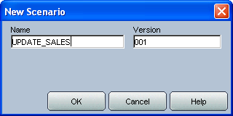
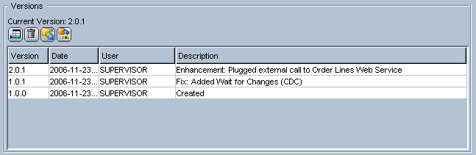
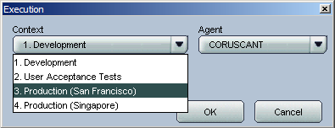
Versioning on ODI
Versioning on production jobs is mandatory!
You can define when to save and / or restore developement objects versions
Mandatory versioning on production objects is one of tthe most appreciated features since the first releases. It decouples completely development objects from production objects and it can follow the creation of whatever software lifecycle model with different environments of metadata (i.e: current level, current level +1, maintenance, hotfix, pre-production, production, post production metadata and so on)
ODI allows to choose the logical reference to the context of data environment where the job commands will run. ODI Agent is going to launch the deployments of commands directly during the run time execution phase

Slide 54
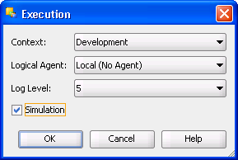
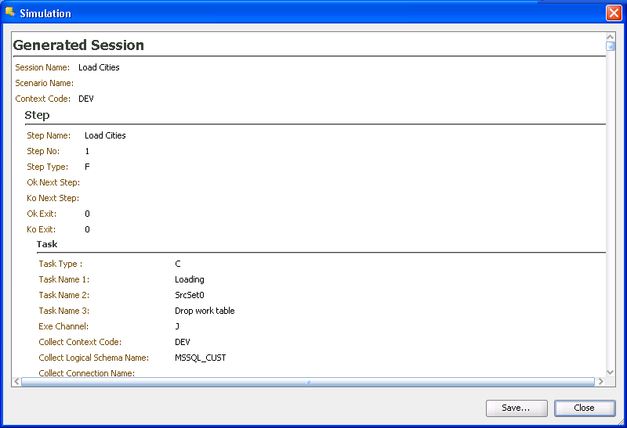
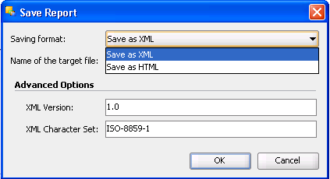
Code Simulation
Just shows generated code.

Slide 55
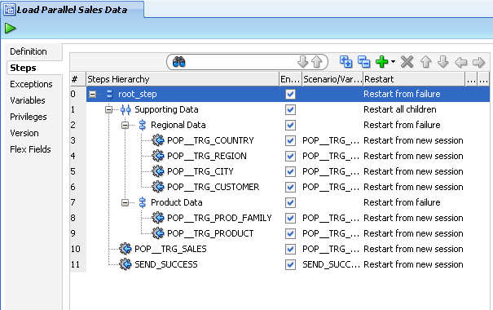
ODI Load Plans
Managing a lot of scenarios with complexity
It’s a new executable object in Oracle Data Integrator that can contain a hierarchy of steps
Load Plan steps can be executed conditionally, in parallel or in series
The leaves of this hierarchy are Scenarios
Packages, interfaces, variables, and procedures can be added to Load Plans for executions in the form of scenarios
Notes:
55

Slide 56
Introduction
What is the OBIEE Data Lineage?
Consolidates ODI metadata with OBIEE
Exposes this metadata in a report-to-source data lineage dashboard in OBIEE
Adds existing OBIEE reports links that allow tracking the origine of the report’s information:
  through the OBIEE RPD layers
  through the ODI integration processes
Notes:
56

Slide 57
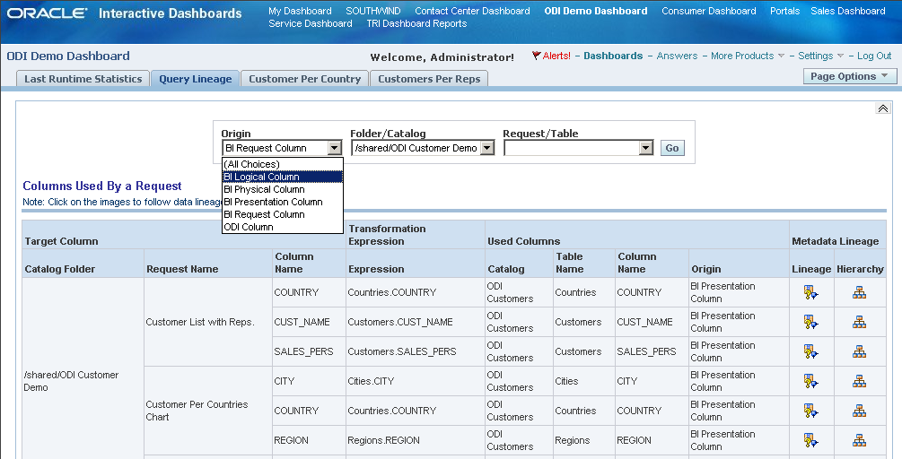
OBIEE Lineage
Lineage Query
Notes:
57

Slide 58
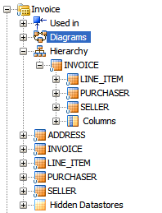
Complex File Processing
Seller
6335722^Company One^First Street 999 San Jose 95129USCA650-801-6250
^Oracle^Bridge Parkway 1600 Redwood Shores 94065USCA650-506-7000
001|Oracle Data Intagrator EE|20000,2,+40000+
002|Application Adapter for ODI|10000,5,+50000+
003|BPEL Process Manager Enterprise Edition|20000,2,+40000+
004|BPEL Process Manager Standard Edition|10000,5,+50000+
005|BPEL Process Manager Developer Edition|1000,20,+20000+#110000
Purchaser
Line Items
<schema attributeFormDefault="qualified"
...
<element name="invoice" type="tns:invoiceType" />
<complexType name="invoiceType">
<sequence>
<element name="purchaser" type="tns:partnerType" />
<element name="seller" type="tns:partnerType" />
<element name="line-item" type="tns:line-itemType"
...
</sequence>
</complexType>
...
Complex File Driver
Complex File Schema (nXSD) generated with Native Format Builder Wizard.
Supports Delimited, Fixed, Complex files, Cobol Copybooks.
Notes:
58

Slide 59



Mapping Logical and Physical Resources
Datawarehouse
(Logical Schema)
Agent
Logical Architecture
Direct deployment at run time!
Development
Contexts
Tokyo
Boston
Physical Architecture
Windows
Windows
Windows
MS SQL Server
MS SQL Server A
MS SQL Server
db_dwh
dwh
db_dwh
db_purchase
Development site: New York
Production site: Tokyo
Production site: Boston
Notes:
Let’s now illustrate the meaning of a context graphically using our example infrastructure.
Recall that we have data warehouses situated in New York, Tokyo and Boston. They have different names but share similar data structures.
At the logical architecture level, we have a single logical schema: “Datawarehouse”.
We have three contexts, however.
In the “Development” context, this logical schema is mapped onto the physical schema db_dwh at the New York site.
In the “Tokyo” context, it is mapped onto the physical schema dwh at the Tokyo site.
And similarly for the Boston site.

Slide 60
Respect any lifecycle for software generation
Security
Topology
Versioning
Create and archive versions of models, projects and scenarios
Import released and tested versions of scenarios for production
Master
Repository
Import released versions of models, projects and scenarios for testing
Models
Projects
Models
Execution
Execution
Projects
Work Repository
(Development)
Execution
Execution Repository
(Production)
Work Repository
(Test & QA)
Development – Test – Production Cycle
Notes:
This diagram gives an overview of a typical repository architecture where development, testing and production are carried out in separate work repositories. When the development team finishes working on certain projects, it releases them into the master repository. The testing team imports these released versions for testing in a separate work repository, thus allowing the development team to continue working on the next versions. When the test team successfully validates the developed items, the production team then exports executable versions (called scenarios) into the final production work repository.
This repository structure corresponds to a simple development-test-production cycle.

Slide 61
Oracle Data Integration
The solution for enterprise-wide real-time data
Databases
Mission critical systems and data
Distributed systems
Oracle Golden Gate
Business Intelligence, Performance Management
Legacy systems
ODI EE
Data Warehouses,
MDM
OLAP systems
Enterprise Data Quality
OLTP systems
SOA
Dramatically improve the accessibility, reliability, and
quality of critical data across enterprise systems
Notes:
At Oracle we have taken the three requirements for access, real-time and quality and made them a cornerstone of our data integration strategy. It’s important to be able to manage information across these multiple paradigms (databases, distributed systems, legacy, OLAP, and OLTP) and get them to where they need to go: the mission critical systems that rely on the data, the business intelligence and performance Management systems that need the data for insight and finally for customers, partners that need this information either for reporting or other purposes.
By consolidating these three factors into an integrated solution we can dramatically improve the accessibility, reliability and quality of not just data, but the data you rely on for your business.
61
11/15/2012 11:22 AM
Hasan Rizvi

Slide 62
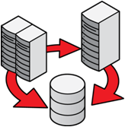
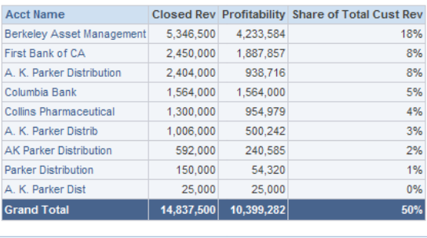

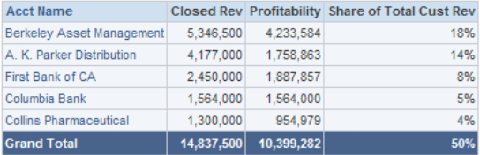
Next Gen Data Warehouse
Change data into valuable Information
The Business Issue
  BI Reports are not trustable, because of the state of source data
Reduce risks
  Improve data quality by integrating cleansing as part of the process
  Eliminate data redundancies
Improve Business Insights
  Improved business insight with improved data quality
  Better profiling of data to eliminate gaps in insight
Do not trust this information!
Profiling
Investigate
Cleansing
Standardize, Enrich, Match
Control
Govern over time

Slide 63
Typical Customer Data Problems
Missing, inconsistent, unstructured, mis-classified
Abbreviations
(often ambiguous)
Attributes non-standard, missing or invalid
Inconsistent formats
1
Widespread duplication (often hard
to spot)
2
3
7
5
3
6
4
6
4
6
8
1
Compound Names
5
Mis-Fielded Data
2
Embedded Additional Information
Erroneous Data
6
3
Mixed Business & Personal Names
International Date Formats
7
4
Multiple Names
Default or Dummy Data
8

Slide 64

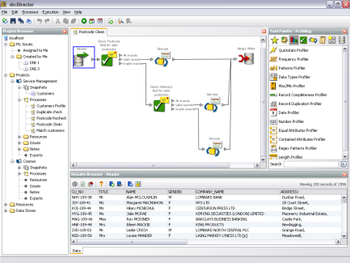
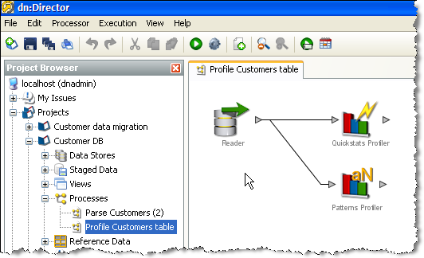
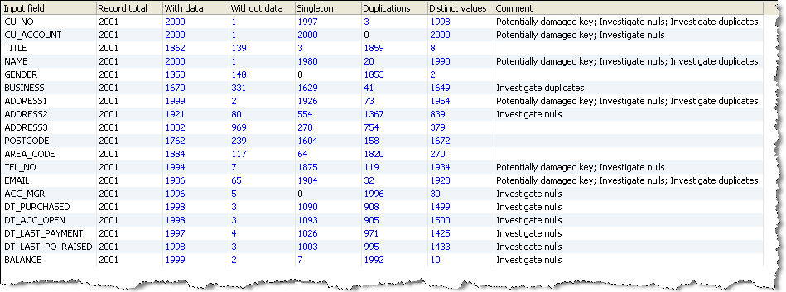
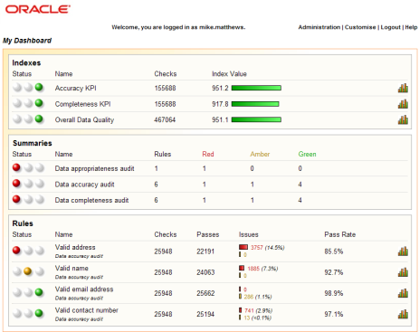
Health Check – Is Your Data “Fit for Purpose”?
Govern
Business & data standards
Your Data
Protect
Current issues, gaps, errors
Improve
Your Experts
Understand current data ‘fitness for purpose’
Estimate DQ impacts & ROI
Identify critical issues & quick wins
Understand

Slide 65
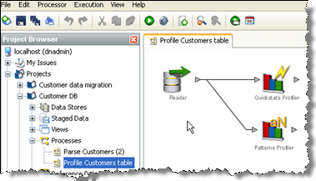
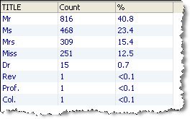
Profiling – Understand the data first
Interactive exploration of data, identifying distribution and outlying values with drill-downs
Identify and quantify issues in data

Slide 66
The Analysis
Six Dimensions of Data Quality
Completeness
Conformity
Consistency
Accuracy
Duplicates
Integrity
What data is missing or unusable?
What data is stored in a non-standard format?
What data values give conflicting information?
What data is incorrect or out of date?
What data records or attributes are repeated?
What data is missing or not referenced?

Slide 67
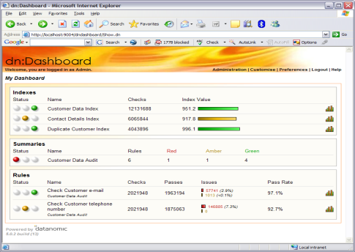
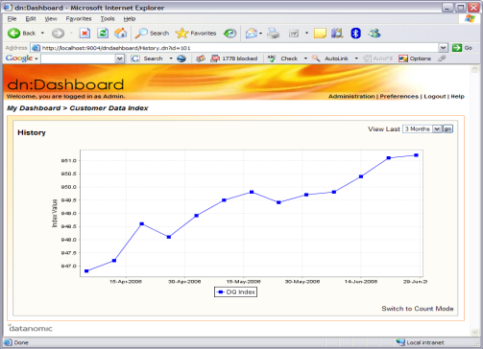
Improve Data, Improve App Performance
Parse/ extract
Enrich
Match/ merge
Govern
Stand-ardize
Verify
‘Gold’ data
Fit for purpose data
Protect
Metrics, KPIs
Improve
Apply data standards
Improve ROI and performance of existing applications
Engage users and executives
Bring data to a known, baseline quality – ready to roll-out new applications and initiatives
Understand

Slide 68

Oracle Enterprise Data Quality – Match
First: Bob
Last: Fulmar
Gender: Male
Email: chem291_rjf@barker.edu
Title: Mr
First: Robert
Last: Fulmar
Gender: Male
DoB: 12/05/1978
Phone: 555-120-1329
Address:
9405 Main St
Fairfax
Virginia
22030
Title: Dr
First: R
Last: Fulmer
DoB: 01/01/1978
Email: chem291_rjf@barker.edu
Address:
9407 Main Street
Fairfax
VA
22031-4001
Title: Dr
First: Robert
Last: Fulmar
Gender: Male
DoB: 12/05/1978
Email: chem291_rjf@barker.edu
Phone: 555-120-1329
Address:
9407 Main St
Fairfax
VA
22031-4001
Match & Merge data from disparate sources
Create the ‘best’ record
Match Individuals
Match Households
Match Businesses

Slide 69
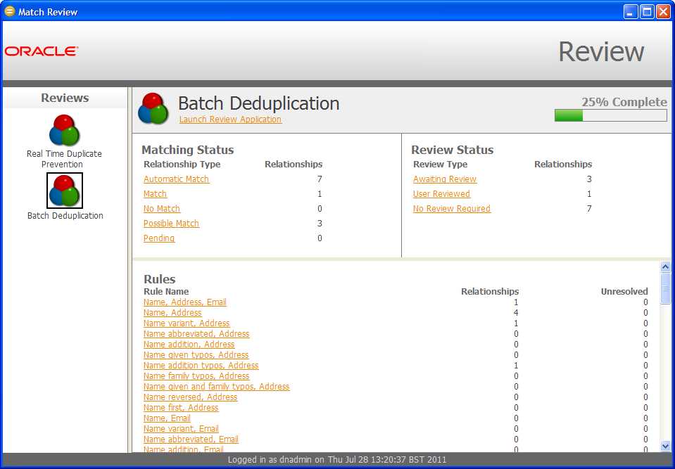
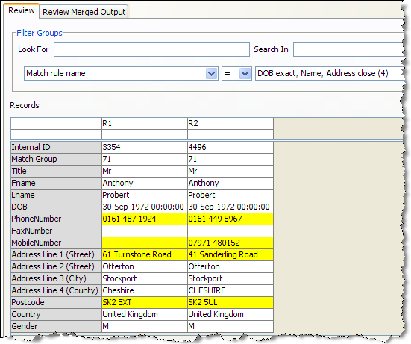


Match Review
Independent End User Review of Matches
Review Matching Records
Review Overview
Decision and Comment History
Manual Decisions
Configurable Decision Workflow
Full Audit Trail and Comments
Match / No Match Decisions Remembered

Slide 70




Parsing – Improve & Review data
Passed
Review color
Parse & classify
Passed & reviewed
records
Notes:
Parsing is another great capability of OEDQ. It works by using a pattern recognition technique, where each single token within a pattern is classified.
In this example you can notice how from a free text string (Vehicle), the parser is able to classify in the appropriate way each single token. Once the process is configured it is possible to route data in different flows like PASSED records and SUBJECT TO REVIEW records. Here records to be reviewed have the color a bit more detailed.
By fine tuning the parser it is possible of course to increase the precision, by adding rules able to interpret more complex string structures.
This is just an example of what OEDQ can do in several use cases. These capabilities can be combined for instance in combination with BIG DATA approaches.

Slide 71
Oracle Enterprise Data Quality – Clean
Name: Dr Ellen Van Der Heijde
Name: Mr RJ & Mrs FB MacDonald
Name: Jalila Abdul-Alim (Do Not Call)
Title: Dr
First: Ellen
Last: Van Der Heijde
Gender: Female
Title: Mr
First: R
Middle: J
Last: MacDonald
Gender: Male
Title: Mrs
First: F
Middle: B
Last: MacDonald
Gender: Female
First: Jalila
Last: Abdul-Alim
Gender: Female
Note: Do Not Call
Standardize, Transform and Parse
Split names and name elements
Identify individuals and businesses
Derive additional attributes
Name: Ms April James DBA AJ Designs
Title: Ms
First: April
Last: James
Gender: Female
Company: AJ Designs
Not just names but any data such as addresses, dates & phone numbers

Slide 72

‘DQ Firewall’ – Continuous Protection for Information Assets
External sources/ feeds
Govern
Hub
Data Integration/ETL
Non-DQ-aware Apps
Protect
DQ-aware Apps
Web service call
Improve
Apply data standards/validate
Understand
Continuous, consistent enforcement of standards
High quality data drives ROI
No more DQ projects!

Slide 73
DQ Governance – Continuous Process Improvement
Source system DQ metrics
Govern
DQ process metrics
Protect
‘Gold’ data
Apply data standards
Target system DQ metrics
Improve
Understand
Monitor ongoing effectiveness
Track and resolve issues
Improve overall effectiveness

Slide 74



Built for the Business User *
Short learning curve & time-to-value
Solution for owners of the business problem
Integrated team collaboration

Slide 75
Oracle Data Integration Solution Topologies
Unidirectional Query Offloading
Bi-Directional
Live Standby or
Active-Active for HA
Peer-to-Peer
Load Balancing,
Multi-Master
Broadcast
Data Distribution
Integration/Consolidation
Data Warehouse
Cascading
Data Marts
Notes:
GoldenGate’s modular architecture allows a number of data movement configurations to be supported. Here are popular examples.

Slide 76



































Global DIS (ODI or OGG or E-DQ) & Telco Customers samples

