Slide 1
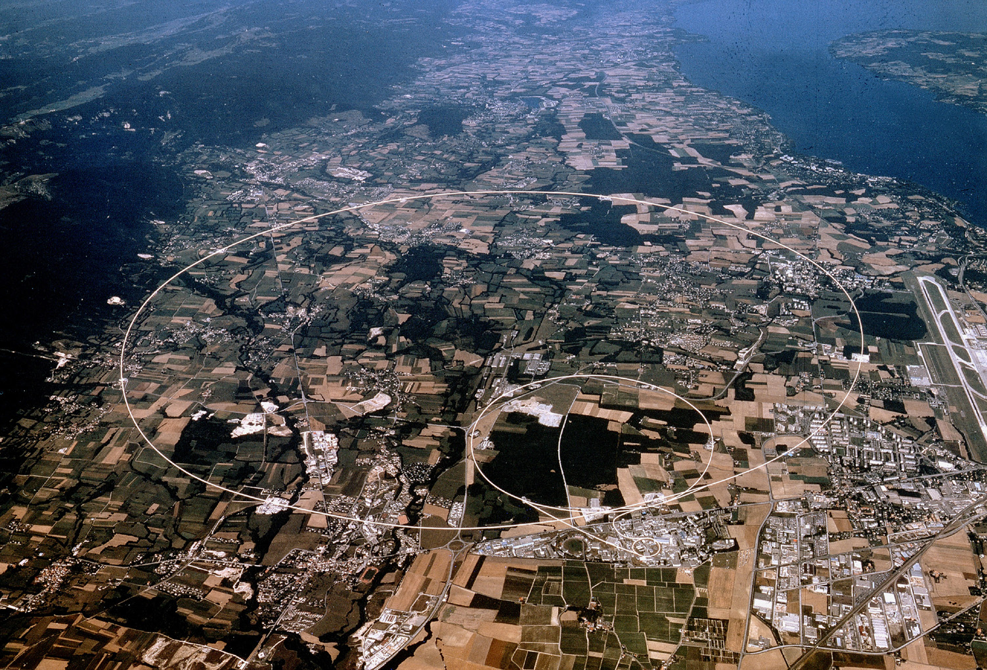

Accelerating Science and Innovation
Introduction
Science
World Collaboration
R.-D. Heuer, CERN CERN Summer Student Programme, July 1, 2009
Notes:
1

Slide 2
Accelerating Science and Innovation
Introduction
CERN
Notes:
2

Slide 3

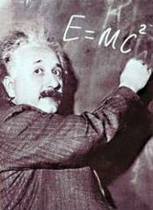


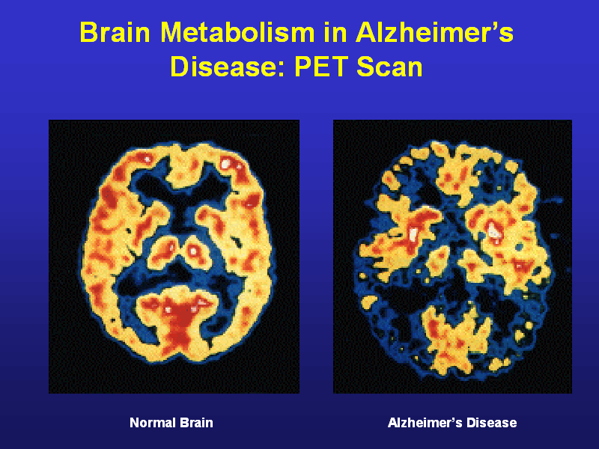
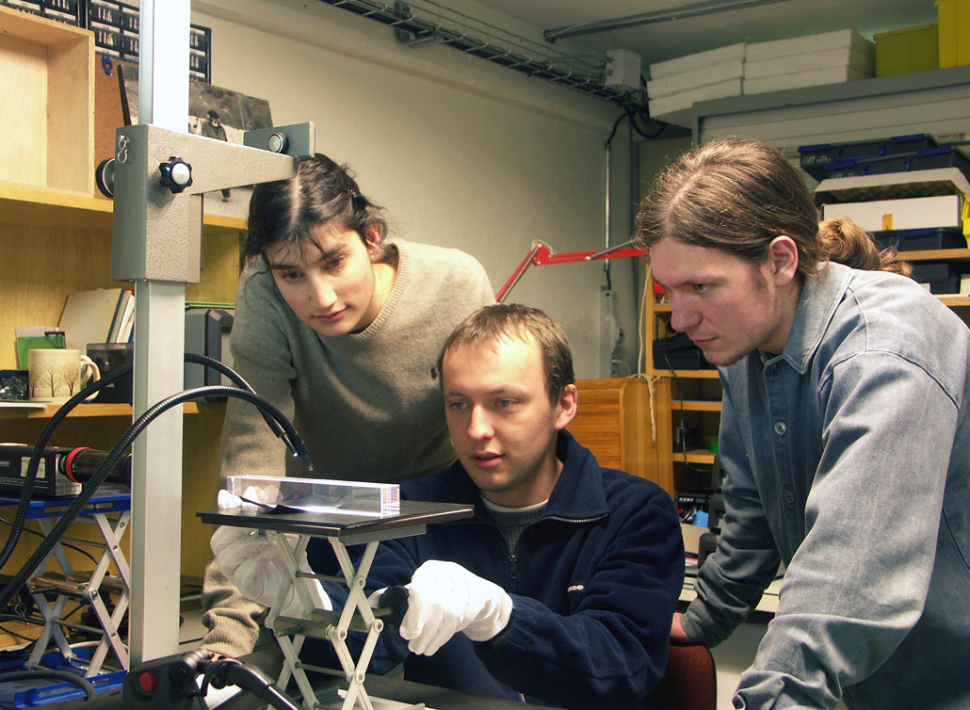
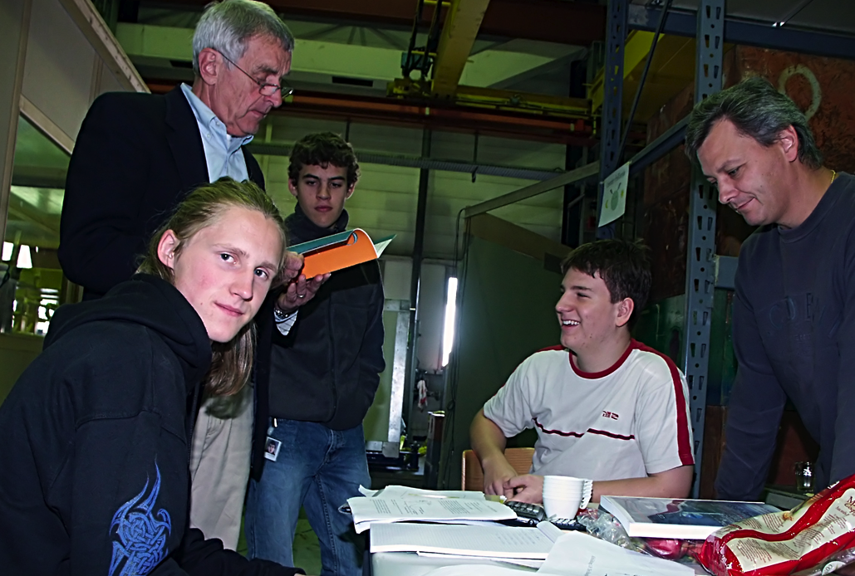
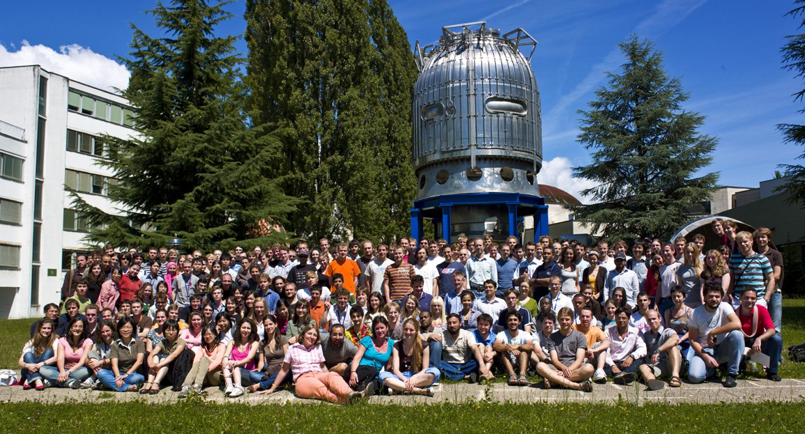
The Mission of CERN
Push back the frontiers of knowledge
E.g. the secrets of the Big Bang …what was the matter like within the first moments of the Universe’s existence?
Develop new technologies for accelerators and detectors
Information technology - the Web and the GRID
Medicine - diagnosis and therapy
Train scientists and engineers of tomorrow
Unite people from different countries and cultures
Notes:
3

Slide 4

CERN in Numbers
2256 staff
~ 700 other paid personnel
~ 9500 users
Budget (2009) 1100 MCHF
20 Member States: Austria, Belgium, Bulgaria, the Czech Republic, Denmark, Finland, France, Germany, Greece, Hungary, Italy, Netherlands, Norway, Poland, Portugal, Slovakia, Spain, Sweden, Switzerland and the United Kingdom.
1 Candidate for Accession to Membership of CERN: Romania
8 Observers to Council: India, Israel, Japan, the Russian Federation, the United States of America, Turkey, the European Commission and Unesco
4
Notes:
4

Slide 5
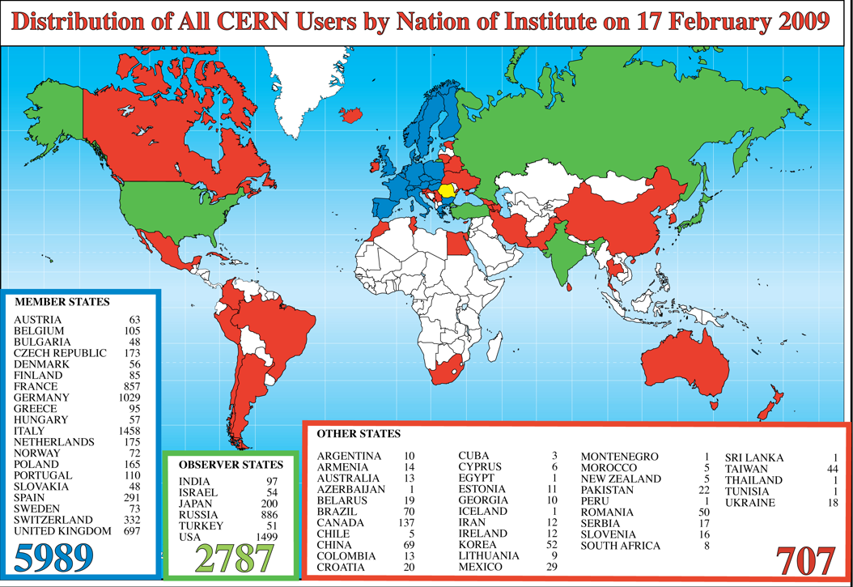
CERN in Numbers
5
Notes:
5

Slide 6
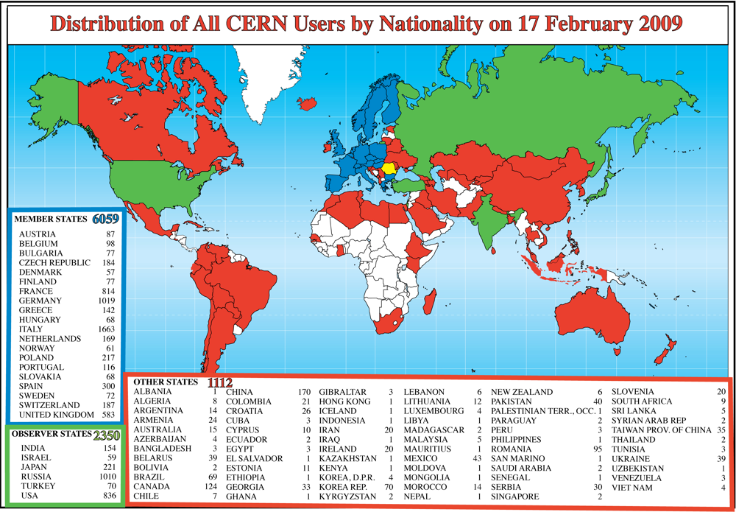
CERN in Numbers
6
Notes:
6

Slide 7
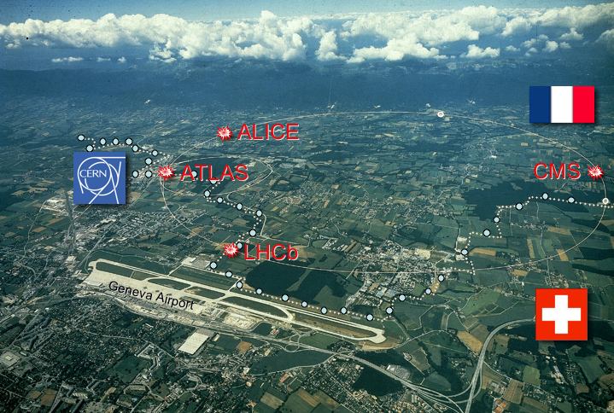
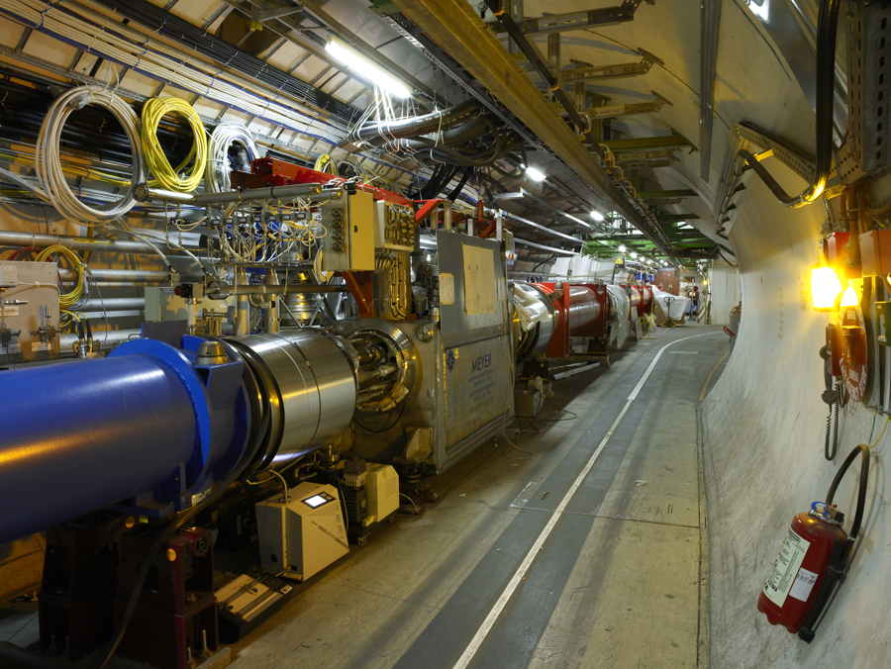
CERN Technologies - Innovation
Three key technology areas at CERN
Accelerating
particle beams
Detecting particles
Large-scale computing (Grid)

Slide 8
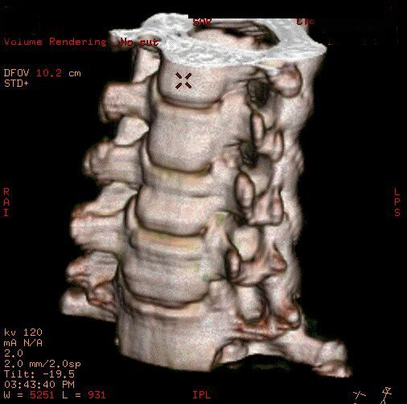
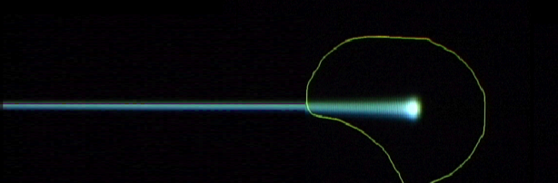
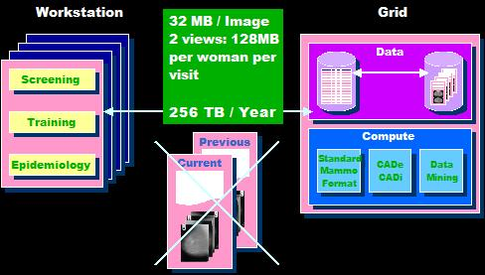
CERN Technologies - Innovation
Medical imaging
Example: medical application
Accelerating
particle beams
Detecting particles
Tumour Target
Charged hadron beam that loses energy in matter
Large-scale computing (Grid)
Grid computing for medical data management and analysis

Slide 9
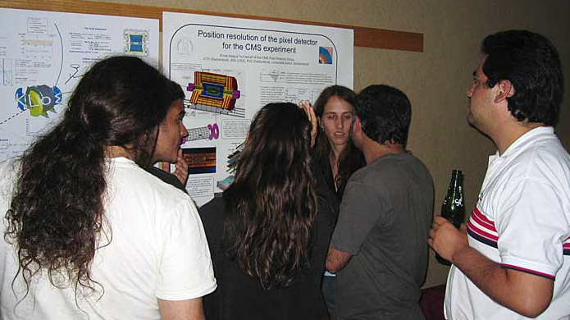
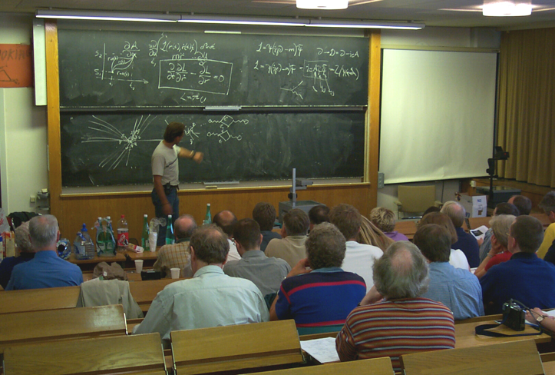

CERN Education Activities
Latin American School
of High Energy Physics
Chile, 2007
Scientists at CERN
Academic Training Programme
Young Researchers
CERN School of High Energy Physics
CERN School of Computing
CERN Accelerator School
School of Computing
Norway, 2008
Physics Students
Summer Students
Programme
CERN Teacher Schools
International and National Programmes

Slide 10
Accelerating Science and Innovation
Introduction
(some) Features of Particle Physics
Notes:
10

Slide 11
Features of Particle Physics
Duration of large particle physics projects:
decade(s)
from science case
via concept, R&D, and design
to realisation and exploitation
Excellent training grounds
in particle physics,
accelerator and detector technologies,
computing

Slide 12
Duration of Projects
1983
First LHC physics workshop 1984
LEP experiments: LoI 1982
driving technology
long term stability
and strategy

Slide 13
Features of Particle Physics
Interplay and Synergy
of different tools
(accelerators – cosmic rays – reactors . . .)
of different facilities
different initial states
lepton collider (electron-positron)
hadron collider (proton-proton)
lepton-hadron collider
at the energy frontier: high collision energy
and intensity frontier: high reaction rate

Slide 14
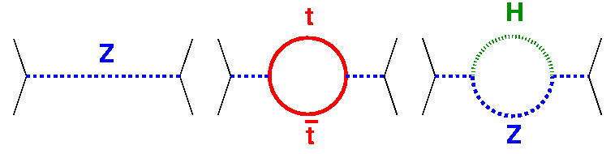
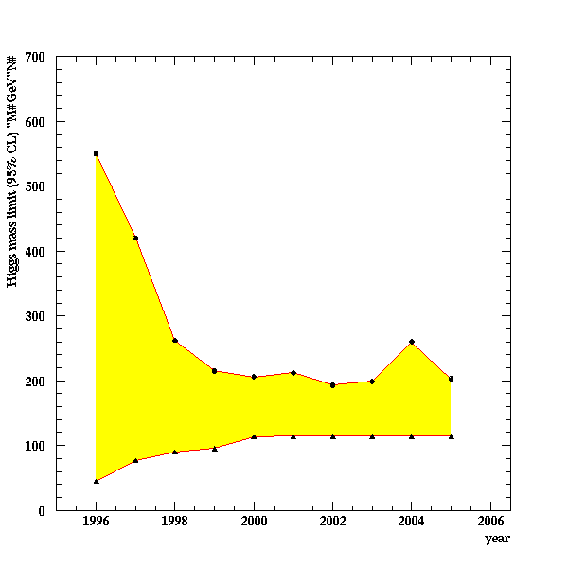
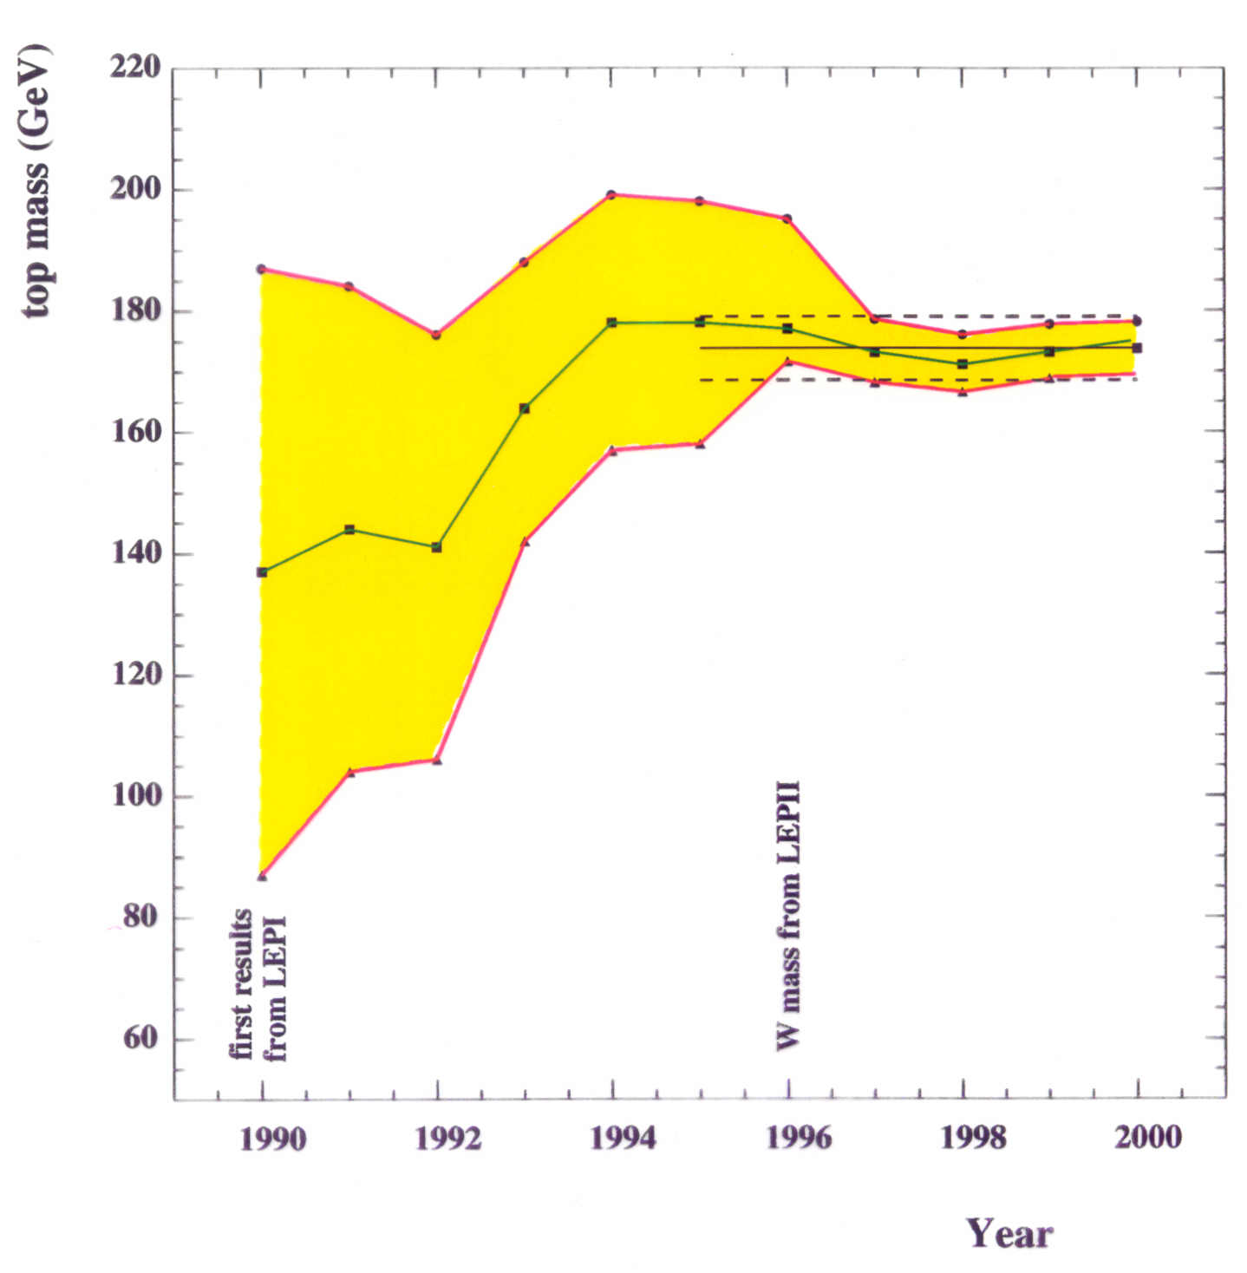
Test of the SM at the Level of Quantum Fluctuations
prediction of the range
for theHiggs mass
indirect determination of the top mass
LEP
possible due to • precision measurements • known higher order electroweak corrections

Slide 15
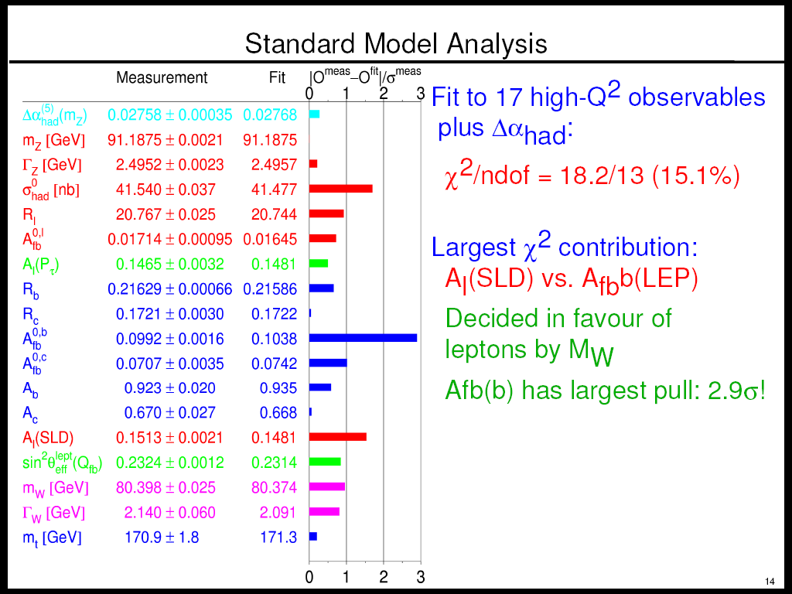
Status Summer Conferences 2007
Without this point,
the fit is too good!
however . . .
. . . one piece missing
within Standard Model
plus many open questions

Slide 16
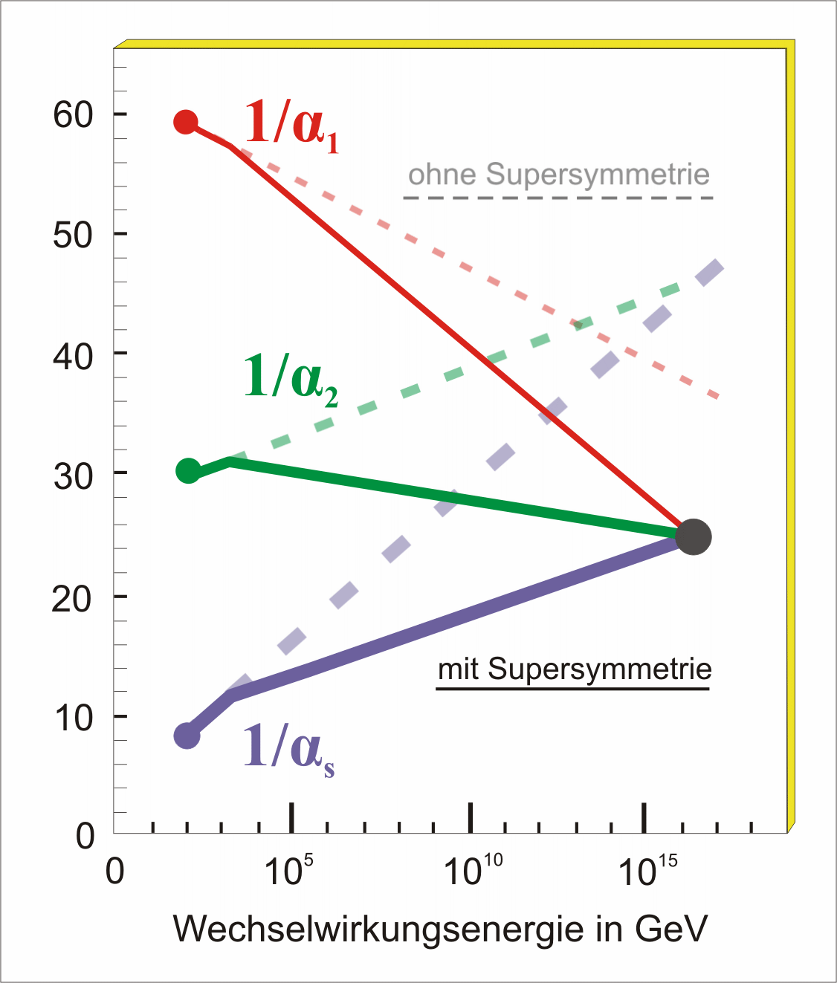
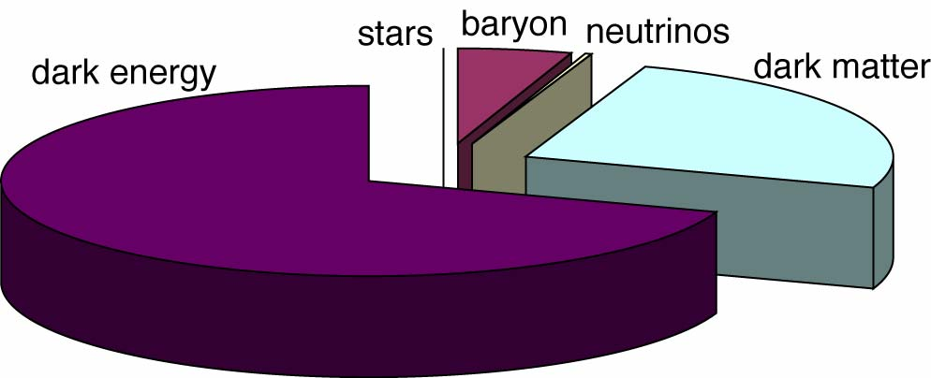
Key Questions of Particle Physics
origin of mass/matter or origin of electroweak symmetry breaking
unification of forces
fundamental symmetry of forces and matter
unification of quantum physics and general relativity
number of space/time dimensions
what is dark matter
what is dark energy

Slide 17
Accelerating Science and Innovation
Science
Particle Physics at CERN: Experiments and Theory
and
CERN and the European Strategy for Particle Physics
Notes:
17

Slide 18
Les Machines du CERN
Main emphasis: High energy frontier
But:
rich program of accelerator based particle physics

Slide 19
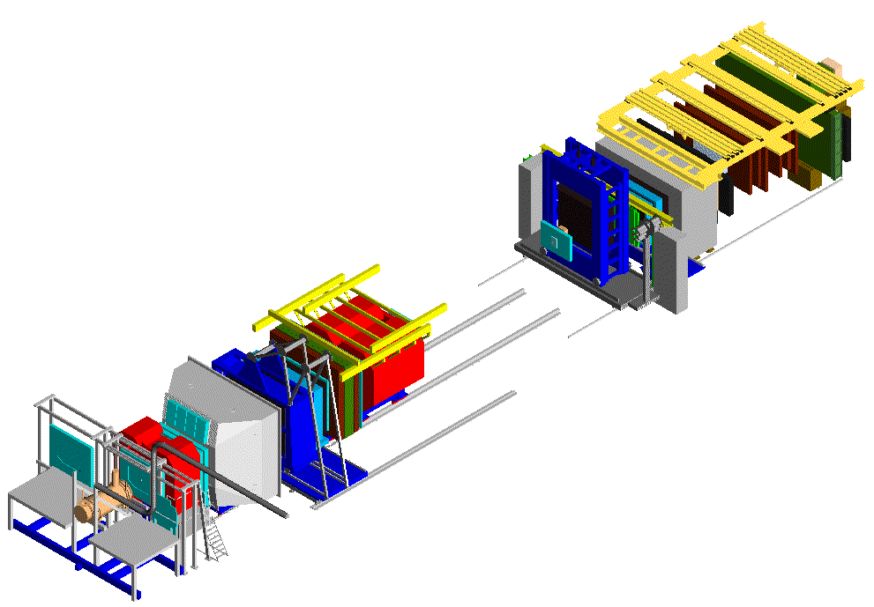
Fixed Target Physics
Heavy-ion Physics
Hadron Structure Physics
COMPASS
• Heavy ion fixed-target physics
- study of matter at extreme energy density
- search for state of quasi-free partons
quarks and gluons → quark-gluon plasma (QGP) ?
60 m
target ion
ion beam
spin structure of nucleon (w/ μ beam)
uds + g QCD spectroscopy (w/ hadron beam)

Slide 20

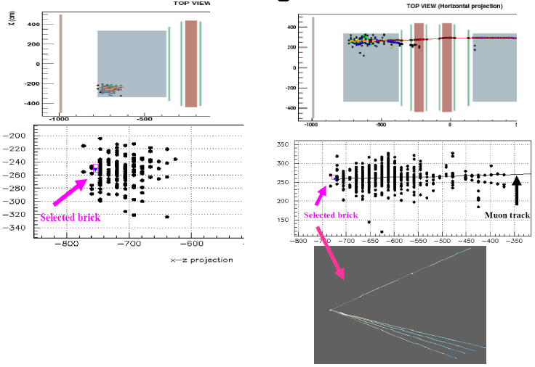
Fixed Target Physics
Antiproton Physics
Neutrino Physics
Cold antiprotons
(“manufacturing anti-matter”)
1. PS p → pp 10⁻⁶/collision
2. AD deceleration + cooling
stochastic + electron
3. Extraction @ ~ 0.1c
4. Produce thousands of anti-H
Anti-H annihilations detected
ATHENA (→ ALPHA)
anti-H (pe⁺) + matter → π⁺π⁻ + γγ
CERN NEUTRINOS TO GRAN SASSO
732 Km
ν_{μ}
732 Km
ν_{τ}
OPERA
Neutral Current
Charge Current

Slide 21
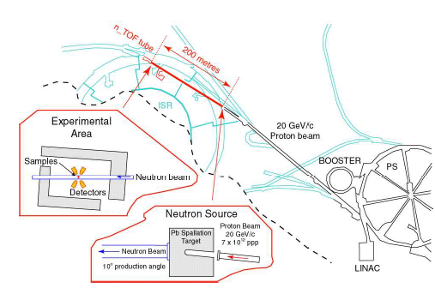
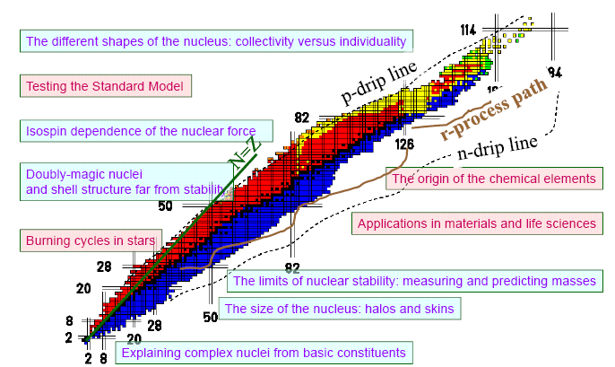
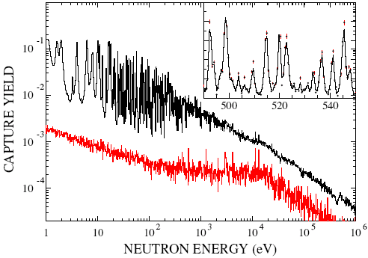
Fixed Target Physics
ISOLDE
nTOF
At thermal energy of kT=30 keV the Maxwellian averaged cross section of this 151Sm (t_{1/2}=93 yr) was determined to be 3100±160 mb, significantly larger than theoretical predictions. Nucleosynthesis in giant branch stars.

Slide 22
The European Strategy for particle physics

Slide 23
The European Strategy for particle physics
The process:
CERN Council Strategy Group established
Open Symposium (Orsay, Jan 31/Feb 1, 2006)
Final Workshop (Zeuthen, May 2006)
Strategy Document approved unanimously
by Council July 14, 2006

Slide 24
The European Strategy for particle physics
Unanimously approved by CERN Council July 14, 2006
LHC
L~10³⁴

Slide 25
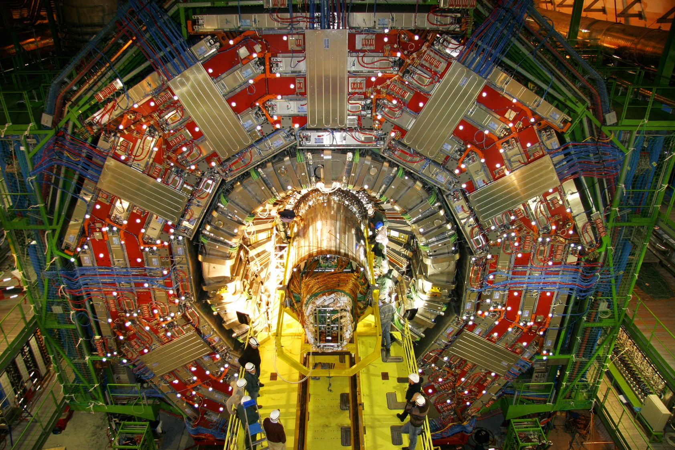
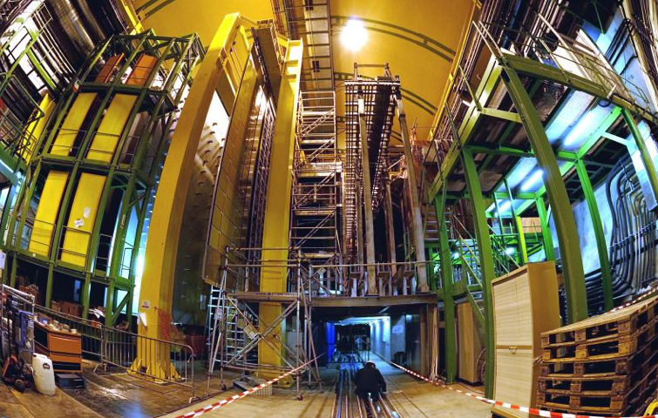
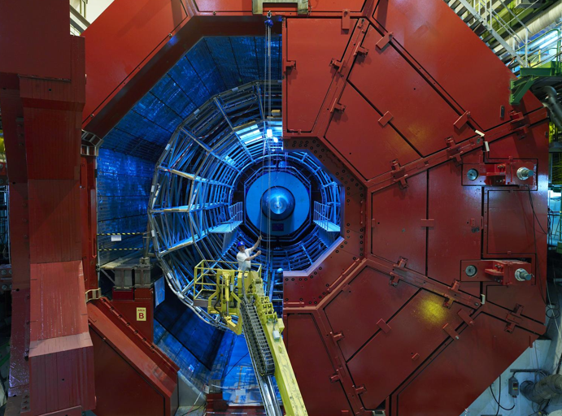
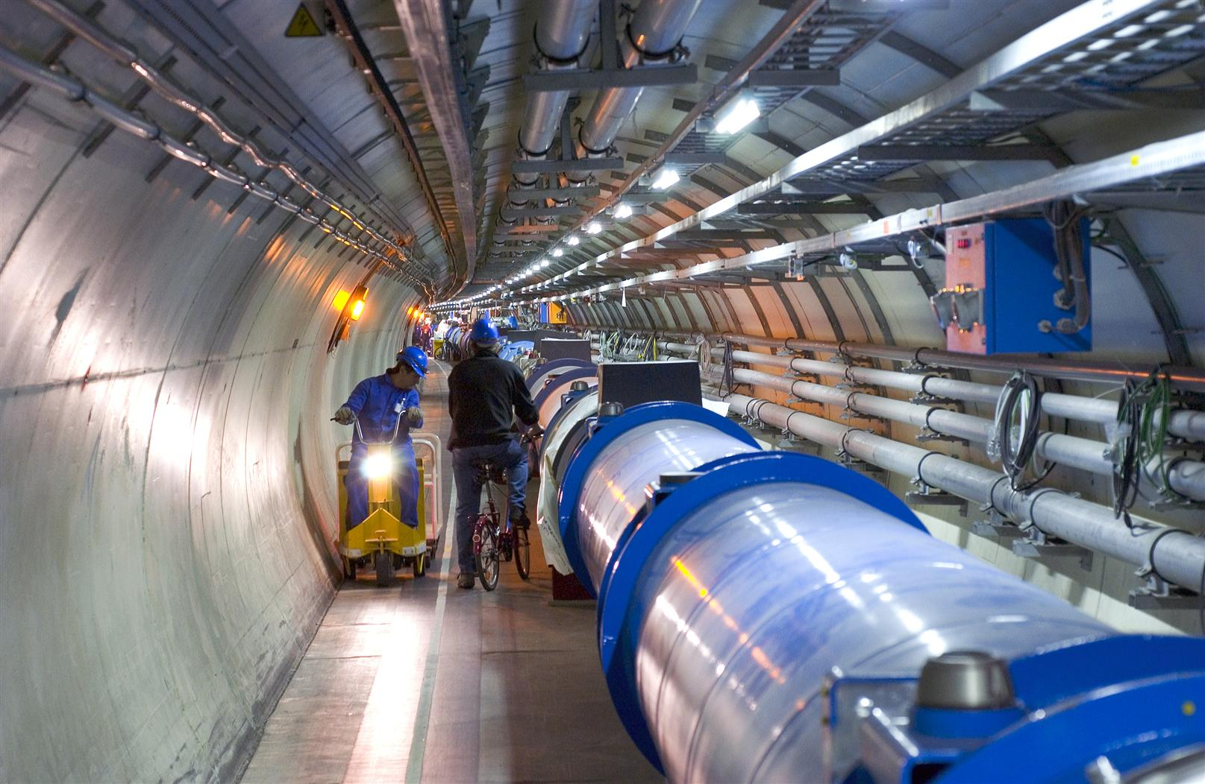
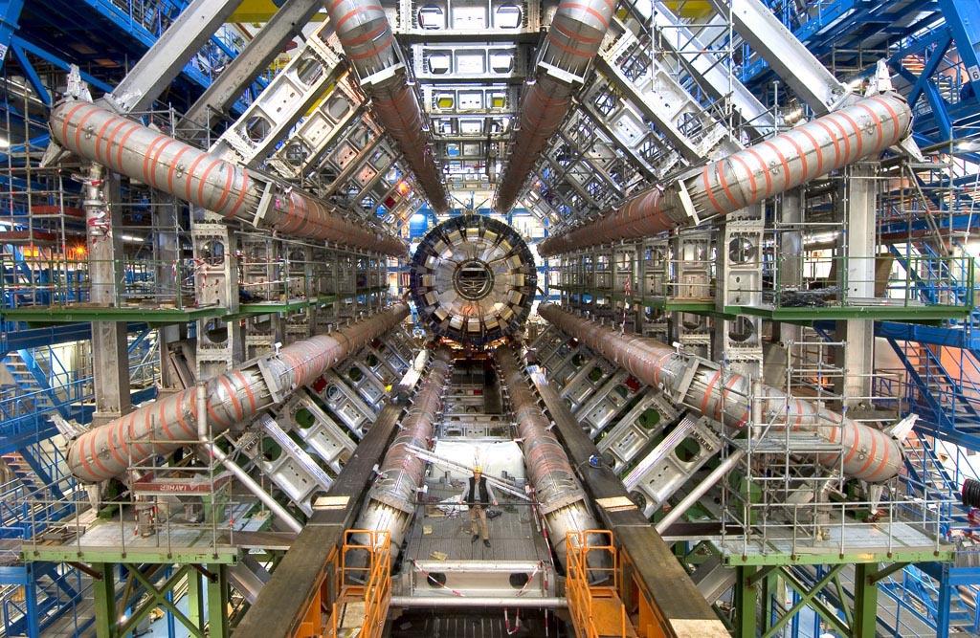
Enter a New Era in Fundamental Science
Start-up of the Large Hadron Collider (LHC), one of the largest and truly global scientific projects ever, is the most exciting turning point in particle physics.
CMS
LHCb
Exploration of a new energy frontier
Proton-proton collisions at E_{CM} = 14 TeV
ALICE
LHC ring:
27 km circumference
ATLAS
Notes:
25

Slide 26
Large Hadron Collider (LHC)
A few characteristics:
The LHC features 1232, 15 m long, 9 T, superconducting dipoles
The tunnel is 27 km in circumference
protons can thus be accelerated to 7 TeV, allowing
14 TeV proton-proton collisions
in the centre-of-mass
The proton beams consist of compact bunches of 10¹¹ protons each,
25 ns apart, leading to a collision rate normalized to the cross section
of
Luminosity = 10³⁴ cm⁻²s⁻¹

Slide 27
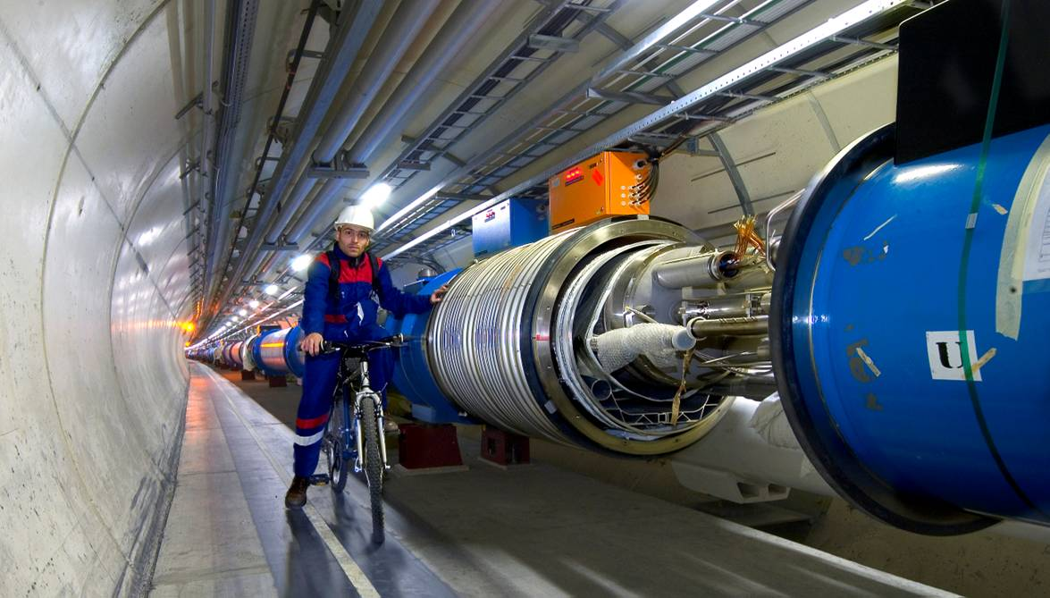
First beam around the ring Sept. 10, 2008
Incident Sept. 19, 2008
Inauguration October 21, 2008

Slide 28
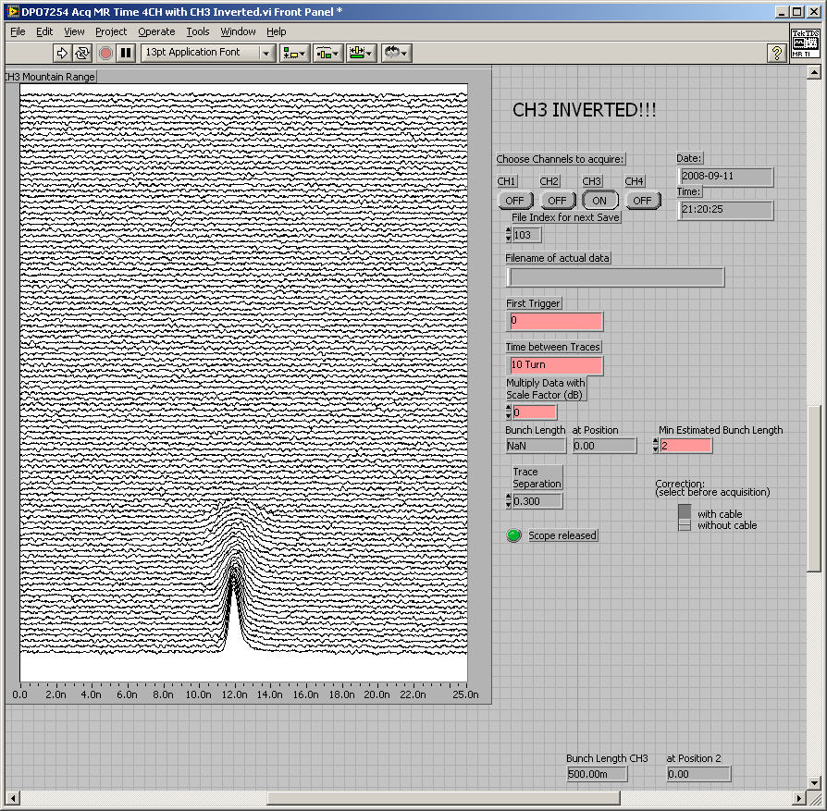
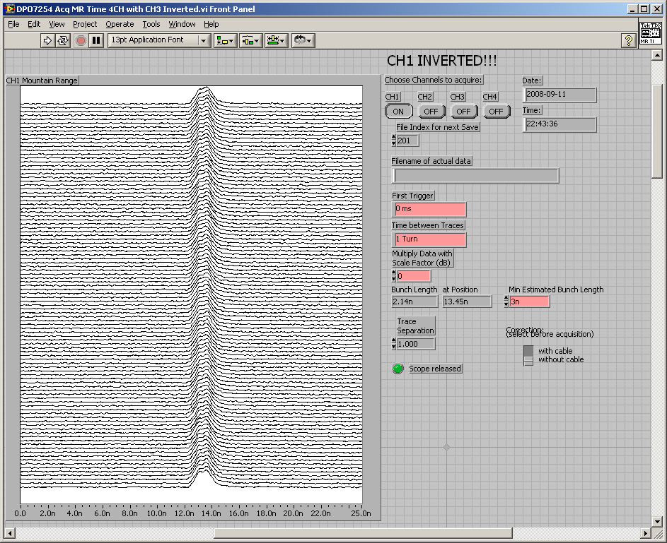
Capture with optimum injection phasing, correct reference
September 10, 2008
Great success for Collider and for Experiments:
working well
Courtesy E. Ciapala
28

Slide 29
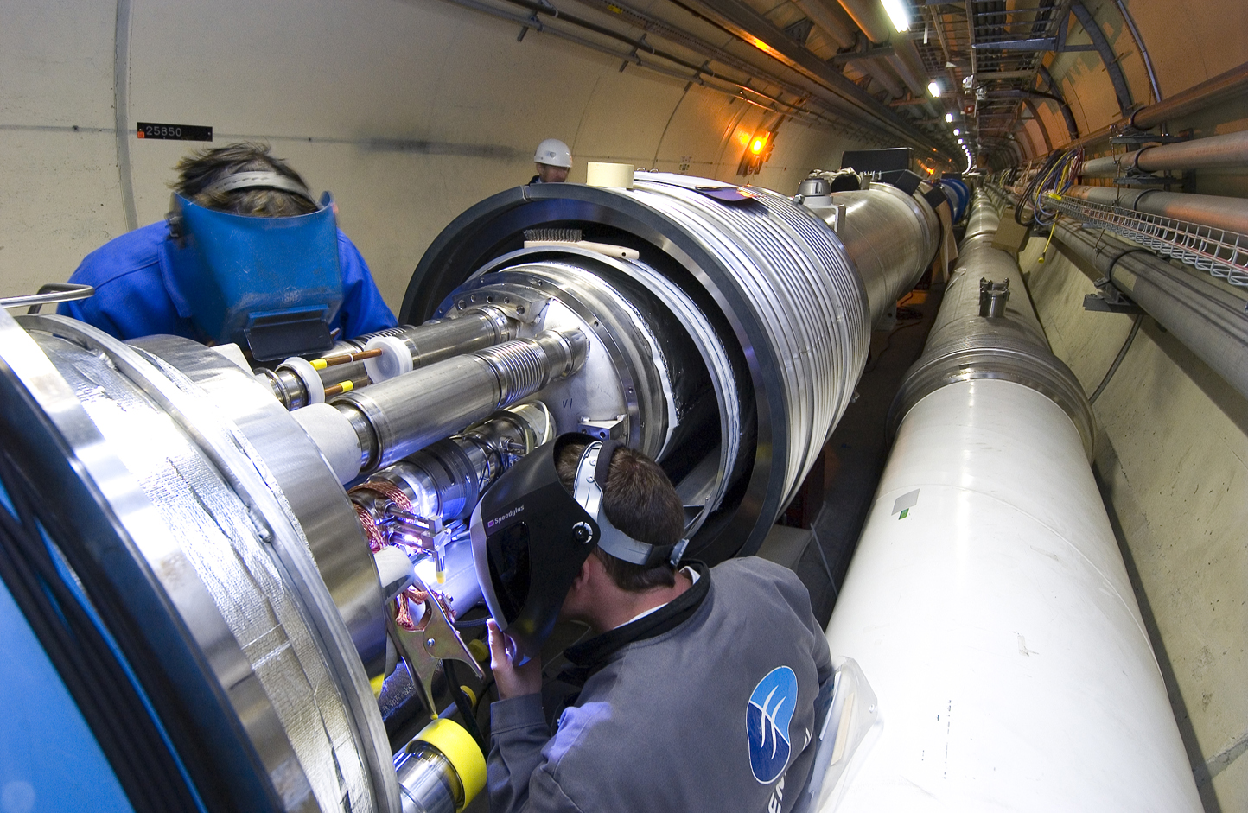
Interconnects
September 19, 2008

Slide 30
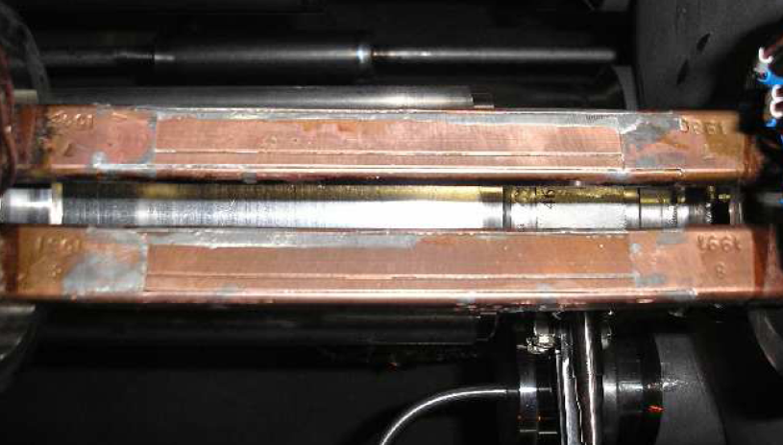
Busbar splice
Specification: resistance below nΩ

Slide 31
Busbar splice

Slide 32
The Large Hadron Collider - Experiments
Two ‘general purpose’ 4π
detectors for pp collisions
at high L; some capabilities for PbPb
ATLAS and CMS
One dedicated PbPb detector with some capabilities
for pp
ALICE
One dedicated detector for studying B mesons
(CP violation; rare decays), produced
in the forward (backward) hemisphere
LHCb
Precision (1%) measurement of total cross section
(and more) TOTEM
Study of forward π⁰ production LHCf

Slide 33
Experimental Challenge
High Interaction Rate: N=Lσ = 10³⁴ x 100 x 10⁻²⁷
pp interaction rate 10⁹ interactions/s
data for only ~100 out of the 40 million crossings can be recorded per sec (100 – 150 MB/sec)
need fast, pipelined, intelligent electronics and sophisticated
data-acquisition
High Energy and Large Particle Multiplicity
~ <20> superposed events in each crossing
~ 1000 tracks stream into the detector every 25 ns
need highly granular detectors with good time resolution for low occupancy
large detectors, a large number of channels
High Radiation Levels
radiation hard (tolerant) detectors and electronics

Slide 34
Physics Requirements
Follow from requirements to observe Higgs boson whether it is heavy or light,
to observe Supersymmetry if it is there (missing energy), to find other new
physics if it is there; all this in the presence of a huge background of
standard processes (QCD)
Very good muon identification and momentum measurement
trigger efficiently and measure charge of a few TeV muons
High energy resolution electromagnetic calorimetry
~ 0.5% @ E_{T}~50 GeV
Powerful inner tracking systems
factor 10 better momentum resolution than at LEP
Hermetic calorimetry
good missing E_{T} resolution
(Affordable detector)

Slide 35
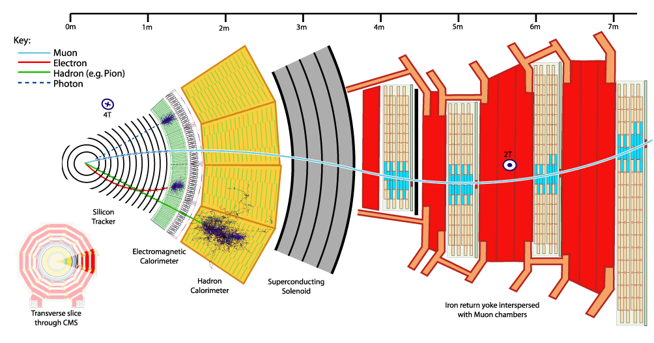
‘Generic’ experimental set-up
Deflection ~ BL²/p → need high B ( s.c.) and large magnets; need high resolution position measurements (10 -100μ)
at large p; also energy and position measurement through total absorption (photon, electron, hadron)

Slide 36

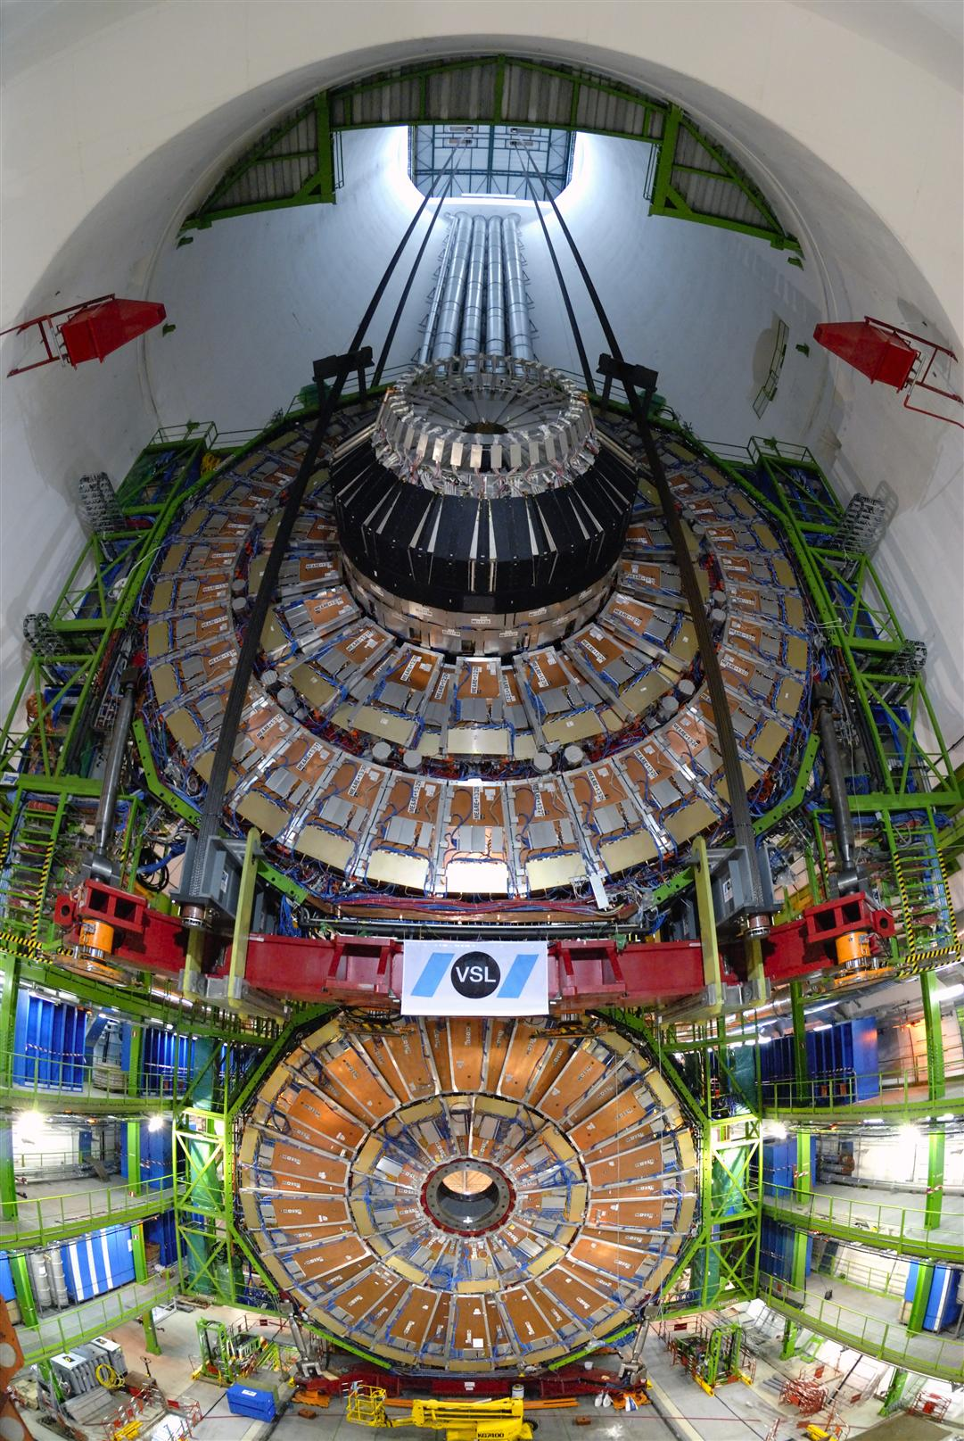

Slide 37
Selectivity - physics
a
Cross sections for various physics processes vary over many orders of magnitude
  Inelastic: 10⁹ Hz
  W→ l ν: 10² Hz
  t t production: 10 Hz
  Higgs (100 GeV/c²): 0.1 Hz
  Higgs (600 GeV/c²): 10^{–2} Hz
Selection needed: 1:10^{10–11}
  Before branching fractions...

Slide 38



The GRID
CERN can only provide ~20% of the required computing capacity
Therefore, the LHC relies on many computing centres around the world interconnected using Grid technology
CERN leads two major global Grid projects:
  WLCG: World-wide LHC Computing Grid Collaboration
  EGEE: Enabling Grid for E-sciencE project for all sciences
The LHC Computing Grid project launched a service with 12 sites in 2003. Today 200 sites in 40 countries with 20,000 PCs
WLCG depends also on OSG and other Grid projects

Slide 39
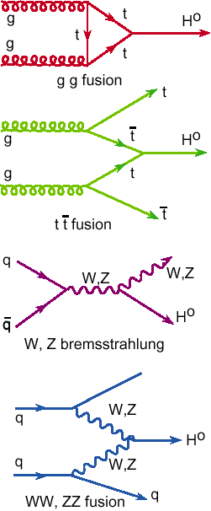
Physics Requirements
At the LHC the SM Higgs provides a good benchmark for the performance of a detector
Natural Width ­ 0.01 1 10 100 GeV
LEP
LEP200: M_{H}>114.4 GeV

Slide 40
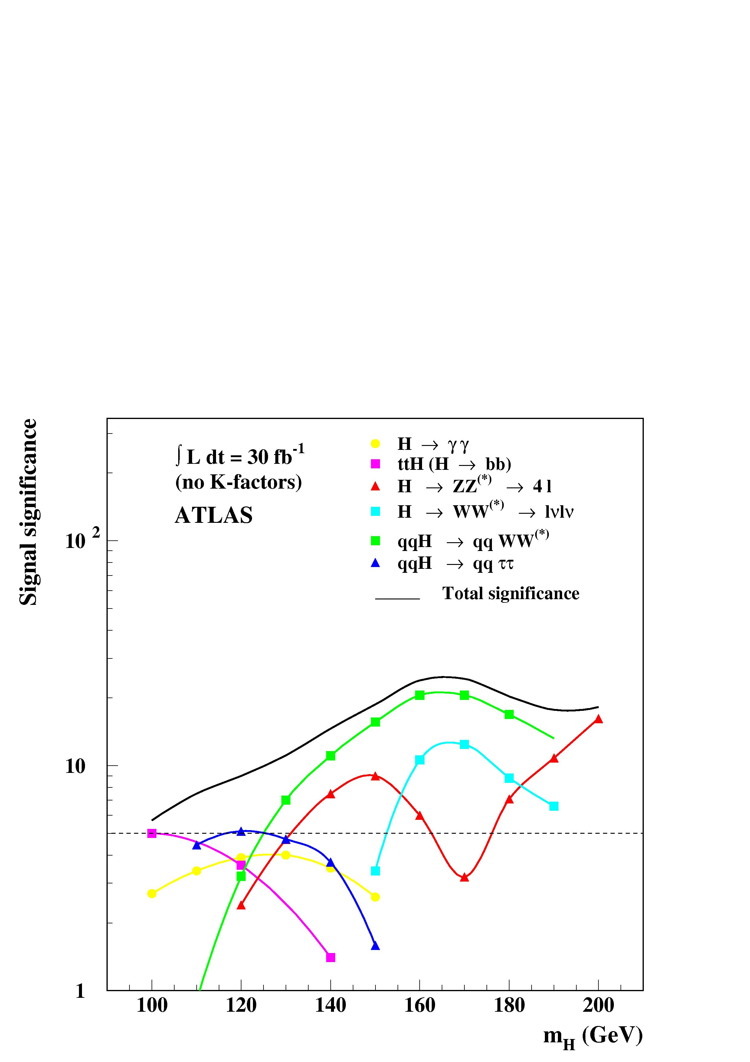
Standard Model Higgs
m_{H} > 114.4 GeV

Slide 41
Is there a Higgs?
What is the Higgs mass?
Is the Higgs a SM-like weak doublet?
Is the Higgs elementary or composite?
Is the stability of M_{W} / M_{P} explained by a symmetry or dynamical principle?
Is supersymmetry effective at the weak scale?
Will we discover DM at the LHC?
Are there extra dimensions? Are there new strong forces?
Are there totally unexpected phenomena?
What is the mechanism of EW breaking?
Standard
Nearly
Standard
Not at all
Standard
Initial phase of LHC will tell
which way nature wants us to go

Slide 42
Initial phase of LHC will tell
which way nature wants us to go
Possible ways beyond initial LHC:
Luminosity upgrade (sLHC)
Doubling the energy (DLHC)
new machine, R&D on high field magnets ongoing
Electron-Positron Collider
ILC
CLIC
Electron-Proton Collider
LHeC

Slide 43
The European Strategy for particle physics
one possible way : luminosity upgrade
sLHC
L~10³⁵

Slide 44
CERN 2008 – 2011: 240 MSFr additional funding
will partly be used to gradually increase performance
of LHC, i.e. towards luminosity upgrade (L~10³⁵) sLHC :
- New inner triplet -> towards L~2*10³⁴
- New Linac (Linac4) -> towards L~5*10³⁴
construction can/will start now → ~ 2012/13
- New PS (PS2 with double circumference)
- Superconducting Proton Linac (SPL)
start design now, ready for decision ~ 2011/12
aimed for L~10³⁵ around 2016/17 if physics requires
- Detector R&D (seed money)
Important: international collaboration

Slide 45
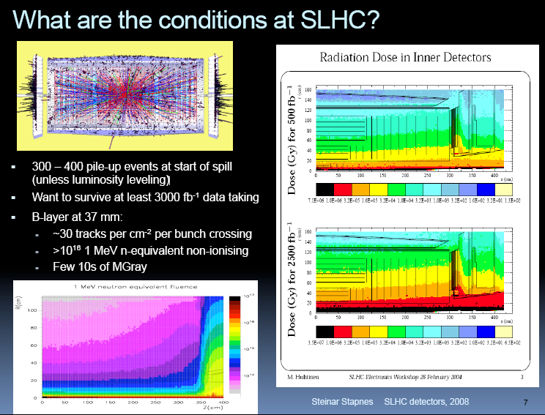
Detector R&D for sLHC mandatory
Concerted efforts are starting now

Slide 46
The European Strategy for particle physics

Slide 47
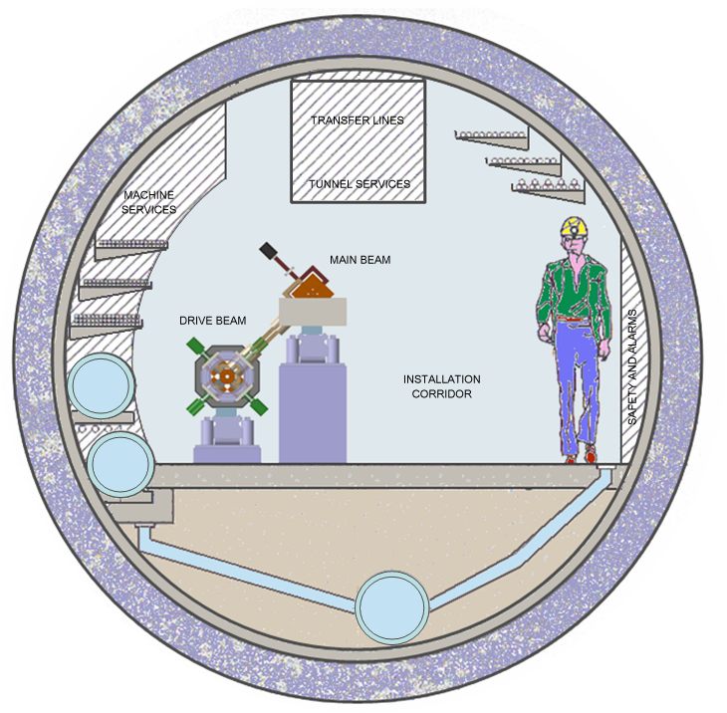
High Energy Colliders: CLIC (E_{cm} up to ~ 3TeV)
CLIC TUNNEL
CROSS-SECTION
High acceleration gradient: ~ 100 MV/m
  “Compact” collider – total length < 50 km at 3 TeV
  Normal conducting acceleration structures at high frequency
Novel Two-Beam Acceleration Scheme
  Cost effective, reliable, efficient
  Simple tunnel, no active elements
  Modular, easy energy upgrade in stages
Aim: Demonstrate all key feasibility issues and document in a
Conceptual Design Report by 2010 and possibly
Technical Design Report by 2015 + ?
QUAD
QUAD
POWER EXTRACTION
STRUCTURE
4.5 m diameter
Drive beam - 95 A, 300 ns
from 2.4 GeV to 240 MeV
12 GHz – 140 MW
ACCELERATING
Main beam – 1 A, 200 ns
from 9 GeV to 1.5 TeV
STRUCTURES
BPM

Slide 48
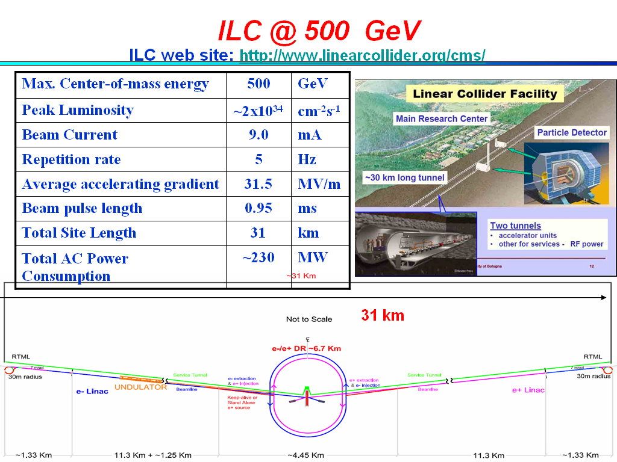
High Energy Colliders: ILC (E_{cm} up to ~ 1TeV)
2-stage process
Technical Design Phase I/II (2010/2012)

Slide 49
Strategy to address LC key issues
Recent progress: much closer collaboration
first meeting: February 08
GDE
CLIC
collaboration
Two weeks ago:
Meeting of ILC and CLIC Steering Committees
Result:
even closer collaboration towards one project
LC detector R&D project established at CERN
ILC
issues
CLIC
issues
RD
detector/physics
issues

Slide 50
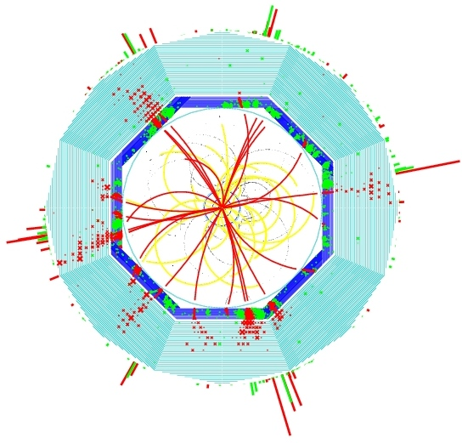
LC Detector challenges: calorimeter
ZHH g qqbbbb
High precision
measurements
demand new approach
to the reconstruction:
particle flow (i.e.
reconstruction of ALL
individual particles)
this requires
unprecedented
granularity
in three dimensions
R&D needed now
for key components
Detector R&D mandatory
and well under way
red:
track based
green:
calorimeter based

Slide 51
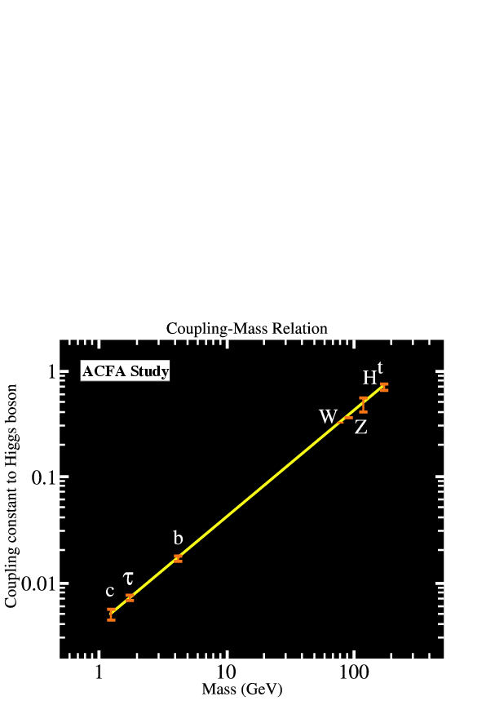
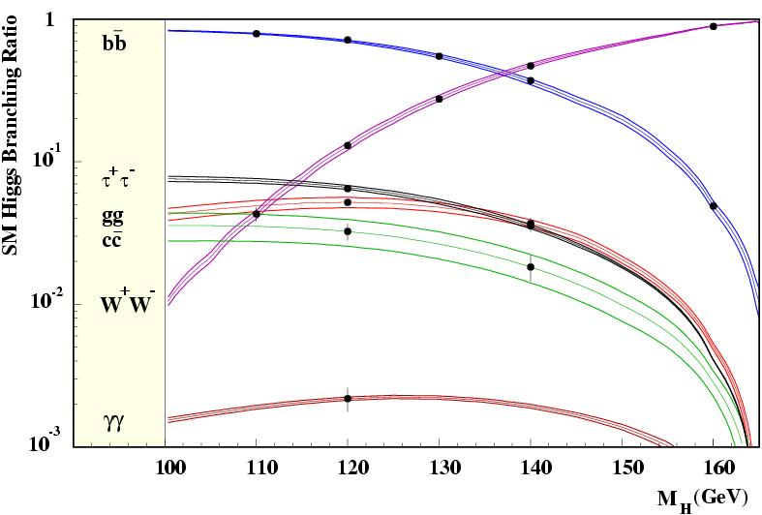
Precision Higgs physics
Determination of
absolute coupling
values with
high precision

Slide 52
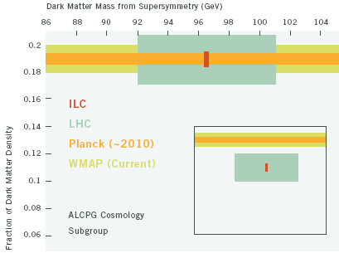
Dark Matter and SUSY
Is dark matter linked to the Lightest Supersymmetric Particle?
LC and satellite data (WMAP and Planck):
complementary views of dark matter.
LC: identify DM particle, measures its mass;
WMAP/Planck: sensitive to total density of dark matter.
Together with LHC they establish the nature of dark matter.
Neutralinos is not the full story

Slide 53
Recent development:
ECFA endorsed a series
of workshop for the
study of ep collisions
in LHC
new physics around 2010 ?
Large Hadron electron Collider
Goal: CDR end 2009
2010/12

Slide 54
Great opportunities ahead
Window of opportunity for decision on
the way forward 2010-2012 (?)

Slide 55
Accelerating Science and Innovation
World Collaboration
Notes:
55

Slide 56
Cooperation works rather well world wide,
so…any changes needed for the future?
facilities for HEP (and other sciences) becoming larger and expensive
funding not increasing
fewer facilities realisable
time scales becoming longer
laboratories are changing missions
→ more coordination and more collaboration required

Slide 57
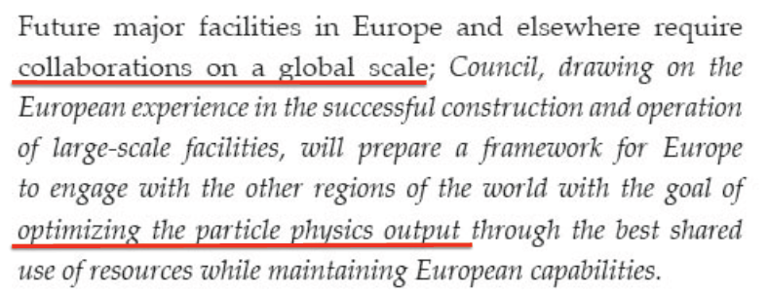
Outlook: Enhancing World Collaboration
Key message
from CERN Council Strategy Document

Slide 58
We are NOW entering a new exciting era of particle physics
Turn on of LHC
allows particle physics experiments
at the highest collision energies ever
Expect
- revolutionary advances in understanding the microcosm
- changes to our view of the early Universe
CERN
unique position as host for the LHC

Slide 59
Results from LHC will guide the way
Expect
period for decision taking on next steps in 2010 to 2012
(at least) concerning energy frontier
(similar situation concerning neutrino sector Θ₁₃)
We are NOW in a new exciting era of accelerator
planning-design-construction-running
and need
intensified efforts on R&D and technical design work
to enable these decisions
global collaboration and stability on long time scales
(reminder: first workshop on LHC was 1984)

Slide 60
Particle Physics can and should play its role as
spearhead in innovations as in the past
now and in future

