Slide 1
Particle Detectors
Summer Student Lectures 2009
Werner Riegler, CERN, werner.riegler@cern.ch
History of Instrumentation ↔ History of Particle Physics
The ‘Real’ World of Particles
Interaction of Particles with Matter
Tracking with Gas and Solid State Detectors
Calorimetry, Particle ID, (Detector Systems)

Slide 2
Detectors based on Ionization
Gas detectors:
  Wire Chambers
  Drift Chambers
  Time Projection Chambers
  Transport of Electrons and Ions in Gases
Solid State Detectors
  Transport of Electrons and Holes in Solids
  Si- Detectors
  Diamond Detectors

Slide 3
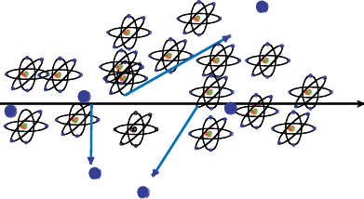
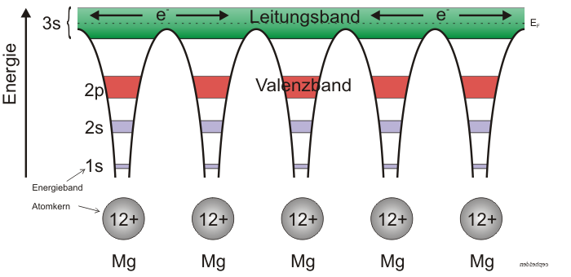
Solid State Detectors
Gas Detectors
In gaseous detectors, a charged particle is liberating electrons from the atoms, which are freely bouncing between the gas atoms.
An applied electric field makes the electrons and ions move,
which induces signals on the metal readout electrodes.
For individual gas atoms, the electron energy levels are discrete.
Solid State Detectors
In solids (crystals), the electron energy levels are in ‘bands’.
Inner shell electrons, in the lower energy bands, are closely bound to the individual atoms and always stay with ‘their’ atoms.
In a crystal there are however energy bands that are still bound states of the crystal, but they belong to the entire crystal. Electrons in these bands and the holes in the lower band can freely move around the crystal, if an electric field is applied.

Slide 4
Solid State Detectors
Free Electron Energy
Unfilled Bands
Conduction Band
Band Gap
Valance Band
Conductor, Insulator, Semiconductor
In case the conduction band is filled the crystal is a conductor.
In case the conduction band is empty and ‘far away’ from
the valence band, the crystal is an insulator.
In case the conduction band is empty but the distance to the valence band is small, the crystal is a semiconductor.

Slide 5
Solid State Detectors
Band Gap, e-h pair Energy
The energy gap between the last filled band – the valence band – and the conduction band is called band gap E_{g}.
The band gap of Diamond/Silicon/Germanium is 5.5, 1.12, 0.66 eV.
The average energy to produce an electron/hole pair for Diamond/Silicon/Germanium is 13, 3.6, 2.9eV.
Temperature, Charged Particle Detection
In case an electron in the valence band gains energy by some process, it can be excited into the conduction band and a hole in the valence band is left behind.
Such a process can be the passage of a charged particle, but also thermal excitation → probability is proportional Exp(-E_{g}/kT).
The number of electrons in the conduction band is therefore increasing with temperature i.e. the conductivity of a semiconductor increases with temperature.
Band Gap

Slide 6

Solid State Detectors
Electron, Hole Movement:
It is possible to treat electrons in the conduction band and holes in the valence band similar to free particles, but with an effective mass different from elementary electrons not embedded in the lattice.
This mass is furthermore dependent on other parameters such as the direction of movement with respect to the crystal axis. All this follows from the QM treatment of the crystal (solid state physics).
Cooling:
If we want to use a semiconductor as a detector for charged particles, the number of charge carriers in the conduction band due to thermal excitation must be smaller than the number of charge carriers in the conduction band produced by the passage of a charged particle.
Diamond (E_{g}=5.5eV) can be used for particle
detection at room temperature,
Silicon (E_{g}=1.12 eV) and Germanium (E_{g}=0.66eV)
must be cooled, or the free charge carriers
must be eliminated by other tricks → doping → see later.

Slide 7
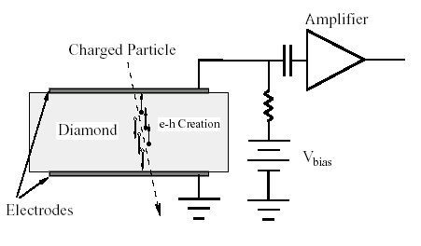
Solid State Detectors
Primary ‘ionization’:
The average energy to produce an electron/hole pair is: Diamond (13eV), Silicon (3.6eV), Germanium (2.9eV)
Comparing to gas detectors, the density of a solid is about a factor 1000 larger than that of a gas and the energy to produce and electron/hole pair e.g. for Si is a factor 7 smaller than the energy to produce an electron-ion pair in Argon.
Solid State vs. Gas Detector:
The number of primary charges in a Si detector is therefore about 10⁴ times larger than the one in gas → while gas detectors need internal charge amplification, solid state detectors don’t need internal amplification.
While in gaseous detectors, the velocity of electrons and ions differs by a factor 1000, the velocity of electrons and holes in many semiconductor detectors is quite similar → very short signals.
Diamond → A solid state ionization chamber
Why do solid state detectors exist only since around 1980 while gas detectors are used since 1906 ?

Slide 8
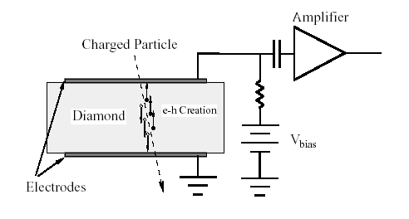
Diamond Detector
Typical thickness – a few 100μm.
<1000 charge carriers/cm³ at room temperature due to large band gap.
Velocity:
μ_{e}=1800 cm²/Vs, μ_{h}=1600 cm²/Vs
Velocity = μE, 10kV/cm → v=180 μm/ns → Very fast signals of only a few ns length !
I₂
Z=D
I₁(t)
z
E
q,v_{h}
Z=z₀
-q, v_{e}
A single e/h par produced in the center
Z=0
I₁
T=2-3ns

Slide 9
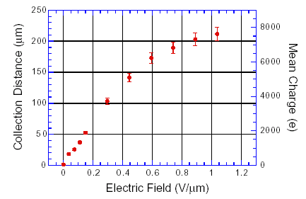
Diamond Detector
I₂
Z=D
E
-q, v_{e}
q,v_{h}
Z=z₀
Z=0
I₁
However, charges are trapped along the track, only about 50% of produced primary charge is induced →
I₁(t)
I₁(t)
T=2-3ns
T=2-3ns

Slide 10
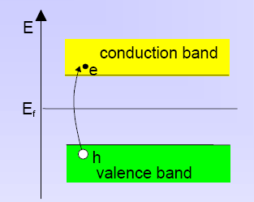
Silicon Detector
Velocity:
μ_{e}=1450 cm²/Vs, μ_{h}=505 cm²/Vs, 3.63eV per e-h pair.
~11000 e/h pairs in 100μm of silicon.
However: Free charge carriers in Si:
T=300 K: e,h = 1.45 x 10¹⁰ / cm³ but only 33000 e/h pairs in 300μm produced by a high energy particle.
Why can we use Si as a solid state detector ???

Slide 11
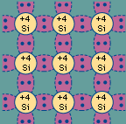
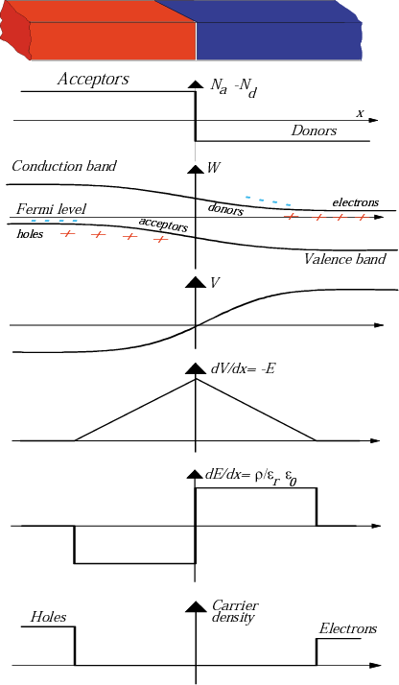
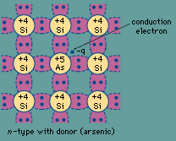
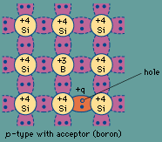
Doping of Silicon
In a silicon crystal at a given temperature the number of electrons in the conduction band is equal to the number of holes in the valence band.
Doping Silicon with Arsen (+5) it becomes and n-type conductor (more electrons than holes).
Doping Silicon with Boron (+3) it becomes a p-type conductor (more holes than electrons).
Bringing p and n in contact makes a diode.
p
n
doping

Slide 12
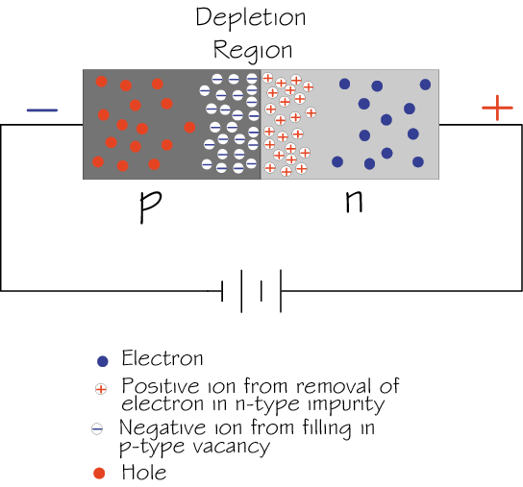
Si-Diode used as a Particle Detector !
At the p-n junction the charges are depleted and a zone free of charge carriers is established.
By applying a voltage, the depletion zone can be extended to the entire diode → highly insulating layer.
An ionizing particle produces free charge carriers in the diode, which drift in the electric field and induce an electrical signal on the metal electrodes.
As silicon is the most commonly used material in the electronics industry, it has one big advantage with respect to other materials, namely highly developed technology.

Slide 13
Under-Depleted Silicon Detector
-
-
+
+
+
+
+
+
-
+
+
-
+
+
+
+
-
+
+
-
+
+
+
+
+
+
+
+
+
-
p
n
Zone without free charge carriers positively charged.
Sensitive Detector Volume.
Zone with free electrons. Conductive.
Insensitive to particles.
Electric Field

Slide 14
Fully-Depleted Silicon Detector
-
-
+
+
+
+
+
+
+
+
+
+
-
+
+
+
+
-
+
+
+
+
+
+
+
+
+
+
-
+
+
+
+
+
-
+
+
+
+
+
+
+
+
-
+
+
+
+
p
n
Zone without free charge carriers positively charged.
Sensitive Detector Volume.
Electric Field

Slide 15
Over-Depleted Silicon Detector
-
-
+
+
+
+
+
+
+
+
+
+
-
+
+
+
+
-
+
+
+
+
+
+
+
+
+
+
-
+
+
+
+
+
-
+
+
+
+
+
+
+
+
-
+
+
+
+
In contrast to the (un-doped) diamond detector where the bulk is neutral and the electric field is therefore constant, the sensitive volume of a doped silicon detector is charged (space charge region) and the field is therefore changing along the detector.
→ Velocity of electrons and holes is not constant along the detector.
p
n
Zone without free charge carriers positively charged.
Sensitive Detector Volume.
Electric Field

Slide 16
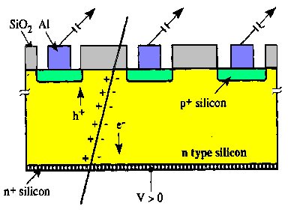
Silicon Detector
ca. 50-150 μm
readout capacitances
Fully depleted zone
SiO₂
passivation
300μm
N (e-h) = 11 000/100μm
Position Resolution down to ~ 5μm !
Solid State Detectors

Slide 17
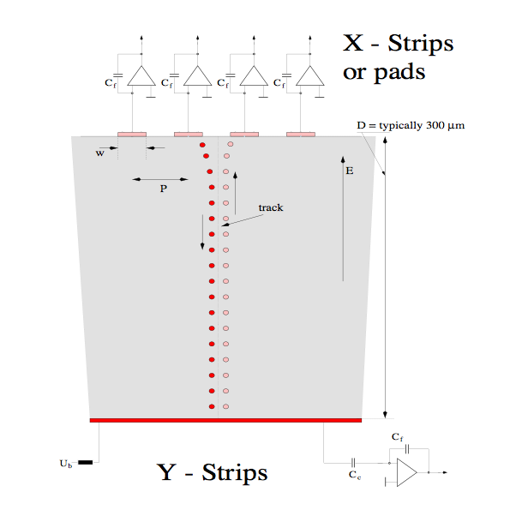
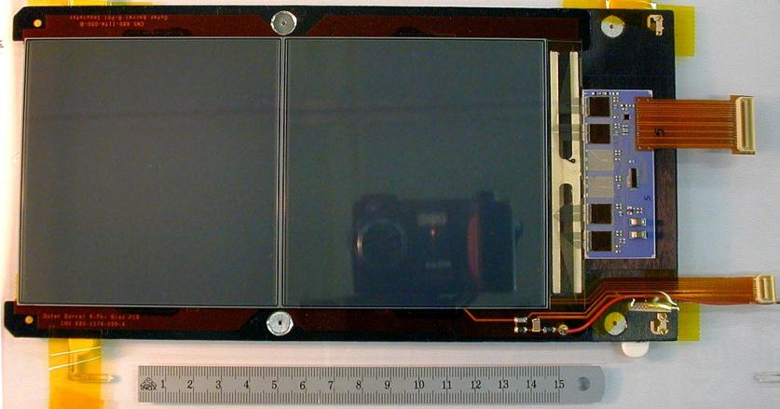
Silicon Detector
Every electrode is connected to an amplifier →
Highly integrated readout electronics.
Two dimensional readout is possible.
CMS Outer Barrel Module
Solid State Detectors

Slide 18
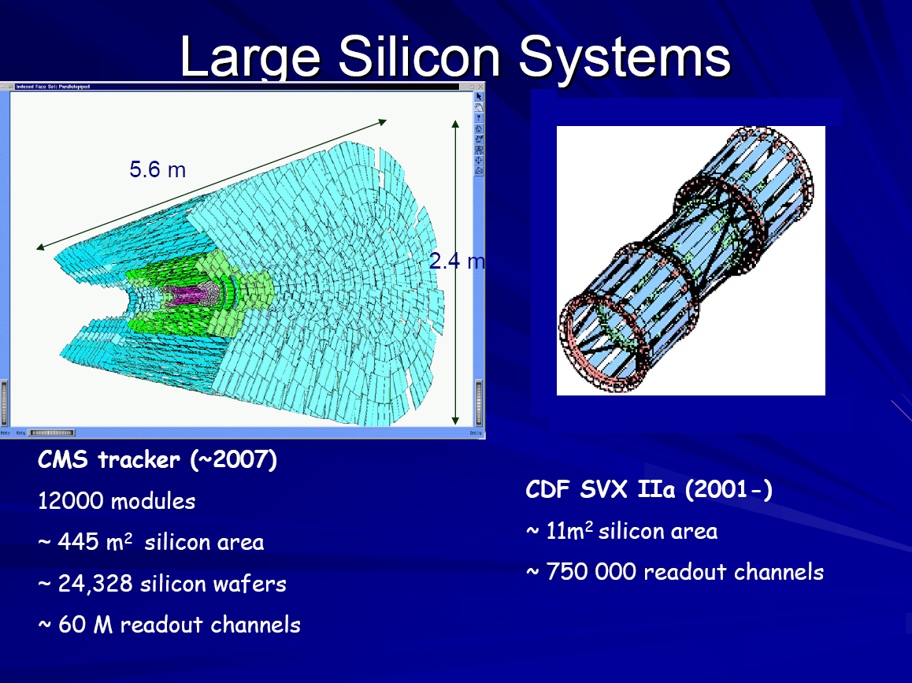

Slide 19
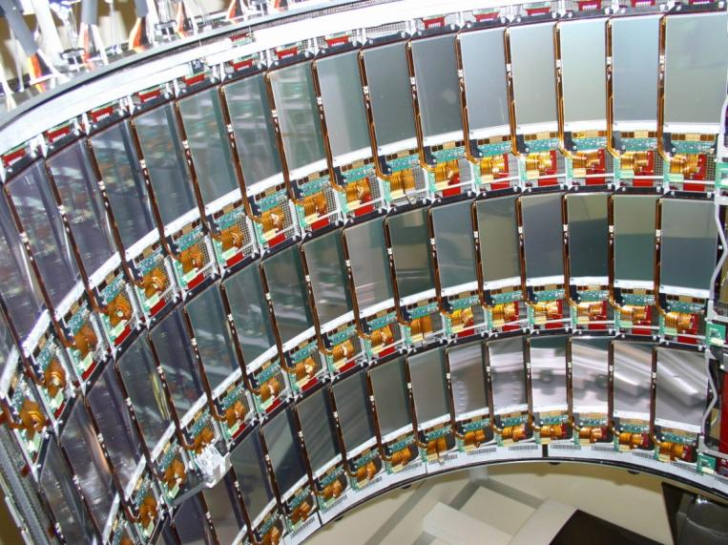
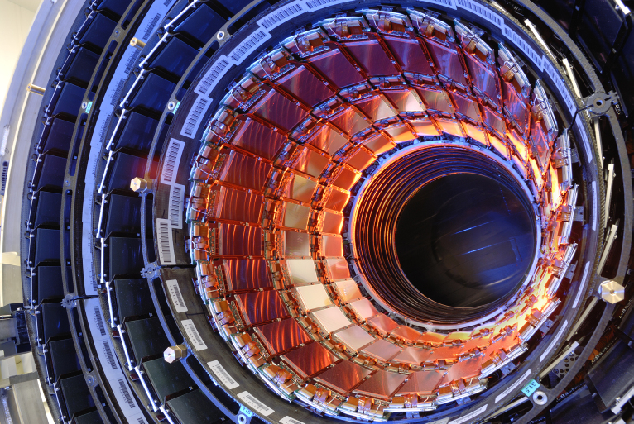
CMS Tracker

Slide 20
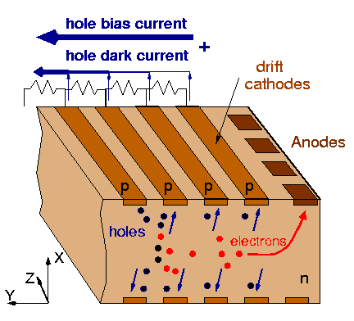
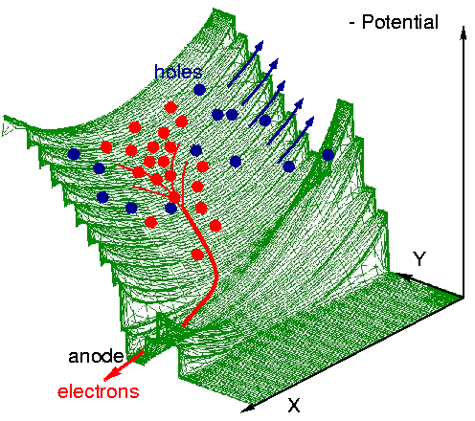
Silicon Drift Detector (like gas TPC !)
bias HV divider
Collection
drift cathodes
pull-up
cathode
ionizing particle
Solid State Detectors

Slide 21
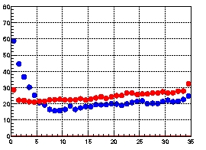
Silicon Drift Detector (like gas TPC !)
Anode axis (Z)
Drift time axis (R-Φ)
Resolution (μm)
Drift distance (mm)
Solid State Detectors

Slide 22
Pixel-Detectors
Problem:
2-dimensional readout of strip detectors results in ‘Ghost Tracks’ at high particle multiplicities i.e. many particles at the same time.
Solution:
Si detectors with 2 dimensional ‘chessboard’ readout. Typical size 50 x 200 μm.
Problem:
Coupling of readout electronics to the detector
Solution:
Bump bonding
Solid State Detectors

Slide 23
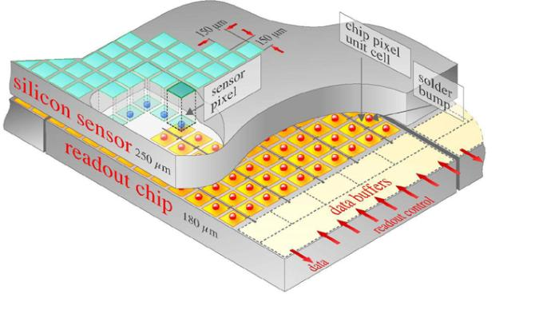
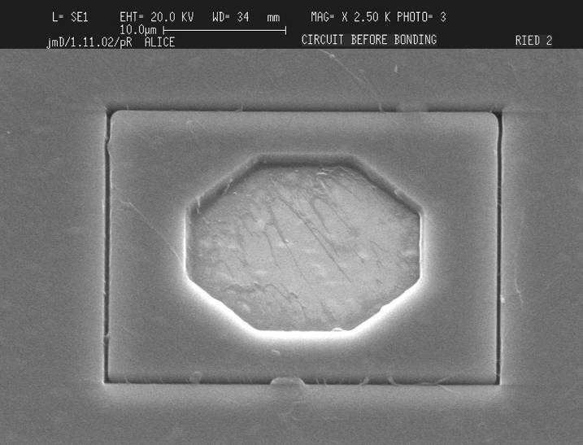
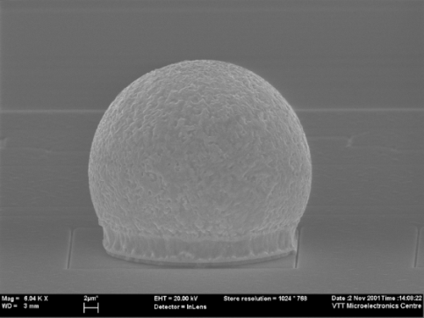
Bump Bonding of each Pixel Sensor to the Readout Electronics
ATLAS: 1.4x10⁸ pixels
Solid State Detectors

Slide 24
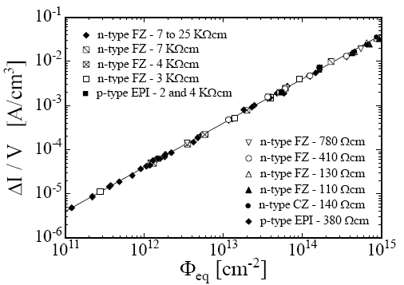
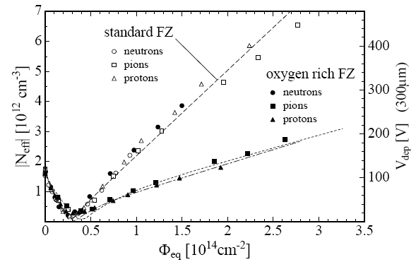
Radiation Effects ‘Aging’
Increase in leakage current
Increase in depletion voltage
Decrease in charge collection efficiency due to under-depletion and charge trapping.

Slide 25
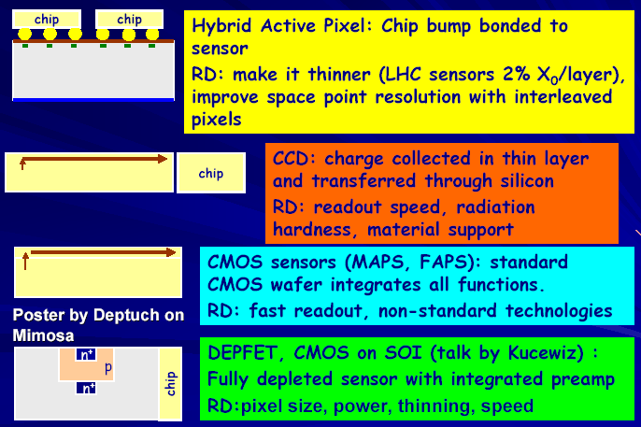
Obvious Goal: Monolithic Solid State Detectors
→Sensor and Readout Electronics as integral unit
Large variety of
monolithic pixel
Detectors are explored,
Currently mostly adapted
to low collision rates of Linear Colliders.

Slide 26
Summary on Solid State Detectors
Solid state detectors provide very high precision tracking in particle physics experiments (down to 5um) for vertex measurement but also for momentum spectroscopy over large areas (CMS).
Technology is improving rapidly due to rapid Silicon development for electronics industry.
Typical numbers where detectors start to strongly degrade are 10¹⁴-10¹⁵ hadron/cm².
Diamond, engineered Silicon and novel geometries provide higher radiation resistance.
Clearly, monolithic solid state detectors are the ultimate goal. Current developments along these lines are useful for low rate applications.

Slide 27
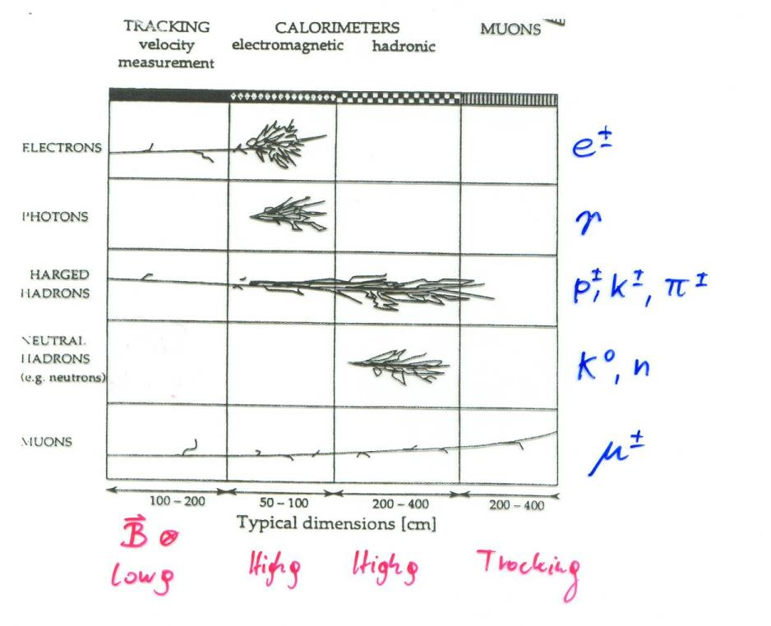
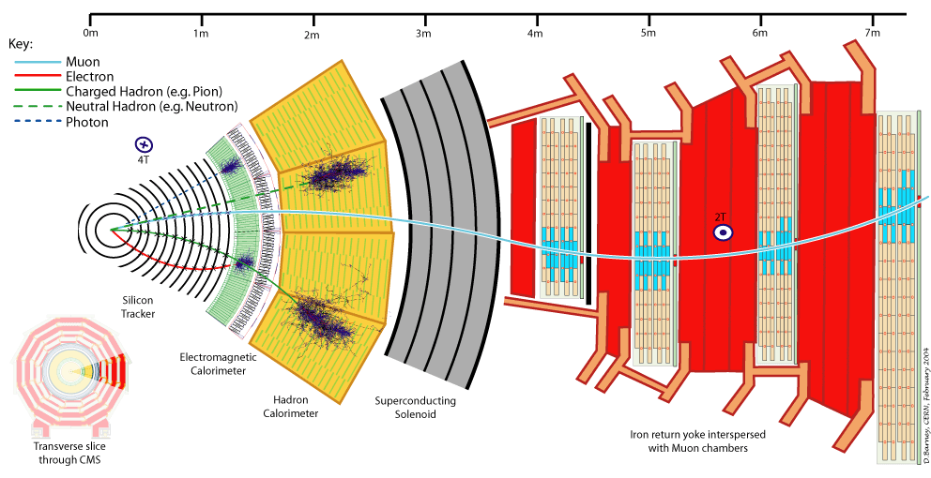
Calorimetry and Particle Identification

Slide 28
Bremsstrahlung
A charged particle of mass M and charge q=Z₁e is deflected by a nucleus of charge Ze (which is partially ‘shielded’ by the electrons). During this deflection the charge is ‘accelerated’ and it therefore radiates → Bremsstrahlung.
Z₂ electrons, q=-e₀
M, q=Z₁ e₀

Slide 29
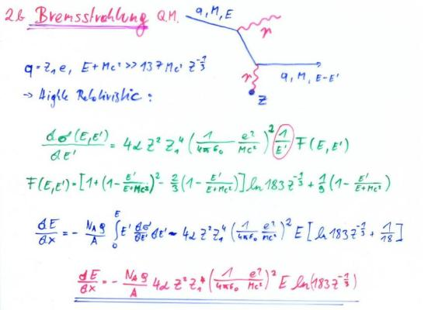
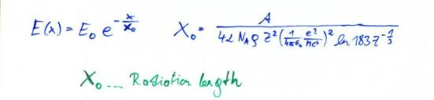
Bremsstrahlung, QM
Proportional to Z²/A of the Material.
Proportional to Z₁⁴ of the incoming particle.
Proportional to ρ of the material.
Proportional 1/M² of the incoming particle.
Proportional to the Energy of the
Incoming particle →
E(x)=Exp(-x/X₀) – ‘Radiation Length’
X₀ ∝ M²A/ (ρ Z₁⁴ Z²)
X₀: Distance where the Energy E₀ of the incoming particle decreases E₀Exp(-1)=0.37E₀ .

Slide 30
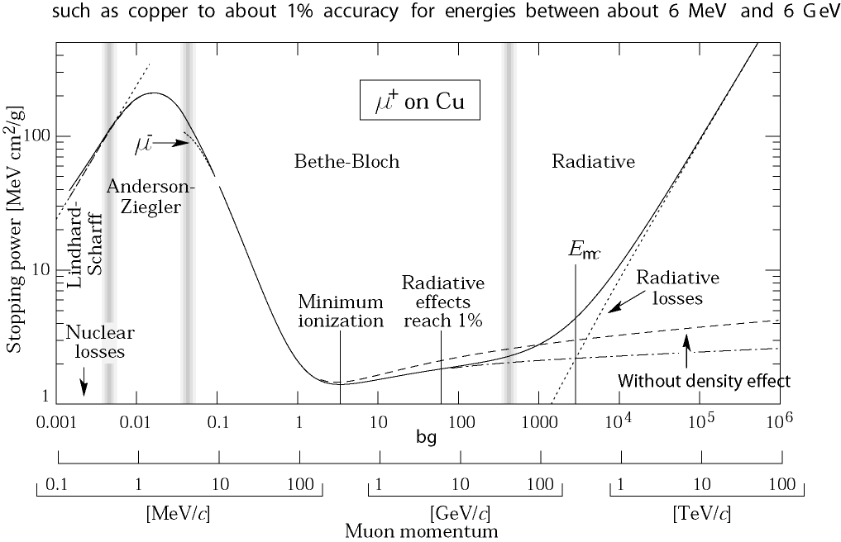
Critical Energy
For the muon, the second lightest particle after the electron, the critical energy is at 400GeV.
The EM Bremsstrahlung is therefore only relevant for electrons at energies of past and present detectors.
Electron Momentum 5 50 500 MeV/c
Critical Energy: If dE/dx (Ionization) = dE/dx (Bremsstrahlung)
Myon in Copper: p ≈ 400GeV
Electron in Copper: p ≈ 20MeV

Slide 31
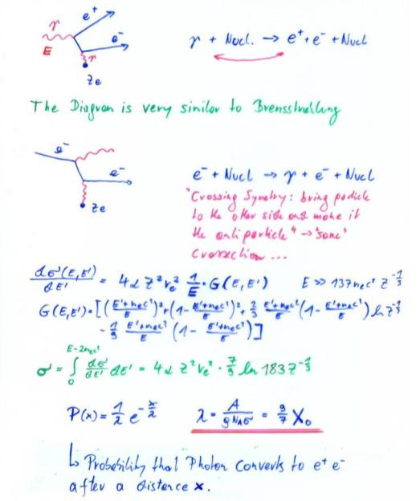
Pair Production, QM
For Eγ>>m_{e}c²=0.5MeV : λ = 9/7X₀
Average distance a high energy photon has to travel before it converts into an e⁺ e⁻ pair is equal to 9/7 of the distance that a high energy electron has to travel before reducing it’s energy from E₀ to E₀*Exp(-1) by photon radiation.

Slide 32
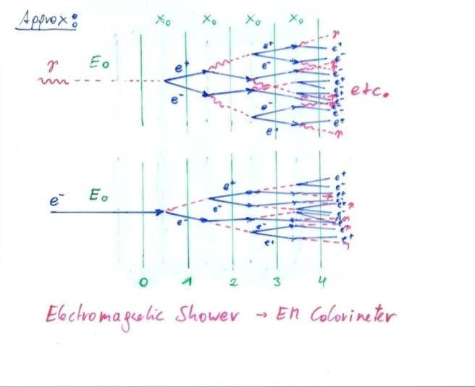
Bremsstrahlung + Pair Production → EM Shower

Slide 33
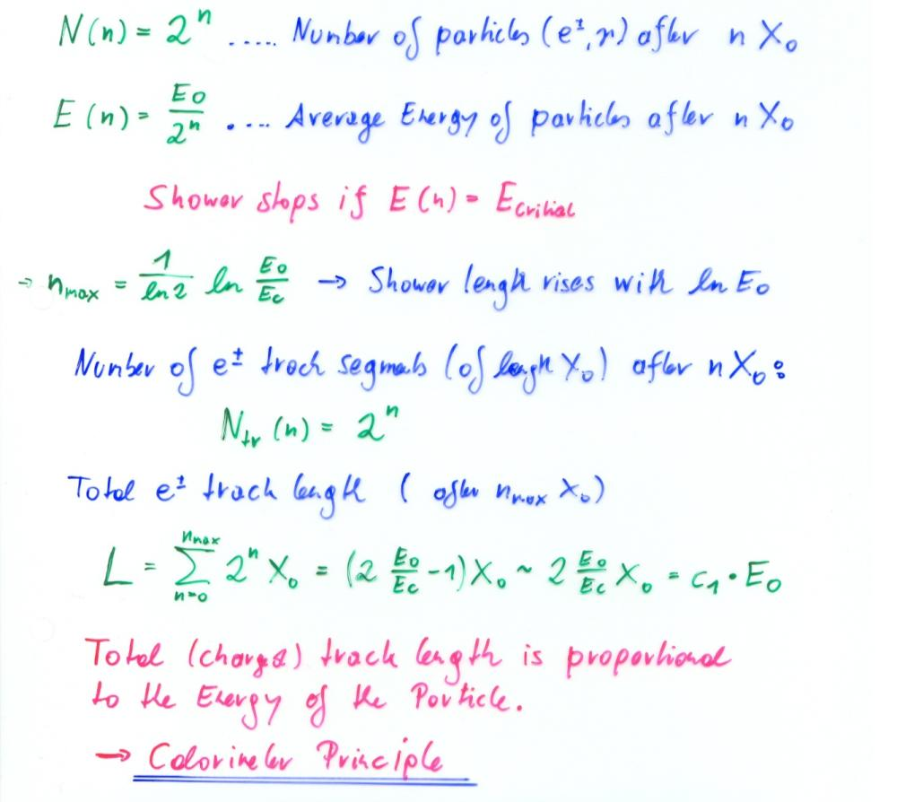
Electro-Magnetic Shower of High Energy Electrons and Photons

Slide 34
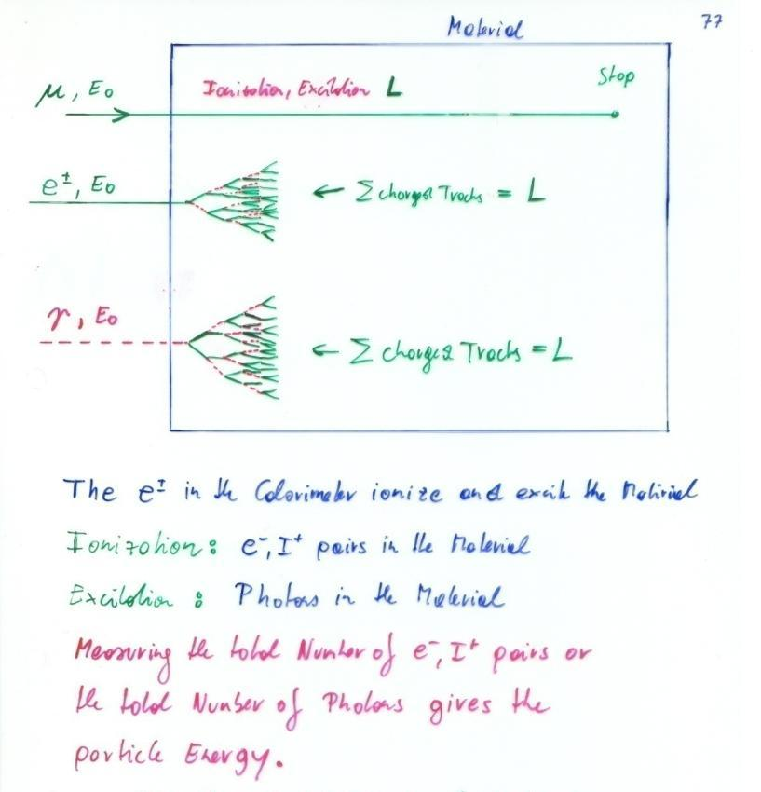
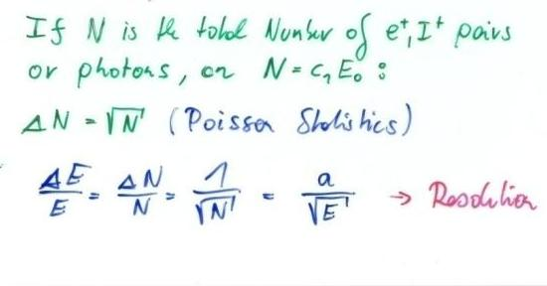
Calorimetry: Energy Measurement by total Absorption of Particles
Only Electrons and High Energy Photons show EM cascades at current GeV-TeV level Energies.
Strongly interacting particles like Pions, Kaons, produce hadonic showers in a similar fashion to the EM cascade
Hadronic calorimetry
Momentum Spectrometer: Δp/p α p
Calorimeter: Δ E/E α 1/ √ E
Energy measurement improves with higher particle energies – LHC !

Slide 35
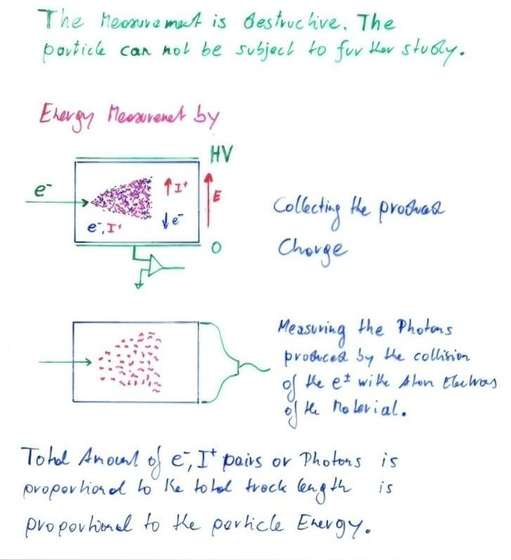
Calorimetry: Energy Measurement by total Absorption of Particles
Liquid Nobel Gases
(Nobel Liquids)
Scintillating Crystals,
Plastic Scintillators

Slide 36
Calorimetry
Calorimeters are blocks of instrumented material in which particles to be measured are fully absorbed and their energy transformed into a measurable quantity.
The interaction of the incident particle with the detector (through electro-magnetic or strong processes) produces a shower of secondary particles with progressively degraded energy.
The energy deposited by the charged particles of the shower in the active part of the calorimeter, which can be detected in the form of charge or light, serves as a measurement of the energy of the incident particle.
C.W. Fabjan and F. Gianotti, Rev. Mod. Phys., Vol. 75, N0. 4, October 2003

Slide 37
Calorimetry
Calorimeters can be classified into:
Electromagnetic Calorimeters,
to measure electrons and photons through their EM interactions.
Hadron Calorimeters,
Used to measure hadrons through their strong and EM interactions.
The construction can be classified into:
Homogeneous Calorimeters,
that are built of only one type of material that performs both tasks, energy degradation and signal generation.
Sampling Calorimeters,
that consist of alternating layers of an absorber, a dense material used to degrade the energy of the incident particle, and an active medium that provides the detectable signal.
C.W. Fabjan and F. Gianotti, Rev. Mod. Phys., Vol. 75, N0. 4, October 2003

Slide 38
Calorimetry
Calorimeters are attractive in our field for various reasons:
In contrast with magnet spectrometers, in which the momentum resolution deteriorates linearly with the particle momentum, on most cases the calorimeter energy resolution improves as 1/Sqrt(E), where E is the energy of the incident particle. Therefore calorimeters are very well suited for high-energy physics experiments.
In contrast to magnet spectrometers, calorimeters are sensitive to all types of particles, charged and neutral. They can even provide indirect detection of neutrinos and their energy through a measurement of the event missing energy.
Calorimeters are commonly used for trigger purposes since they can provide since they can provide fast signals that are easy to process and interpret.
They are space and therefore cost effective. Because the shower length increases only logarithmically with energy, the detector thickness needs to increase only logarithmically with the energy of the particles. In contrast for a fixed momentum resolution, the bending power BL² of a magnetic spectrometer must increase linearly with the particle momentum.
C.W. Fabjan and F. Gianotti, Rev. Mod. Phys., Vol. 75, N0. 4, October 2003

Slide 39
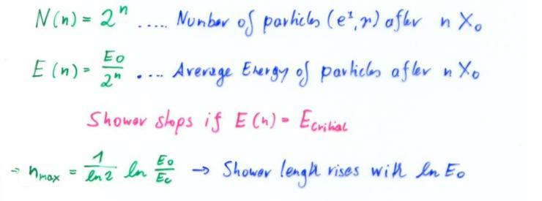
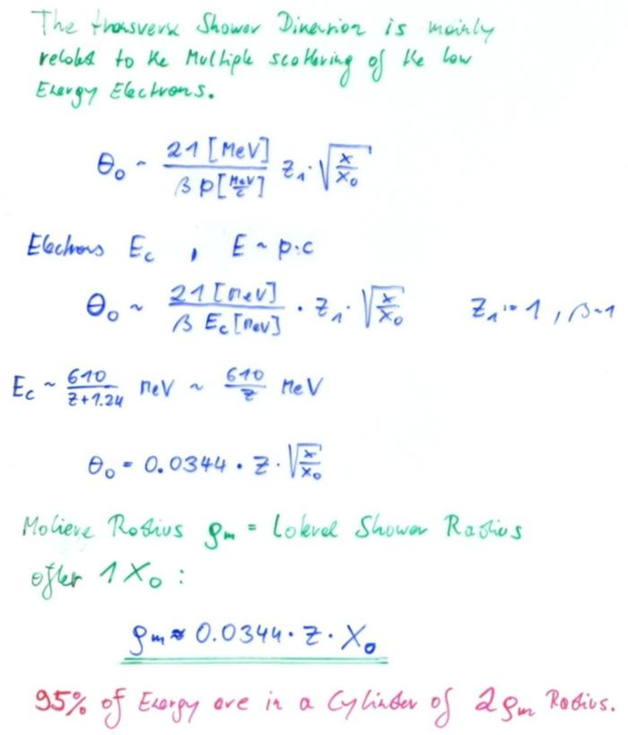
EM Calorimetry
Approximate longitudinal shower development Approximate transverse shower development
Radiation Length X₀ and Moliere Radius are two key parameters for choice of calorimeter materials

Slide 40
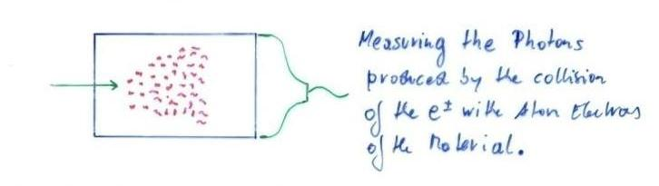
Crystals for Homogeneous EM Calorimetry
In crystals the light emission is related to the crystal structure of the material. Incident charged particles create electron-hole pairs and photons are emitted when electrons return to the valence band.
The incident electron or photon is completely absorbed and the produced amount of light, which is reflected through the transparent crystal, is measured by photomultipliers or solid state photon detectors.

Slide 41
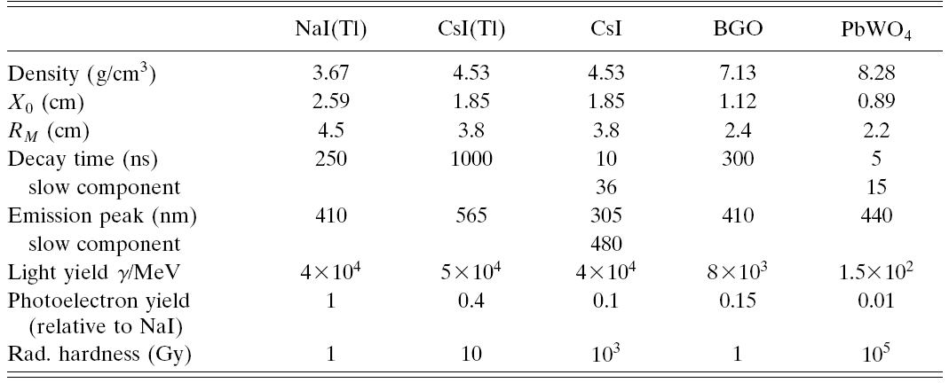
Crystals for Homogeneous EM Calorimetry
Barbar@PEPII,
10ms interaction rate, good light yield, good S/N
KTeV@Tevatron,
High rate,
Good resolution
L3@LEP, 25us bunch crossing,
Low radiation dose
CMS@LHC, 25ns bunch crossing,
high radiation dose

Slide 42
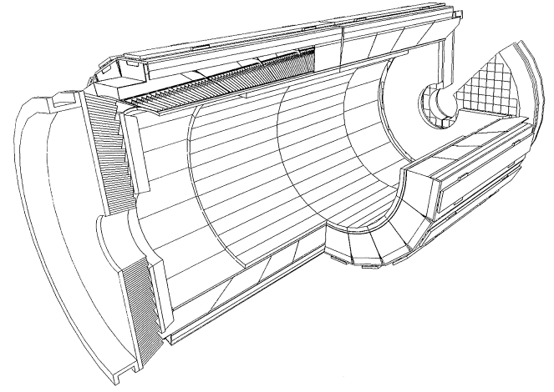
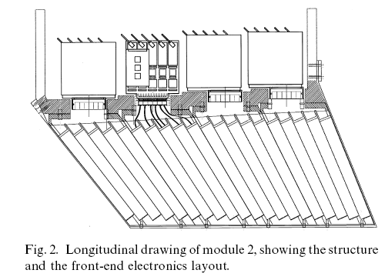
Crystals for Homogeneous EM Calorimetry

Slide 43
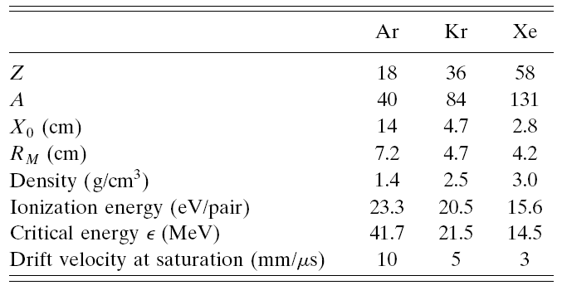
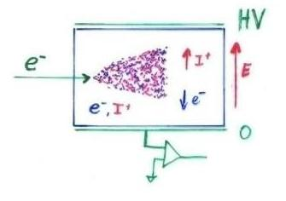
Noble Liquids for Homogeneous EM Calorimetry
When a charge particle traverses these materials, about half the lost energy is converted into ionization and half into scintillation.
The best energy resolution would obviously be obtained by collecting both the charge and light signal. This is however rarely done because of the technical difficulties to extract light and charge in the same instrument.
Krypton is preferred in homogeneous detectors due to small radiation length and therefore compact detectors. Liquid Argon is frequently used due to low cost and high purity in sampling calorimeters (see later).

Slide 44
Noble Liquids for Homogeneous EM Calorimetry
I₂
Z=D
E
-q, v_{I}
q,v_{e}
Z=0
I₁
E.g. Liquid Argon, 5mm/ μs at 1kV/cm, 5mm gap → 1 μs for all electrons to reach the electrode.
The ion velocity is 10³ to 10⁵ times smaller → doesn’t contribute to the signal for electronics of μs integration time.
I₁(t)
T~1μs

Slide 45
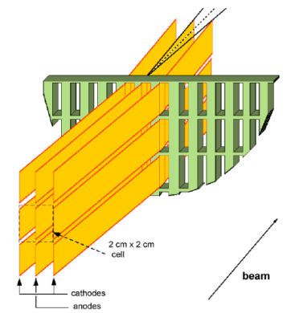
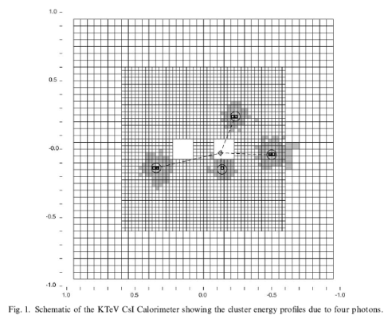
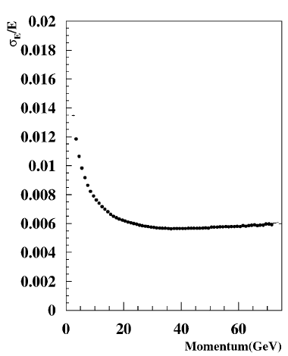
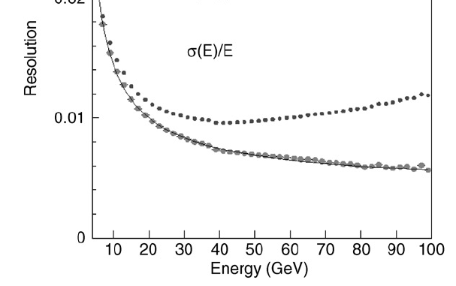
Homogeneous EM Calorimeters, Examples
NA48 Liquid Krypton
2cmx2cm cells
X₀ = 4.7cm
125cm length (27X₀)
ρ = 5.5cm
KTeV CsI
5cmx5cm and
X₀ = 1.85cm
2.5cmx2.5cm crystals
50cm length (27X₀)
ρ = 3.5cm
NA48 Experiment at CERN and KTeV Experiment at Fermilab, both built for measurement of direct CP violation. Homogenous calorimeters with Liquid Krypton (NA48) and CsI (KTeV). Excellent and very similar resolution.
1%
0.8%
0.6%
1%
0.8%
0.6%

Slide 46
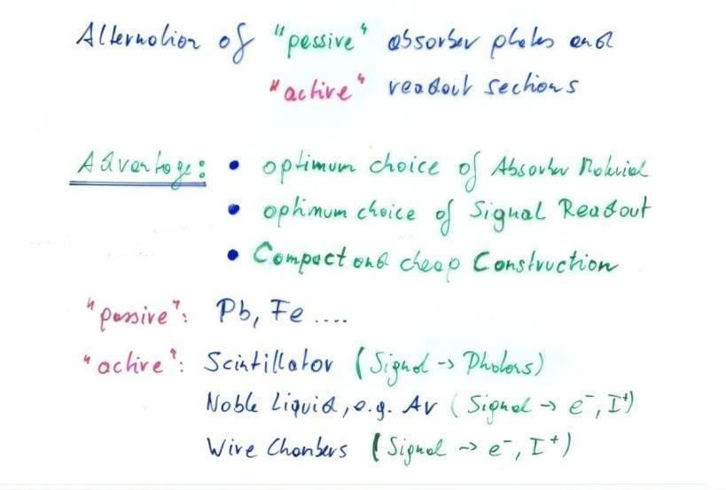

Sampling Calorimeters
Energy resolution of sampling calorimeters is in general worse than that of homogeneous calorimeters, owing to the sampling fluctuations – the fluctuation of ratio of energy deposited in the active and passive material.
The resolution is typically in the range 5-20%/Sqrt[E(GeV)] for EM calorimeters. On the other hand they are relatively easy to segment longitudinally and laterally and therefore they usually offer better space resolution and particle identification than homogeneous calorimeters.
The active medium can be scintillators (organic), solid state detectors, gas detectors or liquids.
Sampling Fraction = Energy deposited in Active/Energy deposited in passive material.

Slide 47


Hadronic Calorimetry

Slide 48


Hadron Calorimeters are Large because  is large
Hadron Calorimeters are large and heavy because the hadronic interaction length , the ‘strong interaction equivalent’ to the EM radiation length X₀, is large (5-10 times larger than X₀)
Because part of the energy is ‘invisible’ (nuclear excitation, slow nucleons), the resolution of hadron calorimeters is typically worse than in EM calorimeters 20-100%/Sqrt[E(GeV)] .

Slide 49
Particle Identification

Slide 50


Particle Identification
The momentum of a charged particle is determined by the bending radius in the magnetic field.
If we measure the velocity in addition to the momentum we find the mass i.e. the particle type !

Slide 51




Time of Flight (TOF)
Detectors with the best possible time resolution are needed. With Scintillators or Resistive Plate Chambers, <50ps can be achieved !
Kaon, Pion, Proton separation up to a few GeV/c.
NA49 combined particle ID: TOF + dE/dx (TPC)

Slide 52



dE/dx Measurements
Measured energy loss
‘average’ energy loss
The energy loss of a particle depends on the particle velocity only (Bethe Bloch Formula)
→ In certain momentum ranges up to tens of GeV, particles can be identified by measuring the energy loss.

Slide 53




Ring Imaging Cherenkov Detector
Measuring the Cerenkov angle i.e. the ring radius when using a spherical mirror determines the particle velocity.

Slide 54


Transition Radiation

Slide 55


Particle Identification
TOF, dE/dx, Cerenkov, Transition radiation (Calorimetry)
Nature provides us with a technique for every momentum rage (gamma rage) !

Slide 56
Particle Identification

Slide 57

ALICE

Slide 58
ALICE Particle ID
Alice uses ~ all
known techniques!
TPC + ITS
(dE/dx)
π/K
K/p
e /π
TOF
e /π
π/K
K/p
HMPID
(RICH)
π/K
K/p
0 1 2 3 4 5 p (GeV/c)
TPC (rel. rise) π /K/p
TRD e /π
PHOS γ /π⁰
π/K
K/p
1 10 100 p (GeV/c)

Slide 59

AMS
Will be installed on the space station.

Slide 60

AMS

Slide 61

AMS

Slide 62
A few Reasons why you want to become an Experimental Particle Physicist
The Standard Model of Particles Physics, a theory that was established in the early 1970ies, is in excellent agreement with experiments. Especially the LEP experiments verified the theory to impressive precision.
The Higgs Particle, a necessary element of the standard model, is being hunted at LHC.
Although the standard model is perfectly fitting the experiment, we know/think that it cannot be the final answer:
CP violation and the other CKM matrix elements are put into the model explicitly and they are not derived from a theory.
The masses of the particles are also unexplained.
The Matter- Antimatter asymmetry in the Universe cannot be explained by the level of standard model CP violation.
The cosmological constant predicted by the standard model differs by 120 orders of magnitude from the observed one.
The Higgs mass renormalization requires fine tuning operations etc. etc.

Slide 63
A few Reasons why you want to become an Experimental Particle Physicist
Incredible efforts by the smartest theorists did not really advance on these questions and did not touch base with experiment.
It is very difficult to find out what is wrong with the theory if all experimental results are fitting the theory.
If we would find the standard model Higgs at LHC it would be an very impressive confirmation of the Standard Model, but we would not at all advance on the questions quoted earlier.
Hopefully we find something in contradiction with the Standard Model !!!
The next step in advancing our knowledge will come from Experiment. Maybe LHC or some telescope, or some astrophysics experiment or some other future accelerator …
We have to invent new technologies for future accelerators and experiments !

Slide 64
x 10¹³ → LHC
Physicist 1: How can we build an accelerator with 10 times more energy ?
Physicist 2: Hmm – I have an idea !! We build a 10 times larger accelerator !
+
1.5V
_
e⁻
You
have to develop the tricks and technologies to advance on the most fundamental questions of Physics !

