Slide 1
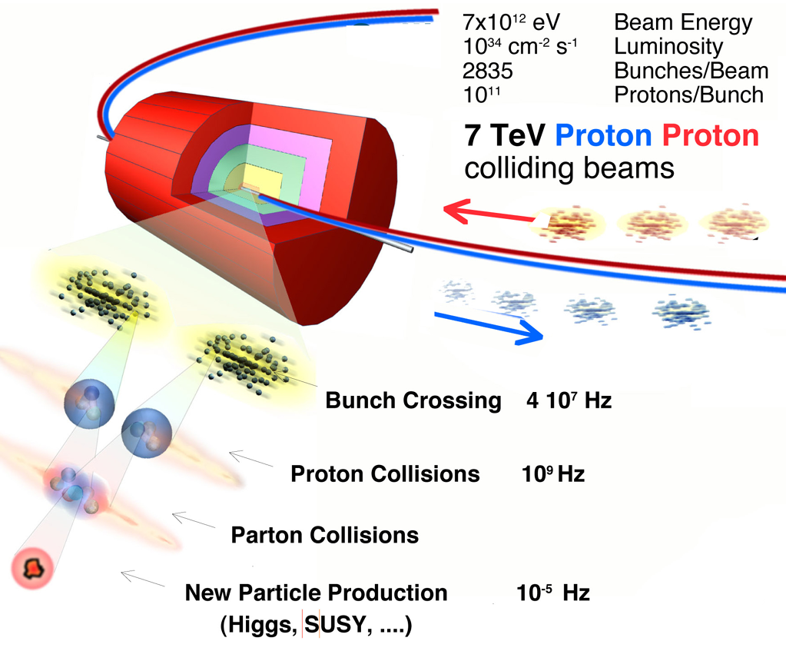
Installation, Commissioning and Startup of ATLAS & CMS Experiments

Slide 2


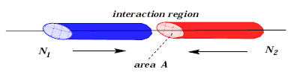
Collider Luminosity
The event rate R that we measure in a collider is proportional to the interaction cross section σ_{int} and the factor of proportionality is called the luminosity
If two bunches containing n₁ and n₂ particles collide with frequency f,
the luminosity is
PHYSICS
COLLIDER

Slide 3
Collider Luminosity
Luminosity is measured in units of
length⁻² * time⁻¹
Typical collider values are in the range of
10^{30±units} cm⁻² sec⁻¹

Slide 4
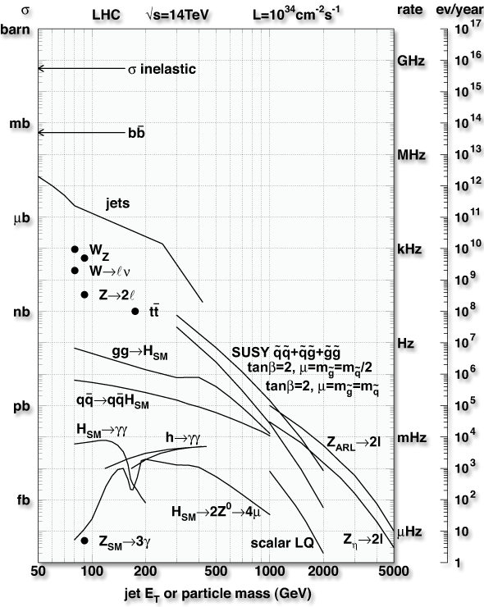
Search for new phenomena at LHC
Luminosity is like money: the more you have the better
10²⁸ Startup
1 event/s
10³¹ First months
10³² First year
1 event/s
10³³ Good machine
1 event/s
10³⁴ Design Lumi
1 event/s
1 event/s

Slide 5
How do we measure these phenomena ?
How physicists go from the "basic ideas of measuring some quantities" to the "design and
constructions and operation of large scale experiments".
?
Experiments
Theory
Falsification
Validation

Slide 6
Theory and Experiments
Exp: Particles have masses: …..why ?
Theo: Mass is given by the interaction with the Higgs field
Exp: Find the Higgs Boson
Exp: There are 3 Forces: ……why ?
Theo: Super Symmetry unifies the Forces
Exp: Find the signals of Super Symmetry

Slide 7
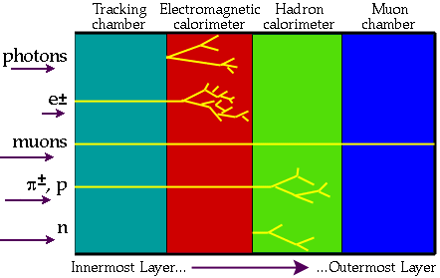
Basic detector
New physics will be detected by the production of NEW PARTICLES. These particles will disintegrate in very short time (10⁻²⁴ s) and we will detect their decay products. The particles that we will detect are particles with “long-life-time”. The LHC detectors are designed to record the largest possible amount of information about these final state particles.

Slide 8
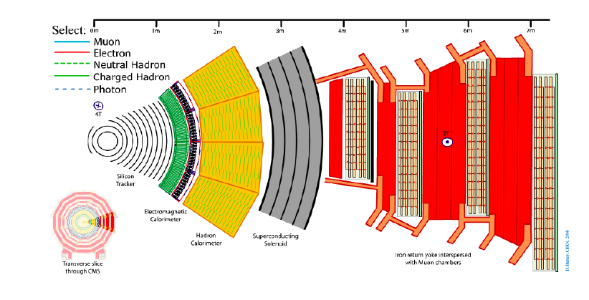
CMS SLICE
http://cms.web.cern.ch/cms/Resources/Website/Media/Videos/Animations/files/CMS_Slice.swf

Slide 9
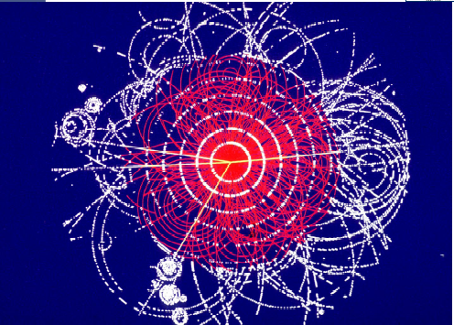
Simulation of an Higgs Boson decay in ATLAS
H→ ZZ →μμee

Slide 10
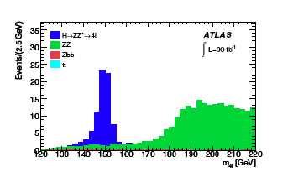
Detecting the Higgs Boson
IF the Higgs boson exists
IF LHC gives large Luminosity for long time
IF you have built a performing detector
IF you have been able to record the events at high rate
IF you are able to reconstruct correctly the events
IF you have aligned and calibrated your detector
IF you have understood your muon and electron identification
IF you are able to run the detector under stable conditions for long time
……. then …… after years of hard work
30fb⁻¹ 1year at L= 10³³ cm⁻² s⁻¹

Slide 11
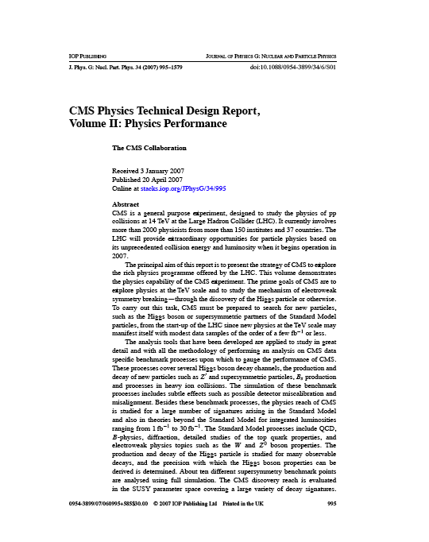
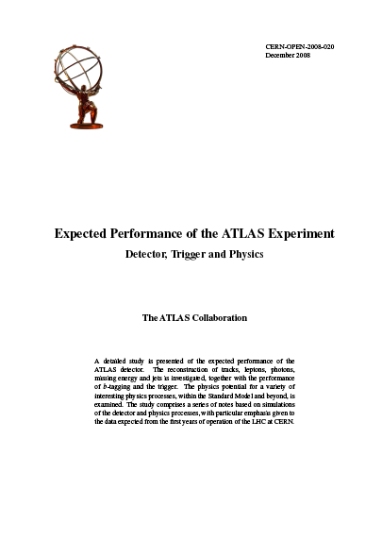
ATLAS and CMS Physics Program
http://cdsweb.cern.ch/record/1125884?ln=en
http://www.iop.org/EJ/abstract/0954-3899/34/6/S01/

Slide 12
What can be done at the beginning ?
LHC first data from Fall 2009…..
100 pb⁻¹ = 6 months at 10³¹ cm⁻² sec⁻¹
at 50% efficiency we may collect several 100 pb⁻¹ during the first LHC run
Channels (examples) | Events to tape for 100 pb-1 | Total statistics from previous Colliders
W→μν | ~10⁶ | ~10⁴ LEP ~10⁶ TEVA.
Z→μμ | ~10⁵ | ~10⁵ TEVATRON
tt →Wb Wb → μν+X | 10⁴ | 10⁴ TEVATRON
SUSY ~ mass 500 GeV | 10² | ----

Slide 13
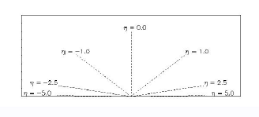
Hadronic Collider variables
p
p_{T}
θ
p_{T} = p sinθ
Pseudorapidity:
θ = 90º → η = 0
θ = 10º → η ≅ 2.4
θ = 170º → η ≅ -2.4

Slide 14
First DAYS
10²⁸ Startup
1 event/s

Slide 15
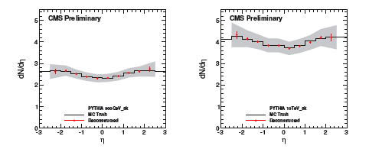
Minimum Bias Events
Most interactions are due to collisions at large distance between incoming protons where protons interact as “ a whole ” → small momentum transfer (Δp ≈  /Δx ) → particles in final state have large longitudinal momentum but small transverse momentum (scattering at large angle is small)
Minimum bias events
50 mb⁻¹
few seconds of data taking

Slide 16
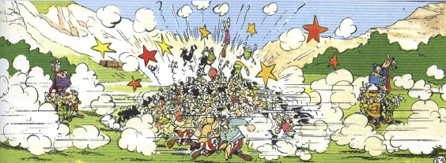
Hard scattering
Monochromatic proton beam can be seen as beam of quarks and gluons with a wide band of energy. Occasionally hard scattering (“ head on”)
between constituents of incoming protons occurs.
x₁p
x₂p
Spectator partons

Slide 17
First weeks
10³¹ Startup
1 event/s

Slide 18
JET Production
At LHC the rate of di-jet mass above 500 GeV is 1 Hz for L = 10³¹
parton+parton → parton+parton
parton can be gluon, quark, anti-quark

Slide 19
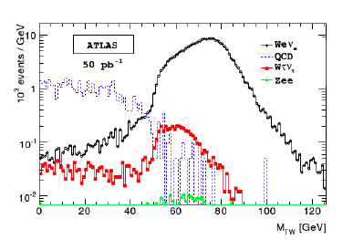
W and Z production
U-quark +anti-d quark -→ W → e ν
few weeks at 10³² cm⁻² sec⁻¹

Slide 20
Can we do physics since the beginning ?
not likely !
first ….we must
understand the detector

Slide 21
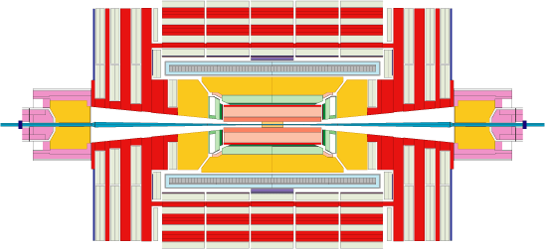
“Pre-Collision Physics Structures”
Cosmic Muons
High energetic muons that traverse
the detector vertically
→particular useful for alignment
and calibration - barrel region.
Beam
Beam Halo Muons
Machine induced secondary particles that cross the detector almost horizontally
→particular useful for
alignment and calibration - endcap region.

Slide 22
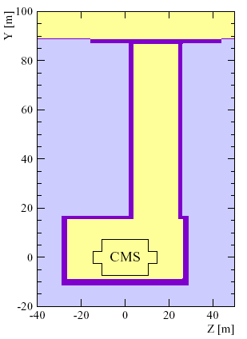
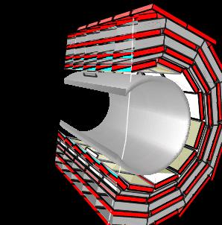
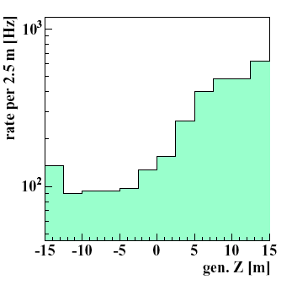
Cosmic Muons
Substantial Rates
for E_{μ}>10 GeV
IP5
N_{HIT}≥1 | Rate[Hz]
CMS tot | ~1800
Muon only | ~1800
calorimeter | ~ 700
tracker | ~ 60
Cosmic Muons:
Special Topology (traverse whole detector) makes them very attractive for various commissioning activities (e.g. alignment, operational experience with high energetic muons, etc …
Asymmetric distribution
due to access shaft

Slide 23
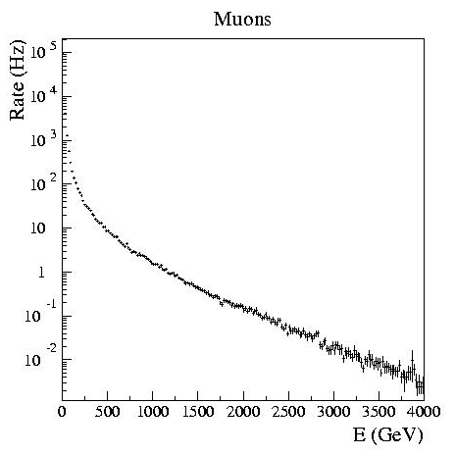
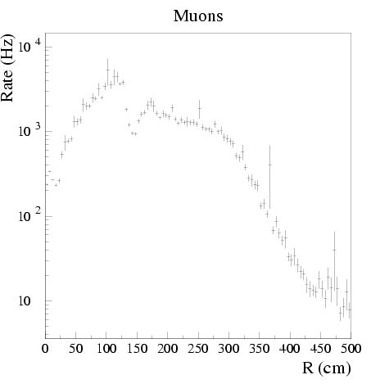
Beam Halo Muons
Beam halo muons are machine induced secondary particles
and cross the detector almost horizontally. Thus leaving essentially signals
in the endcaps.
Muons
Muons
Rather flat rate
E in GeV
R in cm
Substantial Expected Rates for E_{μ}>100 GeV
⇒Very interesting for several commissioning
efforts of the endcap regions
N_{HIT}≥1 | [Hz]
CMS tot | ~1000
Muon | ~ 800
Calo. | ~ 800
tracker | ~ 200

Slide 24
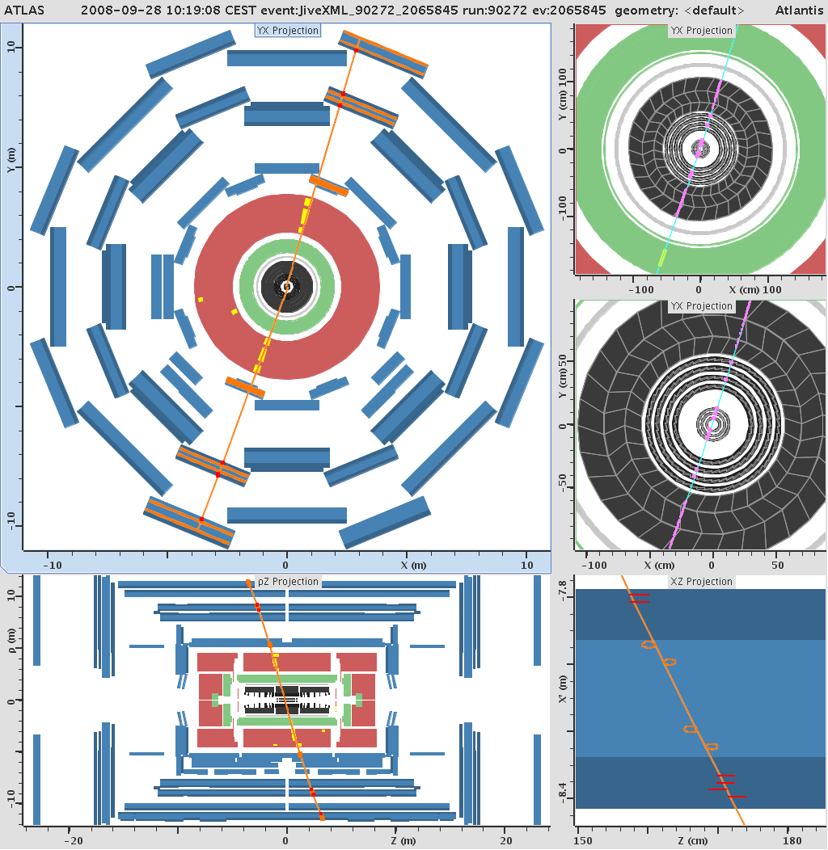
ATLAS COSMIC EVENT

Slide 25
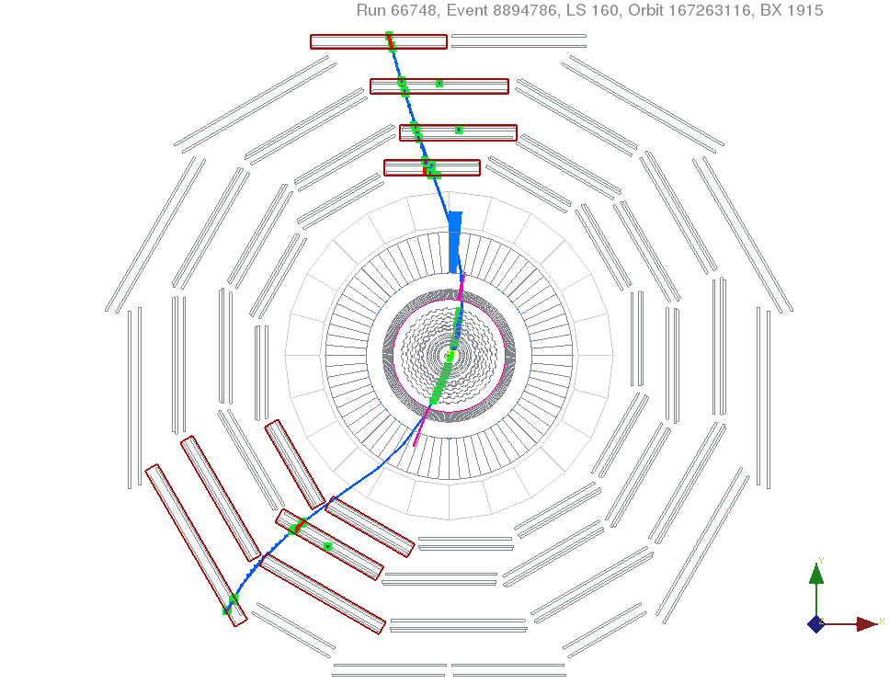
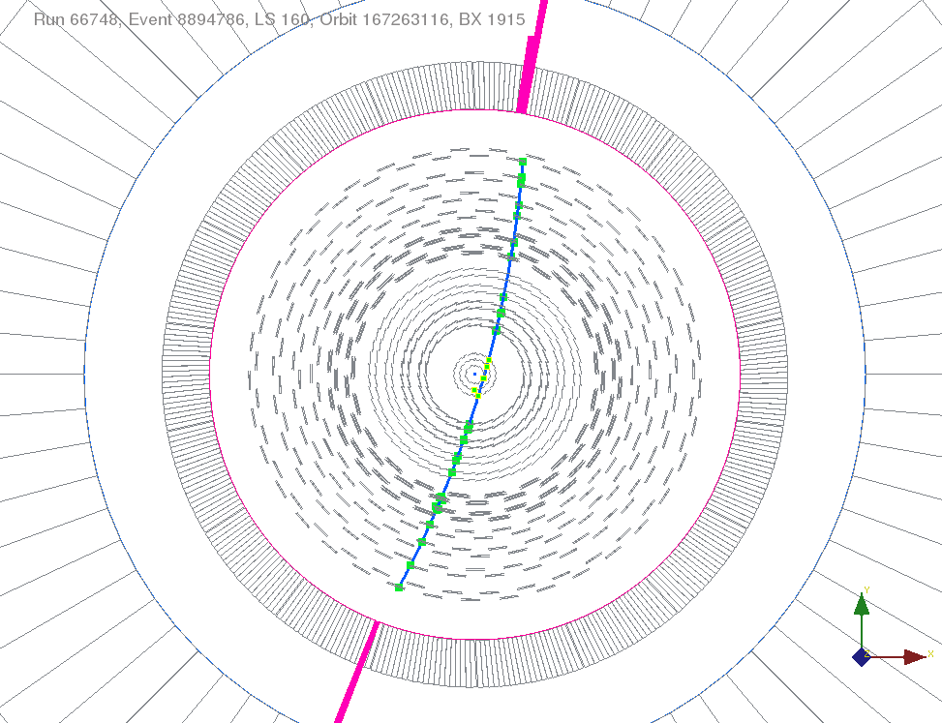
CMS COSMIC EVENT

Slide 26
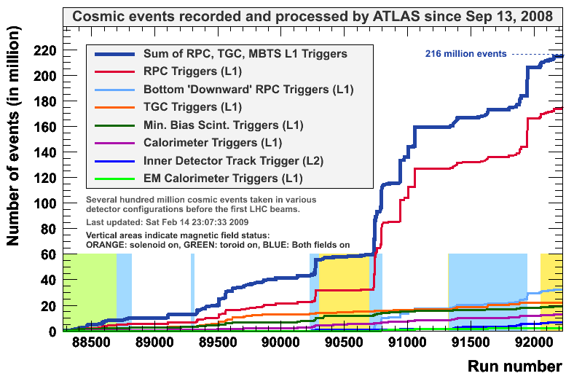
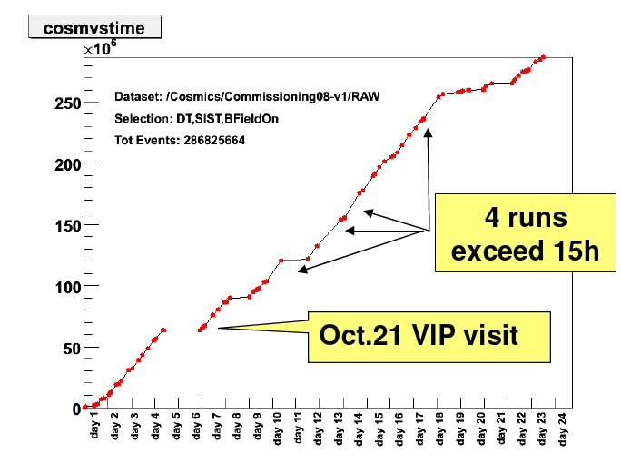
ATLAS and CMS COSMIC RUN

Slide 27
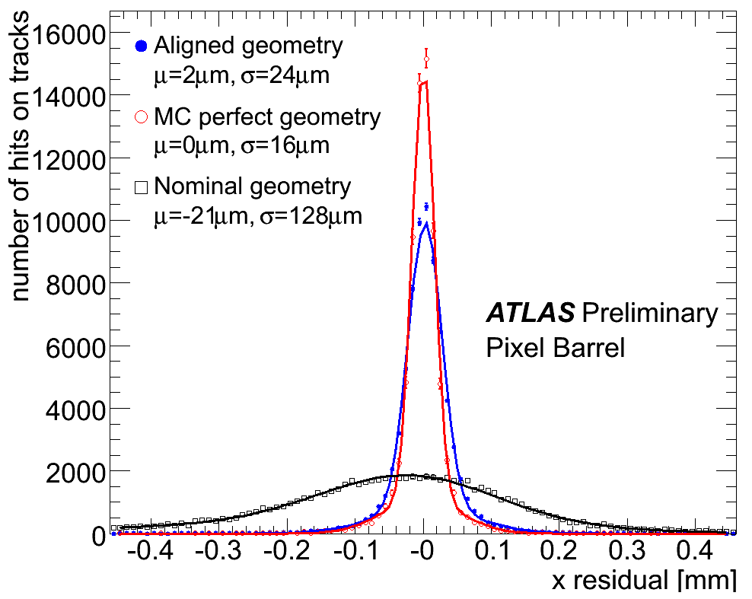
ALIGNMENT

Slide 28
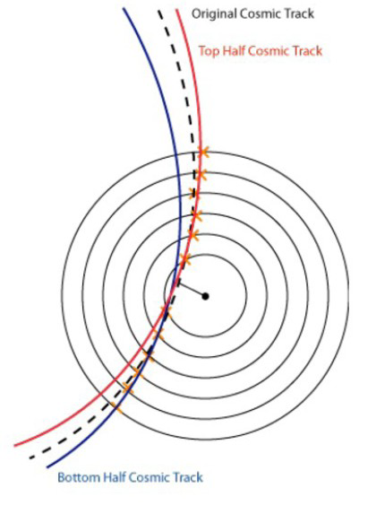
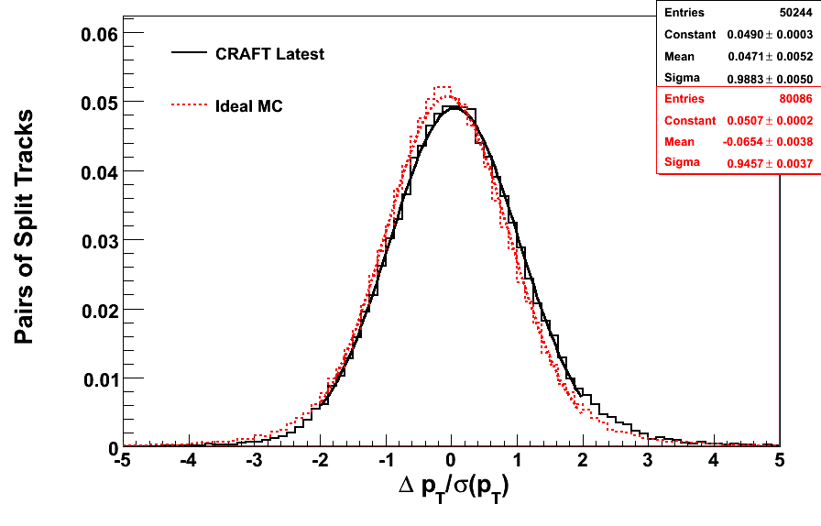
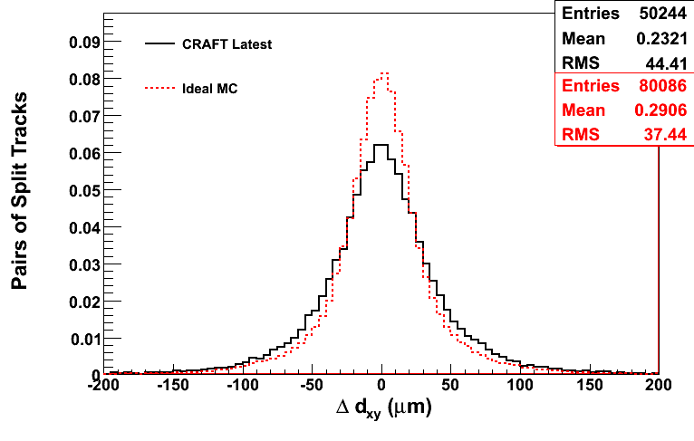
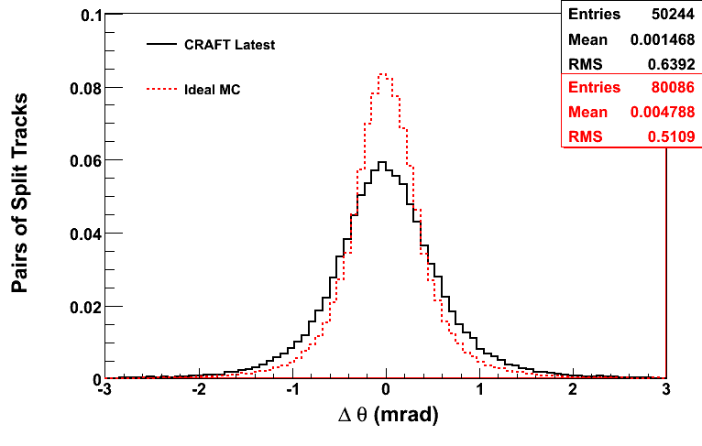
TRACKER RESOLUTION
CMS

Slide 29
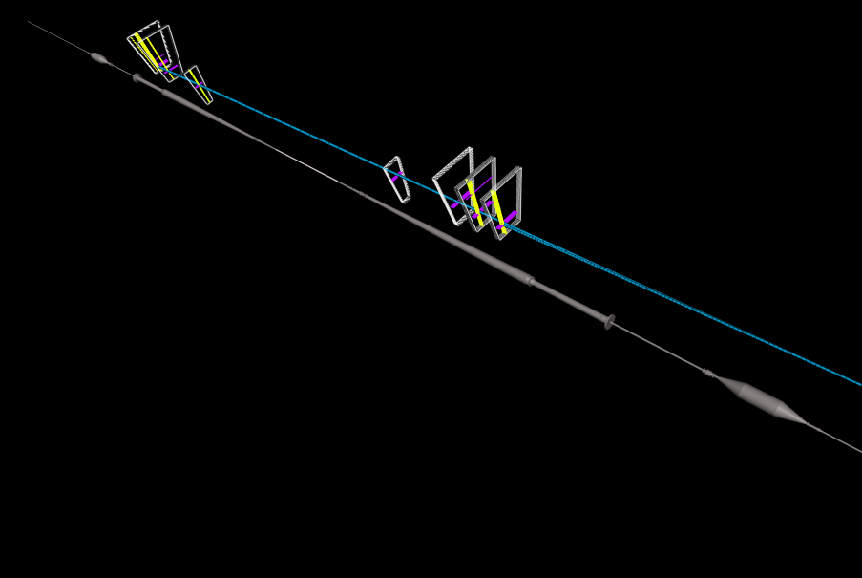
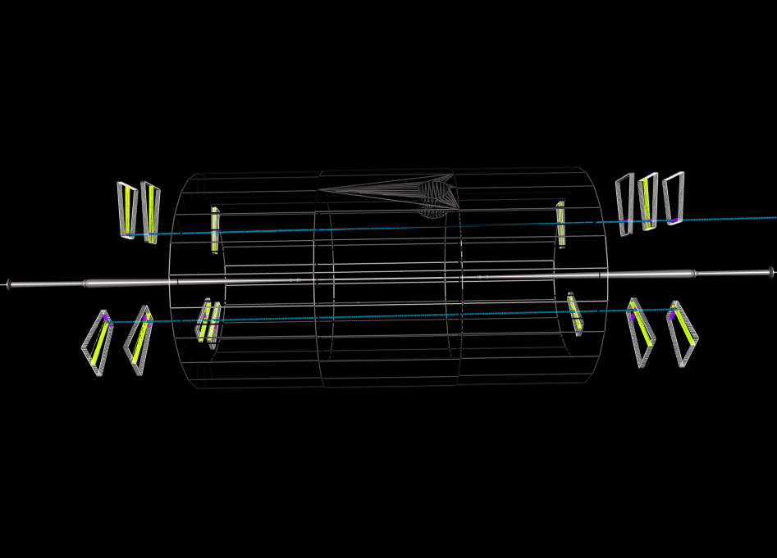
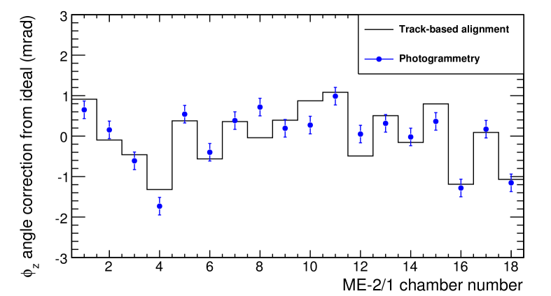
BEAM HALO MUONS IN CMS

Slide 30
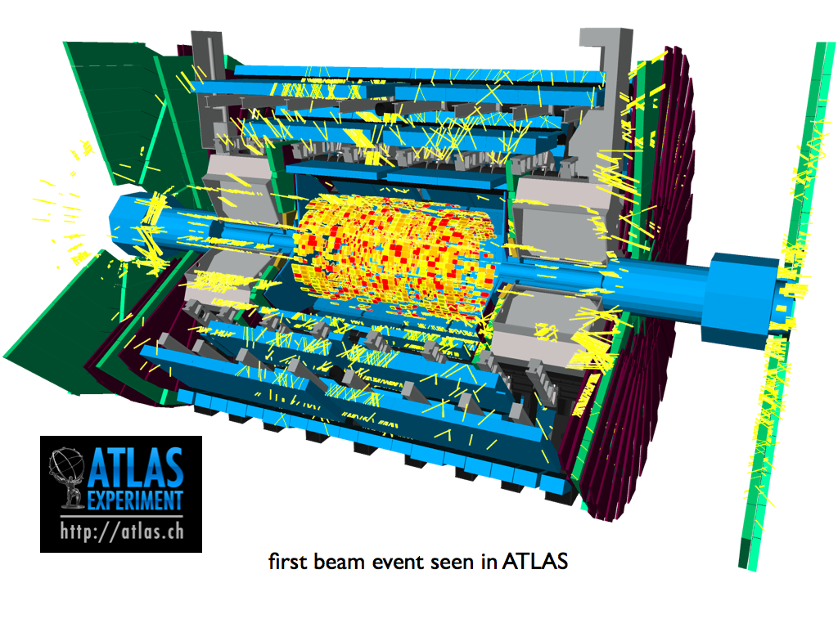
BEAM SPLASH EVENTS
During a test, one bunch of ~10⁹ protons at 450 GeV was dumped on a collimator few hundreds meters upstream of the detectors producing ~ 10⁶ muons (average energy 30 GeV) traversing the detector at the same time

Slide 31
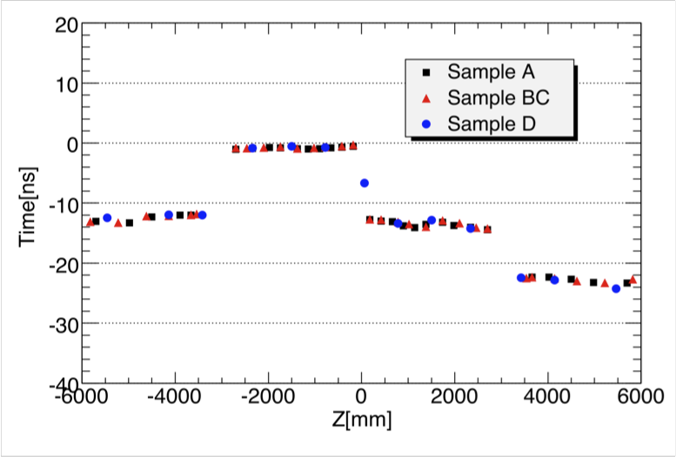
Timing of ATLAS TILE CAL
Each group was calibrated in time with laser
The visible discontinuities at Z= 0, ± 3000 mm are due to the uncorrected time differences between the four TileCal partitions. This data provided the opportunity to correct this discontinuity.

Slide 32
CONCLUSIONS
ATLAS and CMS arrived well prepared to the first rendezvous with the beam on the 10th of September 2008. Unfortunately it lasted only few days. Nonetheless the beam halo and beam splash events have been extremely useful to perform first calibrations
Since then the experiments have collected few hundred millions of cosmic rays that have been used for commissioning and have substantially improved the calibration of the detectors.
In July/August ATLAS and CMS will be again in run with cosmic rays preparing for the second rendezvous with the LHC beam, and this time it will be forever !

Slide 33
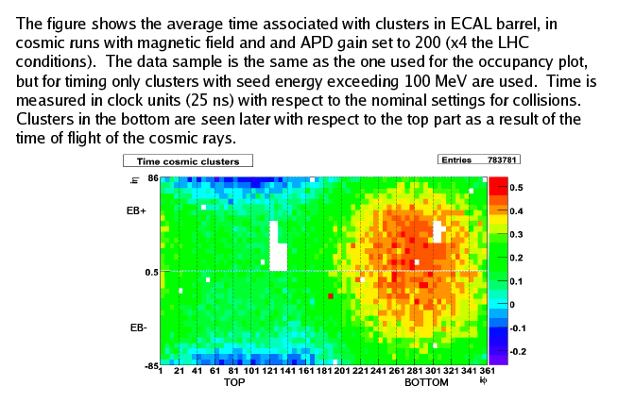
CMS ECAL TIMING

Slide 34
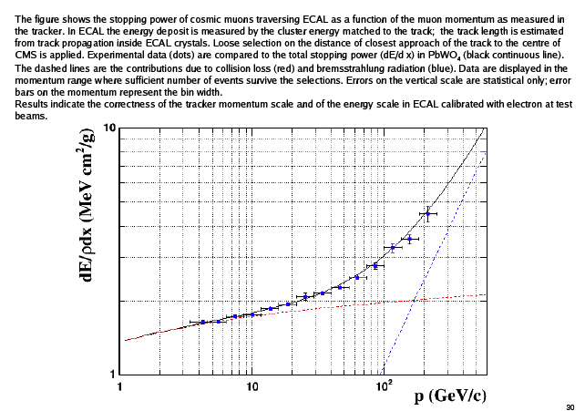
STOPPING POWER IN CMS CRYSTALS

Slide 35
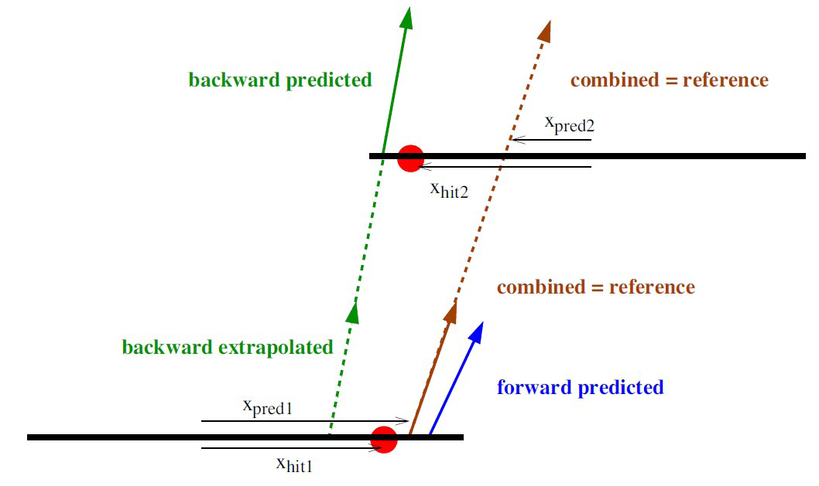
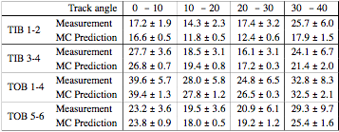
Strip Tracker Hit resolution
Strip hit resolution in TIB and TOB (after alignment)
  From comparison of measured and
  predicted differences of hit positions in
  region of overlap of two modules in a
  same detector layer
Hit resolution measured on CRAFT data and predicted by the model
in the Monte Carlo Simulation, for the different local track angles

