Slide 1
Stringy Predictions for Particle Physics
Cumrun Vafa
May 9, 2012
Phenomenology 2012 Symposium
University of Pittsburgh

Slide 2
The material I will present here is based on work
I have done with Jonathan Heckman.
Some of them include additional colleagues
(Chris Beasley, Vincent Bouchard, Sergio Cecotti,
Miranda Cheng, Clay Cordova , Gordon Kane, Piyush Kumar,
Joseph Marsano, Natalia Saulina, Jihye Seo,
Sakura Schafer-Nameki, Jing Shao, Yuji Tachikawa ,
Alireza Tavanfar and Brian Wecht)
B

Slide 3
String theory has a vast landscape of potential vacua
Which one is ours?
How can string theory make a prediction for particle
physics without resolving this question?
I will not resolve this issue. Yet I indicate how one can
nevertheless make some qualitative and semi-quantitative
predictions about particle physics from reasonable
assumptions.

Slide 4
Supersymmetry:
A basic principle of string theory at the
Planck or GUT scale
What scale is it broken?
1-Much higher scale than weak scale
2-Near the weak scale

Slide 5
Supersymmetry:
A basic principle of string theory at the
Planck or GUT scale
What scale is it broken?
1-Much higher scale than weak scale
predictions for flavor physics
2-Near the weak scale
predictions for LHC physics

Slide 6
The Flavor Puzzles
Why three flavors?
Why masses are so hierarchic for quarks and charged leptons?
Why less hierarchy for neutrinos?
Why the quark mixing matrix (CKM) so hierarchic?
What explains the less hierarchic mixing matrix for leptons (PMNS)?

Slide 7
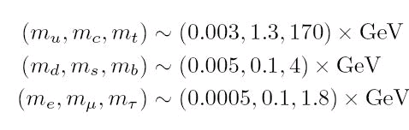
An unexpected mass hierarchy:

Slide 8
Ideas From Particle Physics
1-Why more than 1 flavor? There is no good explanation of this from the viewpoint of particle theory
2-Why hierarchic structure in masses? The best idea from particle theory to explain this comes from the work of
Froggatt-Nielsen: One postulates the existence of additional
U(1) symmetries which are broken only very weakly:

Slide 10
If U(1)xU(1)’ symmetry is an exact symmetry, all the entries of
the matrix which transform non-trivially under either one will
vanish. Thus in this limit the mass matrix would look like:

Slide 11
To get more realistic, one assumes that the U(1)xU(1)’
symmetry is violated by small amounts, captured by
Then we can estimate the order of vanishing
of the entries of the mass matrix based on the corresponding
charges:

Slide 12
Similarly the CKM matrix comes out hierarchical if the
same U(1) symmetries explain the hierarchy of the masses
of u-quarks and d-quarks :

Slide 13
Simple as these ideas sound, it does not offer a complete
picture: What is the meaning of these U(1)’s,
why are they violated, and what sets the size of this violation. Also
what sets the charges of flavors under these U(1)’s?
Clearly to answer these questions, and also to understand
why there is more than one flavor, we need a better picture!

Slide 14
The Main Assumption: String Theory!
Moreover:
1) Gravity should decouple from questions
of particle physics.
2) Local description of extra dimensions.
The phenomenological restrictions lead
to a corner of string landscape: F-Theory.

Slide 15
Gauge interactions are localized on small 7-branes of type IIB, or more precisely its strong coupling limit, F-theory.

Slide 16
Branes, Matter and Interactions in F-theory
Branes come in different types, labeled by A-D-E group,
carrying the corresponding gauge group.
On the intersection of branes, which is a 2-dimensional Riemann
surface, lives matter charged under the gauge symmetry
of the pair of branes:

Slide 17
This leads to 6d matter living on space-time times a
Riemann surface. For the 4d matter spectrum all we
have to do is find the zero modes of the Dirac operator,
taking into account flux on the 7-branes:

Slide 18
Flavors and F-theory
For each matter curve, 10, 5*:

Slide 20
To understand mass hierarchy we need to know why
is hierarchic.

Slide 21
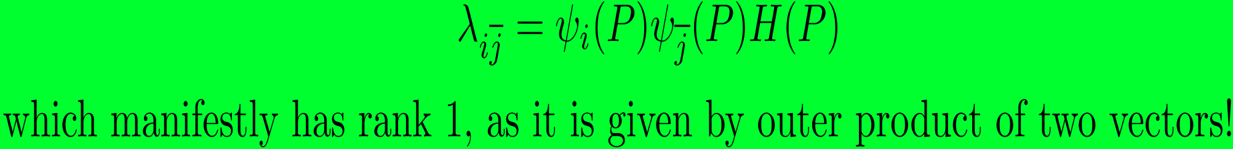
To leading order approximation for overlap of wave-functions

Slide 22
This rank one matrix can be organized as follows:

Slide 23
However, the U(1) symmetries are approximate rotational
symmetries: Curvatures and fluxes break the U(1)’s.
The relevant breaking turns out to be a 3-form flux:
The wave functions get modified and the overlap of wave
functions become non-zero:

Slide 26
F-theory and CKM Hierarchy
The hierarchy of CKM matrix, also receives a natural interpretation:

Slide 27
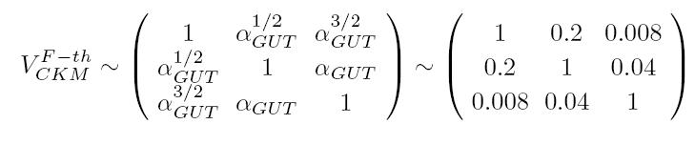
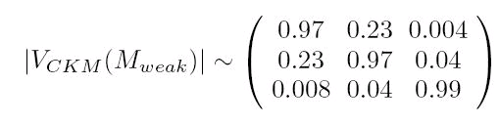
Very close indeed! It also predicts no fourth generation.

Slide 28
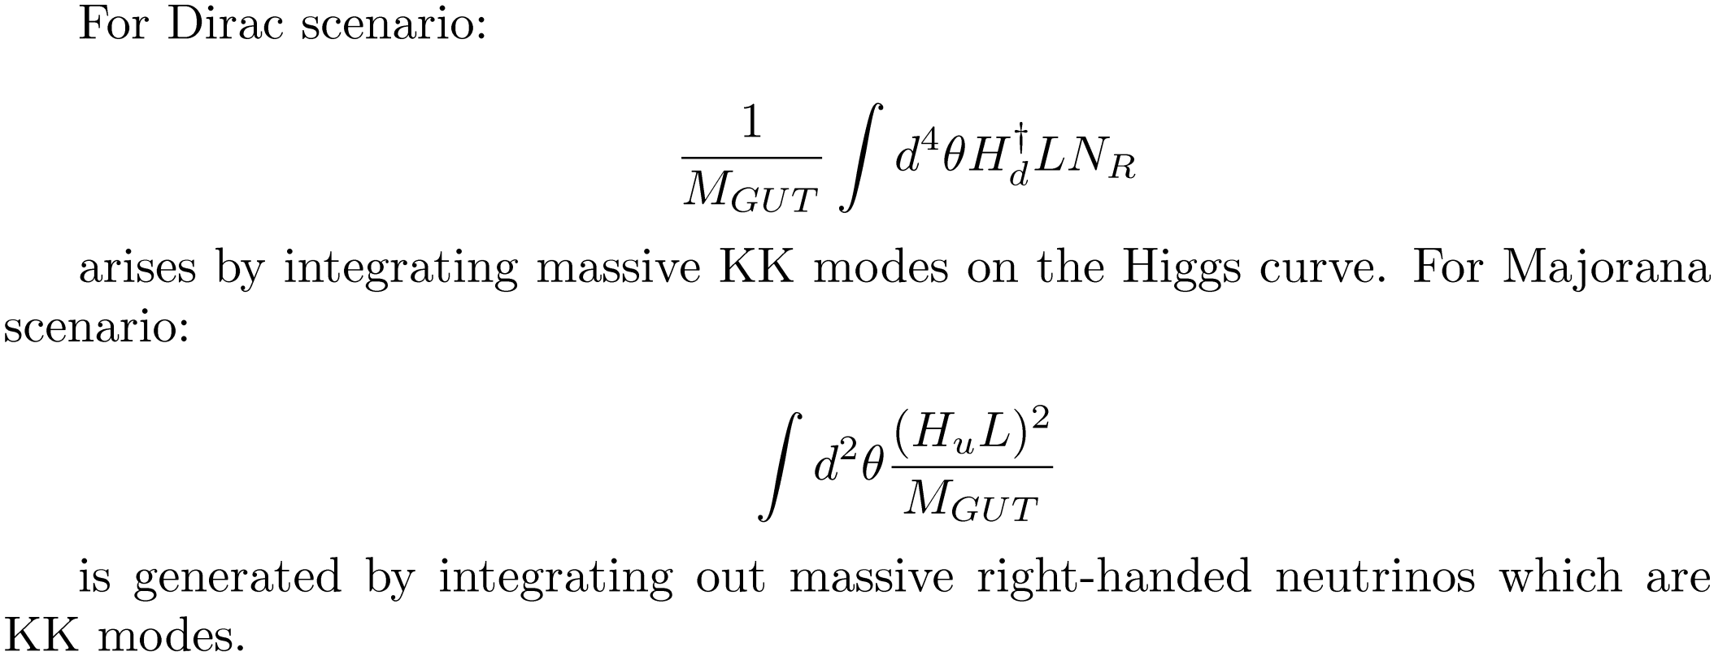
Neutrino Masses and Lepton Mixing Matrix
Both Majorana and Dirac Scenarios can be easily
implemented:

Slide 29
Due to the fact that in either scenario KK modes get
involved, and the KK modes are not zero modes, it
means that they are not holomorphic, i.e. they do not
respect the U(1) FN symmetries. Leads to dilution of
mass and mixing hierarchy.

Slide 32
This is close to current estimates for PMNS.

Slide 33
This is close to current estimates for PMNS.

Slide 34
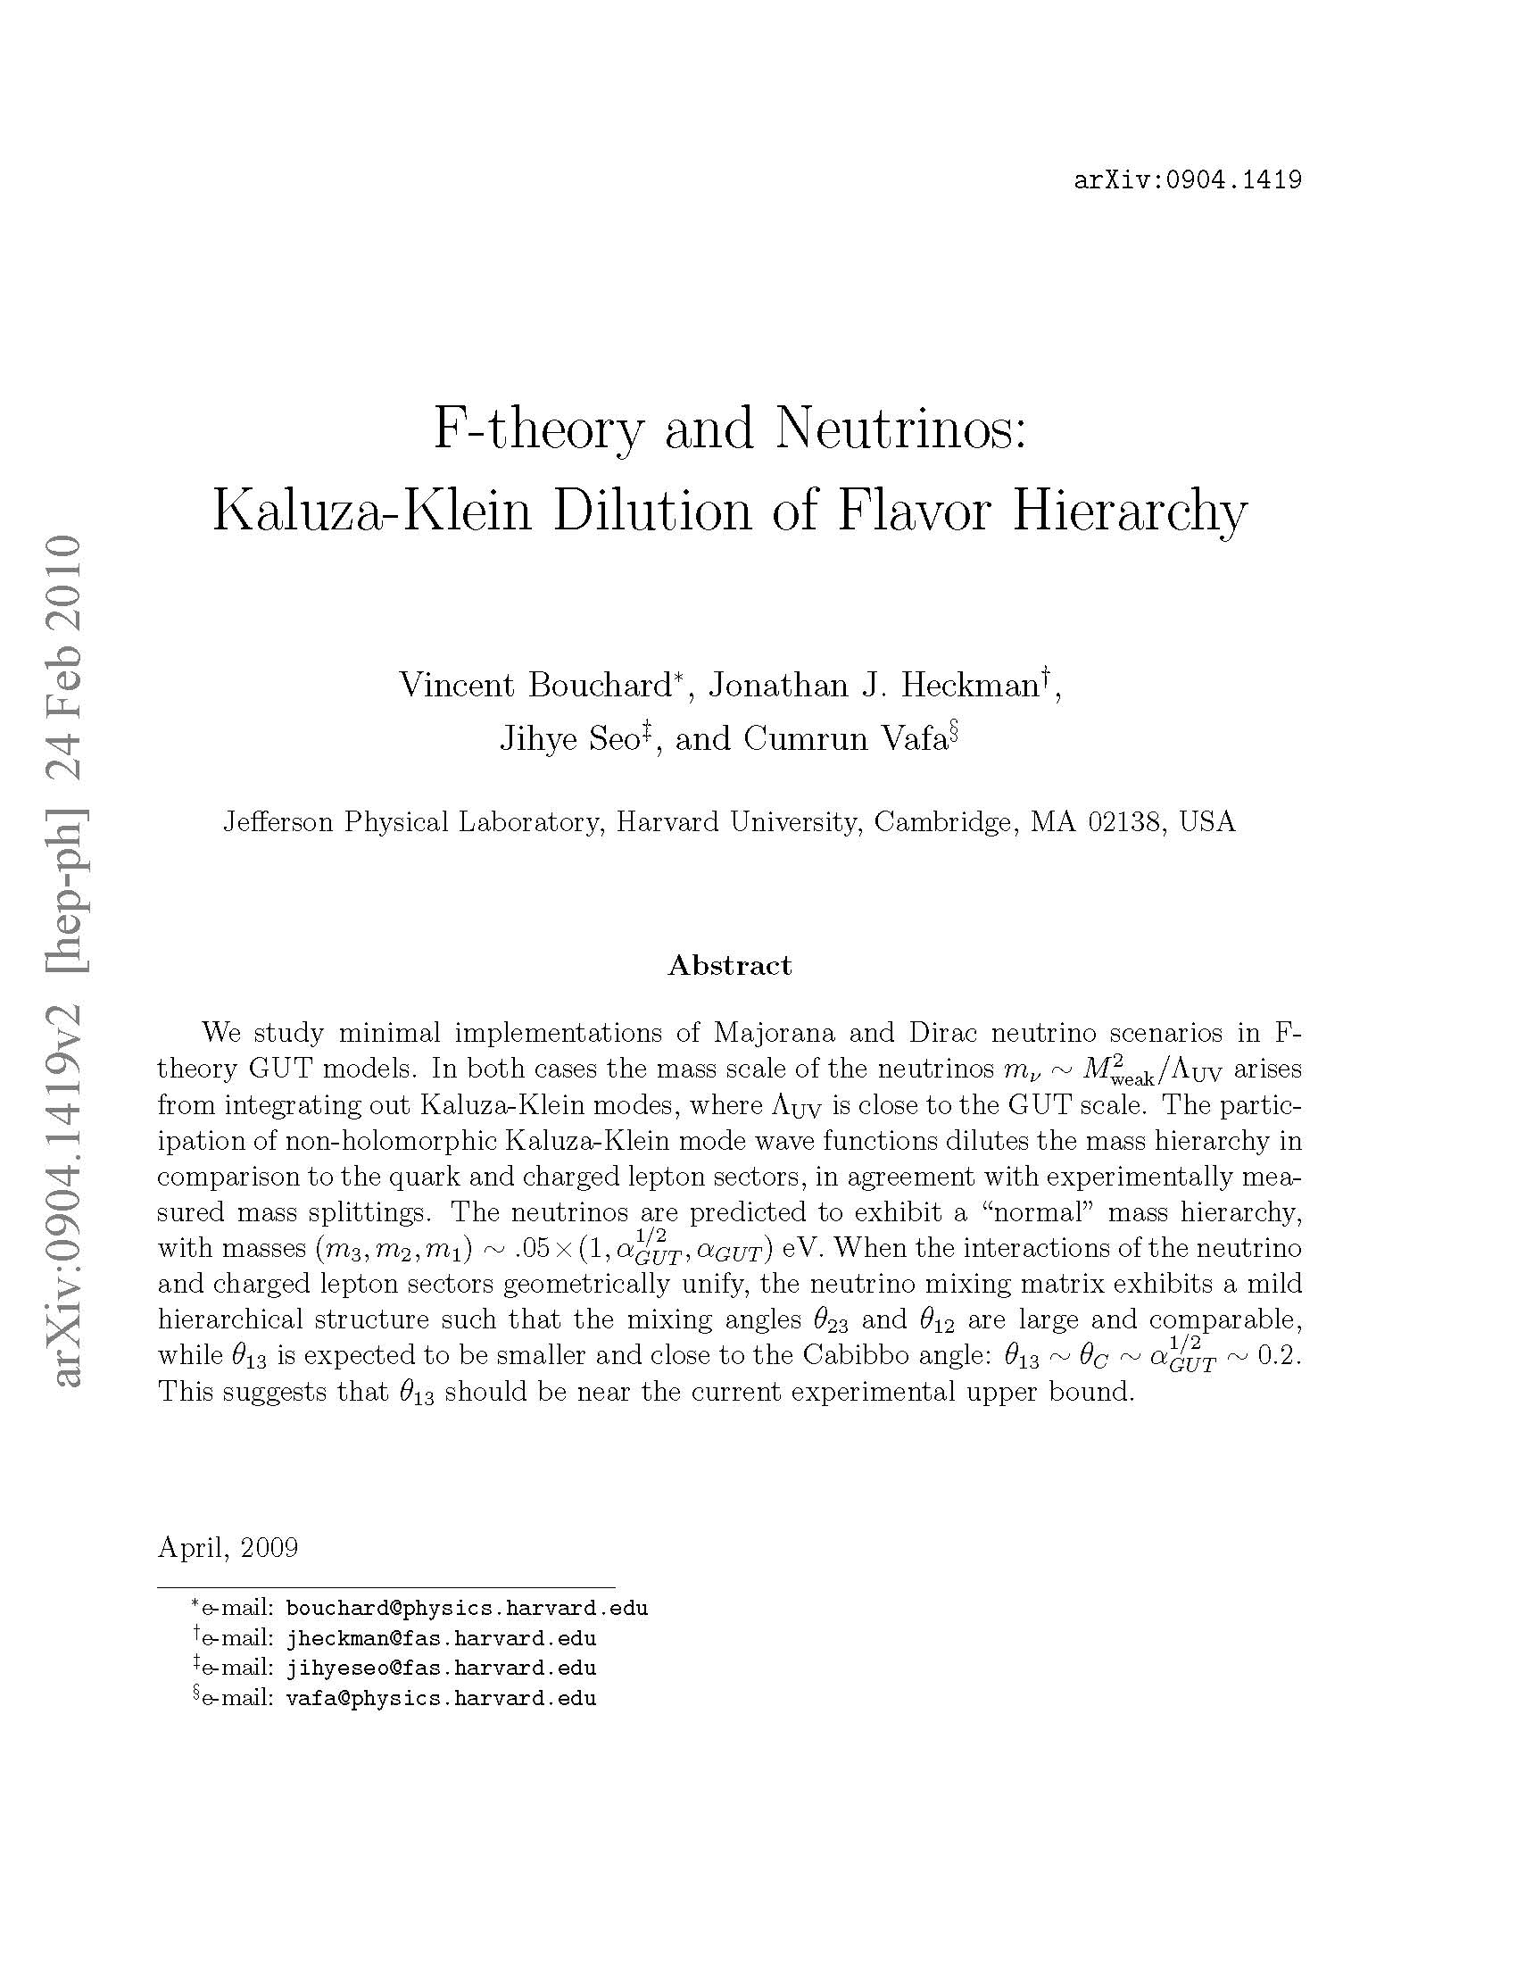

Slide 36
For the U(1) Froggatt-Nielsen symmetry to exaplain both
Flavor and CKM hierarchy we need that there is a point
In the internal geometry where all matter curves meet and
That point should enjoy an E8 symmetry.

Slide 37
What if SUSY persists all the way
down to the weak scale?
(slightly modified) GMSB
GM-mechanism generates mu-term
PQ symmetry important
Leads to: Gravitino LSP, 10-100 MeV
NLSP stau (or possibly Bino)
Mass depends on details of the model.
NLSP relatively long lived (sec-hour)

Slide 39
Furthermore, the fact that there is a point
of E8 symmetry, suggests a novel approach
to Higgs field (related to an additional
conformal sector one can introduce through
D3 branes probing this point).
This has led to a new model for modifying
MSSM (DSSM) which naturally leads to
more massive Higgs, and alleviates
the mini-hierarchy problem in SUSY models.

Slide 41
We will wait to see if SUSY plays any
role at the weak scale!

