Slide 1
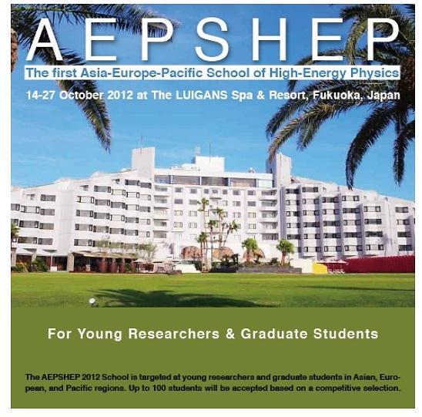

Particle Physics Projects
in Asia
Atsuto Suzuki
(KEK : High Energy Accelerator Research Organization)

Slide 2

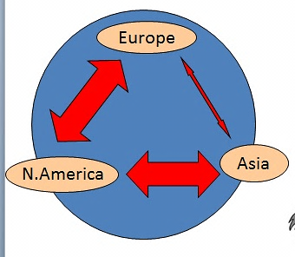
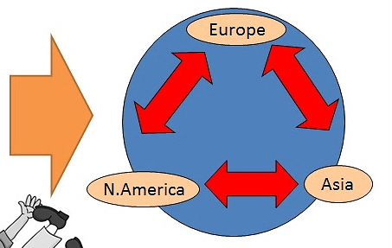
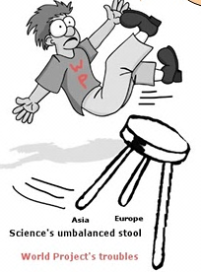
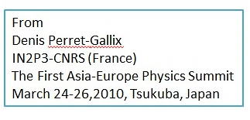

Slide 3
Outline
1. Quark Flavor Project
2. Lepton Flavor Project
3. Energy Frontier Project
4. Non-Accelerator Project
5. Summary

Slide 4
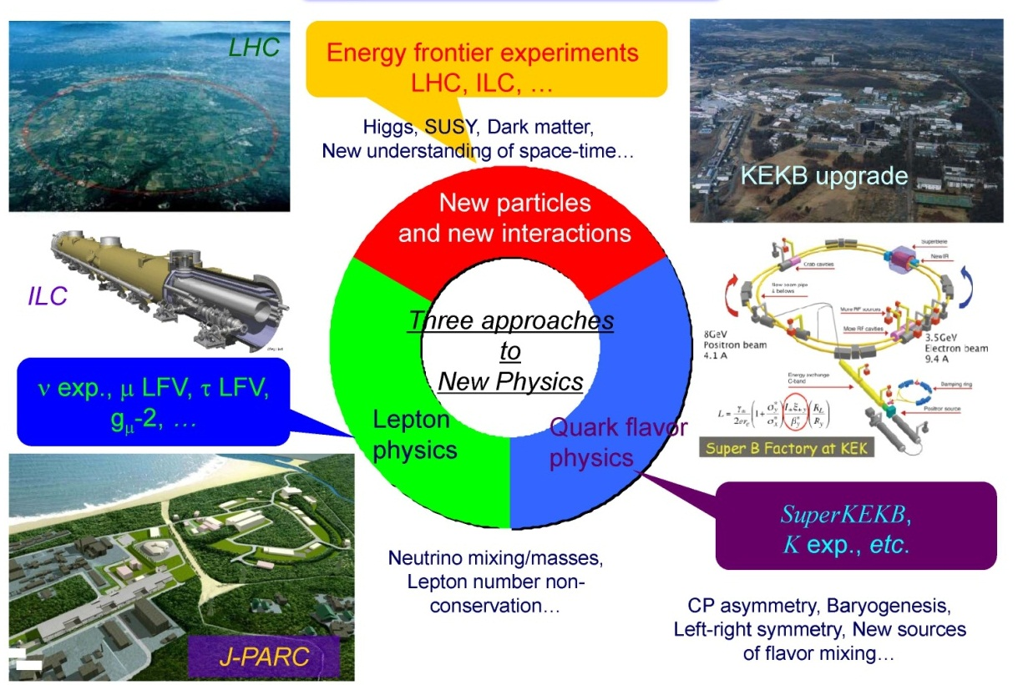
1. Quark Flavor Project
In 2008

Slide 5
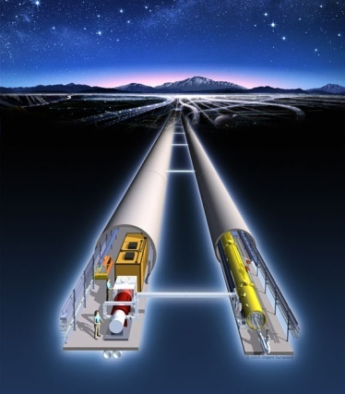
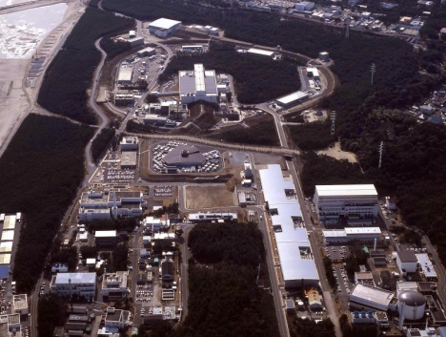
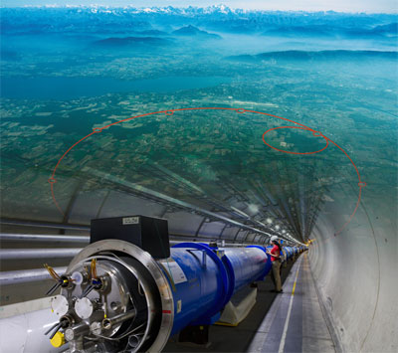
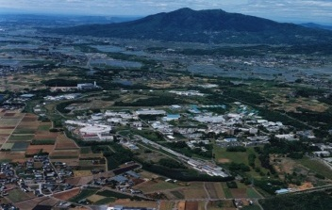
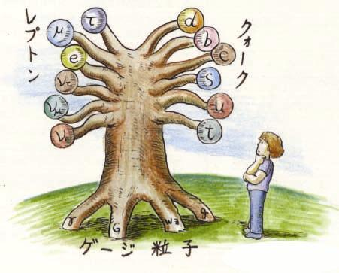
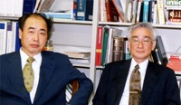
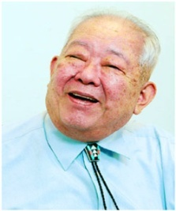
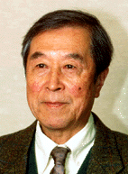
Quest for
Birth-Evolution
of Universe
Quest for Unifying
Matter and Force
International Linear Collider（ILC）
Scientific Activities
Technology Innovations
Talented Human Resources
Lepton CP Asymmetry
Beyond Standard Physics
Power-Upgrade
SuperKEKB
J-PARC
KEK-B
Quark CP Asymmetry
LHC
Lepton
Quark
ν_{τ}
[Origin of Matter]
ν_{μ}
Quest for Neutrinos
ν_{e}
Quest for 6 Quarks
[Origin of Force]
Higgs Particle [Origin of Mass]

Slide 6
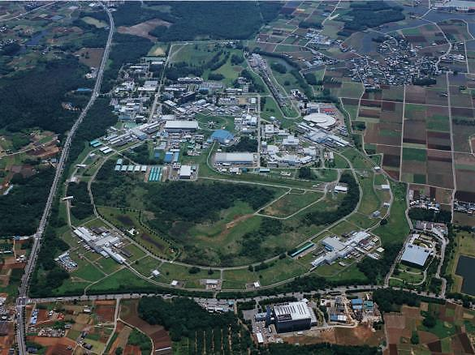
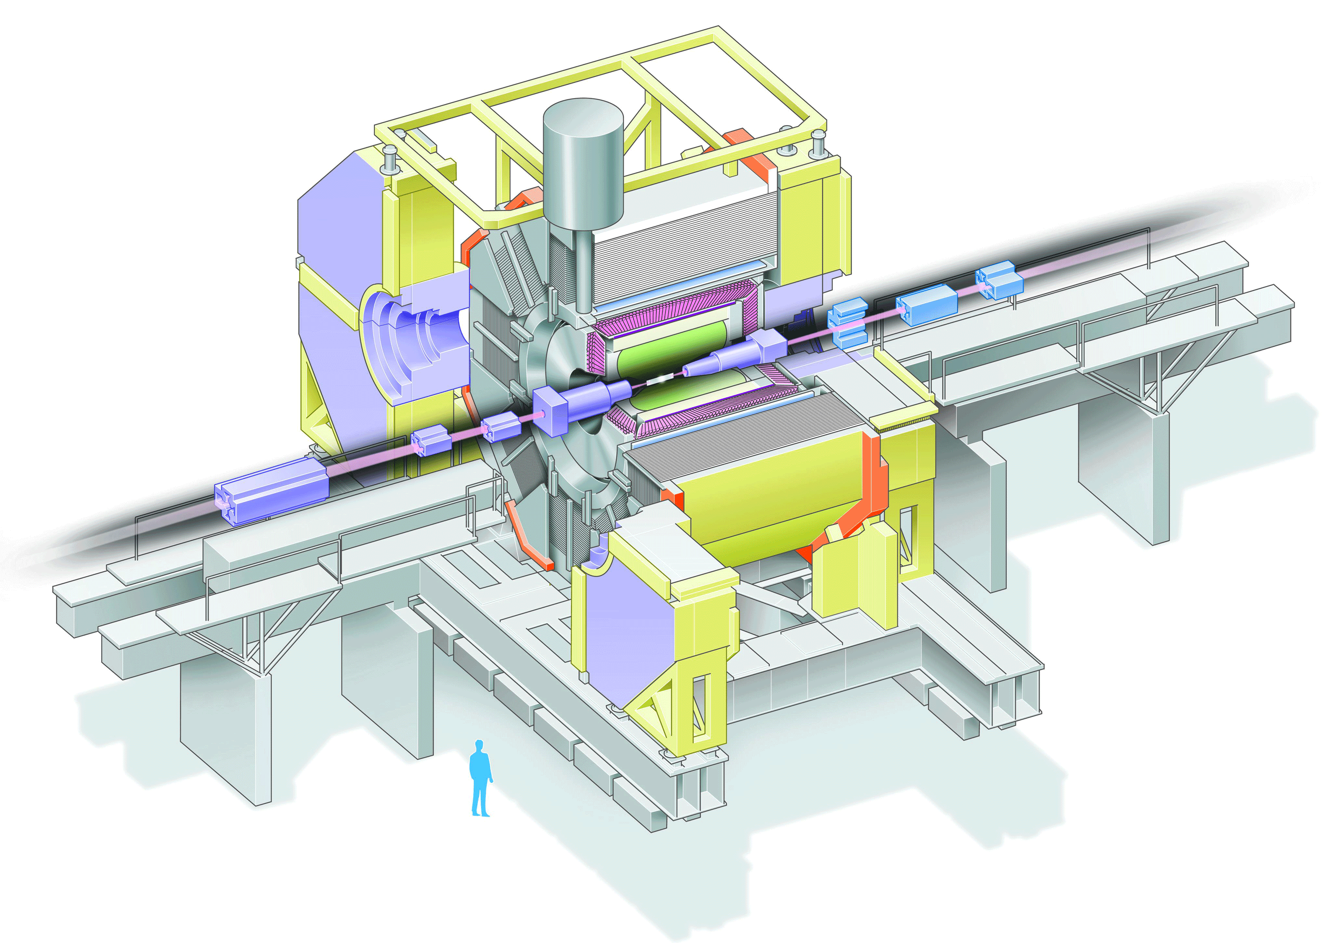
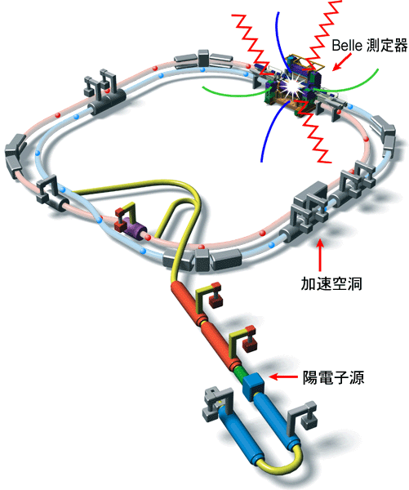
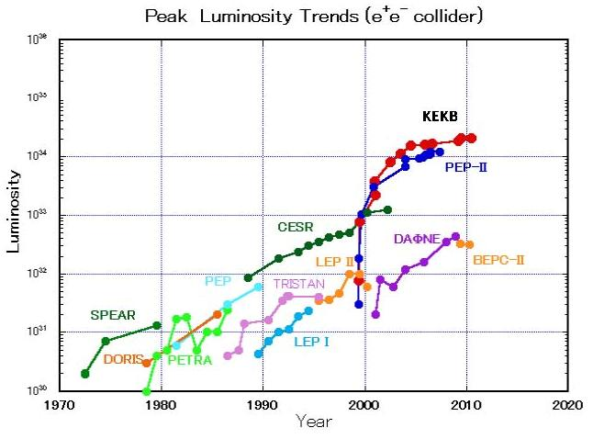
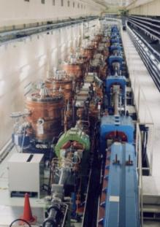
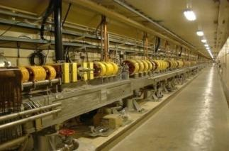
e⁻/e⁺ Collider
KEKB -> SuperKEKB
SCC RF(HER)
Belle Detector
8 GeV
e⁻
3.5 GeV
e⁺
10³⁶
SuperKEKB
Ares RF
cavity
50 times higher luminosity
e⁺ source
Peak Luminosity (cm⁻² s⁻¹)
TRISTAN

Slide 7

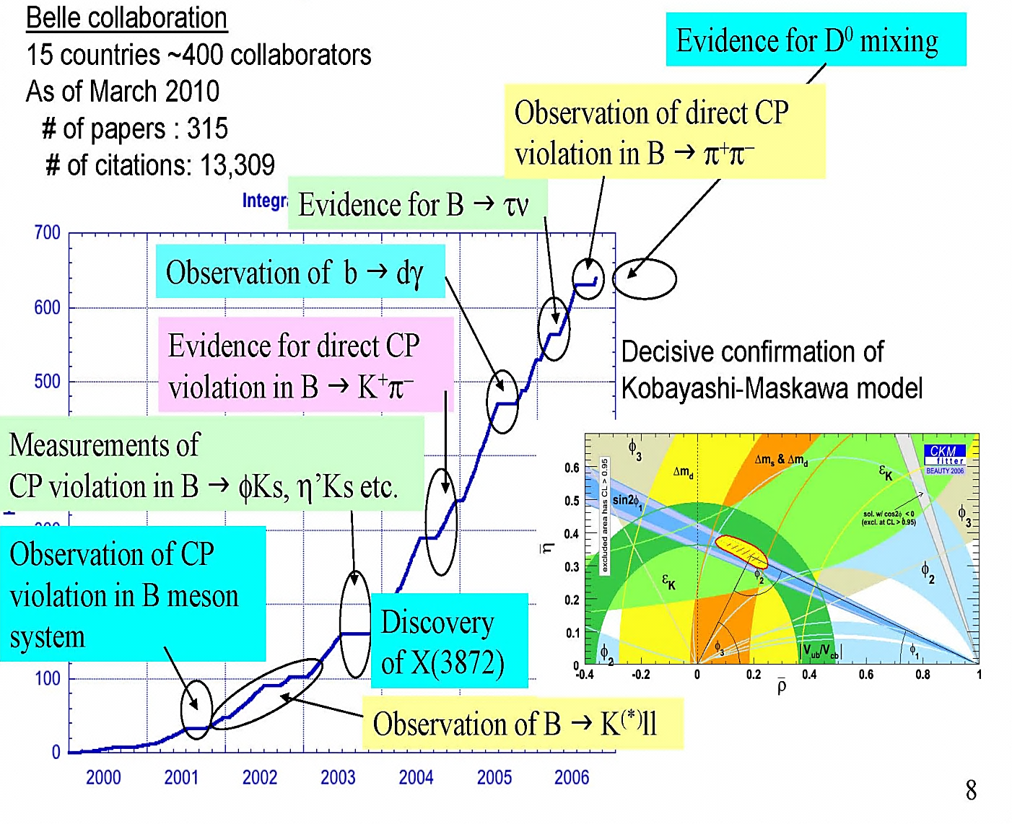
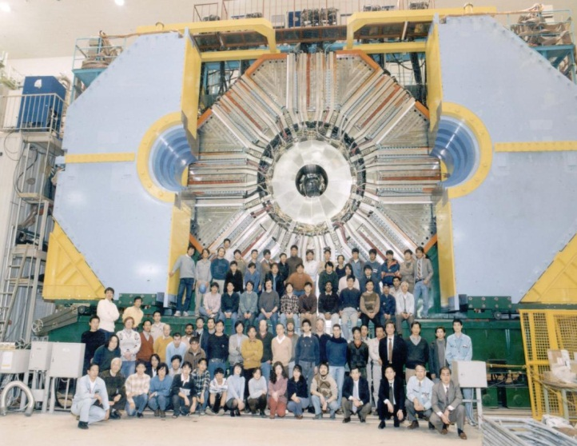
Belle Collaboration
15 countries, 400 collaborators
# of papers : 315
# of citations : 13,309
CPV:
caused by a single phase of CKM matrix

Slide 8


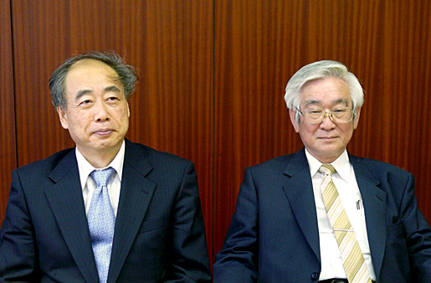
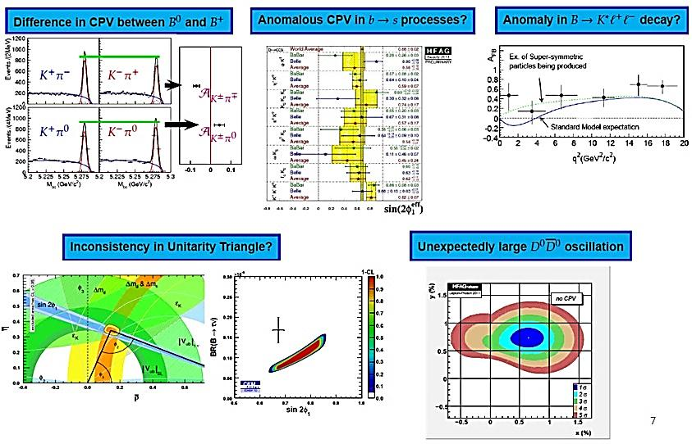
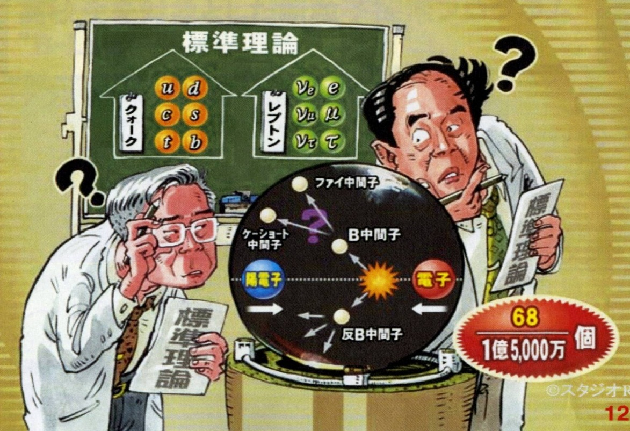

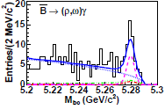
Standard Model
X(3872)
Z(4430)
SM
quark
lepton
Bgdγ transition
BgD*τν
Standard
Model
Standard
Model
Upgrade KEKB to SuperKEKB
with x 50 performance

Slide 9
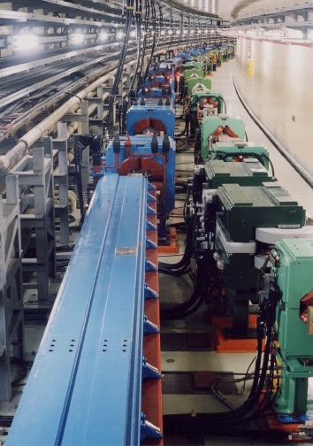


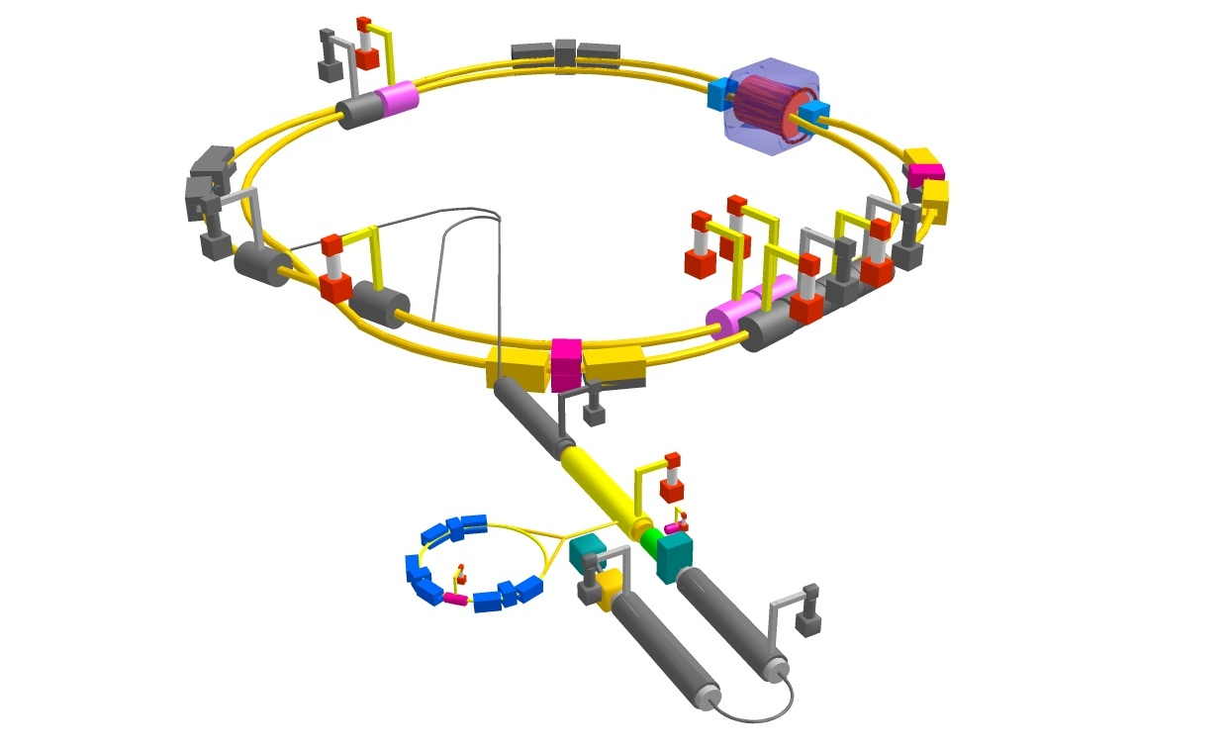
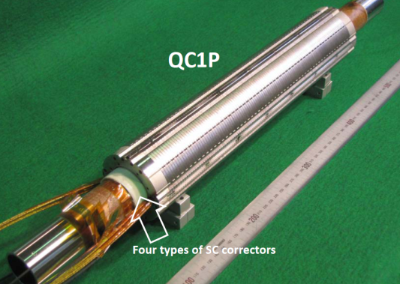
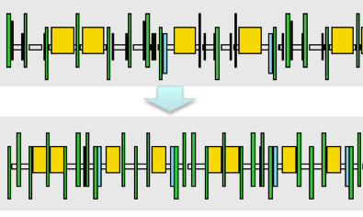
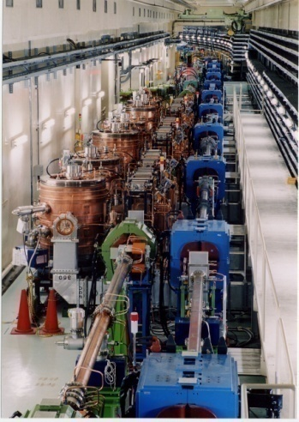
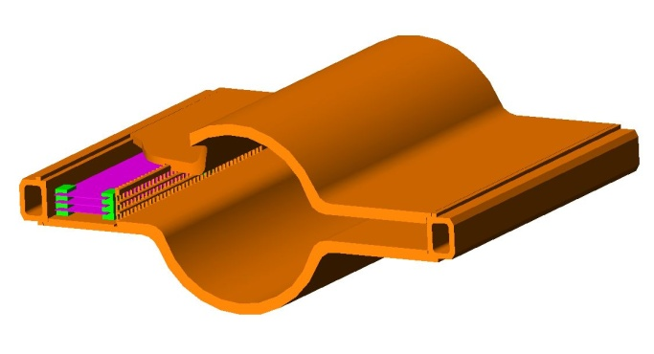
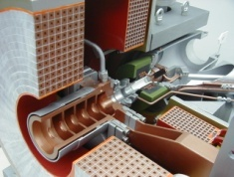
KEKB upgrade to SuperKEKB
Colliding bunches
IR with β_{y}*=0.3mm
SC final focus system
e⁻(2.6A)
SuperKEKB
Low emittance lattice
Add RF systems for higher beam current
e⁺(3.6A)
Damping ring for low emittance positron
injection
Positron
capture section
NEG pumps
LER beampipe to suppress
photoelectron instability
Beam
SR
Target: L = 8x10³⁵/cm²/s

Slide 10
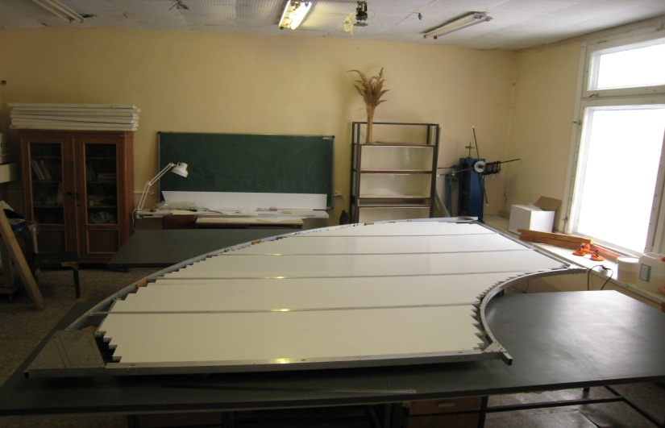
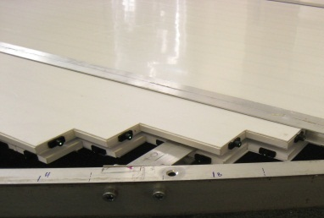
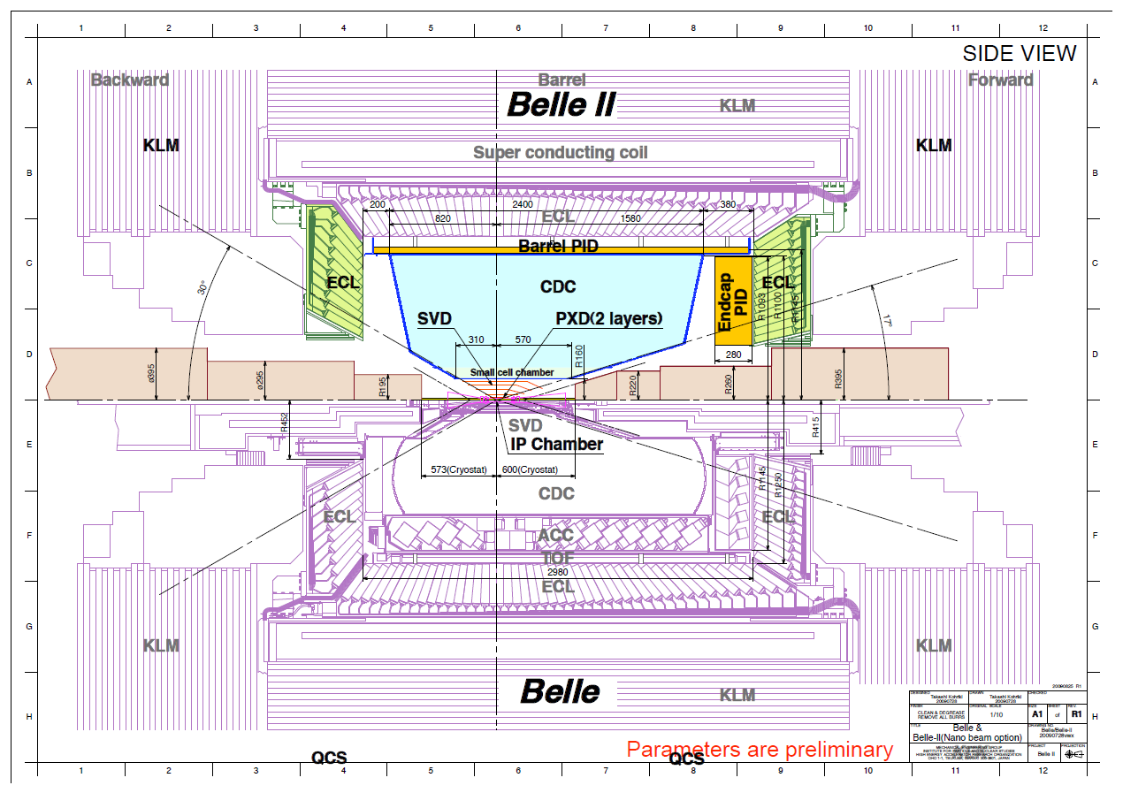
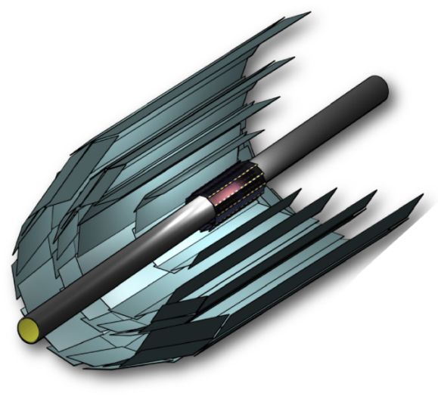
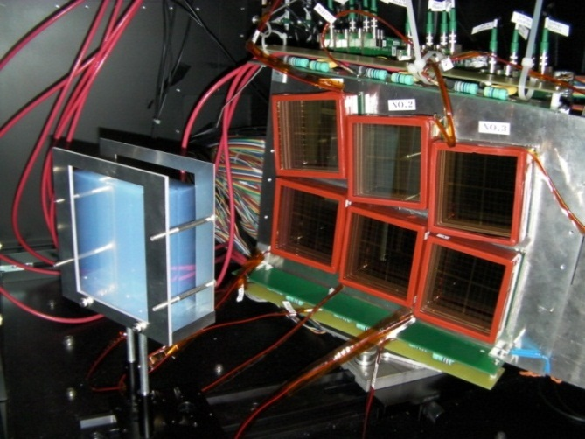
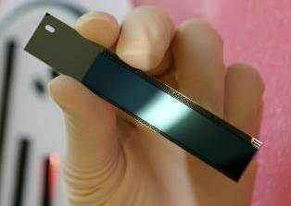
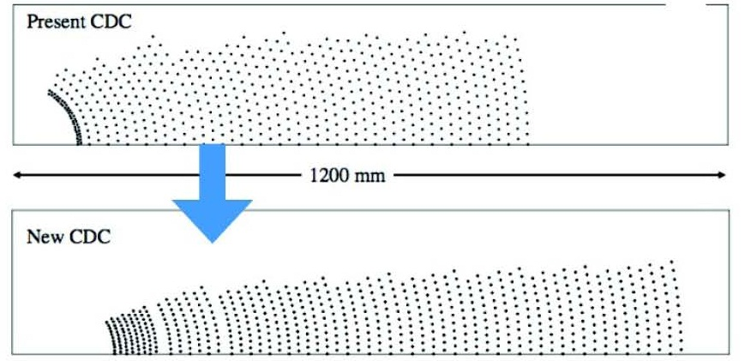
Belle II Detector (in comparison with Belle)
EKLM Module 0 @ITEP
Aerogel- RICH
Bell
SVD: 4 DSSD lyrs g 2 DEPFET lyrs + 4 DSSD lyrs
CDC: small cell, long lever arm
ACC+TOF g TOP+A-RICH
ECL: waveform sampling (+pure CsI for end-caps)
KLM: RPC g Scintillator +MPPC(end-caps)
Bell II

Slide 11
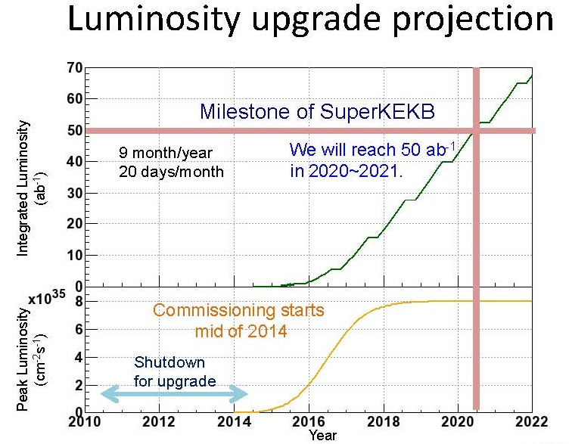
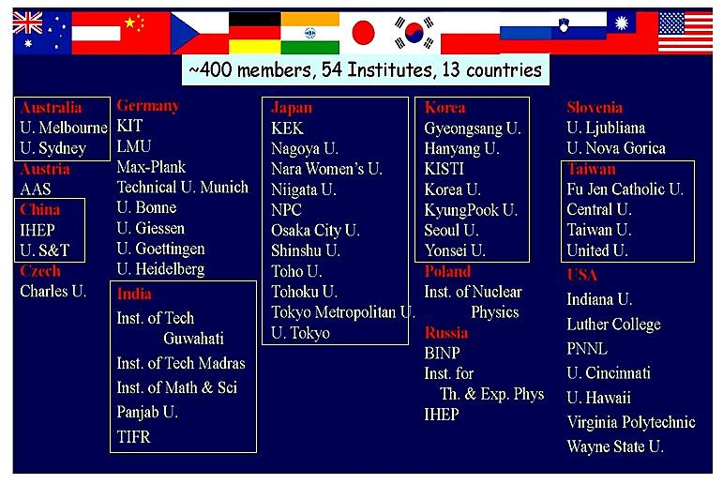
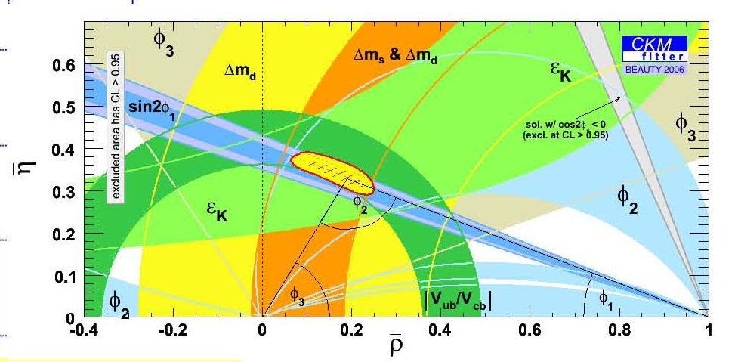
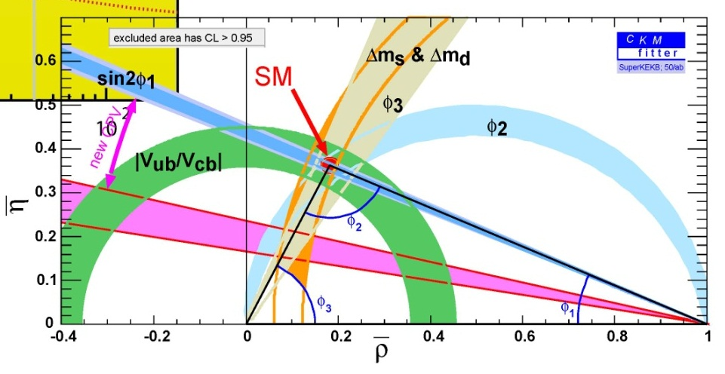
Inconsistency in unitarity triangle?
B -> φK_{s}

Slide 12
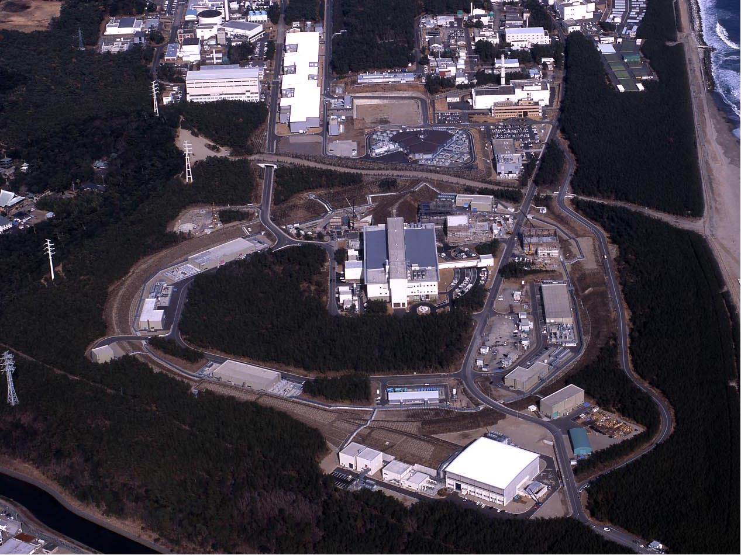
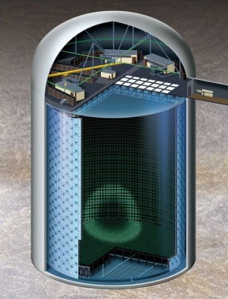
J-PARC Facility
(KEK/JAEA）
Linac
3 GeV RCS
Neutrino Beams (to Kamioka)
Materials and Life Experimental Facility (n, μ)
30 GeV Synchrotron
Hadron Exp. Facility (K)
Joint Project between KEK and JAEA
J-PARC = Japan Proton Accelerator Research Complex
Notes:
The J-PARC consists of three accelerators and three experimental facilities.
●In calendar year of 2007 the linac and 3 GeV synchrotron were completed. ● Then, in fiscal year of 2008 the 50 GeV synchrotron and two experimental facilities, the materials and life experimental facility with neutron and muon beams, and the hadron experimental facility with primarily kaon beams were completed. ● Finally, in fiscal year of 2009, which is the last year, the neutrino facility to send the neutrino beams to Superkamiokande was completed.

Slide 13
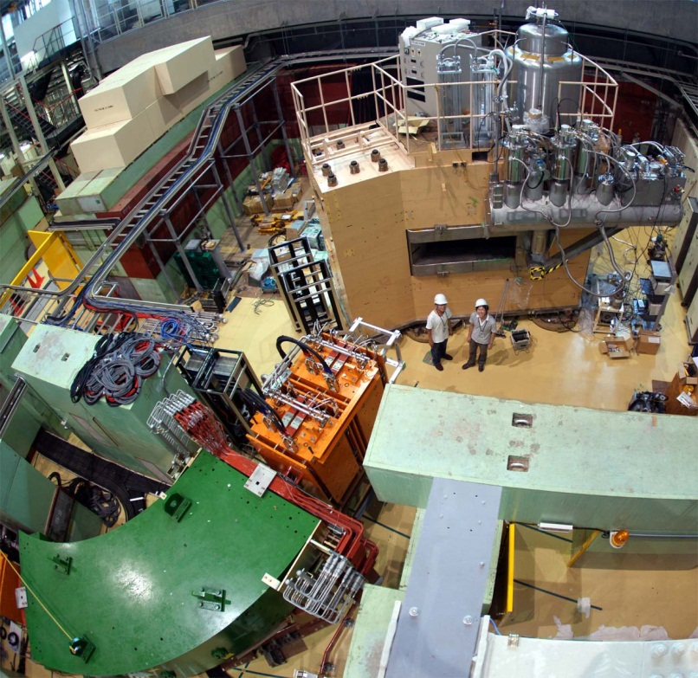
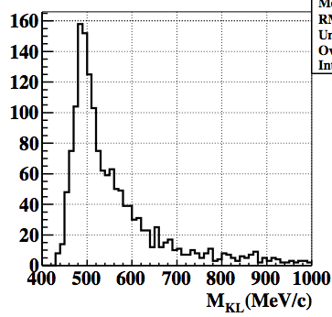
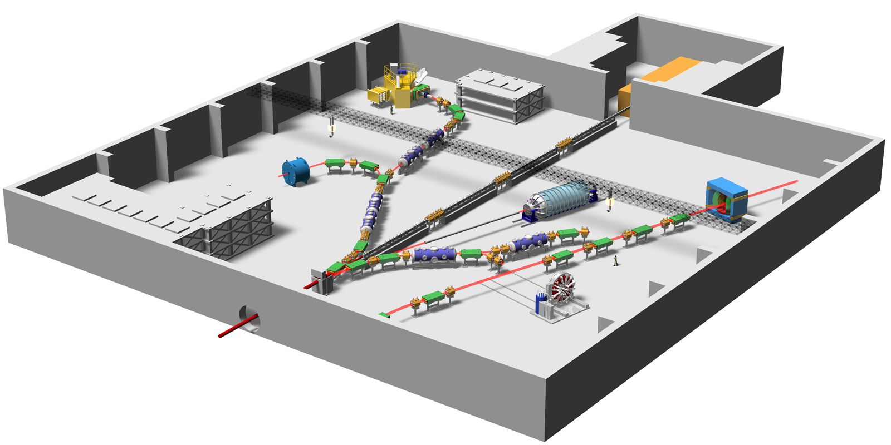
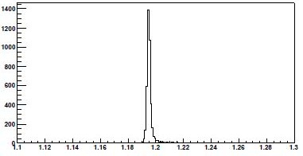




Beam Lines & Experiments Ready at Hadron Hall
High Resolution Hypernucleus
Spectroscopy
KL Rare Decay
K⁰_{Ｌ}→ π⁰ ν ν
Θ⁺ via p(π⁻, K⁻) reaction
K⁰_{L}→π⁺π⁻π⁰
Pentaquark Θ⁺
p(π⁻,K⁺)Σ⁻ @1.25GeV/c
d
u
s
d
u
K1.8
Strangeness Nuclear Matter
KL
K1.8BR
K1.1
High momentum
K1.1BR
kaonic nuclei via stopped K⁻
for Test Experiments
FM Magnet is ready!
Notes:
kkp, phi, hyper, penta
13

Slide 14









Rare Kaon Decay
May 2011

Slide 15






KOTO : Collaboration : 65
Cheju 2
Chonbuk 1
Kyungpook 2
Pusan 3
Soul 2
KEK 7
Kyoto 9
Osaka 11
Saga 6
Yamagata 2
JINR 4
Nat. Taiwan 5
Arizona State 2
Chicago 5
Michigan State 4

Slide 16





Quark Flavor Physics in China (IHEP)

Slide 17



Slide 18


Slide 19









BESIII Collaboration
326 members, 48 Institutes, 10 Countries
274 members, 29 Institutes
5 members, 1 Institutes
8 members, 3 Institutes
4 members, 1 Institutes
9 members, 2 Institutes
11 members, 4 Institutes
3 members, 1 Institutes
1 members, 1 Institutes
1 members, 1 Institutes
10 members, 6 Institutes

Slide 20
2. Lepton Flavor Project
2008
Decisive Neutrino Results from Asia in 2011~2012

Slide 21





Neutrino Oscillation Study in Asia
KamLAND (2002)
Super-Kamiokande (2002)
Kamiokande (1988)
ν₁
ν₂
Kamioka
Kamiokande (early 1990’s)
Super-Kamiokande (1998)
K2K (2004)
T2K: J-PARC
Daya Bay: China
RENO: Korea
(2011, 2012)
ν₃

Slide 22


Slide 23



T2K Experiment
Long-Baseline Neutrino Experiment

Slide 24




Neutrino Beams
(to Kamioka)
Notes:
The J-PARC consists of three accelerators and three experimental facilities.
●In calendar year of 2007 the linac and 3 GeV synchrotron were completed. ● Then, in fiscal year of 2008 the 50 GeV synchrotron and two experimental facilities, the materials and life experimental facility with neutron and muon beams, and the hadron experimental facility with primarily kaon beams were completed. ● Finally, in fiscal year of 2009, which is the last year, the neutrino facility to send the neutrino beams to Superkamiokande was completed.

Slide 25




ν_{μ} → ν_{e} Result from T2K
Super-Kamiokande
50 k-ton of WCD
10 electron neutrino candidates are detected
Expected BG (θ₁₃=0) is estimated to be 2.73±0.37 evts
Probability to observe >=10 evts w/ θ₁₃=0 is 0.08% (3.2σ)
  C.f. 0.7% (2.5σ) in 2011
Definite confirmation of
ELECTRON NEUTRINO APPEARANCE!!

Slide 26


θ₁₃=0 is 0.08% (3.2σ)

Slide 27


Collaboration

Slide 28



Slide 29



20 ton
Gd-loaded LS

Slide 30




N_{detected} / N_{expected}

Slide 31


Slide 32






Near Detector
200m high
70m high
Reactors
100m
300m
290m
1,380m
Far Detector
~17 GW
YongGwang Nuclear Power Plant

Slide 33




16.5 ton Gd-loaded LS

Slide 34






Slide 35



Slide 36




Summary of θ₁₃ & δ_{CP}
T2K
θ₁₃=0 is 0.08% (3.2σ)
Daya Bay
RENO
4.9 σ significance

Slide 37


Latest Result of ν_{μ} →ν_{e} from T2K
Improvement of both reactor and accelerator
experiments will provide first handle on the CP
violating complex phase δ_{CP}.
Expectation with ~50 times more data
(750kWx 5x10⁷s)
Expected
beam power
Stat err only!
May 2012 | 2014 | 2018
190kW | 300kW | 750kW

Slide 38




What is the mass hierarchy ?
Δm²₂₁ : 8.2 ± 0.6 (10⁻⁵ eV²)
m₂ > m₁
810 km
T2K + NOνA
ν_{e} ν_{μ} ν_{τ}
normal inverted
hierarchy
O. Mena et al., hep-ph/0609011v1

Slide 39






Next ν program at J-PARC
Kamioka L=295km OA=2.5deg
Okinoshima L=658km OA=0.78deg
J-PARC
→1.7MW
100kt Liq. Ar TPC
P32 proposal (Lar TPC R&D)
Recommended by J-PARC PAC
(Jan 2010), arXiv:0804.2111

Slide 40






INO

Slide 41

3. Energy Frontier Project

Slide 42





July 4 2012

Slide 43






China
Japan
Korea
China
Taiwan
India
Thailand
Newzealand

Slide 44




Higgs : Welcome ILC
Proton First, Electron Next !
:
Standard Strategy of HEP
Open new road
Higgs Particle Study
Make up the road

Slide 45






ILC Project
in the Glob
e⁻
e⁺
30 ~ 50 km
2004 - 2012
from Warm to Cold Technology
S. Yamada
B. Barish

Slide 46



ILC Physics
LHC discovery of Higgs-like particle :
  Beginning of new era of particle physics
    Is it the Standard Model Higgs?
    Where is the dark matter?
    Is there really new physics at Terascale?
ILC Higgs
  Generate ~10K Higgs (can be tagged!)
    5 σ sensitivity in ~ 1 day (LHC : ~1 year)
  Higgs Brs to a few % (LHC : a few 10s %)
    e.g. H ⇾ cc (LHC : cannot)
  Γ_{tot} to 5% (challenging at LHC)
  CP to 3~4% (mix coeff)
ILC top
  m_{t}(msbar) to 100 MeV (LHC: ~ 1 GeV)
  Anomalous ttZ, tbW, ttg coupl (LHC: hint of ttg only)
ILC new physics
  Composite Higgs scale to 45 TeV (LHC: ~7 TeV)
  Anomalous WWV coupl (x10 better than LHC)
LHC
ILC
ILC: Simple and clean initial&final states
  Specify Initial-state 4-momentum
  & beam polarization : control intermediate state
    (e.g. e_{R} turns of W±&A⁰)
Higgs couplings (ILC)

Slide 47

ILC possible timeline
CY
2010
2011
2012
2013
2014
2015
2016
2017
2018
Baseline established
Technical Design Report complete
Decision to proceed
TDR reviews
ILC
Technical design & R&D program
Site EOI’s
Site/host established
Cost Estimating
SRF system tests
Project Implementation Plan complete
XFEL operation
Physics Run 1
Interconnect repair
Physics Run 2
LHC
Existence of low-lying SUSY known
Higgs energy scale known

Slide 48




World Centers for ILC Technology R&D
DESY/FLASH, EURO-XFEL
FNAL/ILCTA, ANL
INFN
Cornell
SACLAY/XFEL
JLAB
KEK/STF/ATF
SLAC
FLASH@DESY
ATF/STF@KEK
ILCTA@FNAL

Slide 49







ATF: Accelerator Test Facility
for ILC
Generate Low Emittance Beams
Handle Nano-Size Beams

Slide 50





STF : Superconducting Accelerator Test Facility
35 MeV (10⁶ eV)/m
Plug Compatibility Test

Slide 51


Slide 52






KEK : World Center for ILC R&D
Cheer - Party

Slide 53



4. Non-Accelerator Project

Slide 54











1st generation
Kamiokande
(1984 ~ 1995)
2nd generation
Super-Kamiokande
(1996 ~ )
3rd generation
KamLAND
(2002 ~ )
pioneering contribution to astrophysics,
particular for the detection of cosmic neutrinos (2002)

Slide 55







KamLAND-Zen
ββ-Decay Search
MAJORANA
GERDA
SNO+ (56kg ¹⁵⁰Nd)
EXO
Xe mixing
Xe extraction
1st step : 400 kg ¹³⁶Xe
2nd step : 1 ton ¹³⁶Xe
(possible to 10 ton)

Slide 56





Slide 57


Slide 58




XMASS
Dark Matter Search: Xe-loaded Sci.
High Scalability
1st → 2nd → 3rd
1 10
kg ton ton

Slide 59





Jinping underground lab. of Tsinghua Univ.
(2500m rock overburden)
The Jinping-I Hydropower Station (also known as the Jinping-I Dam, Jinping 1st Cascade or Jinping No.1 Hydraulic Power Station), is a large hydroelectric project on the "Jinping Bend" of the Yalong River (Yalong Jjiang) in Sichuan, China.

Slide 60






Slide 61



Slide 62



YangYang Underground Laboratory(Y2L)
(Upper Dam)
(Lower Dam)
(Power Plant)
Y2L
Minimum depth : 700 m
Access to the lab by car (~2km)
Experiments:
KIMS: DM search exp. in operation
AMORE: DBD Search exp. in preparation

Slide 63






KIMS(Korea Invisible Mass Search)
DM search experiment with CsI crystal
CsI(Tl) Crystal 8x8x30 cm³ (8.7 kg) → 103.4 kg in total
3” PMT (9269QA) : Quartz window, RbCs photo cathode
~5 Photo-electron/keV
New Limits
Phys. Rev. Lett. 108, 181301 (2012)
spin-dependent
spin-independent
24,524:3 kg days of exposure

Slide 64


Slide 65







AMORE Experiment at Y2L
Double beta decay search with ⁴⁰Ca¹⁰⁰MoO₄ crystal
Int. Collaboration : Korea, Russia, Ukraine, China
in preparation
⁴⁰Ca¹⁰⁰MoO₄ crystal
Unique in the world (depleted Ca + enriched Mo)
Scintillation crystal + Cryogentic detector
MMC+CMO at low temperature
FWHM = 11.2 keV
5.5 MeV alpha
Energy spectrum for 600 keV gamma
Scintillation readout
good DM detector as well
Cryogenic CaMoO₄ Sensitivity
0.5% FWHM →15 keV FWHM for low temp.
5 years, 100 kg ⁴⁰Ca¹⁰⁰MoO₄ :
T_{1/2} = 7.0x10²⁶ years → <m> = 20 – 70 meV
Fully covers inverted hierarchy

Slide 66





INO : India-based Neutrino
Observatory
50 kton magnetized iron module(s) with
30,000 channel RPC
1000 m

Slide 67


Slide 68


Slide 69


5. Summary
LHC
ILC
Top-Down
Physics
Beyond SM
Bottom-Up

