Slide 1


FCC and CLIC Accelerator Studies
Daniel Schulte for the FCC and CLIC teams
Dubna November 2014

Slide 2
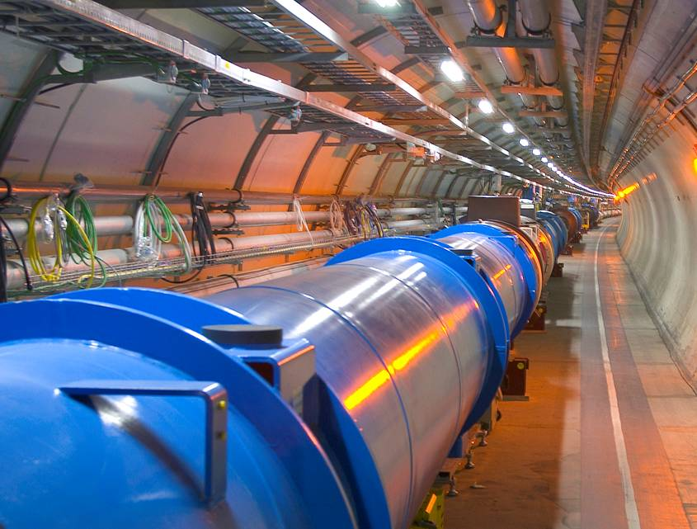
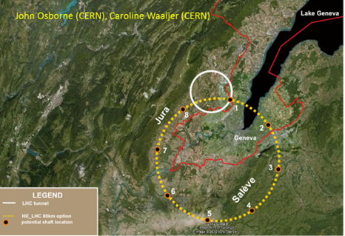
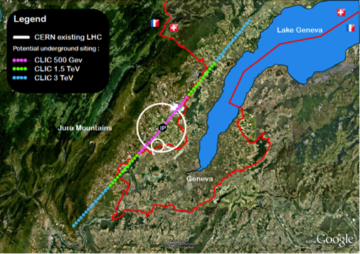
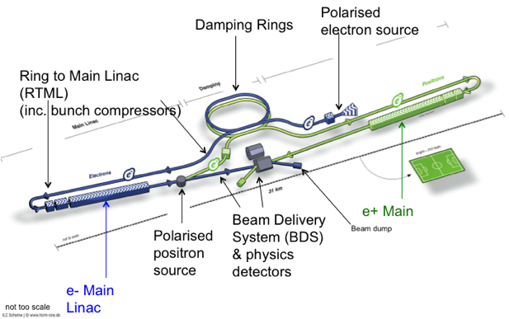
European Strategy
Approved by CERN council, ESFRI roadmap
Identified four highest priorities:
Highest priority is exploitation of the LHC including luminosity upgrades
Europe should be able to propose an ambitious project at CERN after the LHC
  Either high energy proton collider (FCC-hh)
  Or high energy linear collider (CLIC)
Europe welcomes Japan to make a proposal to host ILC
Long baseline neutrino facility

Slide 3
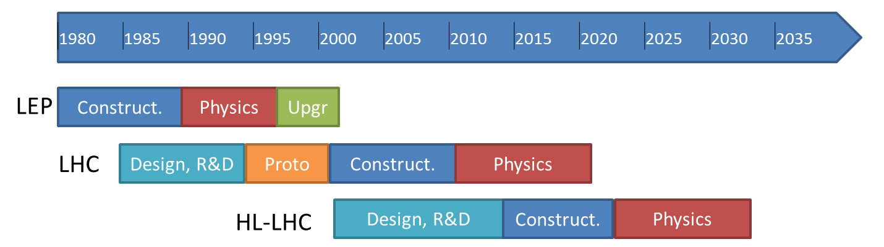
LHC and HL-LHC
c) ... Europe’s top priority should be the exploitation of the full potential of the LHC, including the high-luminosity upgrade of the machine and detectors with a view to collecting ten times more data than in the initial design, by around 2030. …
today

Slide 4
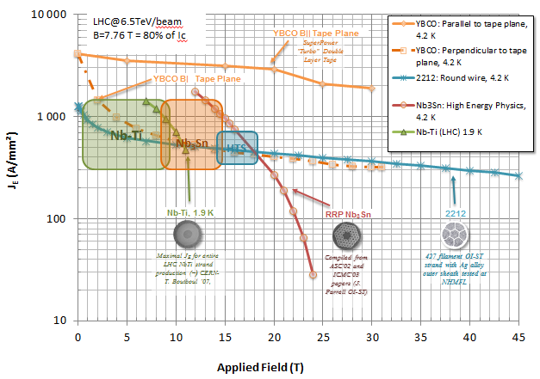
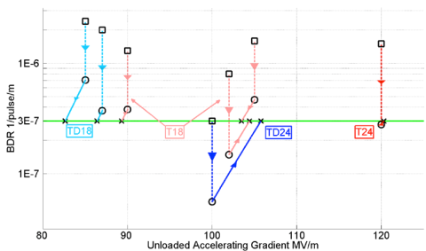
Future Project at CERN
d) …to propose an ambitious post-LHC accelerator project at CERN by the time of the next Strategy update…
… CERN should undertake design studies for accelerator projects in a global context, with emphasis on proton-proton and electron-positron high-energy frontier machines. These design studies should be coupled to a vigorous accelerator R&D programme, including high-field magnets and high-gradient accelerating structures, in collaboration with national institutes, laboratories and universities worldwide.
HFM – FCC-hh
HGA - CLIC

Slide 5
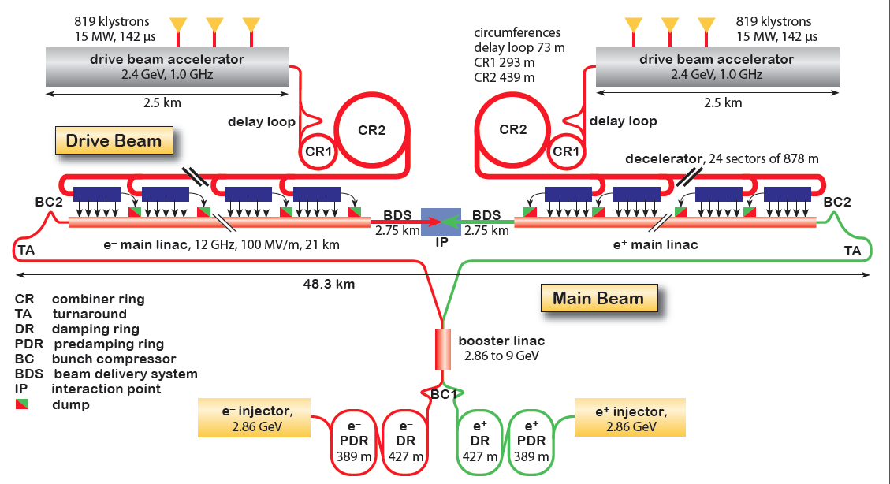
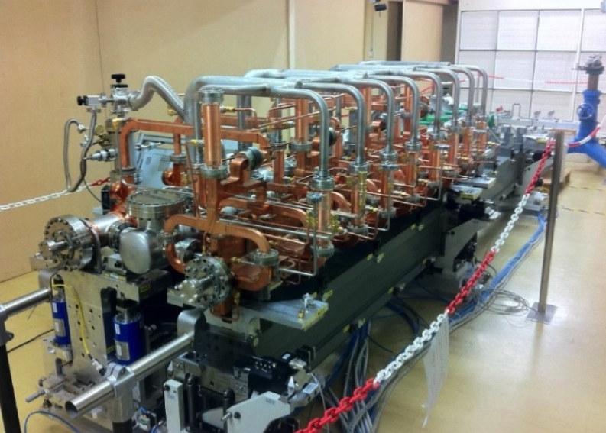
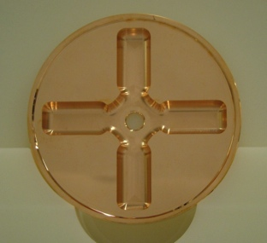
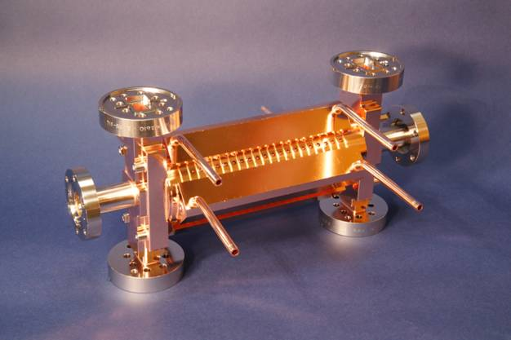
CLIC Layout at 3 TeV
Drive Beam Generation Complex
Drive beam time structure - initial
Drive beam time structure - final
240 ns
240 ns
5.8 μs
140 μs train length - 24 × 24 sub-pulses
4.2 A - 2.4 GeV – 60 cm between bunches
24 pulses – 101 A – 2.5 cm between bunches
Dubna
Dubna
Dubna
Dubna
Main Beam Generation Complex

Slide 6
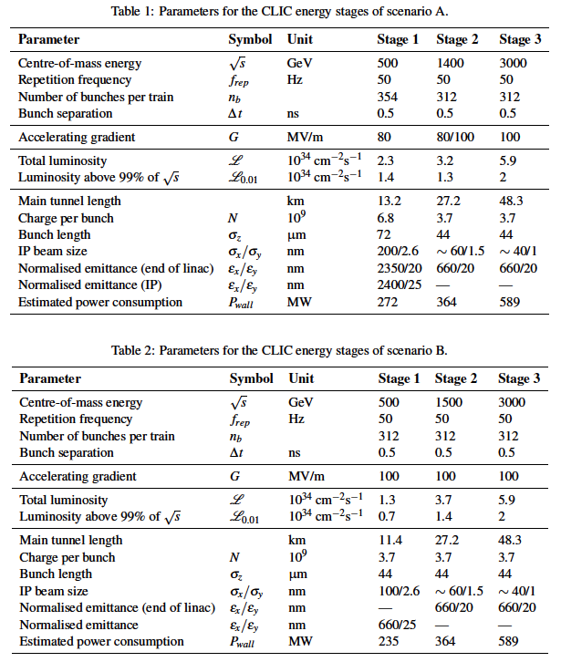
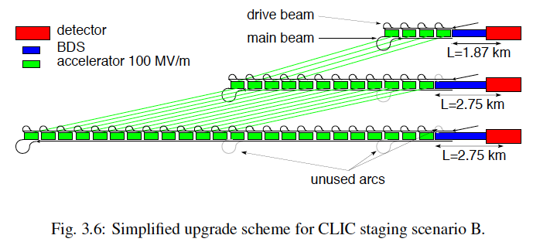
Staged Design Parameters
e⁻ polarisation 80%
Key features:
High gradient (energy/length)
Small beams (luminosity)
Repetition rates and bunch spacing (experimental conditions)

Slide 7
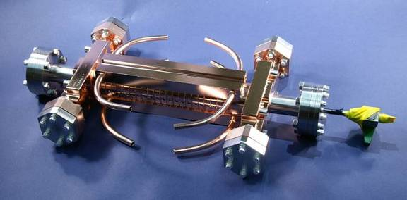
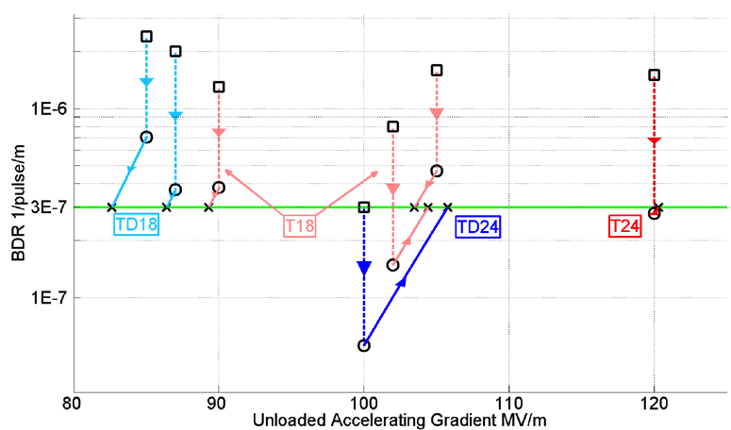
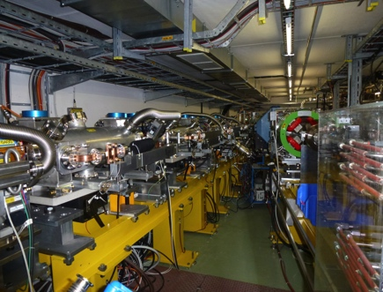
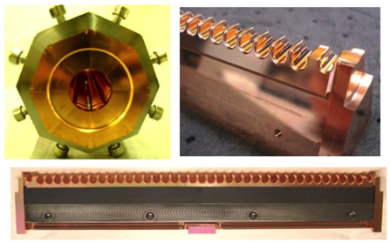
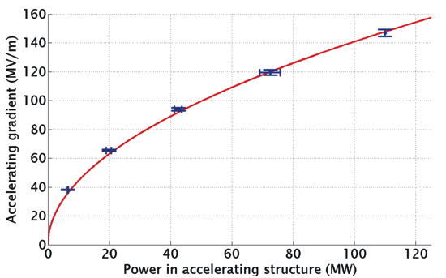
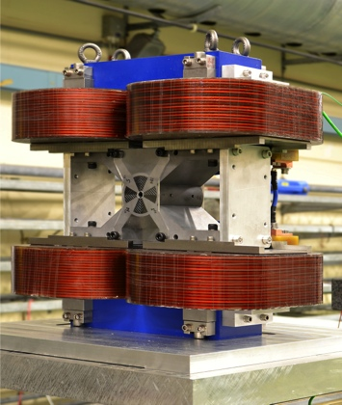
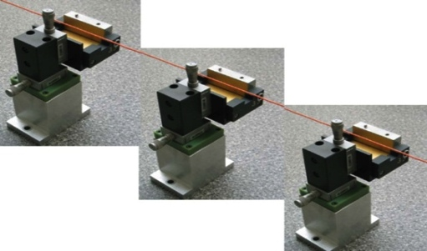
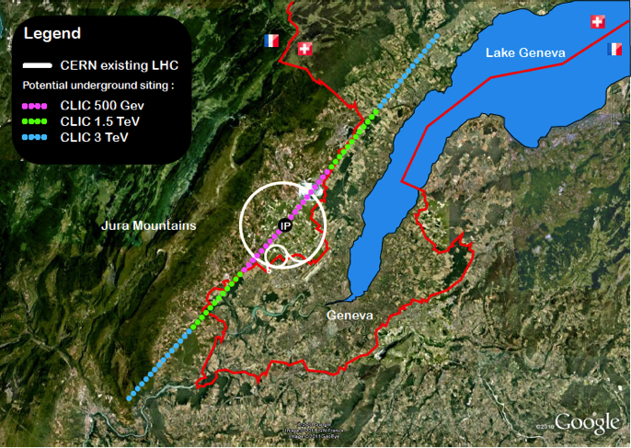
Conclusion of the Accelerator CDR Studies
Main linac gradient
Ongoing test close to or on target
Uncertainty from beam loading being tested
Drive beam scheme
Generation tested, used to accelerate test beam above specifications, deceleration as expected
Improvements on operation, reliability, losses, more deceleration studies underway
Links to reports:
Accelerator:
https://edms.cern.ch/document/1234244/
Physics and detector:
http://arxiv.org/pdf/1202.5940v1
Executive summary:
http://arxiv.org/pdf/1209.2543v1
Input for European strategy:
http://arxiv.org/pdf/1208.1402v1
TD24 baseline: Unloaded 106 MV/m
Expected with beam loading 0-16% less
CLIC Nominal, unloaded
CLIC Nominal, loaded
Luminosity
Damping ring like an ambitious light source, no show stopper
Alignment system principle demonstrated
Stabilisation system developed, benchmarked, better system in pipeline
Simulations on or close to the target
Operation &
Machine Protection
Start-up sequence and low energy operation defined
Most critical failure studied and first reliability studies
Implementation
Consistent staged implementation scenario defined
Schedules, cost and power developed and presented
Site and CE studies documented

Slide 8
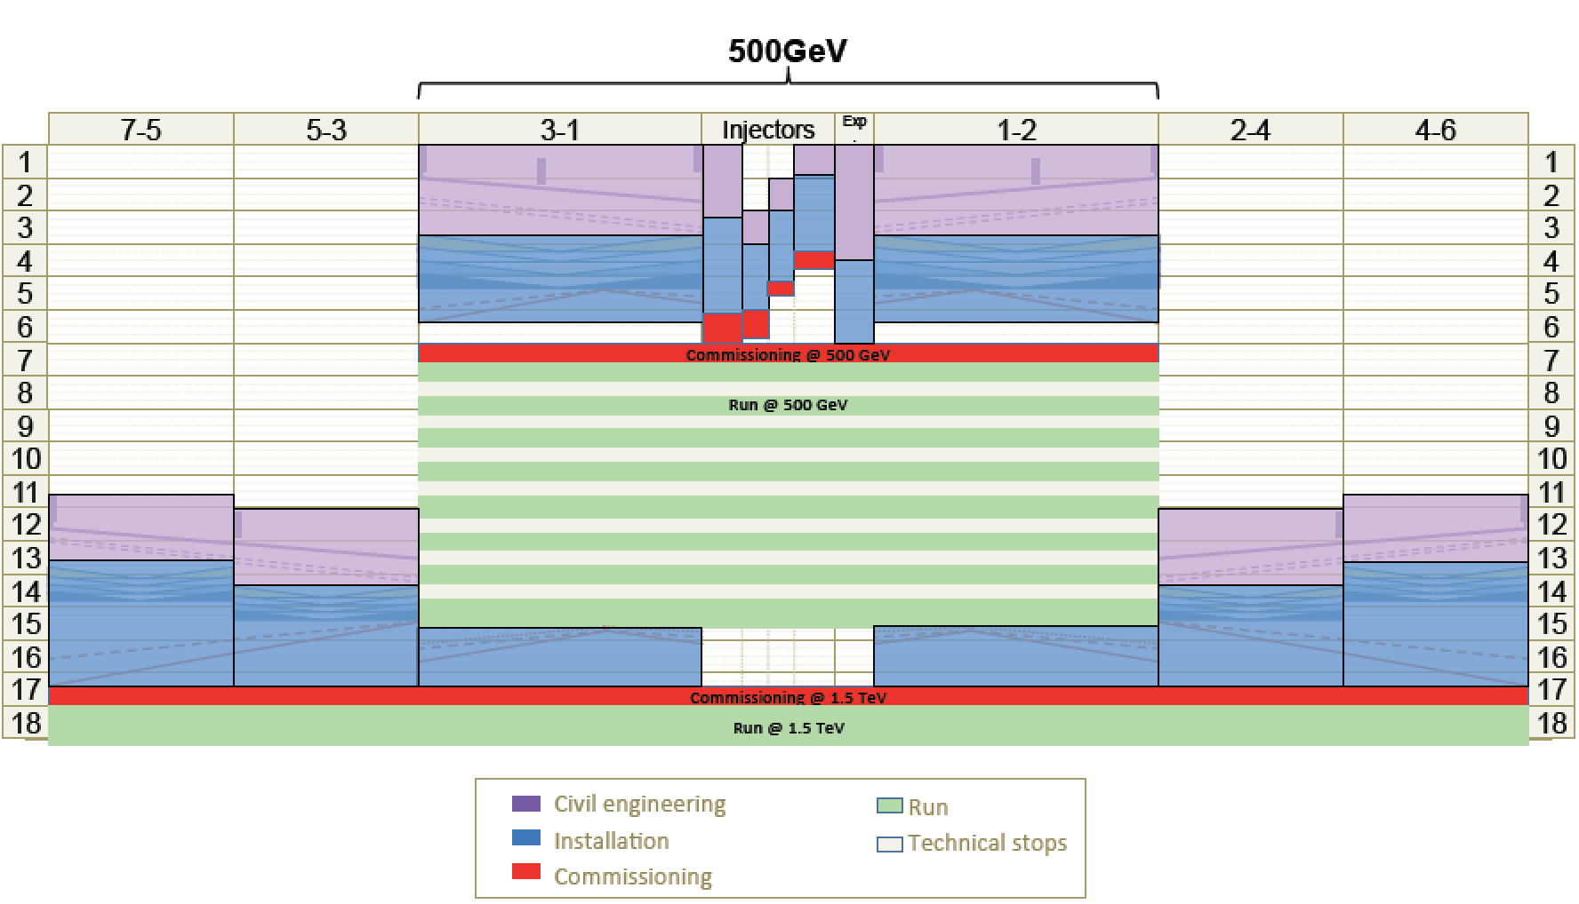
Timeline
2013-18 Development Phase
Develop a Project Plan for a staged implementation in agreement with LHC findings; further technical developments with industry, performance studies for accelerator parts and systems, as well as for detectors.
4-5 year Preparation Phase
Finalise implementation parameters, Drive Beam Facility and other system verifications, site authorisation and preparation for industrial procurement.
Prepare detailed Technical Proposals for the detector-systems.
Construction Phase
Stage 1 construction of CLIC, in parallel with detector construction.
Preparation for implementation of further stages.
2018-19 Decisions
On the basis of LHC data
and Project Plans (for CLIC and other potential projects), take decisions about next project(s) at the Energy Frontier.
2024-25 Construction Start
Ready for full construction
and main tunnel excavation.
Commissioning
Becoming ready for data-taking as the LHC programme reaches completion.
S. Stapnes

Slide 9
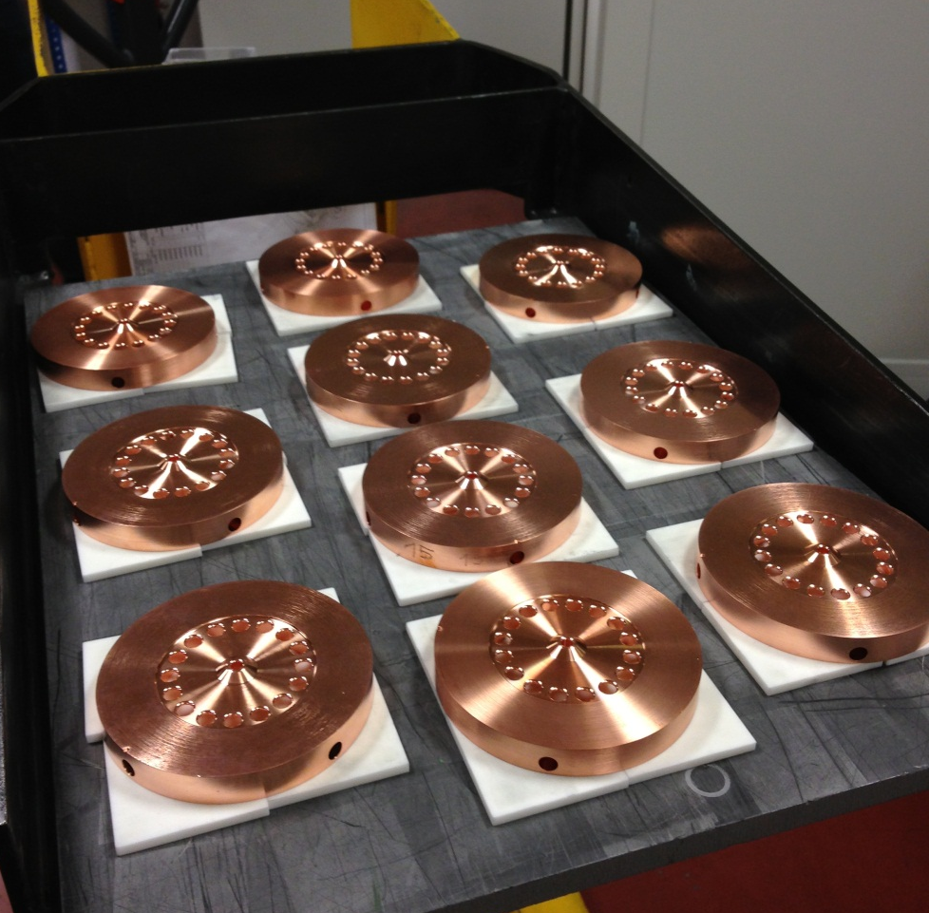
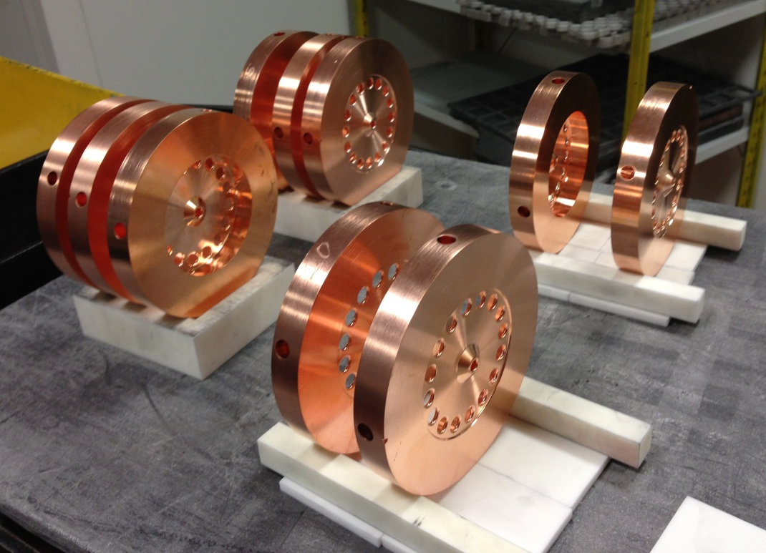
Main activities
Parameters, Design and Implementation:
  Integrated Baseline Design and Parameters
  Cost and power optimisation in design and technological developments, optimal stages
  Links to experimental programme and integrate experimental results
X-band Technologies
High gradient structures and high eff RF
New X-band High power Testing Facilities (x3)
Use of Xband technologies for FELs
Xband disk, Xband teststand

Slide 10

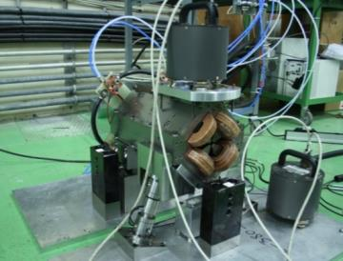

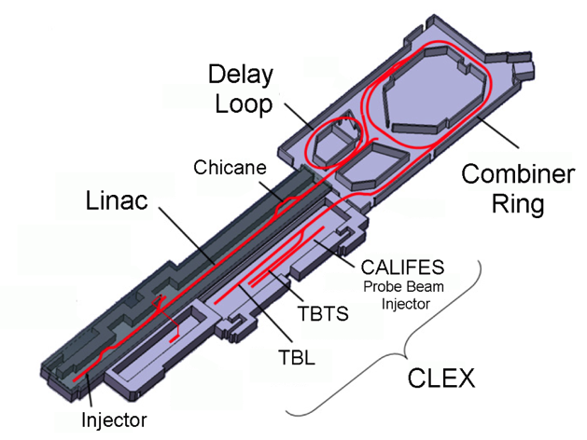
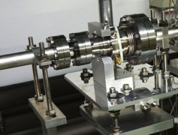
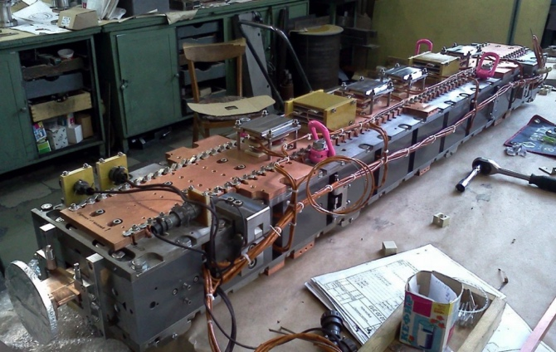
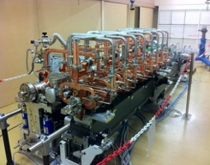
Main activities
Experimental verification
Drive Beam and two beam scheme (CTF3)
Low emittance ring tests – low emittances
System Tests: ATF – final focus, FACET and FELs – beam based alignment and emittance preservation in linacs (see later)
Technical Developments
Key components for systemtests, machine performance, cost or power reduction
QD0, nm-stabilization, BPM, NbTi wiggler
Module into CTF

Slide 11
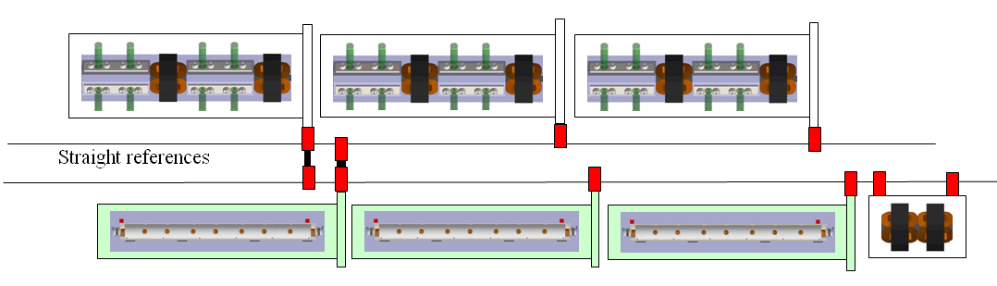
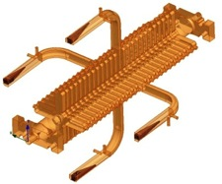
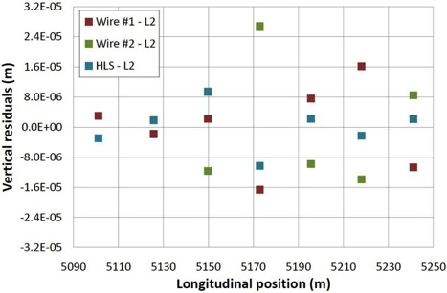
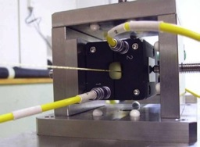
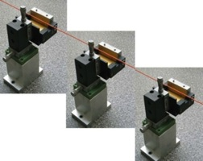
Performance verifications – CLIC
Stabilise quadrupole
O(1nm) @ 1Hz
1) Pre-align BPMs+quads
accuracy O(10μm) over about 200m
3) Use wake-field monitors accuracy O(3.5μm) – CTF3
2) Beam-based alignment
Test of prototype shows
  vertical RMS error of 11μm
  i.e. accuracy is approx. 13.5μm

Slide 13
ATF2: Stabilisation Experiment
The CLIC coll. is very interested in a longer term programme at ATF2 and ideas exist for:
Building 2 octupoles for ATF2 (to study FFS tuning with octupoles)
Test of OTR/ODR system at ATF2
Test and use of accurate kicker/amplifier system is considered
General support for ATF2 operation

Slide 14
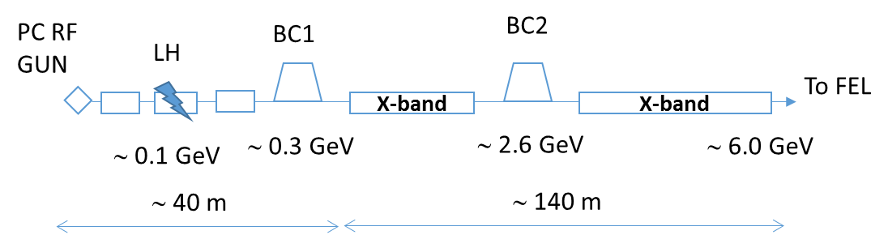
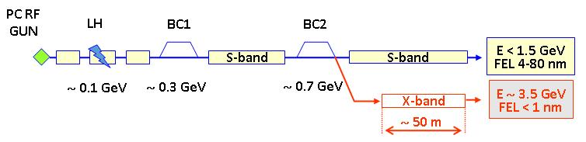
X-Band and FELs
X-band technology appears interesting for compact, relatively low cost FELs – new or extensions
  Logical step after S-band and C-band
  Example similar to SwissFEL: E=6 GeV, Ne=0.25 nC, σ_{z}=8μm
Use of X-band in other projects will support industrialisation
  They will be klystron-based, additional synergy with klystron-based first energy stage
Started to collaborate on use of X-band in FELs
  Australian Light Source, Turkish Accelerator Centre, Elettra, SINAP, Cockcroft Institute, TU Athens, U. Oslo, Uppsala University, CERN
Share common work between partners
  Cost model and optimisation
  Beam dynamics, e.g. beam-based alignment
  Accelerator systems, e.g. alignment, instrumentation…
Define common standard solutions
  Common RF component design, -> industry standard
  High repetition rate klystrons (500Hz soon to be ordered for CLIC)
Great potential for collaboration

Slide 15
































Current CLIC Collaboration
29 Countries – over 70 Institutes
Accelerator
collaboration
Detector
collaboration
Accelerator + Detector collaboration
Notes:
The CLIC accelerator and detector&physics studies are already set up at international collaboraitons with wide participation from member and non-member states

Slide 16
FCC Accelerator Study Goals
The main emphasis of the conceptual design study shall be the long-term goal of a hadron collider with a centre-of-mass energy of the order of 100 TeV in a new tunnel of 80 - 100 km circumference for the purposes of studying physics at the highest energies.
The conceptual design study shall also include a lepton collider and its detectors, as a potential intermediate step towards realization of the hadron facility. Potential synergies with linear collider detector designs should be considered.
Options for e-p scenarios and their impact on the infrastructure shall be examined at conceptual level.
The study shall include cost and energy optimisation, industrialisation aspects and provide implementation scenarios, including schedule and cost profiles

Slide 17
FCC-hh
A baseline parameter list exists: http://indico.cern.ch/event/282344/material/3/
A somewhat conservative first approach, will now make a conceptual design and optimise the parameters and look at alternative parameters
 | LHC | HL-LHC | FCC-hh
Cms energy [TeV] | 14 | 14 | 100
Luminosity [10³⁴cm⁻²s⁻¹] | 1 | 5 | 5
Bunch distance [ns] | 25 | 25 | 25
Background events/bx | 27 | 135 | 170
Bunch length [cm] | 7.5 | 7.5 | 8
Two main experiments sharing the beam-beam tuneshift
  Two reserve experimental areas not contributing to tuneshift
80% of circumference filled with bunches

Slide 18
Preliminary Layout
First layout developed (different sizes under investigation)
Collider ring design (lattice/hardware design)
Site studies
Injector studies
Machine detector interface
Input for lepton option
Will need iterations

Slide 19
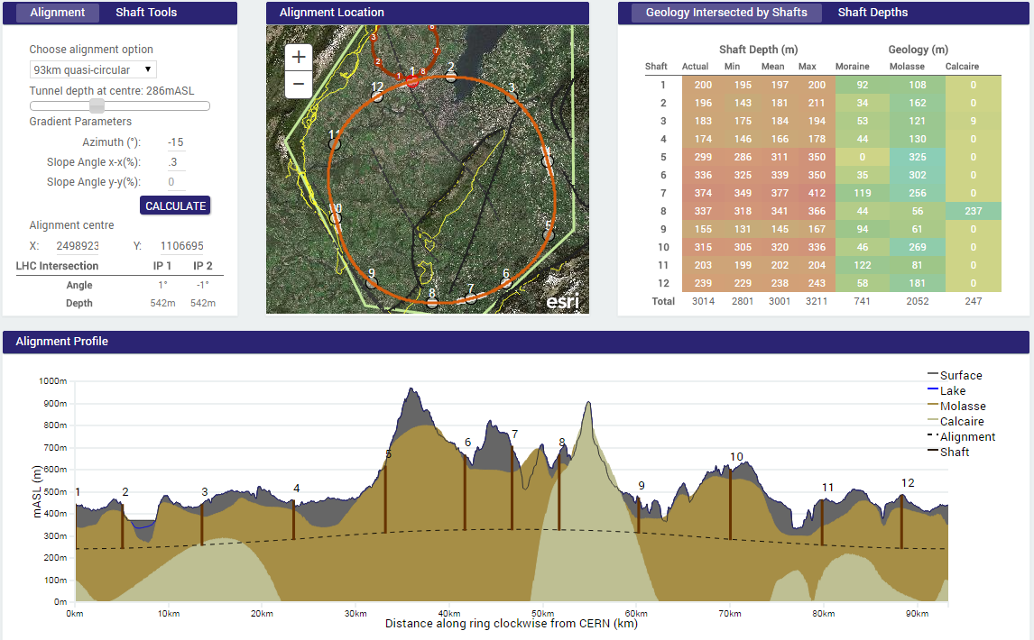
Site Study (93km example)
PRELIMINARY
Preliminary conclusions:
93km seems to fit the site really well, likely better than smaller ring
100km tunnel appears possible
The LHC could be used as an injector
J. Osborne & C. Cook

Slide 20
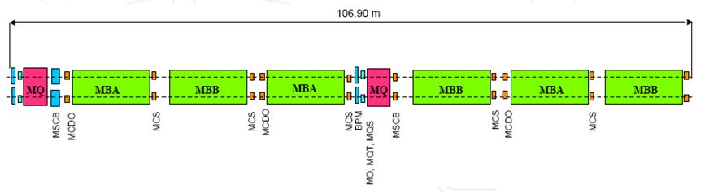
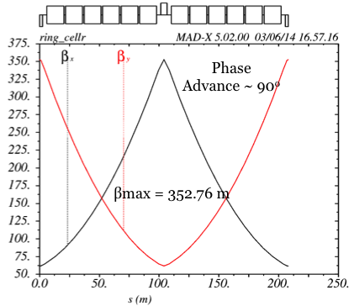
Arc Cell Layout
106.9m
LHC arc cell
Long cell => good dipole filling factor (fewer and shorter quadrupoles)
Short cells => more stable beam (smaller beta-function)
Scale from LHC
Natural scaling for same technology 107m => ~300m
For FCC magnet technology => 200m
Dipole length should be similar (transport)
First lattice design exists (B. Holzer, R. Alemany Fernandez)

Slide 21
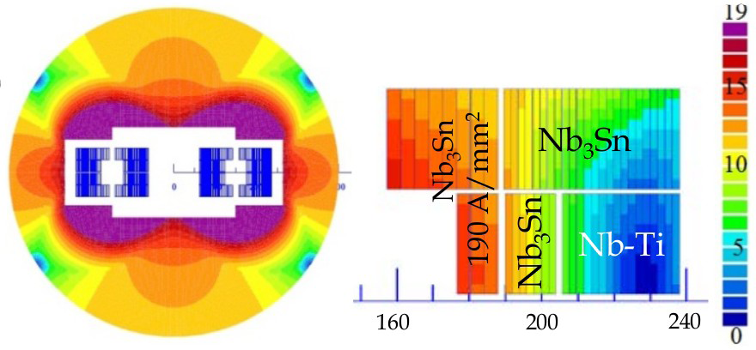
FCC-hh Challenges: Magnets
Arc dipoles are the main cost and parameter driver
Baseline is Nb₃Sn at 16T
HTS at 20T also to be studied as alternative
Coil sketch of a 15 T magnet with grading, E. Todesco
Field level is a challenge but many additional questions:
Aperture
Field quality
Different design choices (e.g. slanted solenoids) should be explored
Goal is to develop prototypes in all regions

Slide 22
Beam Parameters
 | LHC | HL-LHC | HE-LHC | FCC-hh
Bunch charge [10¹¹] | 1.15 | 2.2 | 1 | 1 (0.2)
Norm. emitt. [μm] | 3.75 | 2.5 | 1.38 | 2.2(0.44)
IP beta-function [m] | 0.55 | 0.15 | 0.35 | 1.1
IP beam size [μm] | 16.7 | 7.1 | 5.2 | 6.8 (3)
RMS bunch length [cm] | 7.55 | 7.55 | 7.55 | 8
Values in brackets for 5ns spacing
Same values for 16T and 20T design
Beam-beam tuneshift for two IP 0.01
Beta-function at IP scaled with sqrt(E) from one LHC insertion line design with 0.4m (some safety margin)

Slide 23
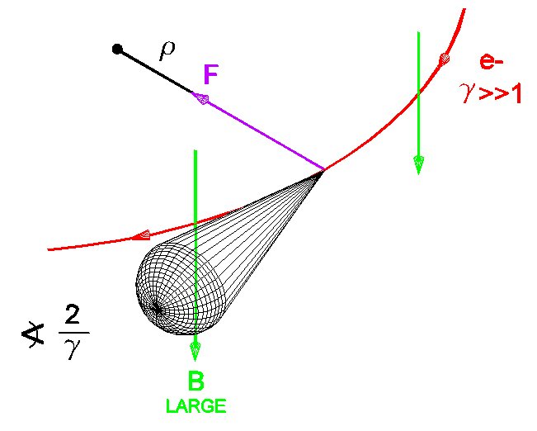
Synchrotron Radiation
At 50 TeV even protons radiate significantly
Total power of 5 MW (LHC 7kW)
Needs to be cooled away
Equivalent to 30W/m /beam in the arcs (16T magnets)
LHC <0.2W/m, total heat load 1W/m
Critical energy 4.3keV, close to B-factory
Protons lose energy
They are damped
Emittance improves with time
Typical transverse damping time 1 hour

Slide 24
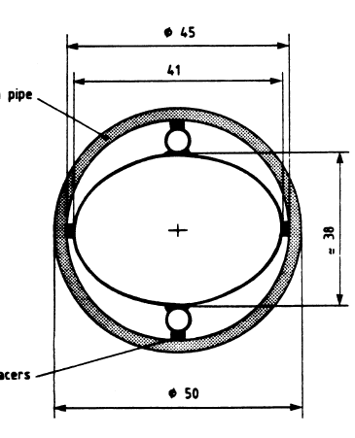
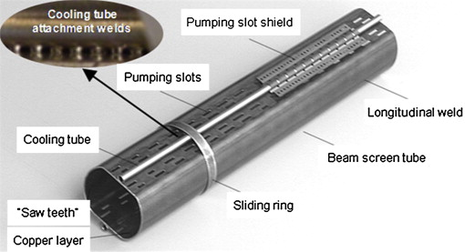
LHC-Type Beam Pipe Design
Current ambitious goal
beam aperture: 2x13mm
magnet aperture: 2x20mm
Space for shielding: 7mm
Most of the power will be cooled at the beam screen, i.e. at its temperature
A part is going into the magnets, i.e. cooled at 2-4K

Slide 25
Power for Cooling
Better use only some temperatures in order to maintain good vacuum
<20, 40K-60K, 100K-120K, >190K
300MW
200MW
100MW
Choose 50K for now
Need 20x5MW=100MW for cooling
Photon stops? Open midplane?
Multi-bunch instability growth time: 25 turns 9 turns
(ΔQ=0.5)

Slide 26
Interaction Region and Final Focus Design
R. Tomas
Two design being investigated:
L* = 46m / 38m (how much is needed?)
β∗ = 0.8m / 0.3m (goal <1.1m)
It is easier to obtain small beta-functions with shorter L*
Will have a tendency to reduce L*
Need to understand detector requirements as soon as possible
Many issues need to be addressed
Magnet performance
Radiation effects
Space constraints from experiments
Beam-beam effects and mitigation
…

Slide 27
Machine Protection and Friends
>8GJ kinetic energy per beam
  Airbus A380 at 720km/h
  24 times larger than in LHC at 14TeV
  Can melt 12t of copper
  Or drill a 300m long hole
  Machine protection
Also small loss is important
  E.g. beam-gas scattering, non-linear dynamics
  Can quench arc magnets
  Background for the experiments
  Activation of the machine
  Collimation system

Slide 28
Collimation
LHC-type solution but other solutions should be investigated
hollow beam as collimator
crystals to guide particles
renewable collimators

Slide 29
Final Triplet
Shield (TAS)
F. Cerutti et al.
Magnets
Total power of background events 100kW per experiment (a car engine)
Already a problem in LHC and HL-LHC (heating, lifetime)
Improved shielding required

Slide 30
More Issues
Lattice design/optimisation, choice of working point, dynamic aperture, …
Impact and mitigation of magnet imperfections
Beam current limitations, impedances, electron cloud, …
Beam-beam effects (head-on and parasitic), crossing angle and potential compensation
Availability
Hardware components
  Collimators
  Crab cavities or other beam-beam devices?
  Feedback
  Shilding
  …
Cost
  Most issues will be pushed when this reduces cost

Slide 31
FCC-ee
Parameter | Z | W | H | t | LEP2
E (GeV) | 45 | 80 | 120 | 175 | 104
I (mA) | 1400 | 152 | 30 | 7 | 4
No. bunches | 16’700 | 4’490 | 1’330 | 98 | 4
β*_{x/y} (mm) | 500 / 1 | 500 / 1 | 500 / 1 | 1000 / 1 | 1500 / 50
ε_{x} (nm)/ε_{y} (pm) | 29/60 | 3.3/7 | 1/2 | 2/2 | 30-50/~250
σ_{x}(μm)/σ_{y}(nm) | 120/250 | 40/84 | 22/45 | 45/45 | 250/3500
ξ_{y} | 0.03 | 0.06 | 0.09 | 0.09 | 0.07
L (10³⁴ cm⁻²s⁻¹) | 28 | 12 | 6.0 | 1.8 | 0.012
Four experiments foreseen, luminosity given is per experiment

Slide 32
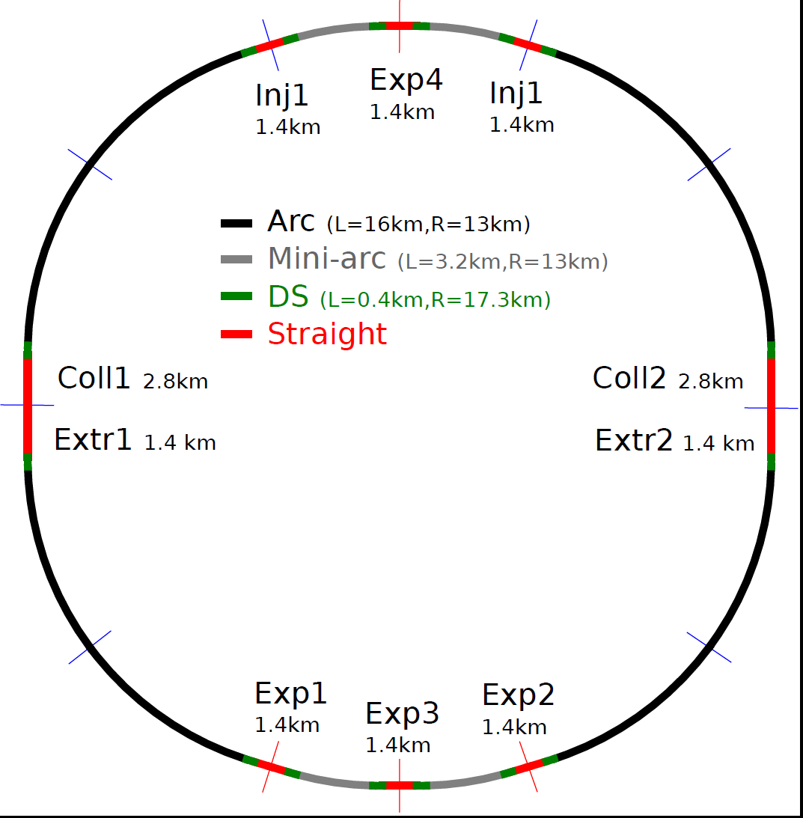
Layout of FCC-ee
INJ + RF
EXP + RF
INJ + RF
RF?
RF?
COLL + EXTR + RF
COLL + EXTR + RF
RF?
RF?
EXP + RF
EXP + RF
EXP + RF

Slide 33
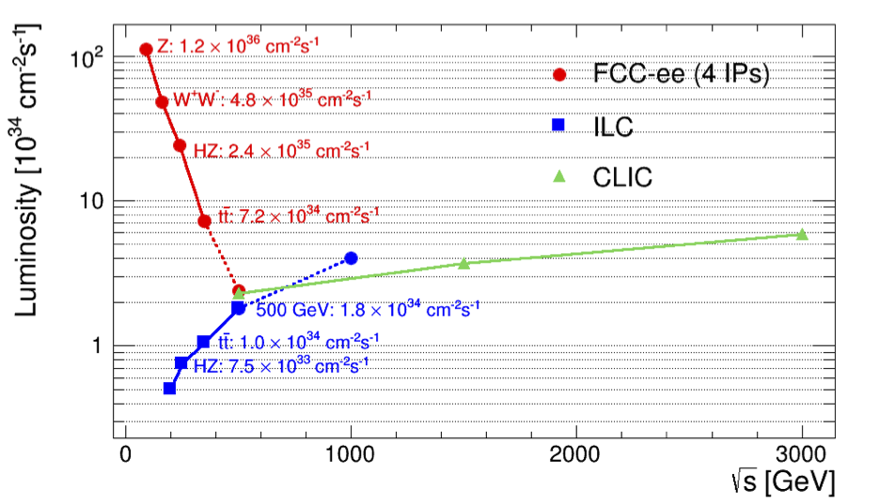
FCC-ee vs. Linear Colliders
F. Gianotti
Circular,
adding four experiments
Modified from original version:
http://arxiv.org/pdf/1308.6176v3.pdf
CepC (2 IPs)
Linear

Slide 34
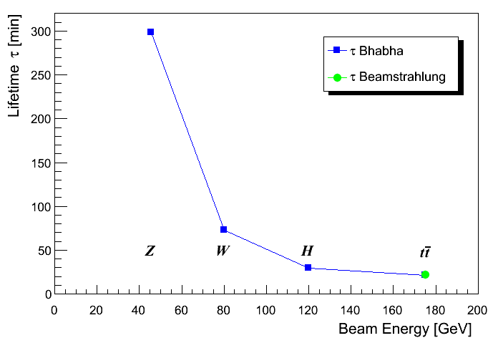
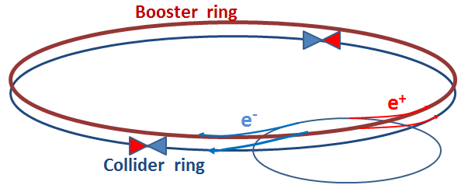
Luminosity Lifetime
Large particle energy loss in IPs and limited energy acceptance (2%) cause limited lifetime
Radiative Bhabha scattering is proportional to luminosity
Beamstrahlung as in linear colliders
n_{ip} = 4
100
0
Need continuous injection (top-up)

Slide 35
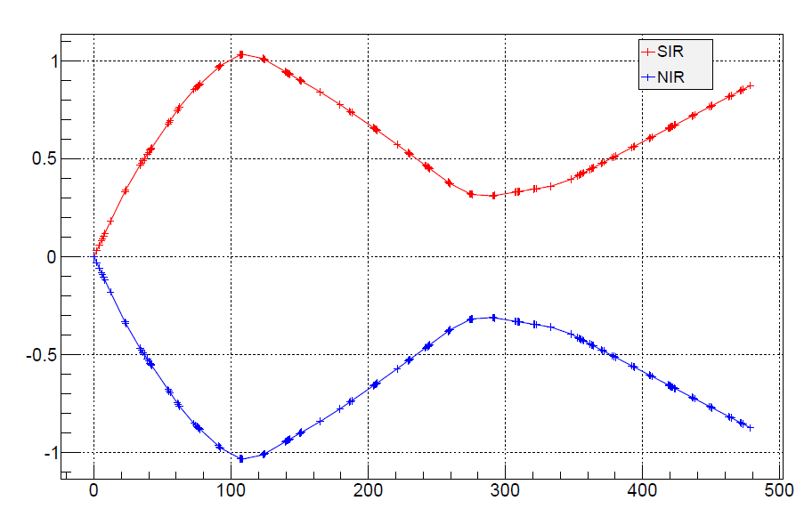
FCC-ee Beam Dynamics Challenges
Energy bandwidth of the experimental insertion with small beta-function is challenging
Goal is 2%
Significant synchrotron radiation produced in experimental insertion, which can be important background
IP
x (m)
θ = 30 mrad
2m
s (m)
Other issues
High beam current at low energies
Polarisation for low energies
Integration with FCC-hh layout
…

Slide 36
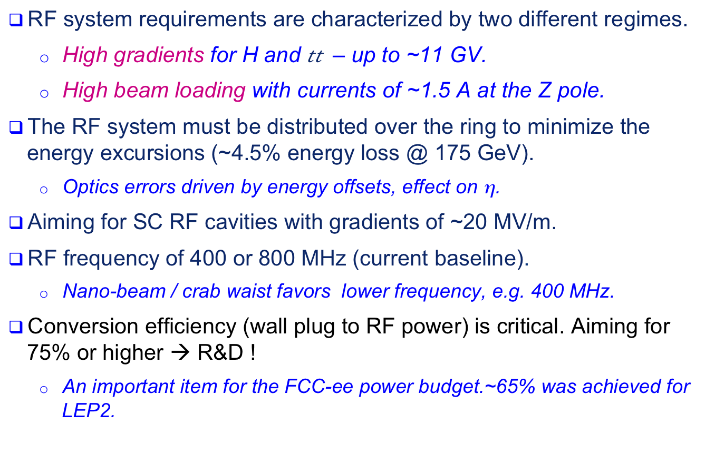
SC RF System
RF system requirements are characterized by two different regimes.
  High gradients for H and $t\overline{t}$ – up to ~11 GV.
  High beam loading with currents of ~1.5 A at the Z pole.
The RF system must be distributed over the ring to minimize the energy excursions (~4.5% energy loss @ 175 GeV).
  Optics errors driven by energy offsets, effect on η.
Aiming for SC RF cavities with gradients of ~20 MV/m.
RF frequency of 400 or 800 MHz (current baseline).
  Nano-beam / crab waist favors lower frequency, e.g. 400 MHz.
Conversion efficiency (wall plug to RF power) is critical. Aiming for 75% or higher → R&D !
  An important item for the FCC-ee power budget.~65% was achieved for LEP2.
J. Wenninger

Slide 37
FCC-he
Tentative design choice: beam parameters as available from hh and ee
  Max. e± beam current at each energy determined by 50 MW SR limit.
  1 physics interaction point, optimization at each energy
Could consider linac-ring design
collider parameters | e± scenarios |  |  | protons
species | e± (polarized) | e± | e± | p
beam energy [GeV] | 80 | 120 | 175 | 50000
luminosity [10³⁴cm⁻²s⁻¹] | 2.3 | 1.2 | 0.15
bunch intensity [10¹¹] | 0.7 | 0.46 | 1.4 | 1.0
#bunches per beam | 4490 | 1360 | 98 | 10600
beam current [mA] | 152 | 30 | 6.6 | 500
σ_{x,y}* [micron] | 4.5, 2.3

Slide 38

Proposed FCC Timeline
2014 |  |  |  | 2015 |  |  |  | 2016 |  |  |  | 2017 |  |  |  | 2018
Q1 | Q2 | Q3 | Q4 | Q1 | Q2 | Q3 | Q4 | Q1 | Q2 | Q3 | Q4 | Q1 | Q2 | Q3 | Q4 | Q1 | Q2 | Q3 | Q4
Prepare
Kick-off, collaboration forming,
→study plan and organisation
Ph 1: Explore options
“weak interaction”
Workshop & Review →identification of baseline
Ph 2: Conceptual study of baseline “strong interact.”
Workshop & Review, cost model, LHC results → study re-scoping?
Ph 3: Study
consolidation
4 large FCC Workshops distributed over participating regions
Workshop & Review
→ contents of CDR
Report
Release CDR & Workshop on next steps

Slide 39

FCC Work and Organisation
Work/meeting structures established based on INDICO, see:
FCC Study: https://indico.cern.ch/category/5153/
In particular:
FCC-hh Hadron Collider Physics and Experiments VIDYO meetings
  https://indico.cern.ch/category/5258/
  Contacts: michelangelo.mangano@cern.ch, fabiola.gianotti@cern.ch, austin.ball@cern.ch
FCC-ee Lepton Collider (TLEP) Physics and Experiments VIDYO meetings
  https://indico.cern.ch/category/5259/
  Contacts: alain.blondel@cern.ch, patrick.janot@cern.ch

Slide 40
FCC Work and Organisation II
FCC-hh Hadron Collider VIDYO meetings
  https://indico.cern.ch/category/5263/
  Contacts: daniel.schulte@cern.ch
FCC-hadron injector meetings
  https://indico.cern.ch/category/5262/
  Contacts: brennan.goddard@cern.ch
FCC-ee (TLEP) Lepton Collider VIDYO meetings
  https://indico.cern.ch/category/5264/
  Contacts: jorg.wenninger@cern.ch,
FCC infrastructure meetings
  https://indico.cern.ch/category/5253/
  Contacts: philippe.lebrun@cern.ch, peter.sollander@cern.ch

Slide 41
Conclusion
The CLIC and FCC studies prepare complementary potential future projects
CLIC study has produced a CDR and is now focusing on the optimisation and industrialisation of the technology
  Outreach is key to this, in particular to FELs
FCC study is working towards a CDR in 2018
  Can use the vast experience and technology from LHC
  But need to meet challenges due to high beam energy and luminosity
Both studies are world-wide collaborative efforts
  Russian contribution is important for both
Let us hope that the LHC will find exciting new physics and guide our choice between the two machines
Many thanks to people from CLIC and FCC from whom I stole slides and who provided the input

Slide 42
Reserve

Slide 43
Expectations after Long Shutdown 1 (2015)
Cms energy 13 TeV
Bunch spacing 25 ns
Expected maximum luminosity: 1.6 x 10³⁴ cm⁻² s⁻¹ ± 20%
  Limited by inner triplet heat load limit, due to collisions debris
Other conditions:
  Similar turn around time
  Similar machine availability
  β* ≤ 0.5m (was 0.6 m in 2012)
    Using new injector beam production scheme (BCMS), resulting in brighter beams.
F. Bordry
 | Number of bunches | Intensity per bunch | Transverse emittance | Peak luminosity | Pile up | Int. yearly luminosity
25 ns BCMS | 2508 | 1.15 × 10¹¹ | 1.9 µm | 1.6×10³⁴ cm⁻²s⁻¹ | ~43 | ~40-45 fb⁻¹

Slide 44
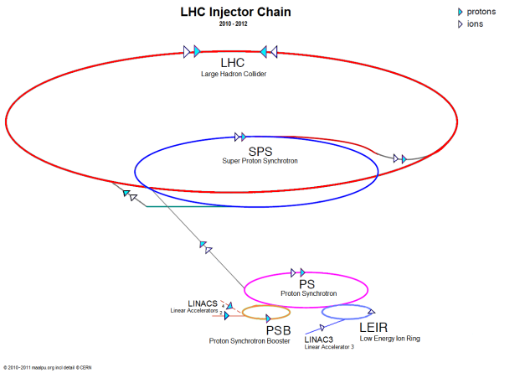

The HL-LHC Project
Goal is to obtain about 3 - 4 fb⁻¹/day (250 to 300 fb⁻¹/year)
Many improvements on the injector chain
Linac 4 - PS booster
PS
SPS
Many improvements on the LHC ring
New IR-quads Nb₃Sn (inner triplets)
  New 11 T Nb₃Sn (short) dipoles
  Collimation upgrade
  Cryogenics upgrade
  Crab Cavities
  Cold powering
  Machine protection
  …

Slide 45

Example of International Collaboration
F. Bordry
Baseline layout of HL-LHC IR region
D2
Q4
with national laboratories but also involving industrial firms

Slide 46
LHC schedule beyond LS1
LS2 starting in 2018 (July) => 18 months + 3 months BC
LS3 LHC: starting in 2023 => 30 months + 3 months BC
Injectors: in 2024 => 13 months + 3 months BC
Physics
Shutdown
Beam commissioning
Technical stop
30 fb⁻¹
YETS
EYETS
YETS
LS 2
YETS
Run 2
Run 3
Run 2
LS 2
Run 3
YETS
LS 3
Run 4
YETS
LS 3
Run 4
300 fb⁻¹
LS 4
Run 5
LS 5
LS 4
Run 5
LS 5
(Extended) Year End Technical Stop: (E)YETS
F. Bordry
3’000 fb⁻¹
LHC schedule approved by CERN management and LHC experiments spokespersons and technical coordinators (December 2013)

Slide 47
General Luminosity Considerations
Luminosity depends on the number of circulating particles
And on how much luminosity one obtains per particle
Use a round beam σ_{x}=σ_{y}
Beam brightness (beam-beam tuneshift, IBS)
Collision point beta-function
Beam current
Need to push beta-function, beam-beam tuneshift, injector brightness, turn-around time to either reduce beam current or increase luminosity
Flat beams also to be considered

Slide 48

Copper Coating
N. Mounet
ΔQ=0.5, can probably assume this upper limit on working point
Need maybe 300μm of copper coating
Difficult because of eddy currents in quench
Induces stress on beam pipe
LHC has 50μm
HTS coating? Lots of work
Impedance, coating technology, ecloud, …

Slide 49

RF Design Considerations
E. Shaposhnikova
400.8 MHz seems a good baseline
16MV minimum with no margin
32MV seems fine
200MHz appear somewhat low
Needs higher voltage (>100MV)
Or longer bunches (12cm)
800MHz appears too high
Combination of 200 and 400MHz?
Assumed impedance (x2)
32MV
24MV
16MV
Bunch length
Feedback design is critical
Emittance control also

Slide 50
Electron Cloud
O. Domingues Sanches De La Blanca
10
10
W/m
W/m
1
0.001
1
2.8
1
3.1
Need to quantitatively asses physics parameters
Flux of photons increases with B, 1.3x10¹⁷m⁻¹s⁻¹, i.e. twice LHC
Critical energy 4.3keV, i.e. 100 times LHC, similar to KEKB, photoemission yield?
Photon capture efficiency?
Likely need mitigation techniques
Need hardware studies, simulation studies and beam experiments

Slide 51
Final Triplet II
Without liner can survive O(30fb⁻¹) with liner O(1800fb⁻¹)
Improved radiation hardness of magnets to be developed
Optimised optics design to minimise losses of pions
F. Cerutti et al.

