Slide 1
Cockcroft Update
Amir & Hao

Slide 2
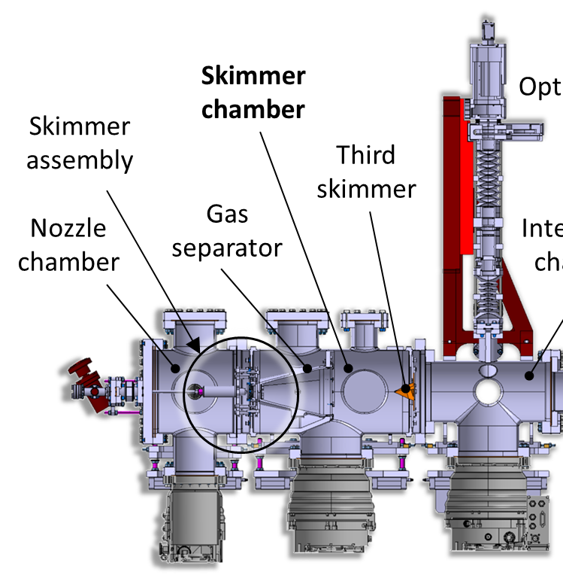
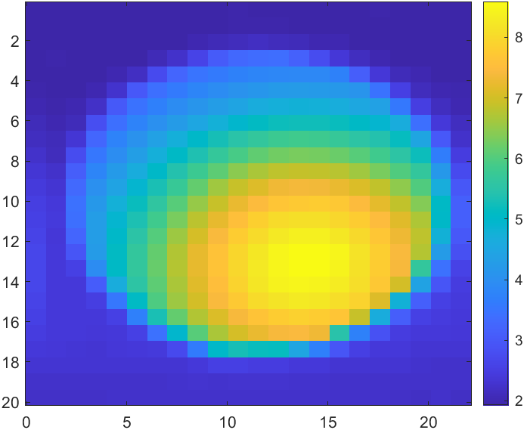
2mm circular 2nd skimmer
The gas-jet 2D density map is measured at the moveable gauge location, 283mm from the first skimmer.
From our previous measurements, it was observed that the gas-jet does not pass through the centre of the 2nd skimmer.
4.14mm
1.84mm
First skimmer :
0mm
Moveable gauge:
283mm
Interaction point:
538mm

Slide 3
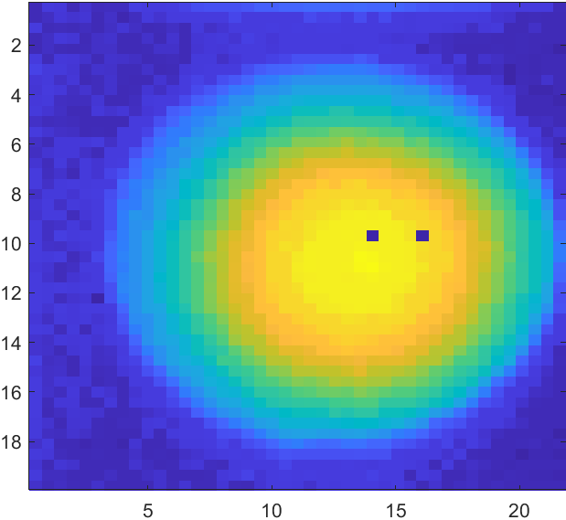
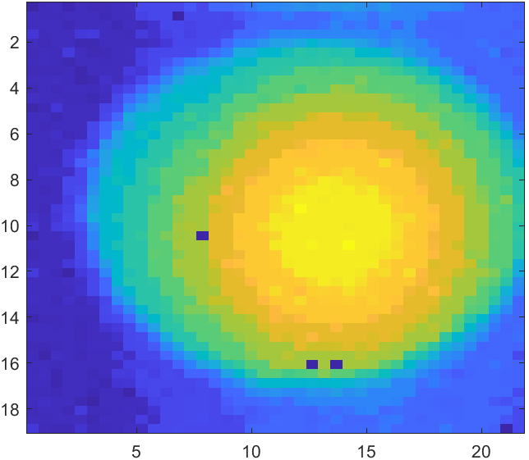
Correcting the position of the 2nd skimmer
1
2
The system was opened, the skimmer assembly was removed and the position of the second skimmer was shifted to the centre of the gas-jet [1].
There was an improvement but the system was still misaligned by ~1.44mm horizontally and 0.48mm vertically [2].
This process was repeated for a second time [3].
At the moveable gauge location, the gas-jet is off-centre by ~1mm vertically and horizontally.
0.48mm
4.14mm
1.44mm
1.84mm
3
1.35mm
1.2mm

Slide 4
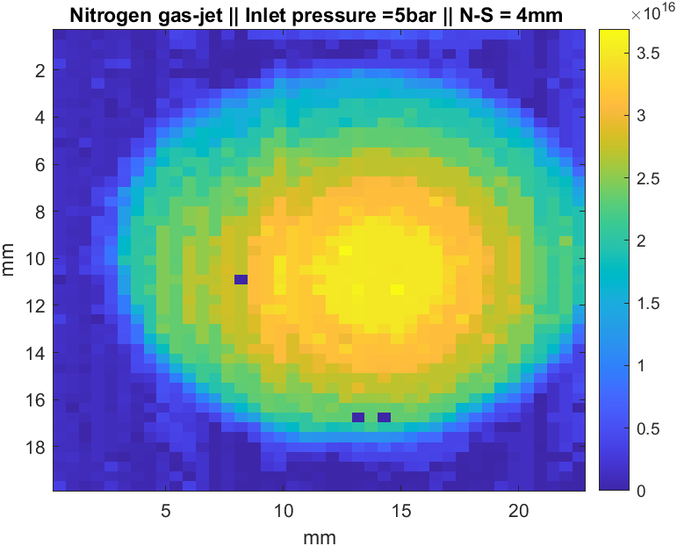
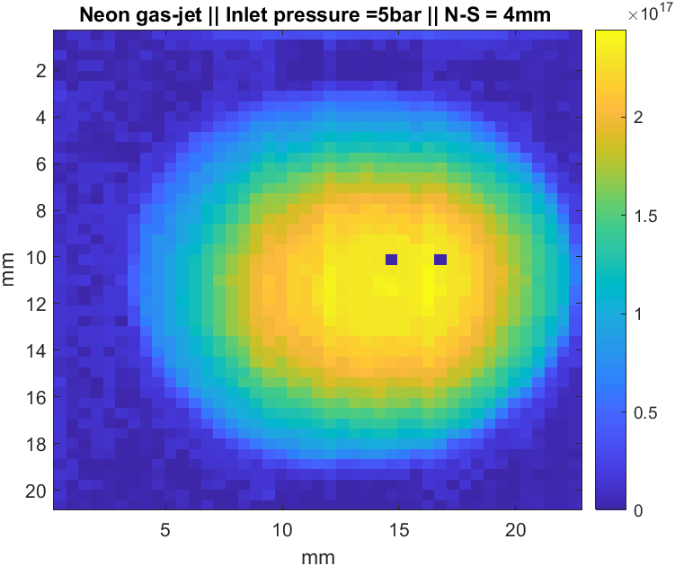
Misalignment
Assuming a uniform expansion from the second skimmer to the moveable gauge location. → The gas-curtain is off centre by 5~10%.
The second skimmer is off-centre by 100 to 150 microns from the centre of the gas-jet.
Density distribution for Nitrogen and Neon, with an inlet pressure of 5bar. Peak density is in agreement with the simulations.
Skimmer 2 location (0mm)
Moveable gauge (+250 mm)
100~150 microns
1 to 1.4mm

Slide 5
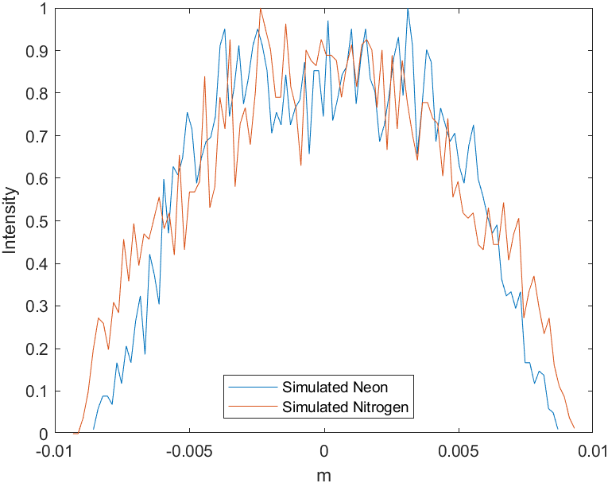
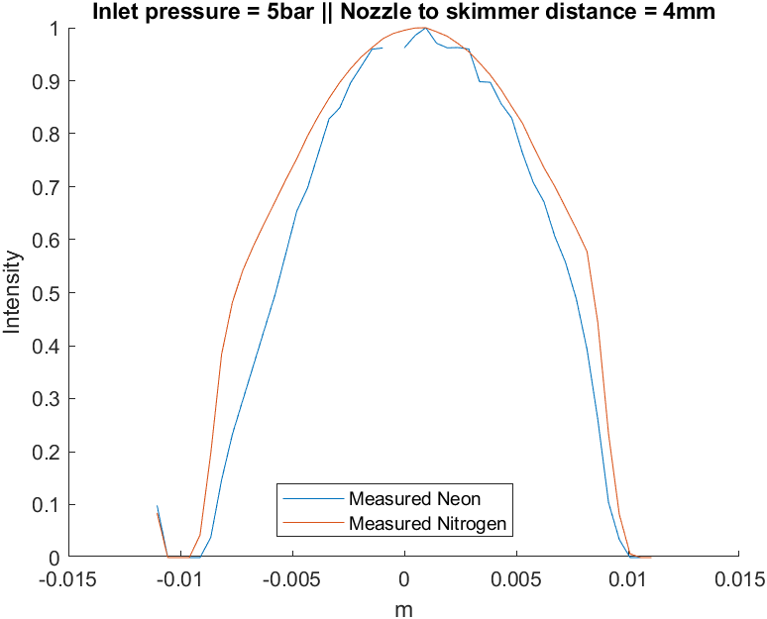
Gas-jet vertical profile
FWHM = 12.5mm
FWHM =13.6mm
FWHM = 13.3mm
FWHM =15.8mm
19.2mm
17.2mm
20.0mm
18.6mm

Slide 6
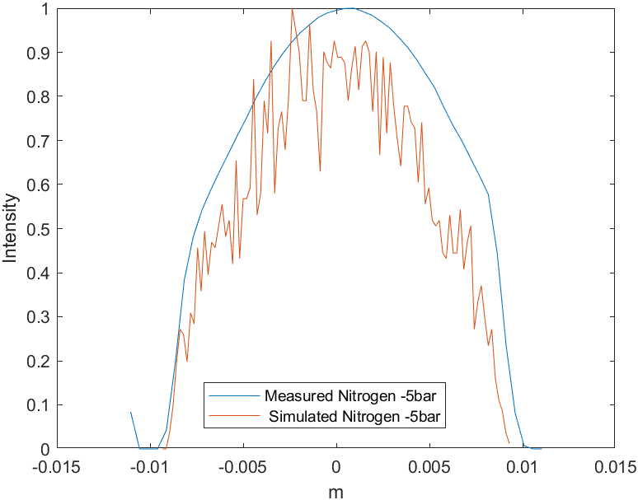
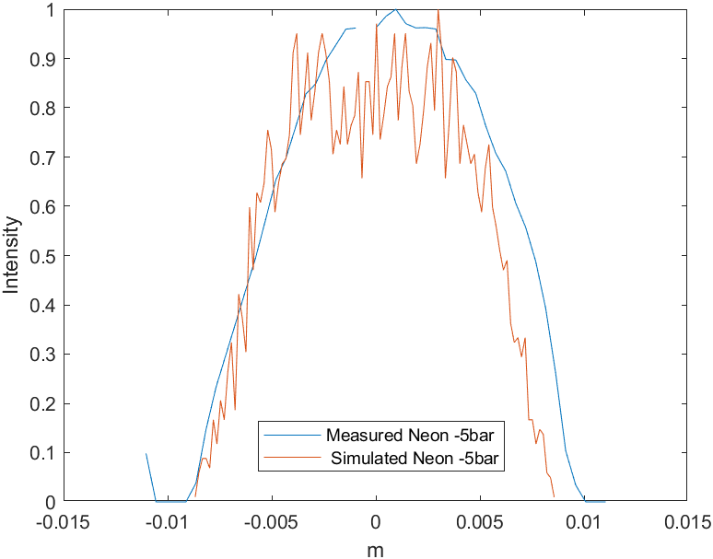
Gas-jet vertical profile

Slide 7
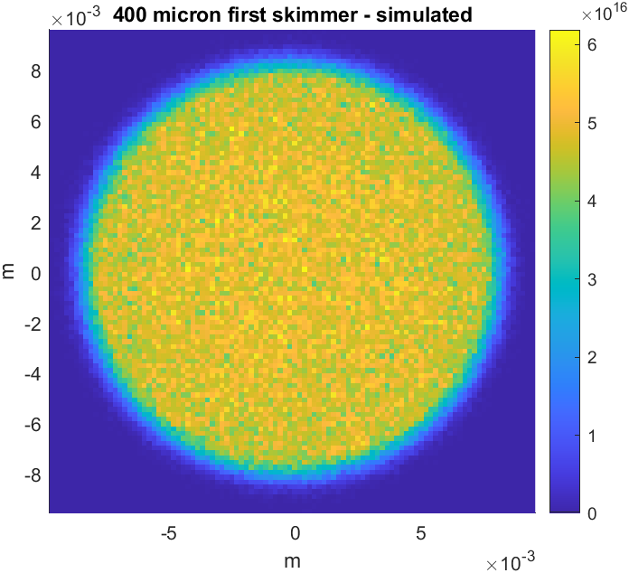
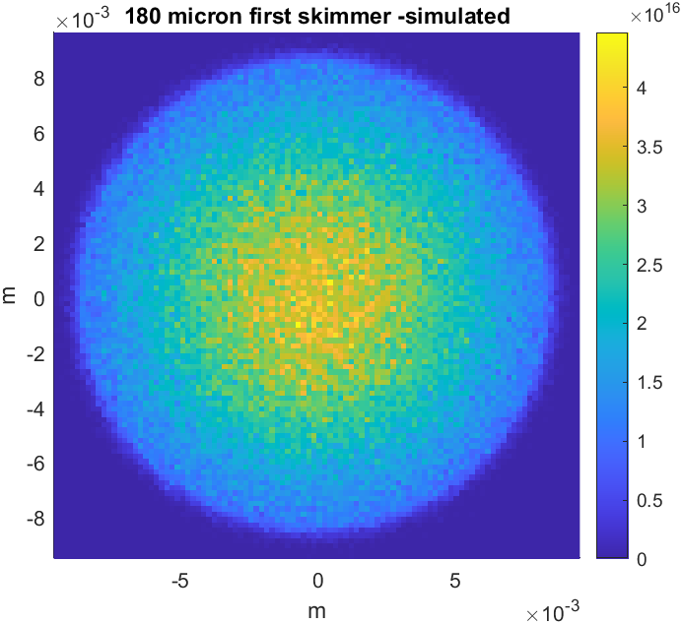
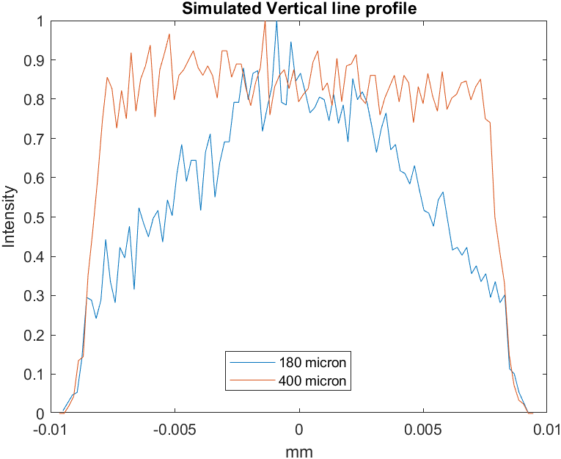
Next step → A more uniform jet
Original arrangement:
  30 micron nozzle
  180 micron first skimmer
  400 micron second skimmer
Current arrangement
  30 micron nozzle
  180 micron first skimmer
  2mm second skimmer
Next step
  30 micron nozzle
  400 micron first skimmer
  2mm second skimmer

Slide 9
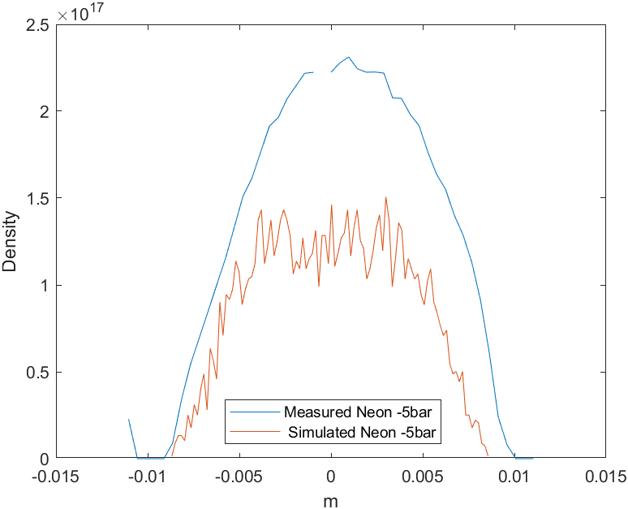
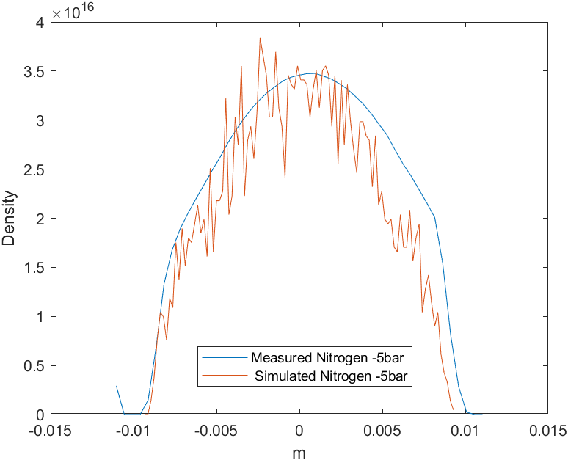
Extra slides

Slide 10
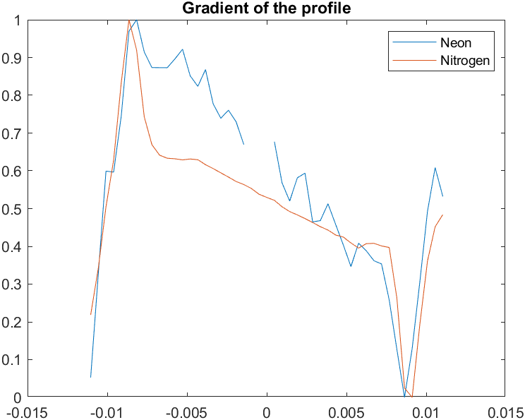
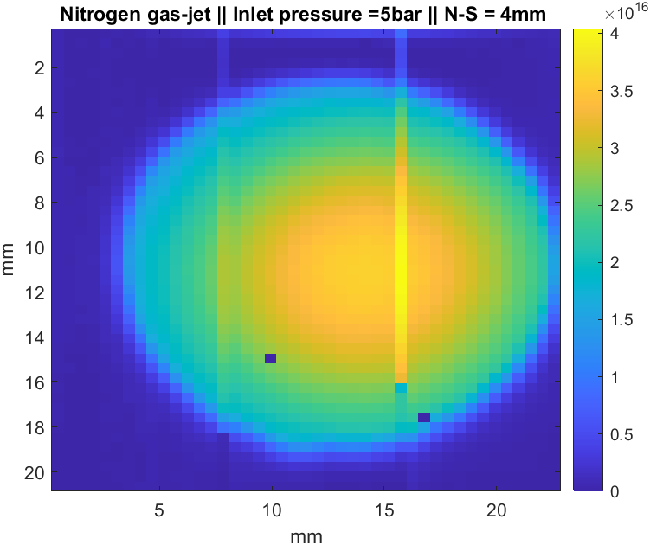
Extra slides

