Slide 2
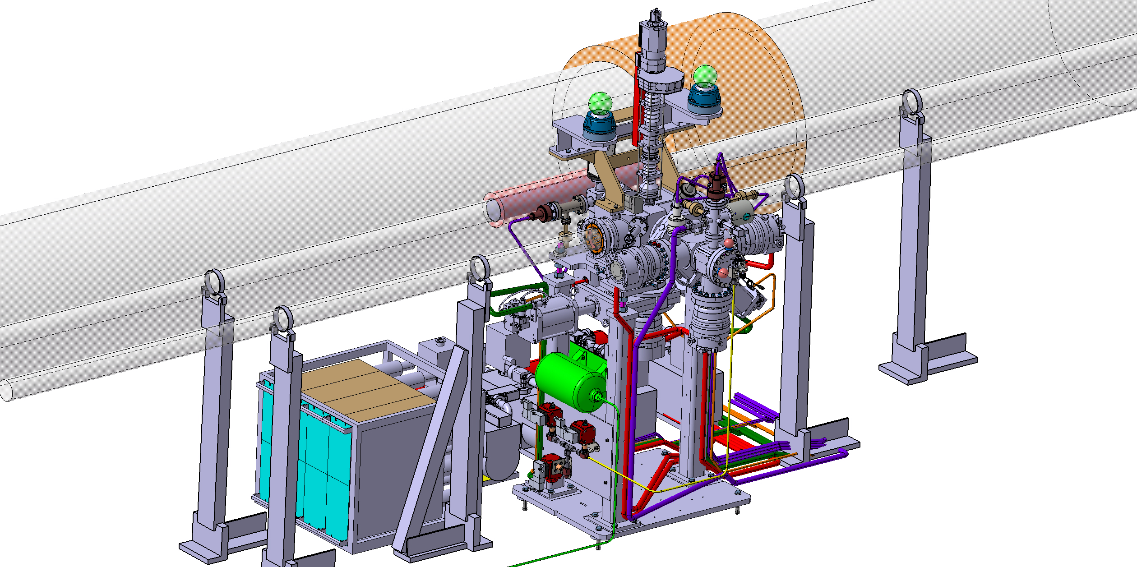
BGC – CERN Updates
Giannis Papazoglou,
February 2021, CERN, Geneva

Slide 3
Tunnel installation
Air Pressure for valves:
  Installed on Friday
Background gas injection system:
  Installation starting this week
Those are the two final parts for the installation

Slide 4
Design updates
Main Camera Assembly
  Last part for the V3Ph2
  Utilize design from the CI version
  To be done by next meeting
V4: Simple Mock up designed

Slide 5
Procurement
Viewports:
  Blanks ready
  Shipment requested for Torr Scientific for the glass addition and pressure testing
Gas injection line solenoids are ordered
Parts for the V4 Mock up are ordered and some already here
To be ordered:
  Ph2 Gauges
  Primary pumps
Potential issue with the bellows → Company is bankrupted!

