Slide 1
Illumination of test stand BGC camera due to cathode radiation
&
Synchrotron radiation on BGC in current LHC setup
Noah Jens – 03.02.2021

Slide 2
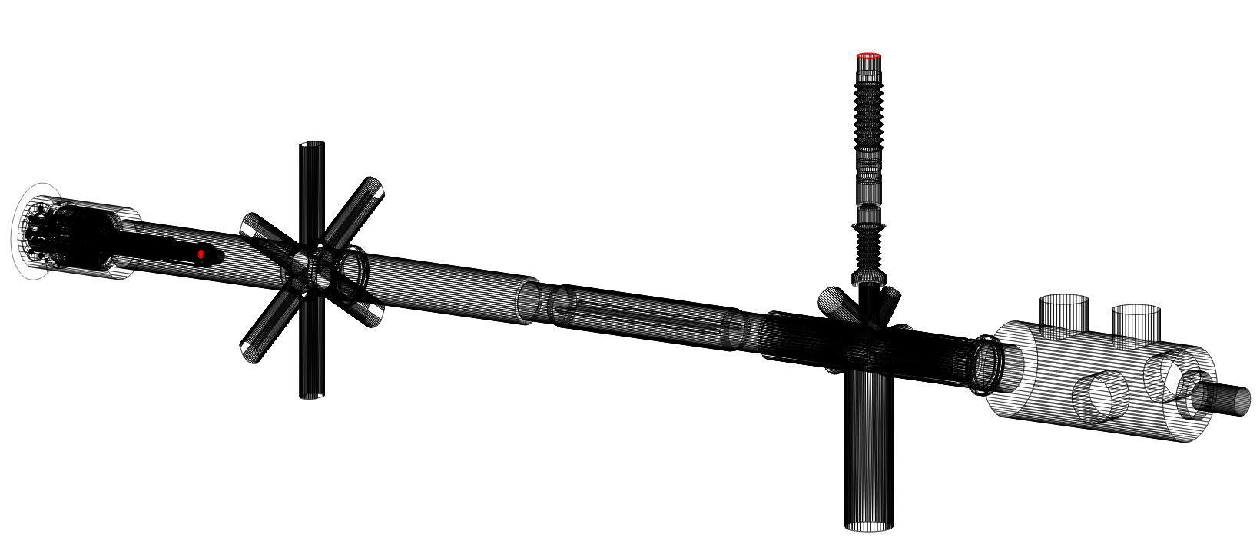
HEL test stand model in MolFlow
Camera
Cathode in e-gun

Slide 3
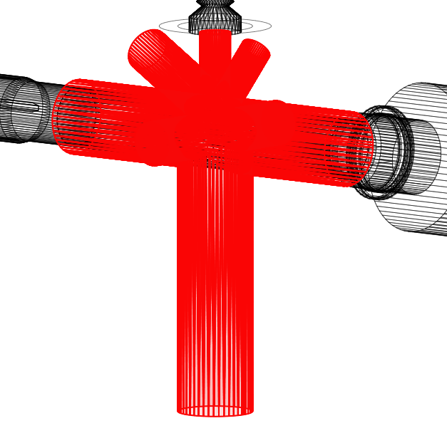
Correction of interaction chamber coating
Interaction chamber is NOT AC coated
about 10875 $\frac{1}{s}$ are expected at camera facet (instead of 1783 $\frac{1}{s}$)

Slide 4
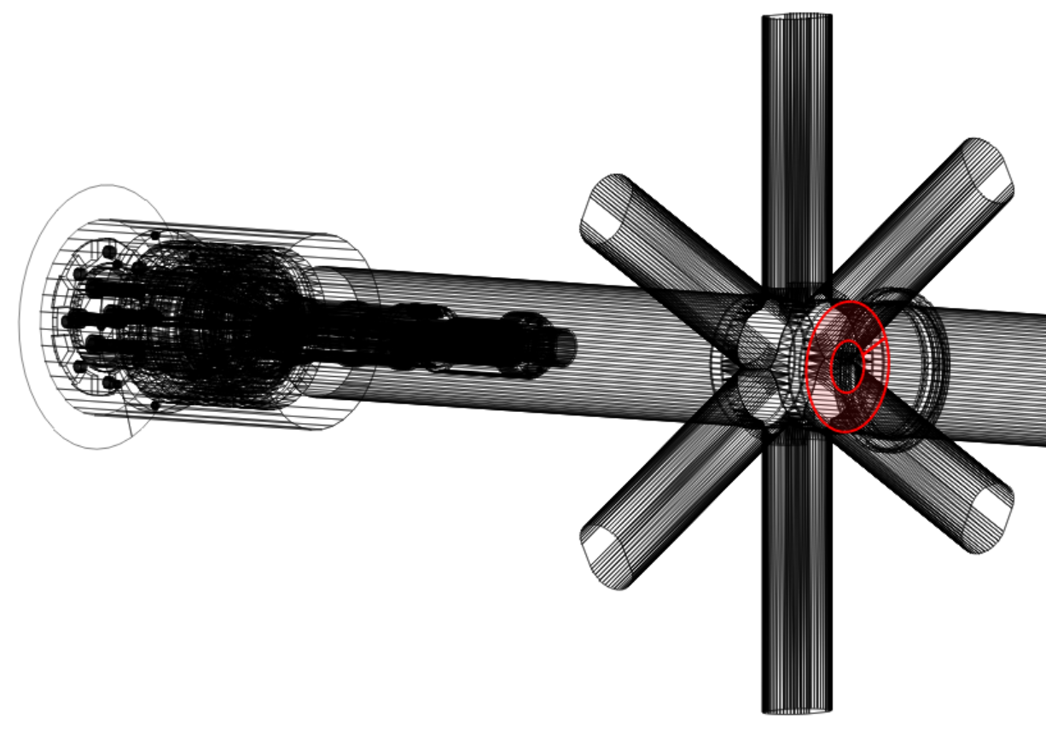
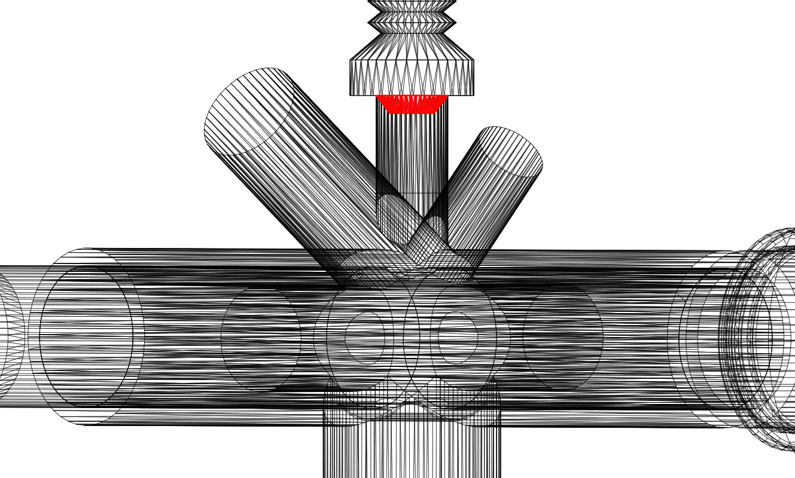
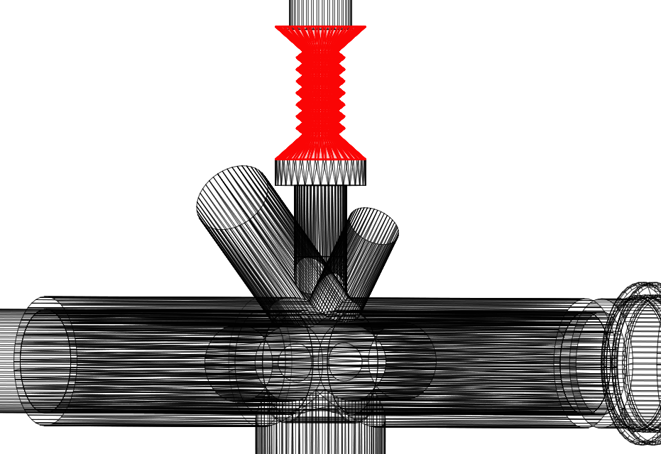
Measures to reduce photon rate at camera
Mask in front of gun
Mask in camera arm
Narrower bellows
30/40/50mm ID
Steel
25mm ID
AC coated
25mm ID

Slide 5
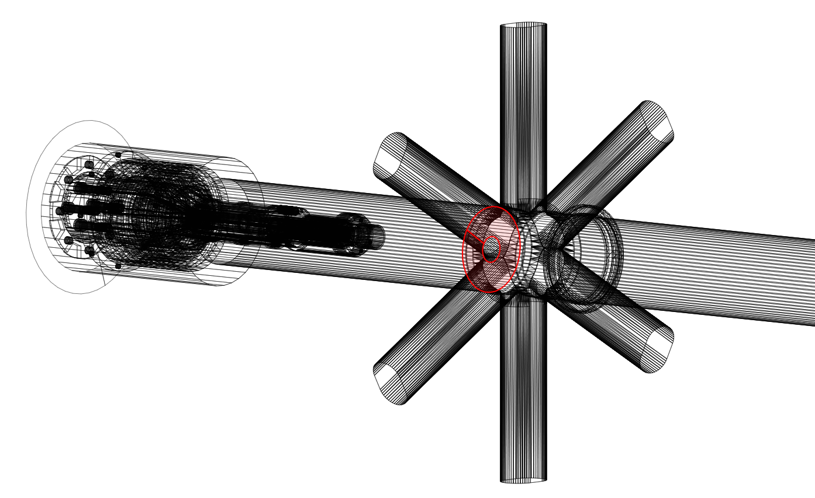
Repositioning of front mask
Front mask moved behind the 8-way intersection to ensure best pumping performance of the gun

Slide 6
Simulation results in photons per second
Mask in front of gun
Mask in camera arm
Narrower bellows
None | 10875 1/s
50mm ID | 4052 1/s
40mm ID | 3011 1/s
30mm ID | 1966 1/s
No front mask | 6186 1/s
50mm ID front mask | 2325 1/s
40mm ID front mask | 1723 1/s
30mm ID front mask | 1088 1/s
No front mask | 4078 1/s
50mm ID front mask | 1597 1/s
40mm ID front mask | 1189 1/s
30mm ID front mask | 737 1/s

Slide 7
Simulation results in counts per second
Due to the maximum transmission of the filter (80%) and the quantum efficiency of the photocathode (10%), the counts per second can be estimated by multiplying the hits by 8%:
Mask in front of gun
Mask in camera arm
Narrower bellows
None | 871 cps
50mm ID | 324 cps
40mm ID | 241 cps
30mm ID | 158 cps
No front mask | 495 cps
50mm ID front mask | 186 cps
40mm ID front mask | 138 cps
30mm ID front mask | 88 cps
No front mask | 327 cps
50mm ID front mask | 128 cps
40mm ID front mask | 96 cps
30mm ID front mask | 59 cps

Slide 8
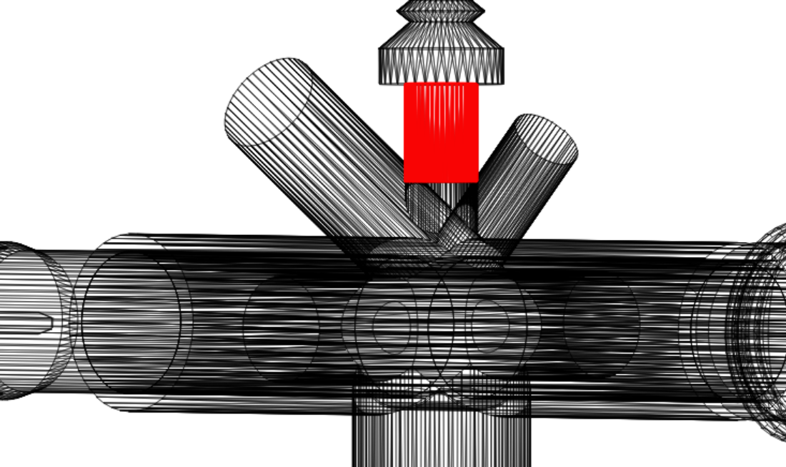
Blackout material in camera arm port in photons per second (top) & counts per second (bottom)
Mask in front of gun
Black port
(sticking factor of 0.9)
None | 10875 1/s
50mm ID | 4052 1/s
40mm ID | 3011 1/s
30mm ID | 1966 1/s
50mm ID front mask | 3549 1/s
40mm ID front mask | 2717 1/s
30mm ID front mask | 1707 1/s
None | 871 cps
50mm ID | 324 cps
40mm ID | 241 cps
30mm ID | 158 cps
50mm ID front mask | 284 cps
40mm ID front mask | 218 cps
30mm ID front mask | 137 cps

Slide 9
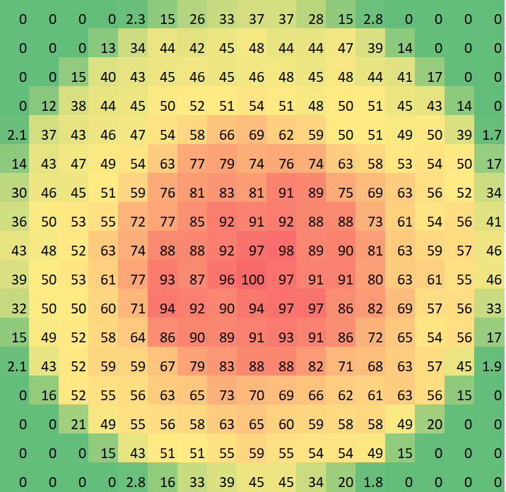
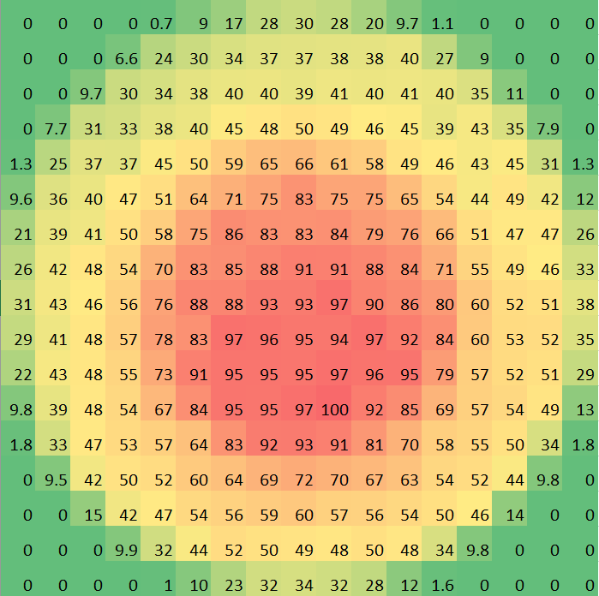
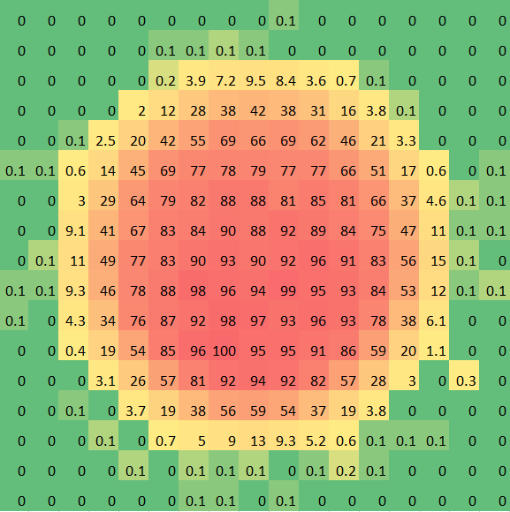
Distribution at the camera facet
(normalized and in percent, no lens system)
Mask front
Mask front & mask in camera arm
Mask front & narrow bellows

Slide 10
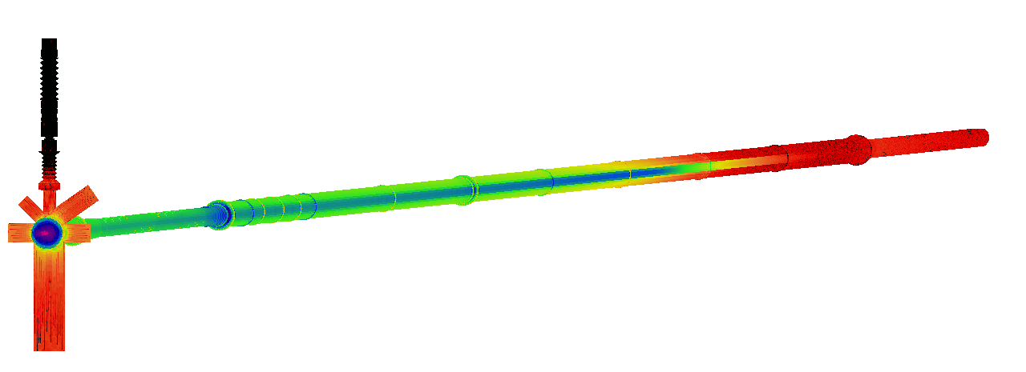
Synchrotron radiation on BGC
Geometry based on the information in the layout database
D3 and D4 bending magnets implemented
D4
D3

Slide 11
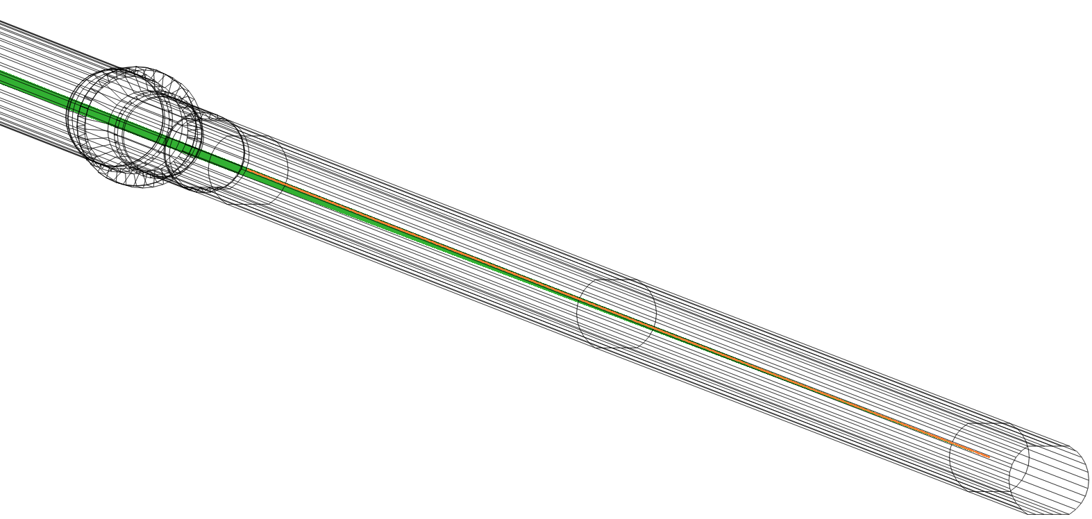
SynRad
Software to simulate synchrotron radiation
Based on the information about beam and magnetic regions

Slide 12
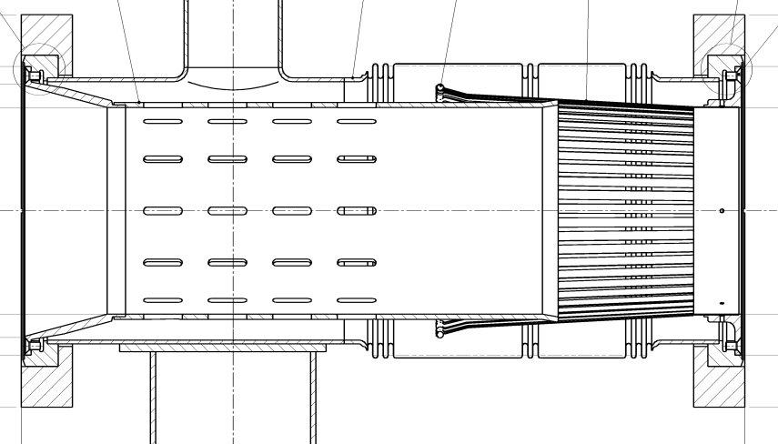
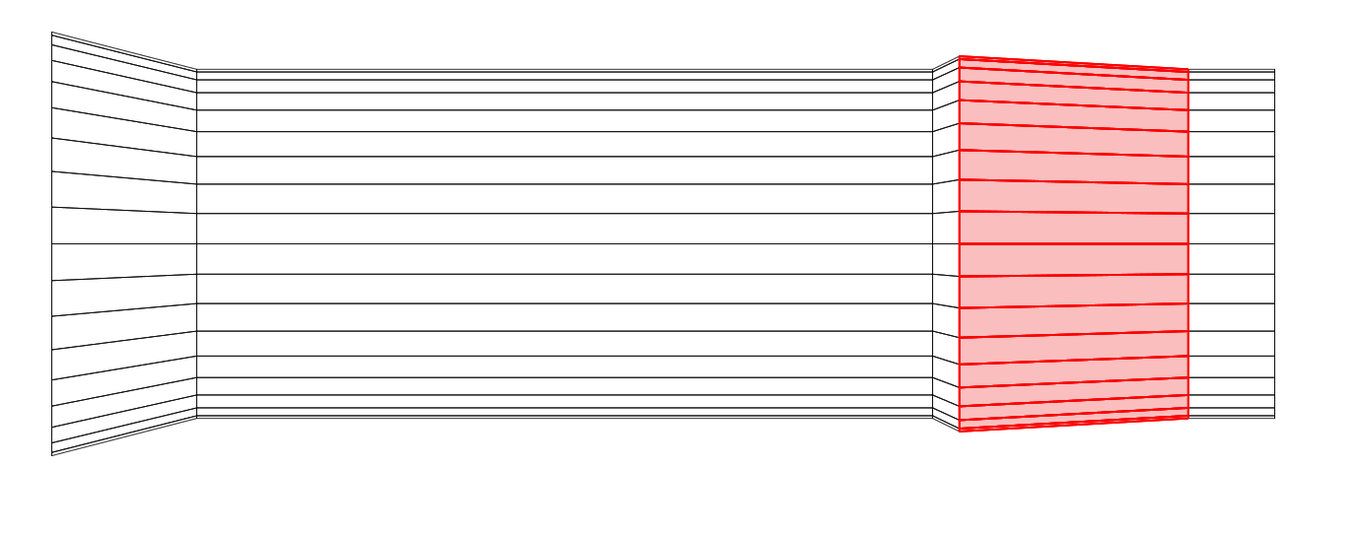
Simplifications
No outer shell assumption that photons, which hit the holes in the RF fingers won’t come back
No adjustments for holes in other regions of the geometry (for example beam screens)
Adjusted sticking factor of RF finger regions, according to the area ratio of holes to metal

Slide 13
Need for iterative simulation
Due to difference in photon flux of about 11 orders of magnitude, not enough test photons hit the camera facet
Low flux mode could not deliver enough statistics either
No direct recording of angle map in SynRad possible
The particle logger can record information about incident angle of each photon

Slide 14
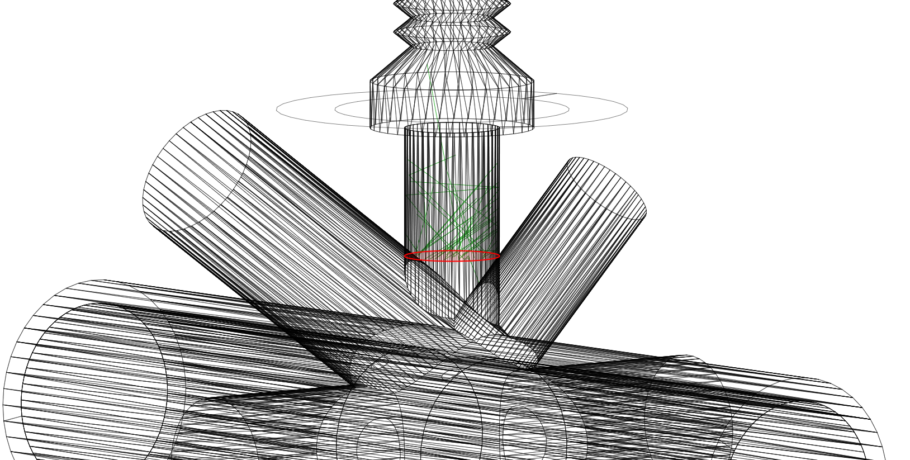
Transferring simulation to MolFlow
Angle map out of the incident angle
New simulation in MolFlow including the angle map and the scaled desorption

Slide 15
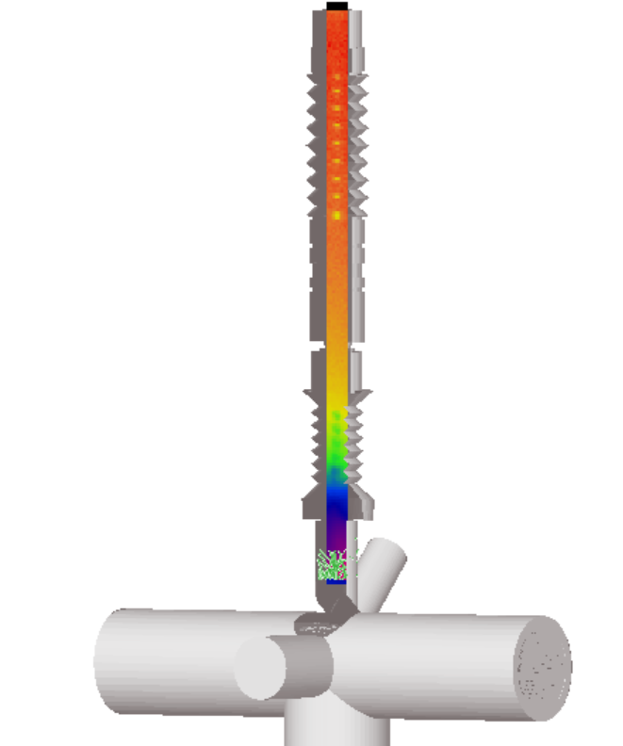

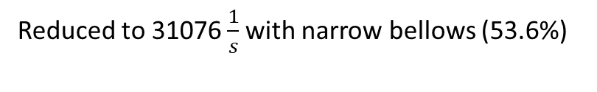
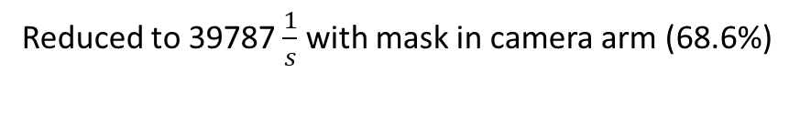

Simulation results
According to the MolFlow simulation the camera facet receives 58004 photons per second
Reduced to 39787 $\frac{1}{s}$ with mask in camera arm (68.6%)
Reduced to 31076 $\frac{1}{s}$with narrow bellows (53.6%)
$$in\frac{1}{s∗m^{2}}$$

