Slide 1
The shaft-chains for magnetic measurements
TM-TECH#1 26/01/2021
Lucio Fiscarelli

Slide 2
Intro
Focus on the shaft chains for magnets tested in horizontal with anti-cryostats
What we already have
What we are going to produce
The dimensions given in this presentation are rounded!
Extensions are not considered (they differ from magnet to magnet)

Slide 3
What we already have and we want to keep
Diameter 40 mm
MB – 2 shaft chains (each composed of 12 ceramic modules with length 1250 mm)
MQ – 2 shaft chains (each composed of 6 ceramic modules with length 750 mm)
MBH – 2 shaft chains (each composed of 6 ceramic modules with length 1250 mm)
Diameter 110 mm
Q2 prototypes – 1 shaft chain (composed of 6 carbon modules with length 1500 mm)*
Q2 – 1 quench antenna (composed of 6 EPGM modules with length 1400 mm)**
* Built by using alredy existing modules, not optimized
** We are thinking of adding one more module for the tranverse localization

Slide 4
What are going to produce
Diameter 110 mm (design completed, procurement on going)
Q2 – 2 shaft chains (composed of 7 carbon modules with length 1500 mm)*
D1 – 1 shaft chain (composed of 6 carbon modules with length 1500 mm)**
CP – 1 shaft chain (composed of 5 carbon modules with length 1500 mm)**
Diameter 70 mm (to be confirmed)
D2 – 2 shaft chains (each composed of 10 carbon modules with length 1500 mm)***
* A complete spare unit is considered
** No spare unit, only spare modules
*** Design not yet started

Slide 5
Open points
Total number of modules
tradeoff among spare policy / storage space / cost
Shaft chains for the D2
we are late for the prototype (alternative solution?)
I see an advantage in including the required carbon shells into the ongoing procurement (maybe as option in the contract)
(spec committee mid March 2021)

Slide 6
Additional slides

Slide 7
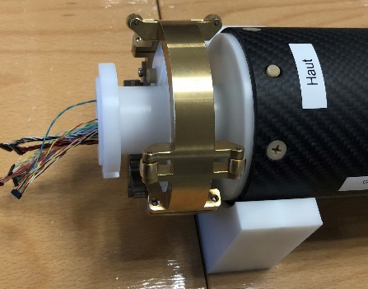
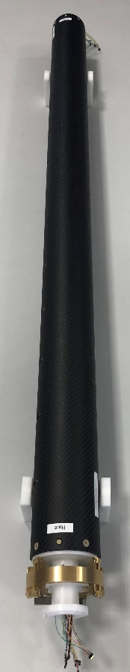
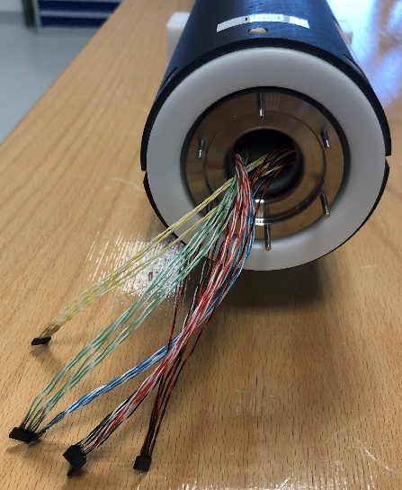
Shaft chain for the Q2 prototype
The 6 segments required for the first complete shaft chain are ready; the PCB coils have been checked in the reference dipole (10⁻⁴ agreement with design value).
The segments have been assembled and some issues have been solved (too large gap of carbon shells for housing the PCB, missing protective layer on PCB circuit). The assembled segments have been calibrated in the reference quadrupole.

Slide 8
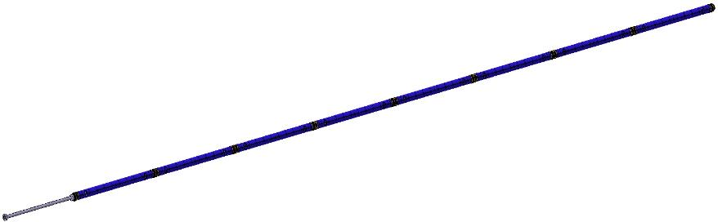
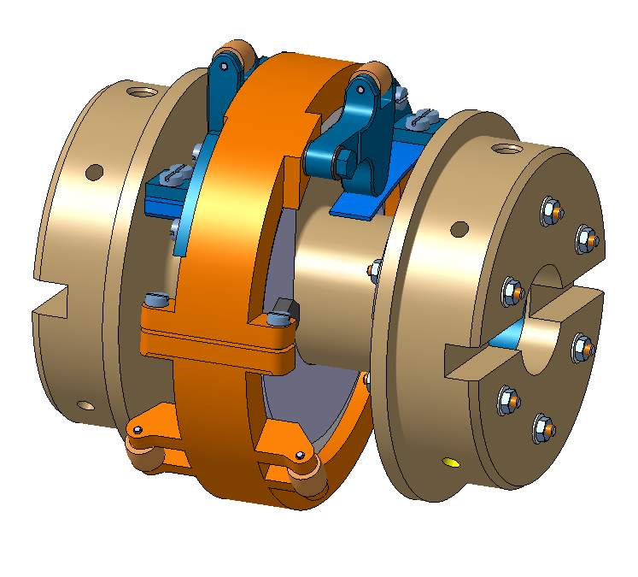


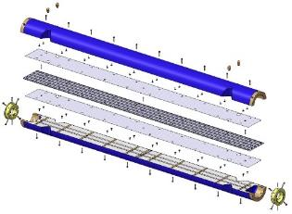
Modules with length of 1.4 m (1.3 m active)
Carbon-fiber shells for stiffness and low weight
Pickup coils made from printed circuit boards (PCB)
Retroreflectors on each module directly linked to the PCBs (best accuracy)
One retroreflector is always visible outside the anti-cryostat
Procurement is ongoing
Market survey done
Spec committee on mid March 2021
Tendering end of March 2021

Slide 9
Q2a/Q2b

Slide 10
Q1/Q3
Reuse of the Q2 shaft chain under the assumption that
  only 1 or 2 of these magnets will be tested
  not parallel operation on the Q2

Slide 11
D1 and CP
Resuse of the same mudules as for the Q2 but diffirent number and different rallonge

Slide 12
D2
Design not yet started (anticryostat diemensions not available)
We should find a way to include these modules into the ongoing procurement

