Slide 1



Carpenter reporting
F. Mangiarotti, I. Koukovinis Platias

Slide 2
Why reporting in Carpenter?
Profit from all the data already in the DB
Standardize outputs
Get the reports done faster!
Getting the reports in Carpenter is a large effort though, because we need to try to accommodate all possible options in a more or less predefined format

Slide 3
Report strategy

Slide 4
Concept
Option to have many types of report
Predefined structure (Parts, Chapters)
Data should be retrievable from DB in form of tables and plots
User can add text and images
“Locking” mechanism to avoid having out-of-date report
“Template” mechanism to re-use old reports
“Keywords” to find old tests after several years

Slide 5
Reporting structure
Report type: indicates what parts and chapters to load for this report type. Currently used to export data to TE-CRG
Part: first division of the report. Example: Introduction, Electrical tests, etc
Chapter: second division of the report. One part may have more than one chapter. Example: HV test, RRR, splice measurements (all in Electrical tests)
Paragraph: here the user can fill out the report. Linked to the chapter; each chapter may have more than one paragraph. The paragraph can be: text, image , table, plot→ post-processing required in ¾ cases

Slide 6
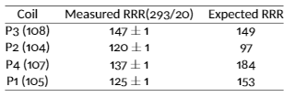
Example: “full report”
Predefined values
User input fields
Electrical tests [Part]
  RRR [Chapter]
    The RRR was measured during warm up in all the coils… [paragraph, text]
    [paragraph, table]
  Electrical insulation tests [Chapter]
    The electrical insulation tests performed on the magnet passed OK. [paragraph, text]
    The tests performed on the test station failed for some reason [paragraph, text]
[other parts]

Slide 7
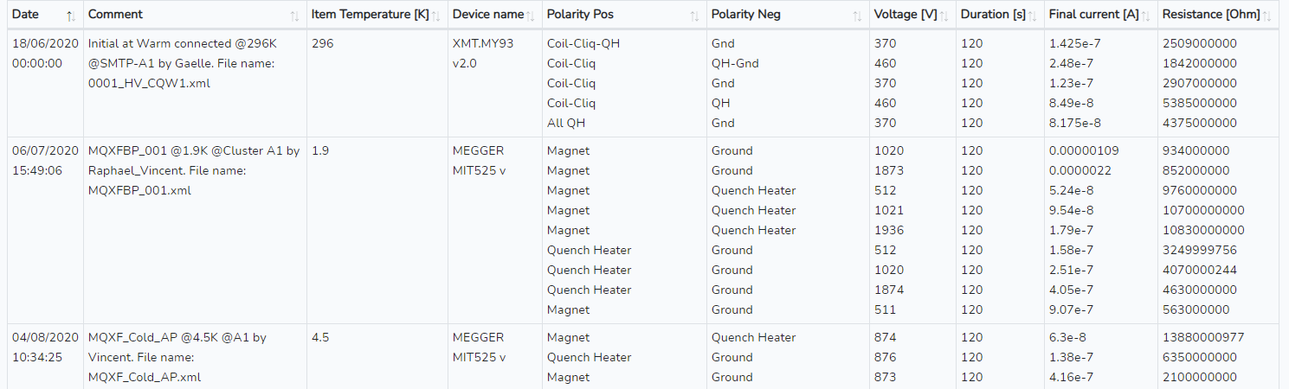
Example: “HV report”
Predefined values
User input fields
Electrical insulation tests [Part]
  Electrical insulation test setup [Chapter]
    We used the Megger device connected directly to the magnet connectors [par. text]
  Electrical insulation tests results [Chapter]
[par. table]

Slide 8
How to deal with tables, plots and images
Tables and plots: they should be “programmed” in text, which is then parsed by the website.
  It will be very hard the first time, but afterwards we reuse the tables and plots and we will get the data formatted in the same way
Images: uploaded to a server or to the DB
  “Cleanest” solution would be to upload to DB, but unclear if it’s easy or if there are limitations
  Since we want to store all reports in EDMS, it should be relatively easy to store the images in EDMS as well
  If not, we can store them in the website server (not the preferred option)

Slide 9
Locking the test plan and/or report
We want to avoid having outdated reports
  This could happen if the test plan results are edited after the report is issued
To avoid this, we implement the “report status” as a lock to edit the test plan, test report or both.
We plan to have many different status to provide multiple options. Some possible examples:
  Unlocked = all free to update as usual
  Report preview = test plan free, report locked (useful to do preliminary reports during operation)
  In work = test plan locked, report can be edited (you don’t want the results to change while writing the report)
  Released = all locked

Slide 10
Templates (a.k.a. “Recipes” in Carpenter)
We already have recipes for item, setup and test plan, so this is not a new idea
When creating a new report, you could choose a recipe which has pre-filled fields. This will be specially useful for automatic plots and tables
The user can then modify all the fields as they see fit, include some new fields or remove unnecessary ones
  We can add some permission to limit who can modify the report from recipe

Slide 11
Keywords
To be able to filter tests after several years, we will provide a list of keywords to apply to the report
The list of possible keywords is also in the DB, so it can be updated if needed.
Examples of interesting keywords: “short to ground”, “spikes”, “degradation”

Slide 12
Implementation ideas

Slide 13
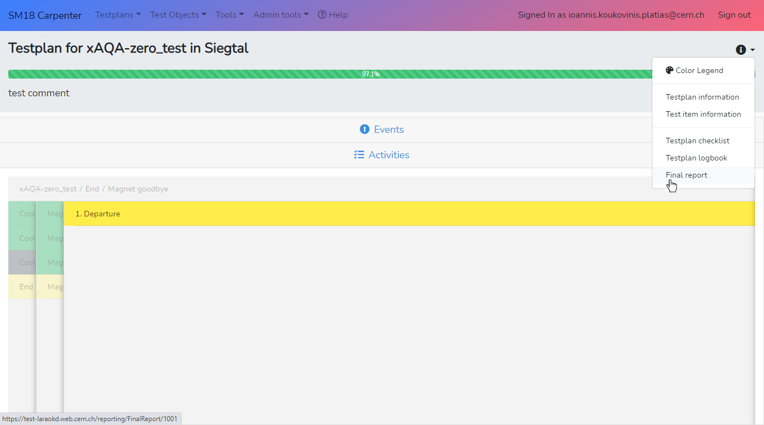
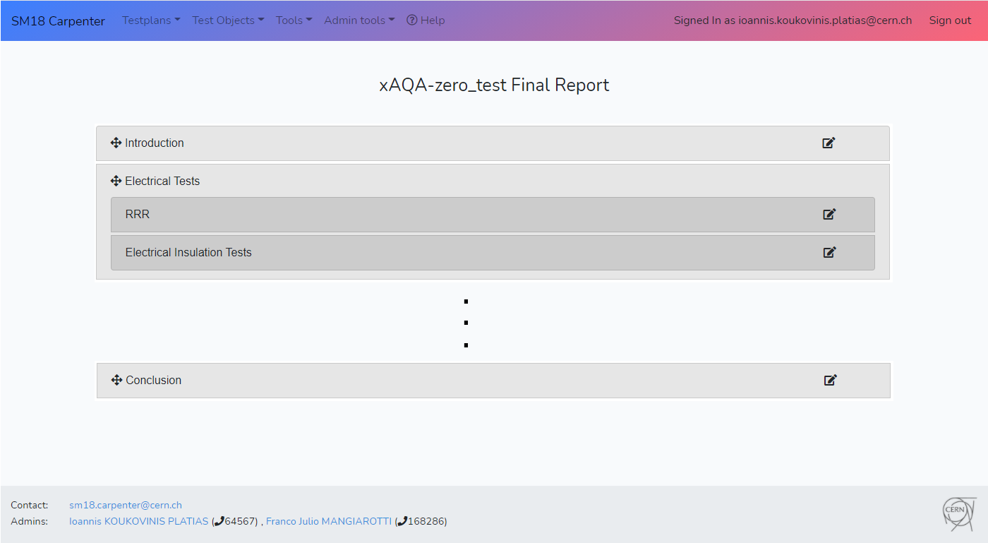
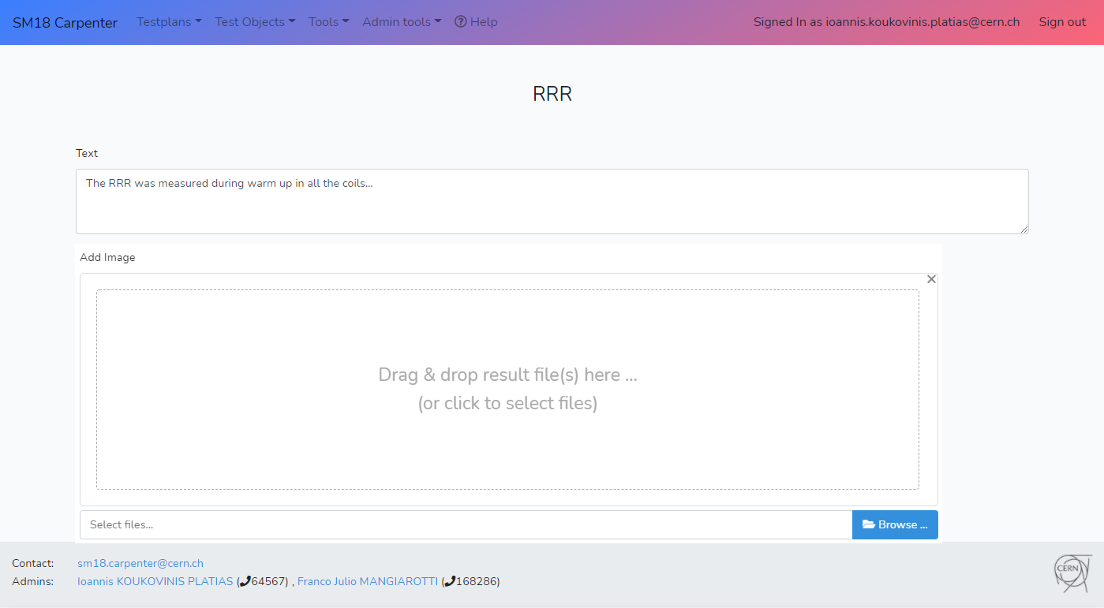

Slide 14
Discussion

Slide 15
Some questions we have for you
Do you think this strategy fits all/most of our needs?
Does it sound simple enough to use, once it is set up (for example, using a template/recipe)?
Is there any functionality that you would like but it’s not foreseen?
How important would it be for you to have the report automatically updated/released in EDMS?

Slide 16
DB layout images
(extra slides)

Slide 17
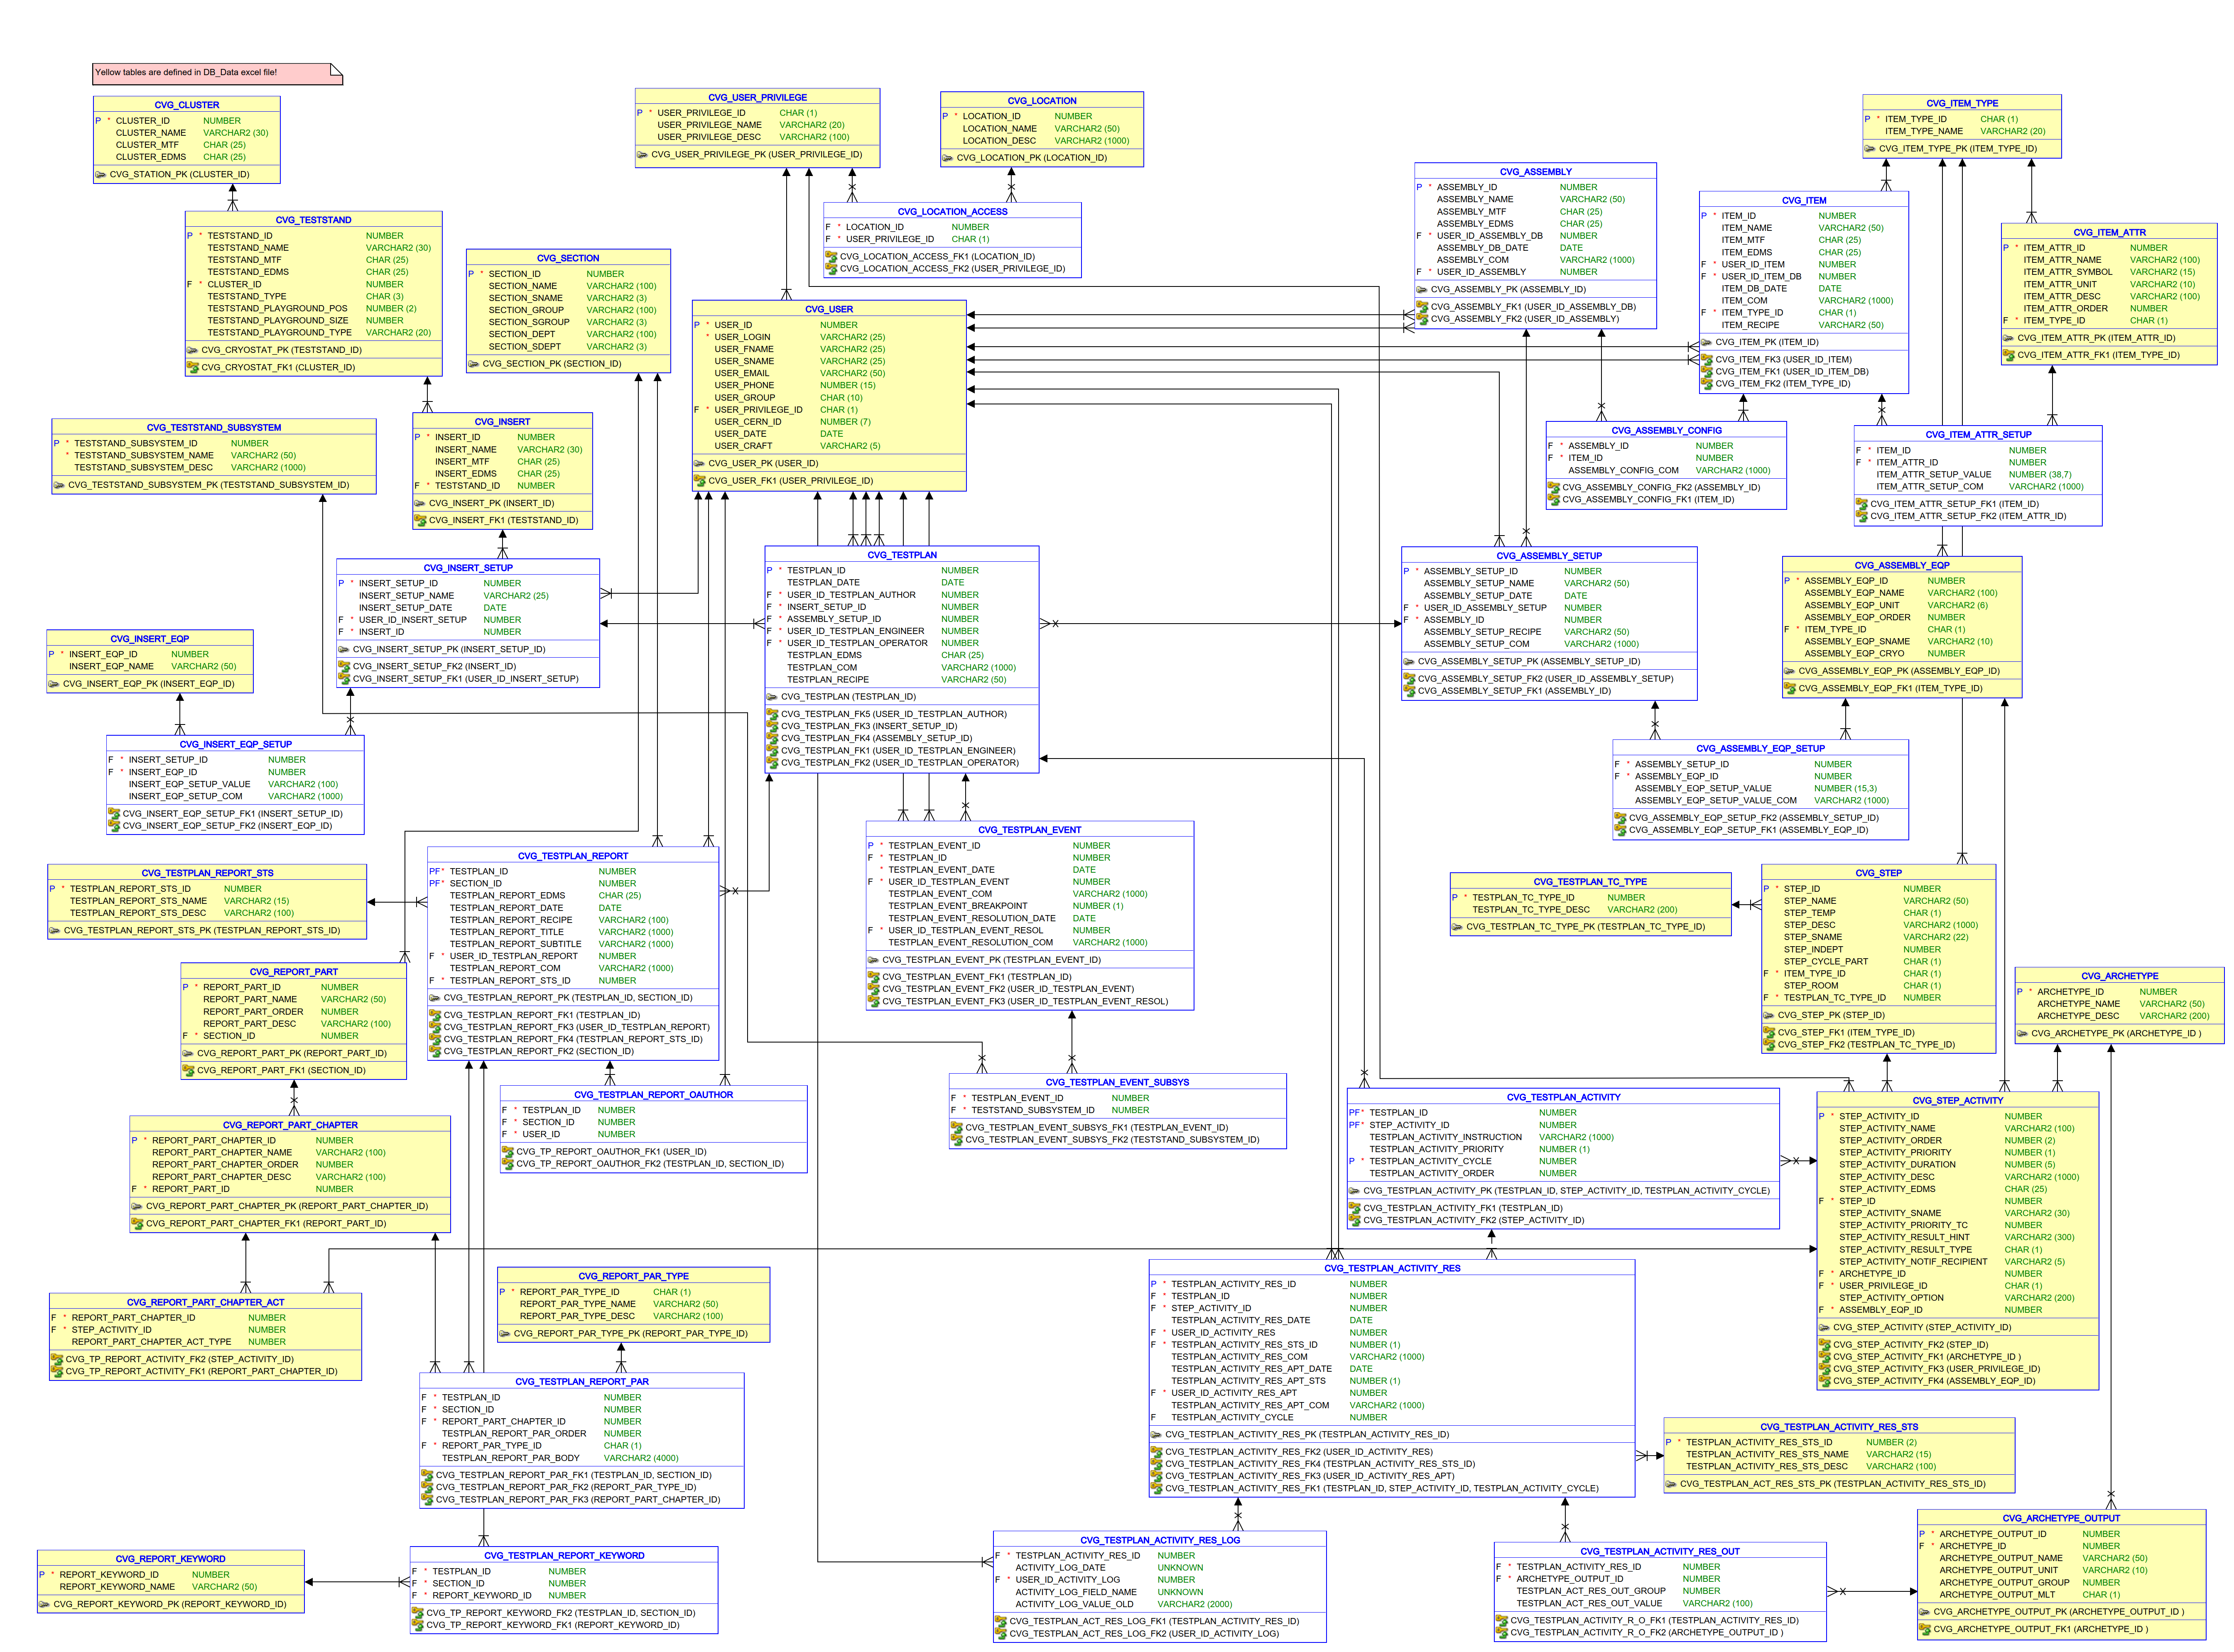
DB layout

Slide 18
DB layout
Test station details
Users and permissions
Test item and test setup information
Testplan
Testplan results, events, data, etc
Reporting
Test
Procedure
Data structure .

Slide 19
DB layout
Reporting corner
In yellow: pre-filled tables, giving the structure and some options
In white: tables that are filled each time to actually write the report

Slide 20
DB layout
Reporting corner
Status options
Structure:
Part
Part
  2.1 Chapter
  2.2 Chapter
In yellow: pre-filled tables, giving the structure and some options
In white: tables that are filled each time to actually write the report
Type of input field (text, image, table, plot)
Links between chapters and test plan activities (to retrieve information)
Keyword list

Slide 21
DB layout
Reporting corner
In yellow: pre-filled tables, giving the structure and some options
In white: tables that are filled each time to actually write the report
This means there are only 4 tables to fill:
Main header
Co-authors
Paragraphs
Keywords

