Slide 2

My journey as an expat
Felix Salazar, PhD
CERN, EP-DT-FS

Slide 3
Spouse follow career
Originally from Venezuela
  Mechanical Eng., Fluid dynamics
Moved to Montréal, for PhDs
  Wife finished her PhD about 1 ½ year earlier than me
Her job search led us to the USA
  Food industry
4 years later, we moved to Switzerland

Slide 4
USA
Wife started her job in early 2015. I finished my PhD in early 2016
In 2015, the employment perspectives in USA were good
  Got several interviews
Dramatic change in 2016
  Long process to obtain work permit
  Decrease of frequency of interviews
  Passport issue
We decided to start a family
  Stay-at-home dad
  Health issues

Slide 5
CV gap
Growing
  Keeping myself busy with stuff that does not fit on a CV
Not getting replies from applications
Risking on becoming unemployable
  Anxiety

Slide 6
Swiss journey
Post Career Break Fellowship program at CERN
  Application submitted just a few hours before the deadline
  Felt like playing a lottery ticket
Wife dream job was in Switzerland
  Nestlé Research Center, in Lausanne
Wife got contacted by Nestlé the same week I received the email from CERN-HR with the selection to the PCB
  Felt like winning the lottery

Slide 7
Post Career Break Fellowship at CERN
Offer a pathway back into research
  Personal reasons
  Unemployment is not considered a career-break
  Nationals of non-member states
Unique figure
  Employs people that market is avoiding
  Gives chance
3-year contract
  Optional last year outside CERN

Slide 8
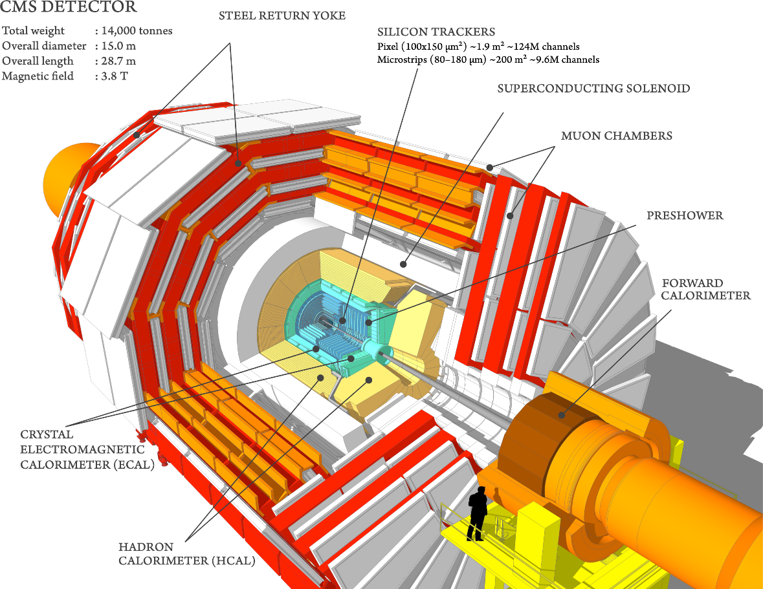
… at CERN
Working within EP-DT-FS
  Cooling of the electronics
  CO₂ as coolant
Special requirements
  Radiation
  Low temperature
  Environmental impact
  Cost
Affect ATLAS, CMS and LHCb
  HL-LHC (2026)

Slide 9
Some technicalities…
Why CO₂?
Challenges of CO₂
Radiation vs. silicon chips
  Low-temperature requirement
Traditional refrigerants
  Radiation stability
Environmental impact
  GWP, ODP
Price
Two-phase flow
  Allows uniform temperature
High pressure in the system
  Mass constraint
  Micro-channels
Transport properties
  Density, viscosity, surface tension
Material compatibility
Boiling regime in micro scale not fully understood

Slide 10
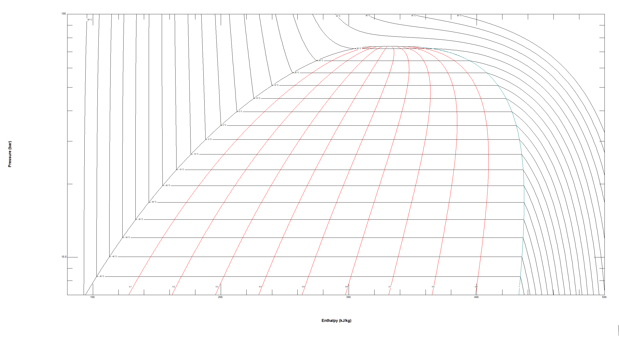
More technicalities…
CO₂ boiling in microchannel
Experimental work
  Diameter, flow conditions, head load, material.
Data analysis
  Empiric correlations
Control
Improve future designs

Slide 11
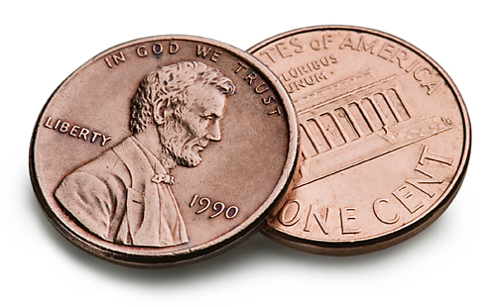
My two cents…
Life happens
Always check work authorization
Communicate
Fill the CV gap
  Volunteer, online classes, etc.
Networking
Know that you are not alone
Shoot for the stars
  … the moon

Slide 12
Thanks
my Wife, CERN, HR team, IDCN, and you

