Slide 1
RPCs as possible solutions for a large detector volume outside the main detector
I. Laktineh
IP2I-Lyon, France

Slide 2

Resistive Plate Chamber
The RPC is a very simple gaseous detector
Carbon resistive layer for h.v.
Pickup strips
2 mm bakelite
2 mm gas gap
2 mm bakelite
Mylar
Pickup strips
Layer of linseed oil
R. Santonico et al. NIM 187 (1981) 377-380

Slide 3
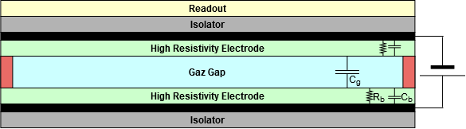
Single-gap
Multi-gap
Signal electrode
Cathode -10 kV
(-8 kV)
(-6 kV)
(-4 kV)
(-2 kV)
Anode 0 V
Signal electrode

Slide 4
Resistive Plate Chamber
Advantages
Simplicity, robustness, efficiency, sparks free, fast timing and cost effectiveness
Limitations
Rate detection capability is limited → Low Resistivity Materials are being developed
→ Gas mixtures currently used are not eco-friendly→ New gases are being investigated
RPC are used essentially as a muon detector with projects to be used in calorimetry and muon tomography.
Two kinds of electrodes have been used up to now
HPL (Bakelite) : L3, BaBar, OPERA, CMS, ATLAS, ALICE, DAYABAY
needs “good” linseed oil treatment and humidity
Glass : Belle, ALICE, STAR
absence of humidity is mandatory.
Limited rate capability (unless moderate resistivity electrodes are used)

Slide 5
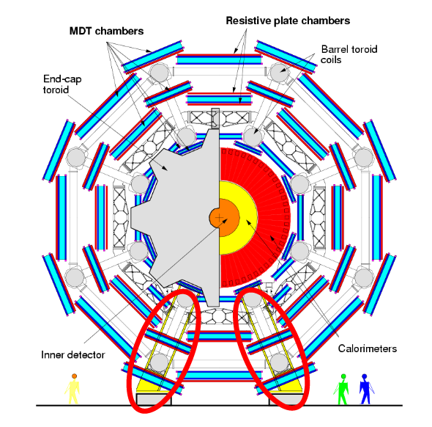
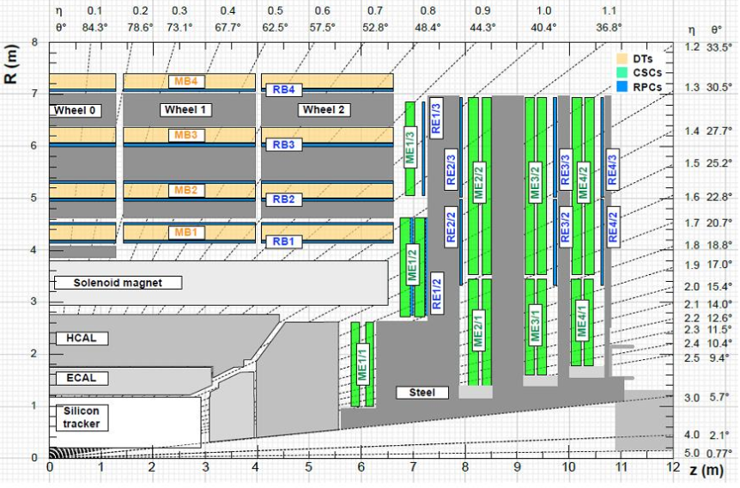
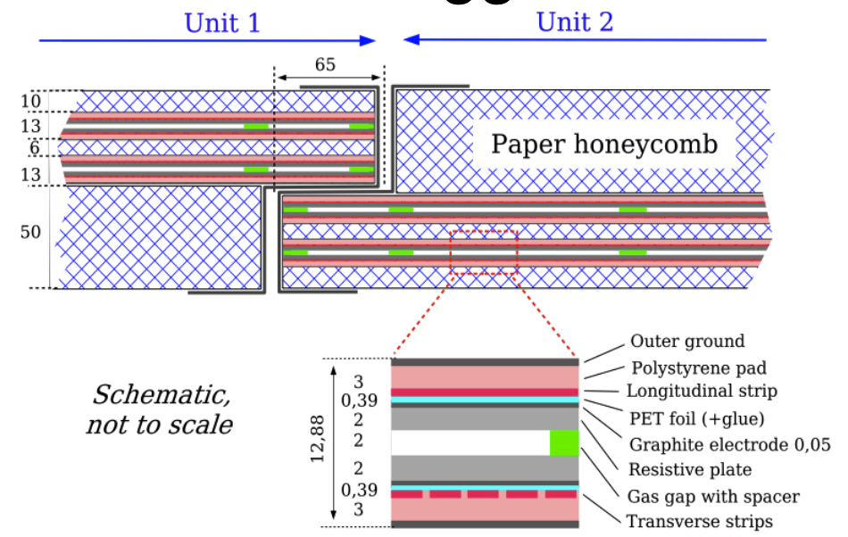
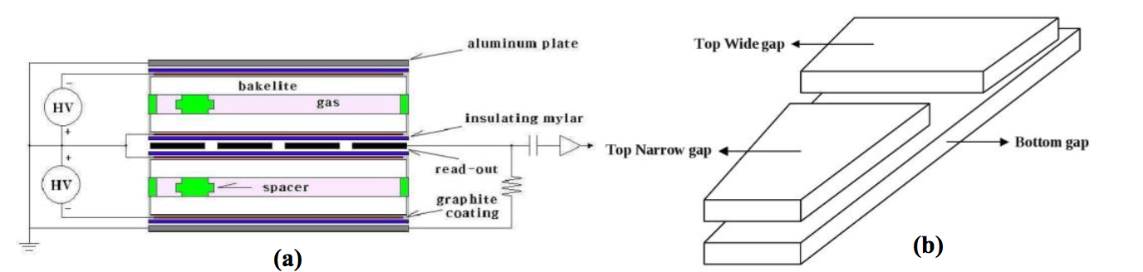
RPC
RPC are present in the CMS, ATLAS and ALICE muon stations.
Their fast timing capability makes of them excellent trigger tools
New stations were added/instrumented during the first LS
In CMS strips are along eta. In ATLAS strips are in both eta and phi

Slide 6
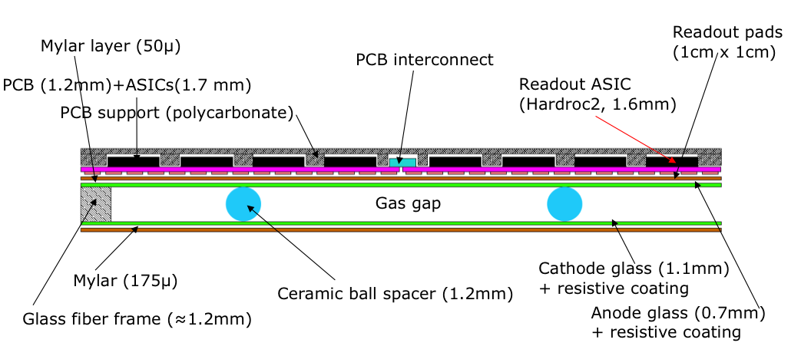
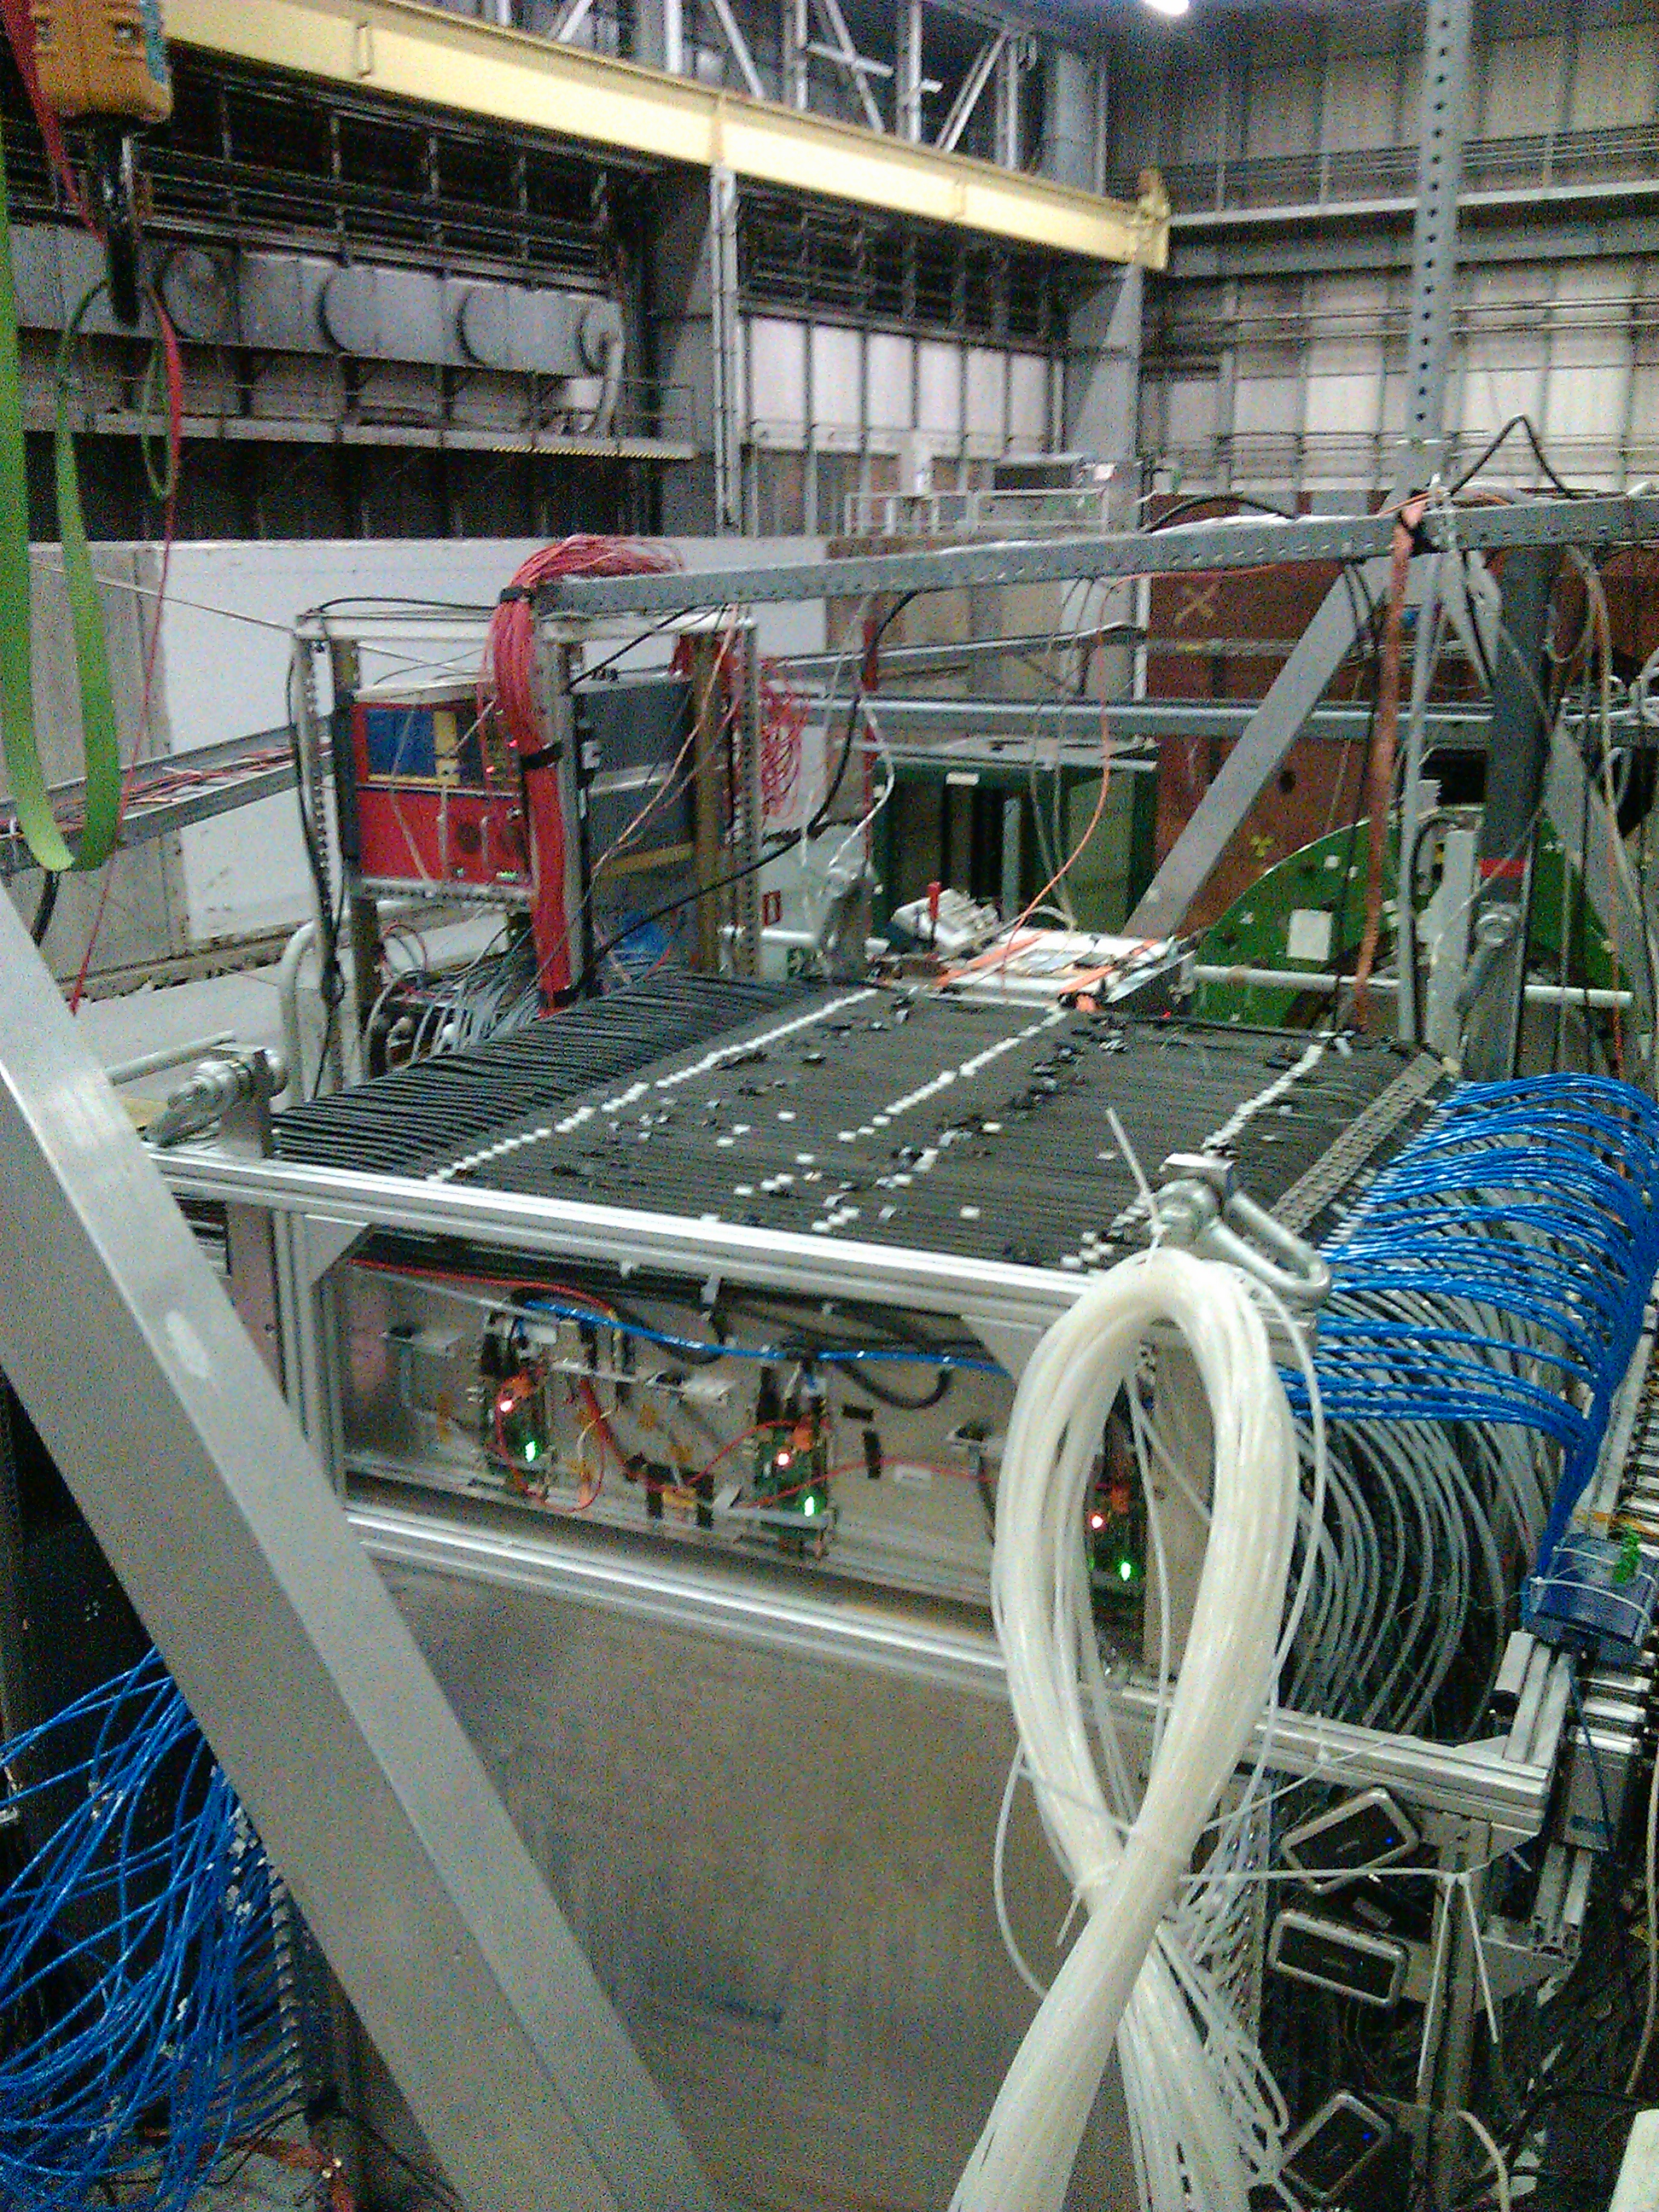
RPC for high granularity HCAL
Two prototypes using GRPC were built by
The CALICE collaboration (DHCAL & SDHCAL)
for future LC experiments
SDHCAL : A 1.3 m³ technological prototype with 48 GRPC (1 m2) read out by 1 cm² pads (> 450000 ch)

Slide 7
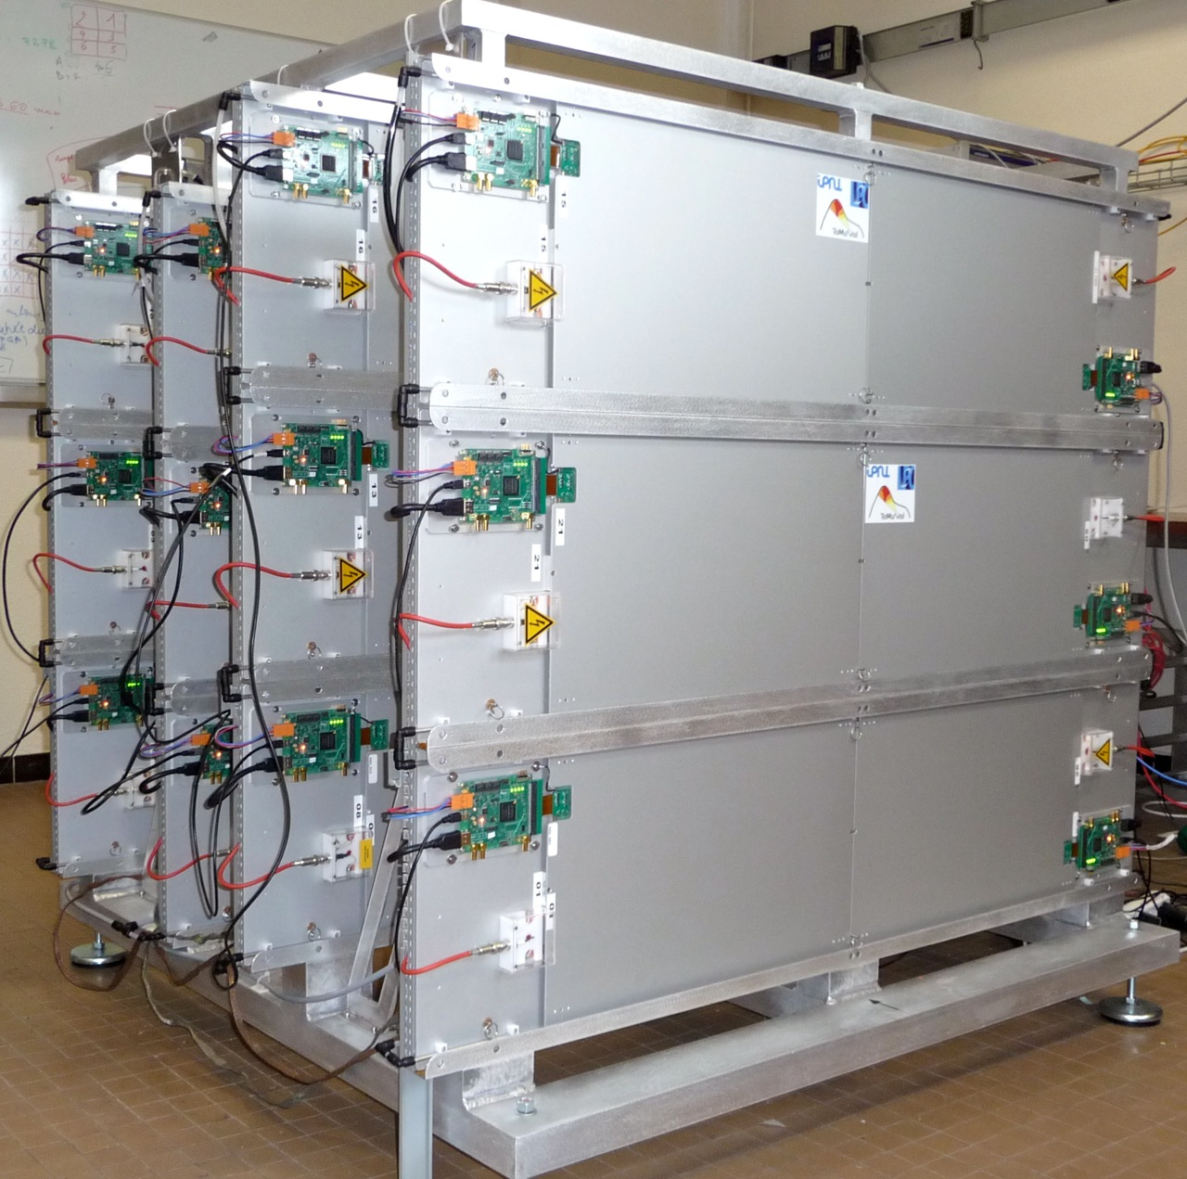
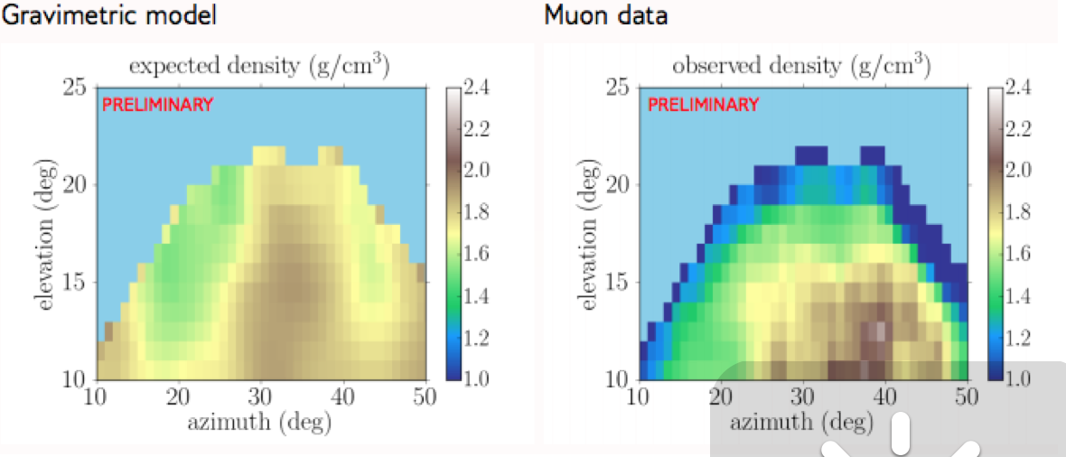
RPC in muography
TOMUVOL is made of 4 large planes of GRPC with high granularity readout to detect the atmospheric muons crossing a volcanic structure.
With a few stations one can achieve tomography and infer the internal structure of volcanoes

Slide 8
RPC cost
Single gap RPC detector is one of the cheapest detector
( a few hundreds $/ M²). They can be built in large format ( several M²)
Readout electronics is affordable if granularity is not an issue
→ pickup strips is the cheapest.
but if granularity is mandatory then two solutions are possible
  Strips read out from both ends with sophisticated fast timing electronics
  Pads which requires a big number of electronic channels

Slide 9
Can we do something to save power and money without impacting the physics
?

Slide 10
There is a solution
PCT/EP2018/053561
Connect the pads/pixels in a special way: woven strips
Two neighboring pixels are connected to two different strips
Each strip is connected to one electronic channel
Share the charge among a few ones
Crossing the fired strip to determine the position
NXN → 3N : Reduction of electronic channels, power consumption and occupancy

Slide 11
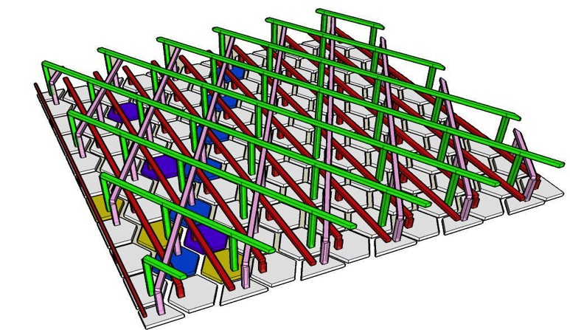
Several shapes of pads/pixels can be used: triangles, lozenges, pentagons, hexagons the most convenient is the triangular shape
The pad/pixel size should be a slightly smaller to the charge extension to feed at least two. In gaseous detector this is always possible.
Having 3 or more directions allows one to eliminate ambiguities (ghost particles)

Slide 12
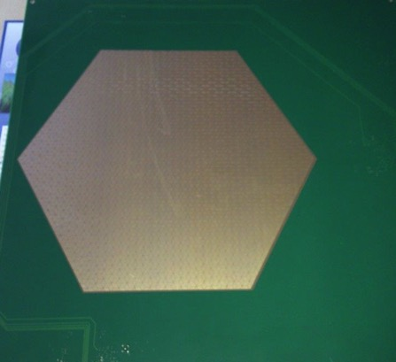
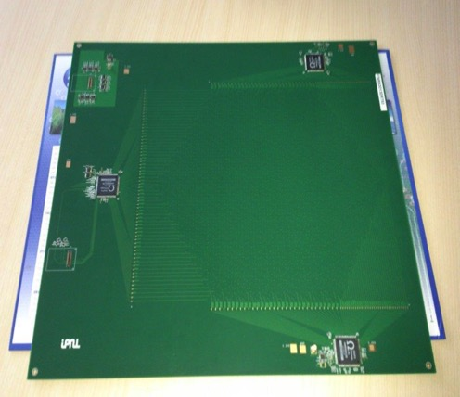
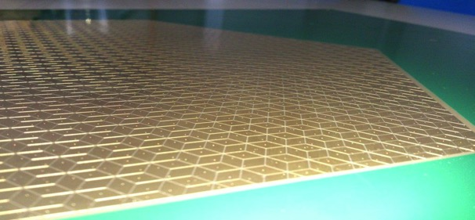
The new scheme was used to design a new PCB with lozenges structure and 3 directions. The readout electronics was set on the same PCB.
30 cm
3 HR2 ASICs rather than 20 for the same surface
Better granularity
Lozenge’s large diagonal : 1 cm

Slide 13
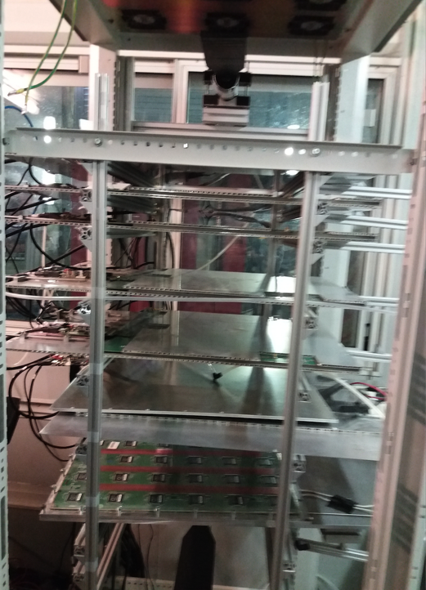
Setup with 5 detectors equipped with the new scheme

Slide 14
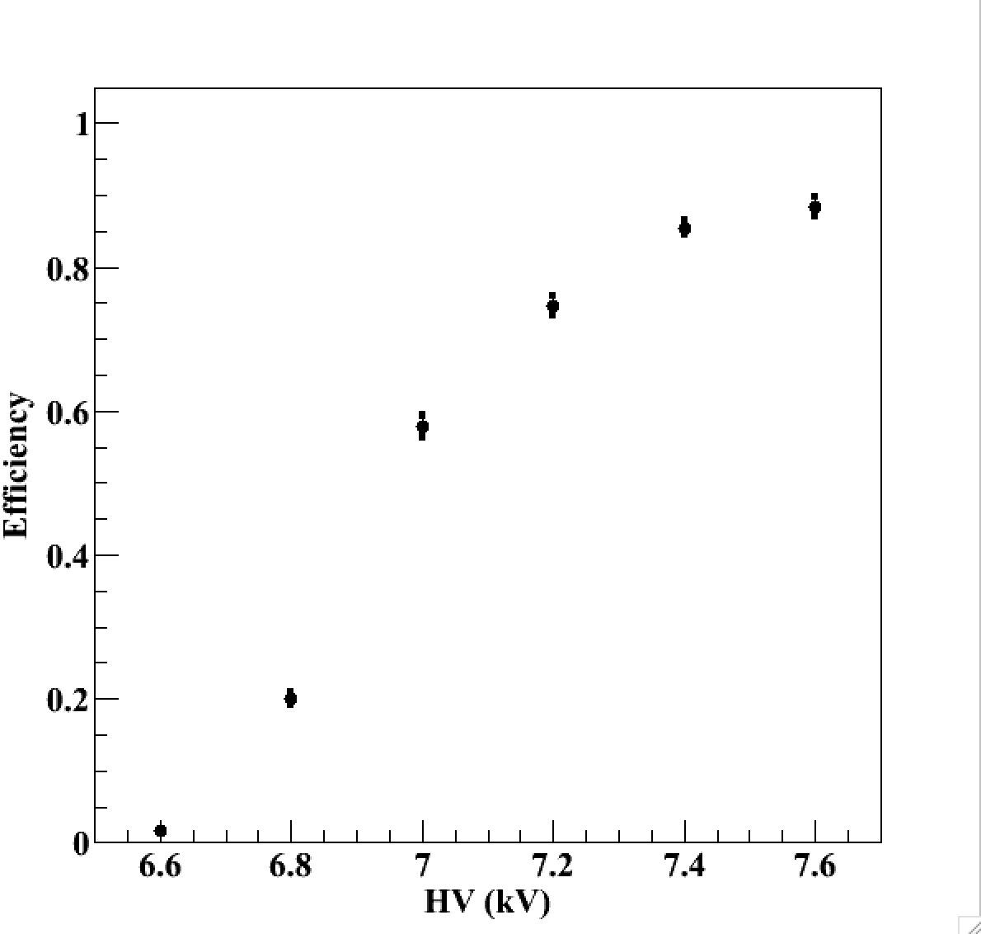
Efficiency vs HV
Threshold ≈ 60 fC
TFE(93%)
CO2 (5%)
SF6 (2%)

Slide 15
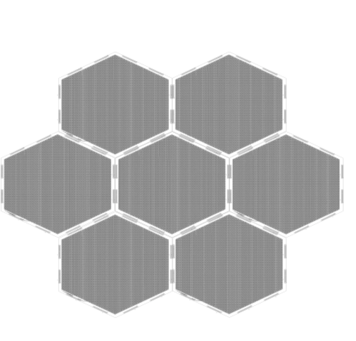
Large surface detectors
To instrument very large gaseous detectors the readout electronics could not be part of the PCB. A solution to separate strips panels from the readout electronics is needed:
Here is the scheme:
FEB
Well matched impedance will help to keep the signal in good shape for long distances

Slide 16
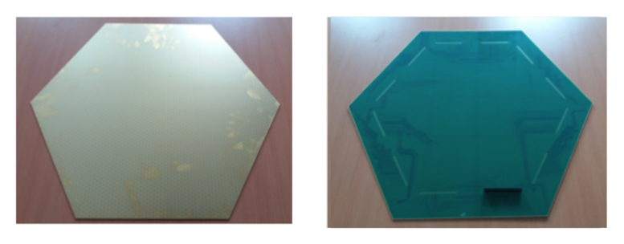
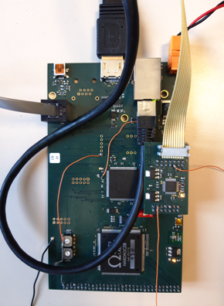
Large surface detectors
62 cm
A board hosting
One Hardroc ASIC
One Microcontroller
To be plugged directly on the back of the PCB, on the edge to read out 64 woven strips (1 HR2 ASIC).

Slide 17
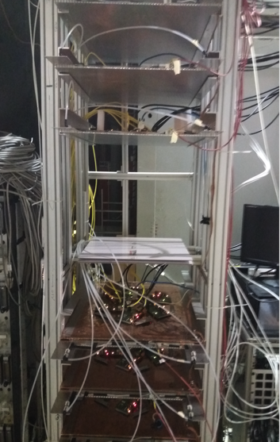
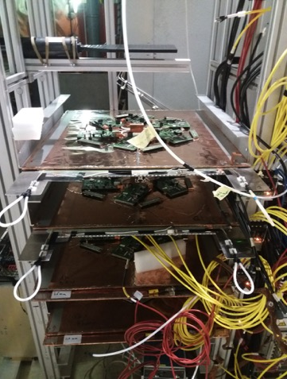
SETUP
The new readout scheme was tested first using a SC-PMT and in a standalone mode.

Slide 18
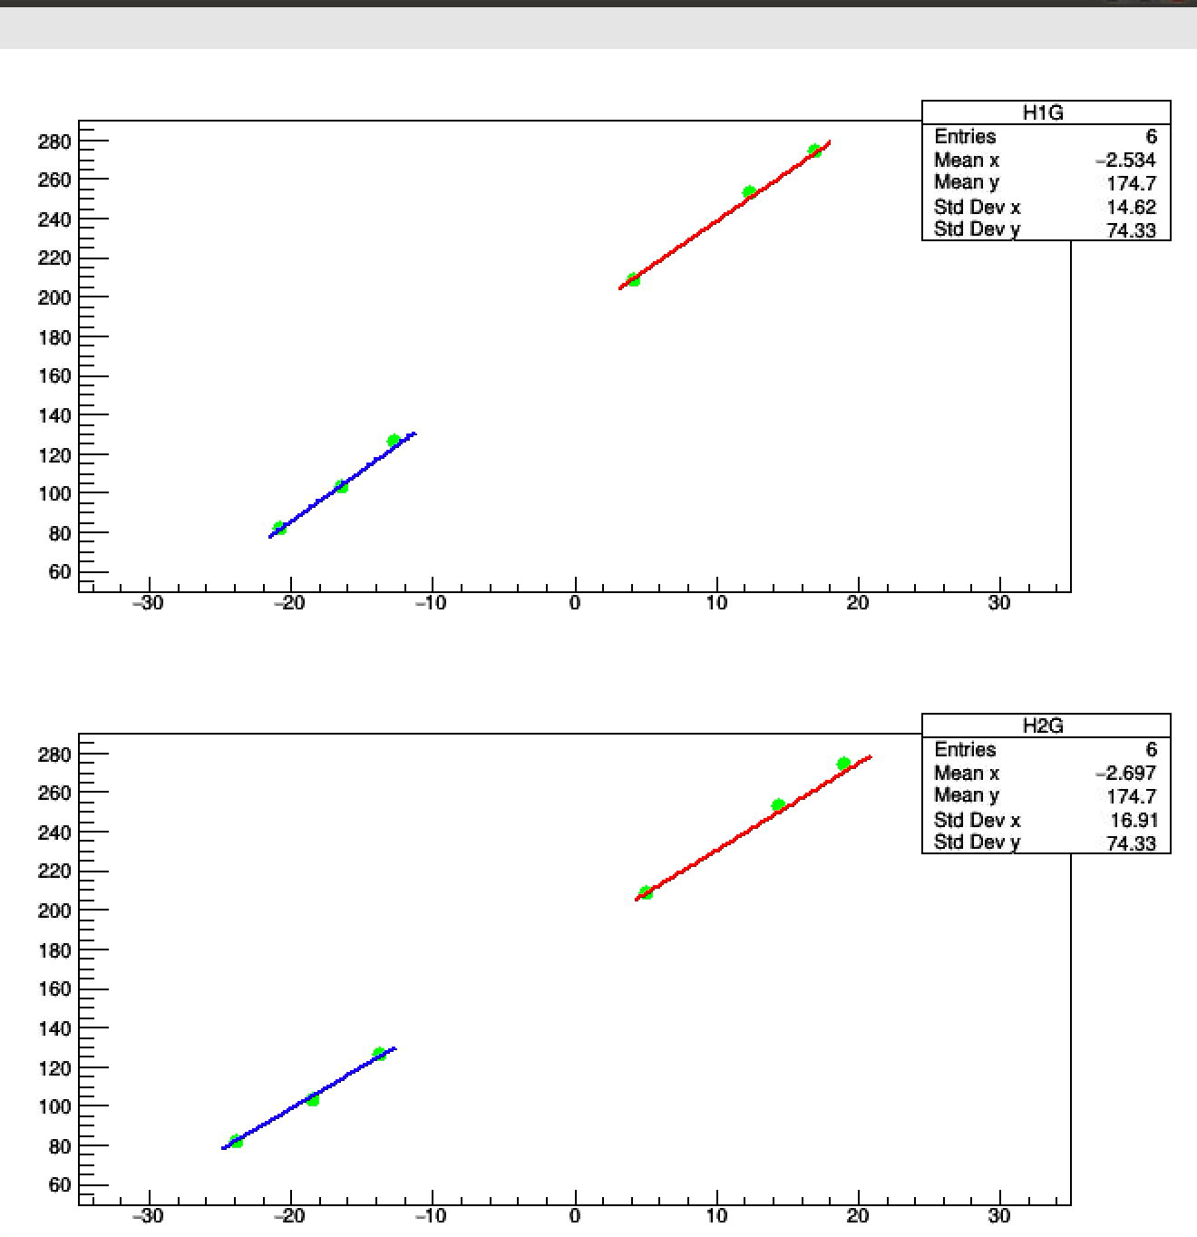

Slide 19
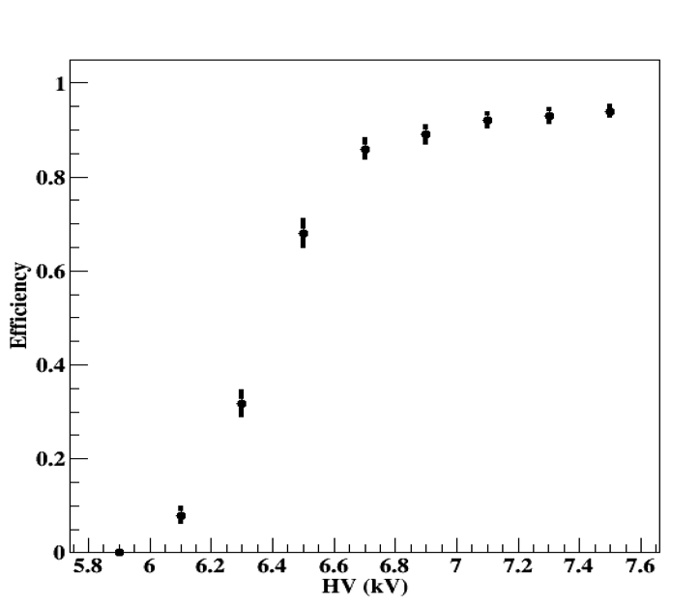
Efficiency with the new scheme
TFE(95.2%)
CO2 (4.5%)
SF6 (0.3%)

Slide 20
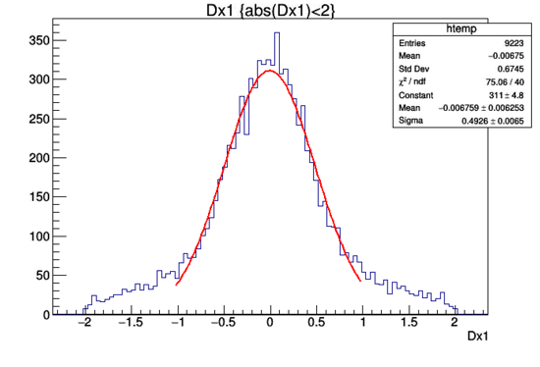
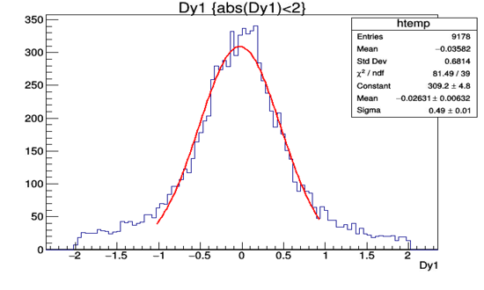
X-residuals (cm)
Y-residuals (cm)

Slide 21
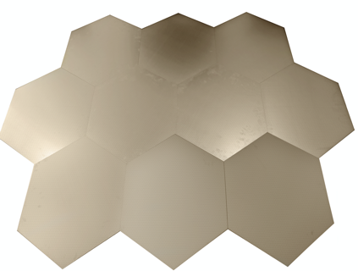

Next Step
We would like to build large detectors similar to those to be used in the Endcaps of ILC, CEPC and FCC muon systems and use the new readout scheme to validate completely the concept.

Slide 22
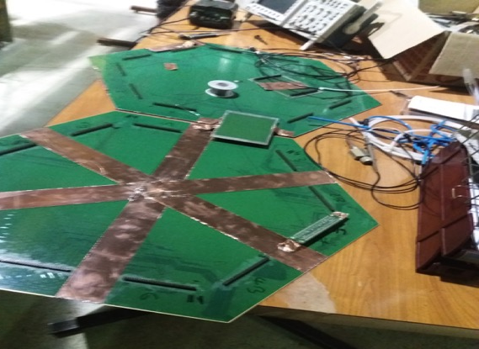
Connecting two neighboring PCBs using impedance-matched connectors will allow to cover a large detector easily.
No signal loss was observed by injecting a signal on the furthest end of the first PCB and detecting it on the opposite side of the second PCB

Slide 23
Conclusion
A new scheme allowing a reduced cost and reduced power consumption without reducing the granularity is proposed to equip large RPC detectors.
This solution is very useful if one wants to use the muon detectors as a tail catcher or needs to separate tracks at low cost.
Large RPC detectors will be built and equipped with the new scheme soon.
The scheme could be applied to any MPGD in principle (similar ideas were attempted by the CERN group using GEM 20 years ago..)

Slide 24
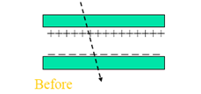
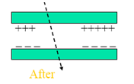
High rate capability RPC
Present CMS RPC chambers were certified to be efficient up to 300Hz/cm²
irradiated with photons up to an integrated charge of 0.05 C/cm², and a neutron fluence of
10¹² n/cm² and equivalent dose of about 45 Gy was reached.
Rate capability of the RPC is related to the voltage drop in the resistive plate: ΔV = I R = q ρ d Φ
To have RPC with increased rate capability one should reduce:
  electrode resistivity ρ: as low as the RPC principle still stands (> 10⁹ Ωcm)
  → low-resistivity HPL or doped glass (Tsinghua glass)
  electrode thickness d: depends on electrode material
  easy for glass, possible for HPL
  produced charge q : depends on gas mixture and number of gaps
  The less the charge produced, faster the eviction : beneficial also for chamber aging but this necessitates to increase FE electronics sensitivity

Slide 25
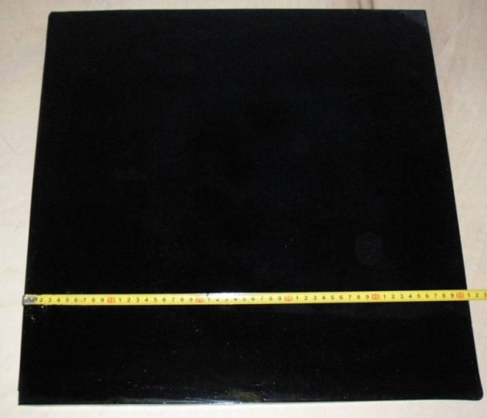
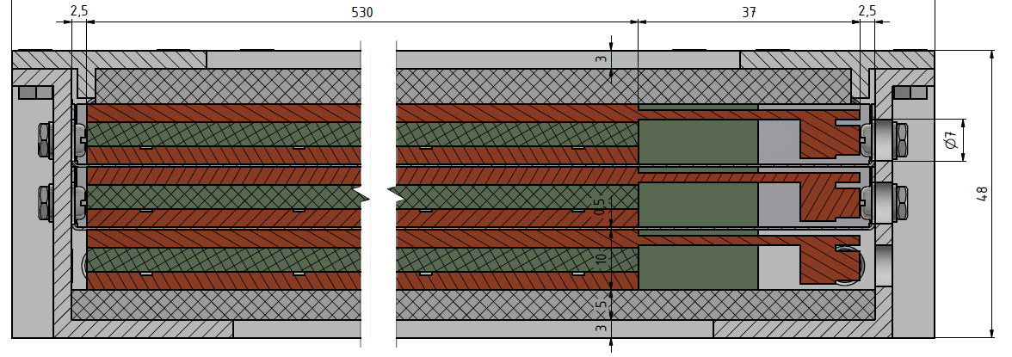
Electrode Resistivity and thickness
1kV applied on a glass plate 32days; integrated charge: 1 C/cm²
Low-resistivity material :
New resistive material such
the glass developed by the
Tsinghua university
or new plastics doped with
nanoparticles
Thin gas gap
Triplet of new RPCs with 1mm gas gap in support frame and Faraday cage of 48 mm overall thickness → fits into assigned 50 mm envelope.

Slide 26
Eco-friendly gases
The current gases used to operate RPCs were the result of long and fastidious investigation. They were chosen to produce enough primary electron/electons and to keep the streamer rate and avalanche size as small as possible
In CMS/ATLAS the used gas mixture is 94.7 % C2H2F4, 5% C4H10, 0.3% SF6
Problem: GWP is too high for R134A (1300) and SF6(24000). CO2 GWP is 1
As a consequence the production of freon gases will be stopped/reduced in the near future So new eco-friendly gases are needed.
HFO-1234ze could be an alternative but higher voltage is needed to operate RPC
REPLACING R134a WITH HFO-1234ze
Helium-HFO-1234ze BASED GAS MIXTURES
Streamer probability

Slide 27
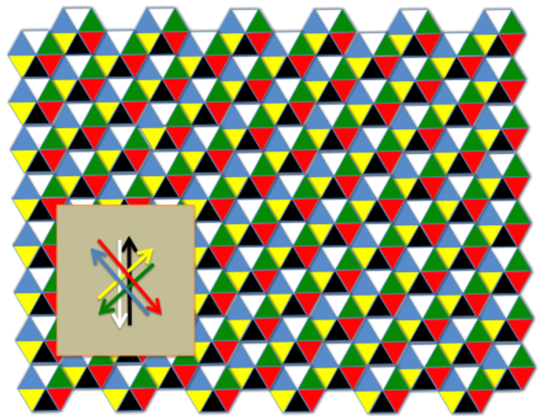
One can read the signal from both sides and get profit of the difference in time arrival to improve the position resolution and get the absolute time as well.

Slide 28
3 crossings
5 crossings
8 crossings

