Slide 1
Data challenges at FCC-hh
W. Riegler
ECFA Detector R&D Roadmap Symposium of Task Force 7 Electronics and On-detector Processing
March 25th 2019

Slide 2


Slide 3
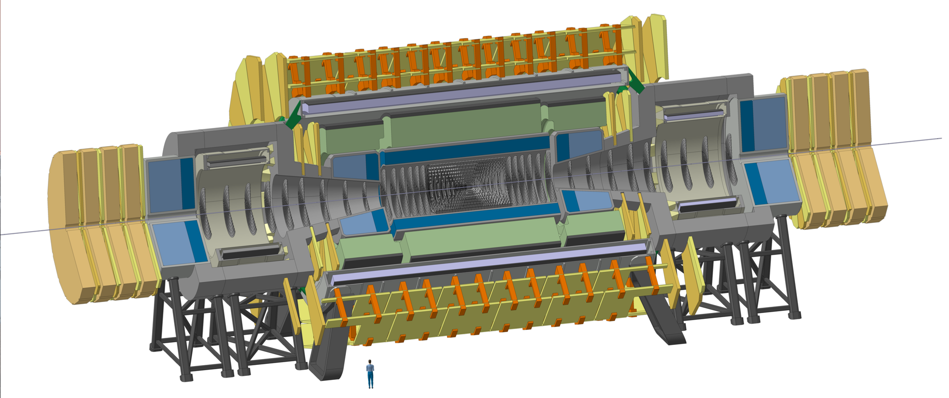
FCC-hh Reference Detector
4T, 10m solenoid, unshielded
Forward solenoids, unshielded
Silicon tracker
Barrel ECAL LAr
Barrel HCAL Fe/Sci
Endcap HCAL/ECAL LAr
Forward HCAL/ECAL LAr
50m length, 20m diameter
similar to size of ATLAS

Slide 4
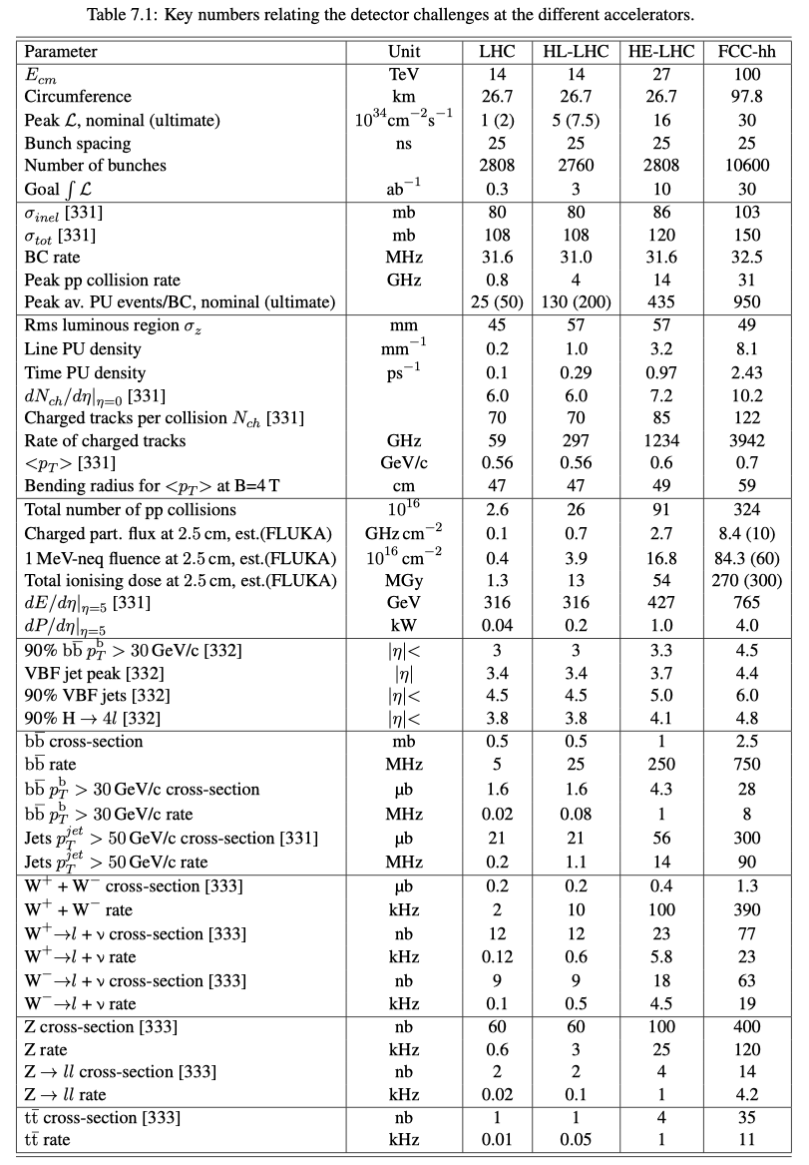
Parameter Table
… to define the specifications and requirement for such a detector.
… to relate the challenges for detectors at the between LHC/HL-LHC/HE-LHC and FCC-hh.

Slide 5
Parameter Table
31 GHz of pp collisions
Pile-up 1000
4 THz of tracks

Slide 6
Parameter Table
First tracking layer:
10GHz/cm² charged particles
10¹⁸ hadrons/cm² for 30ab⁻¹
Increased Boost at 100TeV ‘spreads out’ light SM physics by 1-1.5 units of rapidity.

Slide 7
Parameter Table
100MHz of jets p_{T}>50GeV
400kHz of Ws
120kHz of Zs
11kHz of Top

Slide 8
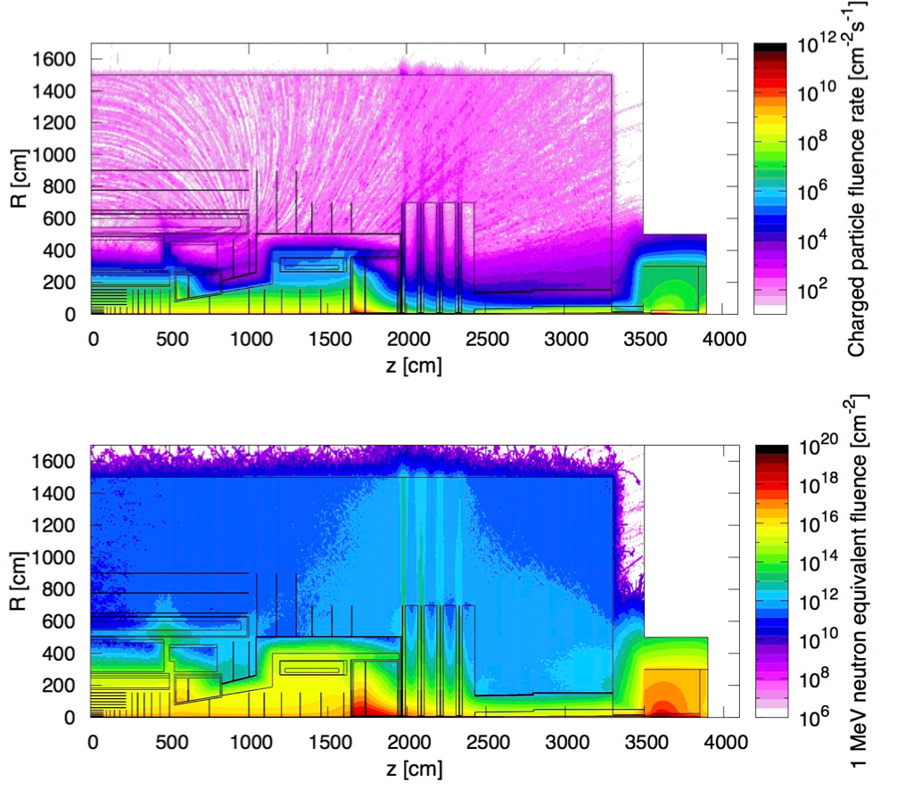
Radiation Studies for L=3x10³⁶ cm⁻²s⁻¹ and 30ab⁻¹
Maximum of 10kHz/cm² of charged particle rate in the Barrel and Forward Muon System, similar to HL-LHC Muon Systems.
In the tracker volume the charged particle rate is just a function of distance from the beampipe with rather small dependence on z.
Hadron fluence in the order of 10¹⁸ /cm² close to the beampipe and 10¹⁵ -10¹⁶ /cm² (HL-LHC levels) for r>40cm.
Extreme fluences in the forward calorimeter …
Triplet (z=40m), Triplet shielding TAS (z=35m) and related radiation are nicely ‘burried’ inside the tunnel.

Slide 9
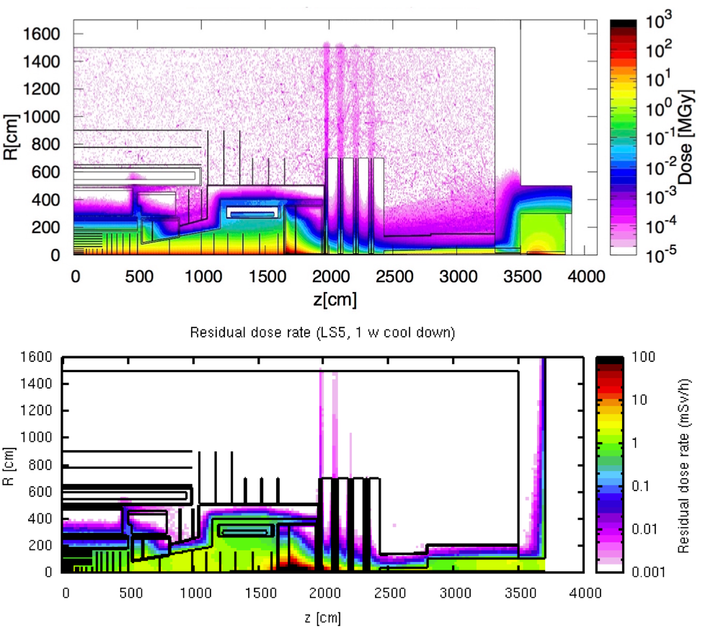
Radiation Studies for L=3x10³⁶ cm⁻²s⁻¹ and 30ab⁻¹
Dose of 300MGy in the first tracker layers.
<10kGy in HCAL barrel and extended barrel.
Dose from activation towards the end of FCC operation, 1 week of cooldown, so significant decrease for 1month, 1 year.

Slide 10
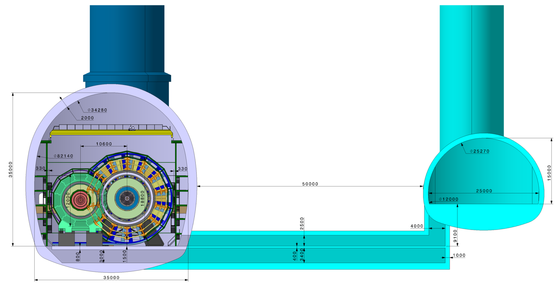
FCC-hh Reference Detector Cavern
Distance of 50m for
civil engineering
stray field reduction
Radiation shielding (10-15m would be sufficient)
Detector Cavern
Service Cavern

Slide 11
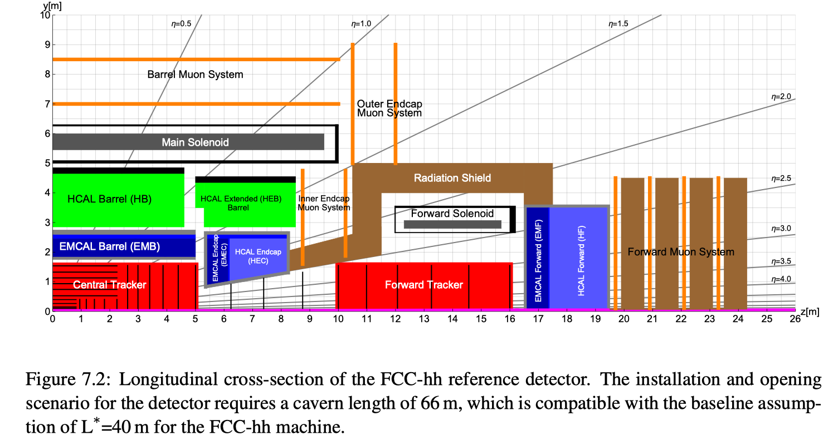
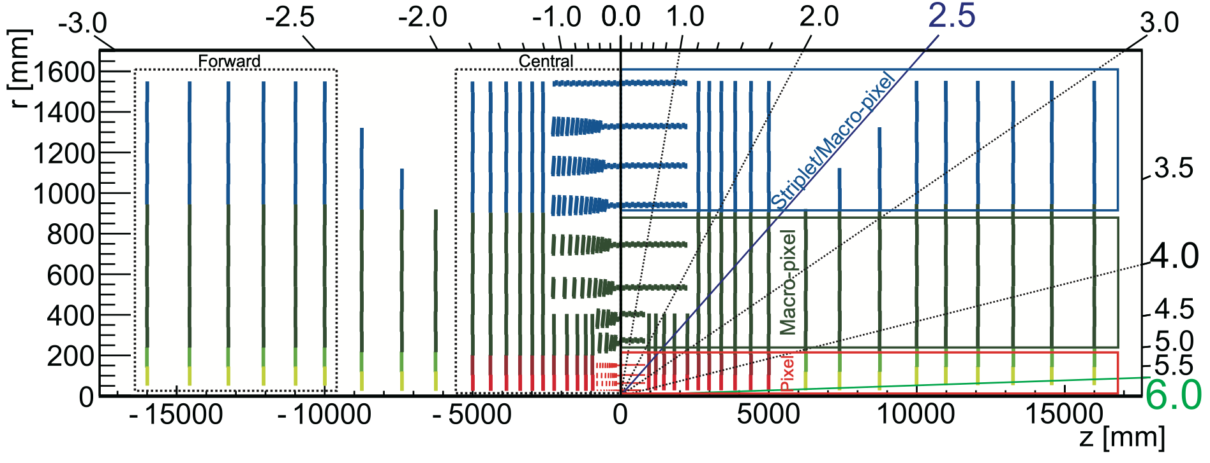
Tracker Layout
Silicon tracker, two options studied, ‘tilted’ and ‘’flat’ layout’.
390m² of silicon for tilted layout and 430m² for flat layout.
ATLAS CMS Phase-II silicon trackers have around 250m².
25-33.3μm x 50-400μm pixels for r < 200 mm
33μm x 400μm pixels for 200 mm < r < 900 mm
33μm x 2-50mm strips for 900 mm < r < 1600 mm
This represents and r-phi resolution of 7.5-9.5μm per detector layer
16 x 10⁹ channels vs. 6 x 10⁹ and 2.2 x 10⁹ for ATLAS/CMS Phase-II trackers

Slide 12
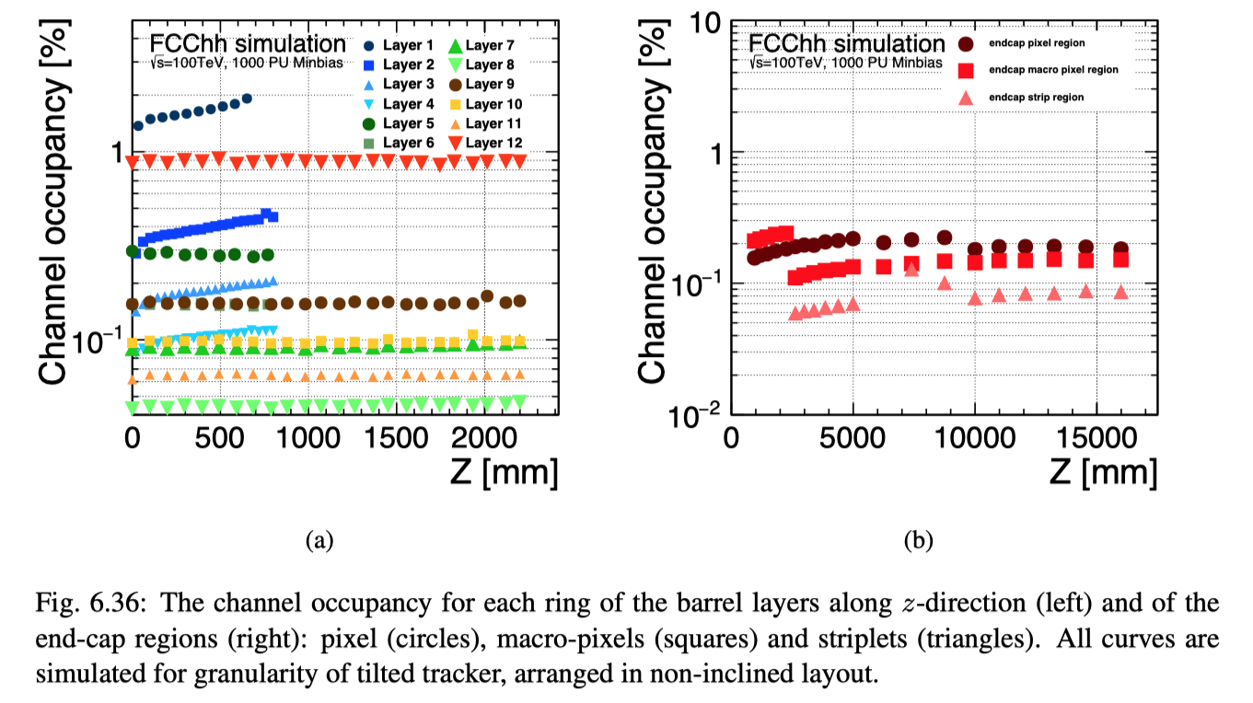
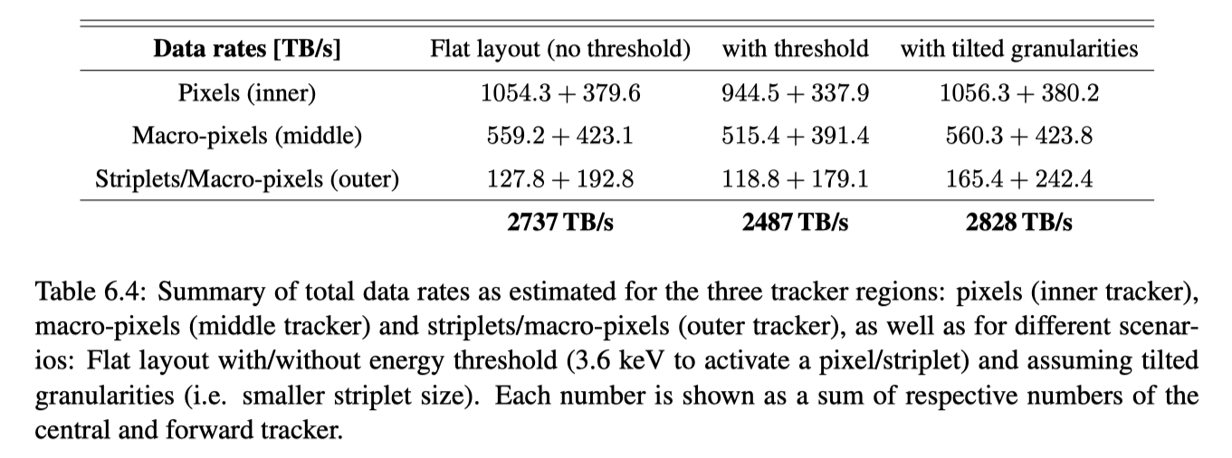
Data Rates and Occupancies
Granularity was optimized for reasonable occupancy
3 PB/s of data from the tracker

Slide 13
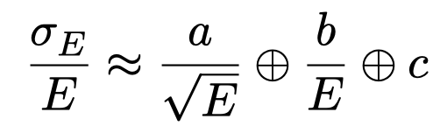
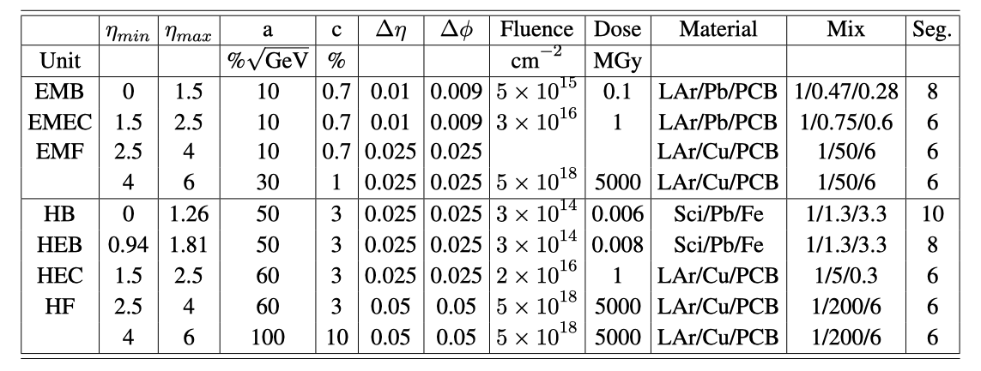
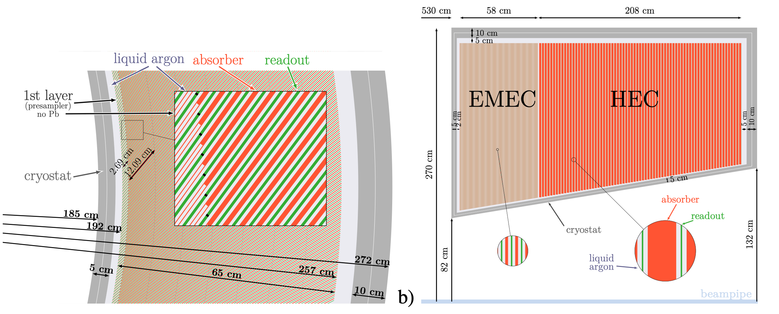
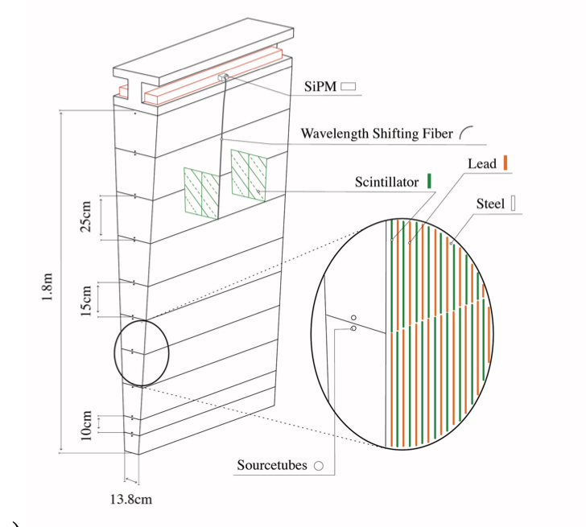
Calorimetry
LAr and Fe/Pb/Sci are used as reference technologies.
Silicon calorimetry will be extensively ‘evaluated’ in the CMS Phase-II upgrade.
The calorimeter system is ‘inspired’ by ATLAS (LAr, TileCal), with increased granularity and with the forward for (η > 2.5) moved to z=16.5m to make space for the forward tracker und to achieve coverage up to η = 6.
For the EMCAL Barrel, the demand for increased granularity motivated a deviation from the ATLAS ‘accordion’ structure to a geometry with inclined plates.
HCAL Barrel

Slide 14
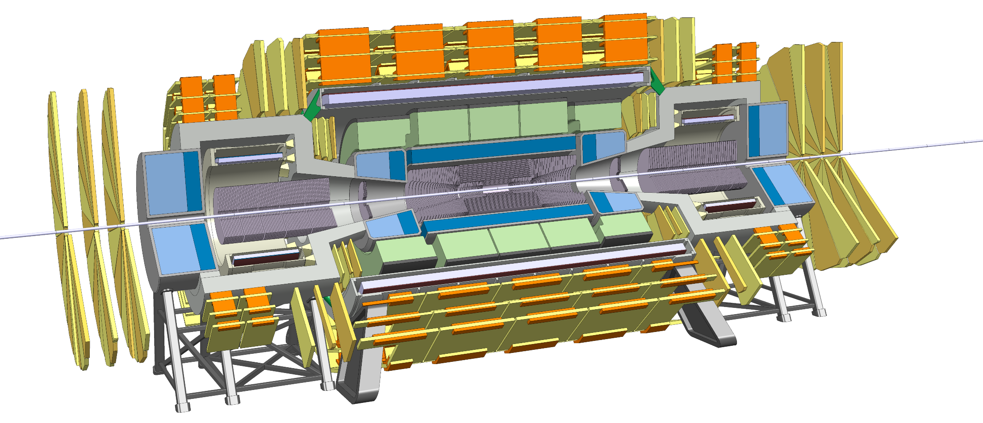
Trigger/DAQ
Tracking:
Reading the tracker at 40MHz would produce about 3000 TByte/s.
Questions to be studied:
Can the L1 Calo+Muon Trigger have enough selectivity to allow readout of the tracker at a reduced rate of e.g. 1MHz ?
Is an un-triggered readout of the tracker at 40MHz feasible ?
How to deal with the radiation requirements for the electronics and the links ?
Calorimetry:
ATLAS Phase2 calorimetry will be digitized at 40MHz and sent via optical fibers to L1 electronics outside the cavern at 25TByte/s to create the L1 Trigger at about 10us latency.
ATLAS Muon system will also be read out at 40MHz to produce a L1 Trigger.
Reading out the FCC detector calorimetry and muon system at 40MHz will result in 200-300 TByte/s, which seems feasible.

Slide 16
Moore‘s Law
http://www.livescience.com/23074-future-computers.html
“If the doubling of computing power every two years continues to hold, then by 2030 whatever technology we're using will be sufficiently small that we can fit all the computing power that's in a human brain into a physical volume the size of a brain”,
explained Peter Denning, distinguished professor of computer science at the Naval Postgraduate School and an expert on innovation in computing.
"Futurists believe that's what you need for artificial intelligence. At that point, the computer starts thinking for itself.“
Computers will anyway by themselves figure out what to do with the data by 2060.

