Slide 1

Particle Physics and Quantum Technology (QTFP)
Themis Bowcock

Slide 2
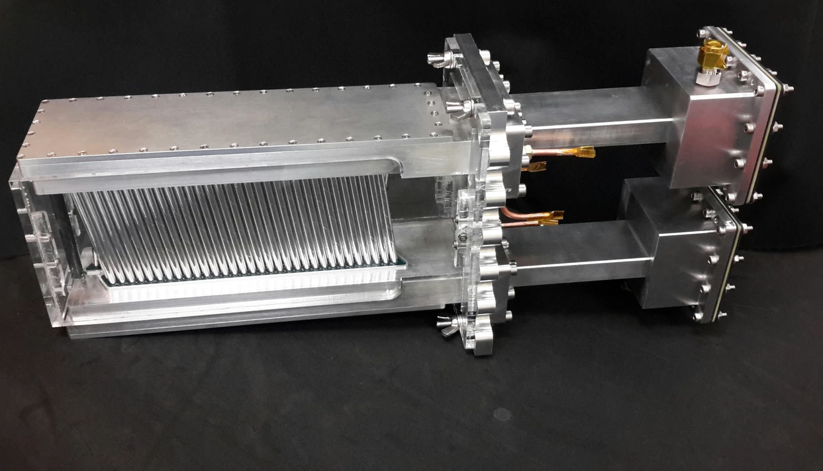
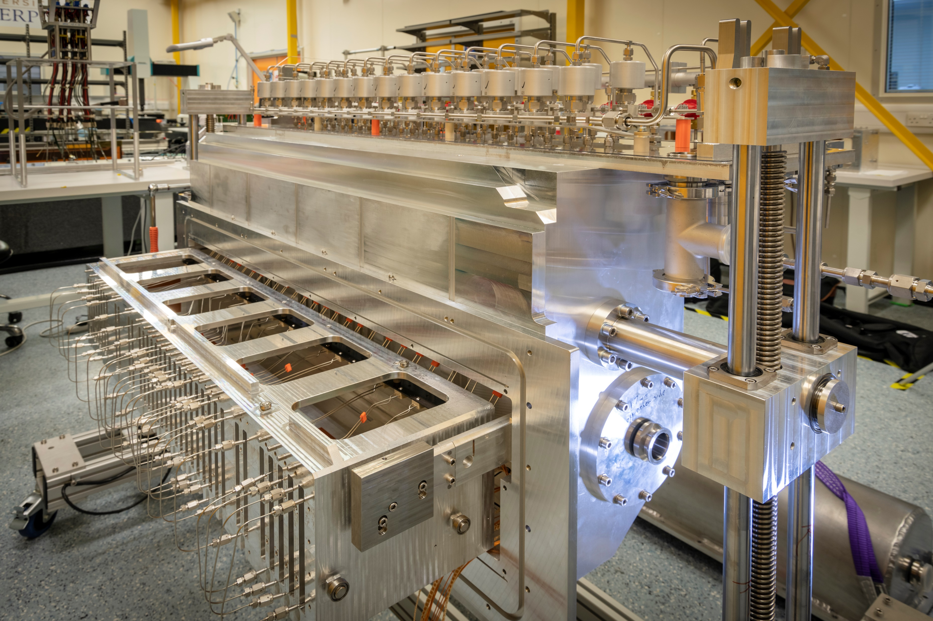



Preamble
Personal views (not representing UK or quantum community)
Thanks to many especially Ian Shipsey
  Reference talk to HEP Forum in Durham Nov 2020 (and slides)
Key elements of science case including
  Atom interferometry network in UK
  Making a measurement of neutrino mass
  Ref. Oliver Buchmuller this meeting
  and Ruben Saakyan UK HEP Forum
Quantum Technology
Fundamental
Physics

Slide 3
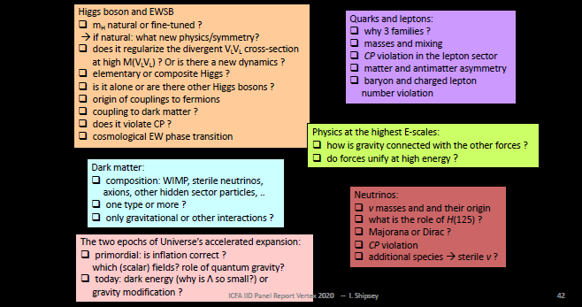
Great time to be a fundamental physicist…
Modified from slide by F. Gianotti
Our scope is broad
Many tools:
accelerator,
non-accelerator
cosmological

Slide 4
Why a new programme in UK?
Describe (briefly) how we got involved
  one of many paths for PP groups
Give a brief description of UK’s QFTP Programme
  International context
  Pointers to resources
“Reflections”
  What happens next?
  Choices for the community, conflicts and opportunities
Summary

Slide 5

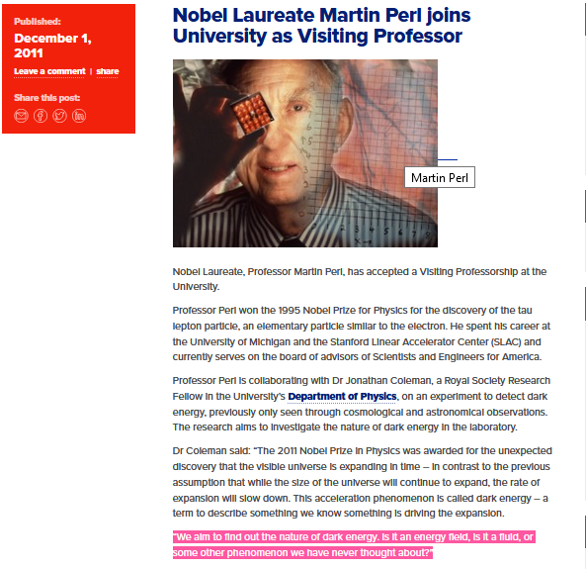

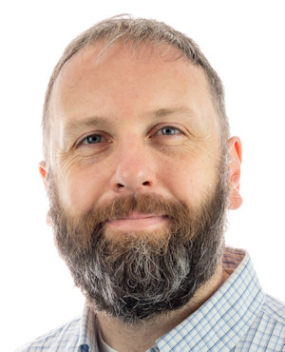
The arc … to be continued
At Liverpool (in the PP group) in 2011
”We aim to find out the nature of dark energy. Is it an energy field, is it a fluid, or some other phenomenon we have never thought about?
Jon Coleman (ex BaBar)
Build an atom interferometer to attack this question within the PP group FUNDING NOT READILY AVAILABLE!!!

Slide 6
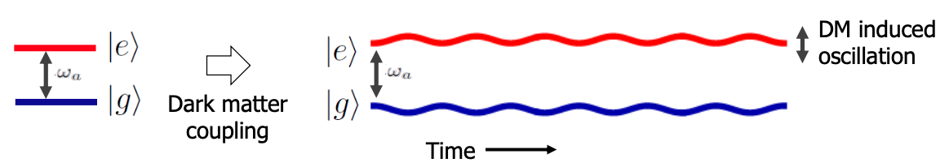
See AION talk
Atoms as de Broglie waves in quantum superposition of states
Large wavepacket separation to increase sensitivity to:
  Ultralight dark matter (10⁻²² eV – 10⁻¹⁴ eV)
  Mid-band gravitational waves (30 mHz – 10 Hz)
DM Affects fundamental constants (m_{e} and ⍺), altering atomic energy level separation
Same configuration used for gravitational wave measurements

Slide 7
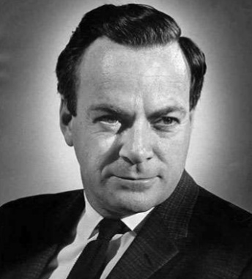
One of many examples: so why quantum?
We are no longer in an era of “no-lose” theorems/strategies
  SM may hold up to Planck scale?
  Precision instruments and measurements could play a vital role
Sensitivity in new regimes
  E.g. light axion searches
Simulation and Computing Technology
Modified from slide by I. Shipsey
Nature isn't classical, dammit, and if you want to make a
simulation of nature, you'd better make it quantum
mechanical," Feynman (1981).

Slide 8
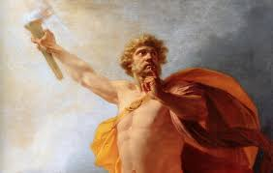
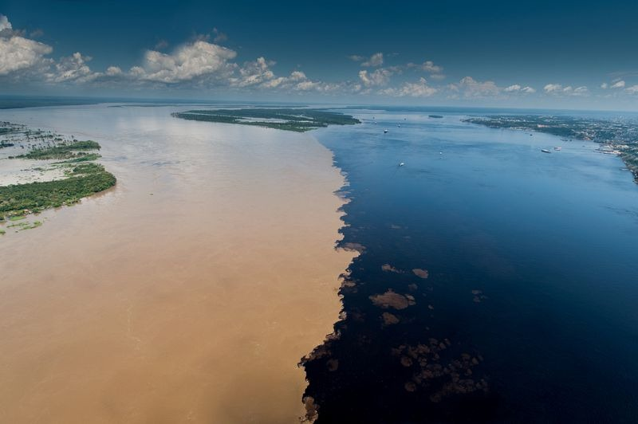
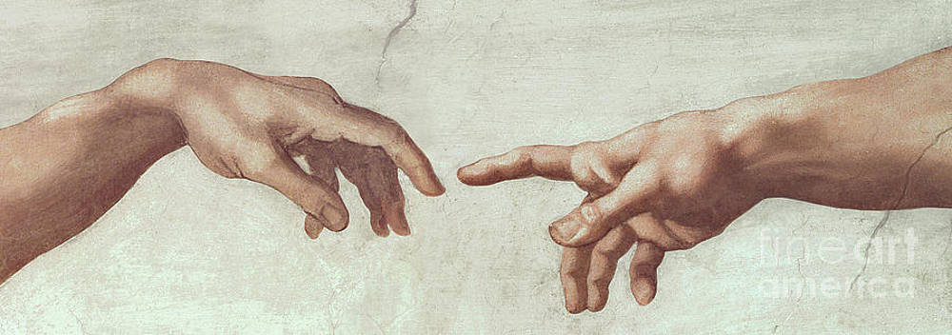



QFTP UK
“The Confluence” – a perfect match
New ways to look at the Universe
Unanswered questions – mysteries

Slide 9
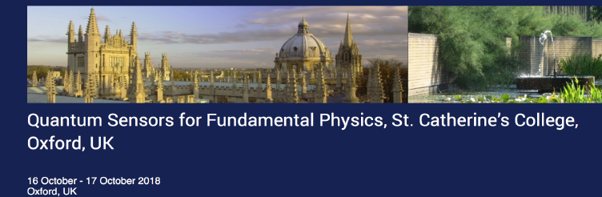

Quantum Sensors for Fundamental Physics and Society Workshop I (2018)
Four goals
  To survey the extraordinary science opportunities and UK capabilities to exploit this science in a world class programnme
  To demonstrate to UK funding agencies the immense interest in UK for Quantum Sensors
  To build a community around key experiments
  To work with STFC/EPSRC to bid for funding to Strategic Priorities Fund
http://qsfp.physics.ox.ac.uk/
Kai Bongs (Birmingham)
Ed Daw (Sheffield)
John March-Russell (Oxford)
Ruben Saakyan (UCL)
… + Liverpool
Ian Shipsey

Slide 10
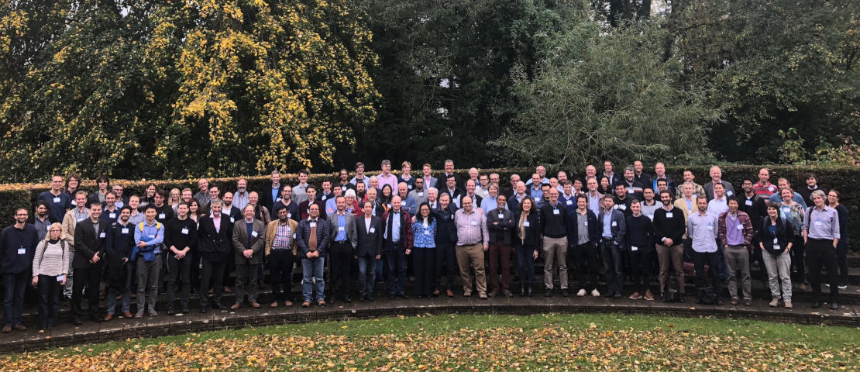
UK “building the community” % Science Case
Building a community: essential for creation of QFTP
Young Experimentalists
Theorists
Group Leaders
PP and non PP
>140 scientists from EPSRC & STFC
Modified from slide by I. Shipsey

Slide 11
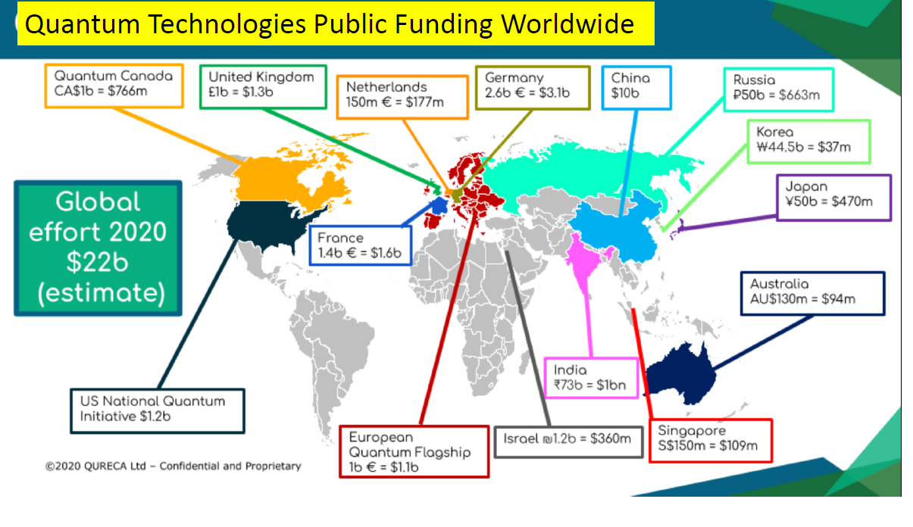
International Context Funding
Slide by I. Shipsey

Slide 12
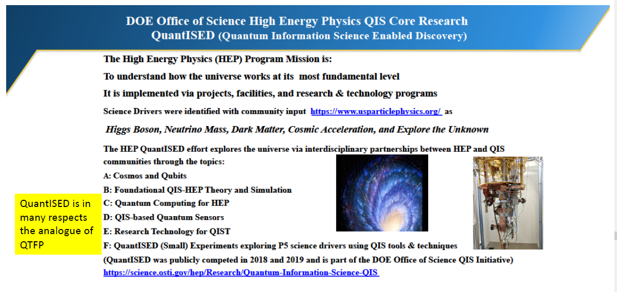
US Initiative including QuantiSED

Slide 13
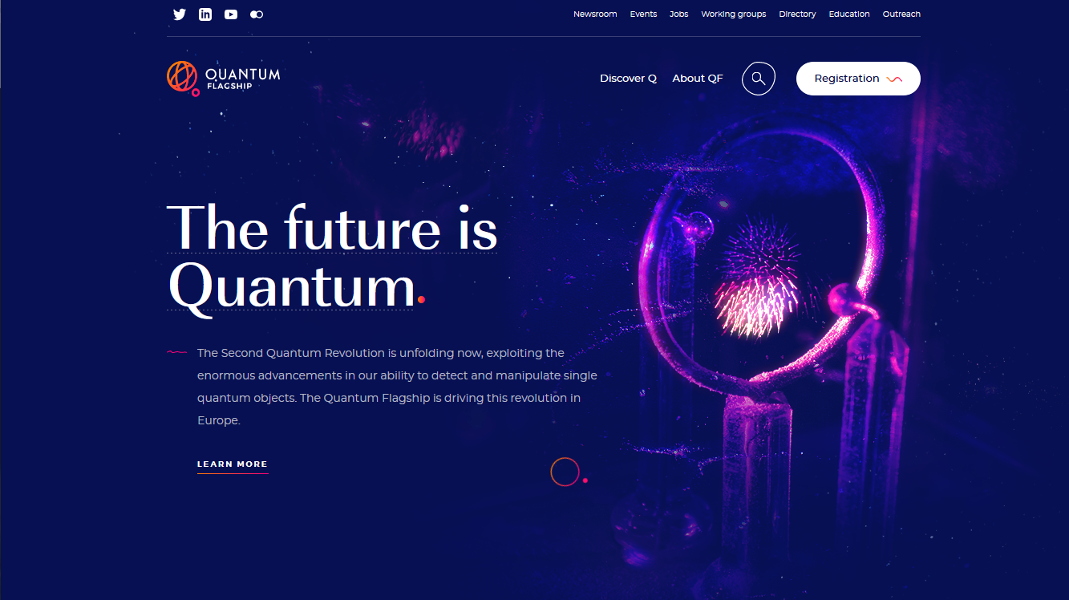

https://qt.eu/

Slide 14
Meanwhile domestic landscape (UK) …
UK National Quantum Technology Programme
NQTP vital for QFTP
£40M for Quantum Sensors for Fundamental Physics
Phase I 2015-2019
Phase 2 2020-2024
Approx £1B including training, and National Quantum Computing Centre..

Slide 15
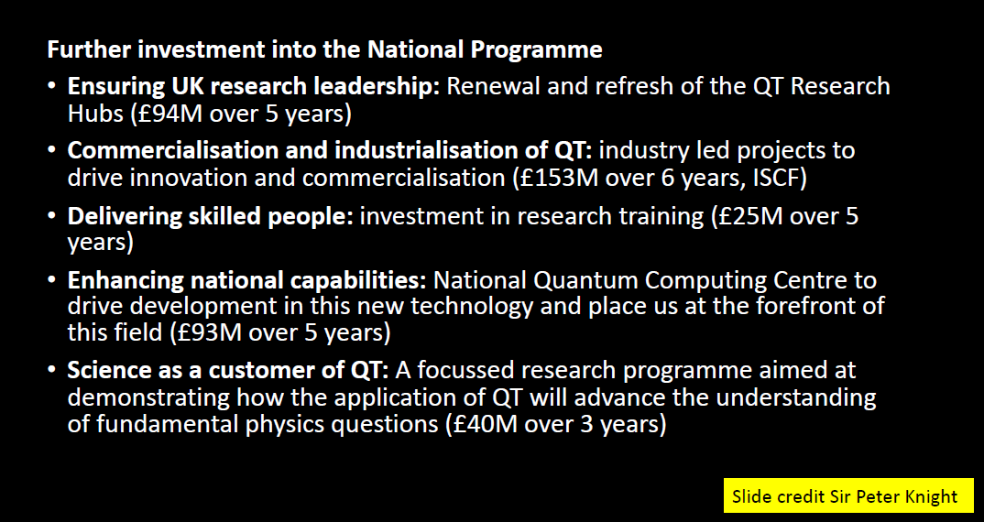


NQTP Phase 2. 2019- a non HEP perspective

Slide 16
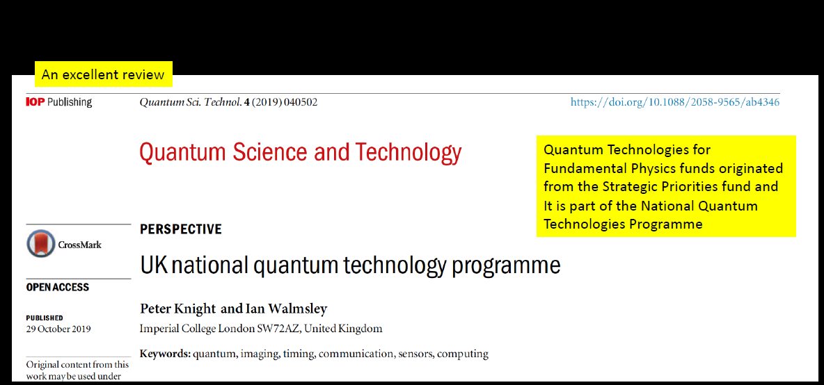


Slide 17




£
Slide modified from original by I. Shipsey

Slide 18
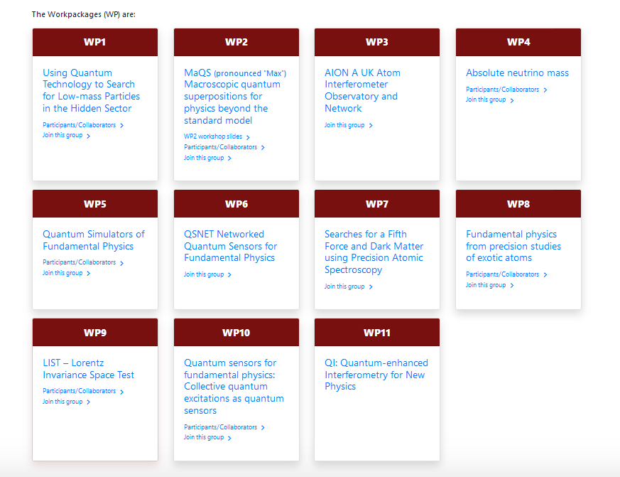
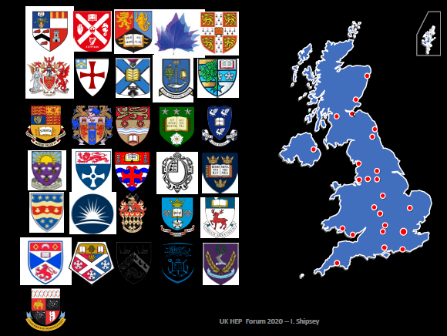
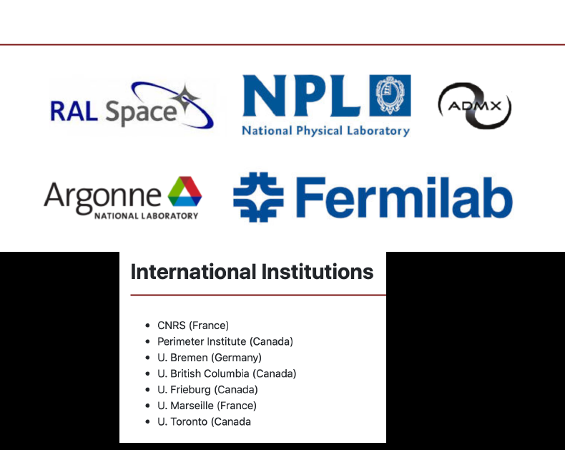
Original Proposals/Workpackages

Slide 19

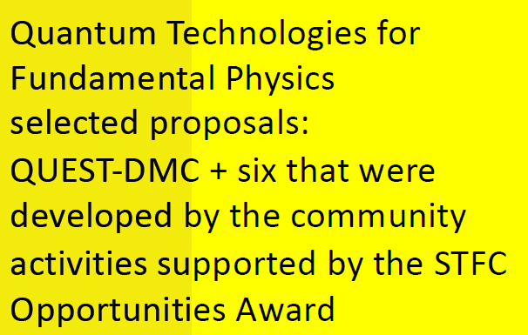
Seven areas supported
Oliver
Ruben
+

Slide 20
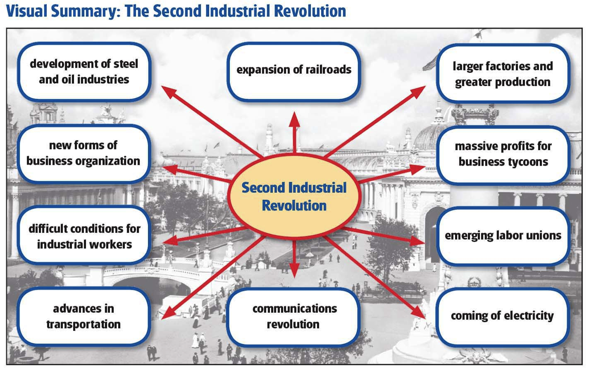

2nd Quantum Revolutioun ….
The second quantum revolution
Dowling & Milburn 2002
Alain Aspect
Quantum 1.0^{[4]} These include: laser systems, transistors, semiconductor devices, MRI imagers etc . The UK Defence Science and Technology Laboratory (Dstl) grouped these devices tgat rely on the effects of quantum mechanics.
Second Quantum Revolution “The hallmark of this on is the realization that we humans are no longer passive observers of the quantum world that Nature has given us.” - Dowling
                P
First Industrial Revolution: use of steam, interchangeable parts and mass production,
Second Industrial Revolution: railroads, large-scale iron and steel production, machinery in manufacturing, greatly increased use of steam power, telegraph, use of petroleum. Modern organizational methods for operating large scale businesses over vast areas came into use.

Slide 21



Hubs or Distributed
First Quantum Wave
  Largely hub based
  Expensive, “risky” (although note all the successes)
  Many defence drivers
2nd Quantum Wave
  Much looser confederation – as technology progresses
    Using rather than heavily R&D
    Lower technological tariff for excellence
    Risk transferred to project goals rather then tech.
  Earlier stage PIs (for creativity and expression)
  Do the old hubs try and absorb (centres of expertise)

Slide 22
A second call
Community building. Who are the constituents?
Hub or “dispersed”?
Is it a threat?
  Some see it as a possible diversion of funds
  Others as competitor
The opportunity?

Slide 23

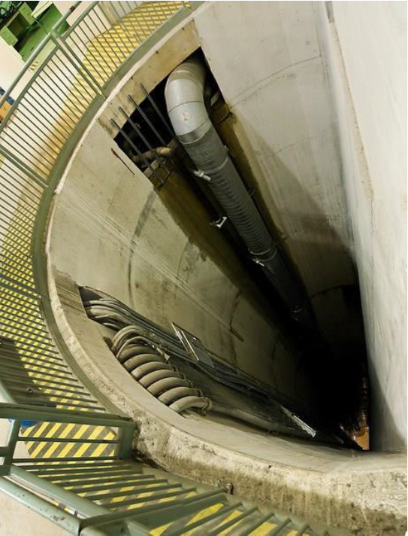
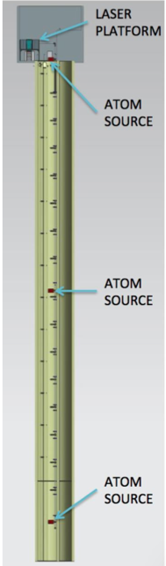

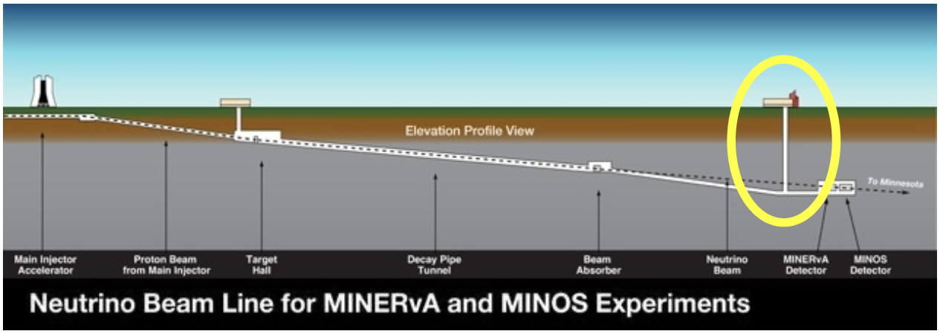








MAGIS-100
2021
100m baseline – MINOS access shaft
3 interferometers (2x50m sections)
  3 Sr atom sources
  Differential measurements, GGN
Sensitivity proportional to baseline L
  2L/c ~ gravitational wave signal
Intermediate step to full scale detector for GWs

Slide 24
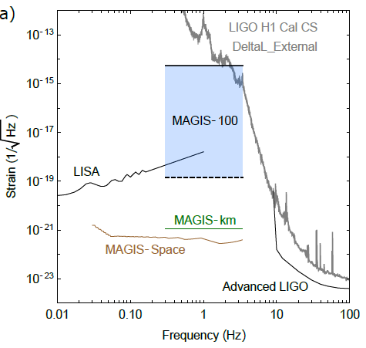
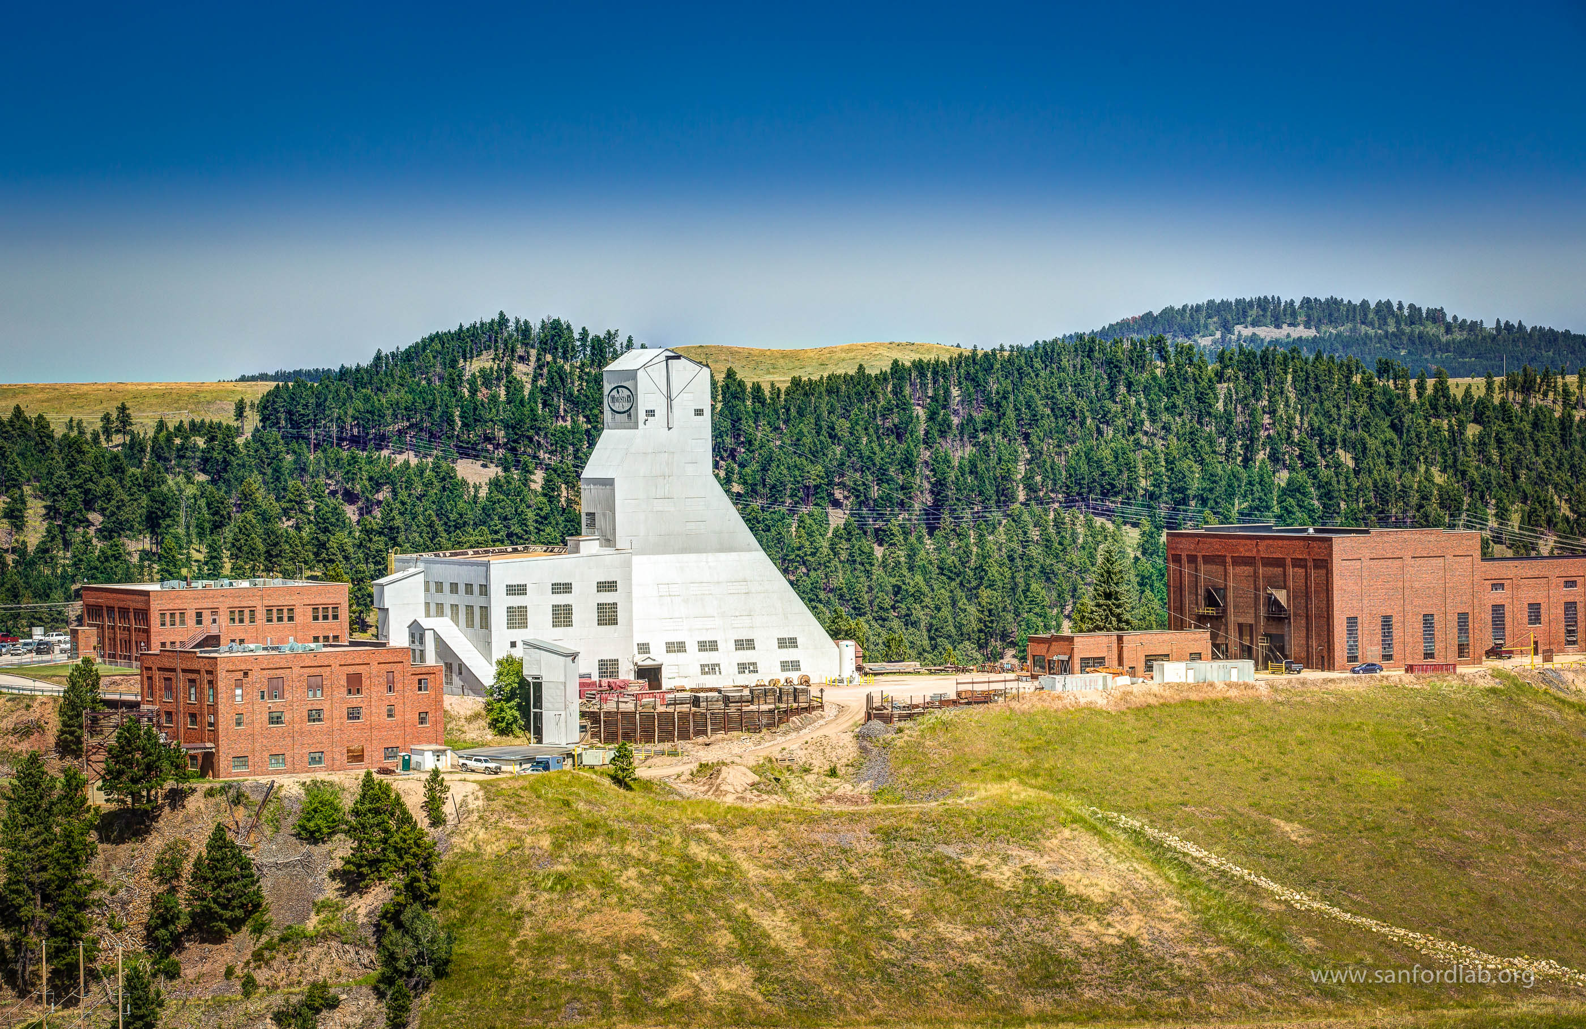
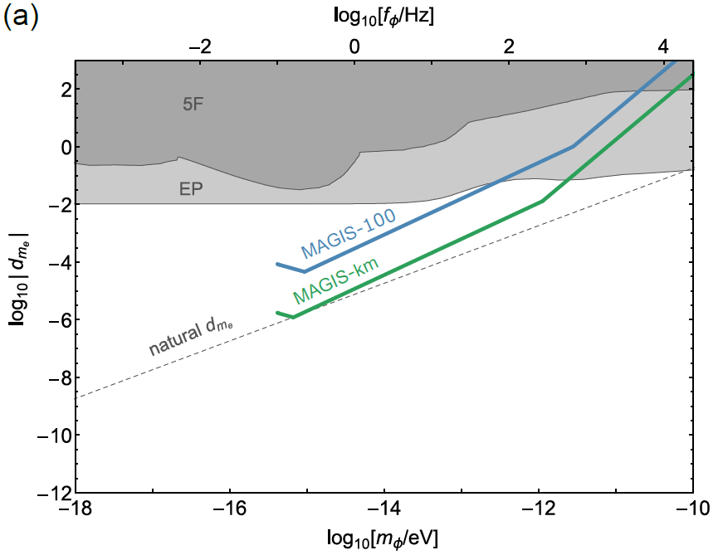
MAGIS-1km SURF
1km baseline
Proposed to be built at Homestake mine (SURF)
  Vertical network of twenty x 50m interferometer sections
Increased sensitivity to gravity waves
  Between ALIGO and LISA
Towards end of decade

Slide 25
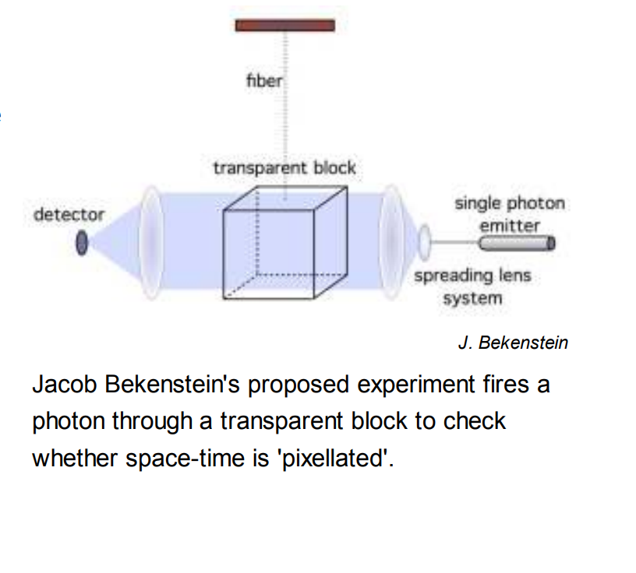
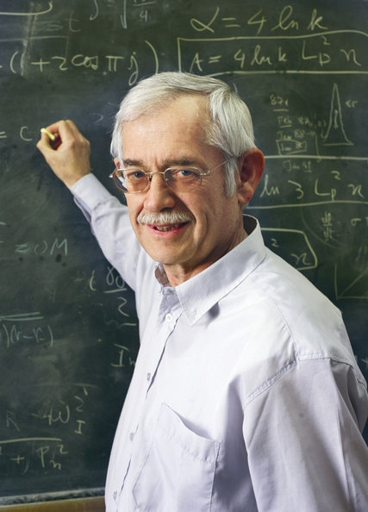
Many other possible ideas e.g.
Investigating the Planck Scale directly
Discussions (2014) on building experiment to test his proposal
Prototype 2015-2016. Next stage?

Slide 26
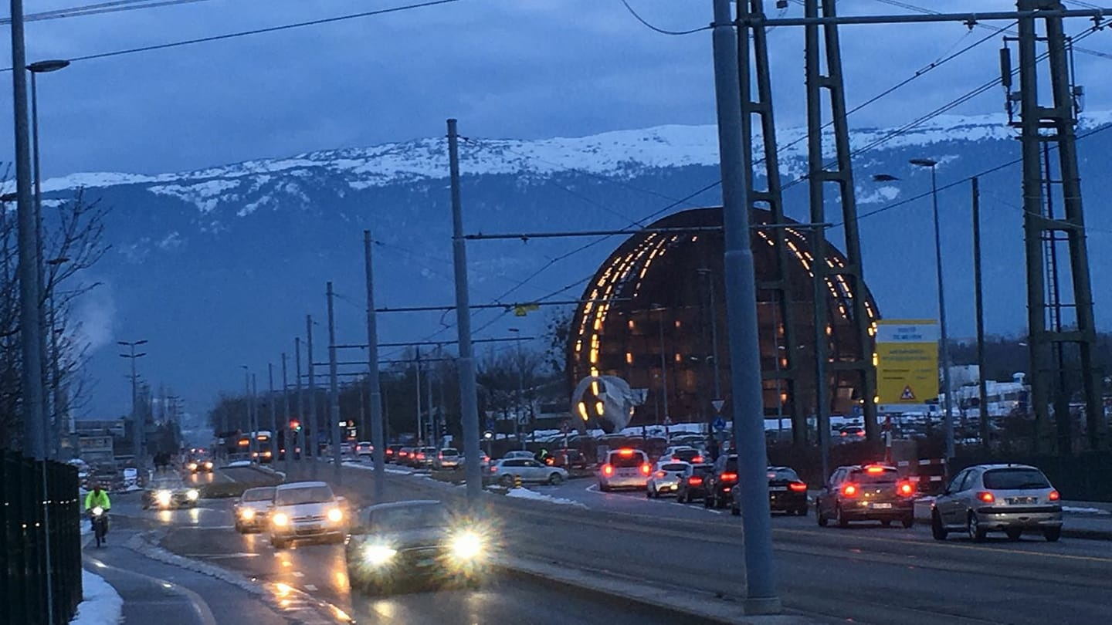
Summary
Quantum can help us answer some of our deepest physics questions
Cross-over technologies
Our UK strategy(ies)
Funding
Questions
How does our (CERN) facility based community thrive/benefit?
What are long term implications (historical precedent?)

Slide 27
BACKUP

Slide 28
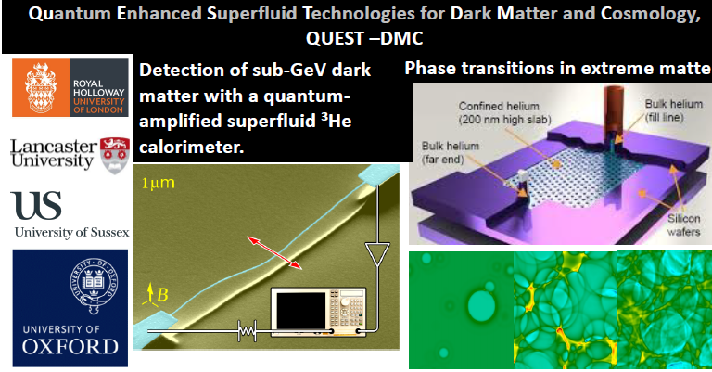
Slide modified from original by I. Shipsey

Slide 29
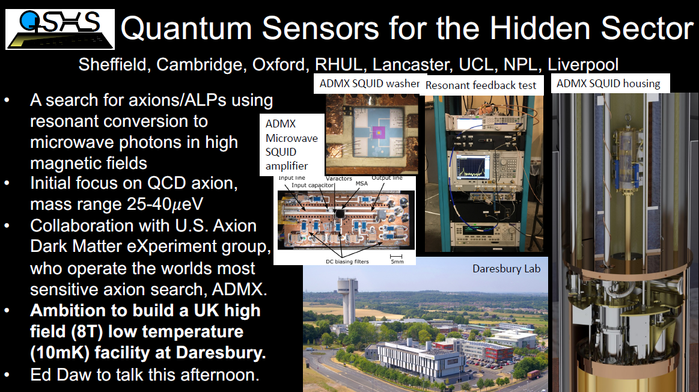
WP1

Slide 30
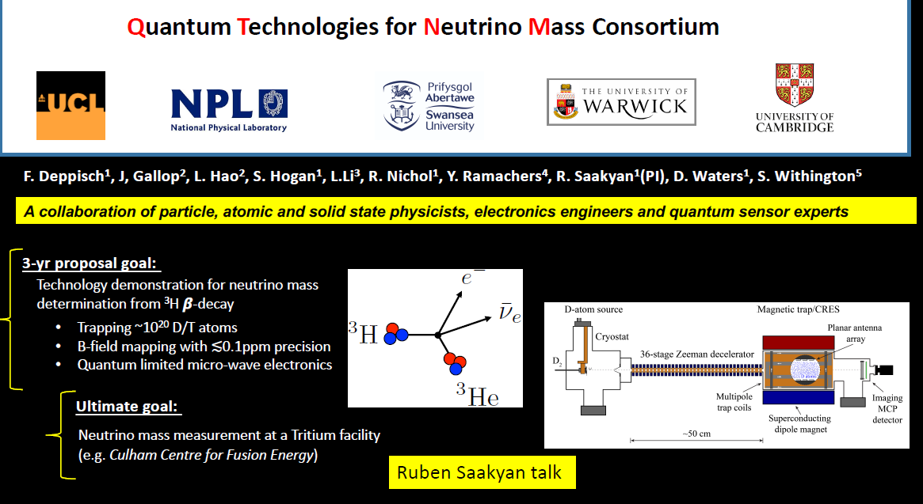
WP4

Slide 31
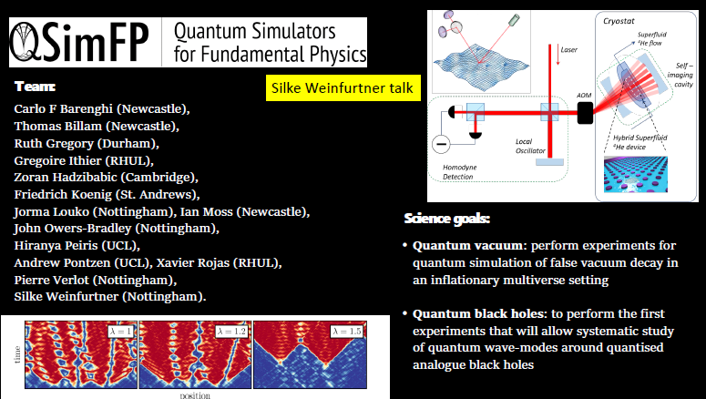
WP5

Slide 32
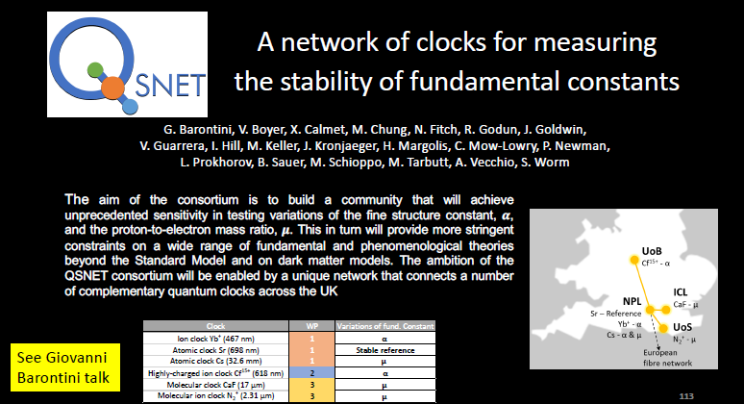
Slide modified from original by I. Shipsey
WP6

Slide 33
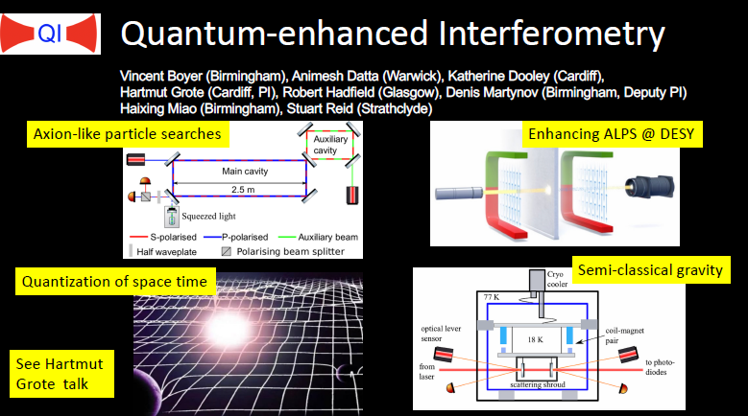
WP11

