Slide 1


Luminosity monitors at SuperKEKB
FCC-ee MDI Meeting #30 and FCCIE WP2.3 Meeting # 1
Frank Zimmermann
thanks to Yoshihiro Funakoshi, Hiroyuki Nakayama, Kazuhito Ohmi, Katsunobu Oide
2021-02-08

Slide 2
There are three luminosity monitors at SuperKEKB
1.: monitor based on the ECL (Electromagnetic CaLorimeter) detector and detects Bhabha events (e+ and e-) with back-to-back coincidence.
2.+3: fast luminosity monitors called LumiBelle2 and ZDLM (Zero Degree Luminosity Monitor). LumiBelle2 uses the diamond sensor and has been developed by the French team (P Bambade et. al). ZDLM uses a Cherenkov detector plus a scintillator and has been developed by Uehara-san at KEK. The two detectors are located 13.9 m downstream from IP and detect positrons which lost energy due to radiative Bhabha process. LumiBelle2 and ZDLM show almost equivalent performance so far. But redundancy is a good thing.
Y. Funakoshi

Slide 3
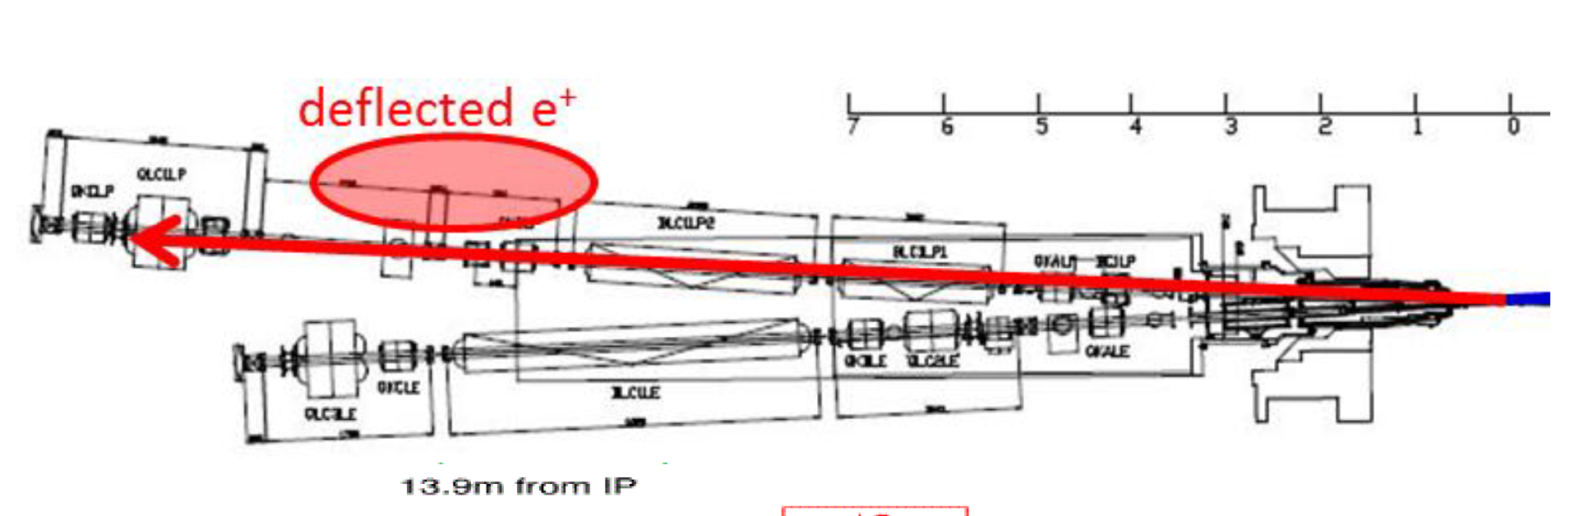
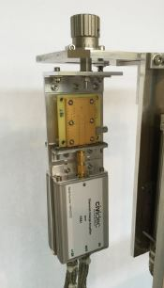
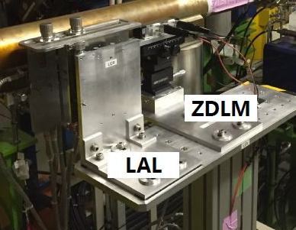
Fast luminosity monitors
diamond and scintillator based fast luminosity monitors located downstream of Belle II, for IP orbit feedback using "dithering" method and for IP aberration tuning
two complementary techniques developed at LAL and KEK:
  ∼ 5x5x0.5 mm³ single crystal CVD diamond sensors (CVD DS) pairs coupled to fast charge / current amplifiers (LAL) (LumiBelle 2)
  Cerenkov detector + scintillator (ZDLM group @ KEK)
positioned together outside of the beam pipe
detect positrons which have lost energy due to radiative Bhabha process
Y. Funakoshi

Slide 4
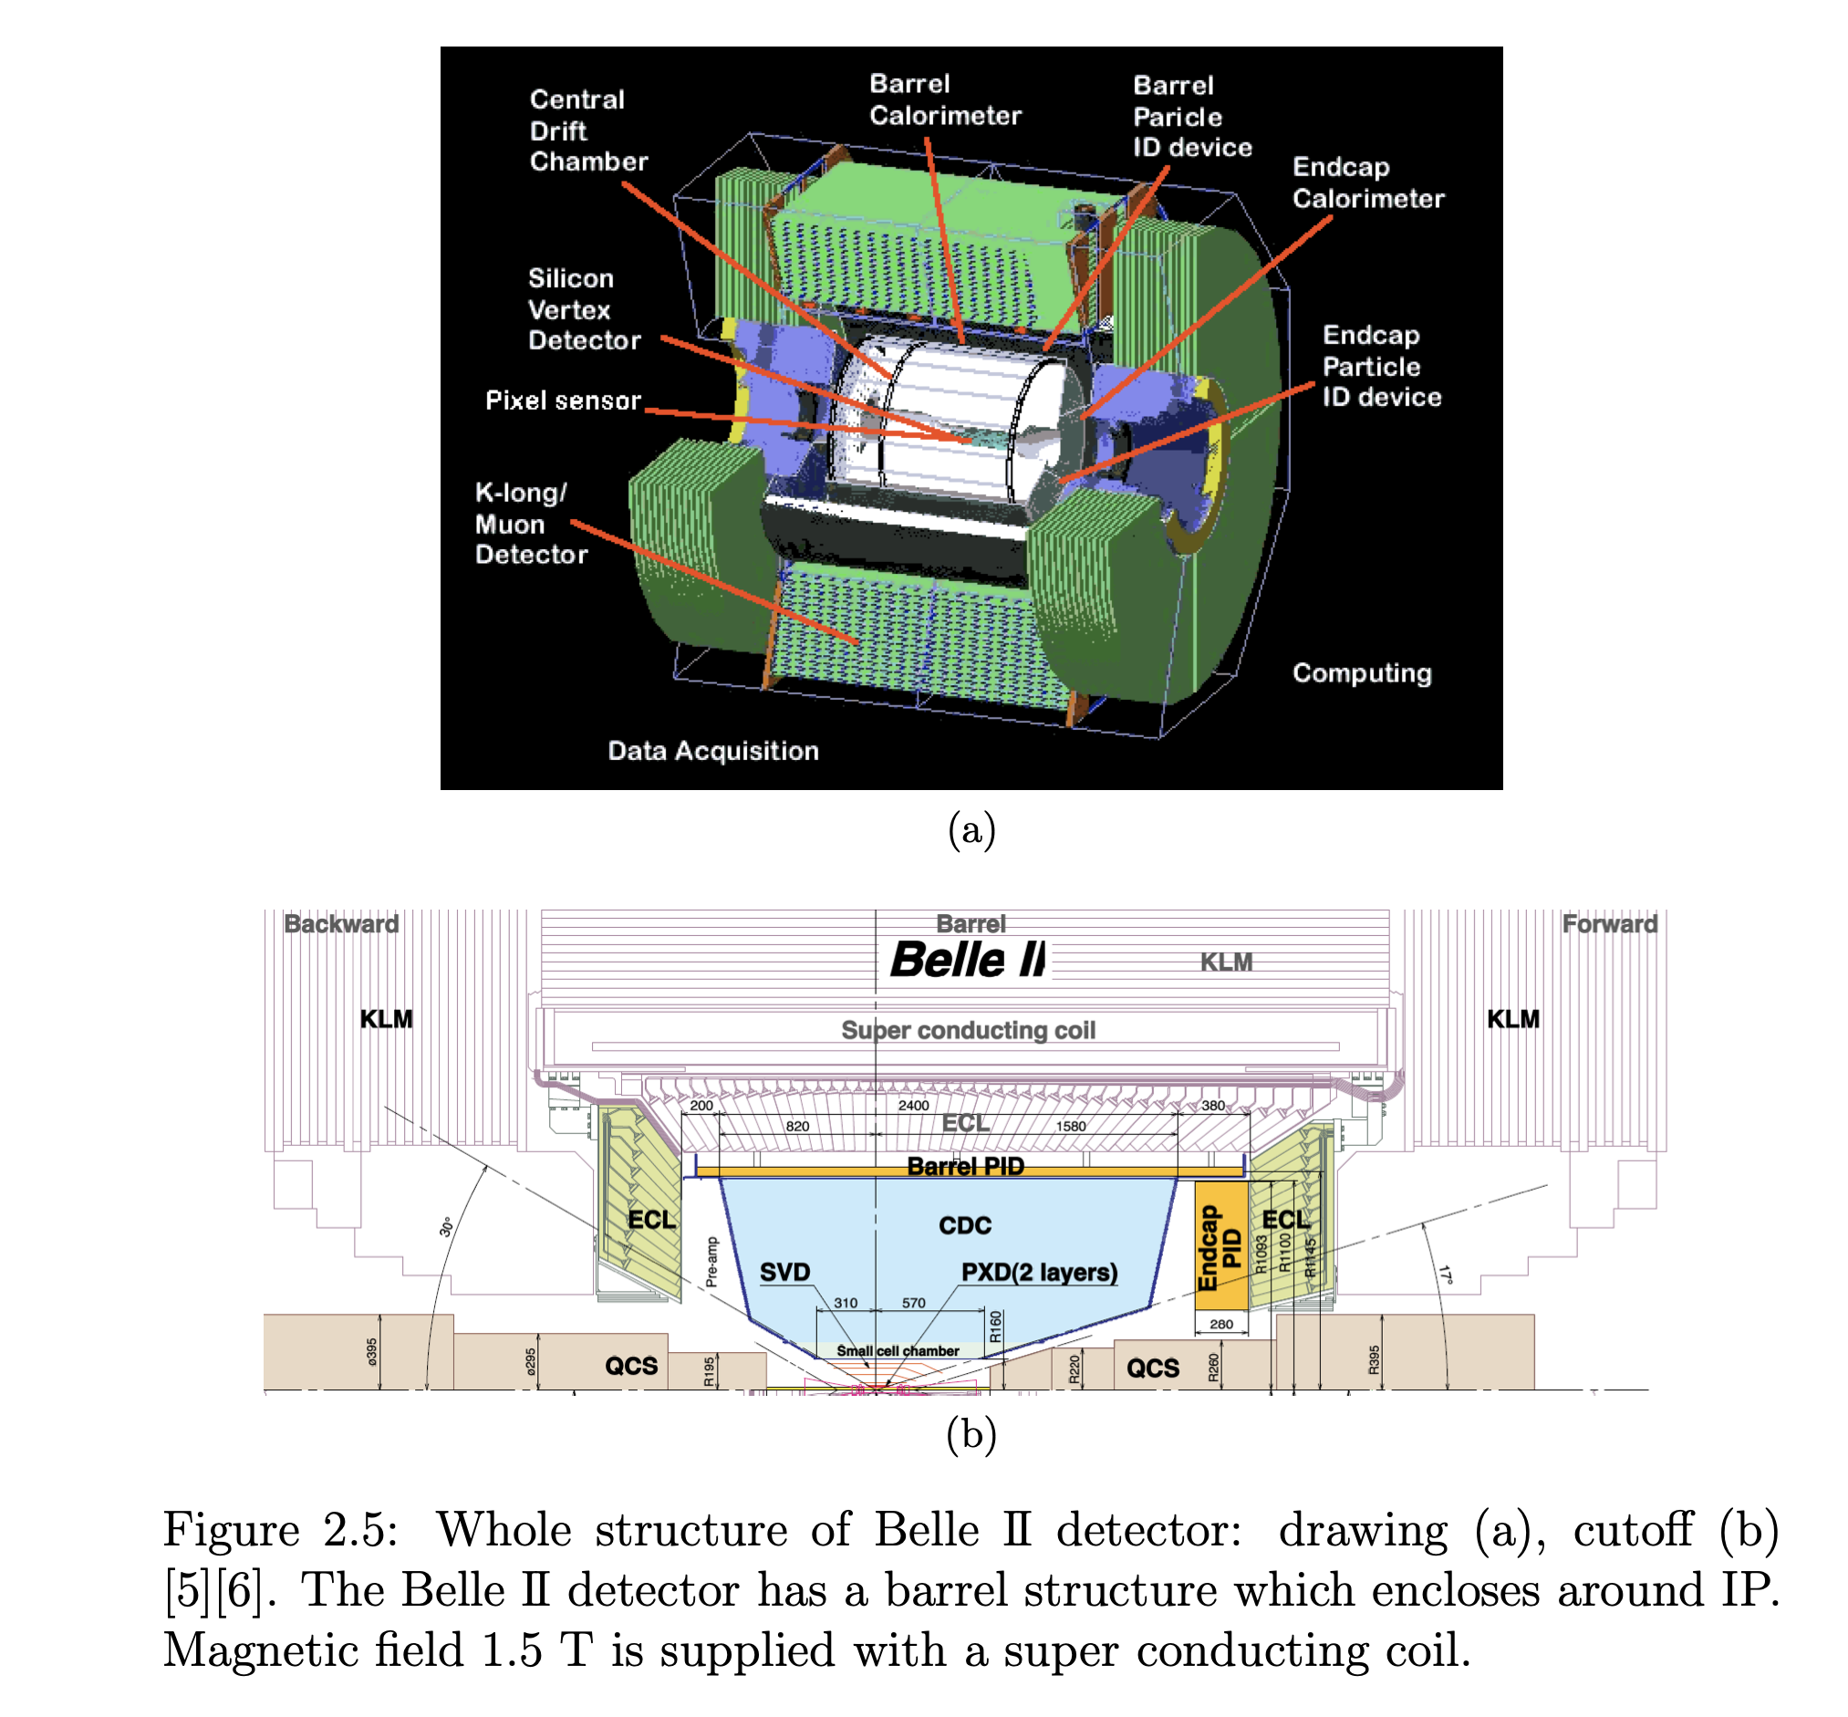
Belle 2 detector
ECL, CsI crystals inside Belle II detector, are used for measurement of delivered luminosity.
Y. Funakoshi

Slide 5
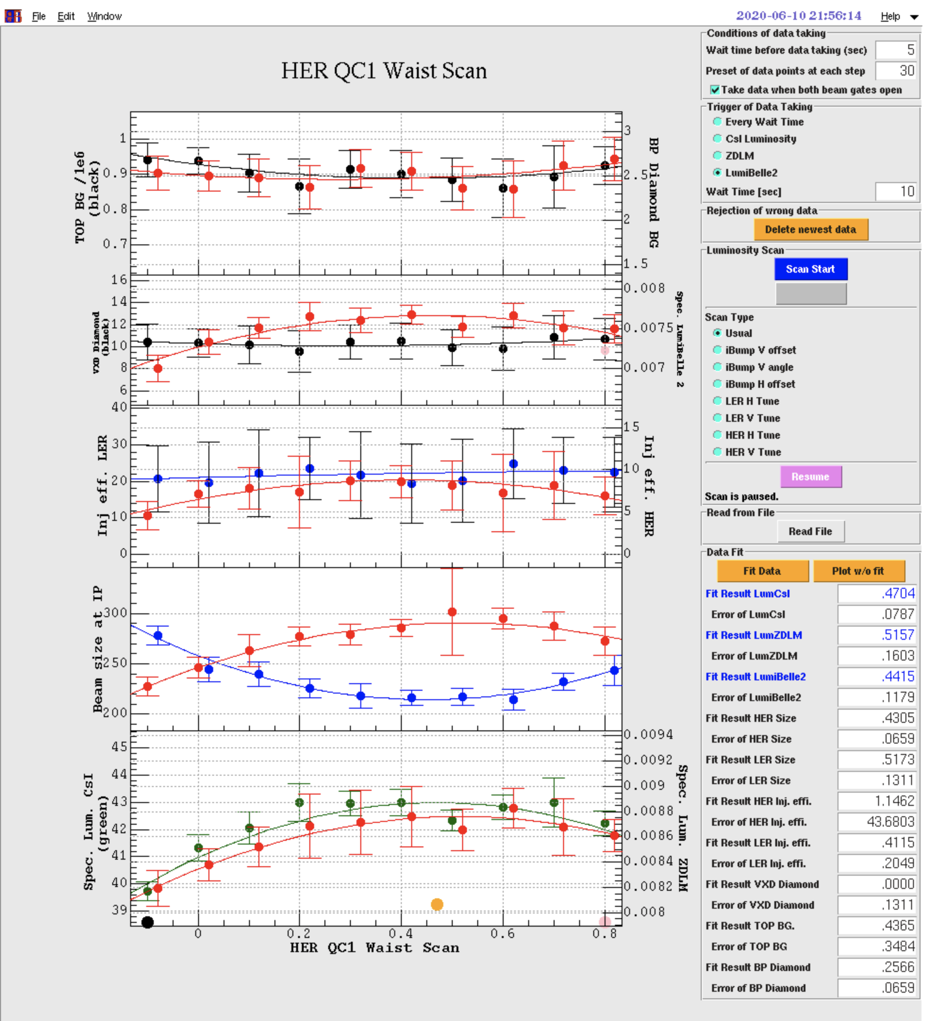
(1) Luminosity scan during physics run
Typically 15 or 30 minutes for the whole scan - EPICS data updated every second. ECL: moving average of 20 seconds: fast luminosity monitors instantaneous.
The scan itself is very slow and there is no big difference in the scan results. We need to wait for some time after parameter changes until IP orbit feedback restores luminosity.
In this kind of scan, data for beam sizes, injection efficiency & detector beam background data in addition to luminosity.
Scanning waist point, IP vertical dispersion, IP local coupling parameters,target values of IP orbit feedback system and others.
LumiBelle2
Y. Funakoshi
CsI
ZDLM

Slide 6
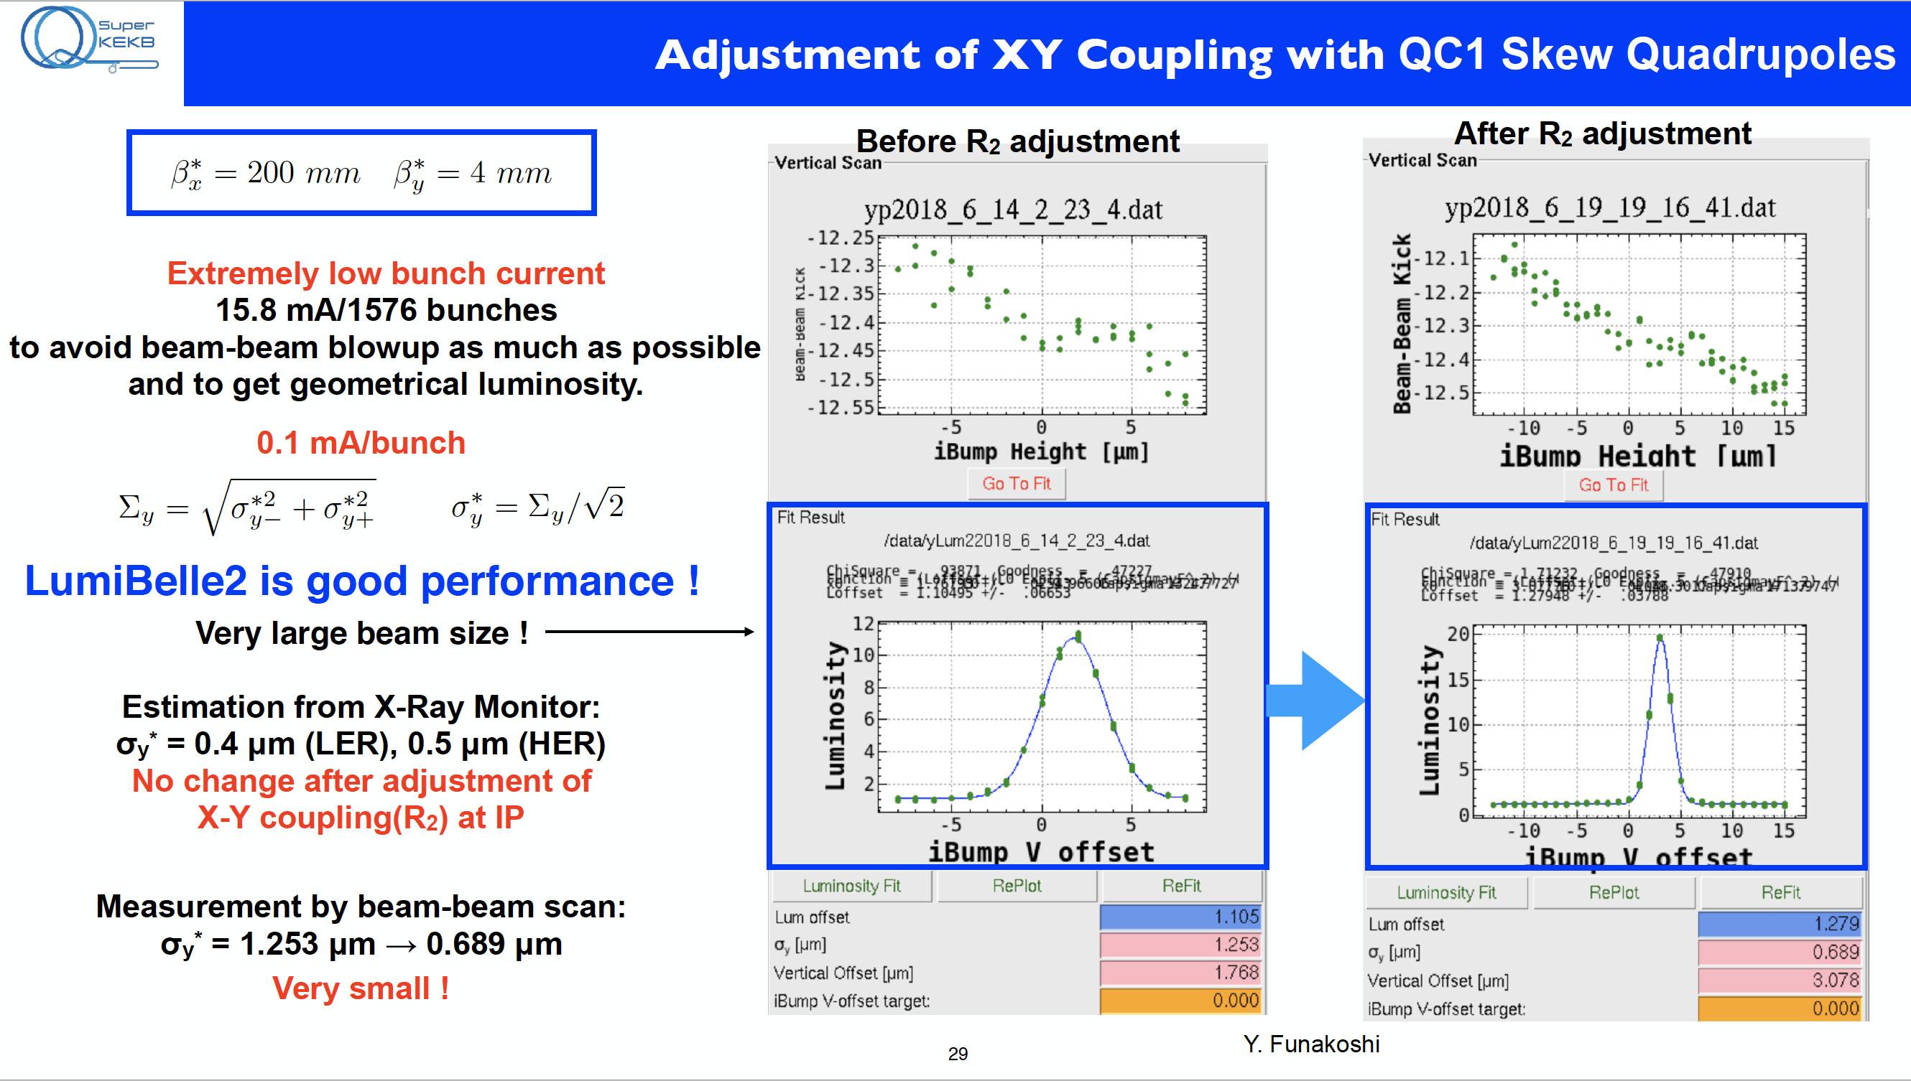
(2) The beam orbit (offset) scan with low bunch currents
In this scan, the 2 fast luminosity monitors are used since the event rates with the low angle luminosity monitors are high. The ECL luminosity monitor cannot be used for this purpose due to low statistics. A typical scan result is shown. The signal-to-noise ratio with the low luminosity seems sufficient in this example. This scan can be used for finding beam collision after a long shutdown.
Y. Funakoshi
Phase 2

Slide 7
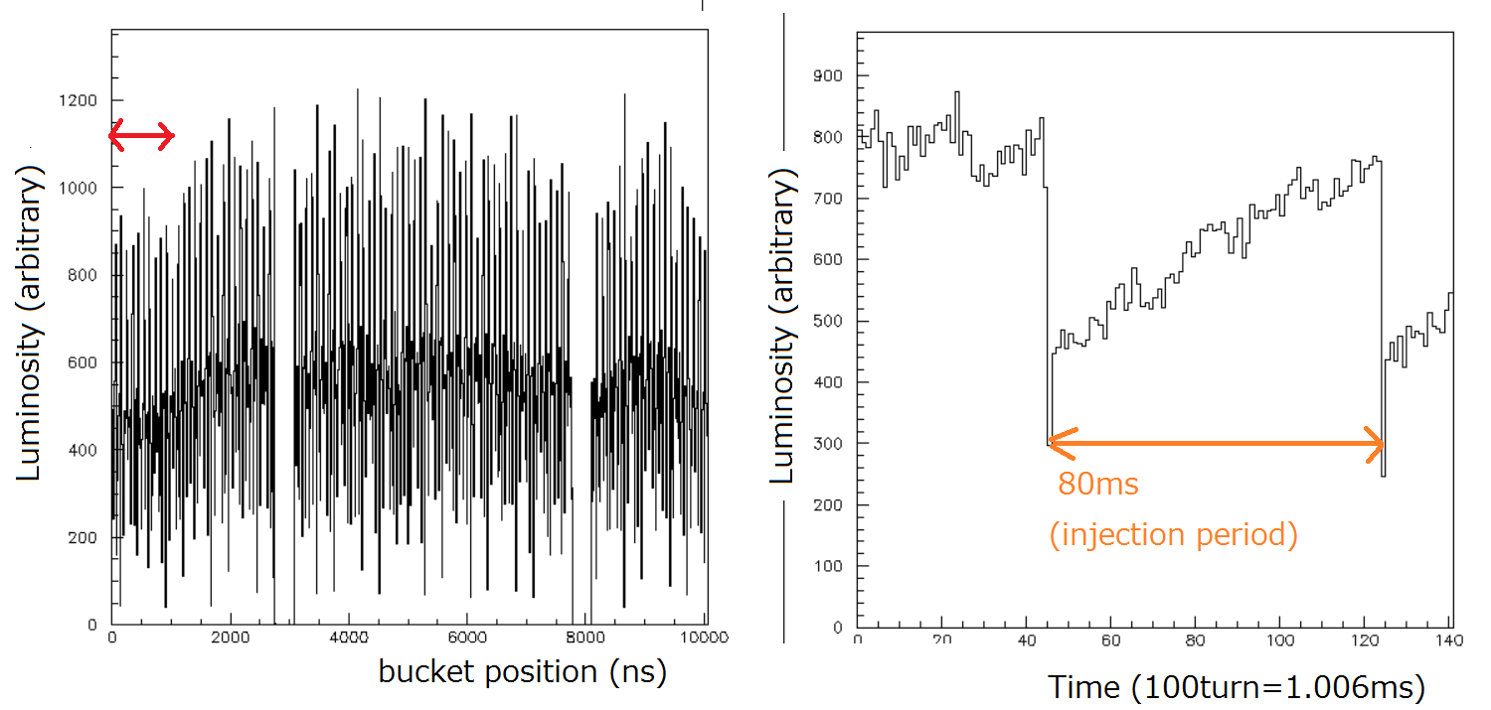
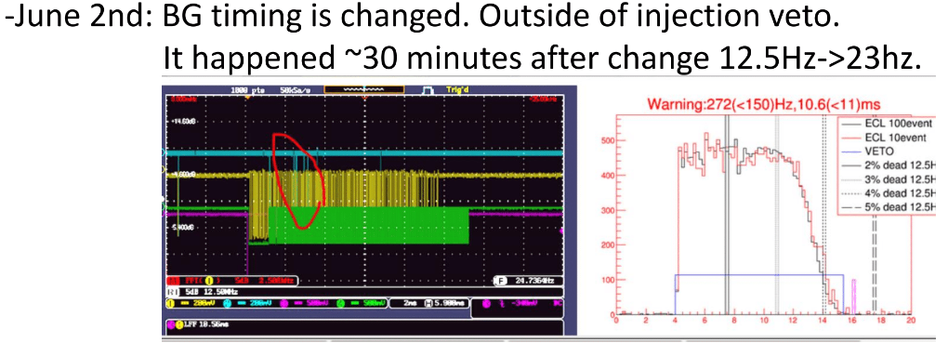
Motivation
(3) Fast luminosity change
By using the fast luminosity monitors, we can know a fast change in the luminosity.
Examples shows fast luminosity drop just after LER injection observed by ZDLM. This problem was much mitigated by installing a skew-Q magnet between two injection kickers. This means that the horizontal kickers kicked the beam in the vertical direction also.
(4) Bunch-by-bunch luminosity
The bunch-by-bunch luminosity can be measured by the fast luminosity monitors. But the ECL Luminosity monitor cannot offer this kind of data. A typical result is shown below
Y. Funakoshi
Decrease luminosity drop
due to injection oscillation
Reduce duration time and BG
Radioactivation of collimator delay
Improve injection efficiency
By Uehara
By Koga

Slide 8
(5) Luminosity dithering feedback
The two fast luminosity monitors were originally designed and have been developed for the luminosity dithering system. The system has been developed at KEK with getting help of SLAC people and its beam test was successfully done. But so far the system is not needed in the real operation. When the IP vertical beta function is squeezed further, we will need the system.
In summary, the fast luminosity monitors are indispensable for the luminosity tuning. I think that almost all tuning can be done without the ECL luminosity monitor. But the ECL luminosity monitor is indispensable for determining the absolute value of the luminosity.

