Slide 1
Wire labelling and wire bundle insertion into capillaries
H. Prin
Cryo Meeting, Wednesday 3 Feb 2021,
https://indico.cern.ch/event/1002810/

Slide 2
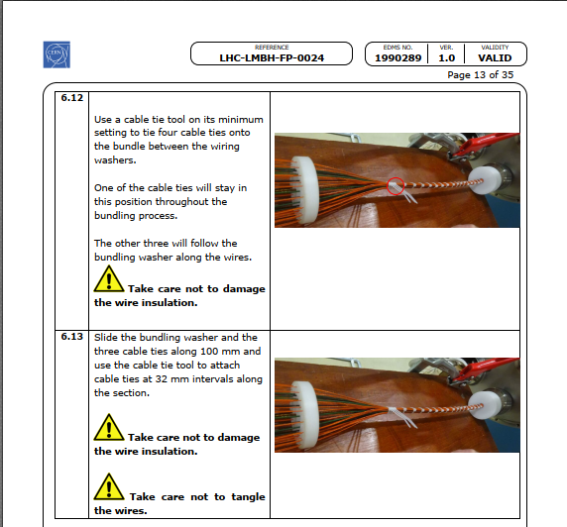
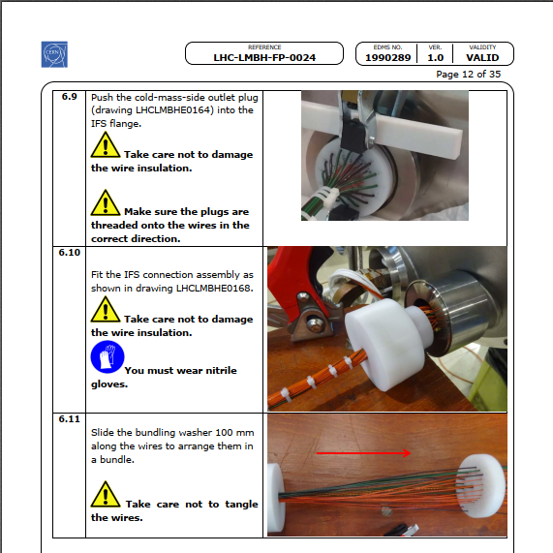
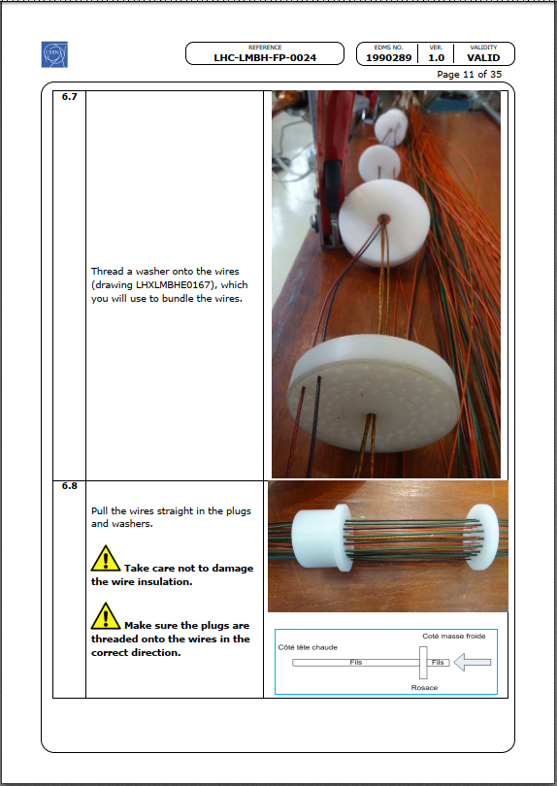
IFS installation procedure
Example of the 11T procedure: EDMS 1990289
The final procedure for the quadrupole cold masses is drafted (EDMS 2378105), in French, but not finalised yet. It will be very similar to the one used on the dipole cold mass.
The CLIQ and k-mod connection procedures will be part of this document. They are presently being developed.

Slide 3
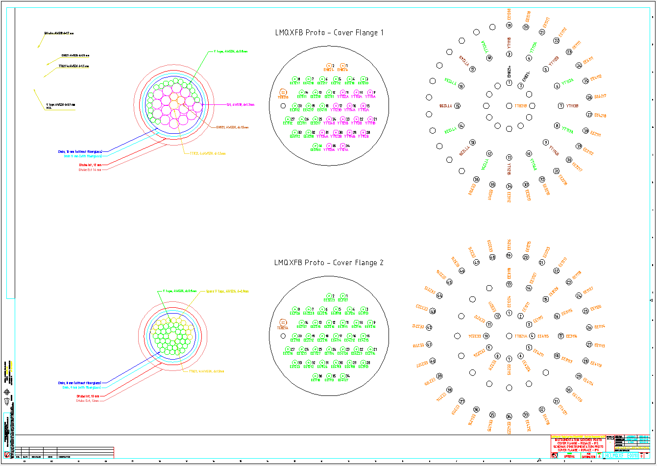
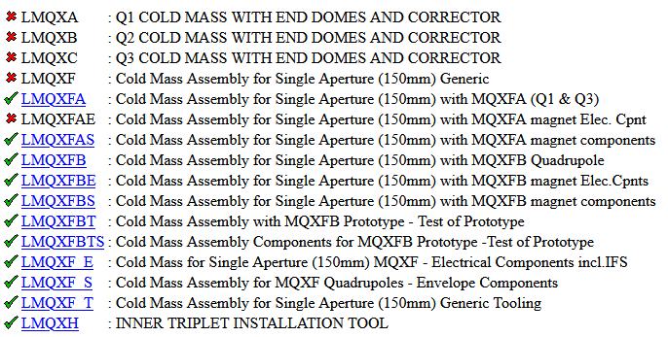
Labelling Example
Example of the LMQXFBT cold mass
to test the MQXFB prototypes and first series magnet
Drawings for the LMQXFA and LMQXFB cold masses will be completed following this outline by the end of February. They present:
the distribution in the barrel
the cover flange layout
The number and type of wires in the capillary
They will be stored under the equipment codes LHCLMQXFAE and LMQXFBE

Slide 4
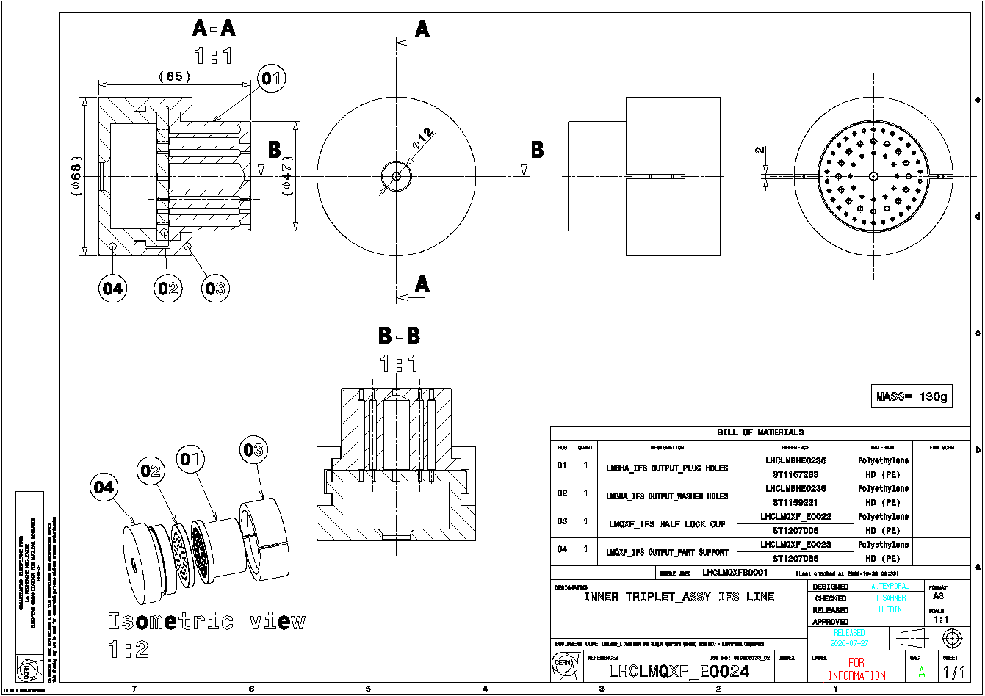
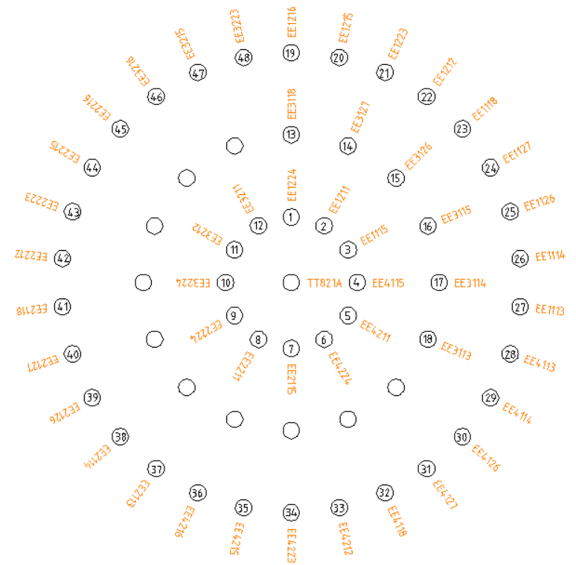
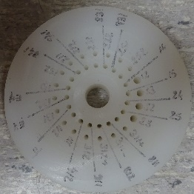
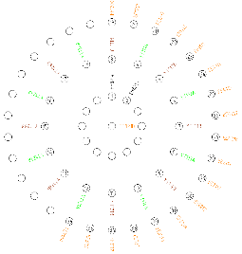
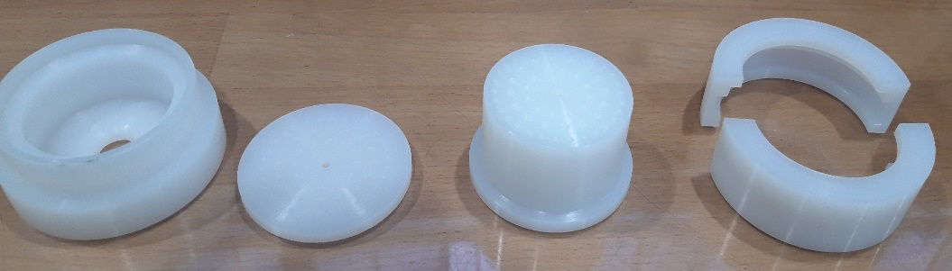
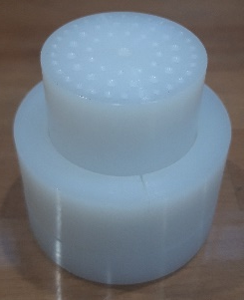
IFS Barrels Pieces and Labelling
Drawings LHCLMQXF_0024
10 out 90 sets delivered today (Feb. the 3rd)
Ongoing study to imprint the 58 passages in pieces 3 and 4 (engraving, inking…) from 1 to 58
The drawing mentioned in the previous slide will associate the wire Id (EE, YT, EH…) to the passage number.

Slide 5
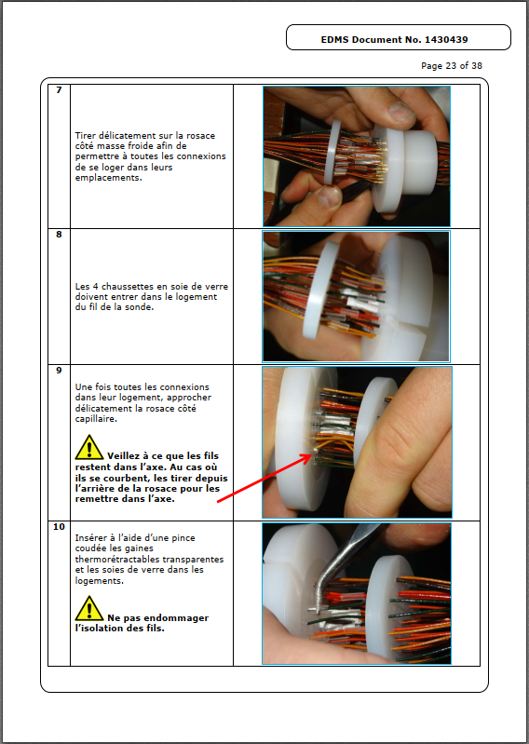
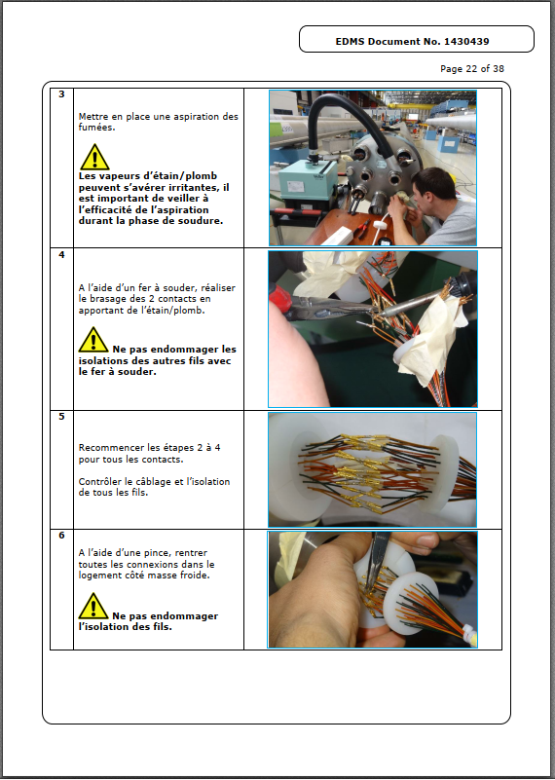
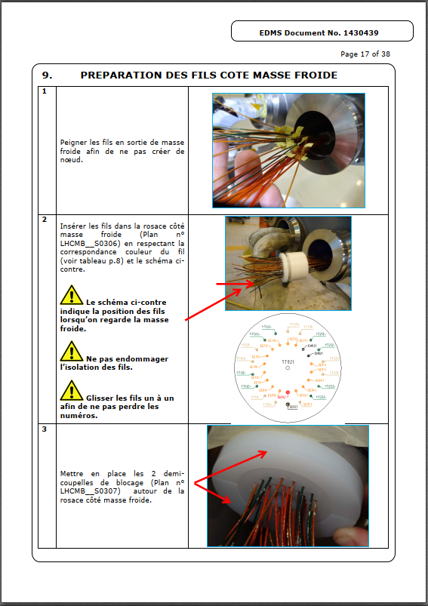
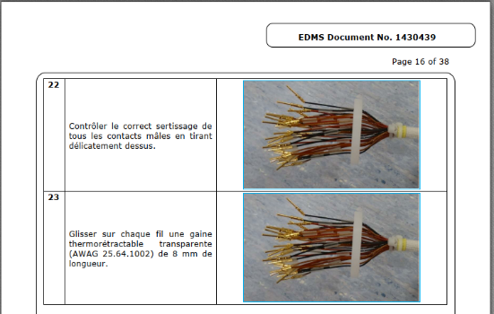
Repair procedure
Example of the 11T repair procedure: EDMS 1430439
Could be used as baseline for any repair on a IFS capillary.

