Slide 1
Wire routing through IFS Plug
R. Bossert, L. Martin, T. Strauss

Slide 2
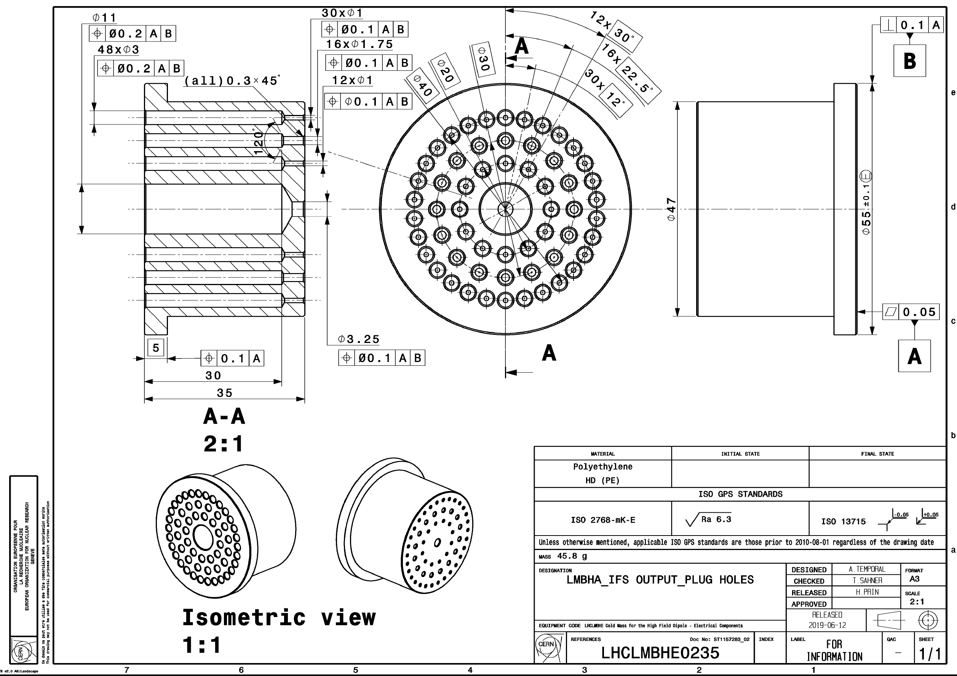
Currently:
16 holes – 1.75 mm dia.
42 holes – 1 mm dia.
1 hole – 3.25 mm dia
59 total holes

Slide 3
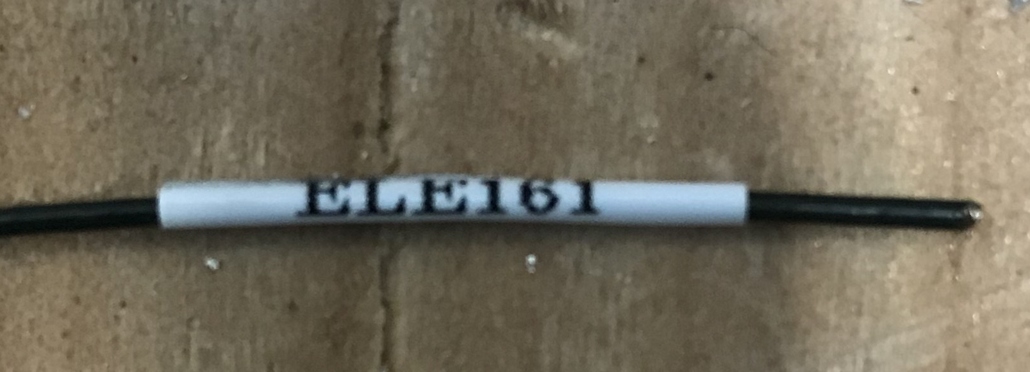
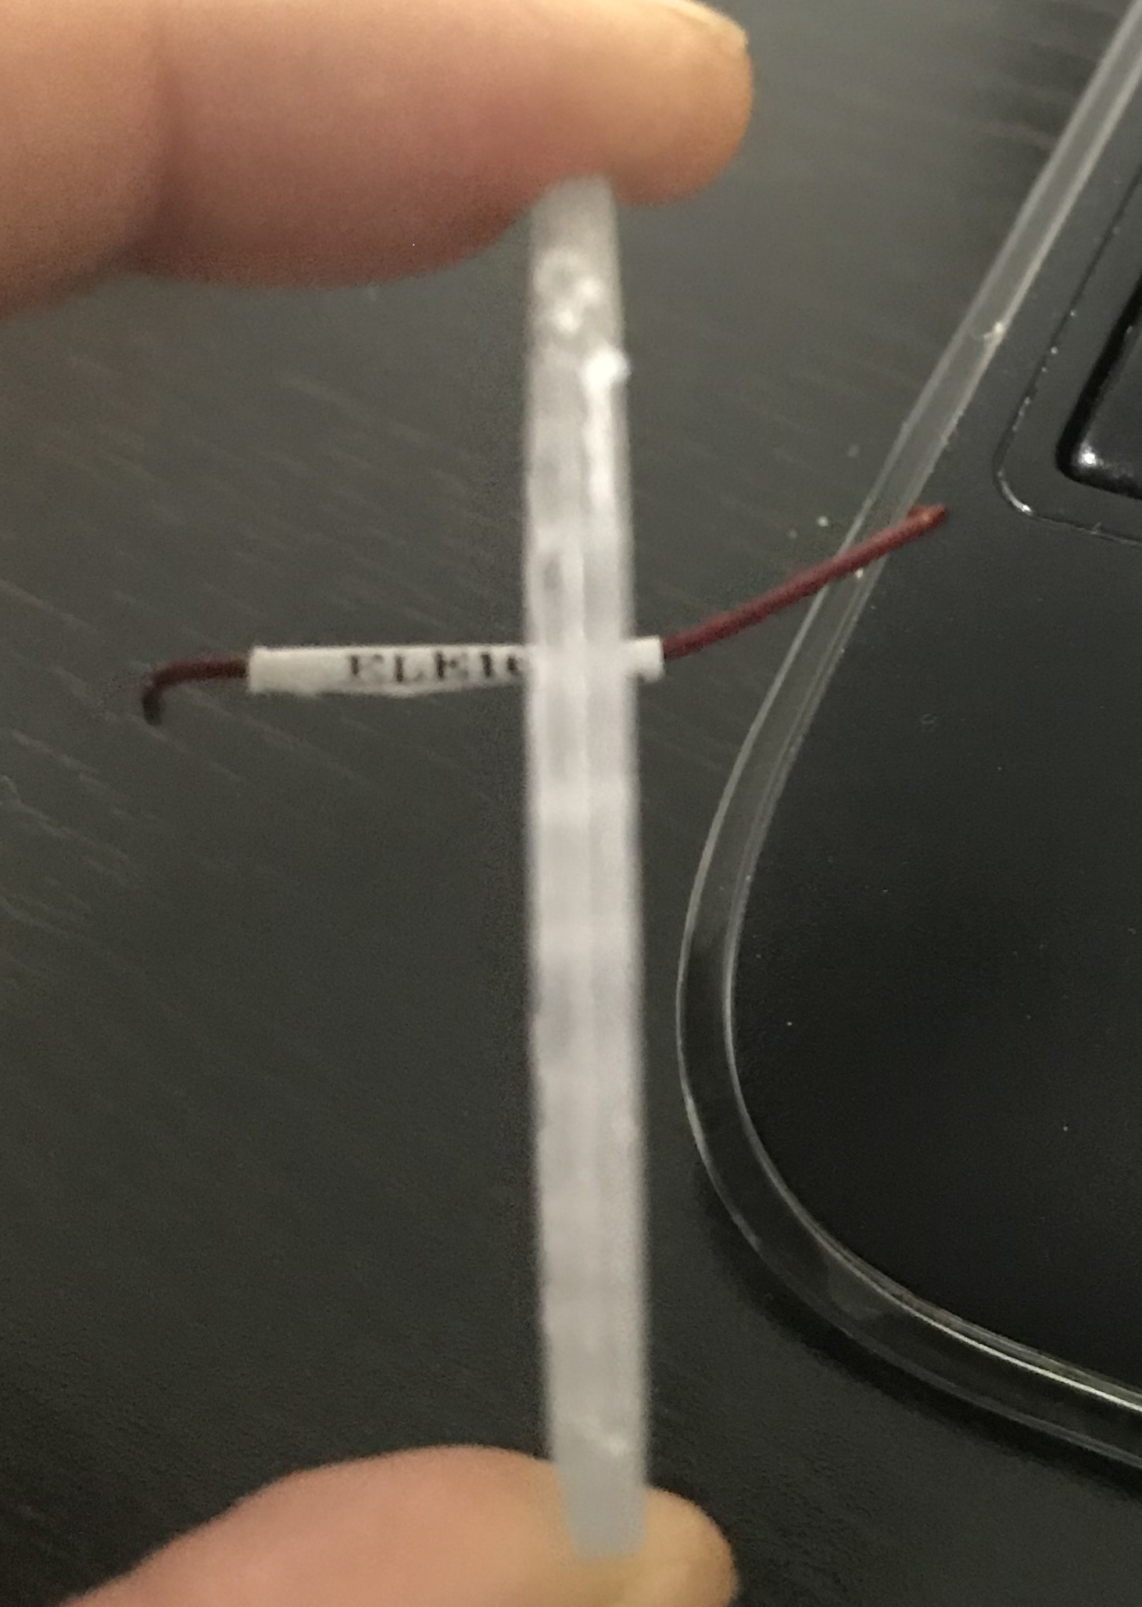
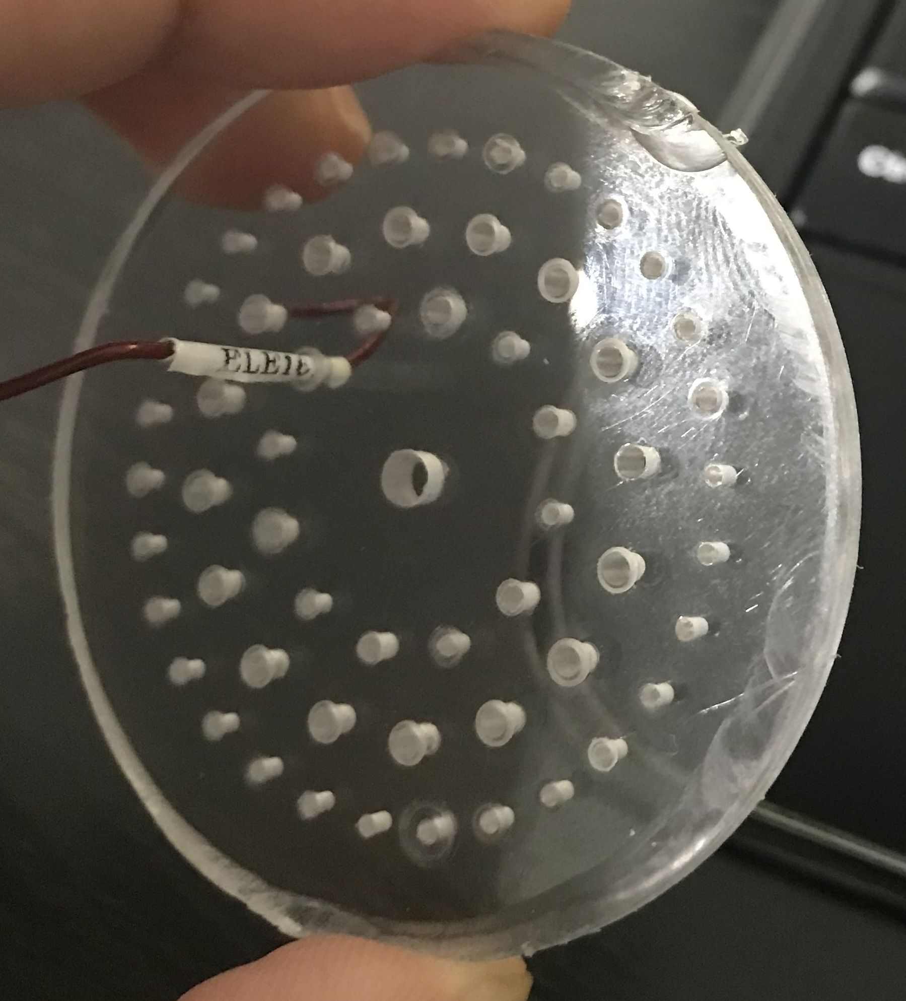

Slide 4
The Cold Mass is instrumented with temperature sensors, warm up heaters and voltage taps. In addition there are Quench protection heater wires and several other voltage taps that are mounted on the MQXFA magnet coils that will be routed out of the cold mass through the instrumentation port to the IFS capillary (R-T-19). The table below consists of a list of the all instrumentation wires which exit the end dome (R-T-18). The instrumentation wiring diagram is shown CERN drawing number LHCLMQXF E0001
Lead or Wire | Qty per end | Wire Diameter (mm) | Label (mm) | Shrink Tubing (mm) | Total Diameter (mm) | Exit port | Notes
Quench Protection Heater Wires | 16 | 1.70 | 0.2 | 0.5 | 2.4 | IFS Capillary | From the quench protection heaters bonded to the coils Total of 4 wires from each coil. Jumpered on the return end of magnets during magnet construction. 18 AWG polyimide coated wire.
Magnet Voltage Taps | 16 | 0.90 | 0.2 | 0.5 | 1.6 | IFS Capillary | Voltage taps which extend from the end of the coils. 4 taps from each coil. 26 AWG polyimide coated wires.
Cold Mass Voltage Taps | 4 or 5 | 0.90 | 0.2 | 0.5 | 1.6 | IFS Capillary | 5 on Qa end and 4 on Qb end. 26AWG polyimide coated wires.
Temperature Sensor Wires | 2 bundles (8 total wires) | 1.42 | 0.2 | 0.5 | 2.12 | IFS Capillary | Four wires from each temperature sensor. 30AWG polyimide coated wire.
Cryo Heater Wires (Warmup Heaters) | 4 | 1.70 | 0.2 | 0.5 | 2.4 | IFS Capillary | Two wires from each Heater. 18 AWG polyimide coated wire.
Temperature Sensor for Wires on Horizontal Test Stand | 2 bundles (8 total wires) | 0.8 | 0.2 | 0.5 | 1.5 | IFS Capillary | Two sensors, 1 quad-twist bundle (4 wires) for each temperature sensor. 36AWG quad-twist polyimide + Tefzel single strand wire, used only for MTF testing.

Slide 5
Comments and questions:
There are 16 holes which are 1.75mm diameter, and this is the same number of holes as there are wires for quench protection heaters, which are 1.7 mm thick, so there are no places for other wires that are thicker than 1 mm.
The thermometer wires from CERN come in two bundles of four. Are we to put each bundle of four wires through one hole? If so, the wires bundles are slightly over 1.4 mm thick and would need to have larger holes drilled out.
There are 4 cryo (warmup) heater wires that are 1.7 mm thick and these would also need to have larger holes drilled for them.
This assumes that the thermometer wires will be threaded through the plug in bundles of four.

Slide 6
Dimensions in mm
Wire Type | Without Labels |  | With Labels |  | Qty. of wires
 | Wire size | Hole Size | Wire Size | Hole Size
Quench Protection | 1.7 | 1.75 | 2.4 | 2.5 | 16
Voltage Taps | .9 | 1 | 1.6 | 1.75 | 21
CERN Thermometers | 1.42 | 1.75 | 2.12 | 2.5 | 2
Cryo (Warmup) Heaters | 1.7 | 1.75 | 2.4 | 2.5 | 4
MTF Thermometers | .8 | 1 | 1.5 | 1.75 | 2
Totals without labels: 22 holes @ 1.75 mm dia.
23 holes @ 1 mm dia.
Totals with labels: 22 holes @ 2.5 mm dia.
23 holes @ 1.75 mm dia.

Slide 7
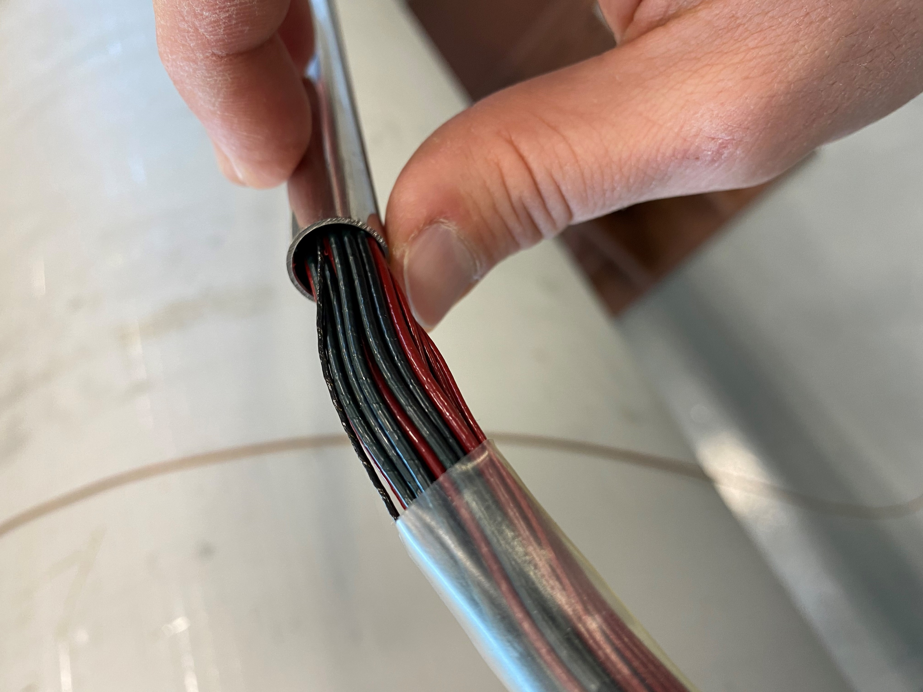
Comments and questions:
Thomas made a mock up of the wires that pass through the IFS capillary. We would like to try adding the labels and sleeve. What is the sleeve made of and where to we get it from?

