Slide 1
Pulsed DC System Update L4 RFQ
4th February 2021

Slide 2
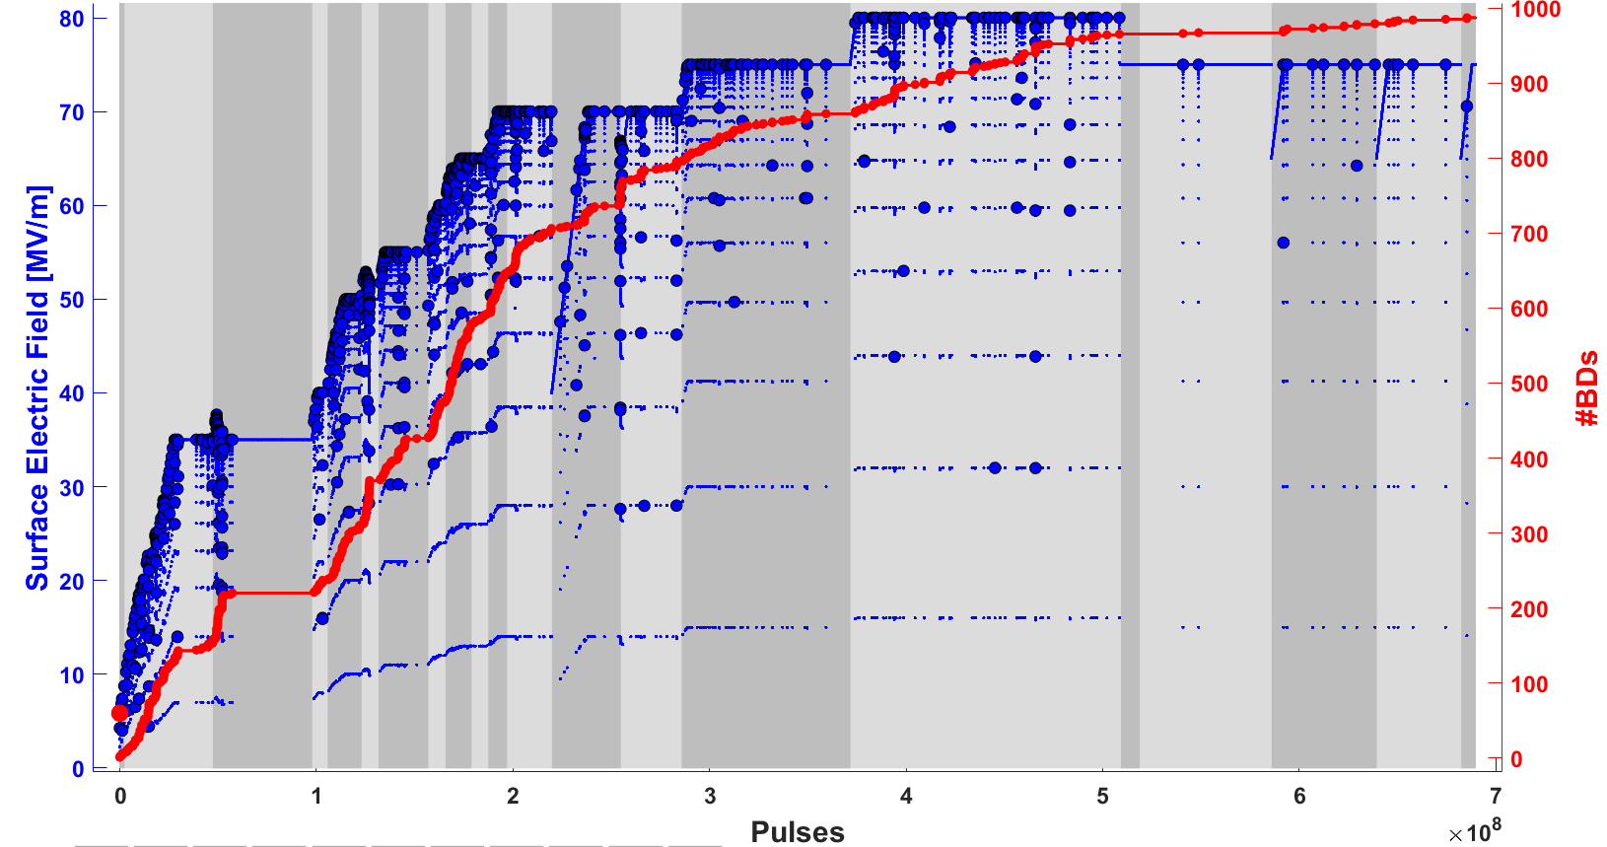
All Runs
100µs 200Hz
250µs 200Hz
500µs 100Hz
1000µs 100Hz

Slide 3
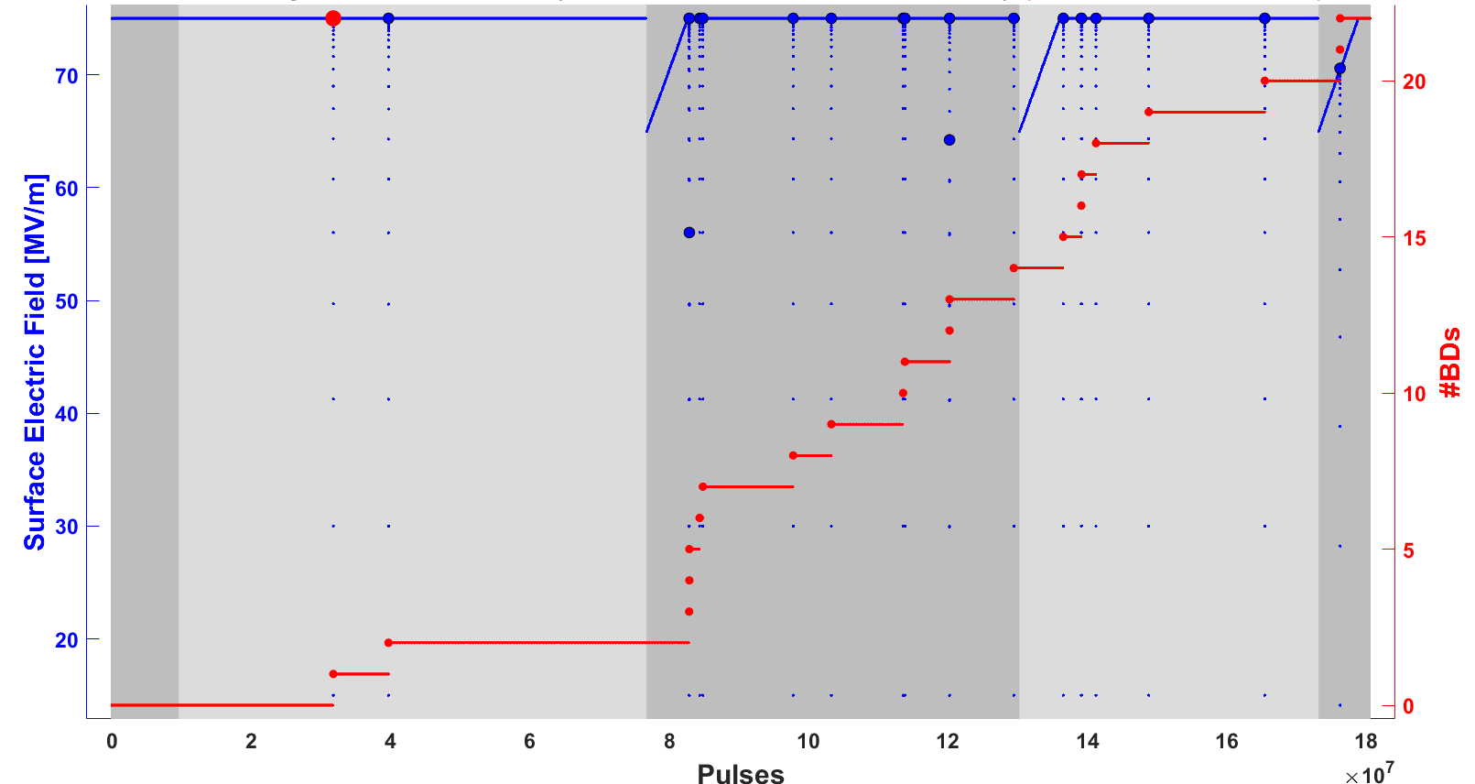
Pulse Length Dependence
100µs 200Hz
250µs 200Hz
500µs 100Hz
1000µs 100Hz

Slide 4
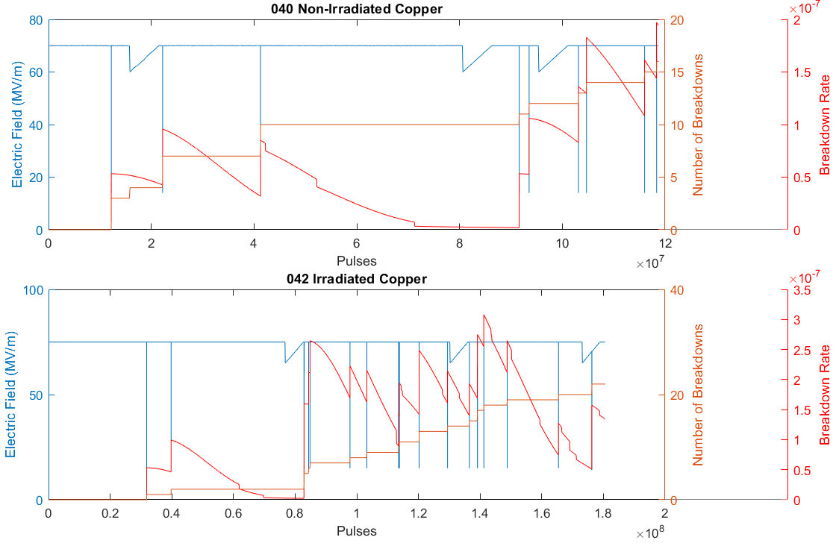
Pulse Length Dependence Comparison

Slide 5
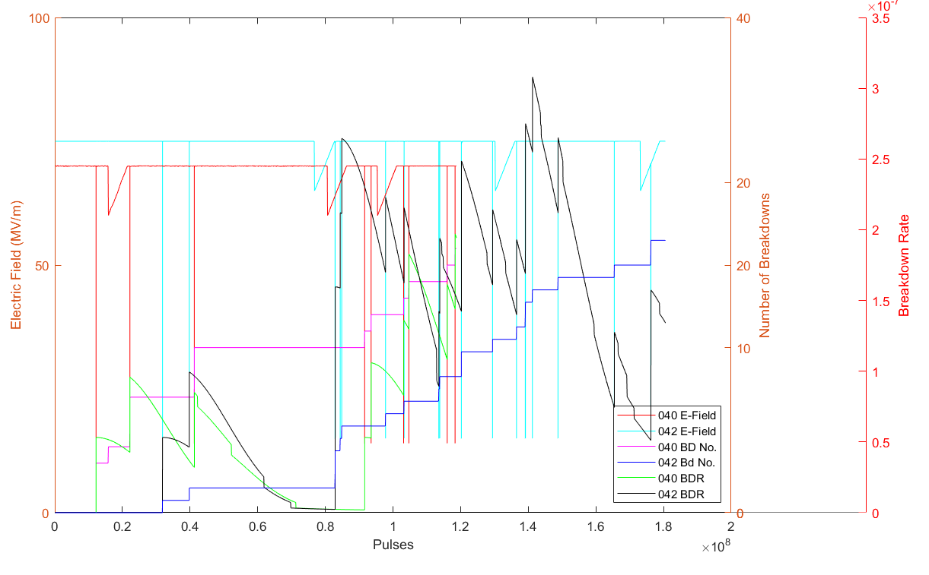
Pulse Length Dependence Comparison

Slide 6
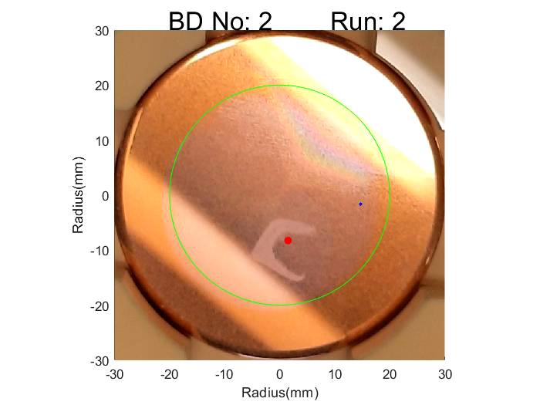
Breakdown Locations

