Slide 1
Nb cathode inspection after irradiation at CERN
Anité Pérez Fontenla
04.02.2021

Slide 2
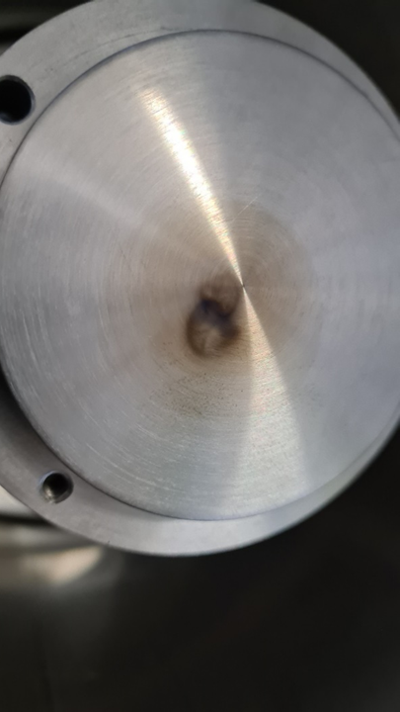
Image courtesy of A. Lombardi

Slide 3
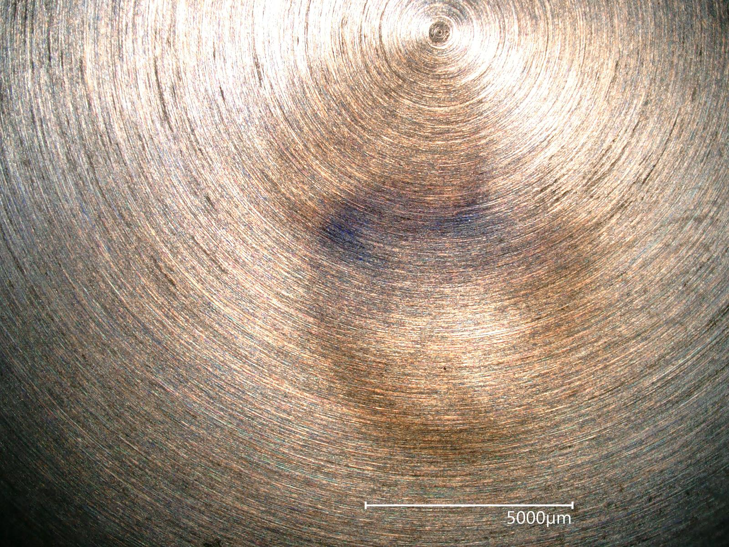
2nd irradiation
1st irradiation

Slide 4
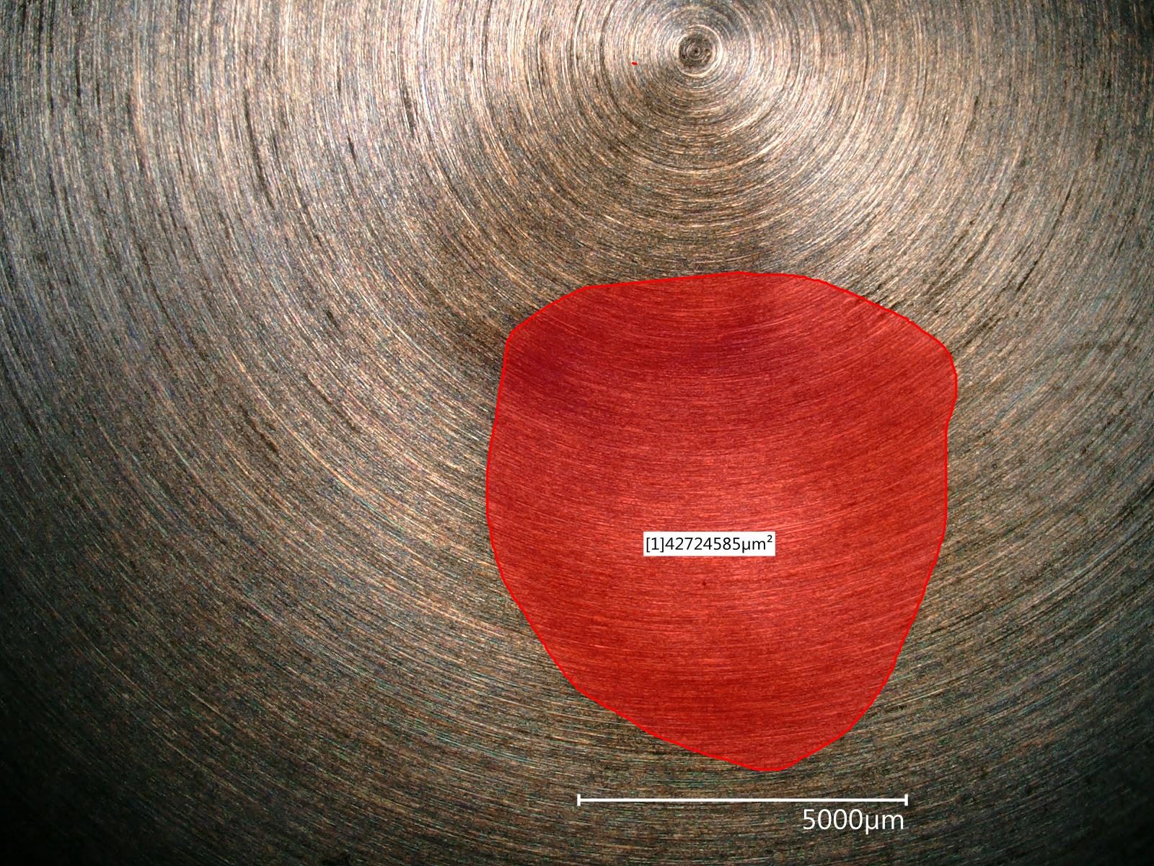

Slide 5
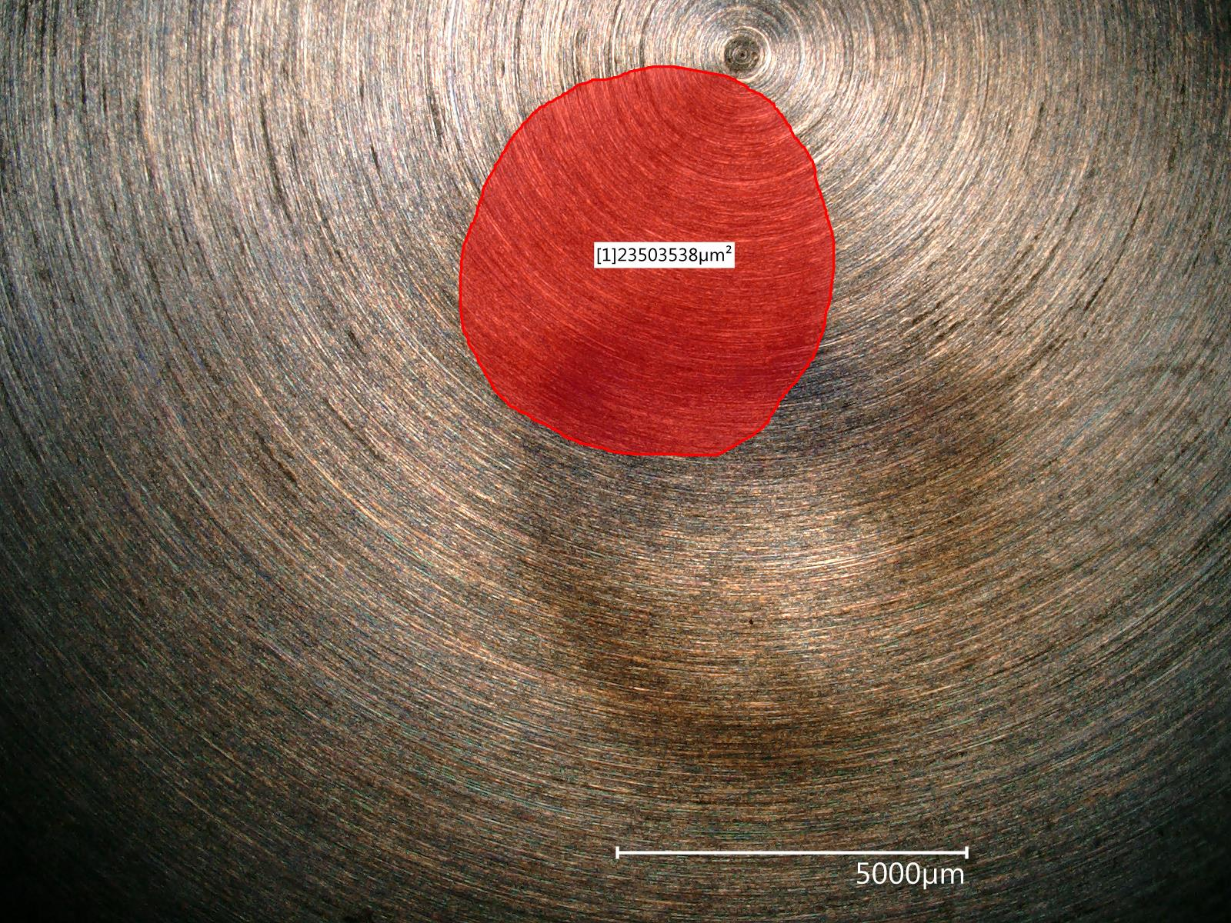

Slide 6
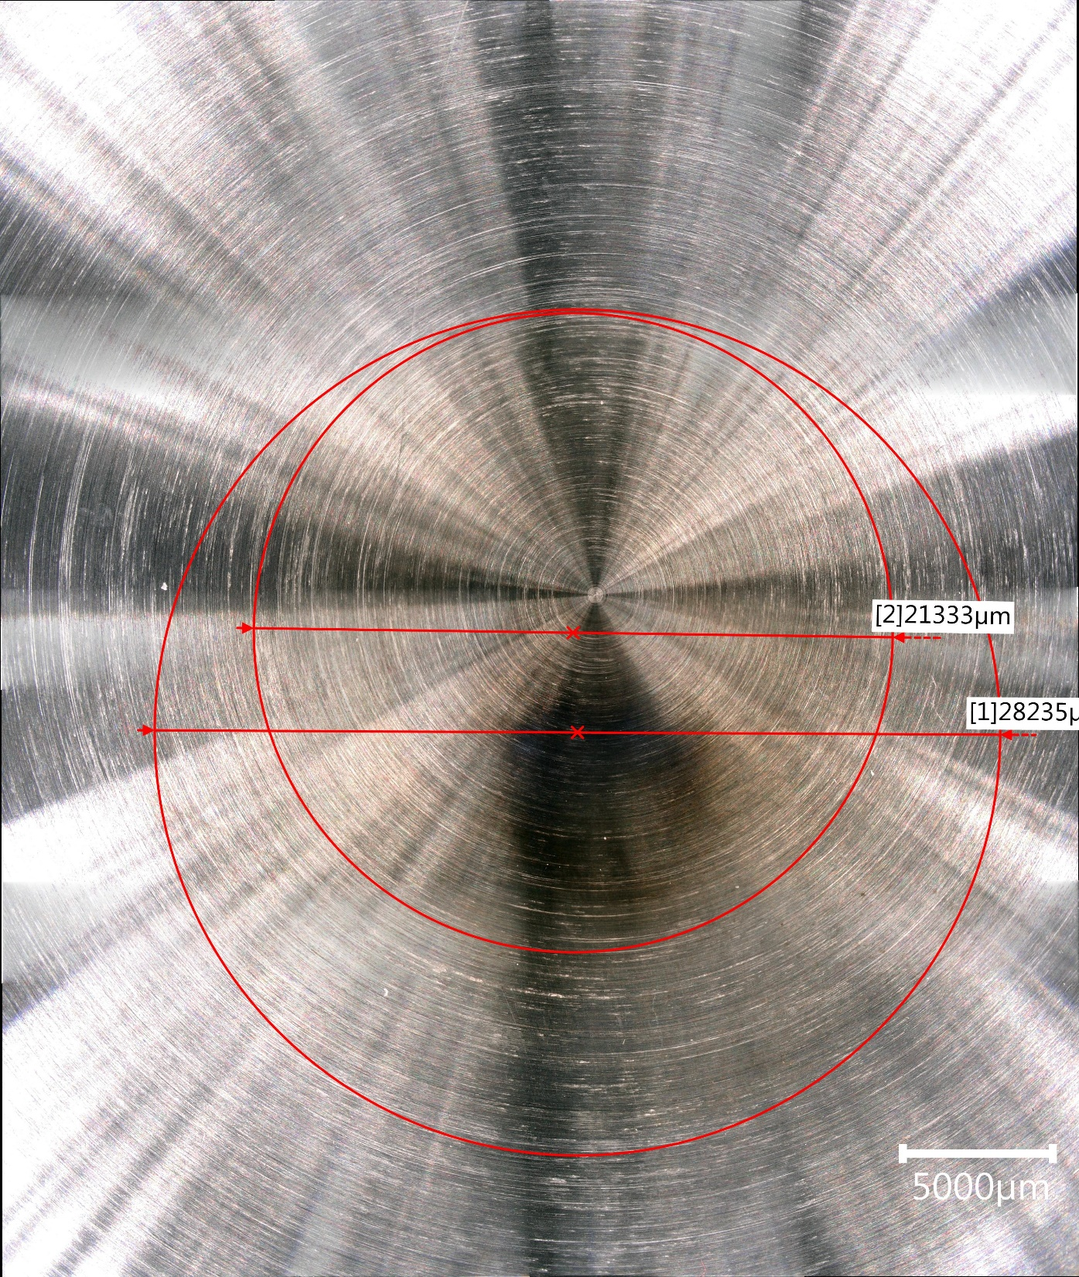

Slide 7
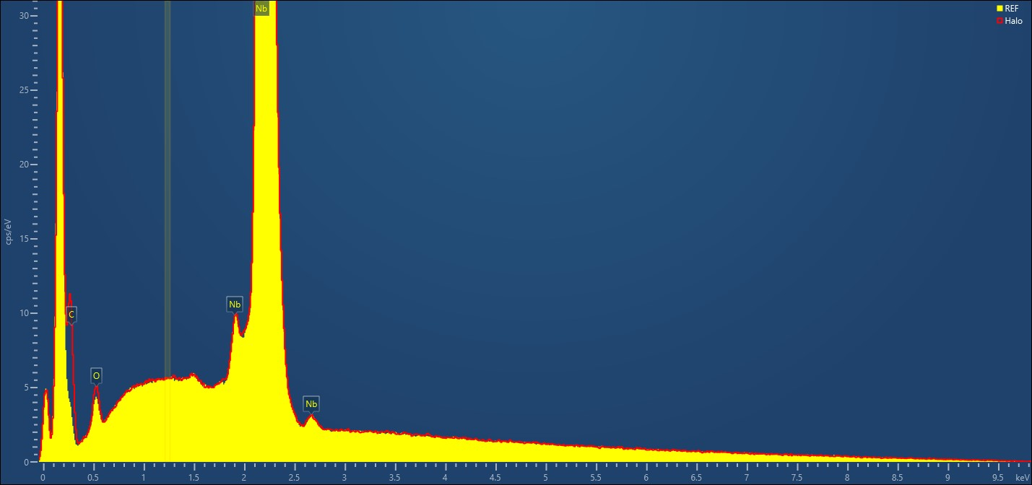
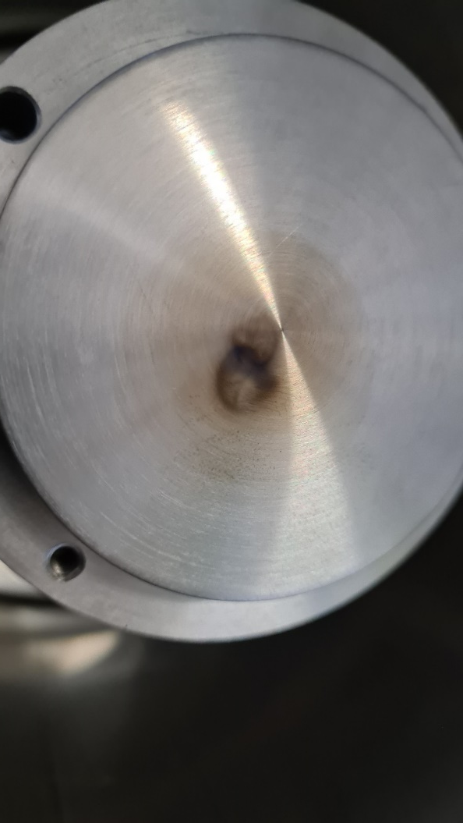

REF
HALO
IRRAD
 | REF | HALO | IRRAD
Element | Wt%
C | 2.7 | 10.4 | 18.9
O | 1.0 | 1.4 | 0.9
Nb | 96.3 | 88.2 | 80.2

Slide 8


