Slide 1

CDR redaction: discussion
Authors: K. Artoos, C. Collette, C. Hauviller
Goal of the discussion:
Possibility to give input and participate on contents of the report
Two options are under study: CERN “stiff option” and LAPP “soft option”
CDR baseline for MBQ will be the CERN rigid option.
LAPP soft option will be described in the chapter Final Focus
LAPP development can me mentioned in the “Outlook for TDR phase” as alternative option.

Slide 2
Contents
5.16.1 Overview
5.16.2 Ground vibration at various sites
5.16.3 Technical noise
5.16.3.1 Water Cooling
5.16.3.2 Vacuum and Vacuum Pipes
5.16.3.3 Ventilation
5.16.4 Stabilization concept
5.16.5 Technical description
5.16.5.1 Sensors
5.16.5.2 Actuators
5.16.5.3 Real-time controller
5.16.5.4 Quadrupole dynamics
5.16.5.5 Quadrupole stabilization
5.16.6 Experimental validations
5.16.6.1 Test bench 1
5.16.6.2 Test bench 2
5.16.7 Technical issues
5.16.7.1 Compatibility with accelerator environment
5.16.7.2 Compatibility with the alignment stage
5.16.7.3 Other technical issues
5.16.8 Component inventory
5.16.8.1 Table
5.16.9 Cost considerations
5.16.10 Outlook for Technical Design Report phase

Slide 3
5.16.1 Overview
Definition objective stabilisation equipment
Definition integrated R.M.S. + standardised way of measuring it
(number of averages, block size, windows used,...)
Description additional requirements/ functions
(alignment, robustness against external forces, nano positioning)
Remark: chapter 5.16.7. technical issues will detail accelerator environment

Slide 4
5.16.2 Ground vibration at various sites
Reference list of performed measurements (website list)
DESY; LAPP Lavista, SLAC,...
Summary graph of measurements R.M.S.: lower and upper limits of what can be expected.
Site dependence, influence of depth of tunnel
Coherence + updated model of ground motion (short with reference)
Mention ATL law, Petterson Low Noise model.
Summary graph representative for accelerator environments

Slide 5
5.16.3 Technical noise
5.16.3.1 Water Cooling
5.16.3.2 Vacuum and Vacuum Pipes
5.16.3.3 Ventilation
List of available measurements + simulations, references. Your input welcome!
Refer to chapters in CDR that describe the above systems, list critical items
Acceptable levels of technical noise
Measures that can limit the technical noise ?
Propagation of technical noise ?
reference to work B. Bolzon Acoustic noise

Slide 6
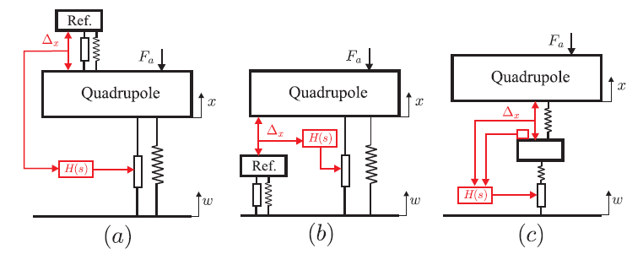
5.16.4 Stabilization concept
Choice of the stabilization concept (stiff, fully active) through comparison different strategies
Advantages/ disadvantages analysis
Robustness of stabilisation system against technical noise

Slide 7
5.16.5 Technical description
5.16.5.1 Sensors
5.16.5.2 Actuators
5.16.5.3 Real-time controller
5.16.5.4 Quadrupole dynamics
5.16.5.5 Quadrupole stabilization

Slide 8
5.16.5 Technical description
5.16.5.1 Sensors
List essential technical requirements
Broadband seismometers: short description
Transfer function
Obtained resolution and system noise, coupling between directions,...
Temperature sensitivity

Slide 9
5.16.5 Technical description
5.16.5.2 Actuators
Technical requirements >> choice of piezo actuators
Technical specification piezo actuator + amplifier

Slide 10
5.16.5 Technical description
5.16.5.3 Real-time controller
Sampling speed/ bandwidth/ anti aliasing
Requirements ADC and DAC noise
Requirements latency + determinism
Controller design

Slide 11
5.16.5 Technical description
5.16.5.4 Quadrupole dynamics
Technical requirements actuating support >> stiff parallel structure with flexural joints.
Orientation legs, resolution, stiffness, forces, kinematics
Pairs of inclined legs + sensor
Selection degrees of freedom >> x-y guide blocked in longitudinal + roll
Conceptual drawing support

Slide 12
5.16.5 Technical description
5.16.5.5 Quadrupole stabilisation
Control law combining above elements.

Slide 13
5.16.6 Experimental validations
5.16.6.1 Test bench 1
Scaled single degree of freedom system
(membrane)
Results stabilisation + nano positioning
5.16.6.2 Test bench 2
Tripod and “quadruped” Two degrees of freedom with equivalent mass
Results stabilisation + nano positioning
Remark: possibility to add results test bench 1 and test bench 2after the first draft.
possibility to add results full quadrupole type 4 until March 2011.

Slide 14
5.16.7 Technical issues
5.16.7.1 Compatibility with accelerator environment
Radiation, magnetic field, integration
5.16.7.2 Compatibility with the alignment stage
5.16.7.3 Other technical issues
! Temperature stability air
Transportability
Machine protection
Power consumption

Slide 15
5.16.8 Component inventory
5.16.8.1 Table
5.16.9 Cost considerations
Cost drivers + availability components ?
5.16.10 Outlook for Technical Design Report phase
Alternative options + results (Lavista option)
Optimisation mechanical design
Customisation electronics
Improvements components (sensors !, actuator resolution)

