Slide 1
CLIC
Stabilization day #10
CERN
14 September 2010

Slide 2
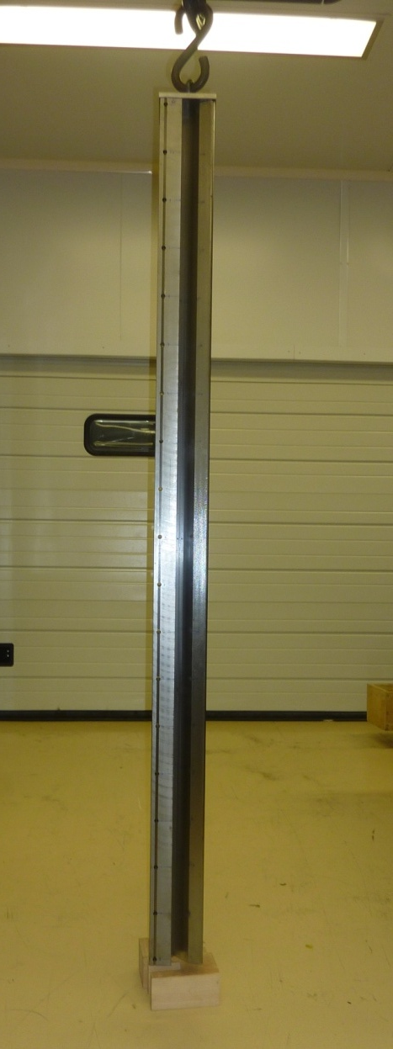
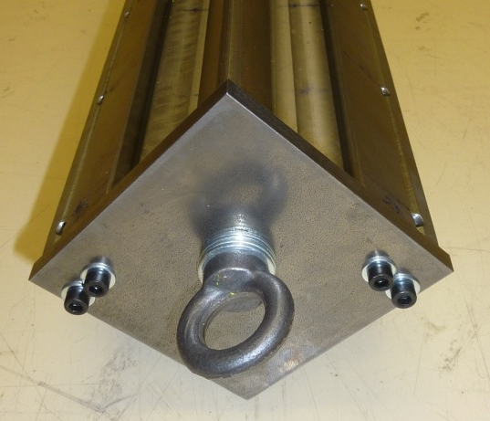
Type 4 pole :
Eigen modes measurements
  Experimental set up :
Boundary conditions :
Experimental set up as close as possible to boundary free conditions
Pole suspended through an interface plate
Anchoring point located at section center of gravity

Slide 3
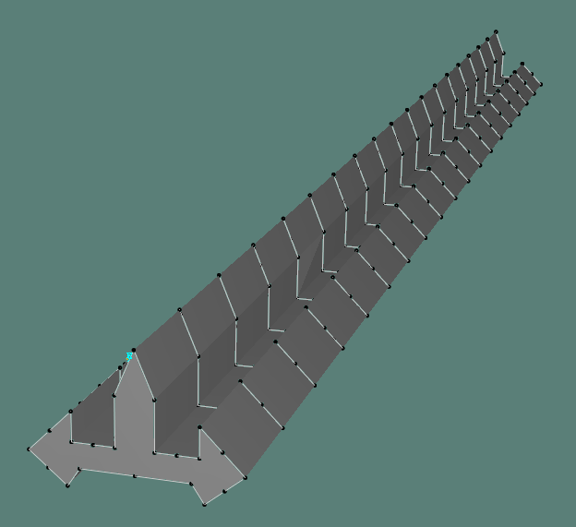
Eigen modes measurements
  Experimental set up :
Acquisition system and sensors :
Pulse (B&K-3560-B020 + B&K-3560-C)
Tri-axial accelerometers (B&K-4524) x3
Impact hammer (B&K-8207)
Geometry representation & measurement points :
19 sections along the pole
9 measurement points on each section
Impact point on pole tip at half length
2 orthogonal impacting directions
Frequency response functions :
5 averages / measurement sequence
Frequency range 0 to 800 Hz

Slide 4
Eigen modes measurements
  Results :
Mode | Experimental frequency (Hz) | Modal Damping (%)
1 | 115 | 0,373
2 | 205 | 0,188
3 | 272 | 0,067
4 | 306 | 0,141
5 | 529 | 0,049
6 | 548 | 0,055
7 | 568 | 0,182
*Clic main beam quadrupole : Eigen mode computation (p 11)

Slide 5
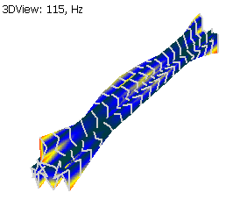
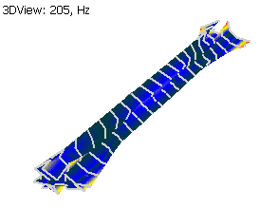
Eigen modes measurements
  Deformed shapes :
Mode 1
Mode 2

Slide 6
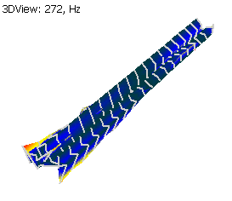
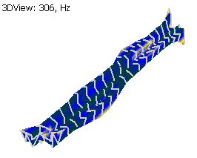
Eigen modes measurements
  Deformed shapes :
Mode 3
Mode 4

Slide 7
FEA / measurements comparison
  Results :
Mode | Experimental frequency (Hz) | Computed frequency (Hz)* | Error %
1 | 115 | 114 | 0,87%
2 | 205 | 212 | 3,36%
3 | 272 | 278 | 2,18%
4 | 306 | 306 | 0,00%
5 | 529 | - | -
6 | 548 | - | -
7 | 568 | - | -
*Clic main beam quadrupole : Eigen mode computation (p 11)

Slide 8
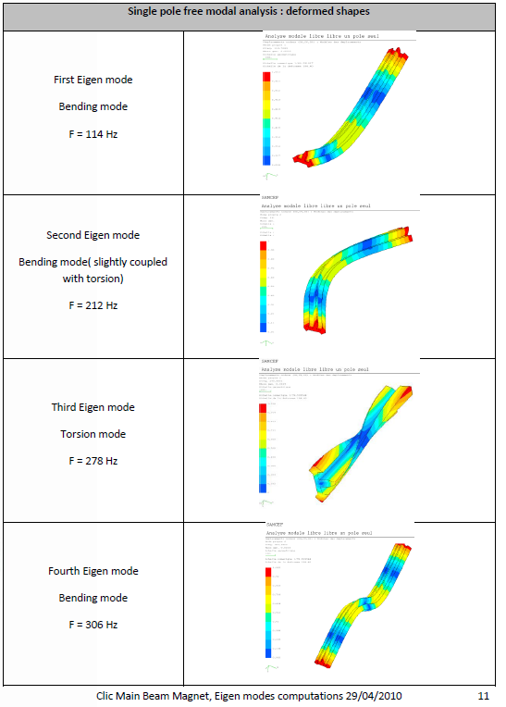
FEA / measurements comparison
115 Hz
205 Hz
272 Hz
306 Hz

