Slide 1
Cam based system for CLIC main beam quadrupole pre-alignment – status, 1 DOF tests and next steps
Juha Kemppinen
Hélène Mainaud Durand
Friedrich Lackner

Slide 2
About me
M.Sc in Tampere University of Technology
  Major: Machine automation (mechatronics)
  Minor: Electronics
CERN Technical Student 2/2009-3/2010
  M.Sc Thesis in EN-HE Group
  Supervisor Keith Kershaw

Slide 3
CLIC MB Quad pre-alignment
CLIC requirements
  Rigid support, low vertical dimension
  High first Eigenfrequency of supporting structure
  Low Friction in contact points
  Simple kinematics
  Low amount of internal degrees of freedom
Hexapod structures not enough rigid
Wedge systems have too high contact friction
Cam based system was chosen for further studies

Slide 4
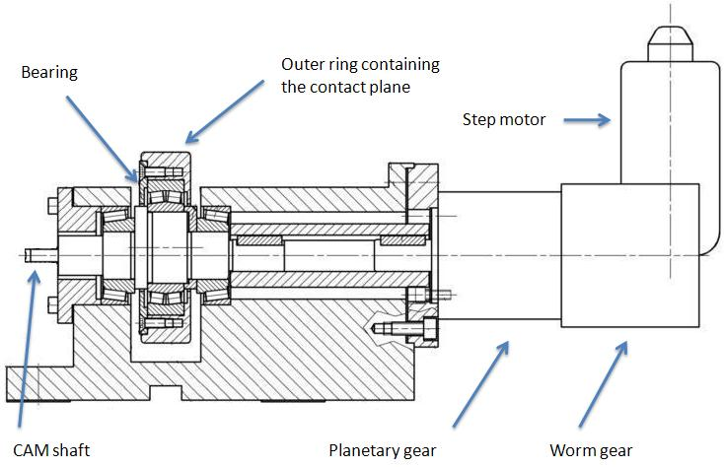
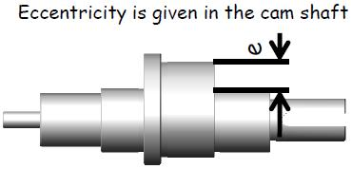
Cam mover (PSI/SLS)

Slide 5
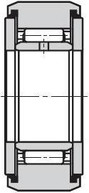
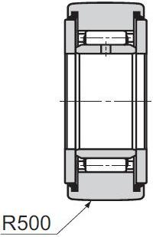
Cam mover
The PSI/SLS cam mover design was tested in 1 DOF mock-up with the original spherical bearing as well as with two optional bearings
  IKO Cam roller follower with cylindrical and crowned outer ring

Slide 6
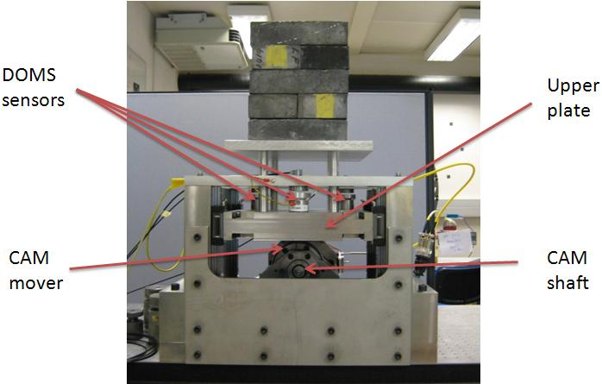
1 DOF mock-up

Slide 7
1 DOF mock-up
Load weight 135 kg
Upper plate’s vertical position measured using 3 capacitive DOMS sensors
  Sensor resolution 0.1 µm
Motor ambient temperature and room temperature measured
  Pt100
Open loop control with motor steps as reference
  Absolute or relative

Slide 8
1 DOF tests - objectives
CLIC specifications more stringent than in existing facilities
  Does cam based system meet CLIC specifications in 1 DOF?
Cam mover repeatability on full stroke
Effect of bearing and outer ring shape on cam mover repeatability
  Bearing stiffness, clearances
Inverse kinematics wasn’t used
  Accuracy wasn’t tested (only precision)

Slide 9
1 DOF tests
Most of the tests were carried out by driving the cam mover between two fixed positions
  Data acquisition after each movement
Preliminary tests were carried out with all three configurations to find best:
  Number of data acquisitions
  Number of tests in a series
  Settling time
  Speed

Slide 10
1 DOF tests – full stroke repeatability
One test sequence from the upper plate’s highest position to the lowest position and back
20 stops per direction (40 per test sequence)
  Measurements during the stops
  Always move the same amount of steps between stops
10 test drives in a series
Analysis: mean value and RMSE between the same measurements of every test drive
  RMSE: sample standard deviation with Bessel’s correction

Slide 11
1 DOF tests - results
Vertical positioning repeatability on full range was less than 1 µm for all three configurations
The best results (0.3 µm RMSE) were attained with configuration 2
  Cam roller follower with cylindrical outer ring
Even better results when only partial stroke was used

Slide 12
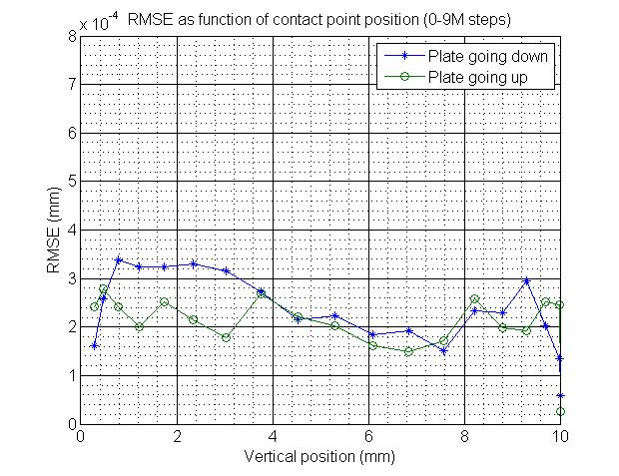
1 DOF tests – full range repeatability (cam roller follower with cylindrical outer ring)

Slide 13
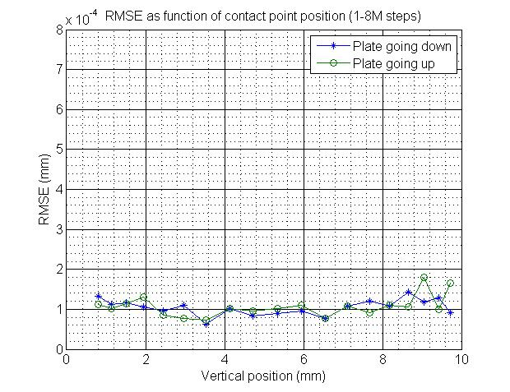
1 DOF tests – partial range repeatability (cam roller follower with cylindrical outer ring)

Slide 14
1 DOF tests - results
Hysteresis ~ 50 µm
Some drifting on long test series
  Few µm, temperature dependent
The repeatability is better when the cam is driven upwards than downwards
None of the three configurations was clearly better than the others
  Sub-micron repeatability can be achieved with all of them

Slide 15
1 DOF mock-up - limitations
Temperature in laboratory varied during the tests
Lack of encoder
Measurement of the 1st Eigenfrequency did not succeed
Resolution/precision of capacitive sensors?

Slide 16
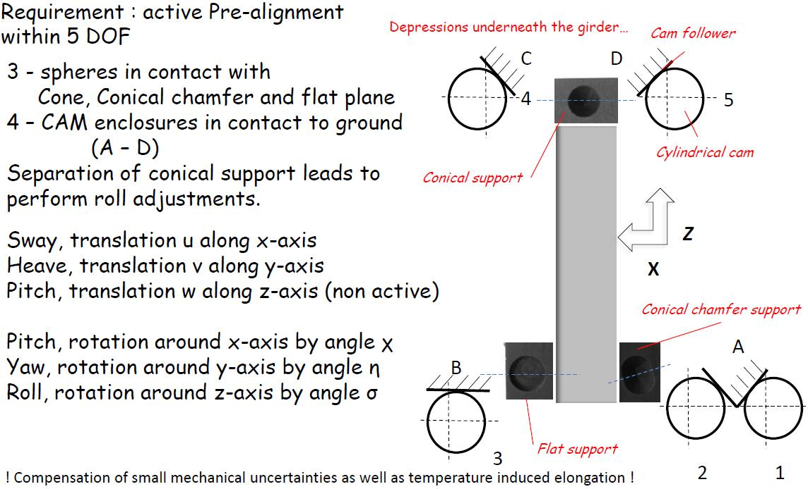
Next steps – 5 DOF mock-up

Slide 17
Next steps – 5 DOF mock-up
Dedicated to pre-alignment
To validate the cam based repositioning concept (resolution < 1 µm)
To measure the support’s Eigenfrequencies
  Compatibility with stabilization requirements
To test and develop repositioning algorithm
To test and compare 2 types of cam bearings
Will be placed in building 927 in CERN Prevessin site

Slide 18
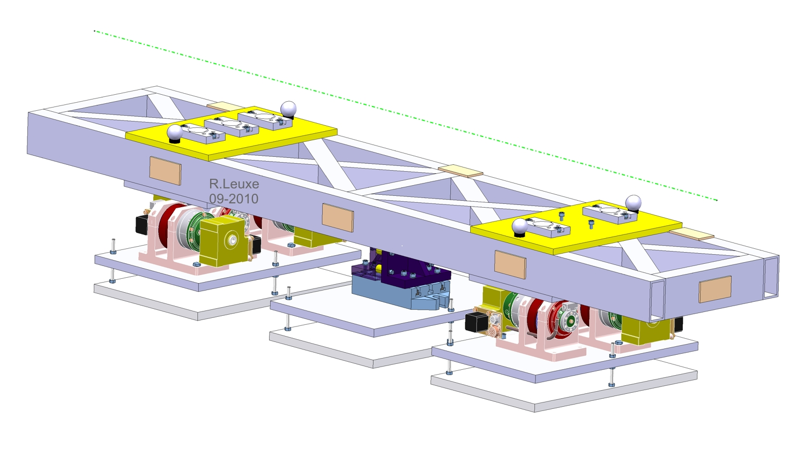
Next steps – 5 DOF mock-up
Interface plate
  Provides stiffness
  < 1 µm deformation on self weight in the center

Slide 19
Next steps – 5 DOF mock-up
After a market survey, ZTS VVU Kosice was chosen as the supplier of the cam movers
Lots of optimization iteration was performed on the cam movers to reach the final design
  Space and assembly restrictions
  Stiffness
  Vibrations
  Etc.

Slide 20
Next steps – 5 DOF mock-up
Cam movers from ZTS VVU Kosice
  Gearboxes optimized for the system to reduce backlash and improve accuracy
 | 1 DOF mock-up | 5 DOF mock-up
Step motor | Oriental Motor PK 268-E2.OB | SX 16-503D
1st gearbox | Gysin GSR025-05 5:1 Backlash ≤ 30 arcmin | Bonfiglioli VF30N-60 60:1 Backlash = 30±10 arcmin
2nd gearbox | Gysin GPL090-3 144:1 Planetary gear Backlash ≤ 50 arcmin | Spinea TS 80-i-E 85:1 Harmonic drive Zero backlash

Slide 21
Next steps – 5 DOF mock-up
Schedule
  Delivery of the 5 cam movers → mid November
    Validation tests before delivery
  Mock-up ready → before Christmas
  Repositioning algorithm tests → February 2011
  Validation of the concept → April 2011

Slide 22
Next steps – compact cam mover
Length of type 1 MB Quads is only 50 cm (type 4 is 200 cm)
  More compact cam based repositioning solution needed
Schedule
  Design → January 2011
  Prototype delivery → mid 2011
Optimization of interface plates
  Both type 1 and 4

Slide 23
Credits
Hélène Mainaud Durand
Friedrich Lackner
  Cam mover design optimization
  1 DOF mock-up
Raphaël Leuxe
  MB Quad interface plate design
Michel Rousseau & Sylvain Mico
  1 DOF mock-up realization

Slide 24
Thank you!
Questions & comments?

Slide 25
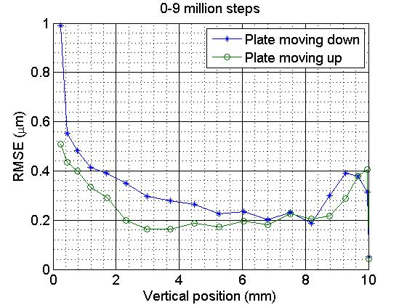
1 DOF tests – full range repeatability (spherical bearing with cylindrical outer ring)

Slide 26
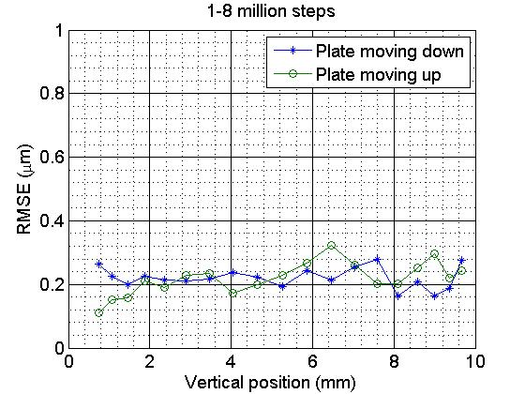
1 DOF tests – partial range repeatability (spherical bearing with cylindrical outer ring)

Slide 27
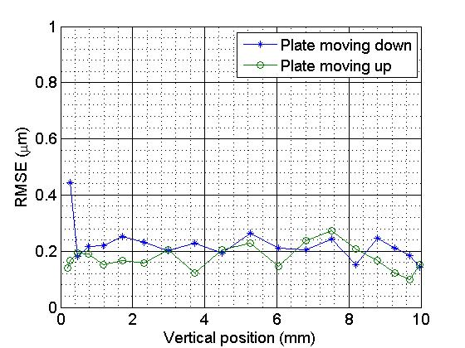
1 DOF tests – full range repeatability (cam roller follower with crowned outer ring)

Slide 28
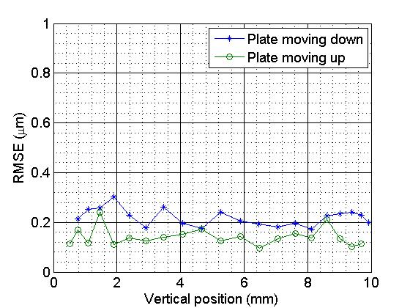
1 DOF tests – partial range repeatability (cam roller follower with crowned outer ring)

Slide 29
1 DOF mock-up
DOMS 1
DOMS 23 = (DOMS 2 + DOMS 3) / 2
CP = (DOMS 1 + DOMS 23) / 2
CP
DOMS 2
DOMS 3
DOMS 23

