Slide 1

14/09/2010
LAViSta
First tests of the LAPP’s support system
LAPP
Laurent Pacquet
Guillaume Deleglise
Jean-Philippe Baud
Andrea Jérémie
Symme
Ronan Le Breton
Adrien Badel
Jacques Lottin

Slide 2
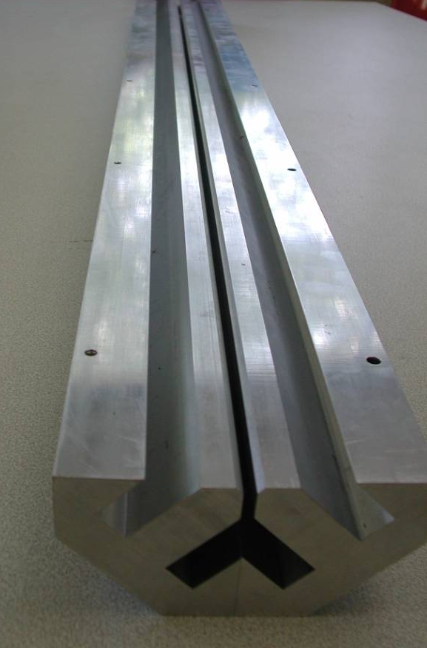
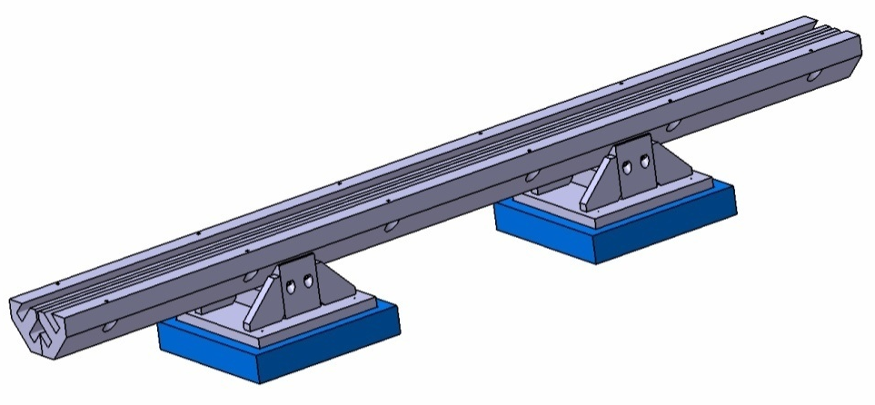
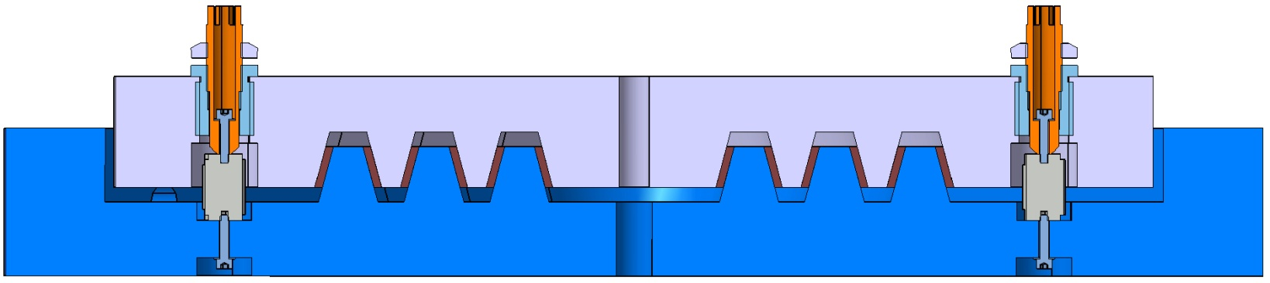
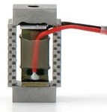
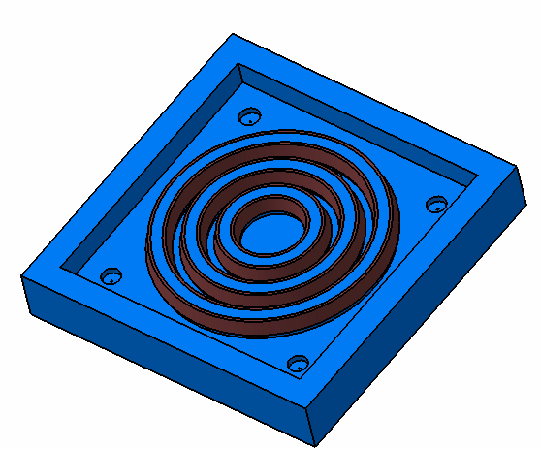
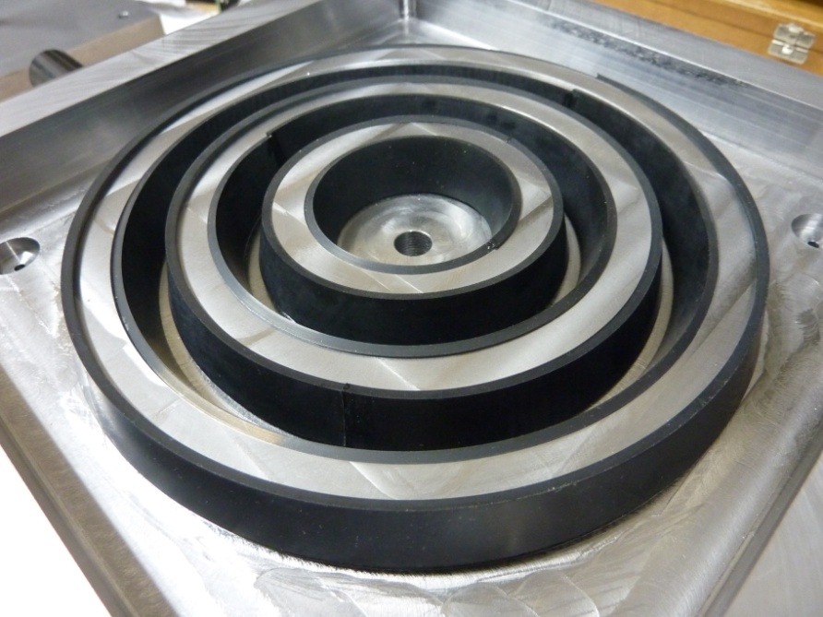
The active support
mid-lower magnet
1355mm
parallelism tuning
53mm
elastomeric joint
base
piezo
actuator
200mm
200mm
Notes:
lets remind reminde
function ball joint to avoid shearing on piezoelectric material
pièces mâle / femelle
2 supports

Slide 3
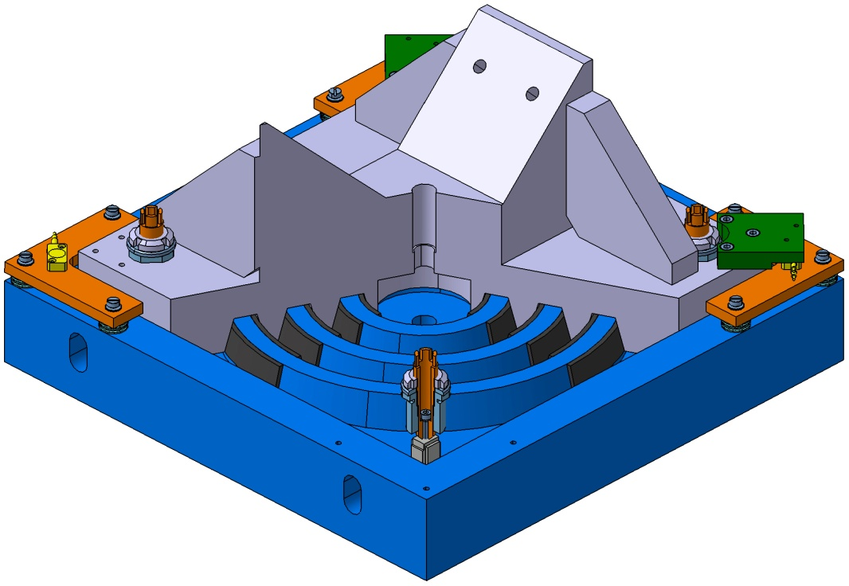
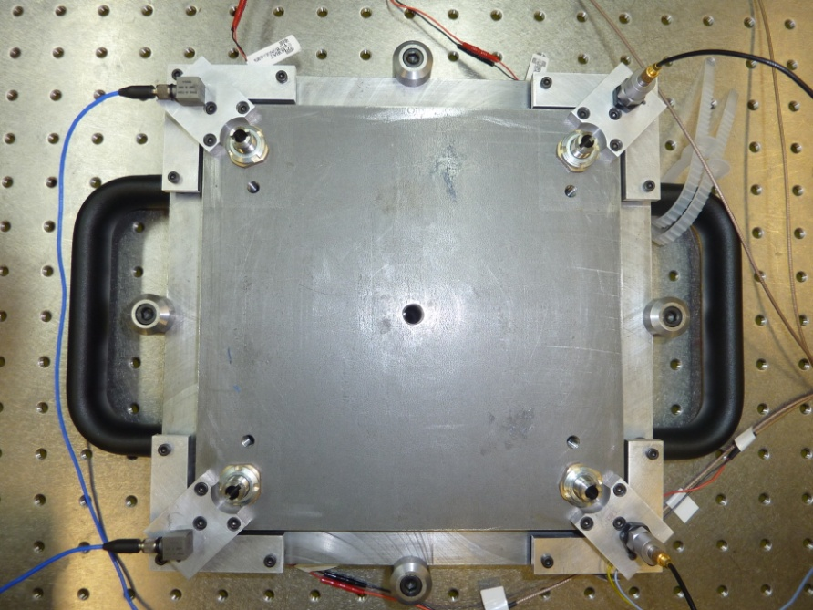
Active system principle
lower electrode of the capacitive sensor
V-support for the magnet
elastomeric strips for guidance
carrying handles
fine adjustments for capacitive sensor (tilt and distance)
piezoelectric actuator below its micrometric screw
micrometric screws in contact with the actuators

Slide 4
Control strategy
piezo
geophone
Stabilized platform
geophone
Base
ground
Capacitive sensor
For feedback control, at least one sensor is required: (upper geophone)
The capacitive sensors give additional information for better control of the actuators elongation
If the lower geophone and the capacitive sensor is used, then the upper geophone is redundant

Slide 5
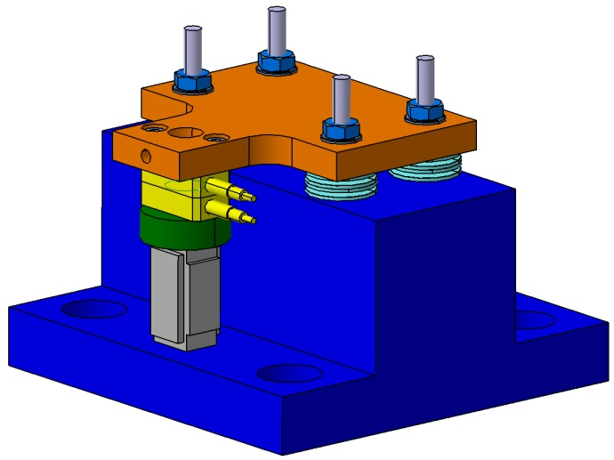
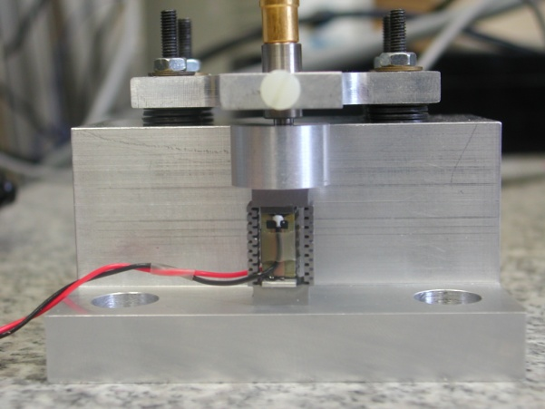
Intermediate
experimental setup
Capacitive sensor PI D-015.00 - 2 sensitive electrodes
Measuring range / voltage | 15 µm / 10 V
Noise at 100 Hz | 1.75 pm/√Hz
Resolution at 3 kHz | 0.075 nm
Linearity | ± 0.05%
Size (each electrode) | 15 x 8 x 4
Piezoelectric actuator Cedrat PPA10M
Maximal displacement | 8 µm
Voltage range | -20 V -> 150 V
Resolution | 0.08 nm
Stiffness | 100 N/µm
Max load | 800 N
Size | 10 x 10 x 18
50mm
70mm
Notes:
This is an intermediate experimental setup used to characterize piezo-actuators and sensors

Slide 6
Experimental setup – measures -
-> data (in blue) well fit with the factory’s calibration data (black plot)

Slide 7
Measurements with the Cedrat actuator
Driving voltage = 20 mVpp
Measured displacement = 0.7 nm
Measurement noise = 0.1 nm
Roughly egal to the sensor noise
Critical point :
to reach a resolution of 0.1 nm, a clean driving voltage in the order of 1mVpp has to be generated
Notes:
&a

Slide 8
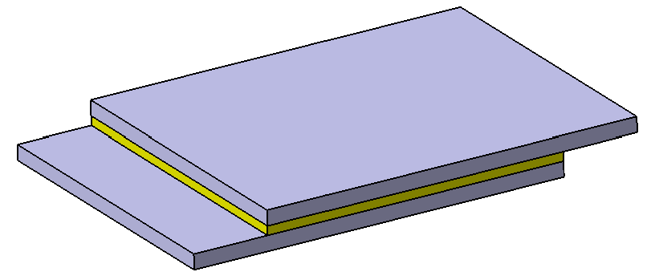
Measurements with the home-made actuator
Driving voltage = 1Vpp
Measured displacement = 0.25 nm
Measurement noise = 0.1 nm
Critical point :
Maximal range: about 40nm

Slide 9
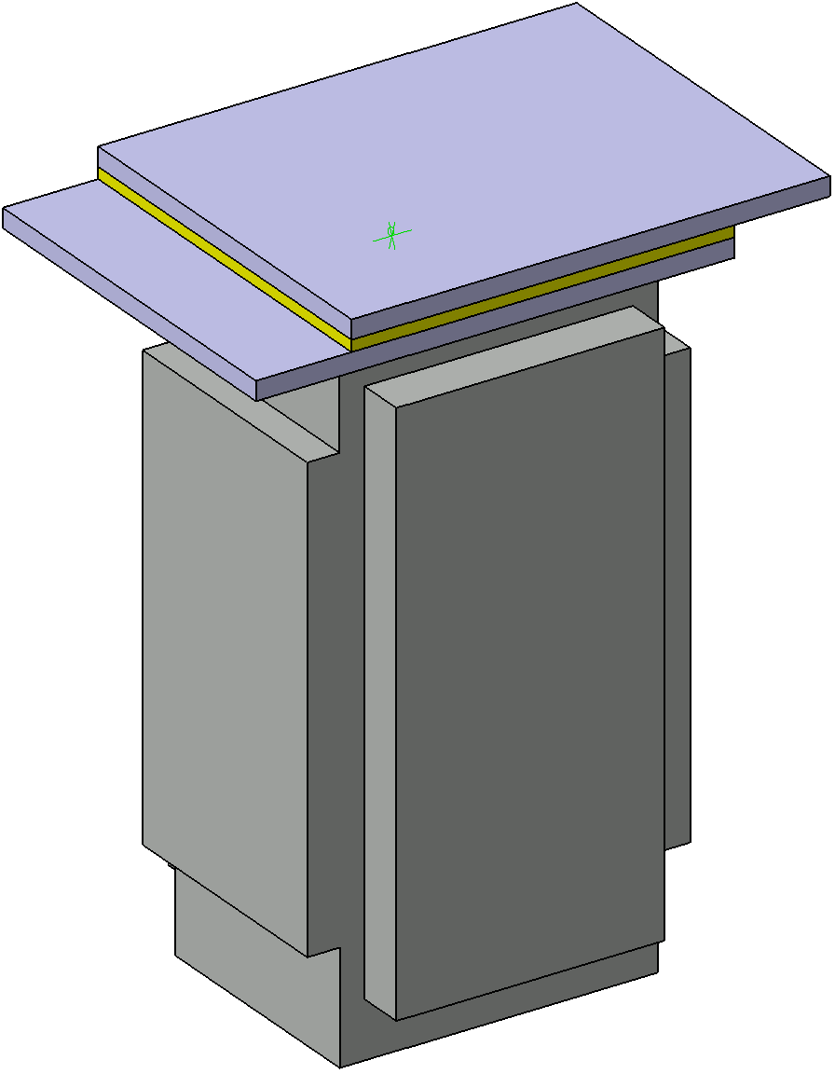
Comparison of both actuators
 | Cedrat PPA10M | Ceramic patch
actuator
size | 10x10x18 | 10x10x0.3 (ceramic)
sensitivity measured | 40 nm/V | 0.25 nm/V
400mV excitation | 16 nm | 0.1 nm
150V excitation | 6 µm | 37.5 nm
Nano-stabilization
Possibility to assemble both actuators to have a larger displacement dynamic.
-> control is more complex to coordinate (two driving voltage)
Micro - positioning

Slide 10
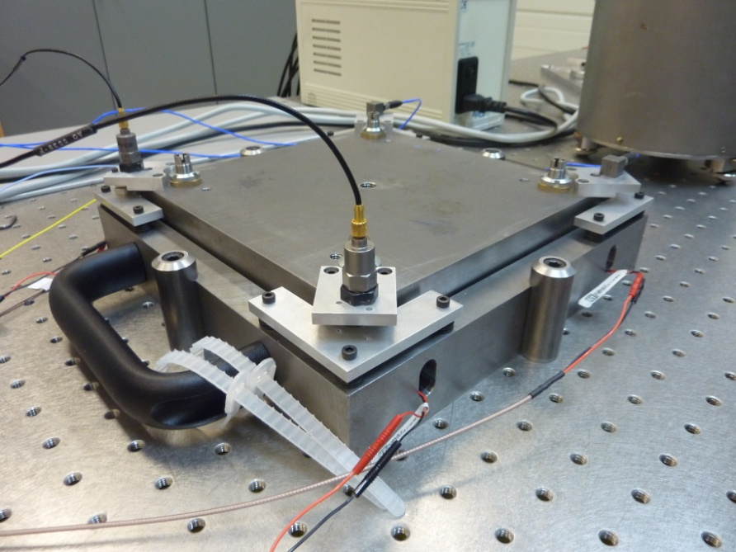
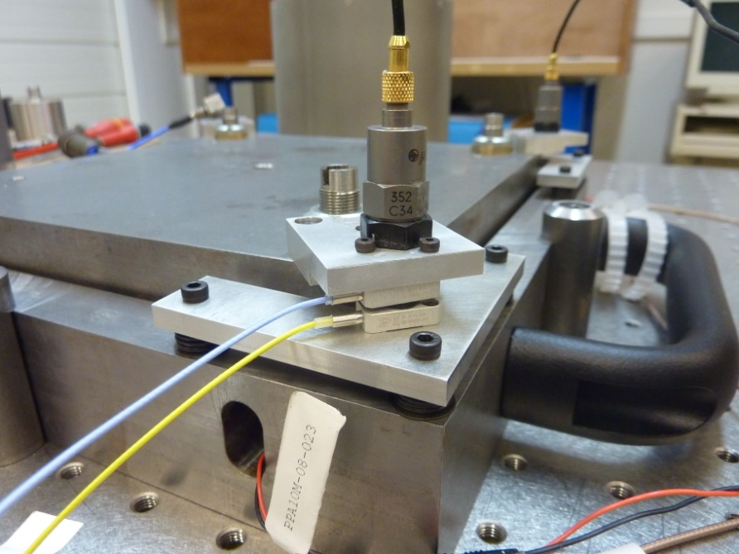
Measurements on the instrumented support
Accelerometric sensor used
 | PCB 352C34 | Bruel & Kjaer
sensitivity [mV/ms⁻²] | 10.02 | 10
frequency range [Hz] | 0.5 – 10 000 | 0.3 - 6000
Experimental conditions :
acquisition rate : 2 kHz
- actuators fed with the same signal, which is a sequence from sinus 1Hz to 100Hz by step of 1Hz ( 0-20V)
accelerometrics signals pass an anti-aliasing filter and are amplified by 40dB, then high-pass filtered at 10Hz by software (poor coherence below)
no filter on capacitive data
- total length recording : about 5 min
4 accelerometric sensors
2 electrodes of the capacitive sensors

Slide 11
Frequency responses of the instrumented support
Signals are coherent
Capacitive sensor has the quickest response

Slide 12
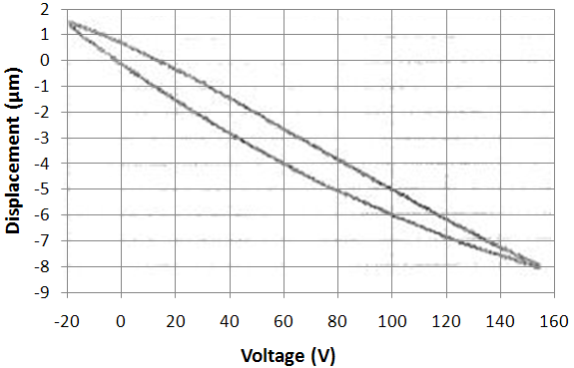
Hysteresis effect
-> Sensibility depends on the operating point
(45nm/V if 10V, 55nm/V with 40V)
-> Implementation of a model of the actuator in the feedback control to counterbalance this hysteresis may be of interest.

Slide 13
Hysteresis compensation in piezoelectric actuator
Hysteresis effect in piezoelectric actuator :
Non linear effect
Asymmetric hysteresis
loop
Sensibility evolves with operating points (30%)
For a given voltage, the elongation depends on the history (ex: [-2.5; -4] at 60V)
×

Slide 14
Hysteresis model
Need for a hysteresis model ?
To obtain a complete model for accurate simulation of the controller
To linearize controller using an inverse hysteresis operator

Slide 15
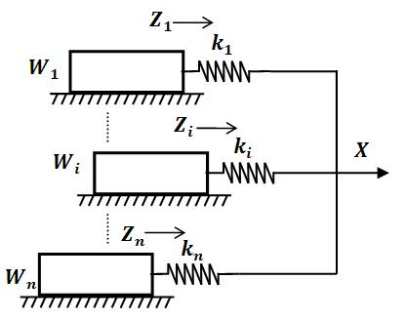
Hysteresis model
How to modelize hysteresis effect?
Generalized Maxwell Slip (GMS)
model of hysteresis (symmetric)
Preisach model (assymmetric)
Other model ?
Representation of the Maxwell-slip model

Slide 16
Preisach model
A weighted combination of elementary relay hysteresis elements : n × (n+1)/2
n: number of step in
the major loop
Used in simulation

Slide 17
Lightweight hysteresis inverse model
A lightweight model [A. Badel]
Asymmetric loops
Only 6 parameters
Easily implementable for the real time inverse model

Slide 18
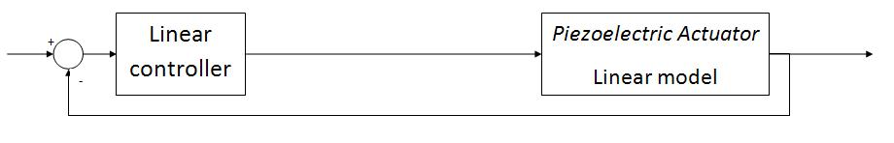
Lightweight hysteresis inverse model

Slide 19
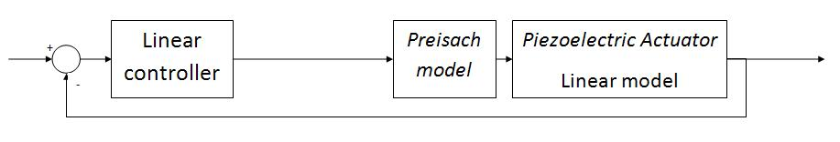
Lightweight hysteresis inverse model
Real model of actuator

Slide 20
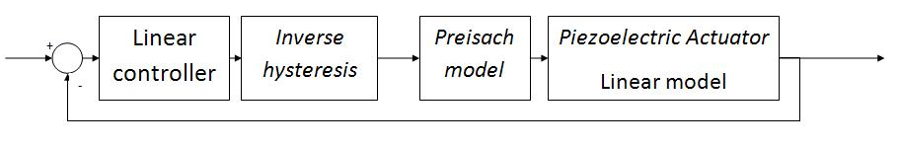
Lightweight hysteresis inverse model
Nonlinear controller
Real model of actuator

Slide 21
Conclusion
Measurement and actuation at the sub-nanometer scale is feasible (at least the measurement of the actuator elongation)
Compromise between actuator range and sensibility is critical. Two stages actuator may be a solution.
Actuator Hysteresis may be a problem (especially for “high” frequencies – still under study)
Real time hysteresis compensation should be feasible

