Slide 1


Optimization of the final focus stabilization
B. Caron, G. Balik, L. Brunetti
LAViSta Team
LAPP-IN2P3-CNRS, Université de Savoie, Annecy, France &
SYMME-POLYTECH Annecy-Chambéry, Université de Savoie, Annecy, France
The 14th September 2010

Slide 2
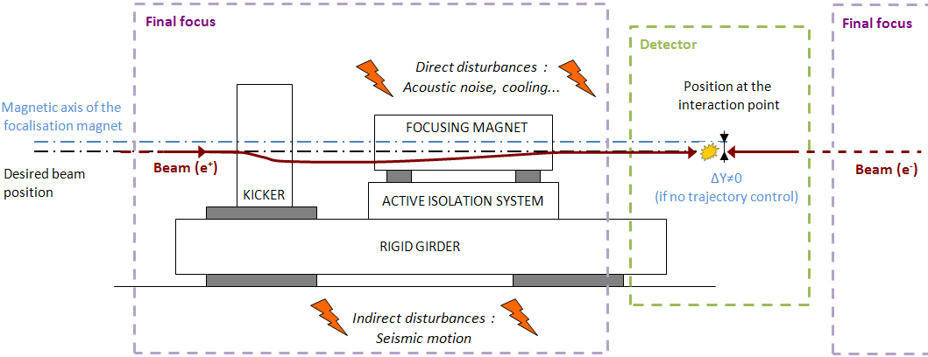
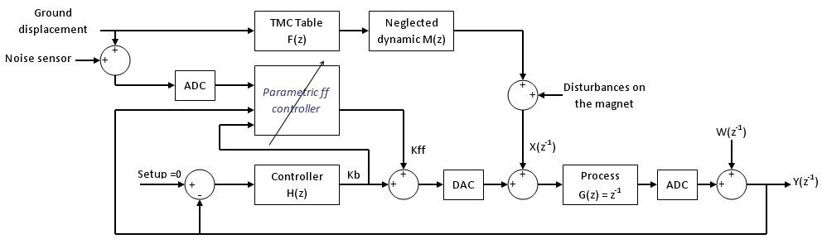
The last status
Global scheme (Feedback (FB) + Feed-Forward ( FF))
Feed
Forward
Adaptive
Control
Parametric controller very sensitive to sensor’s noise
No real benefits using Feed-Forward in simulations
Simulations without Feed-Forward

Slide 3
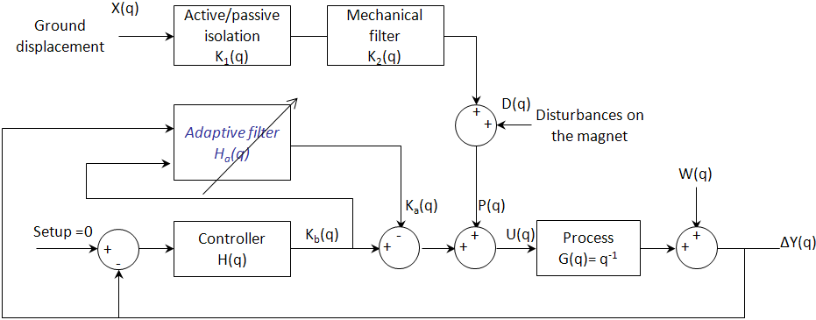
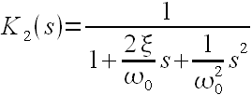
Current design of the controller
Global scheme (FB + Adaptive Filter (AF))
TMC table F(z)
Efficient only for low frequency (<2-3Hz)
Necessity to damp faster motion of the ground
K2: 2nd order low pass filter
ω₀=2πf₀
Ex:
ξ= 0.01
f₀ = 2 Hz

Slide 4
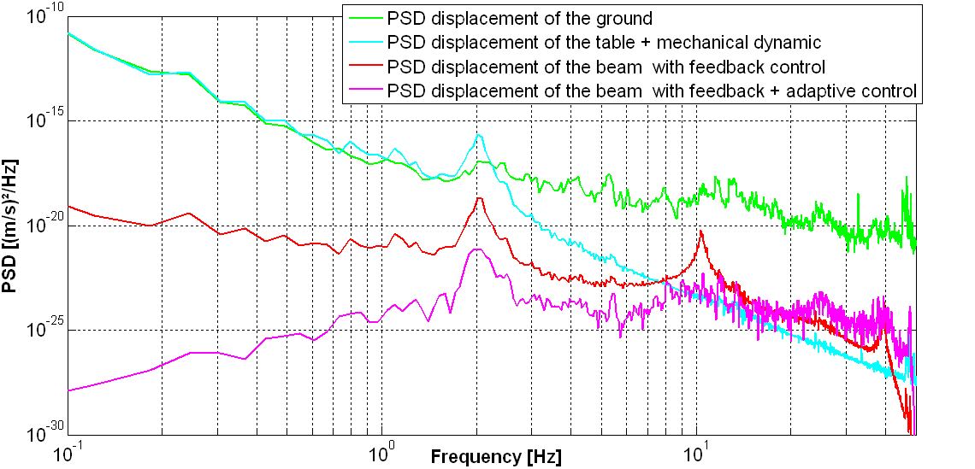
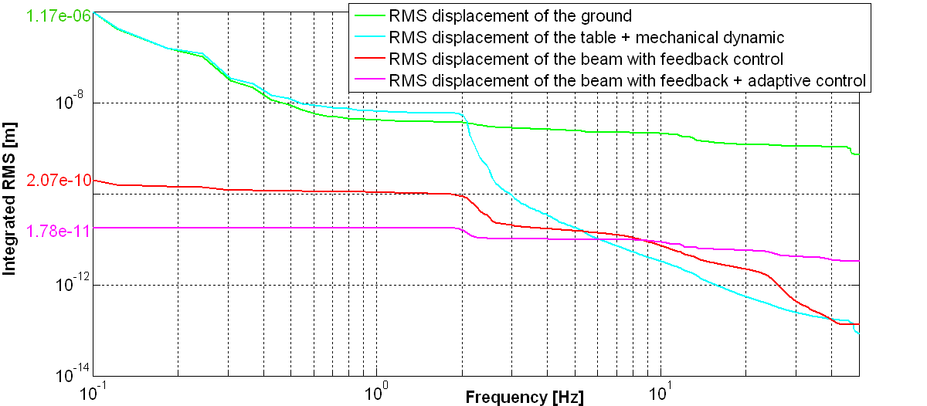
Results
PSD and integrated RMS displacement
PSD [(m/s²)/Hz]
Frequency [Hz]
Robustness
Integrated RMS [m]
Frequency [Hz]

Slide 5
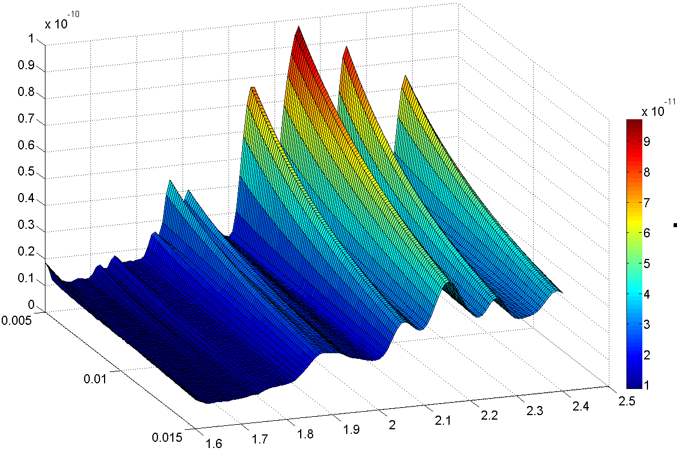
Robustness (Mechanical filter)
Integrated RMS displacement = f(ξ, f₀)
Controller optimized for the PSD of the ground motion filtered by the TMC table + Mechanical support K₂
ξ= 0.01
f₀ = 2 Hz
Integrated RMS [m]
f₀ = f₀ ± 10%
ξ = ξ ± 50%
The worst case:
f₀ = 2.2 Hz
ξ = 0.005
Integrated RMS displacement of the beam 0.1nm @ 0.1Hz
Damping
ratio: ξ
Resonant
frequency: f0 [Hz]

Slide 6

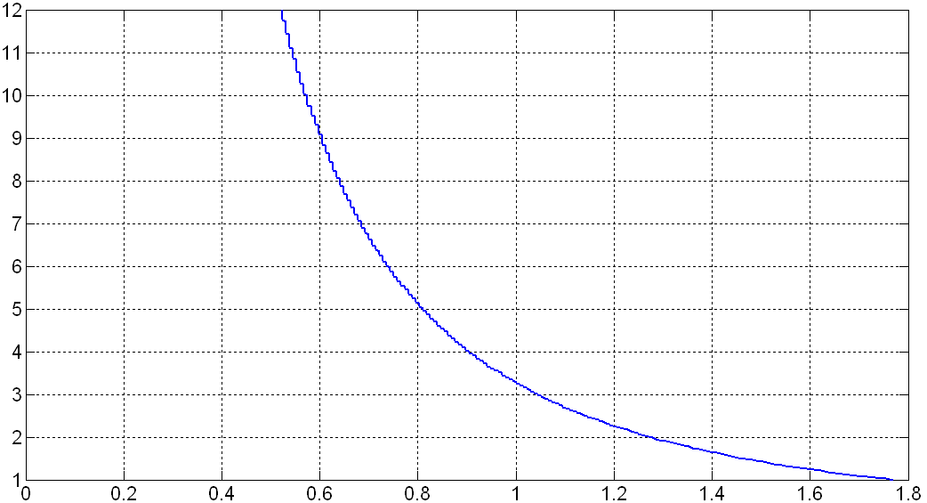
Pattern of a global active/passive isolation
TMC table + Mechanical support = Global active/passive isolation
K₁ K₂ = K_{g}
K_{g}(q)
Static gain G₀
Independent from the damping ratio ξ in the range [0.005 0.7]
Static gain G_{o}
Specification of the future active isolation support
Resonant frequency f₀ [Hz]

Slide 7
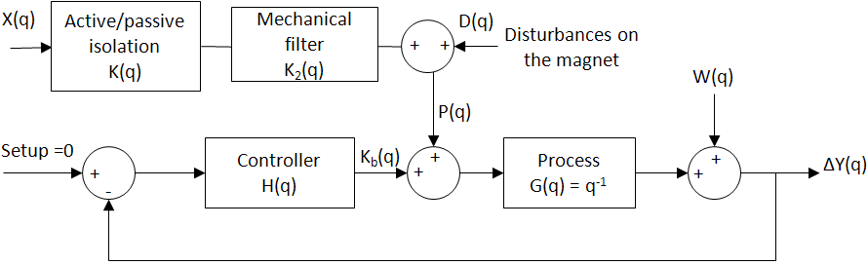
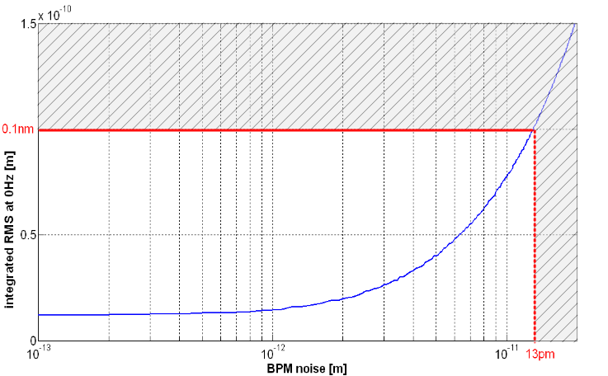
Robustness (BPM noise)
Integrated RMS displacement = f(W)
W: white noise added to the measured displacement
Integrated RMS at 0.1 Hz [m]
BPM noise W [m]
BPM’s noise has to be < 13 pm integrated RMS @ 0.1 Hz

Slide 8
Conclusions
Feedback + Adaptive control:
No Feed-forward => make the configuration easier
Good results
New specification of the active/passive isolation
Algorithm translated into Octave code
Future prospects :
Implementation of the controller under placet/octave

