Slide 1
Feedback design for the BDS
Jürgen Pfingstner
14th of September 2010

Slide 2
Content
The BDS
Analysis of the BDS
Feedback design and results
Summery and future work

Slide 3
1. The BDS

Slide 4
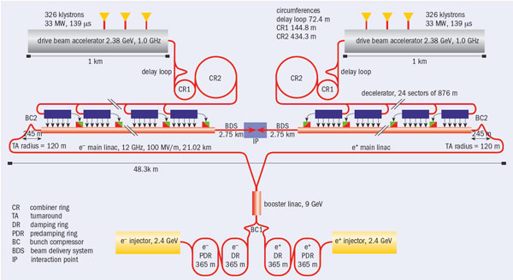
The BDS in the CLIC complex

Slide 5
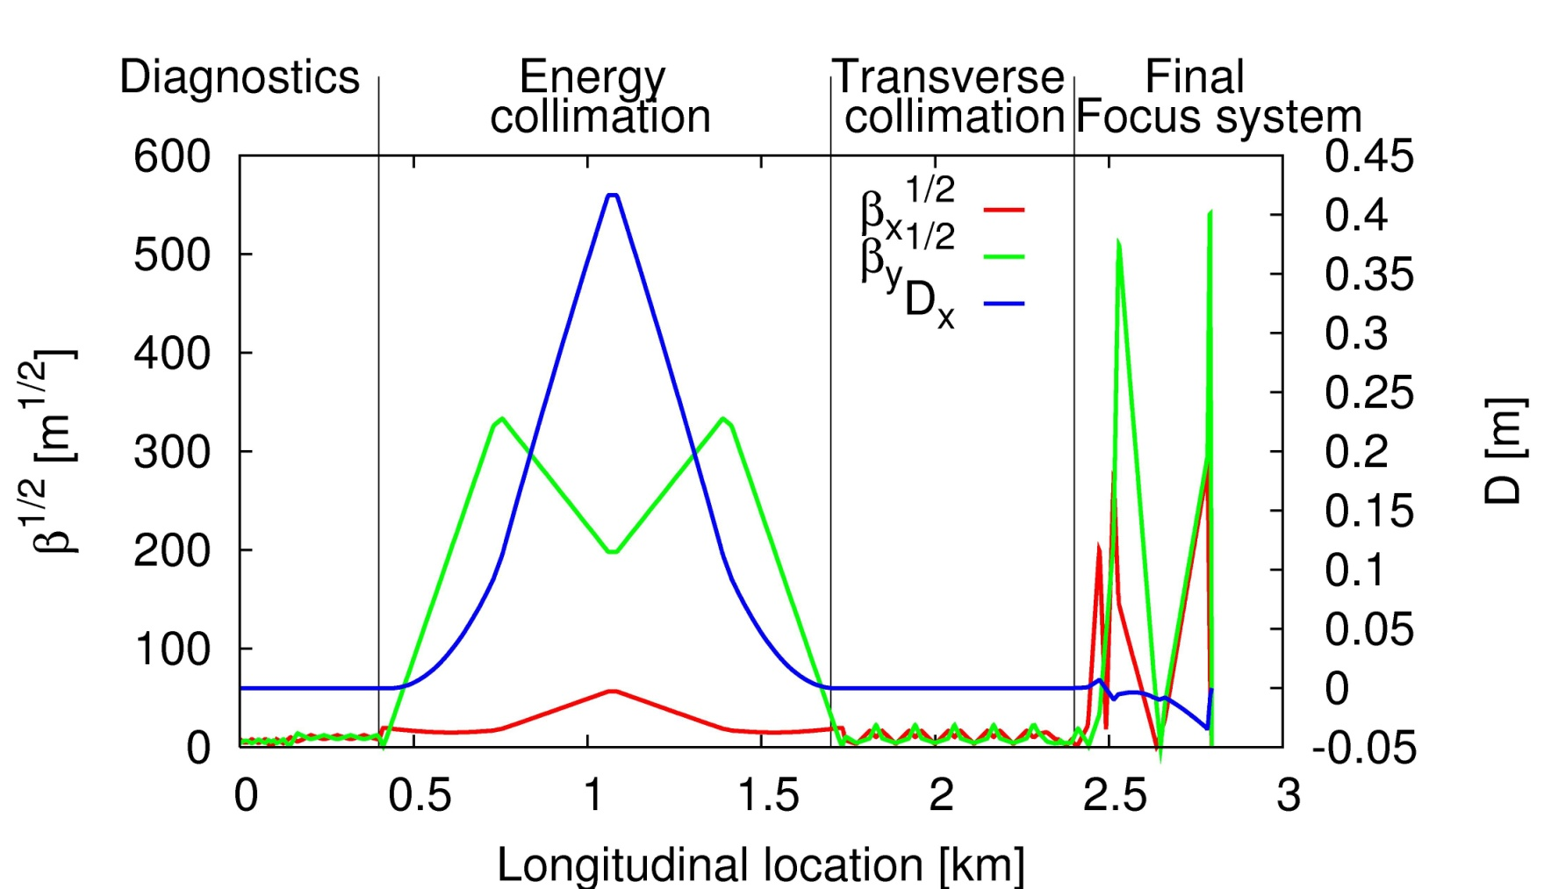
Structure of the BDS
by courtesy of Rogelio Thomas Garcia and Barbara Dalena

Slide 6
Interesting facts about the BDS
Bending magnets act just in the horizontal direction and can be neglected for the vertical feedback.
96 Quadrupoles
16 Sextupoles
112 BPMs
=> 112 x 112 system
Sextupoles are nonlinear elements
=> BDS is nonlinear

Slide 7
2. Analysis of the BDS

Slide 8
How nonlinear is the BDS?
50000 particles are enough
Response matrix should be calculated with a step size of 200 nm
BDS is just slightly nonlinear

Slide 9
How fast is the behavior of the BDS changing? (ATL 50h)
Feedback is changing quite a lot over long time scale

Slide 10
How fast is the behavior of the BDS changing? (ATL 2h)

Slide 11
How fast is the behavior of the BDS changing? (Model B 12s)
Feedback is changing smoothly on short time scale

Slide 12


What should the feedback minimize?
… event rate
… Luminosity for a
Gaussian beam
For Gaussian beam:
and jitter are
good measures
is less relevant
(difference to main linac)
For realistic beam:
only is a good measure
=> GuineaPig
=> Multiplication of beam
with Gaussian profile

Slide 13
Conclusive information for the Feedback design
BDS is nearly linear for small step sizes and over short time ranges
Strong indication that very similar control techniques as for the main linac can be used
The problem of the strong drift over time could be tackled with an on-line system identification algorithm similar to the main linac
=> Strong similarities to the main linac feedback from the beam-based feedback side

Slide 14
3. Feedback design and results

Slide 15
Design principles used
Decoupling of the inputs and outputs
Spatial filtering to reduce the influence of noise
Frequency filtering is based on ATL motion assumption. This will be improved in future designs

Slide 16
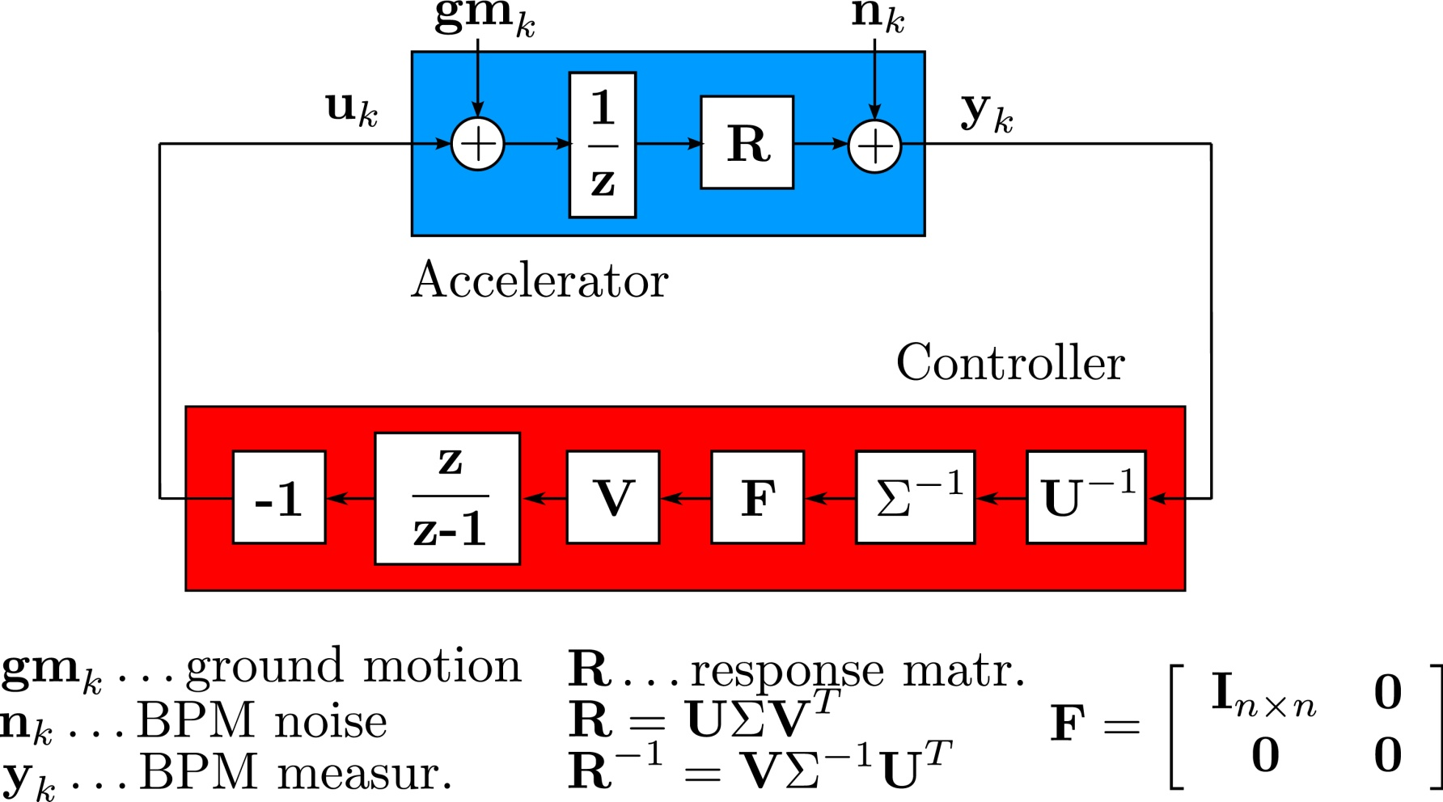
Truncated SVD controller

Slide 17
Reason for the choice of matrix F

Slide 18
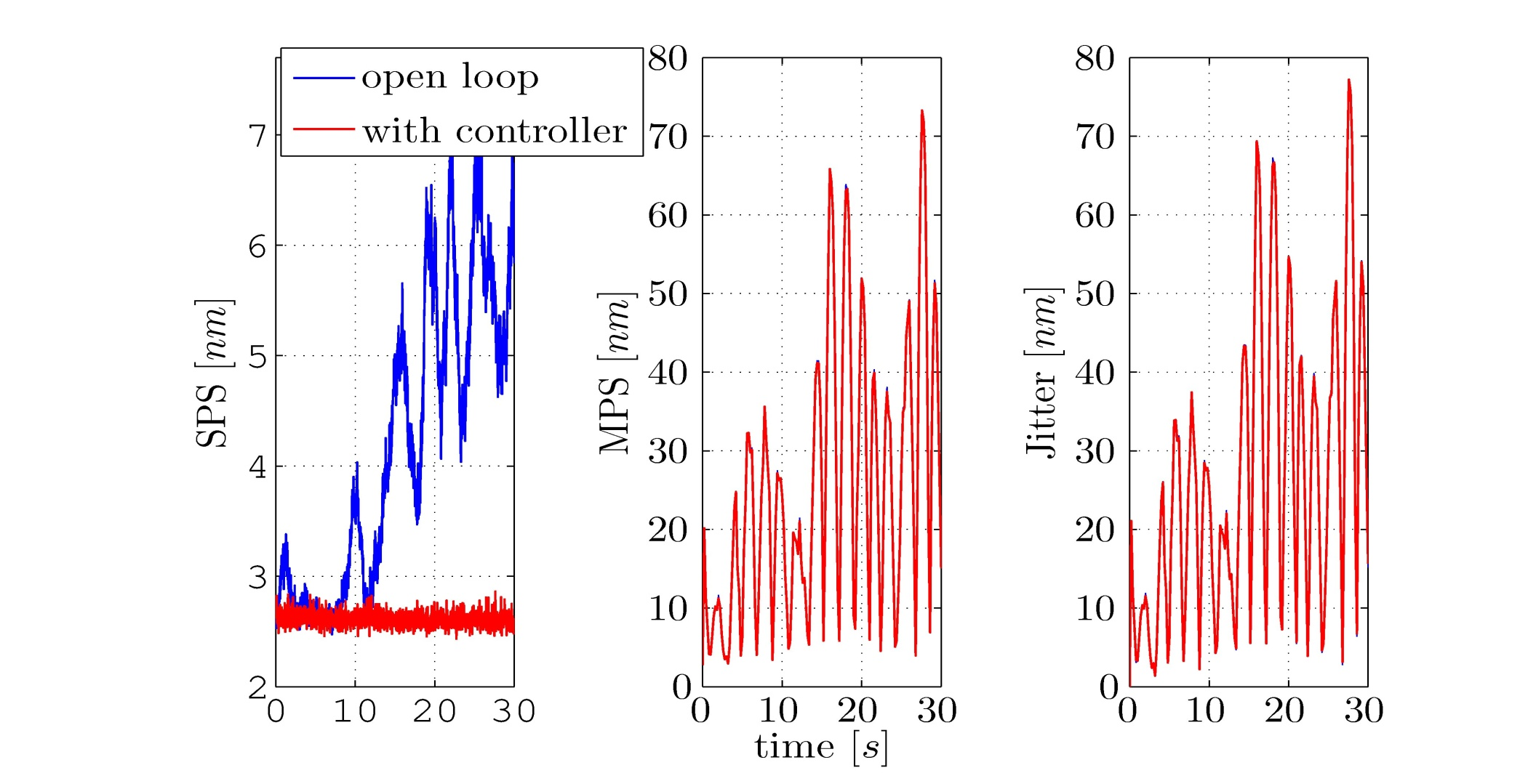
Results: Ground motion mitigation of the control algorithm (sim. in Placet)

Slide 19
Further work
4. Summary
BDS was analyzed with two major results
  => BSD is just moderate nonlinear
  => BDS is changing only slowly over time
Feedback algorithm similar to the feedback of the main linac can keep the RMS beam size on a constant level.
Improving the optimization target from RMS beam size to Daniels luminosity measure
Including mechanical stabilization and IP feedback in the simulations
Optimization of the controller
Robustness studies

Slide 20
Thank you for your attention!

