Slide 1
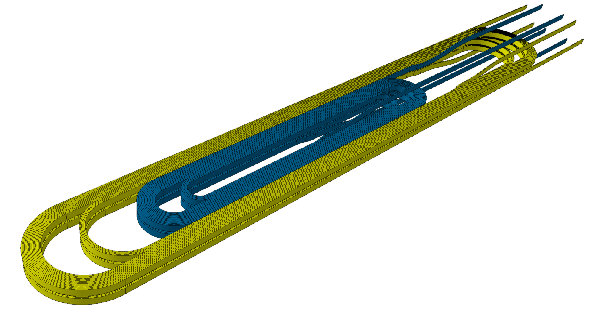

Conceptual Design Review of R2D2
4
- Engineering design -
https://indico.cern.ch/event/1003865/
CEA: M. Durante, E. Rochepault, V. Calvelli, H. Felice,
P. Mallon, P. Manil, G. Minier, G. Maitre, B. Prevet,
S. Perraud, F. Rondeaux
CERN: S. Izquierdo Bermudez, J.C. Perez, D. Tommasini,
J. Fleiter, H. Felice
09/03/2021

Slide 2
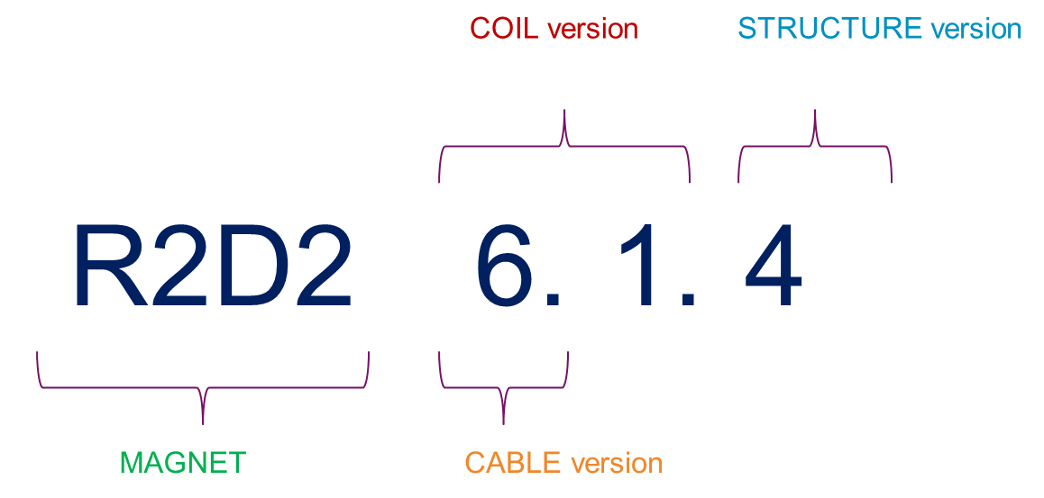
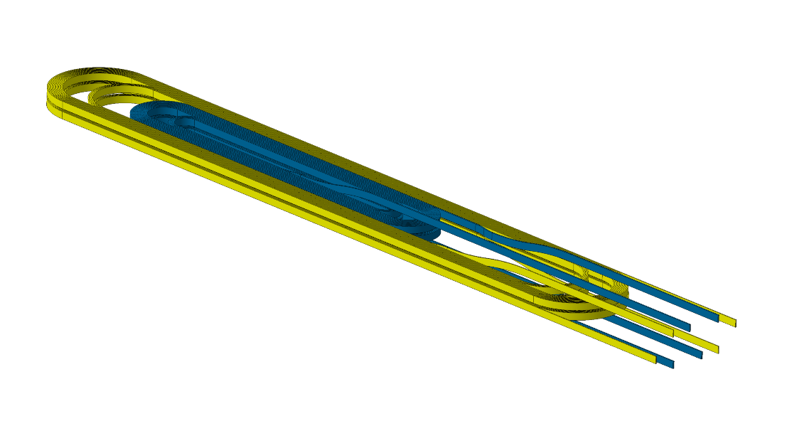


F2D2 ↔ R2D2
F2D2 dipole
L_{tot} = 1400 mm
L_{ss} = 566 mm
4 coils = 4 graded double-pancakes
8 sub-coils (HF/LF)
Double layer
Flared ends
Layer jump + Exit jumps
External joints
R2D2 dipole
L_{tot} = 1300 mm without leads
L_{ss} = 243 mm
2 coils = 2 graded single layer
4 sub-coils (HF/LF)
Single layer
Racetrack
Exit jumps
External joints
1m
F2D2_v8.A
(see 1, E. Rochepault
& 2, V. Calvelli)

Slide 3
R2D2 engineering stakes
How to handle cables in graded coils?
How to ensure longitudinal support?
→ (Unfortunately) R2D2 is not a ‘simplified F2D2’ in all matters (see 2, V. Calvelli)

Slide 4
Cable dimensions
CAD Cable
Section
(margin included)
Virgin, bare
Virgin, insulated
Heat Treated Insulated
Expansion during reaction :
+ 4.6 % thickness
+ 1.3% width
No changes in insulation
0.15
HF
12.58 x 1.97
12.88 x 2.27
13.04 x 2.36
LF
12.58 x 1.25
12.88 x 1.55
13.04 x 1.61

Slide 5
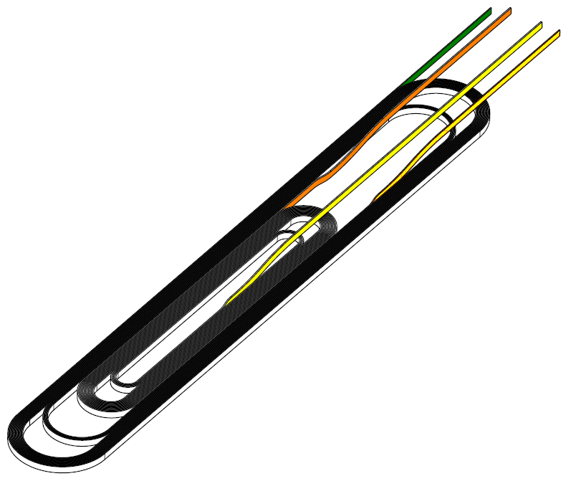

Coil detailed geometry ^{1/3}
Each coil {HF+LF, single-pancake} is designed and fabricated as one impregnated object
1 coil = 2 sub-coils = 2 unit lengths
Splicing is external → Exit jump
F2D2 layer jump design similar to FRESCA2
  HW-bend ‘S-shape’ with EW offset for clamping
  R2D2 has no layer jump but « forerunners »
~336mm
Straight exit LF
Exit jump HF
(replace internal splice)
Layer jump forerunners
FRESCA2
(see 2, V. Calvelli)

Slide 6
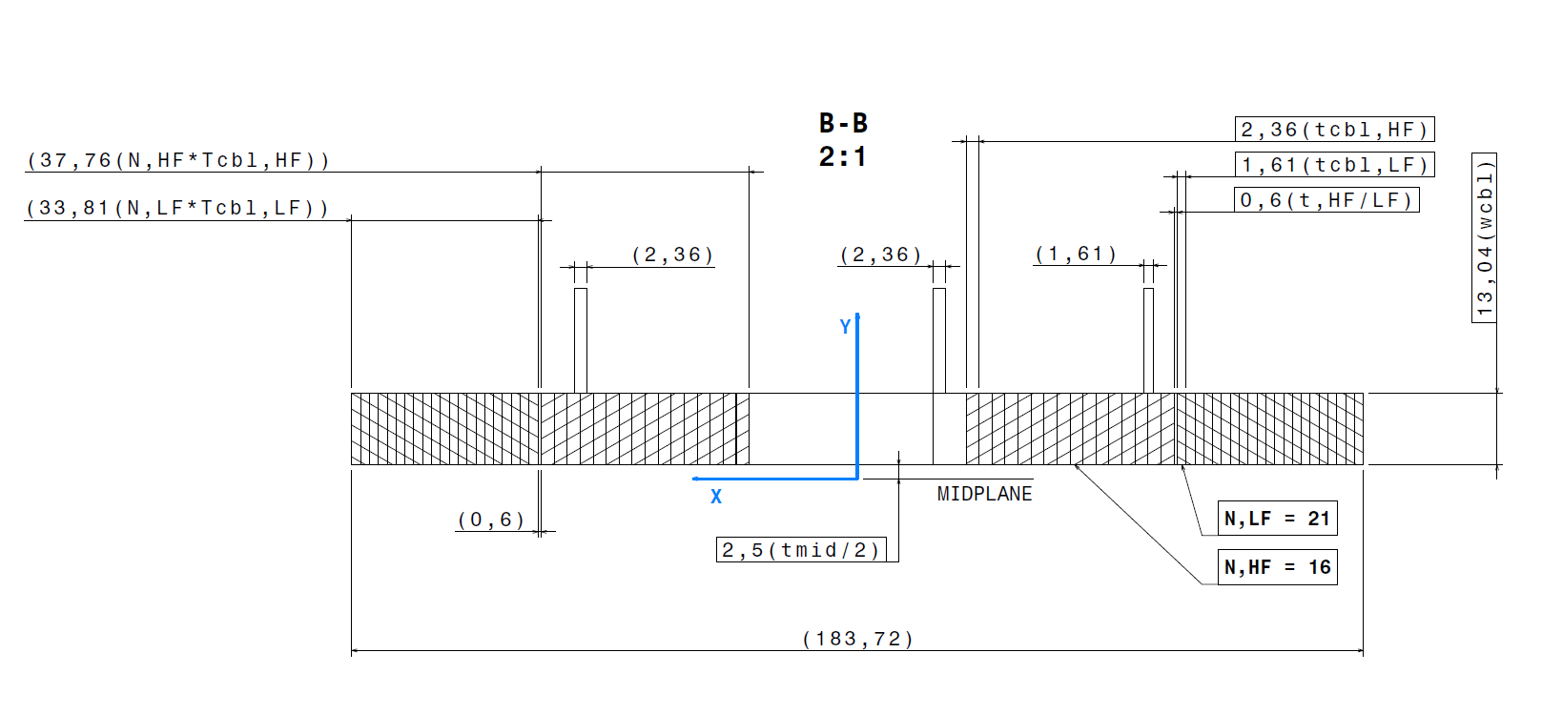
Coil detailed geometry ^{2/3}
Insulated/reacted cables dimensions (w_{HF} = w_{LF} = =w_{cbl})
Magnetic design (see 2, V. Calvelli)

Slide 7
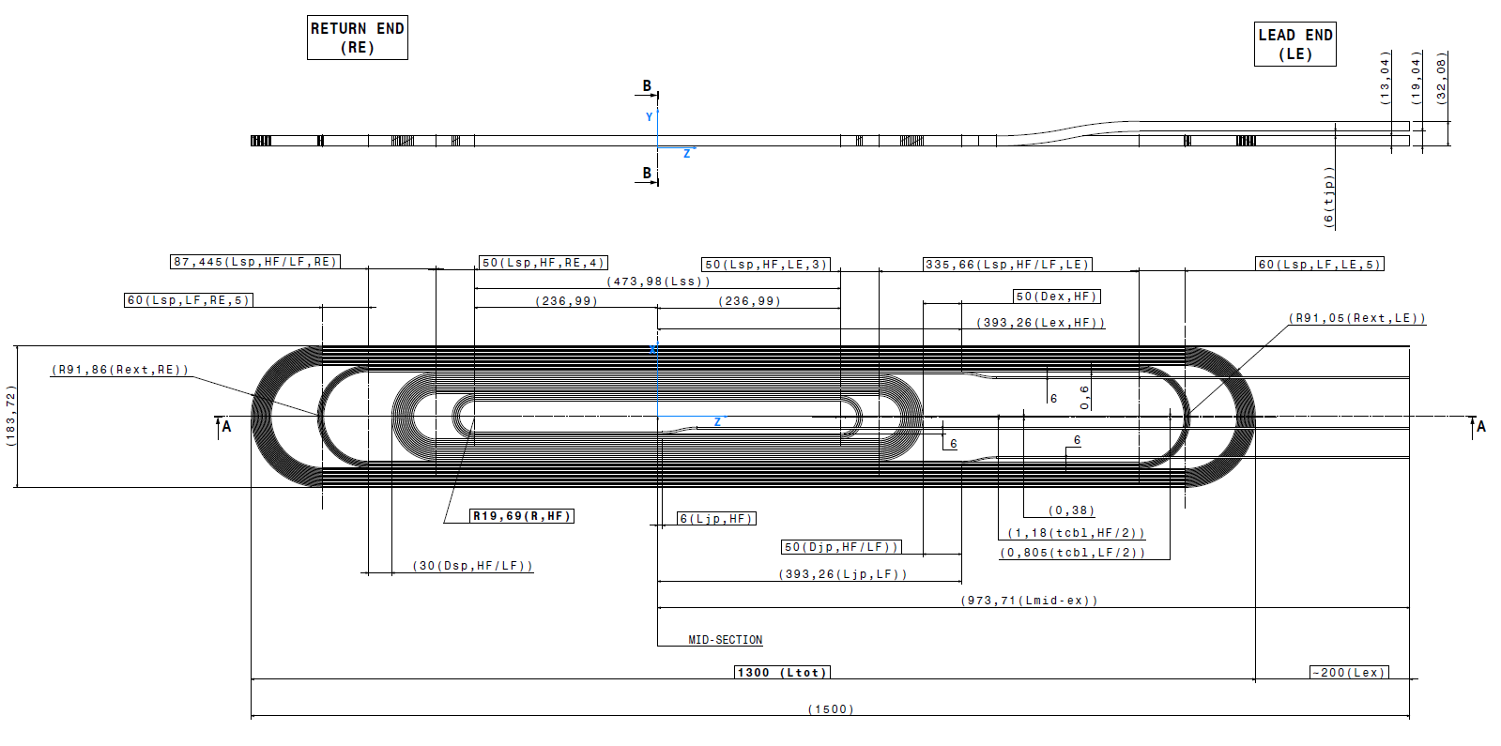
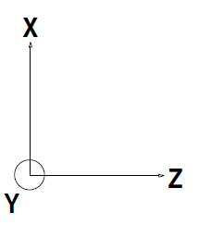
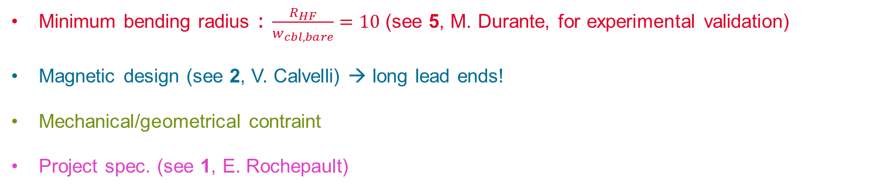
Coil detailed geometry ^{3/3}
Minimum bending radius : $\frac{R_{HF}}{w_{cbl,bare}}=10$(see 5, M. Durante, for experimental validation)
Magnetic design (see 2, V. Calvelli) → long lead ends!
Mechanical/geometrical contraint
Project spec. (see 1, E. Rochepault)
Extended straight section 474 mm
Straight section 243 mm

Slide 8
Cable lengths
From CAD: for one {HF+LF} coil, without margins:
Overall demand including margins and additional lengths:
Cable type | Coil cable length (L_{ex} = 200)
HF | 22,8 m
LF | 55,9 m
HF | 34 m
LF | 67 m

Slide 9
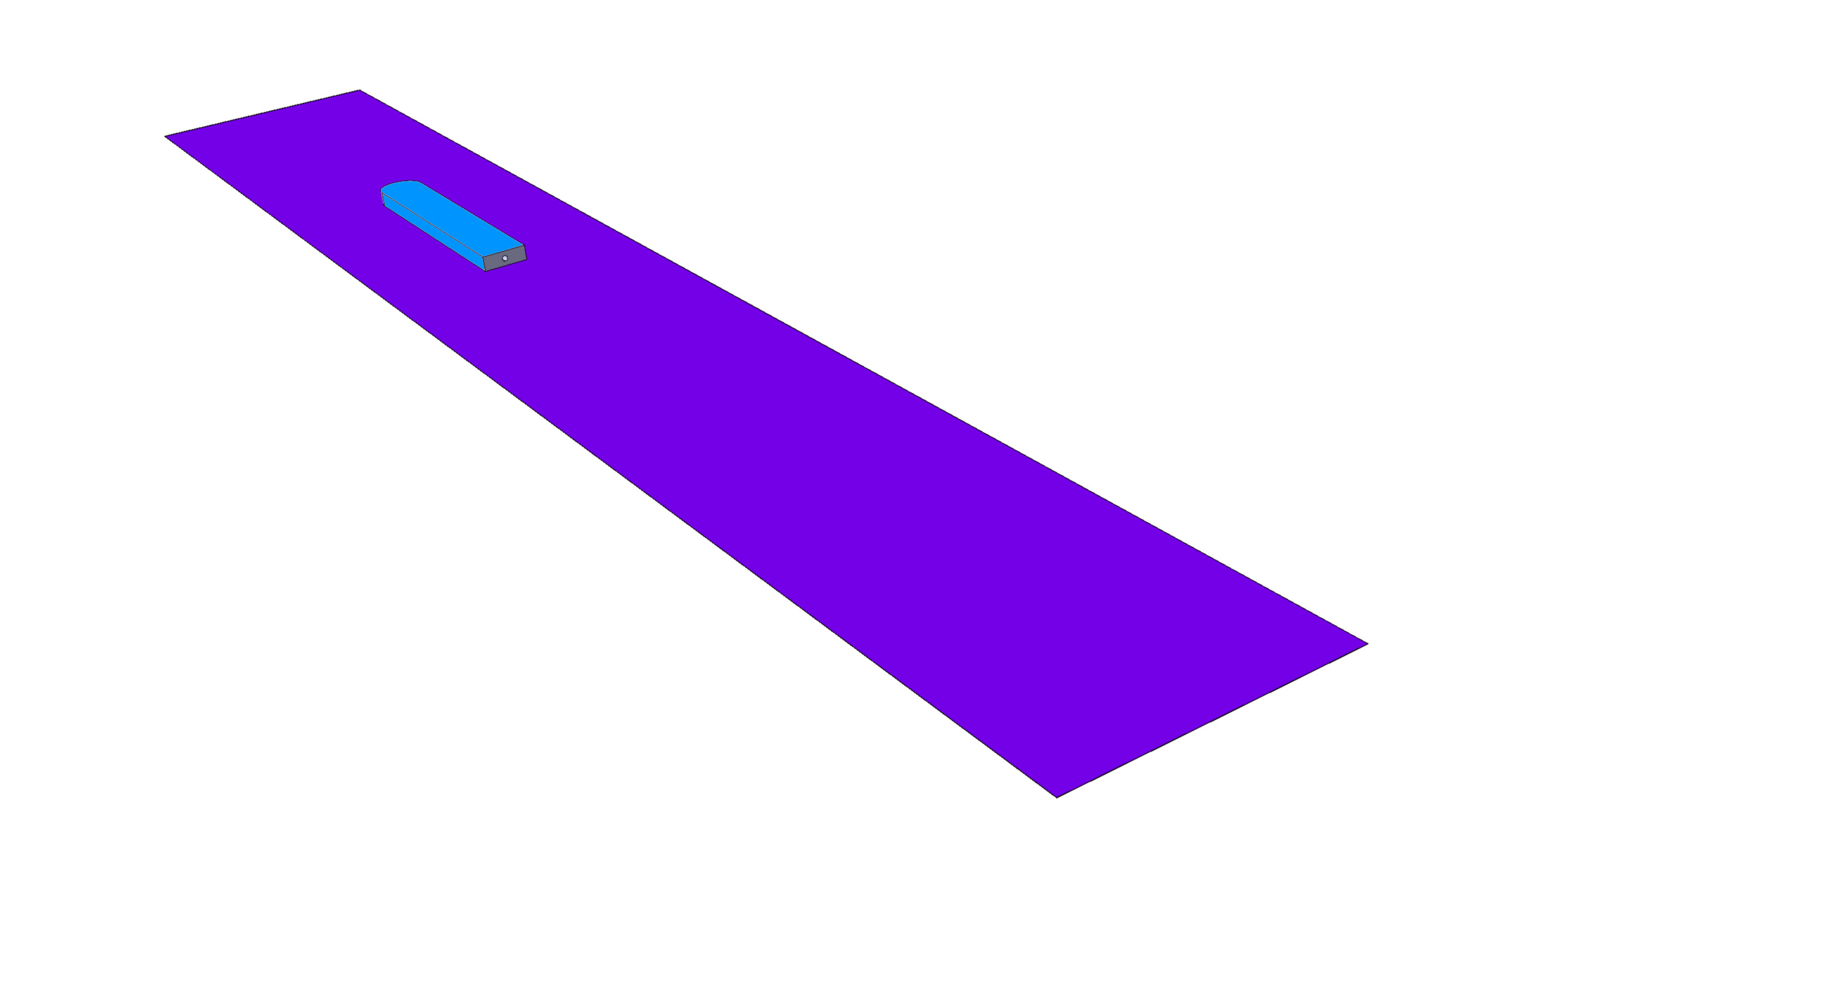
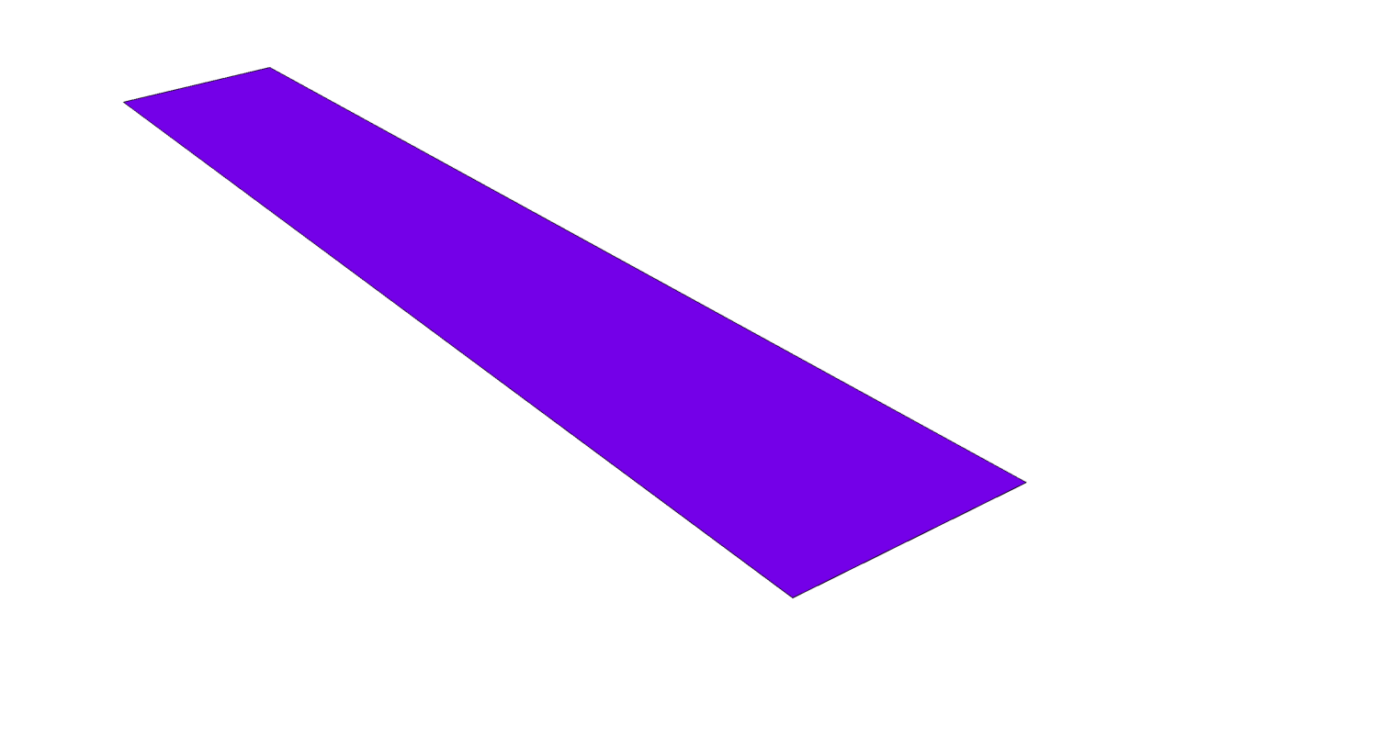
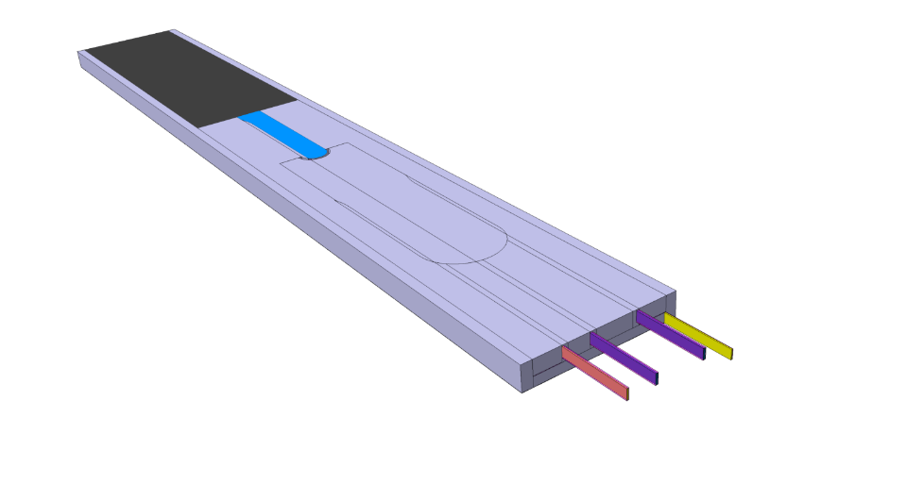
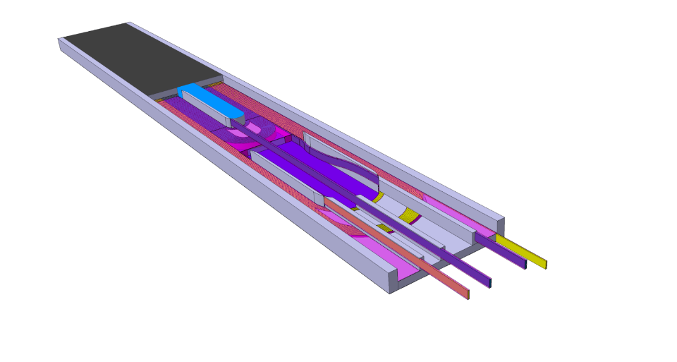
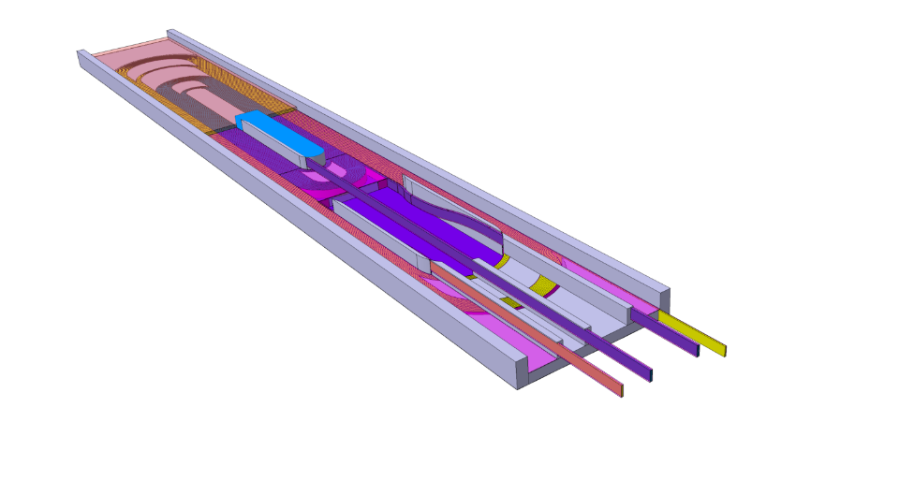
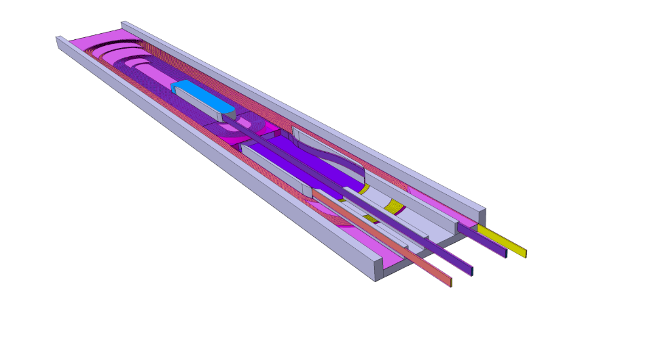
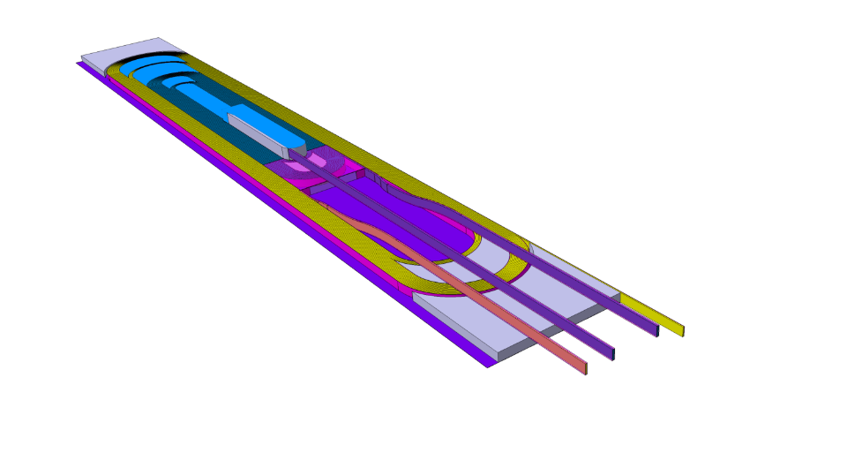
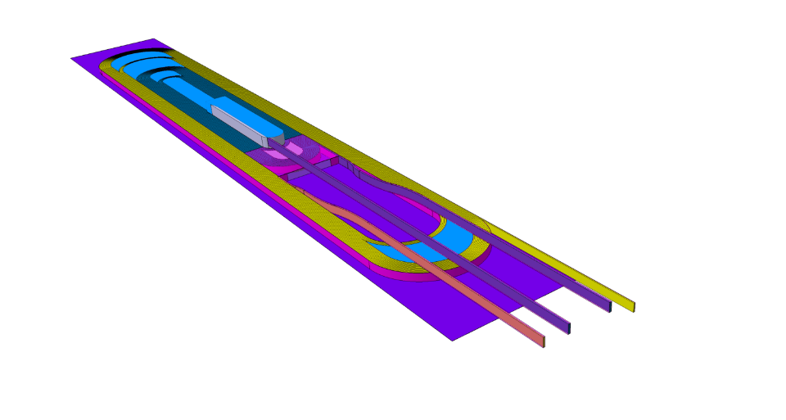
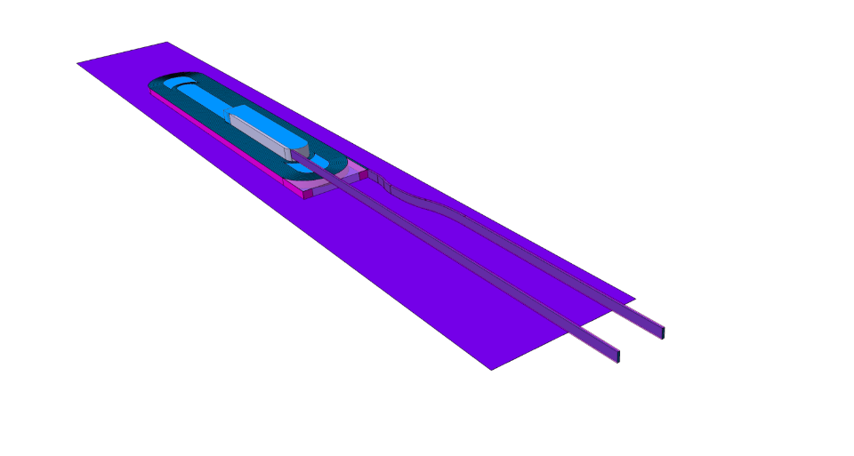

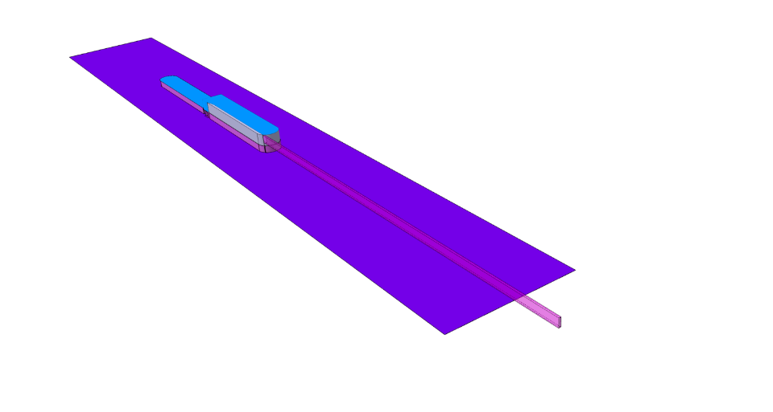
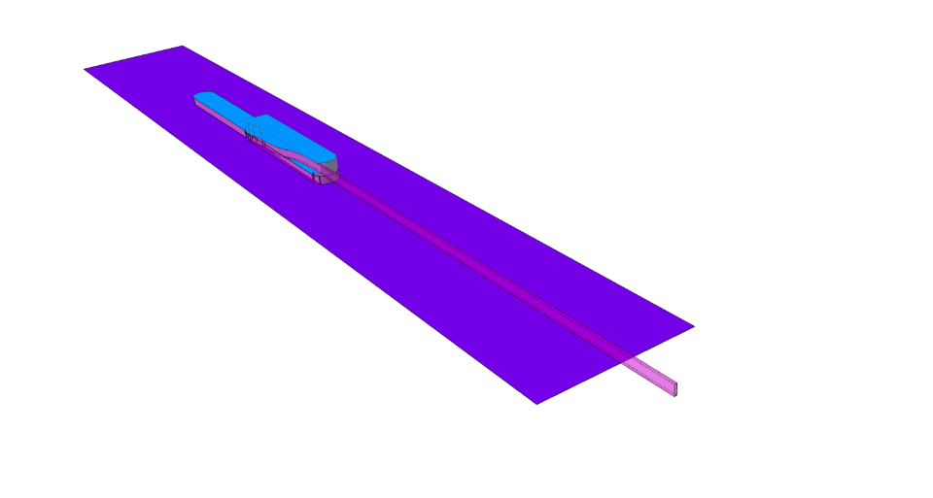
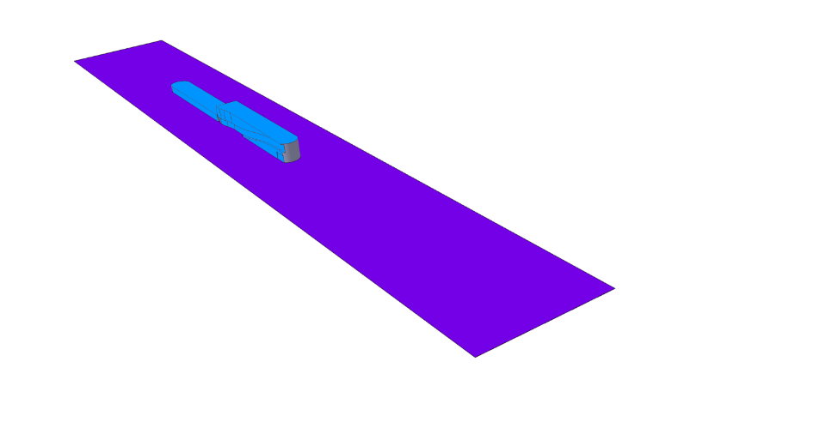
Coil components overview
Preliminary design: details not included
Even with one pancake, each coil has two layers
  → accomodates exit jumps
  → iron filler is used to have a flat coil surface
  → iron fillers contribute to magnetic field
Titanium
Stainless steel (SS)
Iron
Insulation filler
Insulation

Slide 10
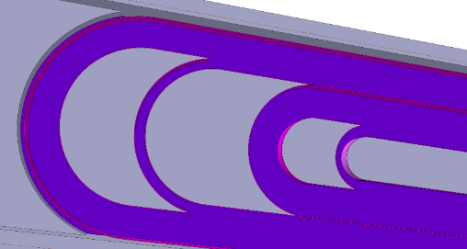
Coil components: closeup on details
Post:
  10mm-split (tbc) for HT contraction
  Thickness variation to accomodate exits
Components insulation
  No coating
  Wrapped insulation
MQXF
HT test

Slide 11
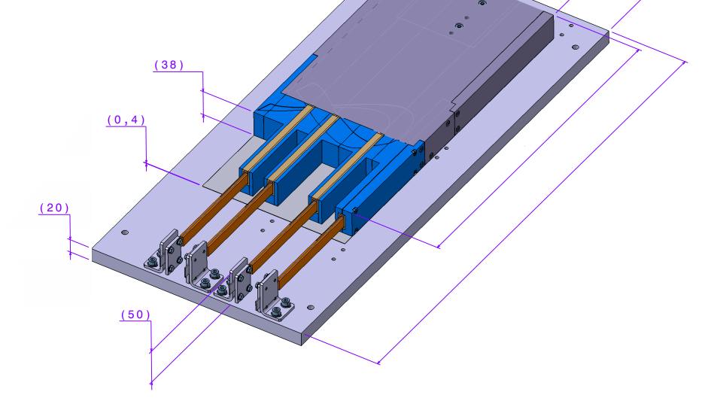
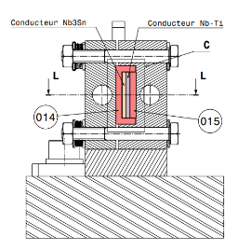
Coil components: splices & joints
Layer jump HF
forerunner
Layer jump LF forerunner
Exit jump HF
Straight exit LF
Splicing procedure similar to FRESCA2’s
  At least 200mm extra length compatible with furnace
  Option: increasing distance between exits (see later)
(see 5, M. Durante, for experimental qualification)

Slide 12
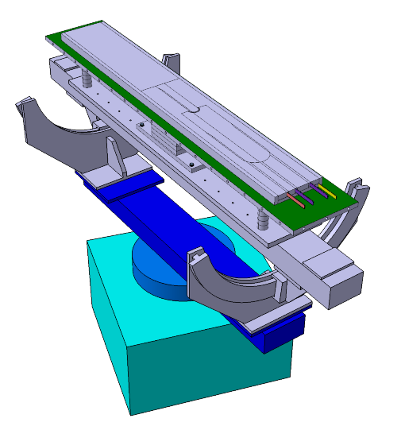
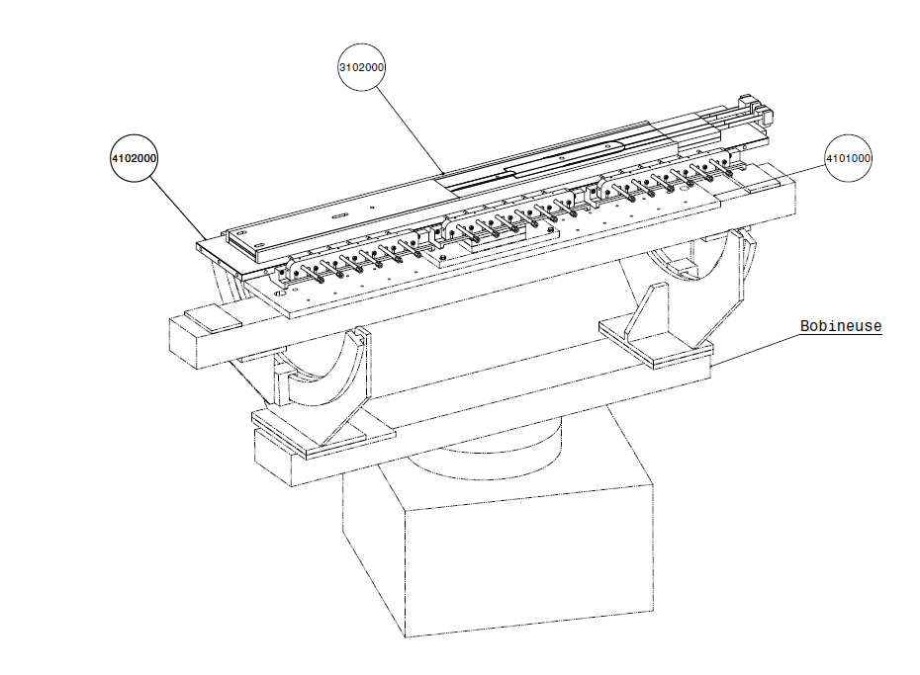
Preliminary winding tooling ^{1/3}
R2D2 winding will be performed at Saclay
Fabrication procedure is inspired from SMC and FRESCA2 feedback
R2D2 is not strictly a fabrication demonstrator for F2D2!

Slide 13
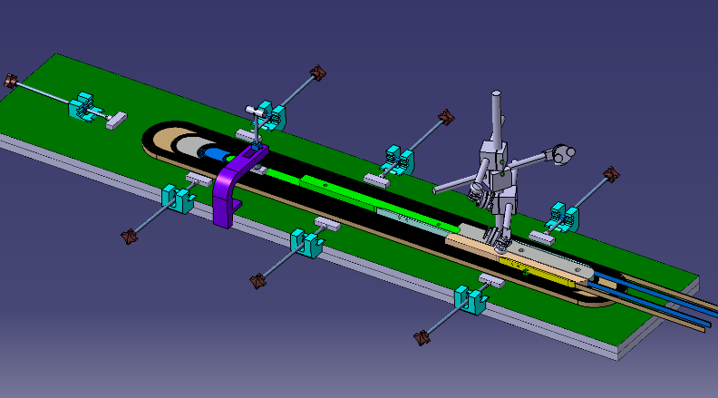
Preliminary winding tooling 2/3
Winding of each sub-coil starts at the layer jump
Mica sheets save space for trace (on lower side)

Slide 14
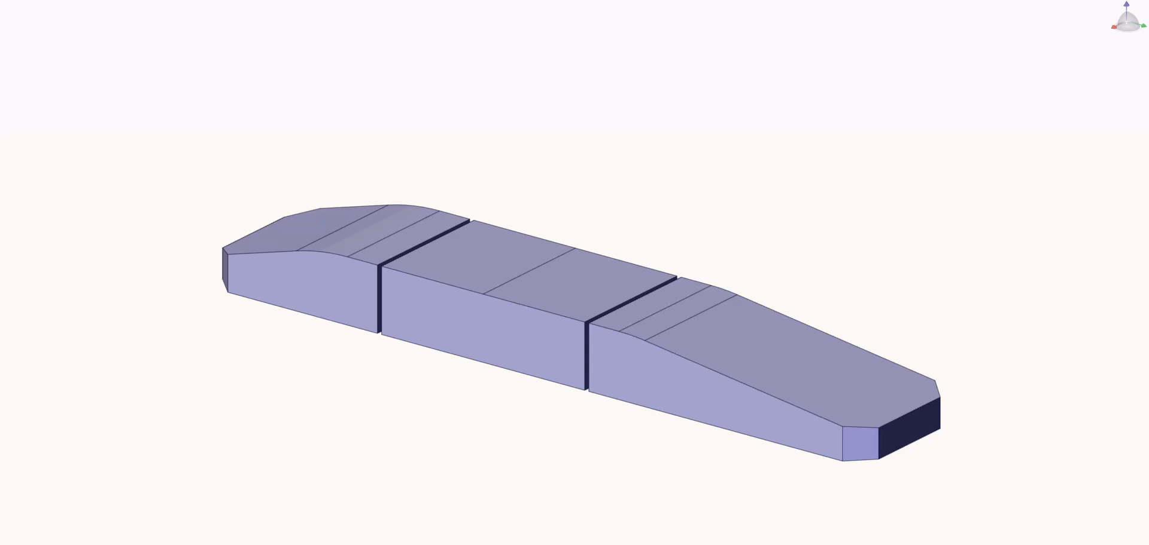
Preliminary winding tooling 3/3
Warning: this animation is based on F2D2 design (double-pancake coil)
Clamping of the jumps/exit will be similar for R2D2

Slide 15
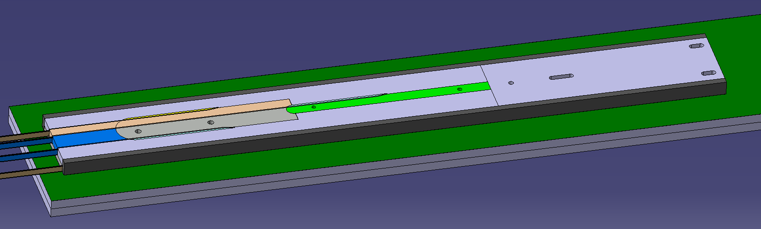
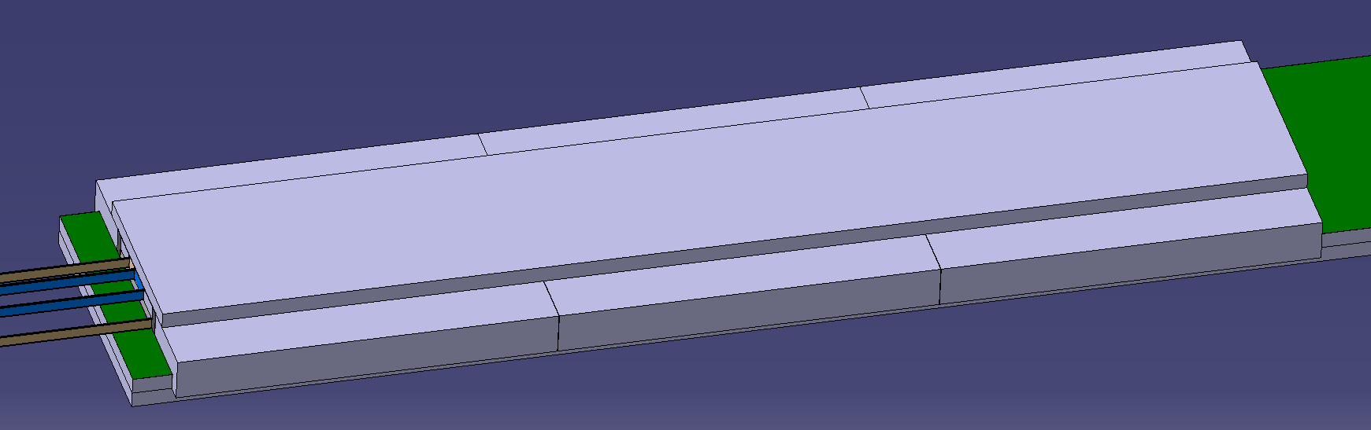
Heat treatment tooling concepts
Reaction performed at Saclay
Coil should be able to slide as much as possible sliding
  Mica sheets all around
  Minimal guiding features, one fix point (LE)

Slide 16

R2D2 reaction configuration
Y
Cavity for reaction
Mold
Mold
Coil / Mold insulation
0.6
Post aligned with the insulated reacted coil
Post
Rail
0.6
Coil / Mold insulation
(mica)
HF
LF
0.6
Post / Coil insulation
(mica + fiberglass)
0.6
Coil / Rail insulation (mica)
Titanium (components)
SS (tooling)

Slide 17
R2D2 impregnation configuration
Impregnation performed at Saclay
  2-layers coil pack integrates SS rails and iron filler that contribute to magnetic field
Impregnation process should be demonstrated on SMC
Y
Mold
Mold / Y-Filler insulation
0.5
Y-Filler (during impregnation ? To be decided with a 3D CAO)
6+0.5
Mold
Coil / Y-Filler insulation
Post aligned with the insulated reacted coil
Post
Rail
Trace + insulation
0.3+0.2
Z
Midshim insulation
HF
LF
X
2
4
1
Titanium (components)
0.6
Rail / Mold insulation
Iron (components)
Post / Coil insulation
Coil / Rail insulation
SS (tooling)

Slide 18
R2D2 final configuration
Y
Y-Pad
Y-Pad / Y-Filler insulation
0.5
Y-Filler
X-Pad
Coil / Y-Filler insulation
6+0.5
Post aligned with the insulated reacted coil
Post
Rail
Trace + insulation
0.3+0.2
Midshim insulation
HF
LF
X
2
Midplane
4
1
0.6
Rail / X-Pad insulation
Post / Coil insulation
Coil / Rail insulation
Titanium (components)
SS (tooling & components)
Iron (components)

Slide 19
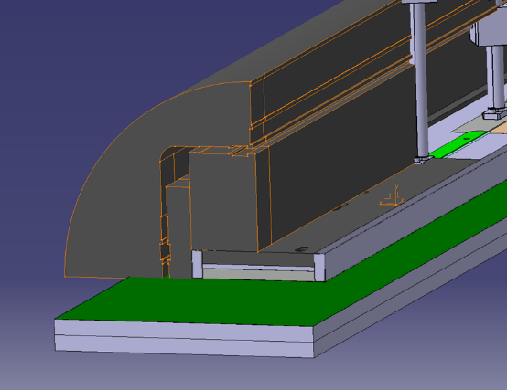
Coil interface with structure
Coil pack integrates iron filler that contribute to magnetic field
Pads (iron)
Rails
Titanium post
& spacers
Iron yoke
Fillers (iron + ins.)
Endshoe

Slide 20
Break for questions?

Slide 21
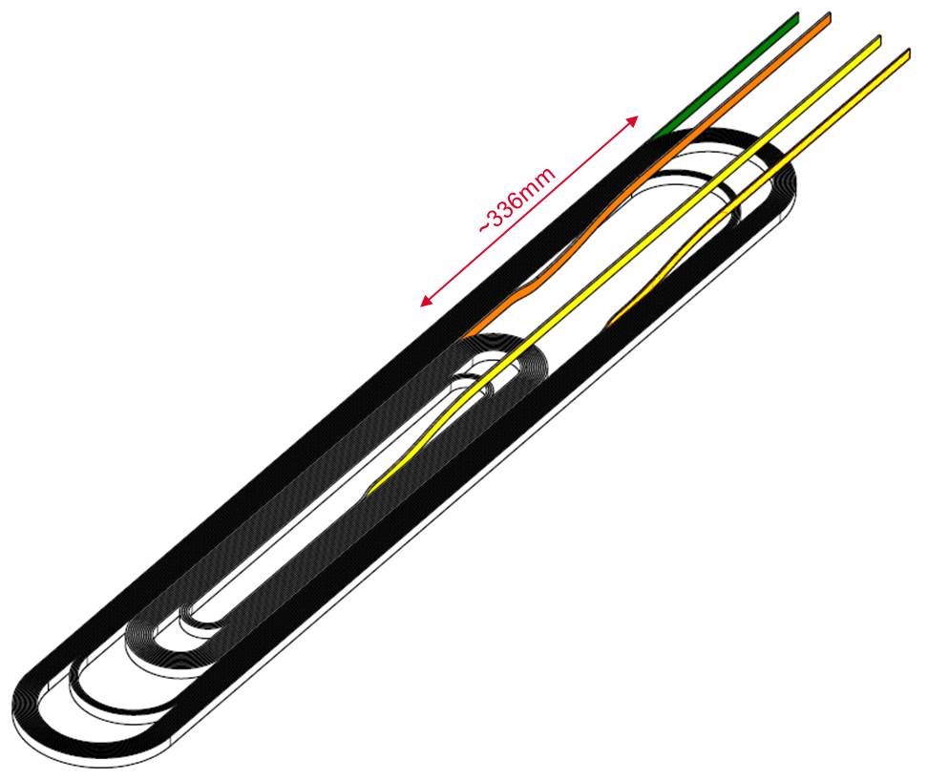
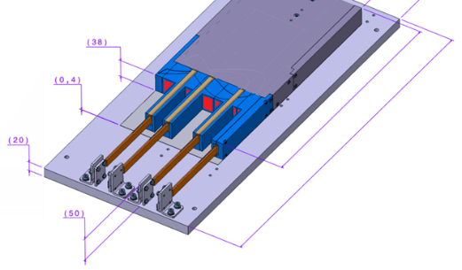
R2D2: longitudinal support concepts
Goals of the longitudinal support:
  No separation in coil-ends
  Safe stress zone (<200 MPa)
External joint → small support area (red surfaces)
Long spacers → difficult to reach coil-pole contact*
« Anything you do to reduce the tails will reduce the risk » (this review, yesterday session)
Is longitudinal support required?
New concept ?
Three approaches
  Conventional
  Rigid wall support
  Internal pre-load

Slide 22
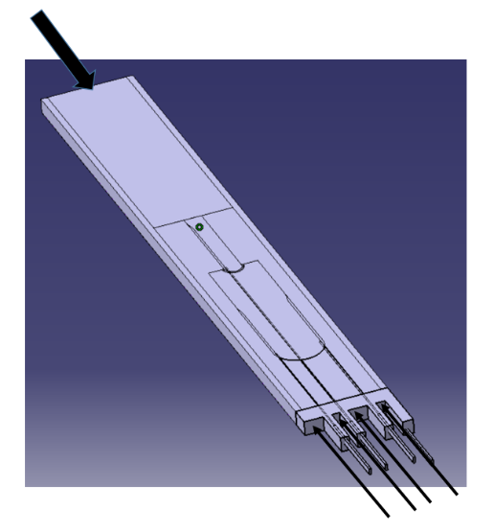
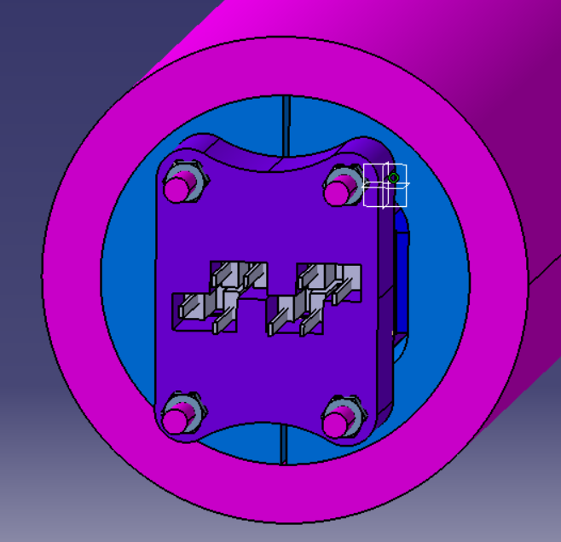
Option 1: conventional ^{1/2}
a) Rods + Endplates (baseline: FRESCA2c)
Pros:
Well-known
Cons:
High forces in Rods
Coil-pole separation at ultimate current
Lead end needs redesign
Asymmetric configuration of exits

Slide 23
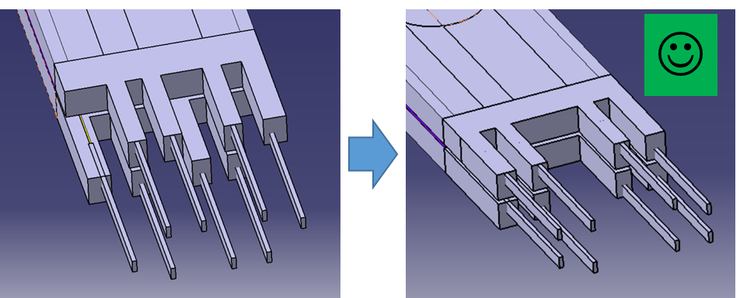
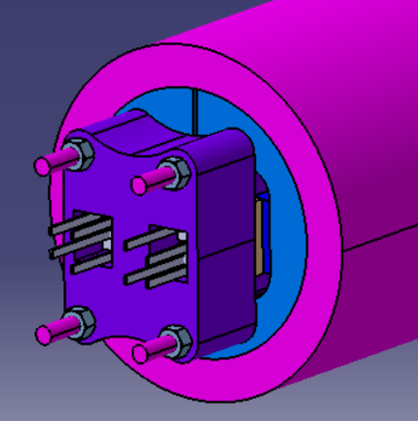
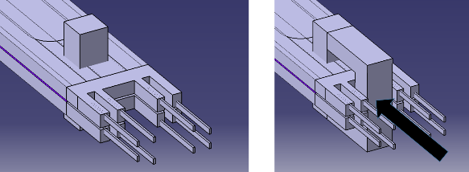
Option 1: conventional ^{2/2}
b) Exit cables can be moved outwards to allow more space for Endplate contact and symmetry
c) Rods pressure is applied directly to the Horseshoe (mechanical bypass or sliding interfaces)

Slide 24
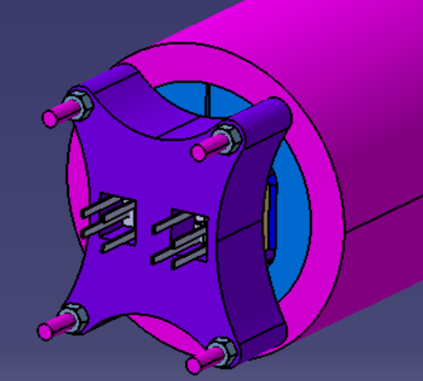
Option 2: Hard wall support
Pros:
Simple and compact
Can benefit from Al structure contraction
No longitudinal pre-stress
Cons:
Little pre-stress at warm, only via bullets
Coil-pole separation

Slide 25
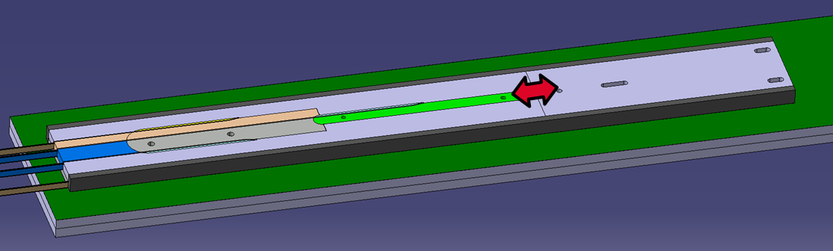
Option 3: internal pre-load
Benefits from split Post
Pros:
« internal » pre-load, via the pole
No coil-pole separation (potentially), no overload of the conductor
Scalable
Cons:
Still requires an external structure to counter-act the force
Need for a detailed engineering study (split Rods)
Need for R&D
Risks for the project

Slide 26
Other open questions
Cable glued on components?
Split post value?
Insulation detailed configuration
Need for additional preliminary tests?
(see 5, M. Durante)

Slide 27
R2D2 Simplified schedule
 | 2020 | 2021 |  |  |  | 2022 |  |  |  | 2023
 | T4 | T1 | T2 | T3 | T4 | T1 | T2 | T3 | T4 | T1 | T2 | T3 | T4
Conceptual Design | 3D mecha +quench
Engineering Design | Components + tooling |  |  |  | Other
R&D and tests |  |  | Splices | winding | heat treat. | Cu coil
Coil Manufacturing |  | Fabrication SMC |  |  |  | Cu coil | Nb3Sn coils
Magnet Assembly |  |  | R&D struct. | R&D struct. |  |  | Cold tests |  |  | Assembly
Protection |  |  | Design QH |  |  | Implementation SG | Implementation QH
Magnet Test |  |  |  |  |  |  |  |  |  | Mecha Analysis | Mecha+Magn+quench Analysis
today
RD-2.1 Conceptual design report F2D2/R2D2
RD-2.2b
Engineering design report R2D2
RD-2.2a
SMC coil
RD-3.1
R2D2 Cu coil
RD-3.2
R2D2 Nb₃Sn coils
RD-4.1
R2D2 Magnet
RD-4.2b
Test reports
Internal review conceptual design R2D2
Coil Fabrication Readiness Review FRR
RD-4.2a
Manufacturing folder
Conceptual Design Review CDR R2D2
Engineering Design Review EDR R2D2
Assembly Readiness Review ARR

Slide 28
Thank you

Slide 29
References
HD1: P. Ferracin, IEEE TAS, 2005
SQ: P. Ferracin, IEEE TAS, 2007+2008
SD: H. Felice, IEEE TAS, 2007
SMC: E. Fornasiere, IEEE TAS, 2013 + other SMC ref
RMC: J.C. Perez, IEEE TAS, 2016 + CERN conv.
MQXF: E. Takala, IEEE TAS, 2021 + other MQXF ref + G. Vallone priv. conv.
FRESCA2: E. Rochepault, IEEE TAS, 2018 + G. Willering, IEEE TAS, 2019
ERMC: M. Garcia, IEEE TAS, 2020
More info: US MDP-FCC 05

Slide 30
Spare

Slide 31
Cable dimensions: spare
Cable does not exist yet
ECC Baseline + Uncertainties management → F2D2/R2D2 Cable Baseline
Parameter | Unit | Proposed
 |  | HF |  | LF |  | Reason of uncertainty
 |  | Value | Uncertainty | Value | Uncertainty
Strand diameter | mm | 1.1 | 0 | 0.7 | 0 | -
Number of strands | - | 21 | +/-1 | 34 | +/-1 | Cabling stability
Unreacted width | mm | 12.446 | +/-0.030 | 12.446 | +/-0.030 | Cabling stability +Ic degradation
Unreacted thickness | mm | 1.969 | +/-0.030 | 1.253 | +/-0.020
Bare cable compaction | % | 10.5 | +/-1.5 | 10.5 | +/-2.5
Packing factor | % | 84.9 | ? | 87.5 | ?
Pitch angle | ° | 16.5 | +/-1 | 16.5 | +/-1
Transposition pitch | mm | 84.0 | +/-5 | 84.0 | +/-5
Width Reaction expansion | % | 1.0 | +0.5/-1.0 | 1.0 | +0.5/-1.0 | Conductor properties
Thickness Reaction expansion | % | 3.0 | +/-0.5 | 3.0 | +/-0.5
Reacted width | mm | 12.570 | +0.090 -0.150 | 12.570 | +0.090 -0.150 | Cabling+Ic degr.+Conductor
Reacted thickness | mm | 2.028 | +/-0.040 | 1.291 | +/-0.030
Insulation thickness | mm | 0.15 | +/-0.01 | 0.15 | +/-0.01 | Braiding

Slide 32
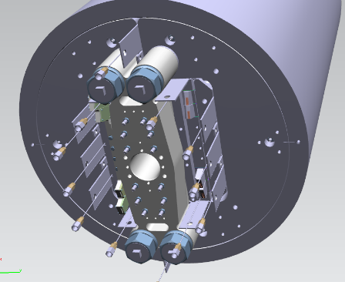
Concepts for longitudinal support
4x Rods
8x Exits
2x Endplate
FRESCAc could serve as baseline: « conventional approach » = 4 Rods + 2 Endplates
FRESCA2c RT load applied by symmetric Endplates on Horseshoes = 40% F_{z,mag}
FRESCA2c resulting load at CD = 68% F_{z,mag}

Slide 33
Longitudinal support: benchmark
Magnet | % EMF, RT | % EMF, cold | Coil-pole | Quench behavior in ends
HD1a | 260 Mpa | ? | 85 µm | Quenches in coil-ends
HD1b | 300 MPa | ? | 35 µm | improved
SQ02a | 40 % | 70 % |  | Improvement of Iss
SQ02b | 80 % | 115%
SQ02c | 0 | 0 |  | Detraining
SD01a | 180 MPa | ? |  | Detraining
SD01b | 0 | 0
SMC | Usually low |  |  | Quenches in coil-ends
RMC-FR2 | 5 % | 32 % | -25 MPa | Quenches in coil-ends
RMC-QXF | 24 % | 52 % | 0 MPa | Quenches in coil-ends
MQXFS1a/b, 3a |  | 50 % | -10 MPa | No clear impact
MQXFS1c, 3b/c, 4, 5 |  | 93 % | 10 MPa
FRESCA2a,b | 28 % | 68 % | 75 µm | No quench in the ends
FRESCA2c | 40 % | 68 % | 160 µm
ERMC | 64 % tbc | 89 % tbc |  | No quench in the ends

Slide 34
Goal of the longitudinal support
No separation here
While keeping the conductor in its safe stresse zone (<200 MPa)

Slide 35
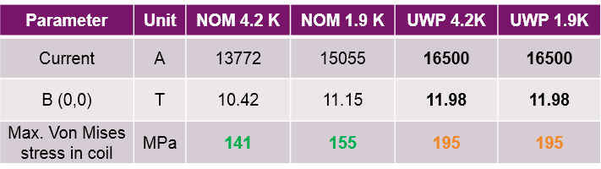
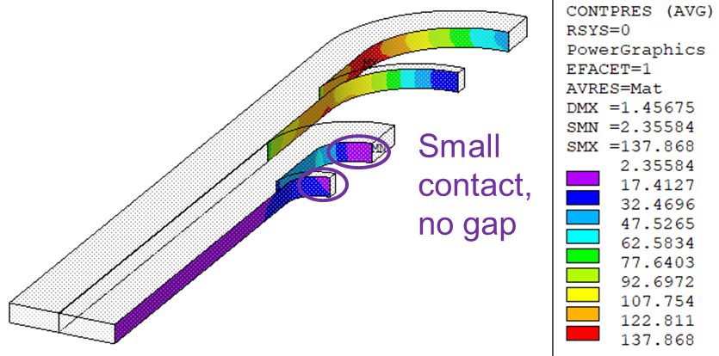
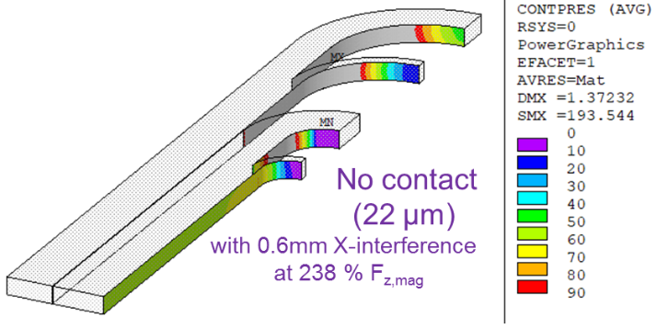
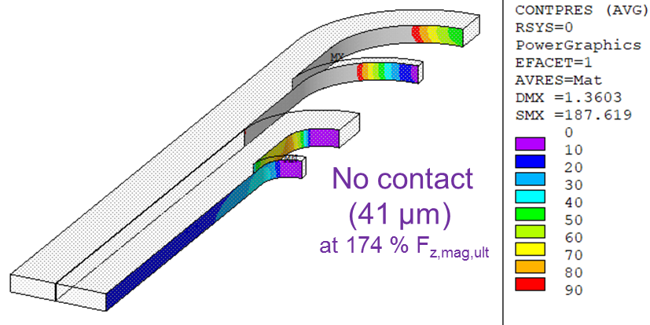
R2D2: expected effect of longitudinal preload
Von Mises stresses < 150 MPa at nominal; < 200 MPa at ultimate (high stresses in ends)
No separation at nominal
(183 % F_{z,mag})
but separation occurs with higher X pre-stress… …or at ultimate
→ Even 174% F_{z,mag} at CD doesn’t guarantee contact criterion at ultimate
(see 3, E. Rochepault)

