Slide 1
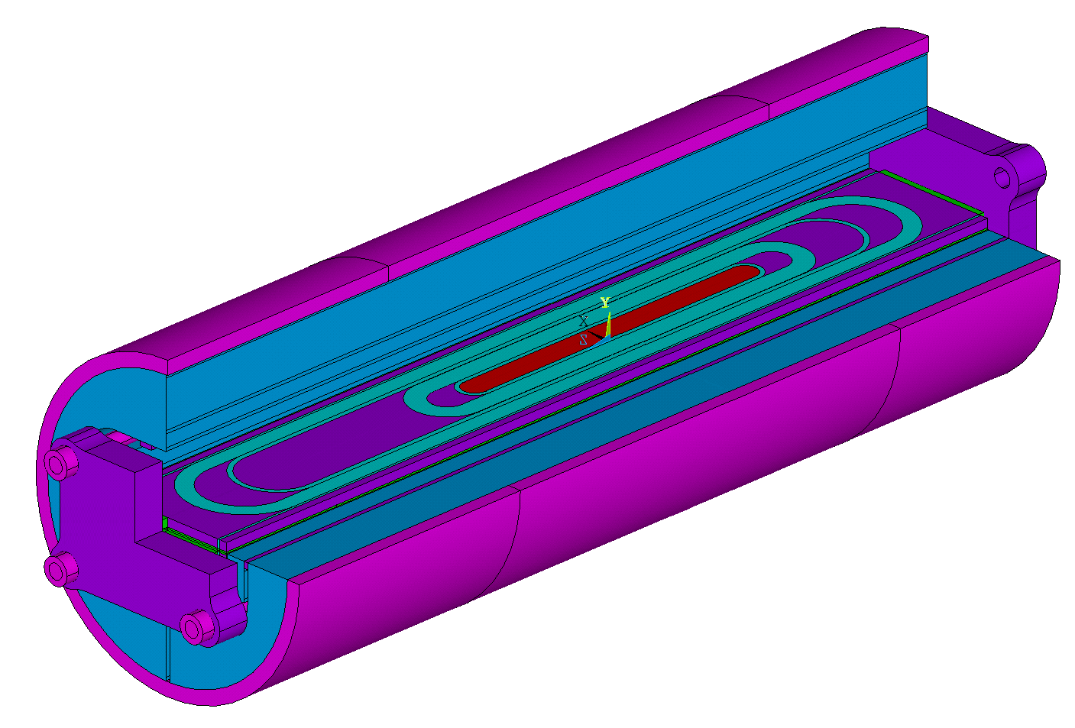

Conceptual Design Review of R2D2
3
- Mechanical Design -
https://indico.cern.ch/event/1003865/
CEA: E. Rochepault, V. Calvelli, M. Durante, H. Felice, P. Mallon, P. Manil, G. Minier, G. Maitre, B. Prevet, S. Perraud, F. Rondeaux
CERN: S. Izquierdo Bermudez, J.C. Perez, D. Tommasini, J. Fleiter, H. Felice
08/03/2021

Slide 2
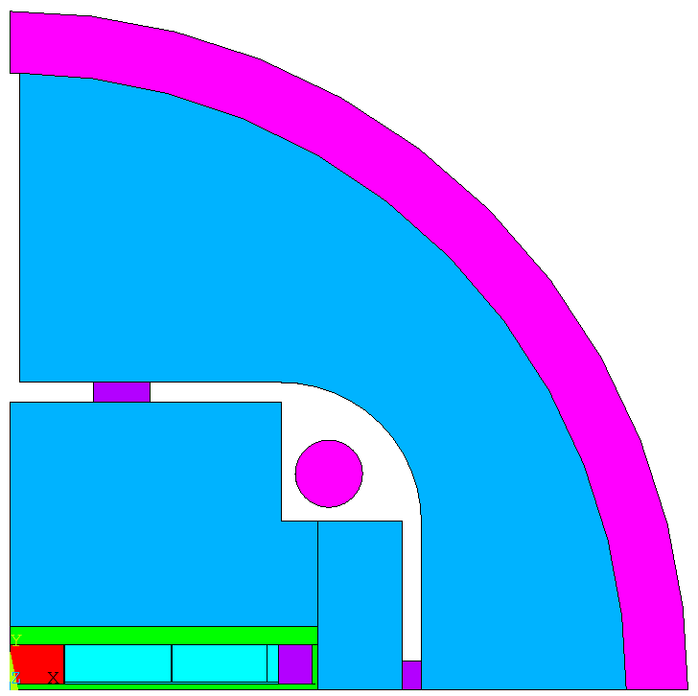
Mechanical Material Properties
Material | Stress limit (MPa, Von Mises) |  | E (GPa) |  | ν | α
 | 293 K | 4.2 K | 293 K | 4.2 K | 293 K / 4.2 K | 293 → 4.2 K
Coil X: Axial direction Y: Azimuthal direction | 150 | 200 | EX = 30 EY = 25 GXY = 21 | EX = 33 EY = 27.5 GXY = 21 | 0.3 | X = 3.1E-3 Y = 3.4E-3
Austenitic steel 316LN | 350 | 1050 | 193 | 210 | 0.28 | 2.8E-3
Al 7075 | 480 | 690 | 70 | 79 | 0.3 | 4.2E-3
Ferromagnetic iron | 180 | 720 | 213 | 224 | 0.28 | 2.0E-3
Pole (Ti6Al4V) | 800 | 1650 | 130 | 130 | 0.3 | 1.7E-3
G11* | 260 |  | 30 | 30 | 0.3
Coil shim material same as coil
  Behavior as a single impregnated pack
  Avoid stress concentrations during cool-down
Plane53 (magnetic), Plane82 (mechanical) elements
Plane stress condition: more conservative

Slide 3
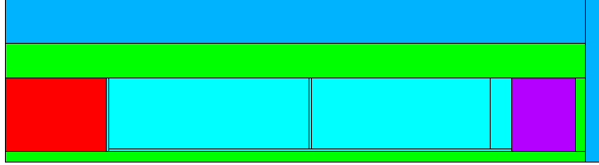
Contacts and Couplings: Coil
Standard contact (Separation and Sliding permitted)
No initial penetration or gap
Friction coefficient = 0.2
Unprescribed interfaces
Standard contact between all interfaces surrounding coil assembly, friction coefficient = 0.2
Coupling between coils and their proximal shims
Coupling used to:
  Force coil pack to behave as a unit
  Avoid stress concentrations during cool-down
IRFU/DACM/LEAS

Slide 4
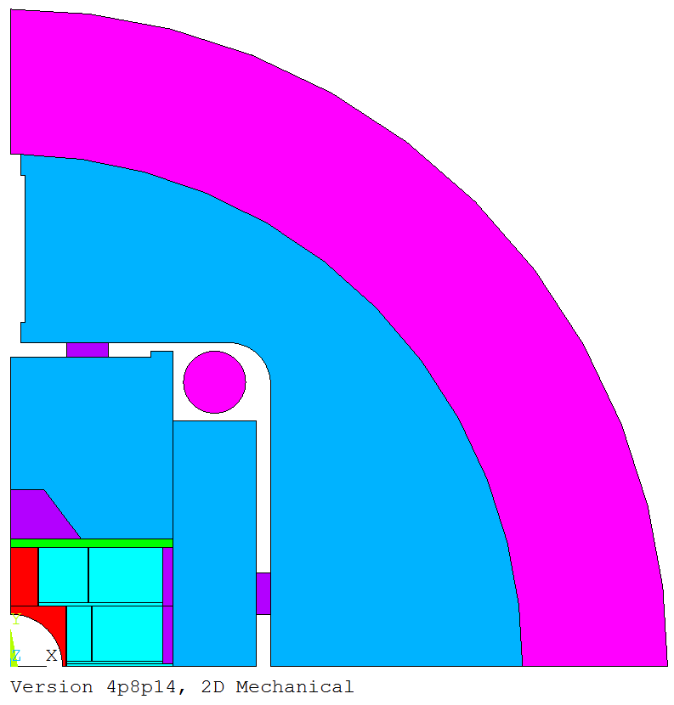
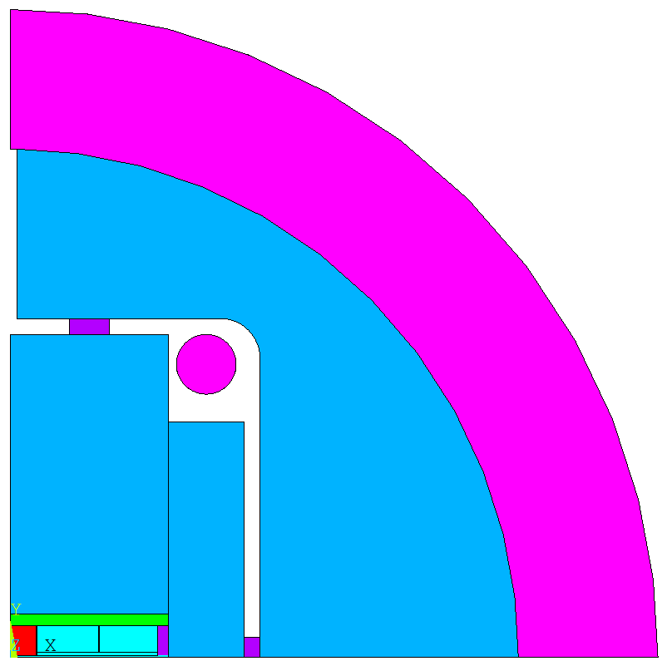
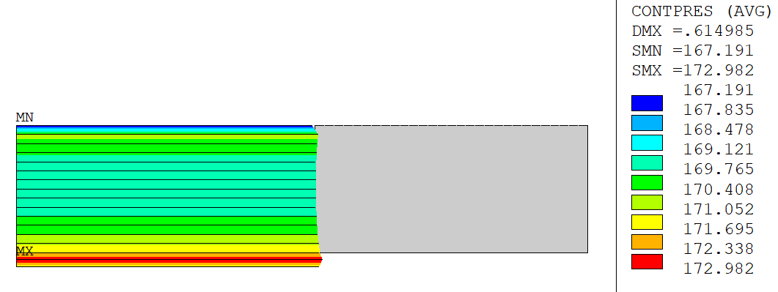
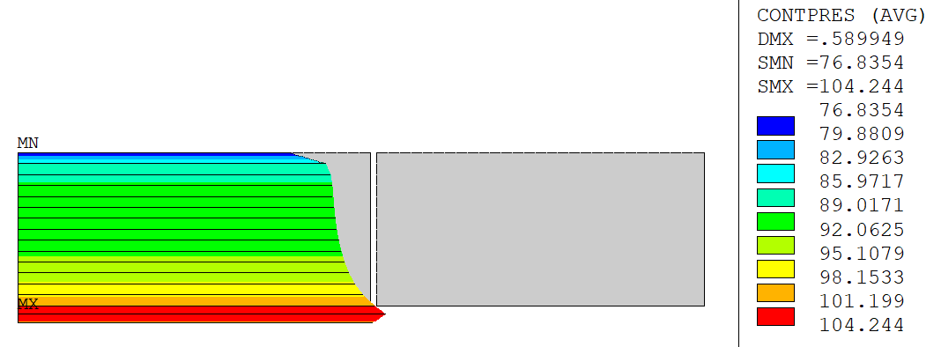
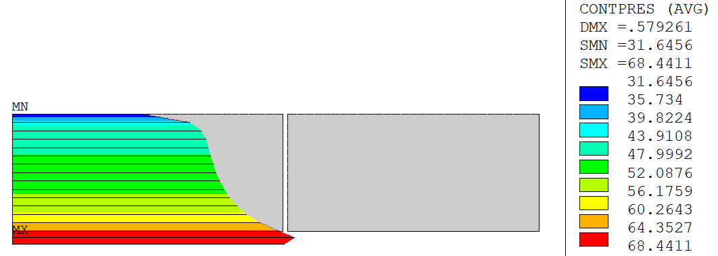
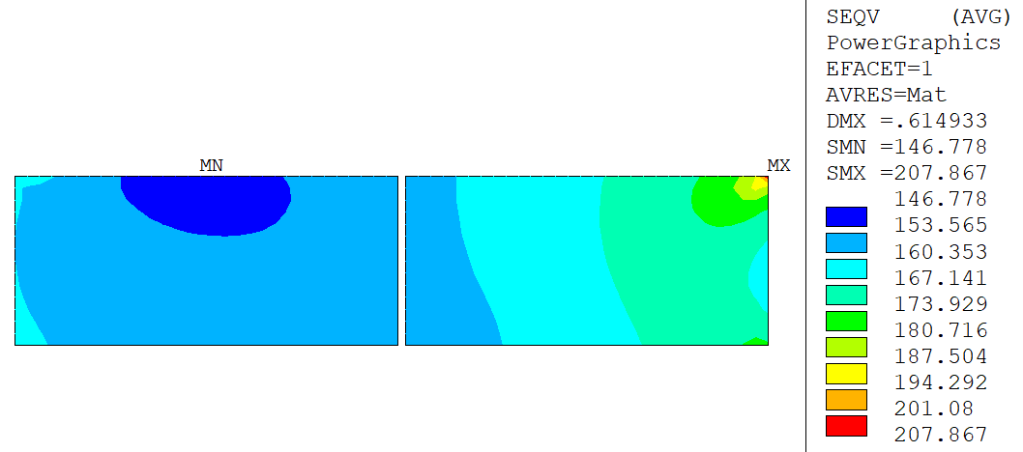
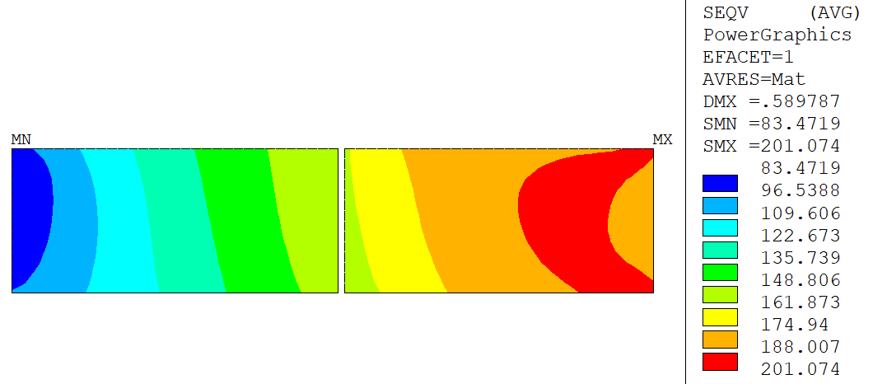
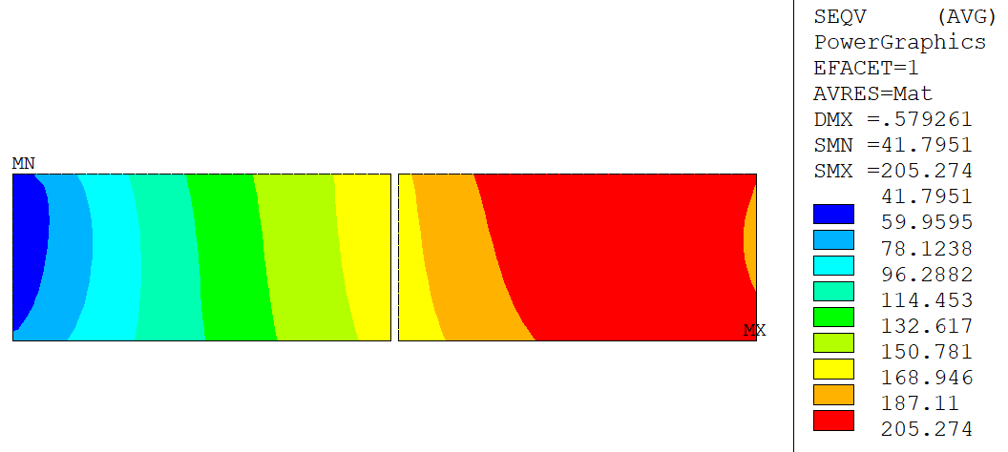
R2D2 coils in F2D2 structure
Too much pre-load because of the thick shell
High peak stress
Need to redesign the structure
Different fillers and pads
→ Marginal cost saving
v6.9.16
0.10 mm Xinterf
0.05 mm Yinterf
+cool-down
Nominal:
13.38 kA, 11T
Short sample:
16.88 kA, 11T
HF
LF
208 MPa
201 MPa
205 MPa

Slide 5
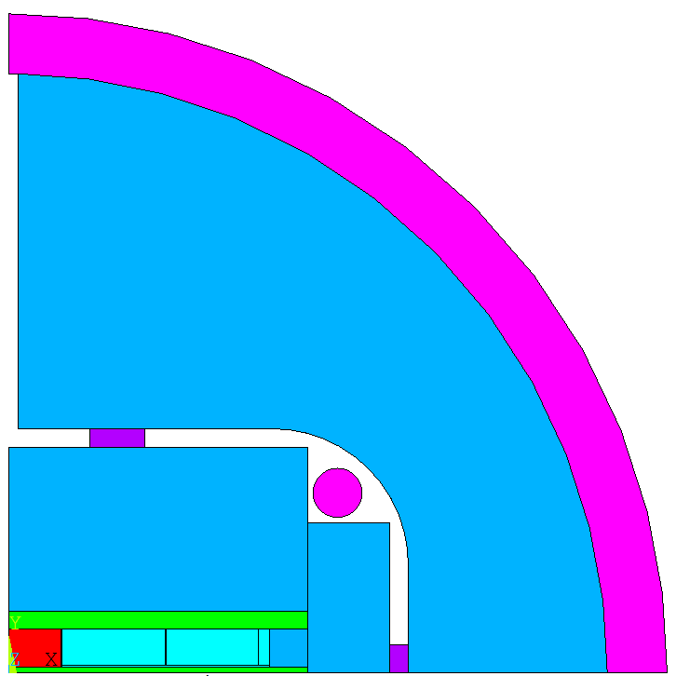
Structure parametric study
Parameter |  | Criterion | I | II | III | IV | V | VI
Shell Thick. (mm) |  | >15 mm | 26 | 22 | 20 | 22 | 22 | 22
Yoke Ext. Rad. (mm) |  | >190 mm | 190 | 190 | 190 | 195 | 210 | 220
Overall Rad. (mm) |  | >205 mm | 216 | 212 | 210 | 217 | 232 | 242
Max. Von Mises stress in coil [MPa] | Nominal SS 1.9K | <150 MPa No limit | 129 217 | 123 247 | 120 201 | 126 211 | 134 218 | 128 222
Coil-Pole Contact [MPa] | Nominal SS 1.9K | >10 MPa >10 MPa | 12 16 | 7 8 | 5 2 | 9 10 | 12 12 | 13 12
Max. Von Mises stress in Iron at max preload [MPa] |  | <180 MPa | 257 | 247 | 240 | 223 | 186 | 174
Step 1: shell thickness/radius reduced to decrease coil stress below 150 MPa at nominal
Step 2: pre-load tuned to guarantee 10 MPa contact from nominal to SS
Step 3: Yoke radius varied to keep peak stress at warm below 180 MPa
v6.14.R1
IRFU/DACM/LEAS

Slide 6
A wide range of pre-load
Parameter | Unit | NOM 4.2 K | NOM 1.9 K | UWP 4.2K | UWP 1.9K | SS 4.2 K | SS 1.9 K
Current | A | 13772 | 15055 | 16500 | 16500 | 17215 | 18819
Margin HF | % | 20.0 | 20.9 | 4.5 | 12.9 | 0.0 | 0.9
Margin LF | % | 20.5 | 20.0 | 4.0 | 11.3 | 0.7 | 0.0
B (0,0) | T | 10.42 | 11.15 | 11.98 | 11.98 | 12.46 | 13.29
Max. Von Mises stress in coil | MPa | 141 | 155 | 195 | 195 | 204 | 231
Min. pre-load for nominal operation
Max. pre-load for SS 1.9K
Structure can withstand high pre-load if required
Coil should be limited to ultimate current
v6.14.R2

Slide 7
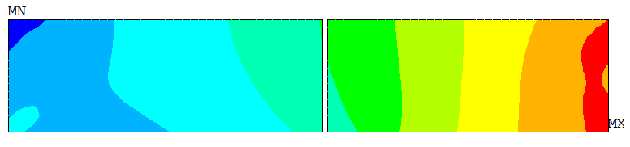
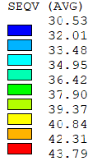
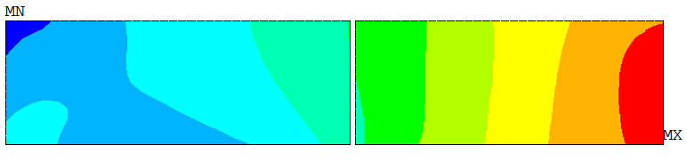
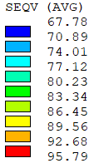

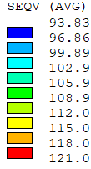
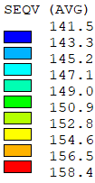
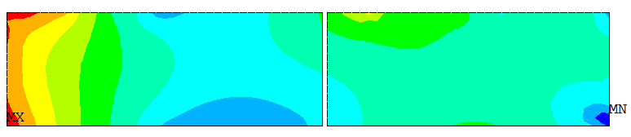
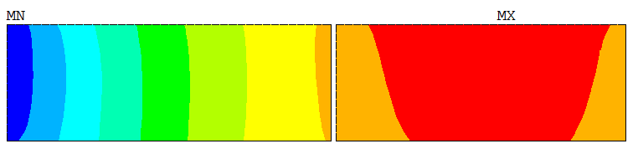
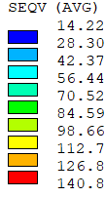
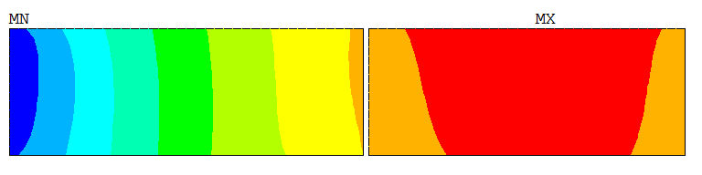
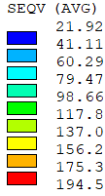
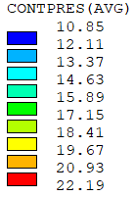
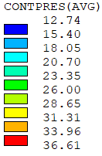
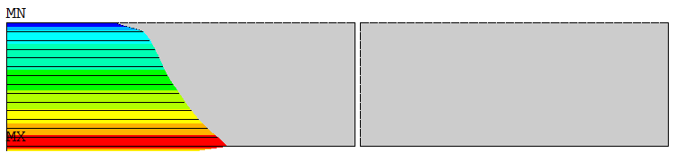
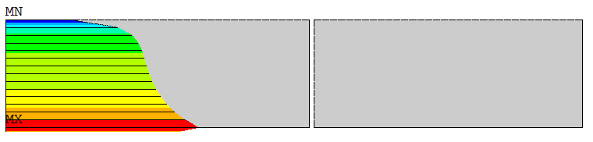
Peak stress in coil and Contacts (Nom.+UWP)
Pre-load | Pre-load
Cool-down | Cool-down
Nominal: 13.7 kA | UWP: 16.5 kA
Nominal: 13.7 kA | UWP: 16.5 kA
44 MPa
96 MPa
121 MPa
158 MPa
141 MPa
195 MPa
11 MPa
13 MPa
v6.14.R2

Slide 8
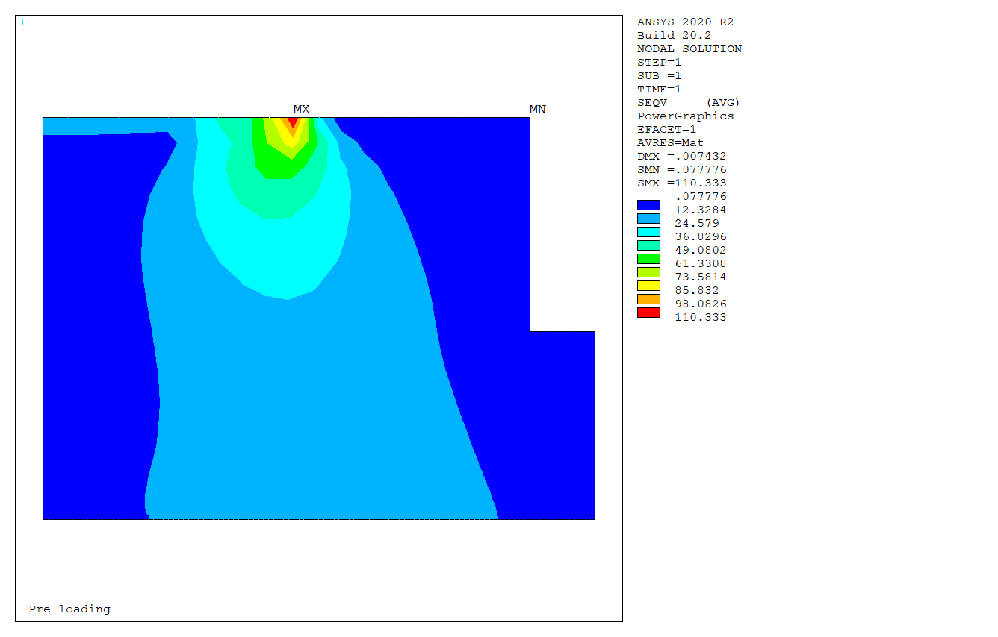
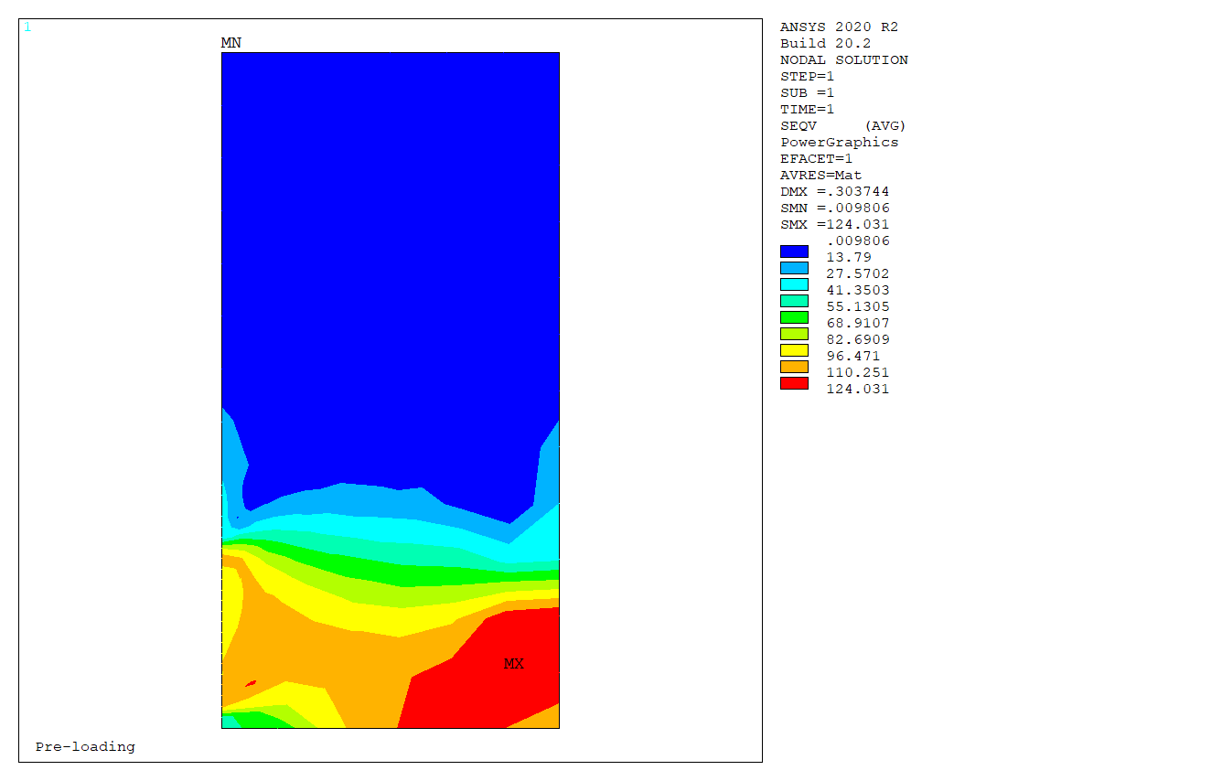
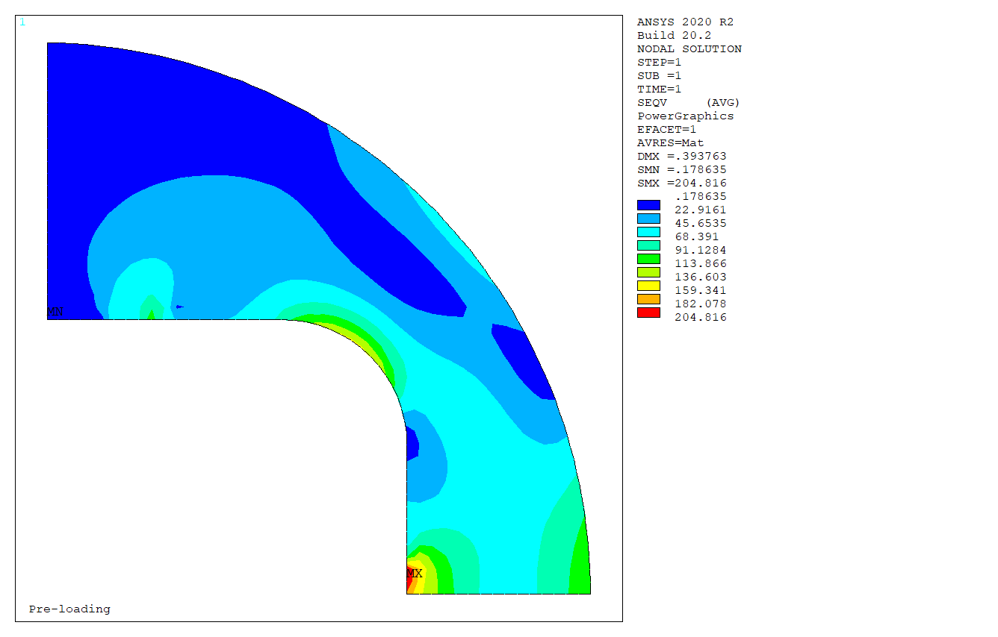
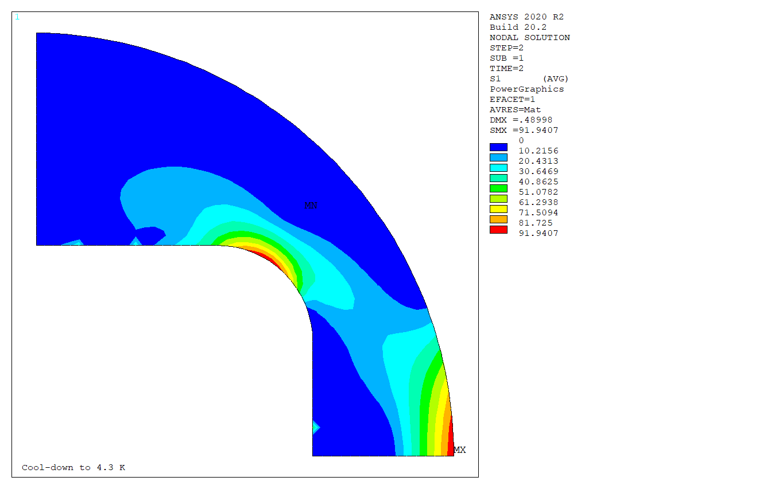

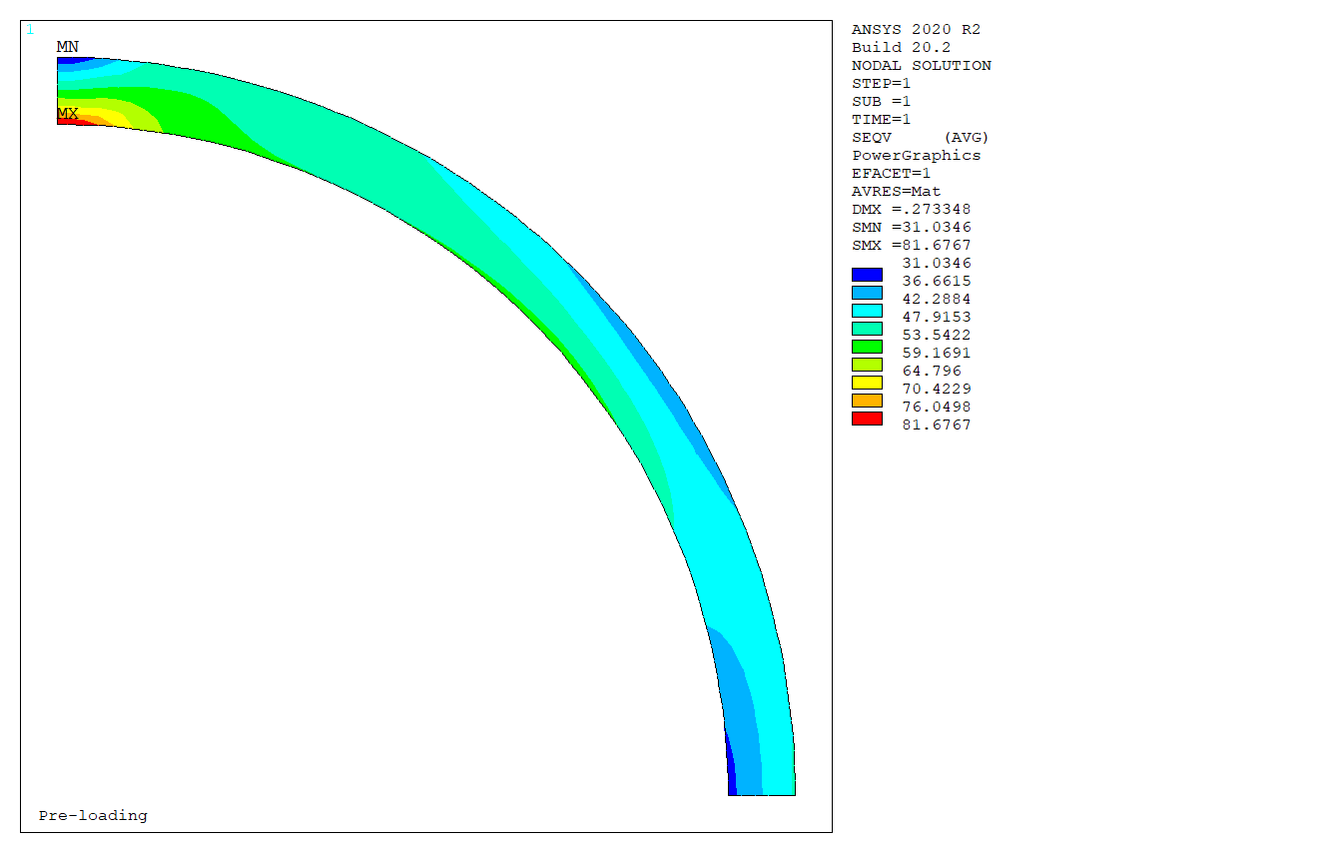
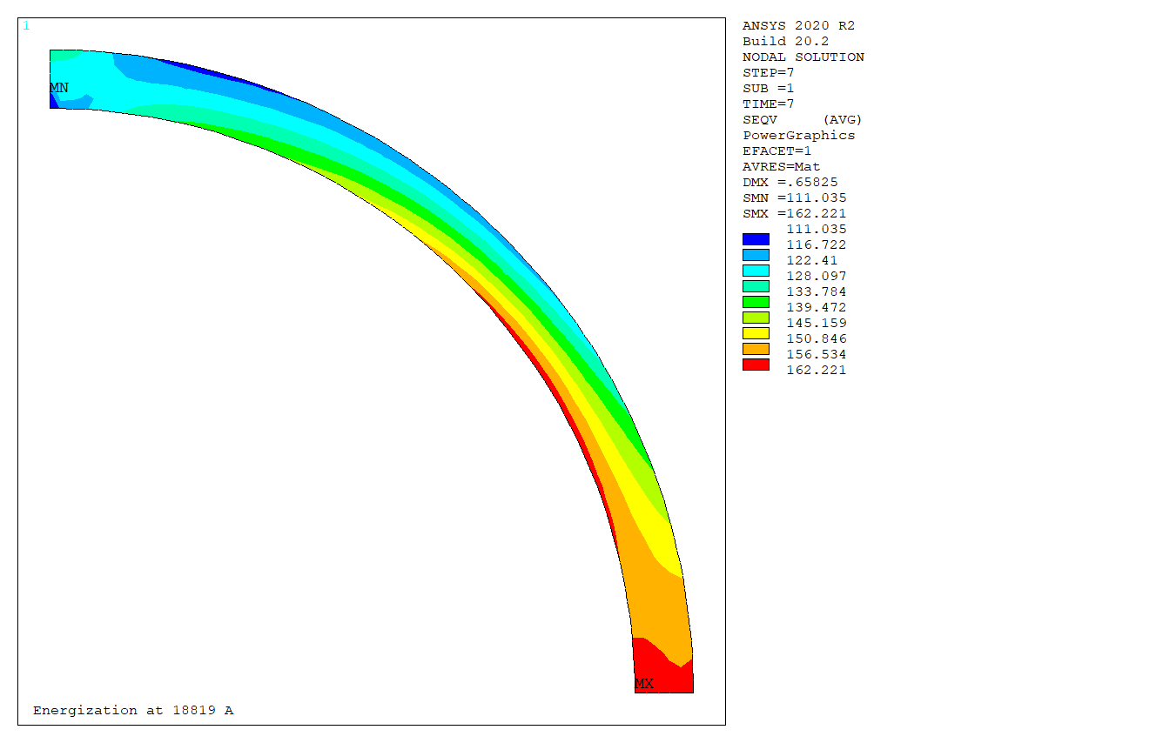
Peak stresses in structure (SS 1.9 K)
124 < 180 MPa
205 > 180 MPa locally
110 < 180 MPa
82 < 480 MPa at warm
162 <690 MPa at cold
S1 = 92 < 200 MPa at cold
S1 = 118 < 200 MPa at SS

Slide 9
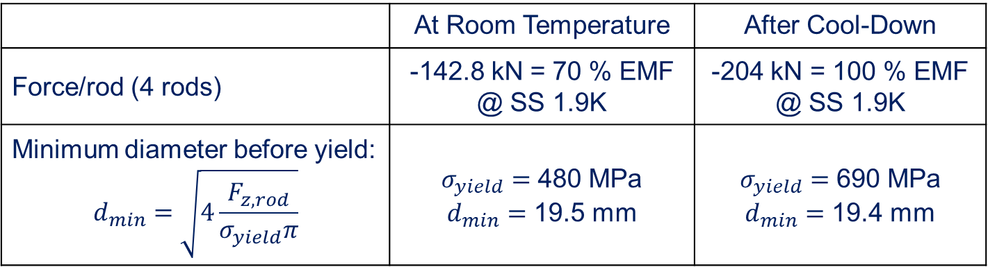
Room for Tie Rods
 | At Room Temperature | After Cool-Down
Force/rod (4 rods) | -142.8 kN = 70 % EMF @ SS 1.9K | -204 kN = 100 % EMF @ SS 1.9K
Minimum diameter before yield: $$d_{min}=\sqrt{4\frac{F_{z,rod}}{σ_{yield}π}}$$ | $σ_{yield}=$ 480 MPa $d_{min}=$ 19.5 mm | $σ_{yield}=$ 690 MPa $d_{min}=$ 19.4 mm
N.b.: 18 mm is minimum diameter for 16.5 kA ultimate working point condition
v6.14.R2
24 mm has been chosen, giving 1.5 safety factor
(see 4, P. Manil for longitudinal pre-load concepts)

Slide 10
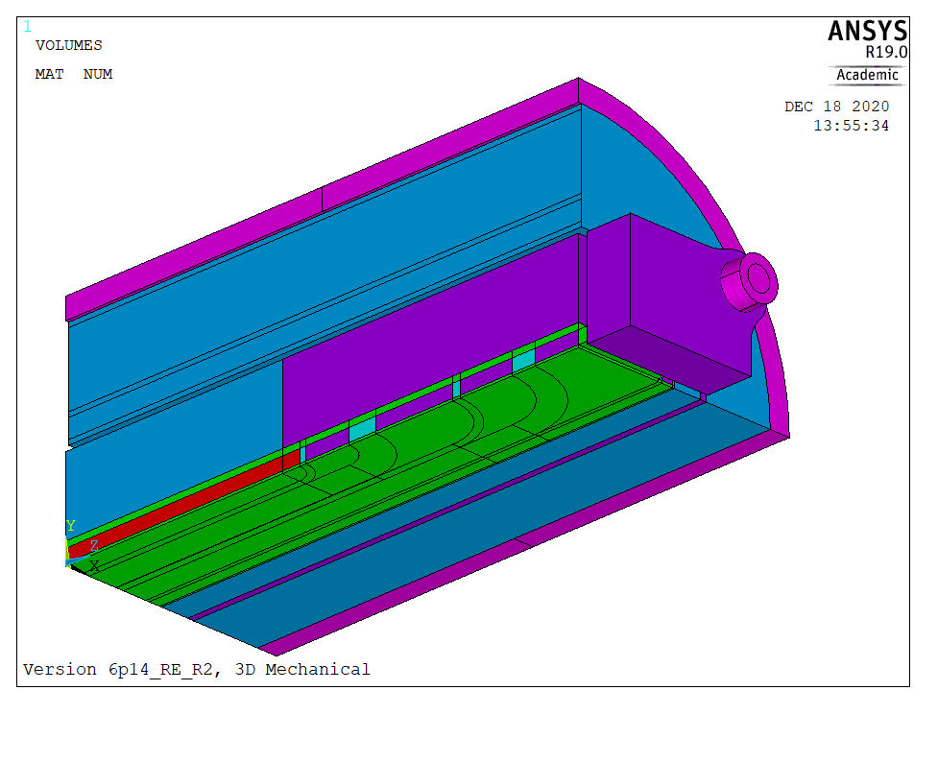

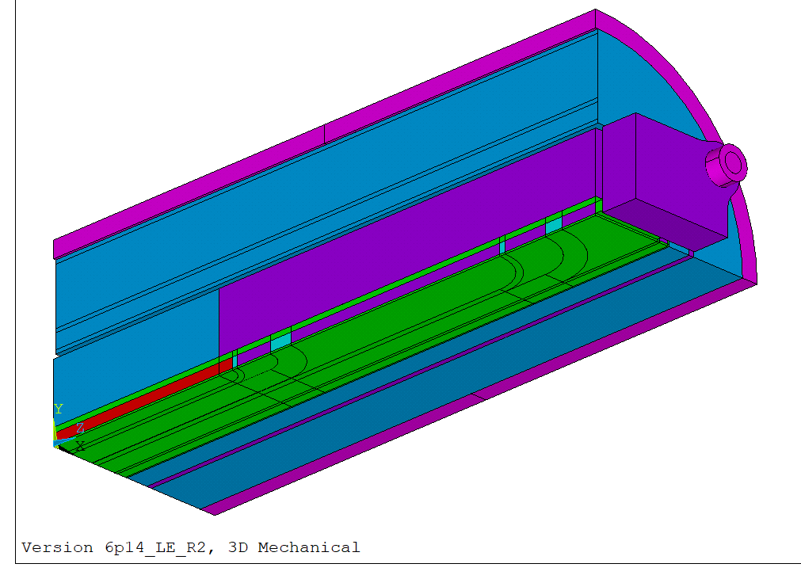
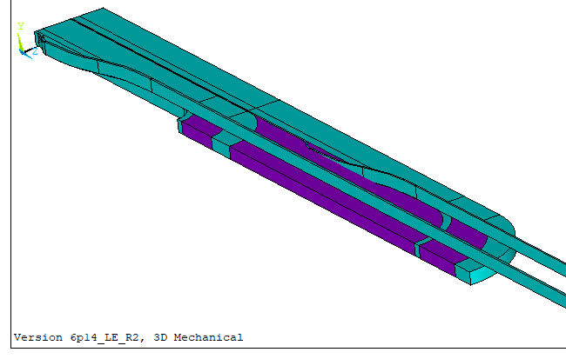
3D Model – Return End RE
RE, symmetric
This presentation
LE, symmetric
LE, with jumps
ongoing
ongoing

Slide 11
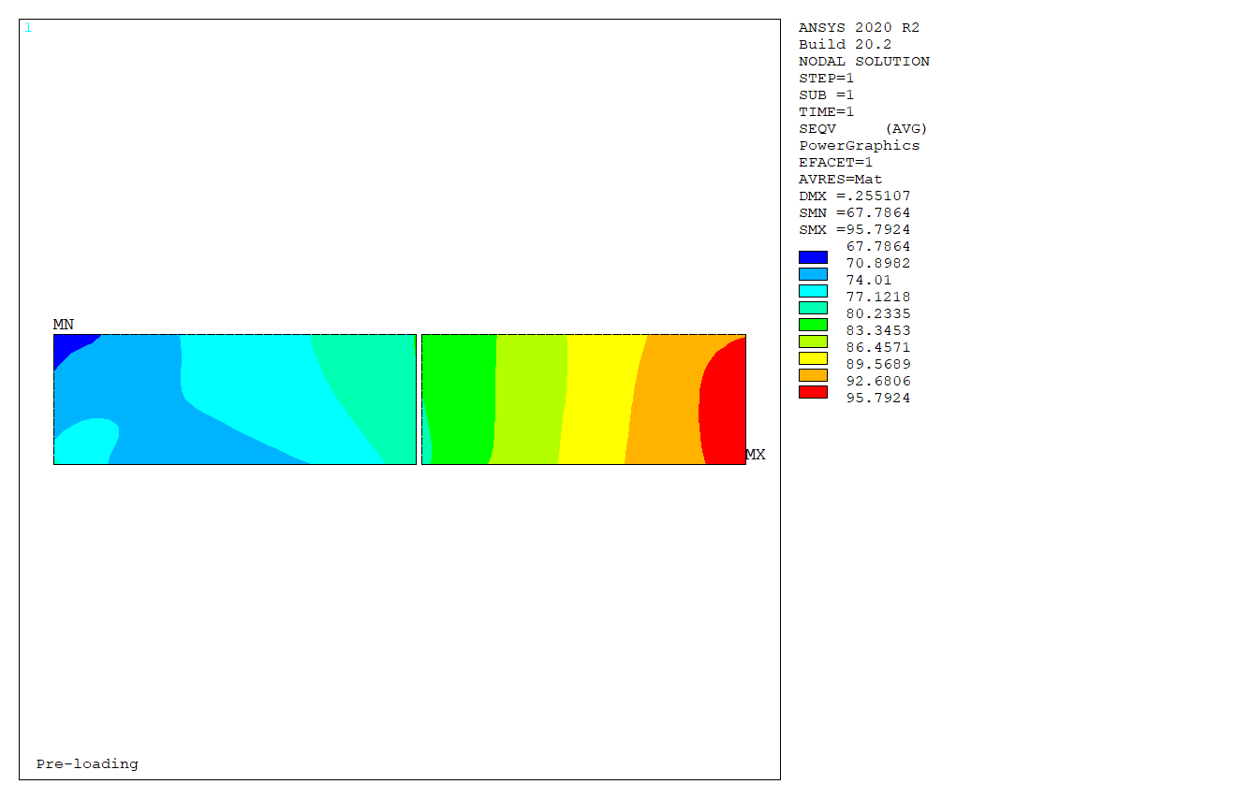
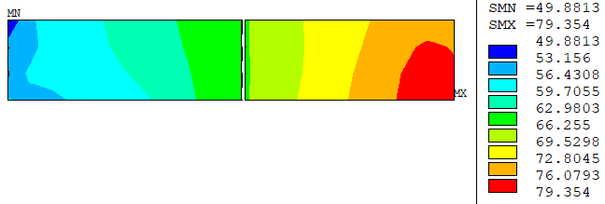
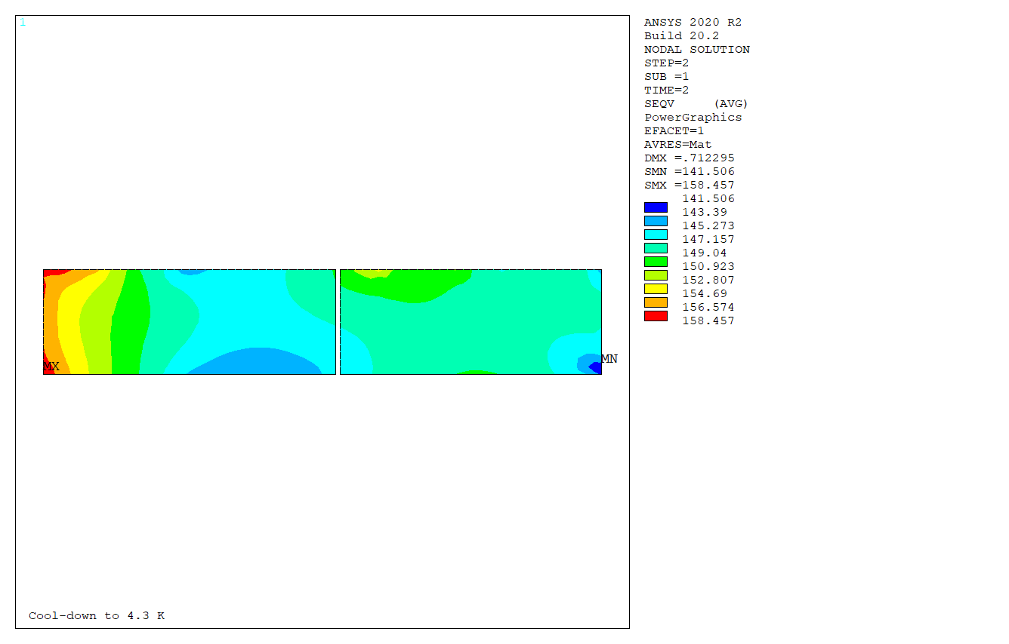
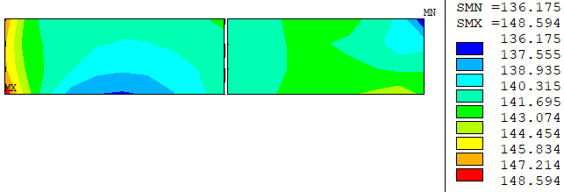
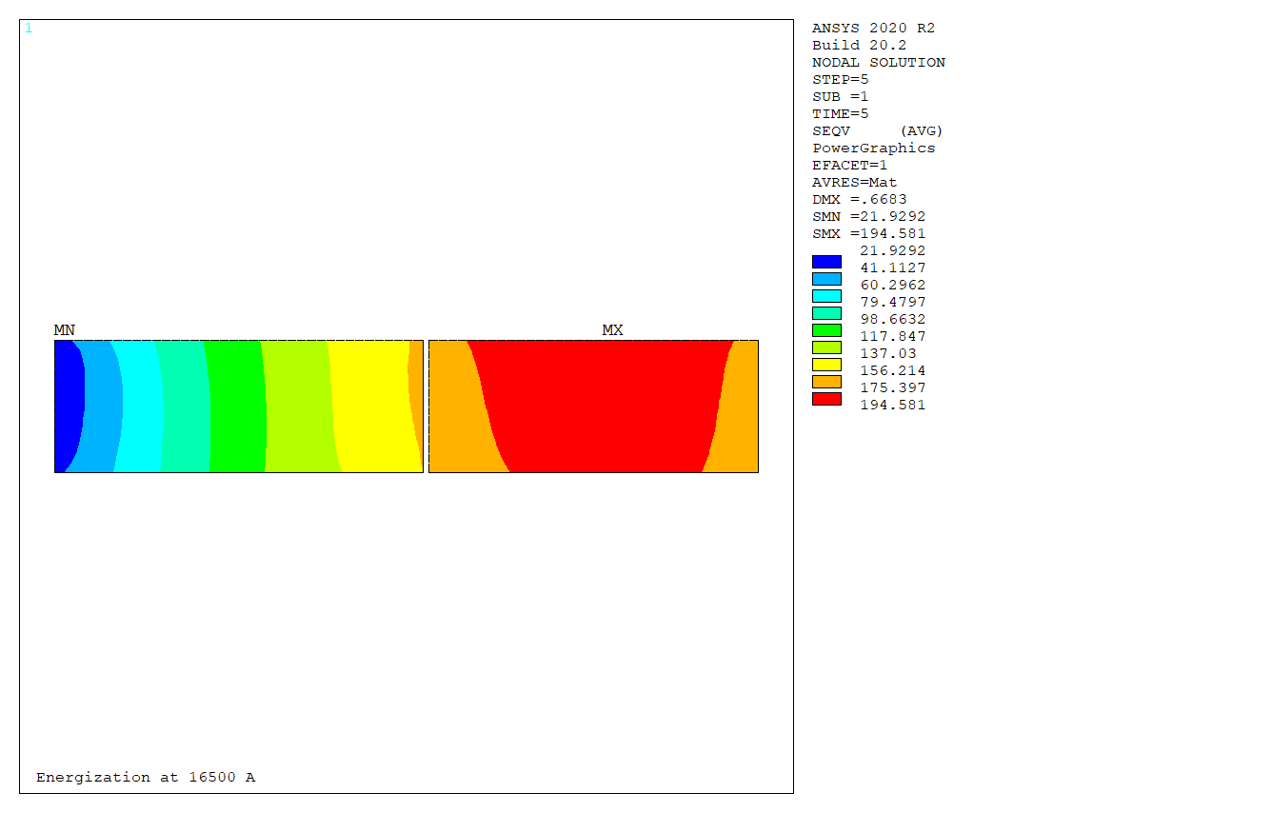
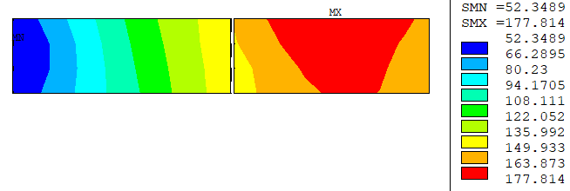
VM Stress – 2D vs 3D (Ultimate)
2D
3D
0.60 mm Xinterf
0.05 mm Yinterf
96 MPa
79 MPa
Cool-down
158 MPa
149 MPa
195 MPa
178 MPa
16.5 kA Ultimate current
Profile and range very similar between 2D/3D
Difference 10-20 MPa in max. VM Stress attributed to 2D plane stress Vs 3D stress, 2D more pessimistic (conservative)
Difference <5 MPa in X Stress

Slide 12
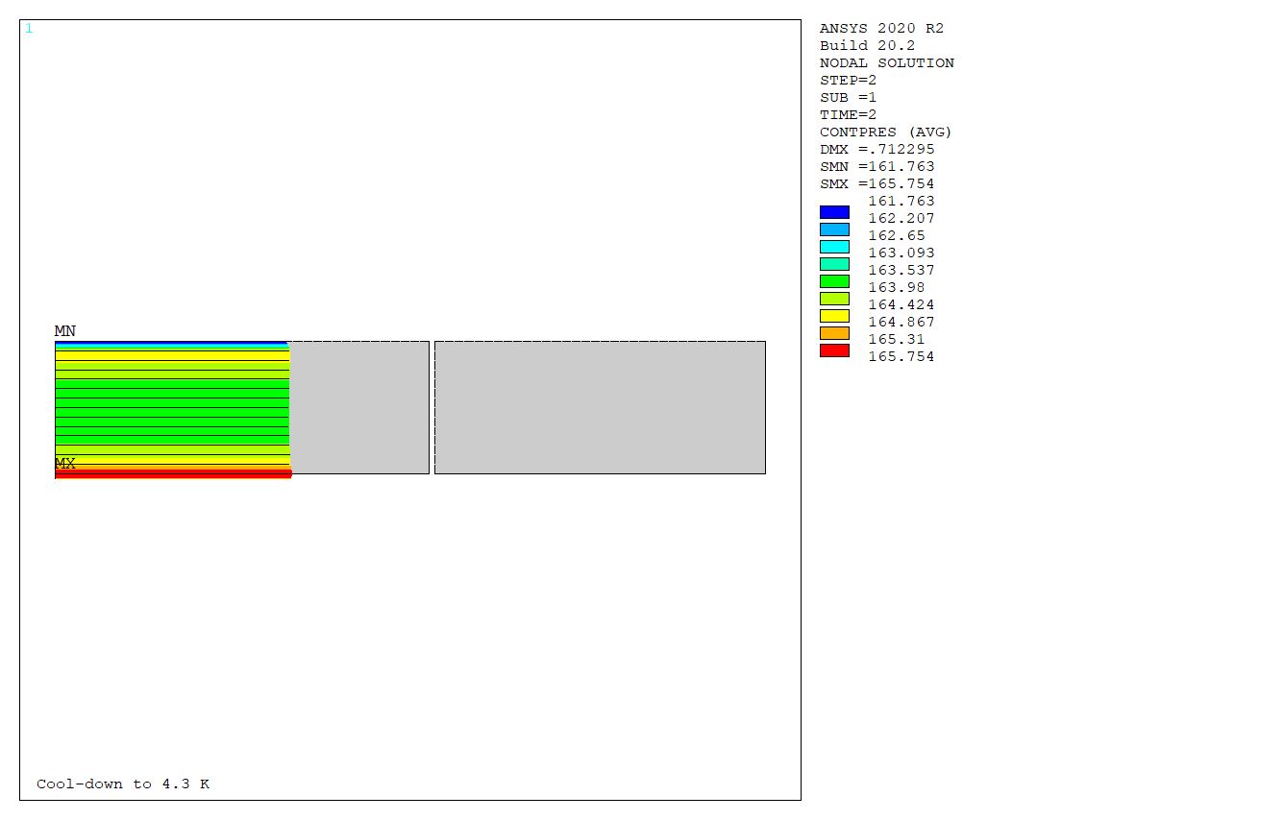
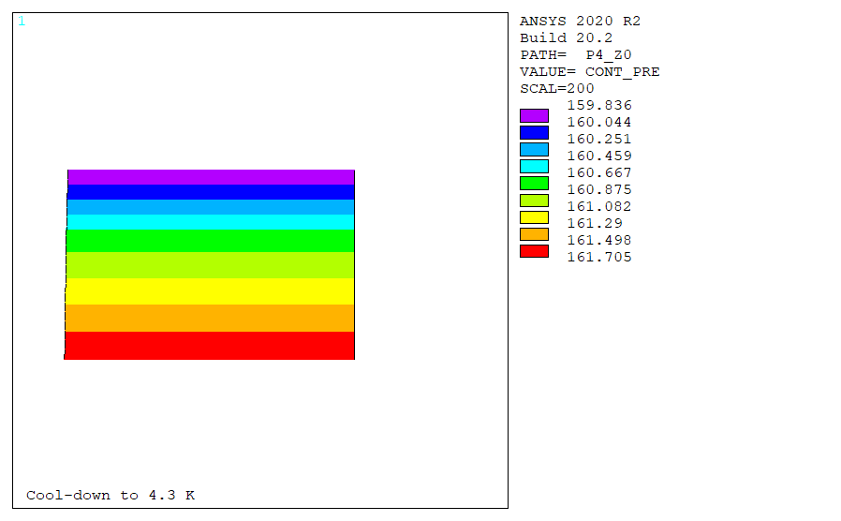
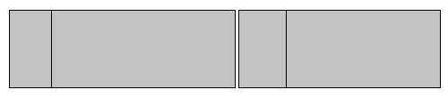
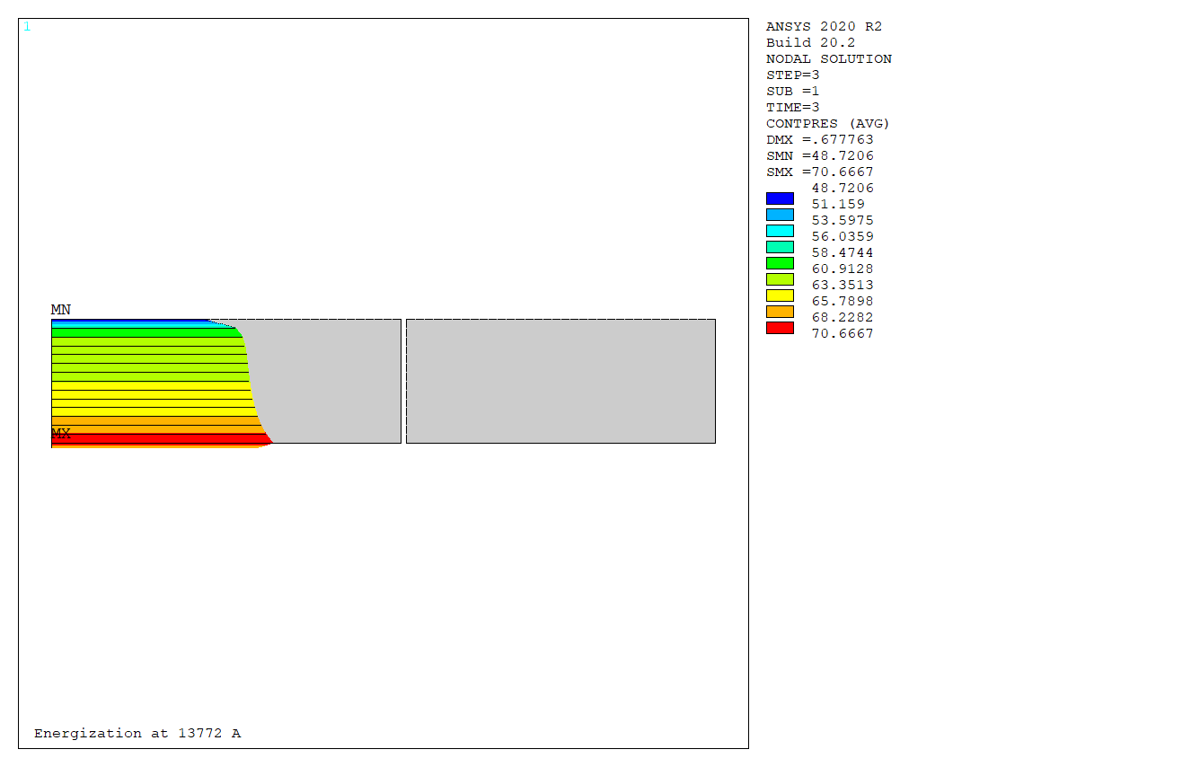
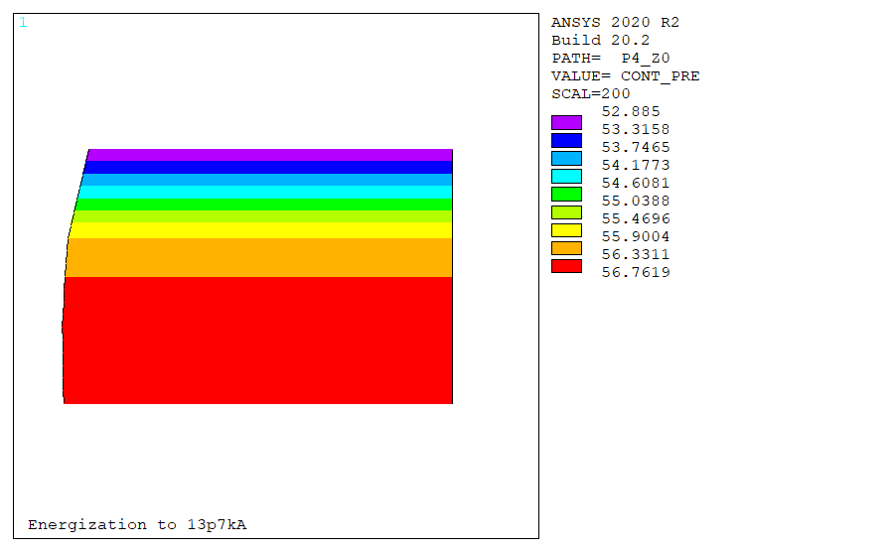
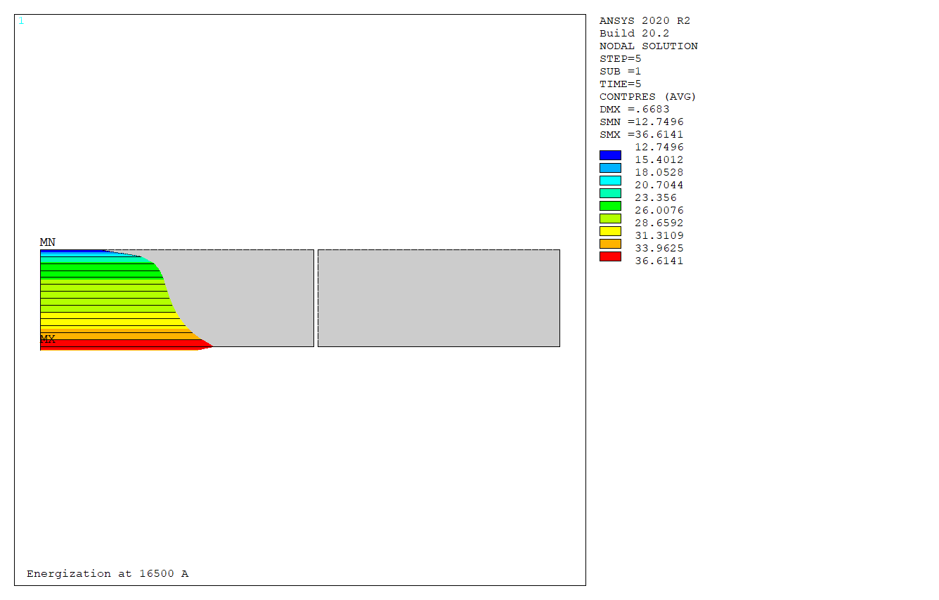
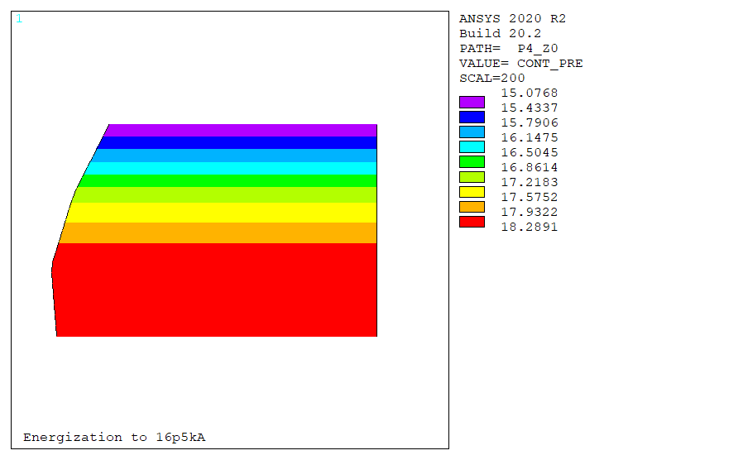
Pole Contact Pressure – 2D vs 3D (Ultimate)
2D
3D
162 MPa
Cool-down
160 MPa
49 MPa
53 MPa
13.7 kA Nominal current
12.7 MPa
15.1 MPa
16.5 kA Ultimate current
Profile and range very similar between 2D/3D
Difference <5 MPa in min. contact pressure
→ pre-load to be slightly corrected → +/-5 MPa on coil stress

Slide 13



VM Stress – 3D (Nominal)
0.25 mm Xinterf
Cool-down
~ 40 MPa
~ 130 MPa
13.7 kA Nominal current
~135 MPa
36 MPa
118 MPa
127 MPa
Higher stresses in coil-ends than in straight section
To be checked with longitudinal pre-load study
Peak stress still < 150 MPa at Nominal

Slide 14



VM Stress – 3D (Ultimate)
0.60 mm Xinterf
Cool-down
~95 MPa
~185 MPa
16.5 kA Ultimate current
~180 MPa
79 MPa
149 MPa
178 MPa
Higher stresses in coil-ends than in straight section
To be checked with longitudinal pre-load study
Peak stress still < 200 MPa at ultimate

Slide 15


Pole contact pressure – 3D (Nominal)
Lorentz forces @ Nominal current: F_{z,mag} = 350 kN /end
Xpreload: 0.25 mm interf.
Z Preload:
  warm: 400 kN = 115 % F_{z,mag}
  Cold: 641 kN = 183 % F_{z,mag}
→ Small >0 contact in the ends with relatively high pre-load
Small contact
Goals of the longitudinal support:
Positive contact pressure
Stress < criteria
No gap

Slide 16

Pole contact pressure – 3D (+ZPreload)
Lorentz forces @ Nominal current: F_{z,mag} = 350 kN /end
Xpreload: 0.25 mm interf.
Increasing Z Preload +40%:
  warm: 529 kN = 151 % F_{z,mag}
  Cold: 783 kN = 224 % F_{z,mag}
→ contacts >0 in the ends if very high pre-load
contacts
>30 MPa
No gap

Slide 17


Pole contact pressure – 3D (+X+ZPreload)
Lorentz forces @ Nominal current: F_{z,mag} = 350 kN /end
Increasing X preload: 0.6 mm interf.
Increasing Z Preload:
  warm: 565 kN = 162 % F_{z,mag}
  Cold: 831 kN = 238 % F_{z,mag}
→ But: contacts lost if transverse pre-load is too high
No contact
22 µm

Slide 18


Pole contact pressure – 3D (Ultimate)
Lorentz forces @ Ultimate current: F_{z,mag} = 477 kN /end
X preload: 0.6 mm interf.
Z Preload:
  warm: 565 kN = 119 % F_{z,mag}
  Cold: 831 kN = 174 % F_{z,mag}
→ Need to considerably increase the pre-load to guarantee full contact in the ends
No contact
(see 4, P. Manil for longitudinal pre-load concepts)
41 µm
13 µm

Slide 19
Conclusions
Attempt to assemble R2D2 coils in the F2D2 structure
  coil stress too high >200MPa
2D Parametric study to find the adequate shell and yoke radiuses
Peak stress in the coil <150 MPa at nominal, <200 at ultimate
Range of pre-load to guarantee 10 MPa coil-pole contact from nominal to SS operation
3D model to study coil-ends:
  Simplified RE symmetric geometry
  ‘Conventional’ tie-rods + end-plates
  Peak stress in coil-ends, but still below criteria
  Possible to guarantee full contact in the ends, but with very high forces in the rods
  Further studies required with detailed models

Slide 20
Thank You!

Slide 21
Model Flow
R2D2_2d_magn
R2D2_2d_mecha
Mat_prop_magn
Mat_prop_mecha
Geo_param
Coil\coil_coords_%coil_version%
Input code
I/O text file
Coil_model
Output Images
Results file
partnames_%magnet_version%
Structure_model
Structure\%part%_%struct_version%
Meshing
Contacts
(contact.mac)
SOLUTION
R2D2_2d_magn_%magnet_version%.rmg
Contact_list
Postproc_magn
%filename%_output
Load_steps
Postproc_fmag
%filename%_fmag
SOLUTION
EOF
Postproc_4
Contact pressure on coils, equivalent stress images
EOF
R2D2 v. 6.14.R2

Slide 22


Symmetry Conditions and Mesh

Slide 23
Minimum Rod Diameter Approximation
3D Magnetic Model: Full energy/length @ 1.9 K, Short Sample (18 kA) = 204 kJ/m per quadrant
F_{z,mag} = 816 kN.
Assuming resultant forces on end-shoes and end-plates are the same.
Assuming 30 % of efforts coming from differential contraction with Al rods (to be checked with mechanical model)
We aim at 100 % of magnetic forces in z after preload at room temperature (RT) + cool-down (CD)
F_{z,RT+CD} = F_{z,mag} = -816 kN
Assumption: 70% of forces are applied at room temperature:
F_{z,RT} = F_{jack} = -571 kN
Force on one rod:
F_{z,rod} = F_{z,mag}/N_{rods} = σ x A_{rod} = σ x ϖd_{rod}²/4

Slide 24




Comparison 2D Vs 3D
2D
3D

Slide 25
R2D2 3D – iso geometric

Slide 26

Forces
Forces imported from Opera 3D
RE,
nominal current 13.7 kA
Per octant
 |  | Fx | Fy | Fz
coil1 | kN | 136 | -16.5 | 8.5
coil2 | kN | 415.3 | -126.8 | 36.7
coil3 | kN | 150.1 | -91.6 | 17.2
coil4 | kN | 28.6 | -319.6 | 25.1
coil | kN | 651.5 | -518.9 | 87.4
Opera | kN | 646 | -491 | -90.3
 |  | HF | LF | total
Fx | kN/m | 1698 | 112 | 1810
Fy | kN/m | -469 | -752 | -1221
Fz | kN/m | 41 | 77 | 118

Slide 27






VM Stress – 2D vs 3D (Nominal)
2D
0.40 mm Xinterf
0.05 mm Yinterf
Cool-down
Nominal current
3D

Slide 28






X Stress – 2D vs 3D (0.2 mm interf)

Slide 29






Pole Contacts – 2D vs 3D (Nominal)
2D
0.40 mm Xinterf
0.05 mm Yinterf
Cool-down
Nominal current
3D

Slide 30






Stresses in Structure – 2D vs 3D (0.2 mm)

Slide 31



VM Stress – 3D

Slide 32



VM Stress – 2D vs 3D (0.8 mm)
2D
3D
0.80 mm Xinterf
0.05 mm Yinterf
104 MPa
Cool-down
168 MPa
201 MPa
16.5 kA Ultimate current

Slide 33
Longitudinal preload
Nominal current
0.25 mm xinterf
0.6 mm xinterf
0.25 mm xinterf

