Slide 1
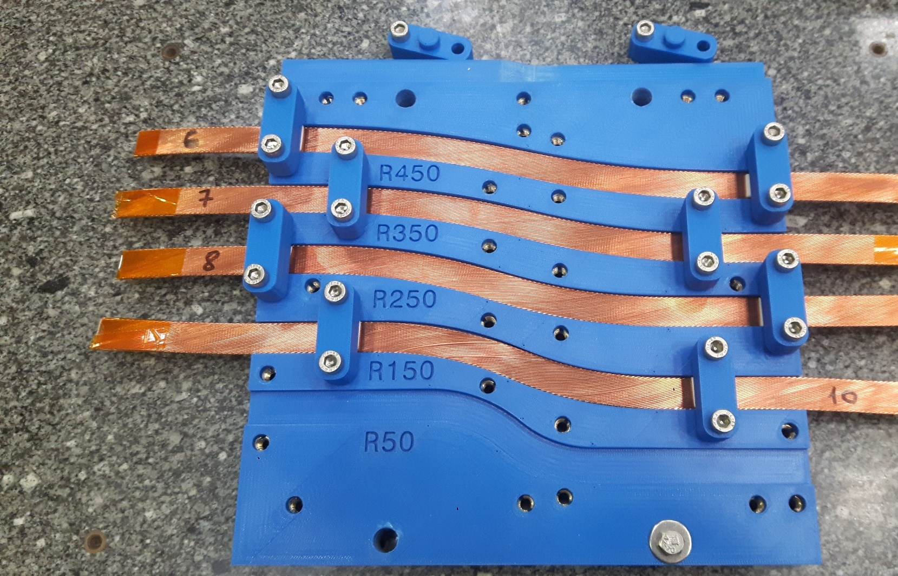

Conceptual Design Review of R2D2
5
- Coil R&D -
https://indico.cern.ch/event/1003865/
CEA: M. Durante, E. Rochepault, V. Calvelli, H. Felice,
P. Mallon, P. Manil, G. Minier, G. Maitre, B. Prevet,
S. Perraud, F. Rondeaux
CERN: S. Izquierdo Bermudez, J.C. Perez, D. Tommasini,
J. Fleiter, H. Felice
09/03/2021

Slide 2
Open questions requiring R&D
What are the safe bending parameters for coil winding?
How to handle the different cables in graded coils ?
How to deal with longitudinal contraction during heat treatment?
How to guide and secure the exits to the outside of the coils?
How to provide margins (geometric, magnetic, mechanical…) to the exit path?
How to perform all the joints in a compact area?
How to apply longitudinal pre-stress without damaging the joint area?
What will be the mechanical behavior of the coils?
What level of transverse pre-stress to apply?
How to guarantee the pre-stress is controlled and reproducible?
Winding R&D
Heat treated winding R&D
Splices R&D
Structure R&D

Slide 3
Coil R&D and tests
Bending tests
Winding mock up
Heat treated cable stacks
Heat treated short coils
Splice tests
Splice mock up
Cable and winding characterization :
  Jc measurements on strands
  Jc measurements on cable under pressure
  Thermomechanical measurements on impregnated cable stacks
Winding R&D
Heat treated winding R&D
Splices R&D

Slide 4
Cable for tests
R2D2 Cable (bare) | # of strands | strand Ø [mm] | Thickness [mm] | Width [mm] | Tp [mm] | Core | Insulation thickness [mm]
R2D2 HF | 21 | 1.1 | 1.97 | 12.58 | 85 | non | 0.15
R2D2 LF | 34 | 0.7 | 1.25
F2D2/R2D2 cables not available today
No existing cable with 1.1 mm diameter strand
FRESCA2 experience has shown that SC conductor is necessary for bending tests
For first bending test campaign we looked for superconducting cable with dimensions as near as possible to final ones
Available cables | Cable (bare)
 | Strand (N x Ø) [mm] | Width [mm] | Thickness [mm] | Keystone [°] | tp | Core
DS 11 T SC | 40 x 0.7 | 14.7 | 1.25 | 0.791 | 100 | 25µm
SMC 11T | 40 x 0.7 | 14.7 | 1.25 | 0 | 100 | non
QXF | 40 x 0.85 | 18.15 | 1.525 * | 0.55 |  | non
FRESCA2 | 40 x 1 | 20.9 | 1.82 | 0 | 120 | non
Hard-way bending tests
Splice tests
Easy-way bending tests

Slide 5
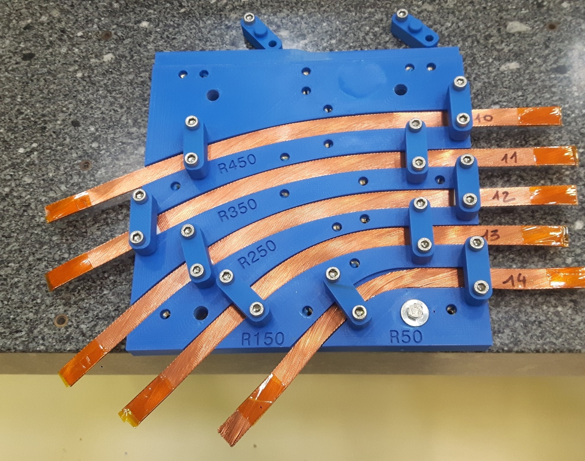


Bending tests
Hardway bending tests – SMC 11T bare cable - C shape
Without winding tension
OK
OK
OK
Too many strand popping
Cable collapsing
250 mm
STRAND POPPING

Slide 6
Bending tests
Hardway bending tests – SMC 11T bare cable – layer jump S shape
Without winding tension
OK
OK
OK
Many strand popping
STRAND POPPING
250 mm

Slide 7
Bending tests
The minimum hard-way bending radius has been fixed to 450 mm
Even if bending radius over 300 mm is considered as acceptable (for instance in order to reduce coil end length)
→ Coil Layer jumps or exit jumps
To be confirmed with final R2D2 cables

Slide 8
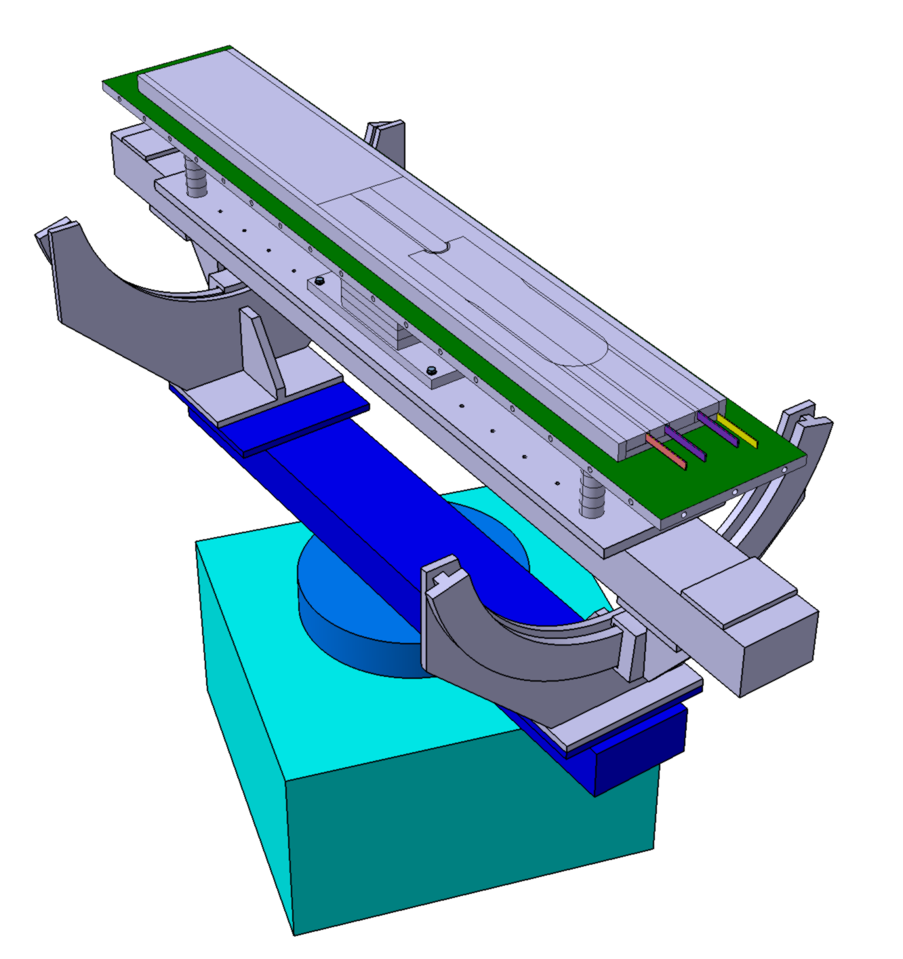
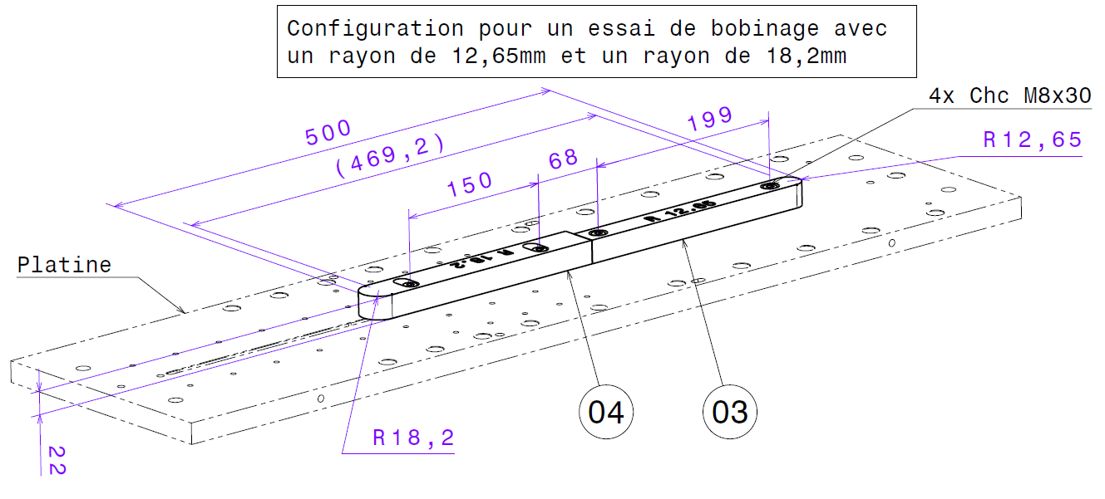
Bending tests
Easy way bending tests realised with FRESCA2 cable, on winding machine
Winding tension applied
Mandrel radius adapted to FRESCA2 cable thickness in order to have:
The same easy-way bending factor (6.95) than for F2D2 cable in F2D2
→ R 12.65 mm
A conservative easy-way bending factor of 10 → R = 18.2 mm

Slide 9
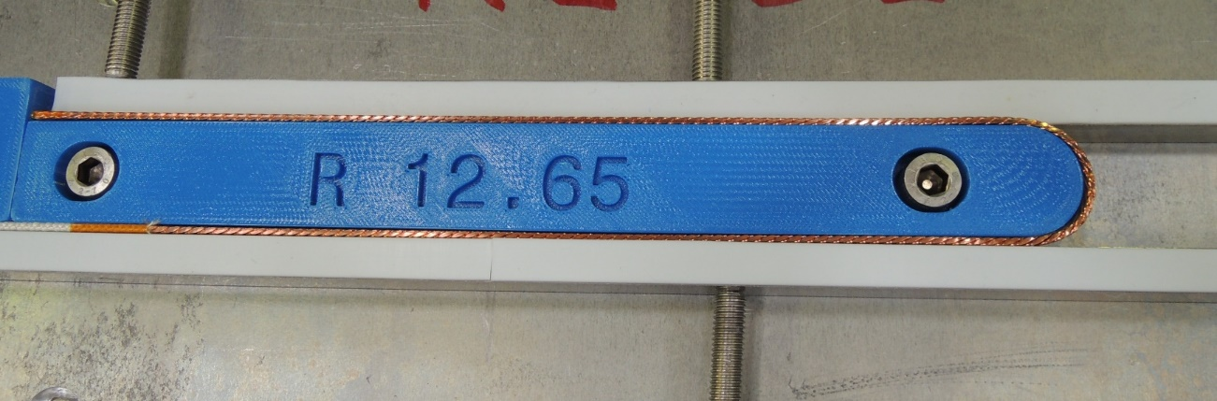
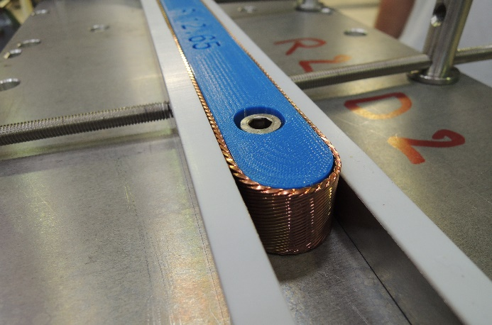
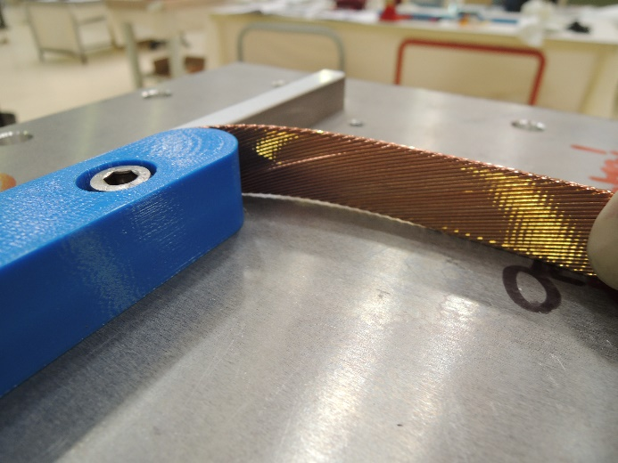
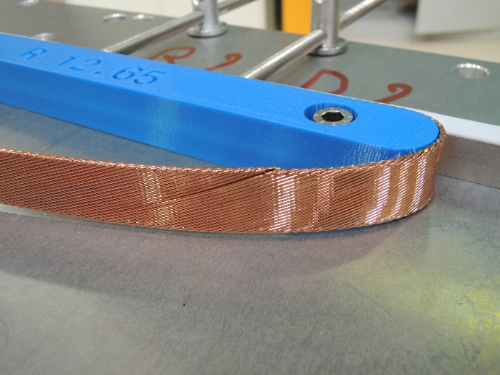
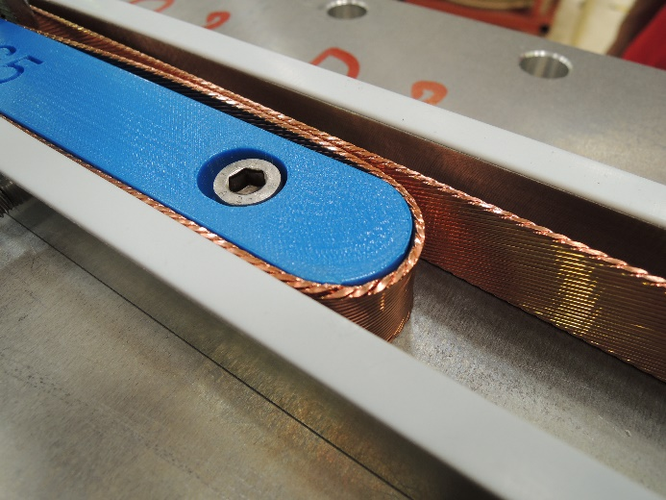
Bending tests
EWBF 6.95, FRESCA2 bare cable Winding tension 10kg
Strand popping, inside and outside the bending
Cable difficult to fix against the mandrel, tend to relax as soon as the lateral pression is over
Dishing, deformation of the cable, top and bottom
STRAND POPPING

Slide 10
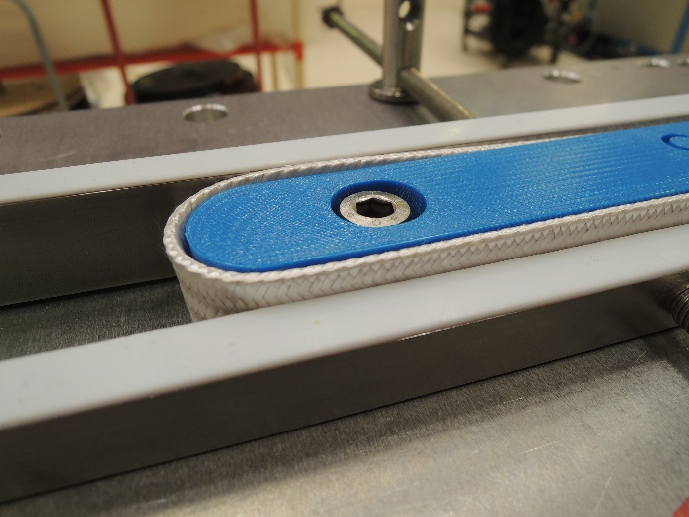
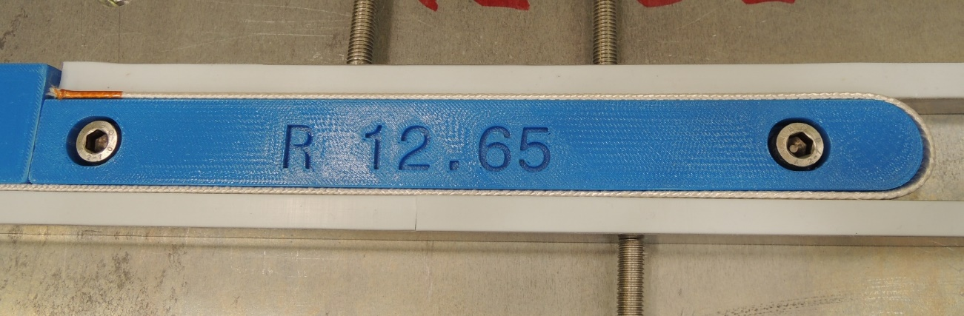
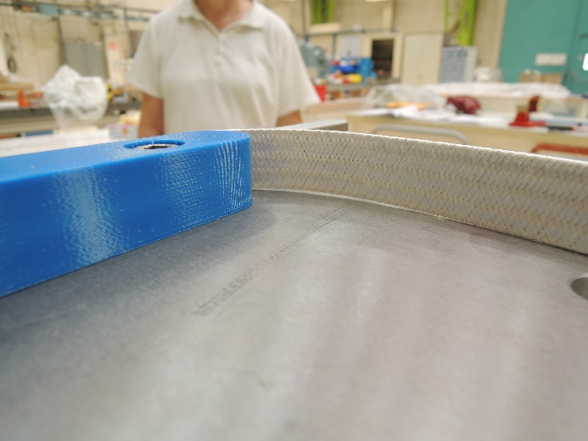
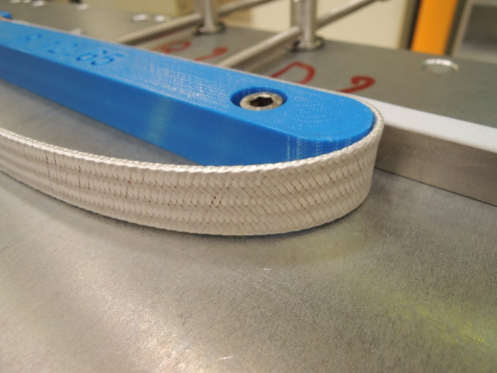
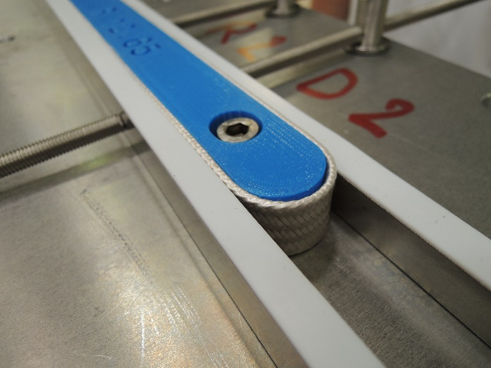
Bending tests
EWBF 6.95, FRESCA2 insulated cable Winding tension 10kg
Strand popping, inside the bending
Cable difficult to fix against the mandrel, tend to relax as soon as the lateral pression is over
Dishing, deformation of the cable, top and bottom

Slide 11
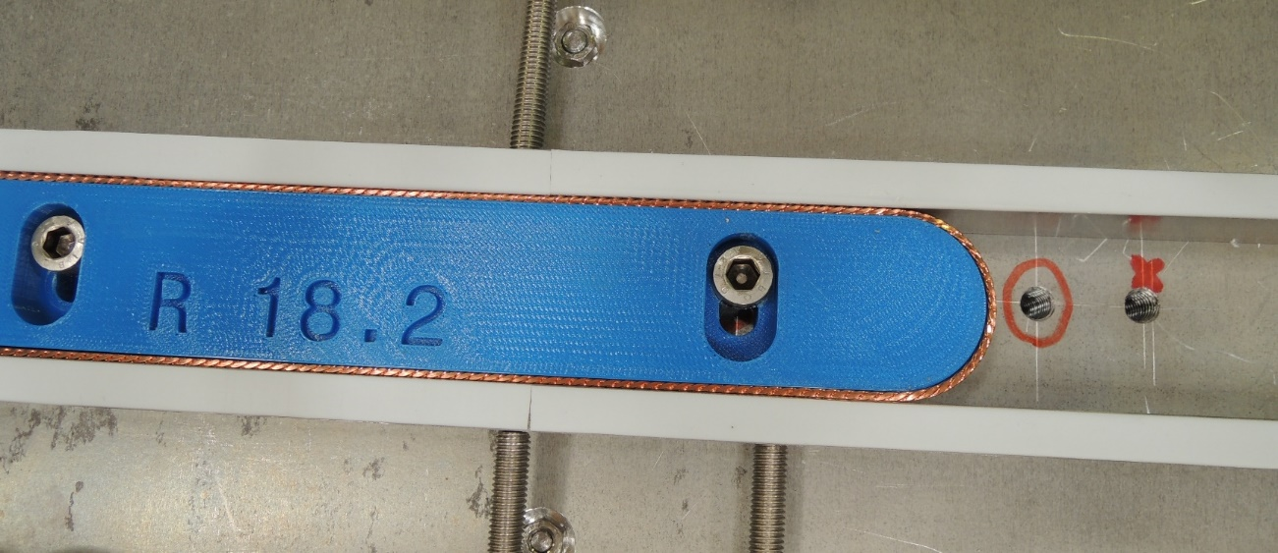
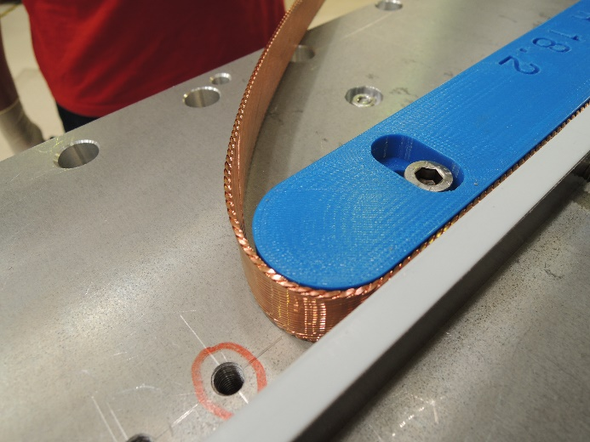
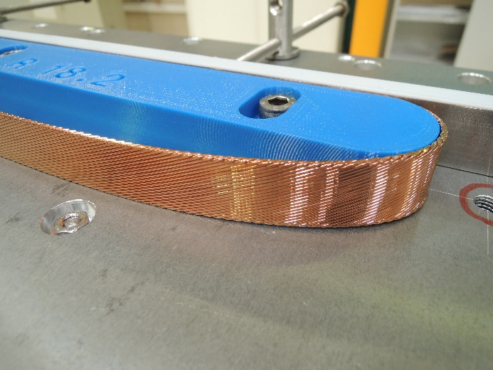
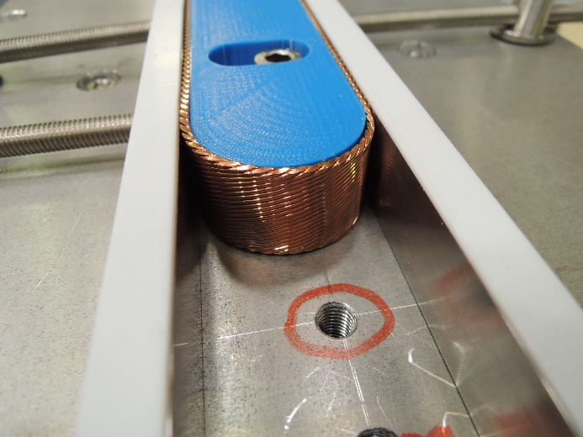
Bending tests
EWBF 10, FRESCA2 bare cable Winding tension 10kg
Strand popping inside the bending, not continuing outside, easy to be replaced
STRAND POPPING INSIDE

Slide 12
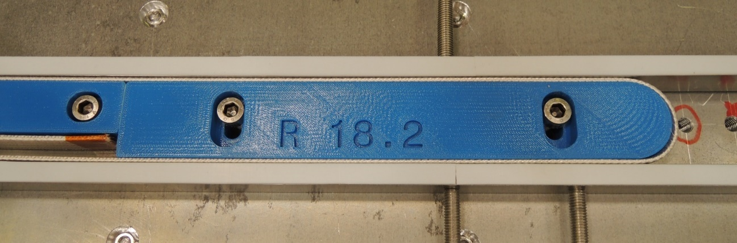
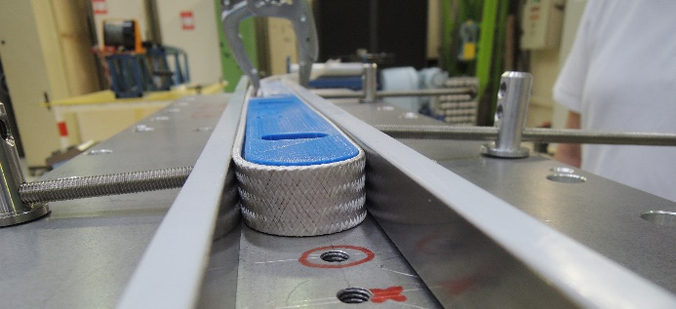
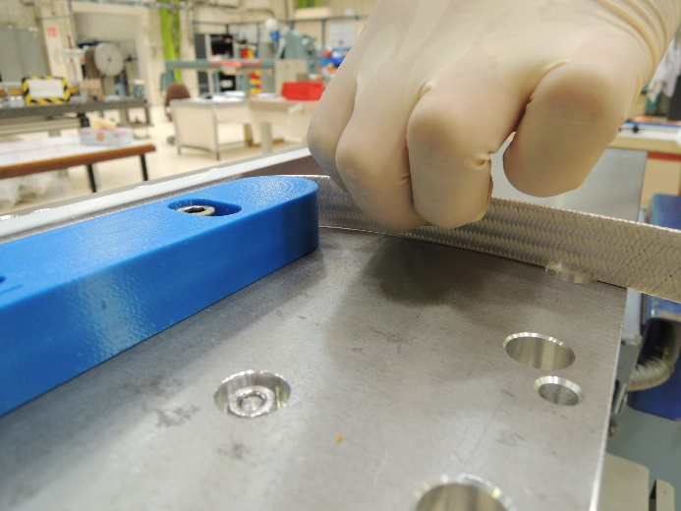
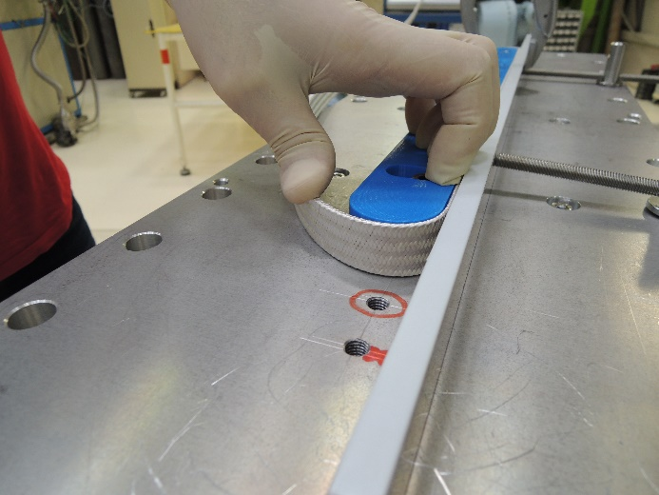
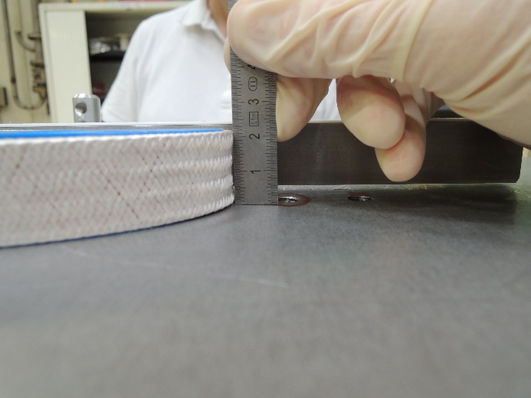
Bending tests
EWBF 10, FRESCA2 insulated cable Winding tension 10kg → 15 kg
No strand popping
Dishing

Slide 13
Bending tests
An easy-way bending factor of 10 seems acceptable
→ Minimum EW bending radius in the coil of 19.7 mm
To be confirmed with final R2D2 cables

Slide 14
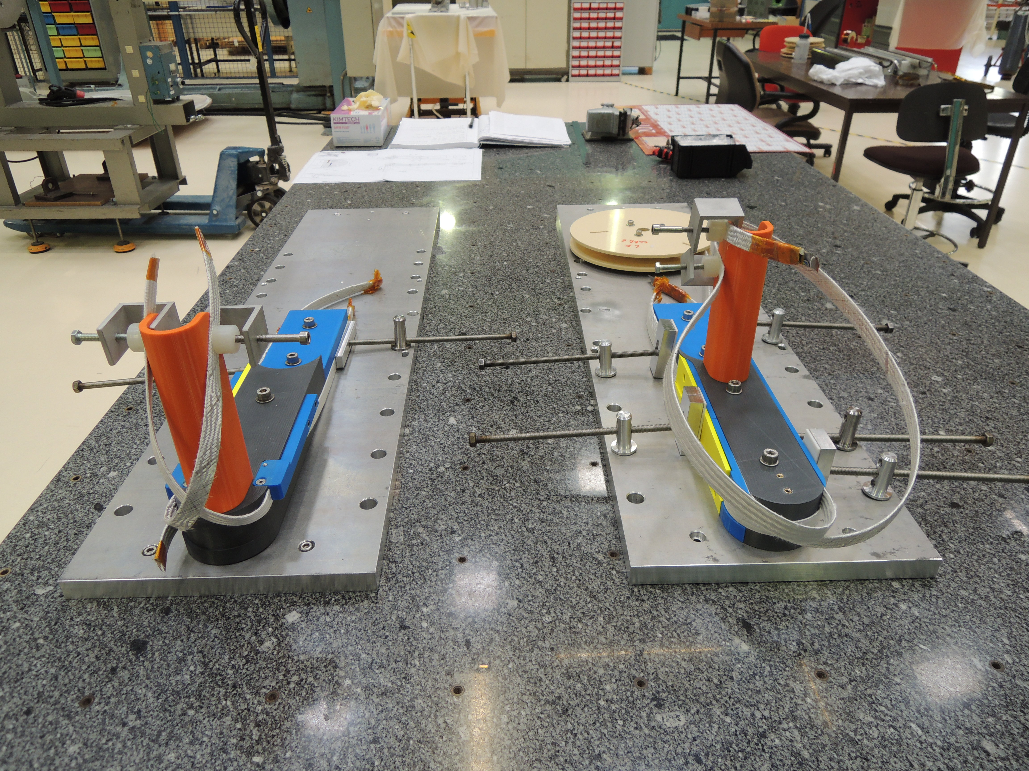
Winding tests (realized for F2D2)

Slide 15
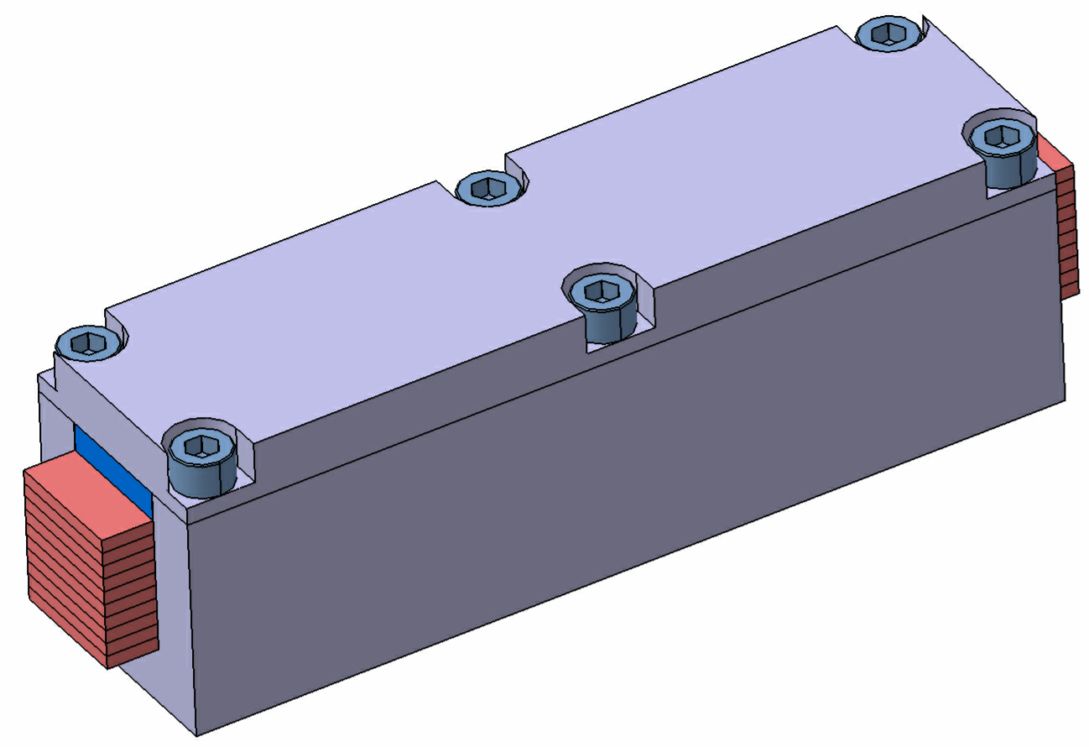
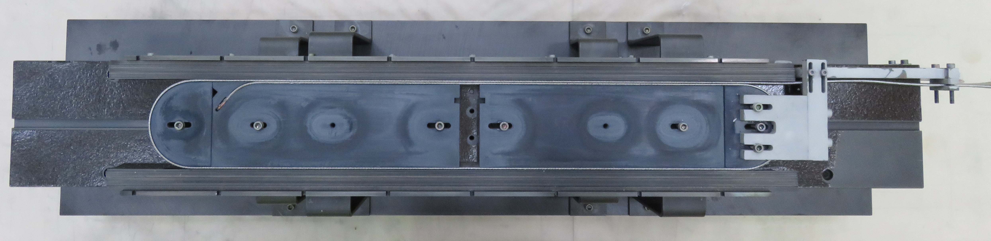
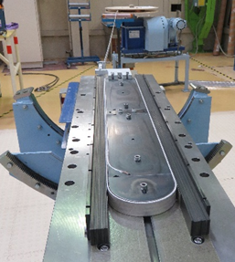
Heat treated coils and stacks
Height measurement campaign on cable stacks made from final superconducting cables, heat treated in free and fixed cavities
Short coils made from R2D2 final superconducting cables
In parallel thesis by Mahmoud ABDEL HAFIZ on cable dimensional changes during heat treatement

Slide 16
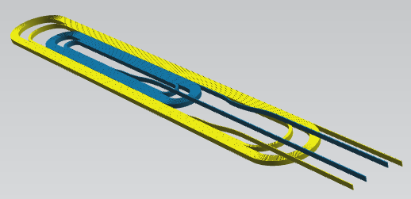
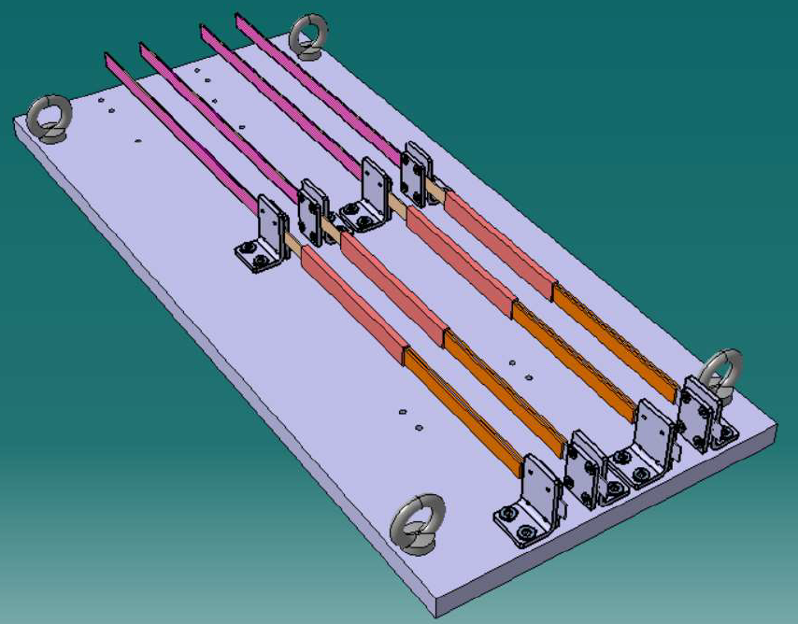
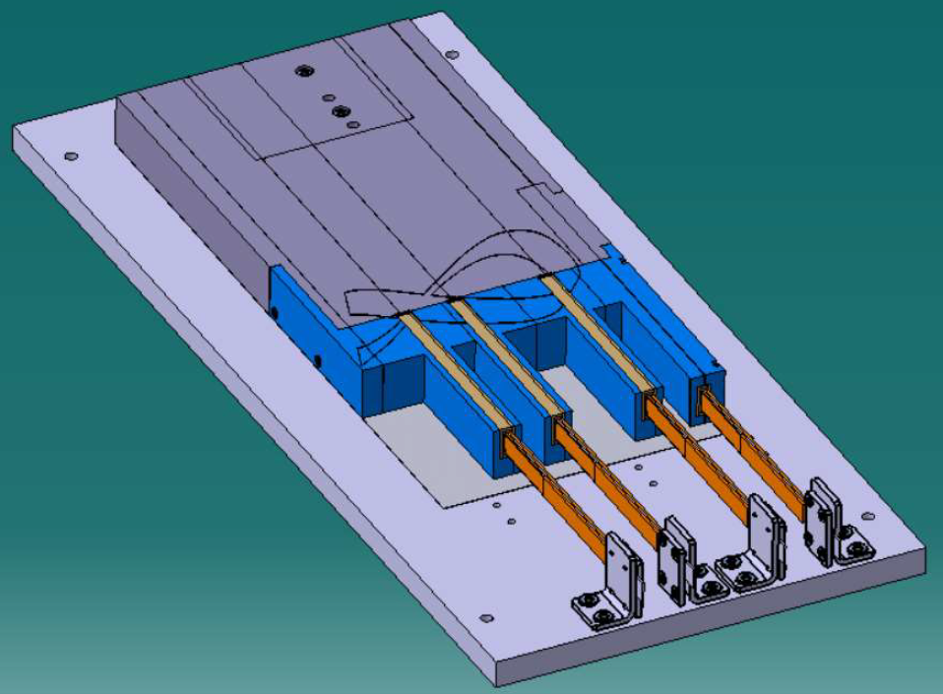
Splices R&D
Coil ends handling and splice realisation in a quite crowded region
a. Splices tests b. Coil Splices Mockup

Slide 17
SPLICES R&D – SPLICE LAYOUT
150 mm (for 82-mm tp)
Stabilized NbTi
Nb3Sn
Cua1
Stabilized NbTi
Insulation
Nb3Sn

Slide 18
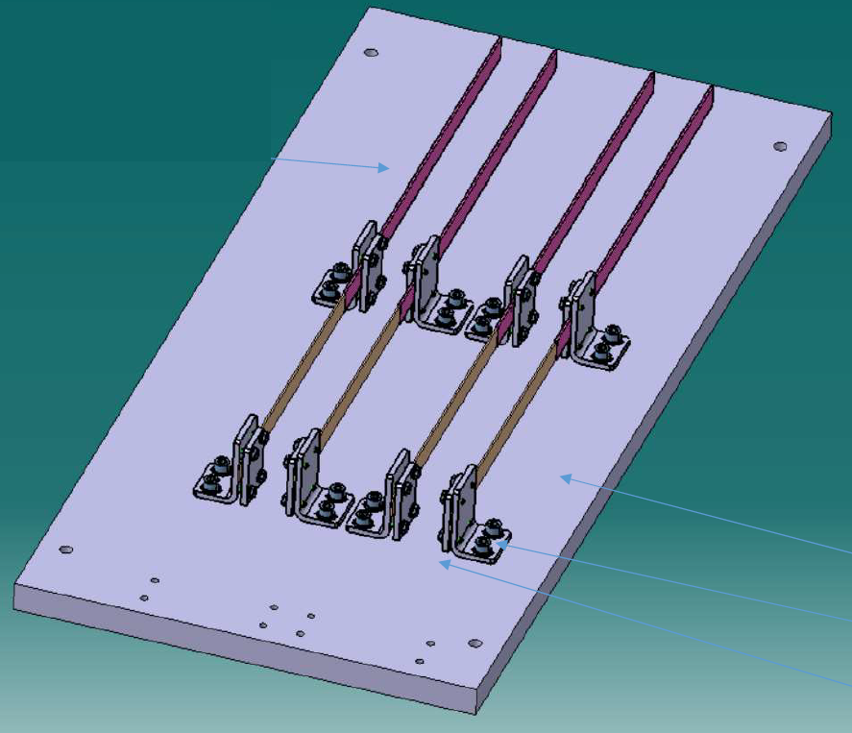
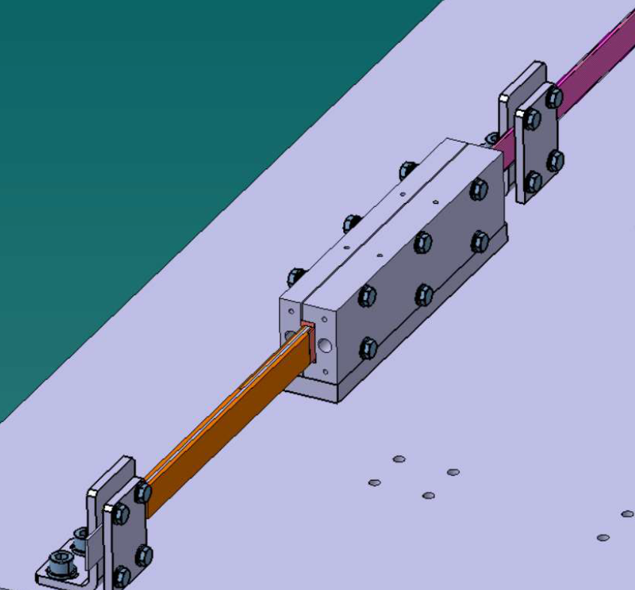
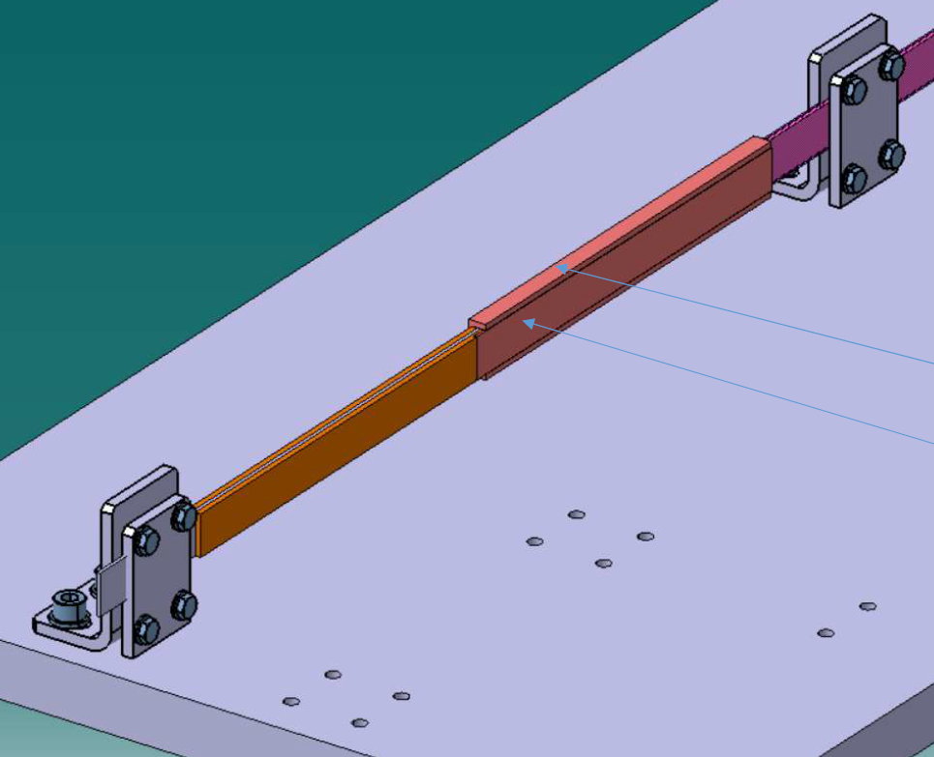
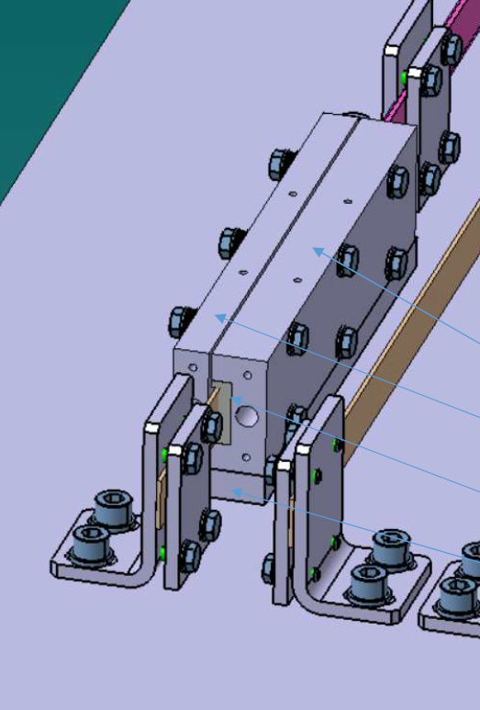
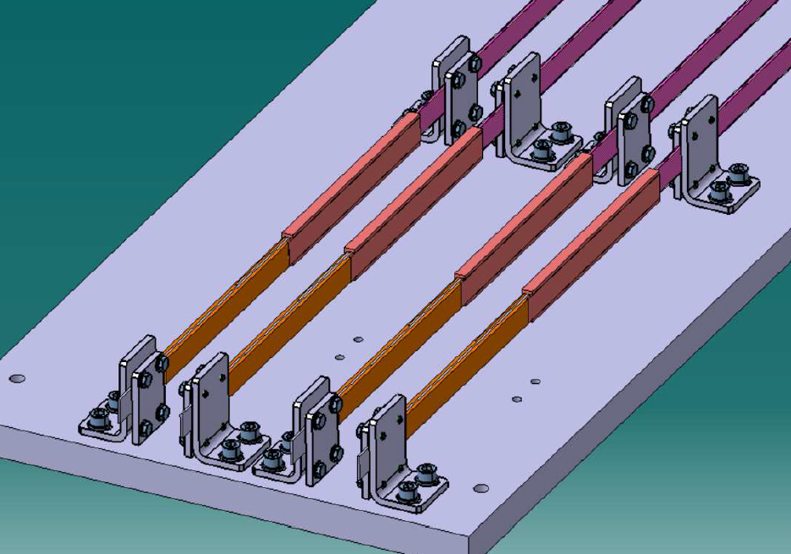
Splices R&D – Splices Tests
Target : Validate splices design, components and splicing procedure
Cable exits Cable Tinning Splice soldering Splice

Slide 19
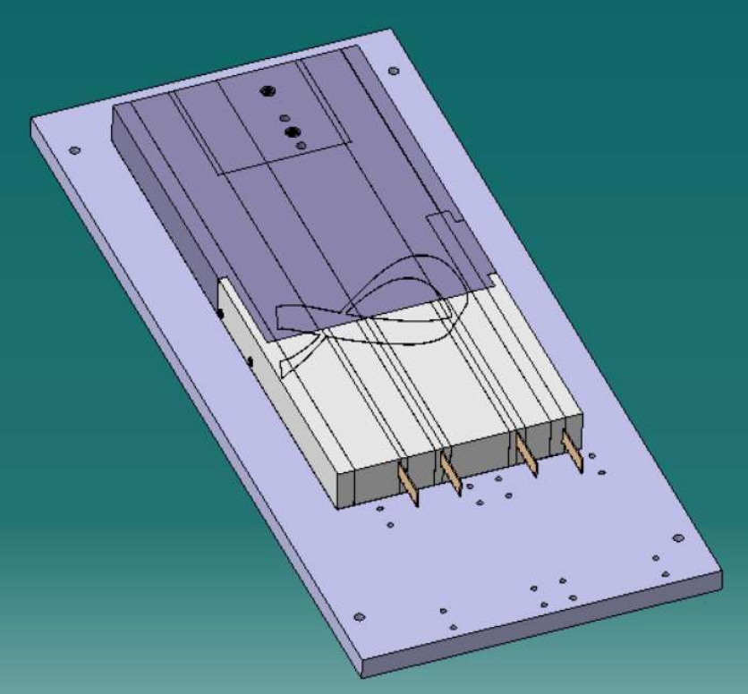
Splices R&D – Coil Splices Mockup
Mockup of the coil end cables in the reaction mold parts, as they will be at the end of the heat treatment
LF exit modified to allow splice soldering

Slide 20
Splices R&D – Coil Splices Mockup
First LF Splice
Cable exits Cable preparation Splice soldering
Splice Splice insulation Insulated splice Splice final support

Slide 21
Splices R&D – Coil Splices Mockup
First HF Splice
Second HF Splice
Second LF Splice

Slide 22
Splices R&D – Coil Splices Mockup
Protection tools of the other cables during splice operation
Coil ends studies
Space available for Longitudal prestress (tested elsewhere) ?

Slide 23
Coil R&D and tests - Status
Bending tests
Winding mock up
Heat treated cable stacks
Heat treated short coils
Splice tests
Splice mock up
Cable and winding characterization :
  Jc measurements on strands
  Jc measurements on cable under pressure
  Thermomechanical measurements on impregnated cable stacks
Done with SMC and FRESCA2 cable – waiting for final cables
Test campaign program to be defined - waiting for final cables
Tools under realization – delivery foreseen by the end of March – waiting for SMC cable short lengths for tests
Test campaign program to be defined
- waiting for final cables

Slide 24
Spares

Slide 25
Bibliography on minimum bending radius
Magnet | status | Cable (bare) |  |  |  | Easy-way min R (EWBF) [mm (/)] | Hard-way min R (HWBF) [mm (/)]
 |  | Strand N x Ø [mm] | Width [mm] | Thickness [mm] | Keystone [°]
HQ | Tested | 35 x 0.8 | 15.15 | 1.437 * | 0.75 |  | 645 (42.57)
11 T | Tested | 40 x 0.7 | 14.95 | 1.253 | 0 | 8 (6.4)
QXF | Tested | 40 x 0.85 | 18.15 | 1.525 * | 0.55 |  | 793 (43.7)
FRESCA2 | In use | 40 x 1 | 20.9 | 1.82 | 0 | 44.7 (24.6) | 700 (33.5)
HD2 | Tested | 51 x 0.8 | 21.86 | 1.40 | 0 | 11.8 (8.4) | 380 (17)
RMM | In fab. | 40 x 1 | 20.9 | 1.82 | 0 | 14 (7.7)
F2D2 HF | Design | 21 x 1.1 | 12.58 | 1.97 | 0 | 13.69 (6.95)** | 450 (36)
R2D2 HF | Design |  |  |  |  | 19.7 (10)
F2D2 LF | Design | 34 x 0.7 |  | 1.25 | 0 | 20 (16)**
R2D2 LF | Design
easy-way bending factor, EWBF = R_{EW}/t_{cbl}
hard-way bending factor, HWBF = R_{HW}/w_{cbl}
*mid-thickness
**from ECC magnetic design

Slide 26
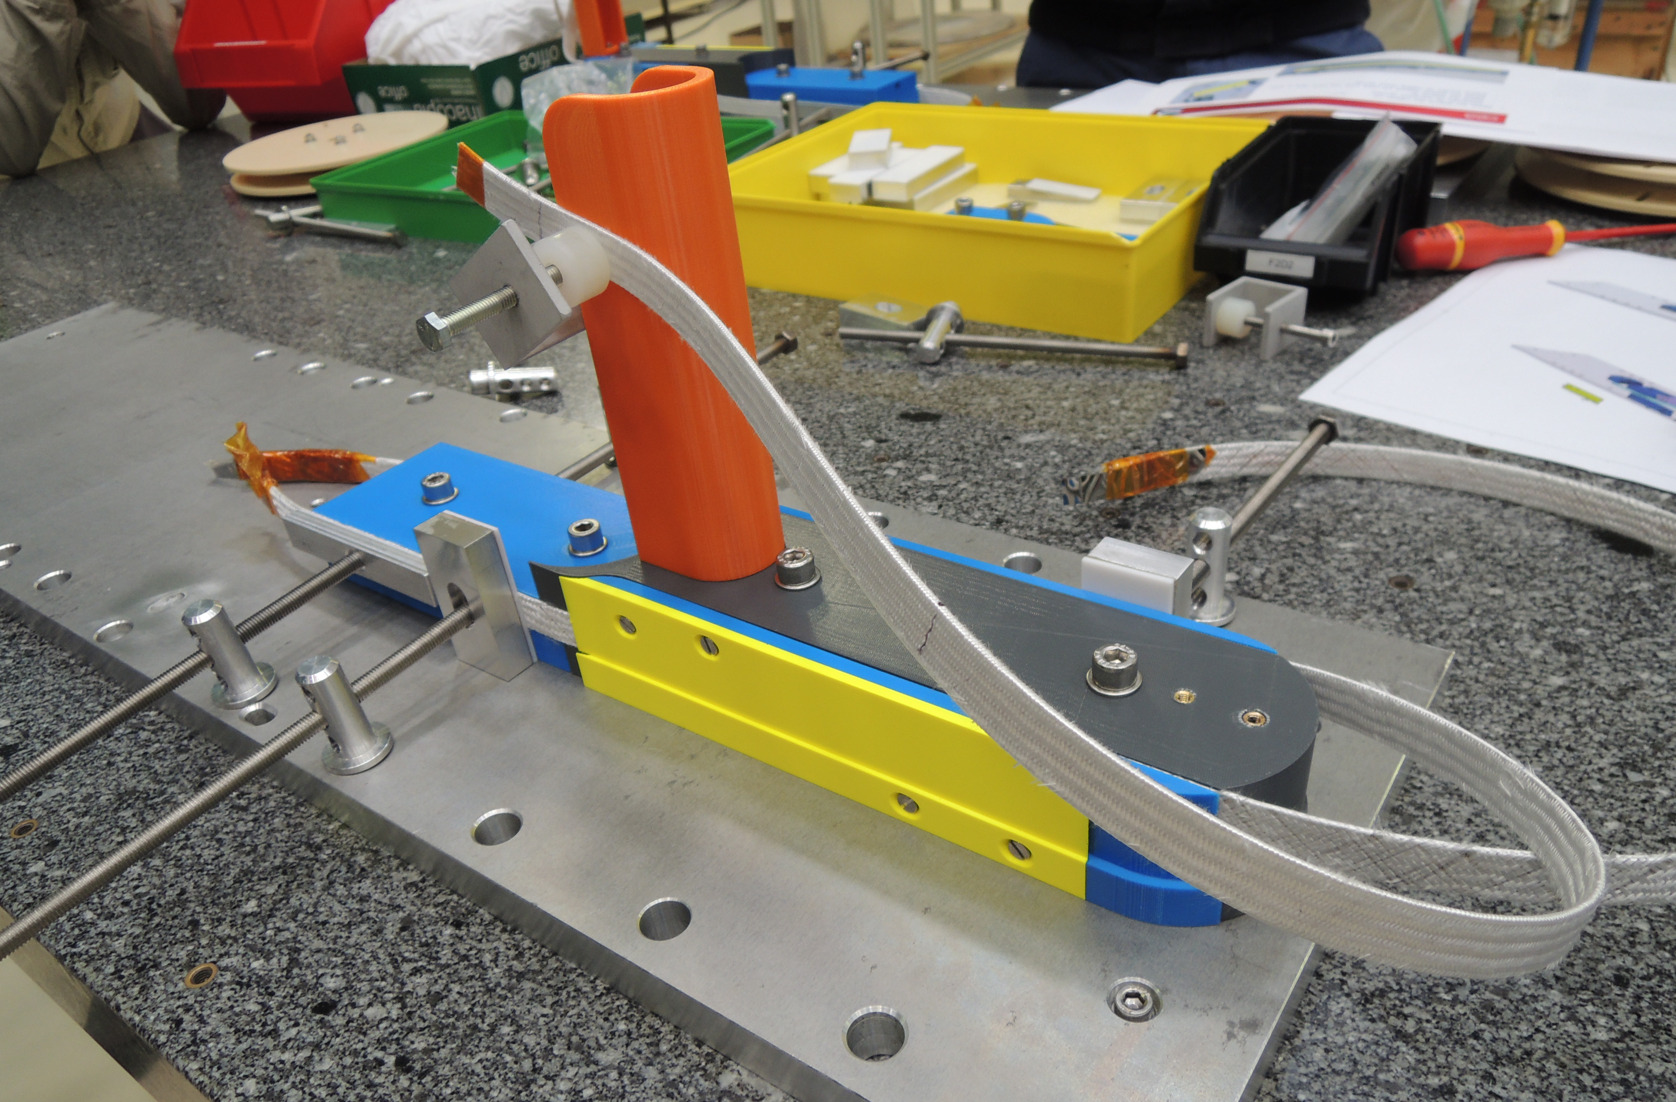
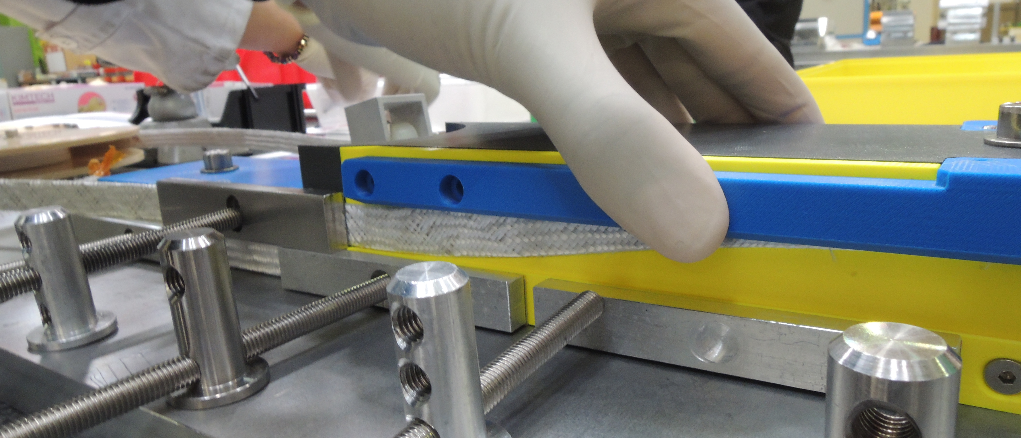
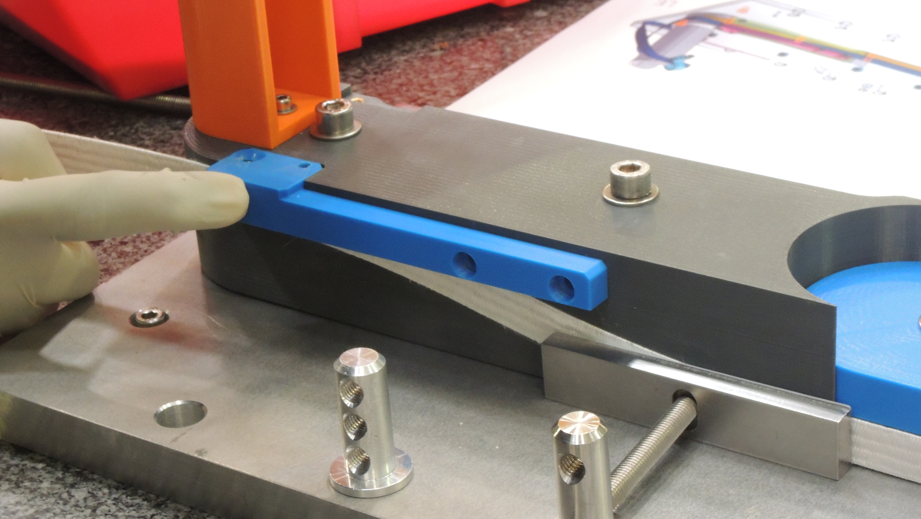
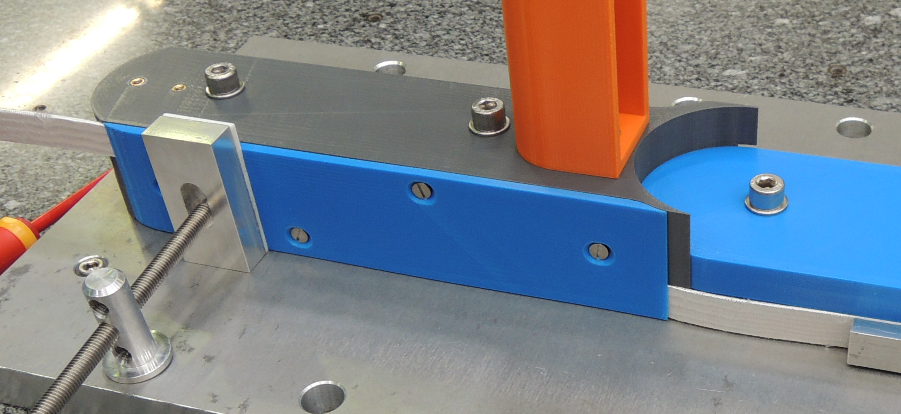
Winding tests (for F2D2) – HF cable exits
F2D2 Options A and B for HF end cable fixing tools and procedure
3HF
4HF
4HF

Slide 27
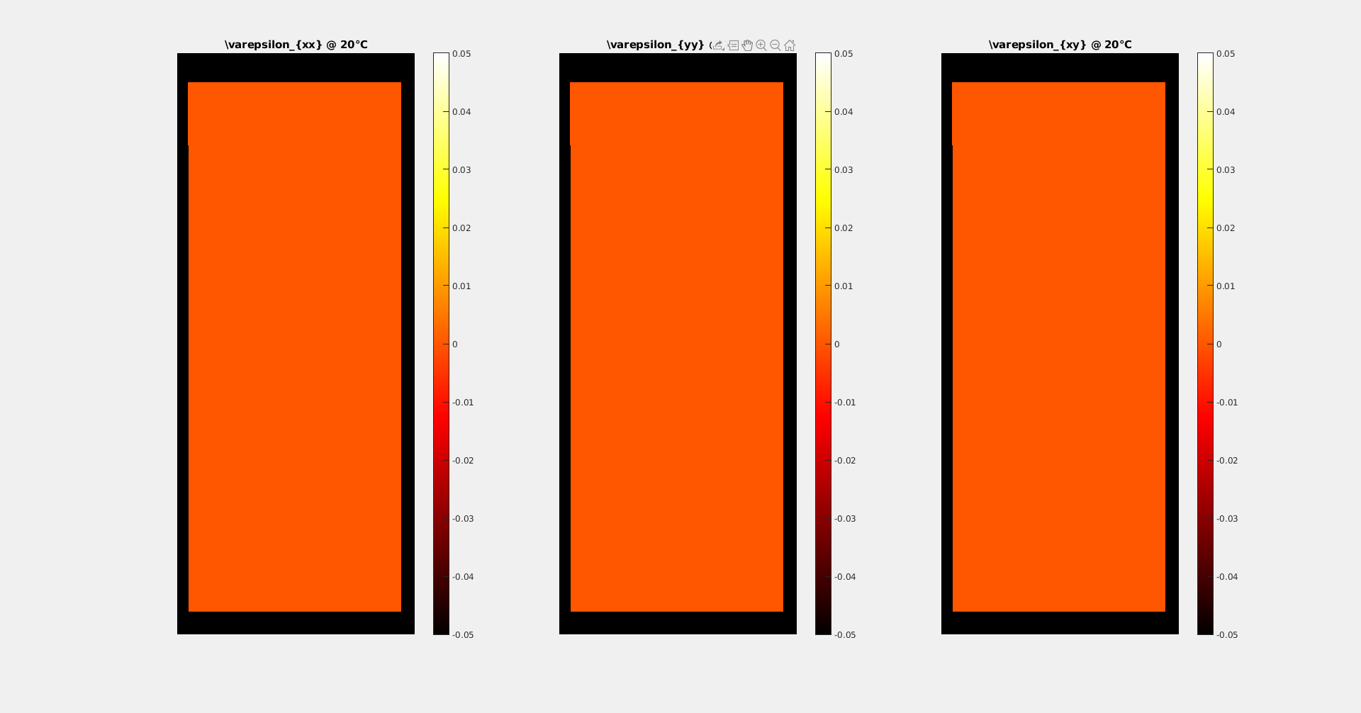
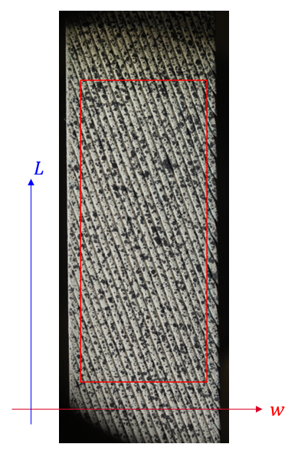
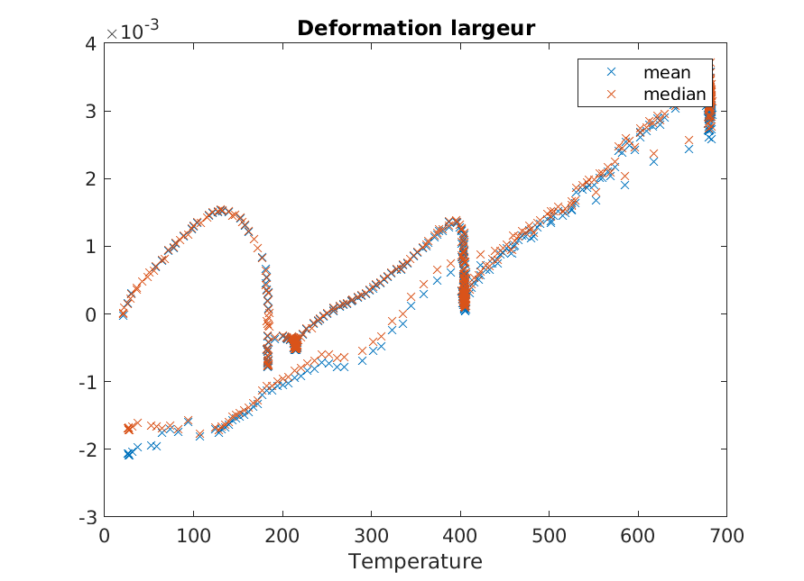
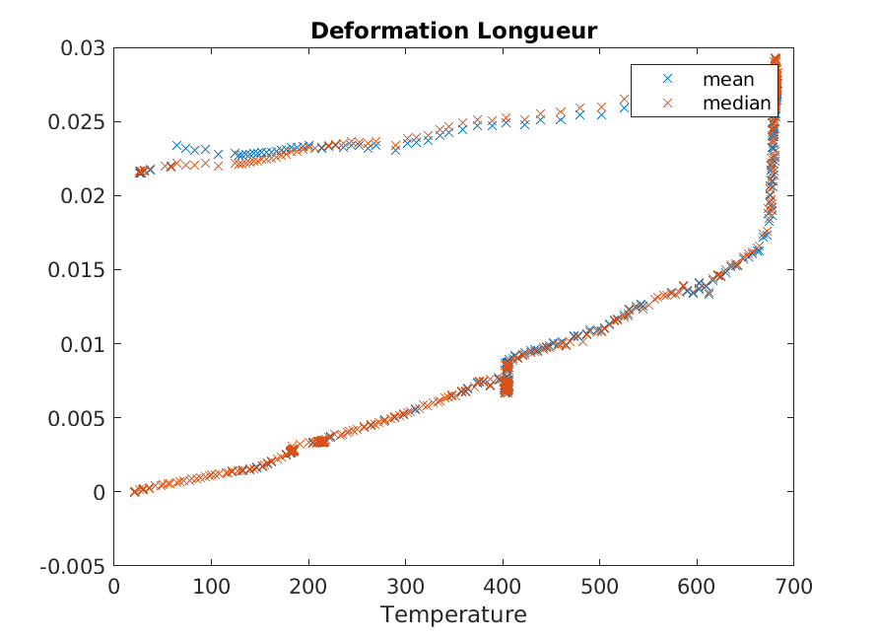
Mesure à échelle du Brin (déformations)
Length [mm/m]
Digital Image Correlation (PhD thesis Mahmoud ABDEL HAFIZ):
displacement field of cables as a function of temperature
Fundamental approach
Not applicable to large coils (for the moment)
Width [mm/m]

