Slide 1
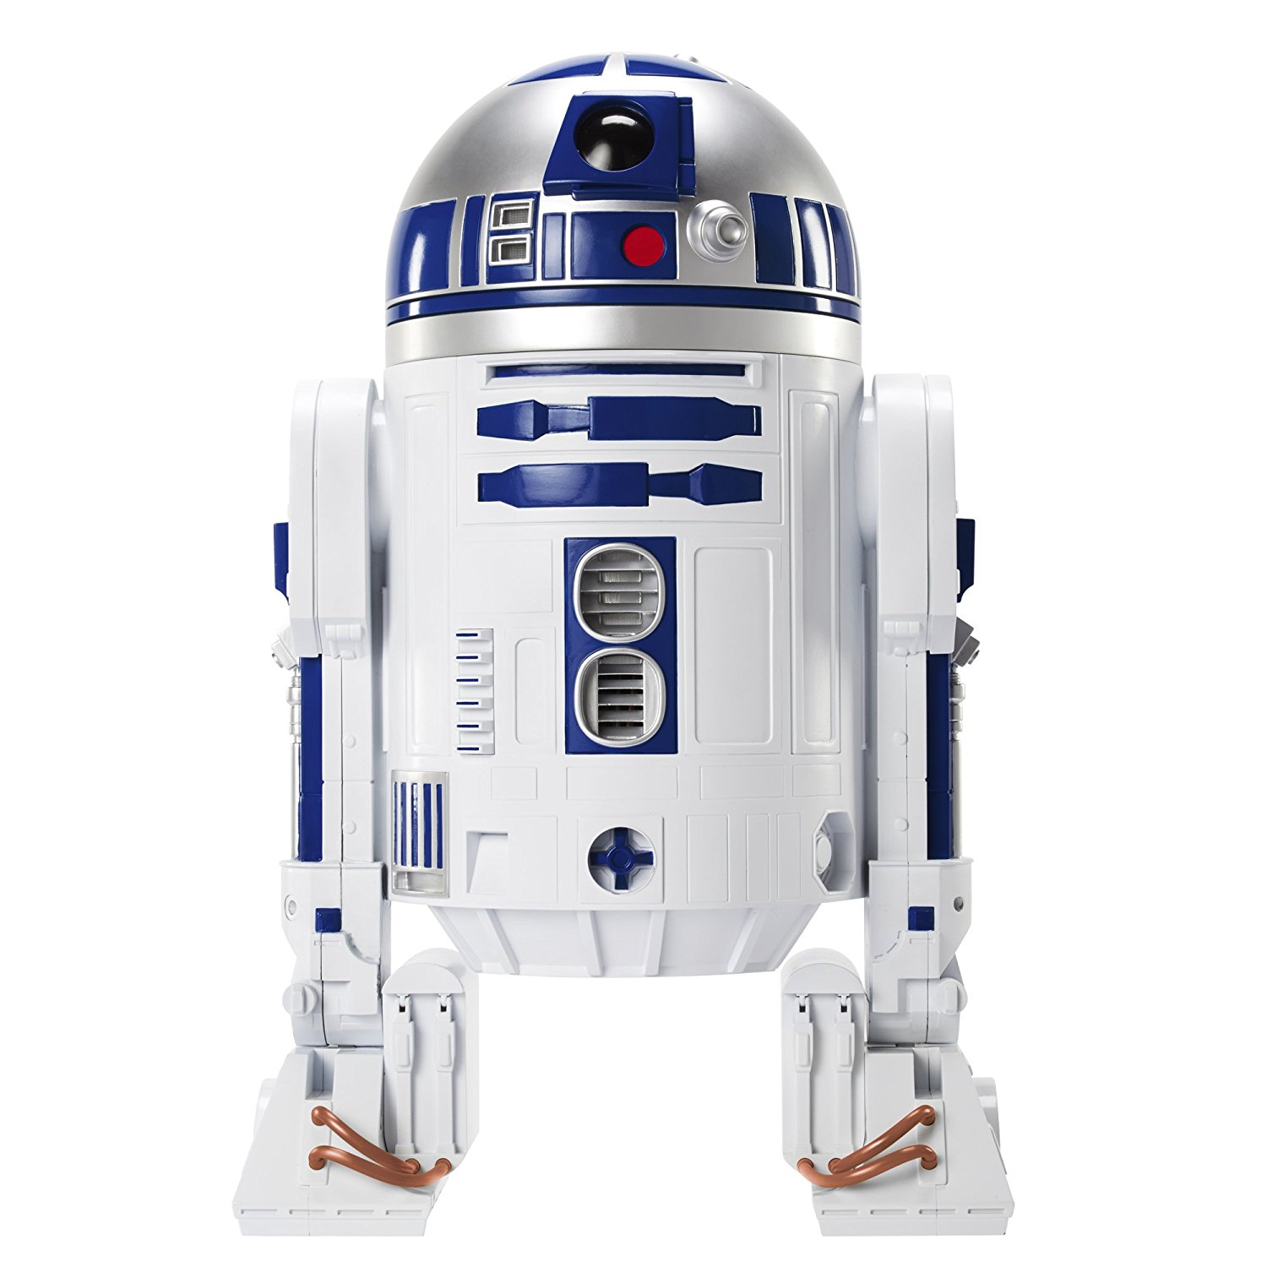

Conceptual Design Review of R2D2
6
- Conclusion -
https://indico.cern.ch/event/1003865/
TM & © Lucasfilm Ltd.
All Rights Reserved
CEA: E. Rochepault, V. Calvelli, M. Durante, H. Felice, P. Mallon, P. Manil, G. Minier, G. Maitre, B. Prevet, S. Perraud, F. Rondeaux
CERN: S. Izquierdo Bermudez, J.C. Perez, D. Tommasini, J. Fleiter, H. Felice
08/03/2021

Slide 2
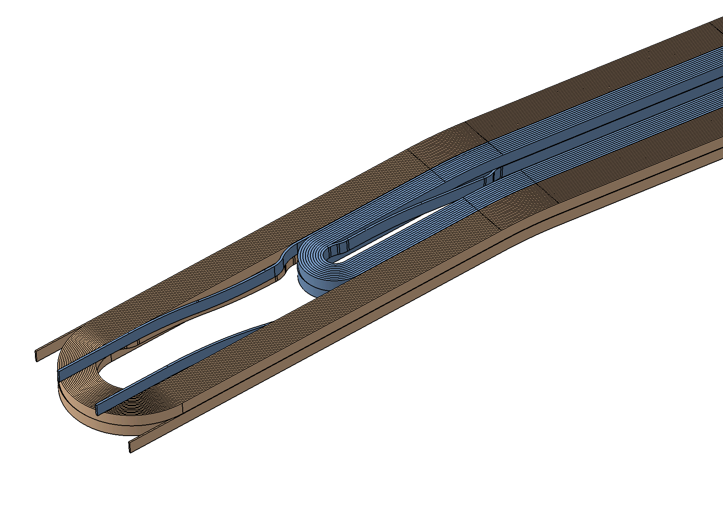
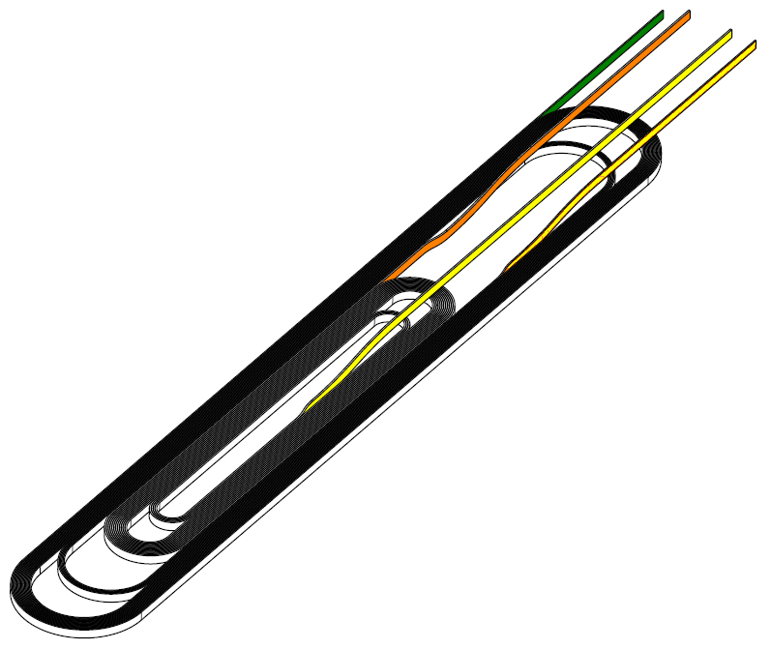
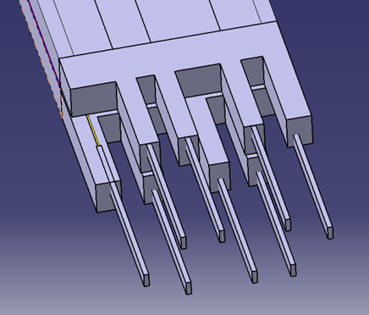
Conclusion
Ultimate goals of the development plan : F2D2 16 T short model
  Requires grading → choice of external splices
  Option for internal splices open
Demonstrate feasibility of external splices on R2D2:
  a 12 T simplified magnet
  Racetracks to simplify coil fabrication and assembly
  Single layer coils to reduce the use of conductor and risk
  Fast turn-over mockups + full size Cu coil
But, additional complexities due to racetracks:
  Difficult protection due to high current/energy densities
  Long spacers to extract leads + reduce field in the ends
  Difficult access for longitudinal pre-load
R2D2 optimized for safety margins, not performance

