Slide 1
SM18 Quench Antenna
TM-TECH#4 22/02/2021
Olivier Ditsch

Slide 2
Intro
Focus on the existing quench antenna systems & modifications to be done
QLOC & LQA for QXF magnets
LQA for 11T magnets
Racks layout

Slide 3
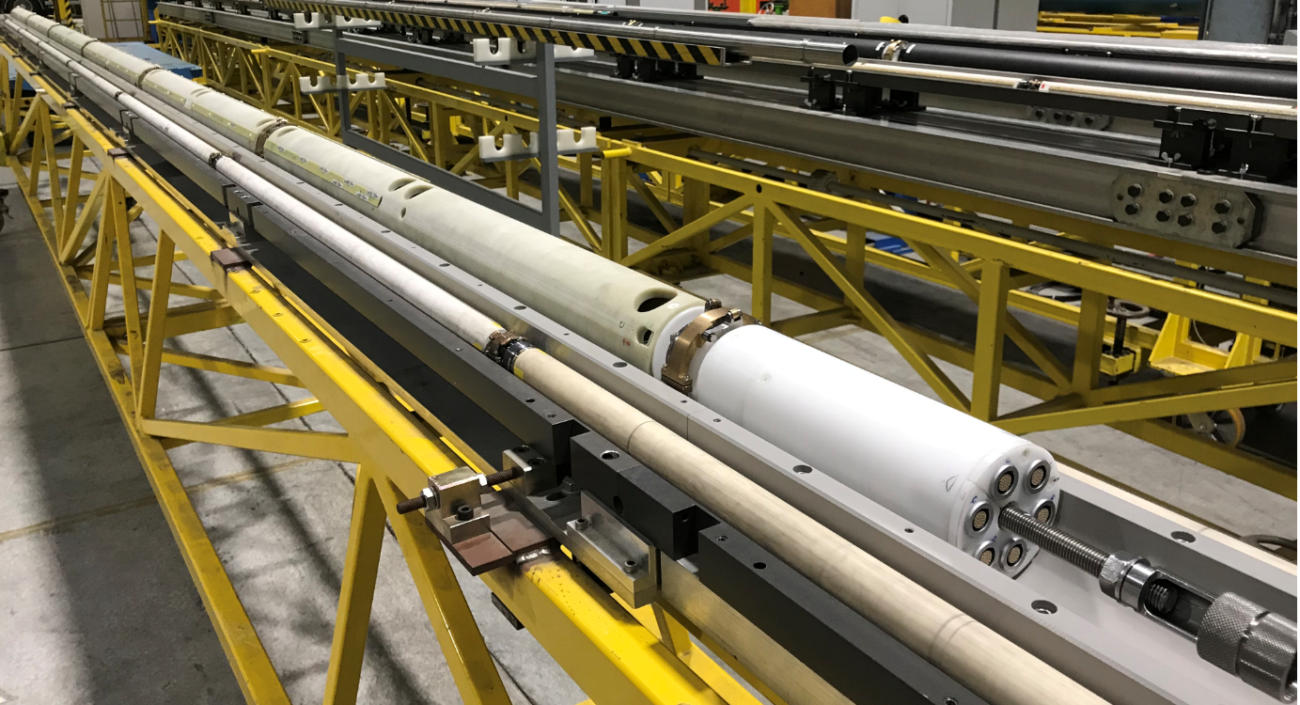
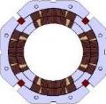
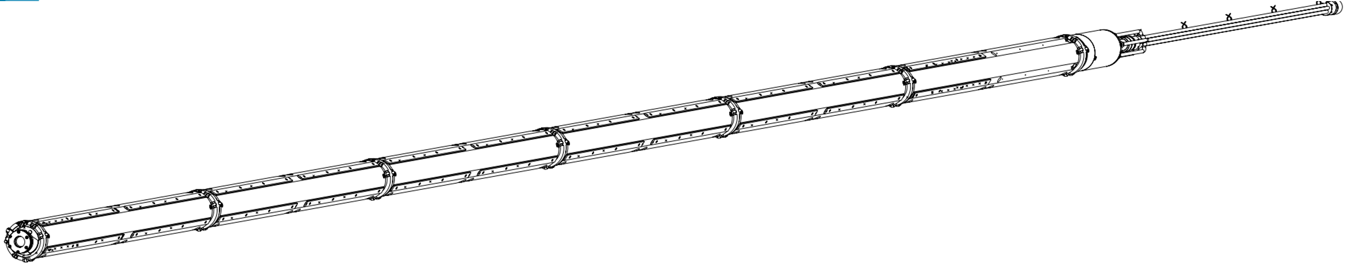
QLOC & LQA QXF Cluster A
1. Hardware design
2. Wiring
3. Modifications
4. New hardware design
5. Open points
6. Data analysis
1 shatf – No Spare

Slide 4
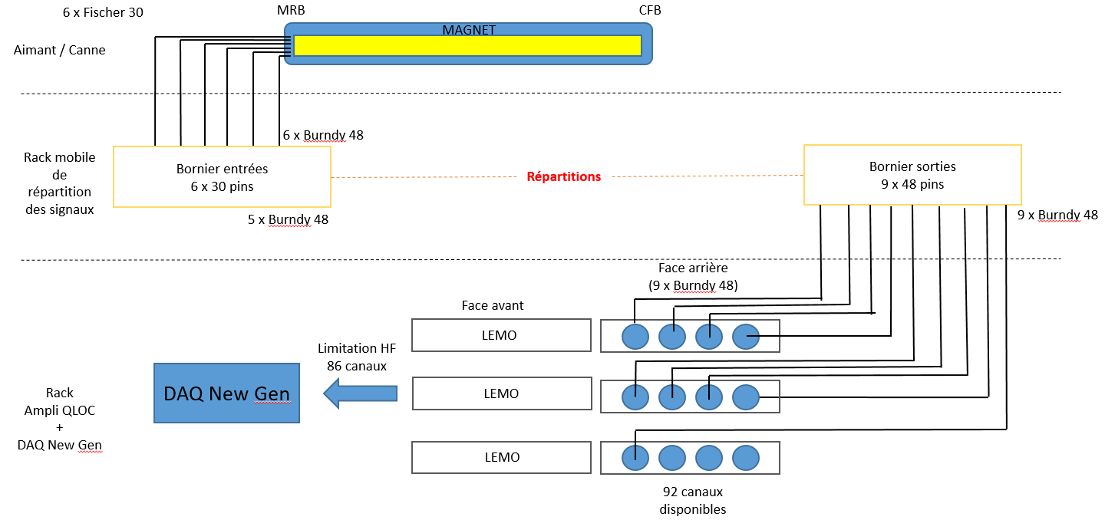
1. Hardware design

Slide 5
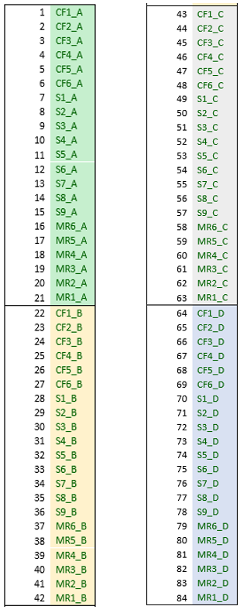
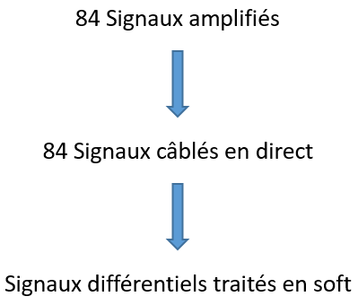
2. Wiring

Slide 6
3. Modifications
Indepedant & mobile rack for bench A2 & F1
«plug & play»
Include the DAQ, amplificators, …

Slide 7
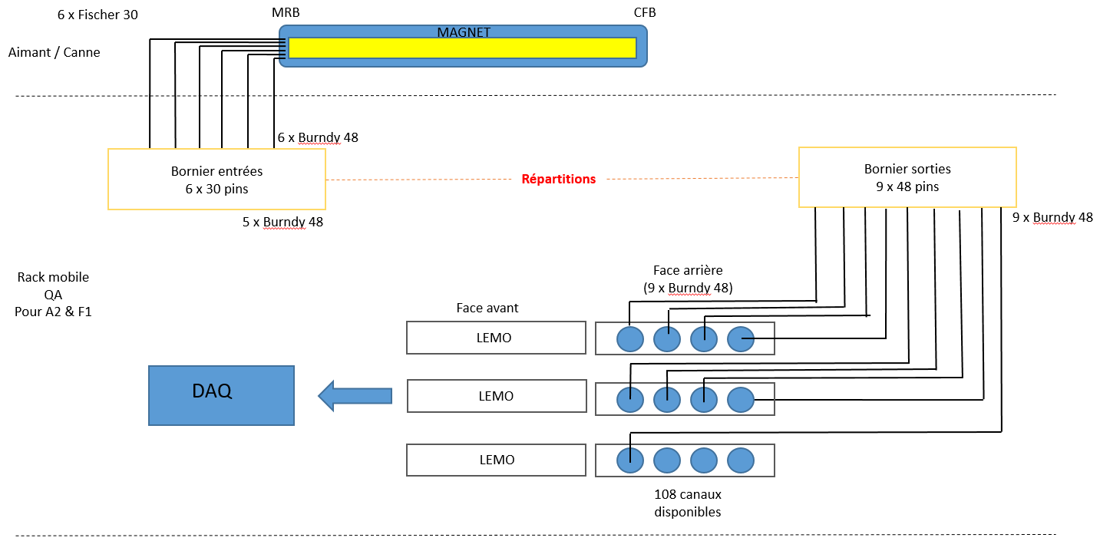
4. New hardware design

Slide 8
5. Open points
DAQ (Hz, HF/LF, …) ?
QLOC ampli ?
Magnet differencial signals?
…

Slide 9
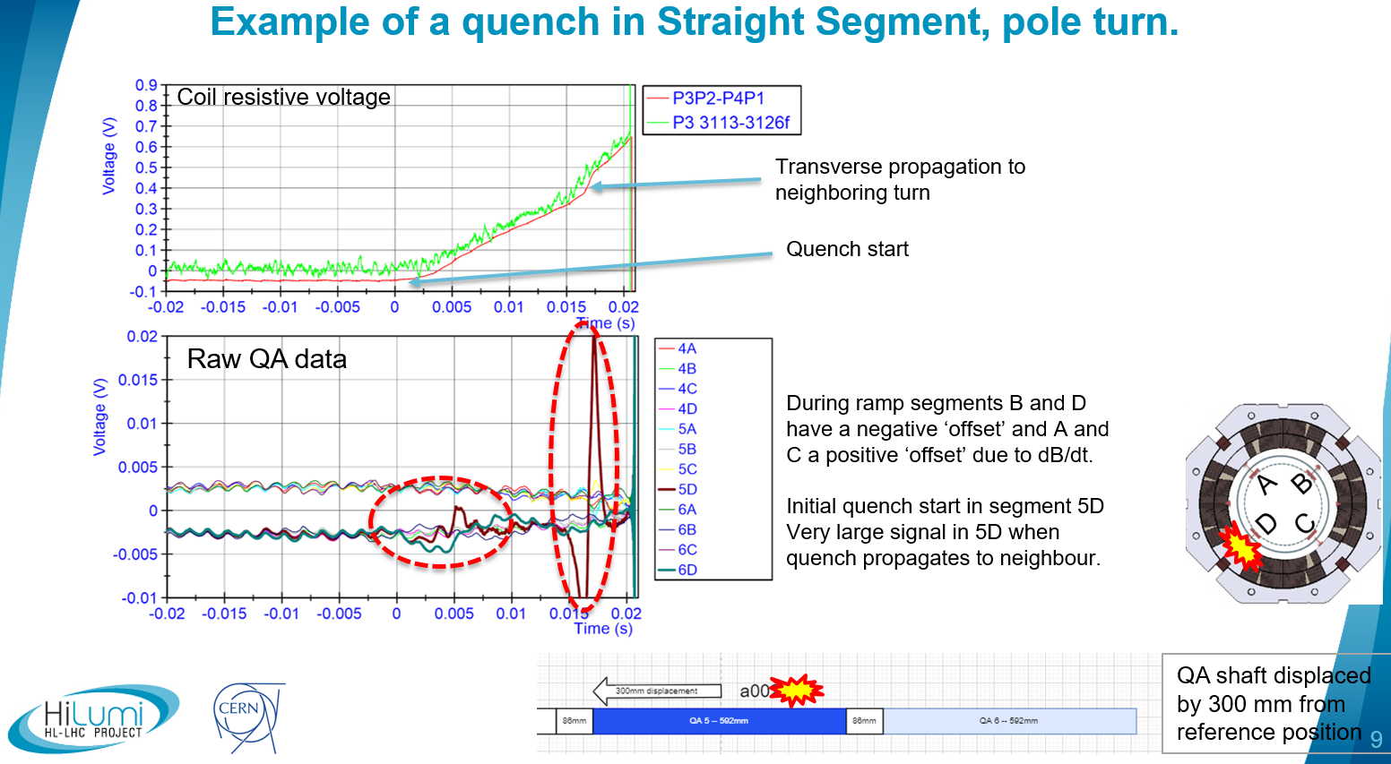
6. Data analysis
Overview new Quench Antenna system for MQXF magnets (G. Willering)

Slide 10
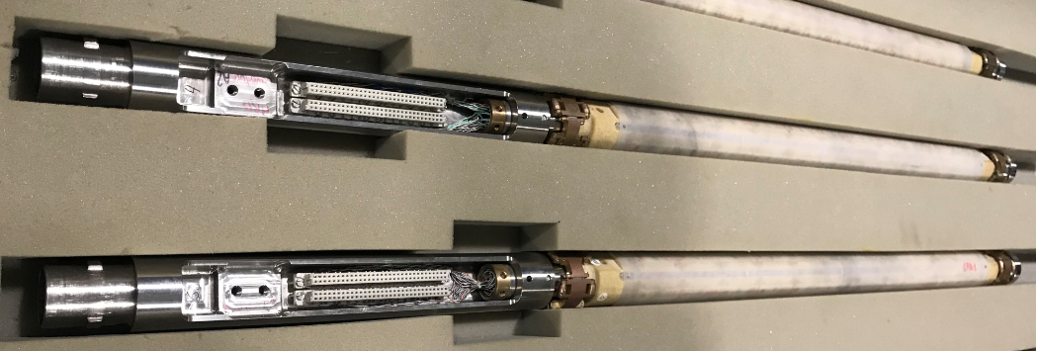
LQA / QLOC 11T Cluster C
1. Hardware design
2. Wiring (LQA)
3. Modifications
4. New hardware design
4 shafts – No Spare

Slide 11
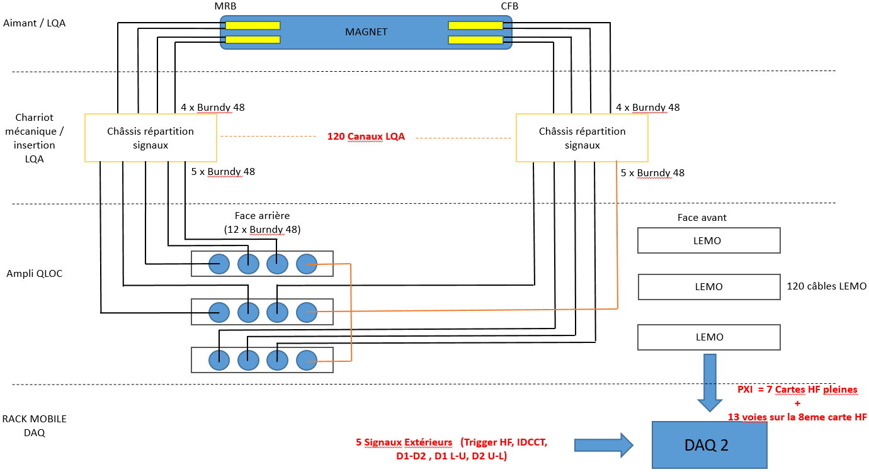
1. Hardware design

Slide 12
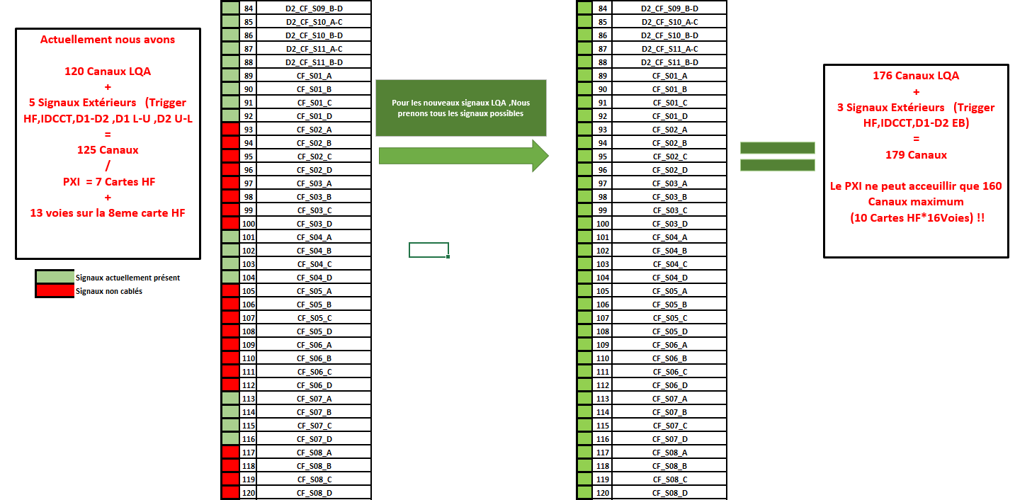
2. Wiring (LQA)

Slide 13
3. Modifications
Indepedant & mobile rack
«plug & play»
QLOC signals & measurement
Include the DAQ, amplificators, …
Avoid cables outside of cable trays

Slide 14
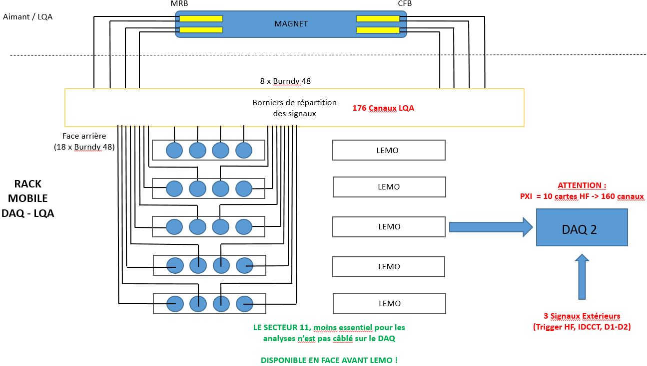
4. New hardware design

Slide 15
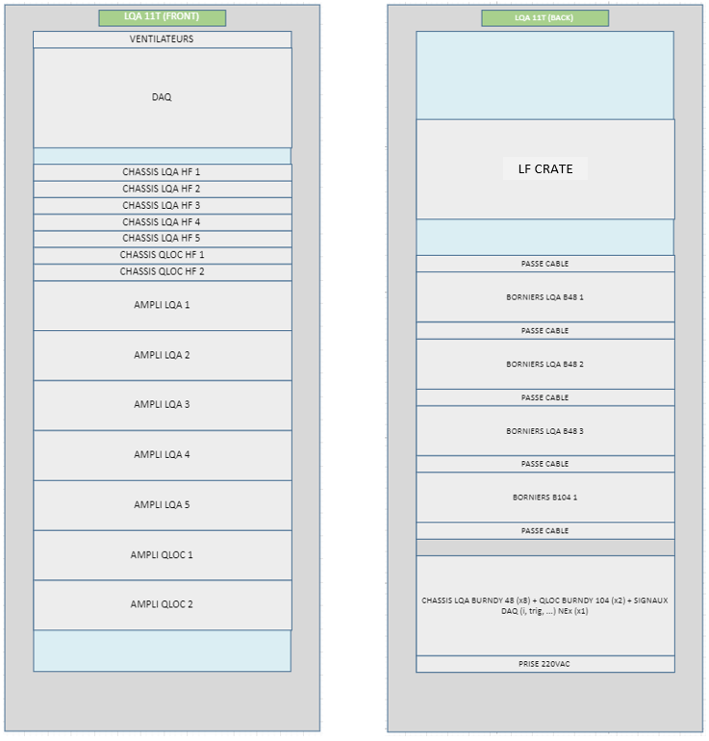
Racks layout
LQA / QLOC 11T

