Slide 1
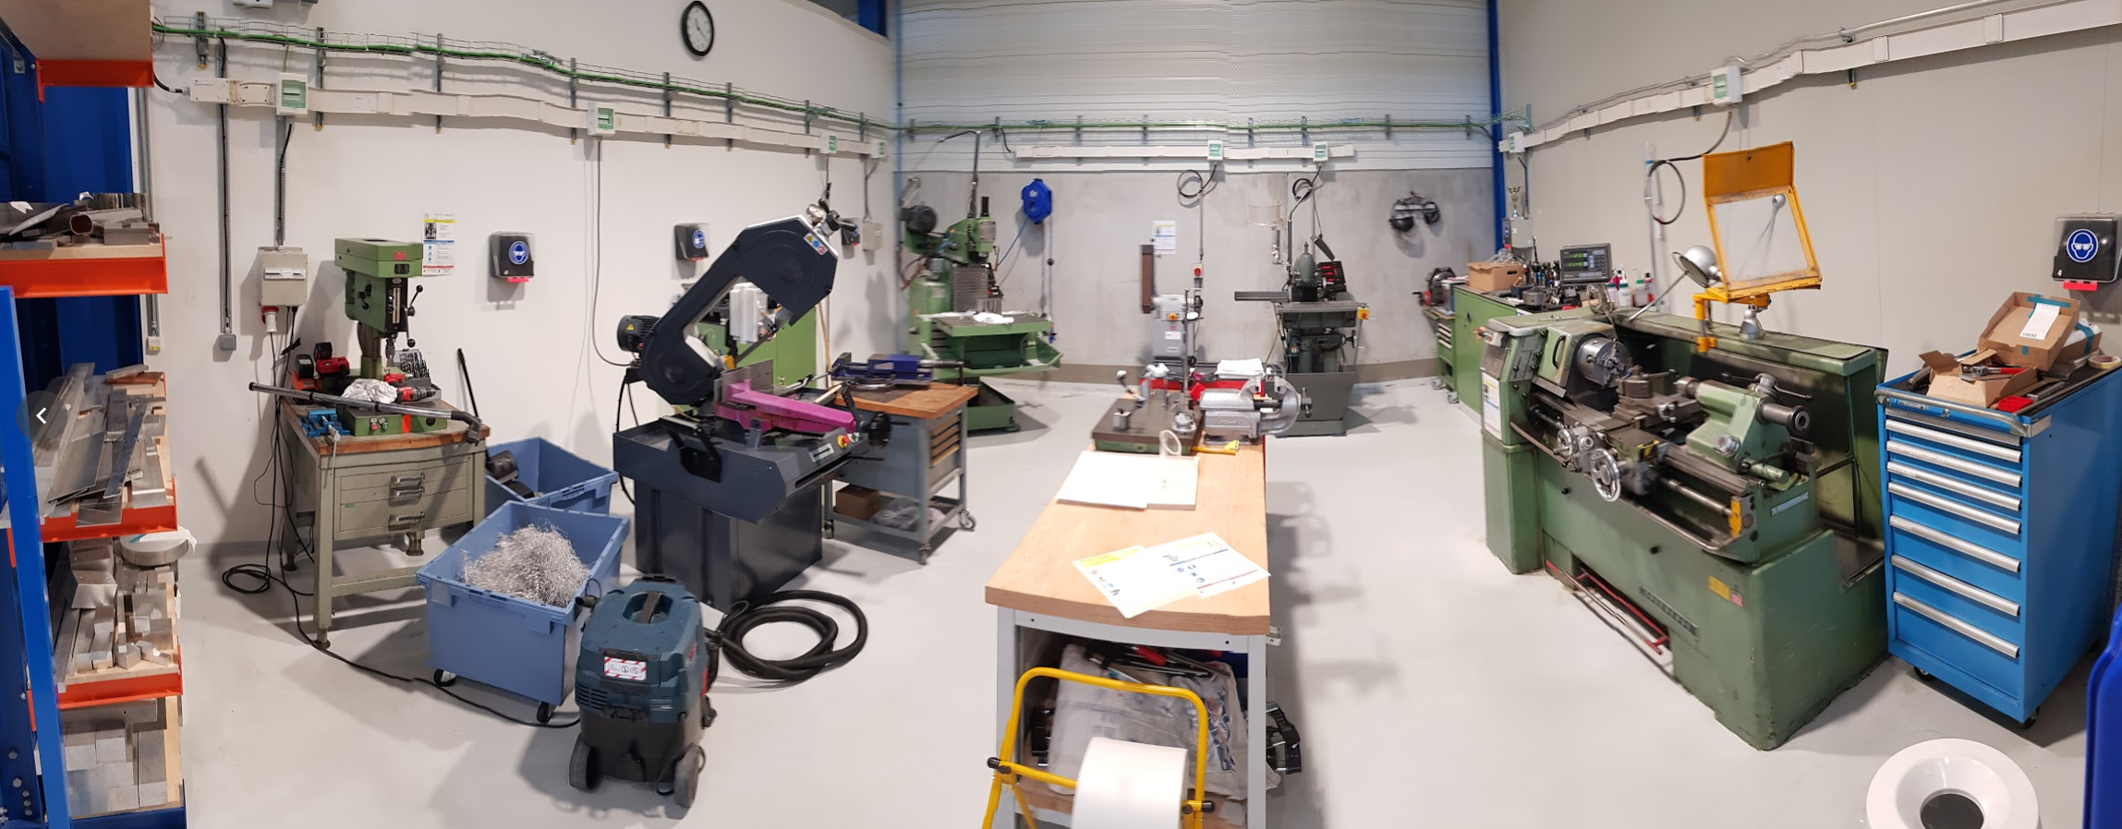
TE/MSC-MT Mechanical Workshop in b. 311
Drill
150 mm max, 40 mm stroke
Band Saw
250 mm max
Milling machine
600×300 mm max, stroke 400 mm
Grinder
Sandpaper belt/wheel
Milling machine
300 mm max, old, draft pieces only
Lathe
∅300×500 mm max
All units (except old milling machine) in good working order
All units OK’d by HSE in 2018 (some yellow stickers missing)
Average usage: mainly 1 FSU at 50%
Indispensable for quick R&D, prototyping, small series

