Slide 1
Discussion test requirements HL-LHC magnets
Gerard Willering, Franco Mangiarotti, Gaëlle Ninet, Lucio Fiscarelli
TE-MSC-TM
March 2021

Slide 2
Contents
Content
- Discuss requirements for LHC series cryo magnets in SM18: Q1/Q3, Q2, D1, D2, CP
Input
Acceptance criteria (as discussed within collaborations in WP3 and in MCF)
(HV, # quenches, maximum current)
Requests for additional reference information by ELQA
Suggestions additional reference info by TM section.
Goal
Reach consensus and write up in EDMS document per magnet.

Slide 3
 | Magnets | Protection | Cold test history | SC | Acceptance EDMS
Q1,Q3 | MQXF | QH + CLIQ | Horizontal at FNAL | Nb₃Sn | 2031083 and 2323981
Q2 | MQXF MCBXF (2 circuits) | QH + CLIQ EE | No Vertical in Upsala | Nb₃Sn NbTi | 2051311
D1 | MBXF | QH + CLIQ | Horizontal at KEK | NbTi | 2045899
D2 | MBRD 2*MCBRD (4 circuits) | QH EE | No Vertical in China | NbTi NbTi | 2051868 2051870
CP | MCBXF (2 circuits) 9 HO correctors | QH+CLIQ QH | Vertical in Upsala Vertical at INFN | NbTi NbTi | 2051311 2045901
MCF circuit parameters

Slide 4
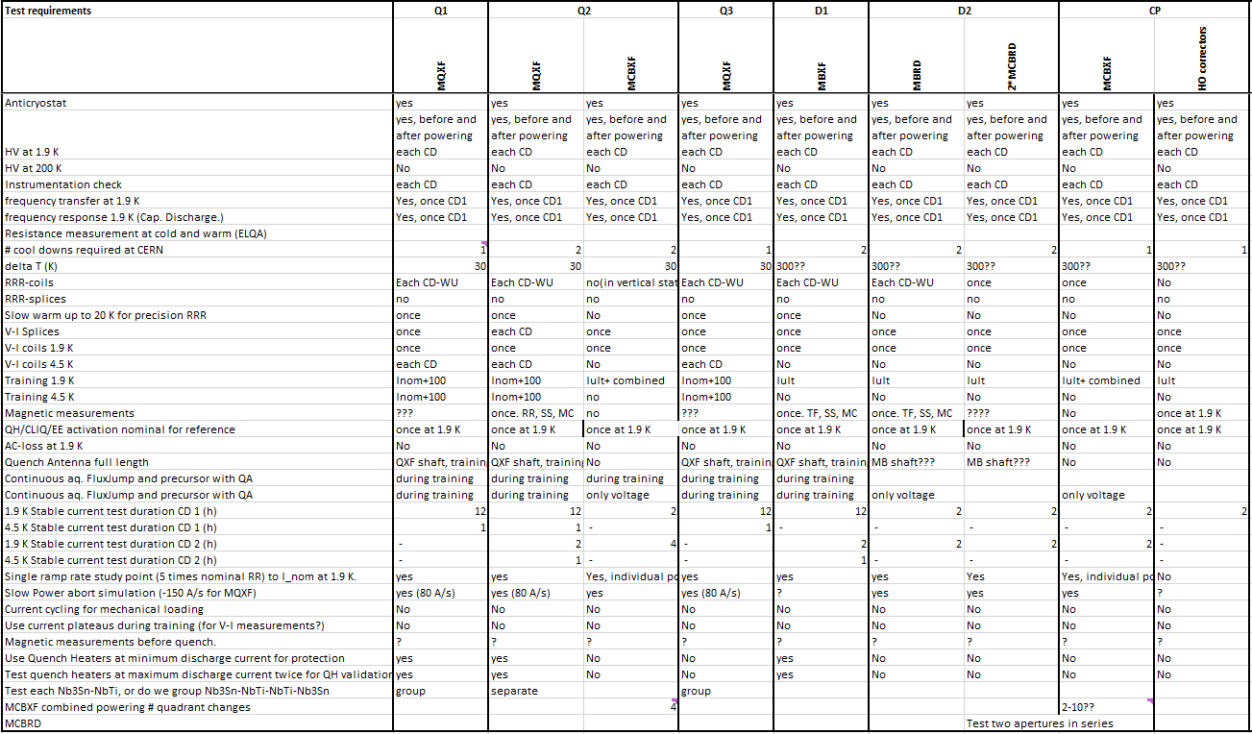
Tentative table with contents to be discussed this meeting

Slide 5
Anticryostats
Anticryostats available for all magnets and required for Quench Antenna and Magnetic measurements for qualification tests.
Q1, Q3: Although tested at FNAL, install anticryostats for additional testing.
Q2: Anticryostats required
D1: Anticryostats required
D2: Anticryostats required
CP: Anticryostats required??
Time required for anticryostat installation/removal:
About 2 days

Slide 6
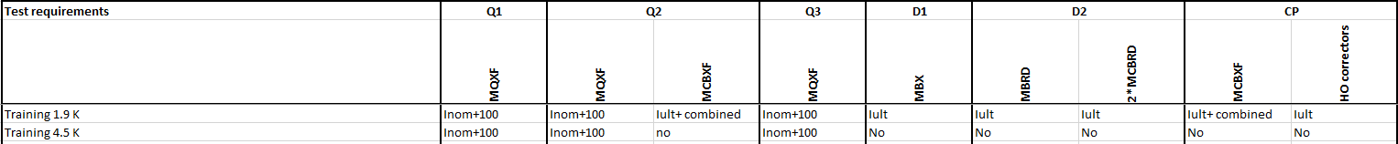
Powering target
For Nb₃Sn magnets the maximum current is I_{nominal}+100 A. (since 2019, see EDMS 2172692)
Proposal:
NbTi magnets are trained to I_{Ultimate} at 1.9 K to prove their margin (as has always been done). No powering needed at 4.5 K.
Nb₃Sn magnets are trained to I_{Nominal} + 100 A at 1.9 K AND at 4.5 K to show their margin.
Special case MCBXF combined powering
Combined powering for nested dipoles MCBXF: only single quadrant power converter available so changing quadrant requires reconnection of power cables. The requested current limits to be defined later.
How many changes in quadrant (torque direction) are required? I propose 4 polarity changes as reasonable value: ++ , +- , ++ , +-, ++
Powering cycle for combined powering: Diagonal, or also cylindrical (90 degrees at a time)?
Time required adding a second temperature for training: 1 to 2 days.

Slide 7
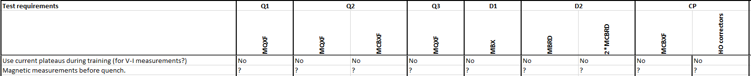
VI or Magnetic measurements during training ramps?
For prototypes current plateaus for V-I measurements were put during the training ramps. This was useful for investigation of performance degradation.
It was also suggested to perform magnetic measurements before/during the first ramps.
Both types of test should not be needed for series magnets.
V-I plateaus or MM will add about 1 hour to each training ramp.

Slide 8
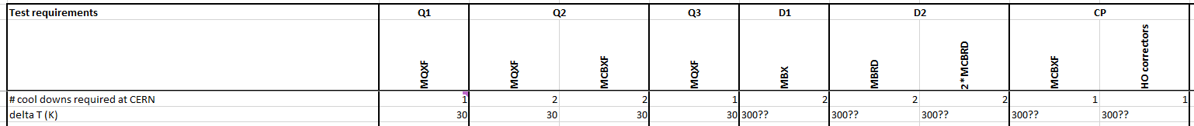
Number of cool downs
Q1, Q3: Single cool down. Cryomagnet already tested at FNAL.
Q2: Two cool downs. MQXF magnets not tested before. MCBXF magnets tested in stand alone in vertical test station at Uppsala
D1: Single cool down. Cryomagnet already tested at KEK
D2: Two cool downs. MBRD magnet not tested before. MCBRD magnets tested in stand alone in vertical test station at IHEP
CP: Single cool down. MCBXF magnets tested in stand alone in vertical test station at Uppsala. HO correctors tested stand alone in vertical test station at INFN.
ΔT
Nb₃Sn magnets: ΔT fixed to 30 K in range 80-300 K for Q1, Q2, Q3
MCBRD: limited due to impregnation + aluminium formers. Need ΔT specification
NbTi magnets: So far all NbTi magnets (MB, MQ, SSSS) cooled without ΔT limit (could go to some150-200 K).
HO correctors: 100 K/m ??
ΔT specification required for D1, D2 and CP.
Time for thermal cycle: About 5 days.
ΔT = 30 K costs about 1 day more per warm and cool down compared to a large ΔT

Slide 9
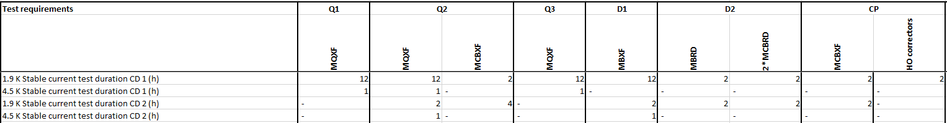
Plateau current test duration
We adopted 12 hours of plateau tests for 11T as this is reasonable in term of time in the test station.
Plateaus all at nominal current, nominal temperature: 12 hours for main magnets, 2 hours for NbTi correctors.
Additional plateaus of 1 hour at nominal current at 4.5 K for Nb₃Sn circuits (during V-I cycle).
Q1, Q3: MQXF test 12 hours at 1.9 K and 1 hour at 4.5 K.
Q2 – Cool down 1 : MQXF test 12 hours at 1.9 K and 1 hour at 4.5 K.
Q2 – Cool down 2 : MQXF test 2 hours at 1.9 K and 1 hour at 4.5 K.
Q2 – MCBXF : only in individual powering, hold the current 2 hours at 1.9 K.
D1 – MBXF : 12 hours at 1.9 K.
D2 – MBRD : 12 hours at 1.9 K.
D2 – MCBRD : 2 hours at 1.9 K.
CP – MCBXF : In individual powering hold the current 2 hours at 1.9 K. In combined powering 30 minutes each quadrant.
CP – HO correctors : To be defined.
Technical question: can we power MCBXF and MQXF simultaneously for the 1.9 K stable current test duration.
Time directly depending on plateau duration.

Slide 10
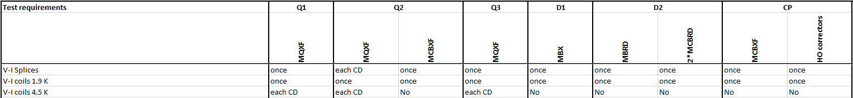
Splice and V-I measurements
Splice resistance has always been stable and not temperature dependent. One measurement at 1.9 K or 4.5 K is needed.
V-I measurement of the coils at 4.5 K are important for Nb₃Sn magnet qualification. Should be verified each cool down.
V-I/splice cycle MQXF 1.9 K: Plateau each 3 kA during ramp up and down, 5 min plateau duration.
V-I/splice cycle MQXF 4.5 K: Plateau each 3 kA during ramp up and down, 5 min plateau duration, nominal current plateau 1 hour
V-I/splice cycle MBXF and MBRD 1.9 K: Plateau each 2 kA during ramp up and down, 5 min plateau duration.
V-I/splice cycle correctors: 1.9 K, 5 to 6 plateaus during ramp up and down, 2 min plateau duration
Q1, Q3: :V-I coils at 1.9 K once and at 4.5 K each cool down. Splice only once (depends on available DMM channels).
Q2 –MQXF :V-I coils at 1.9 K once and at 4.5 K each cool down. Splice only once (depends on available DMM channels).
Q2 – MCBXF : V-I splice/coils at 1.9 K once.
D1 – MBXF : V-I splice/coils at 1.9 K once.
D2 – MBRD : V-I splice/coils at 1.9 K once.
D2 – MCBRD : V-I splice/coils at 1.9 K once.
CP – MCBXF : V-I splice/coils at 1.9 K once.
CP – HO correctors : No need, already measured at INFN?
One V-I splice cycle takes about 2-3 hours (assuming no quench)

Slide 11
Splices strategy
Q1/Q3: 8 coils, 16 Nb₃Sn-NbTi splices, 16 NbTi-NbTi splices between coils (40 channels)
Q2: 4 coils, 8 Nb₃Sn-NbTi splices, 8 NbTi-NbTi splices between coils (20 channels)
Too many channels required to measure seperately each splice.
Proposal: Test always 3 splices combined Nb₃SN-NbTi-NbTi-Nb₃Sn. If the 3 splices combined exceeds 1 nΩ, measure the splices seperately. (This has been used for 11T often as well and gives still high precision results).
Reduced number of channels:
Q1/Q3: 8 coil channels, 9 splice channels.
Q2: 4 coil channels, 5 splice channels.
Limited stock of high precision DMM cards (very expensive). Opitimize when many magnets are under test simultaneously.

Slide 12
Magnetic Measurements
Magnetic Measurement shaft chains
Available for MQXF prototypes
Procurement ongoing for Q2 (including MCBX), CP, and D1
Still under discussion for D2 (including MCBRD).
Standard program:
Main magnets: stretched wire, stair steps, machine cycles, ramp-rate studies
Correctors (on a subset): stretched wire, stair steps
Q1, Q3: : Already done in US, cross check on 2 magnets
Q2 –MQXF : Yes, during first or second cool down.
Q2 – MCBXF : Already done in vertical, cross check on a subset of magnets
D1 – MBXF : Yes, during first or second cool down.
D2 – MBRD : Yes, during first or second cool down.
D2 – MCBRD : Already done in vertical, cross check on a subset of magnets
CP – MCBXF : Already done in vertical, cross check on a subset of magnets
CP – HO correctors: Already done in vertical, cross check on a subset of magnets
Stretched wire: 1 day
Machine cycles: 1 day
Stair steps: 0.5 days
Ramp rate studies: 0.5 days
Stair step can be combined with V-I measurements (but up to nominal)

Slide 13
Powering MCBRD
MCBRD: 2*2 apertures = 4 powered circuits and 8 current leads 450 A.
Issue: Only 4 current leads available, so we need to make a choice how to power them, likely option 2.
(solution with PC and 2*EE under discussion)
MCBRD1
MCBRD2
Aperture 1
Circuit 1
Option 1
Aperture 2
Circuit 2
MCBRD1
MCBRD2
Option 2
Aperture 1
Circuit 1
Aperture 2
Circuit 2

Slide 14
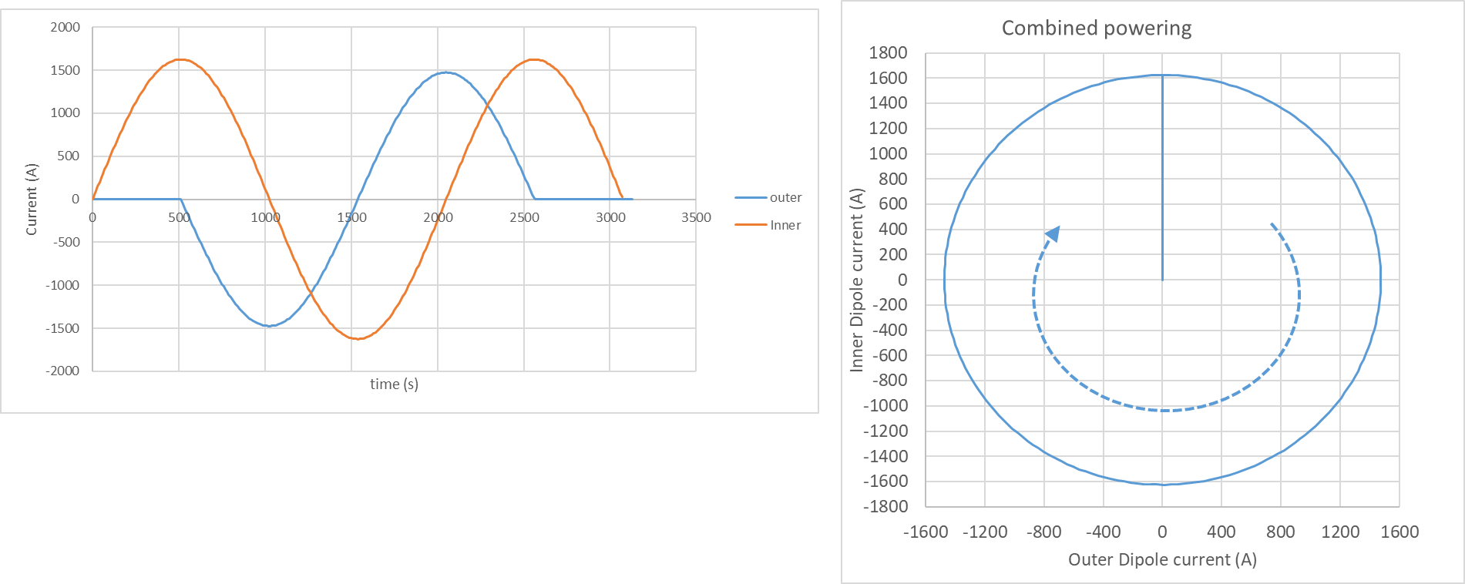
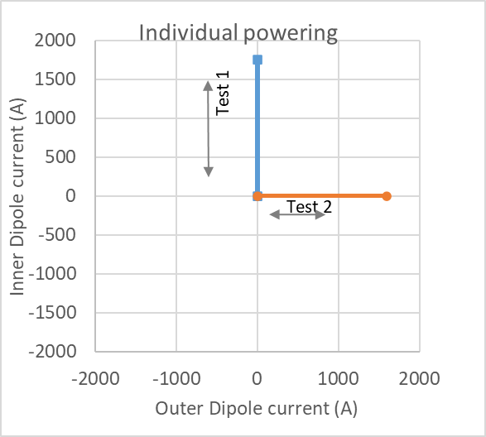
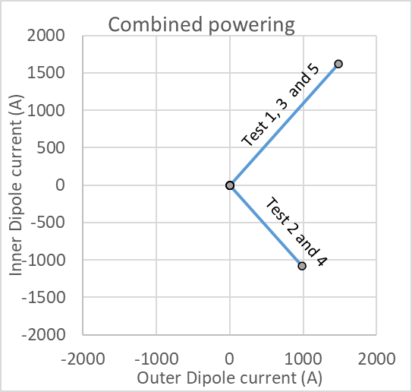
Powering MCBXF
Nested dipole. Combined powering in multiple quadrants.
Issue: Only 1 Quadrant 2 kA power converters available, so inverting current requires swapping of cables.
Combined powering 4 swaps of current: Quadrant 1, 2, 1, 2, 1. Training only in diagonals. (or do we also need 30 and 60 º ?)
(Quandrant 3 and 4 not needed as they have the same forces and torque as quadrant 1 and 2, respectively)
Nicest cycles, but not possible
Each swap of current leads adds about 1 hour.
Powering a new quadrant takes about 1 hour (if no quench).

Slide 15
Continuous data acquisition during ramps
Interest: Flux jumps and vibration spectrum (precursors).
Requires Quench Antenna and/or coil voltages, measured at 10 kHz.
For MCBXF this has a strong interest because of mechanics that limits combined powering.
For main magnets this is interesting data that is good to have as reference.
For Nb₃Sn magnets the voltage of flux jumps are important to have
Q1, Q3: : Yes, voltage and Quench Antenna recording during training.
Q2 –MQXF : Yes, voltage and Quench Antenna recording during training.
Q2 – MCBXF : Yes, voltage recording during individual and combined training. No Quench Antenna available.
D1 – MBXF : Yes.
D2 – MBRD : Yes, voltage recording during training. No long quench antenna available for D2.
D2 – MCBRD : Yes, voltage recording during training.
CP – MCBXF : Yes, voltage recording during individual and combined training. No Quench Antenna available.
CP – HO correctors: No, limited interest
No additional measurement time.
Additional preparation (in parallel ??)

Slide 16
Quench Heaters
For the LHC the minimum and maximum current in the QH are specified for MQXF magnets….
Minimum QH current: Need to be sure protection is sufficient.
Maximum QH current: Need to verify if the QH can withstand the maximum discharge current.
Q1, Q3: : Training with min. QH current (for protection). Two additional discharges at max. QH current (verify QH).
Q2 –MQXF : Training with min. QH current (for protection). Two additional discharges at max. QH current (verify QH).
Q2 – MCBXF : no QH
D1 – MBXF : TBC
D2 – MBRD : TBC
D2 – MCBRD : no QH
CP – MCBXF : no QH
CP – HO correctors: no QH
Test max QH current:
Modifications + discharges about 3 hours.

Slide 17
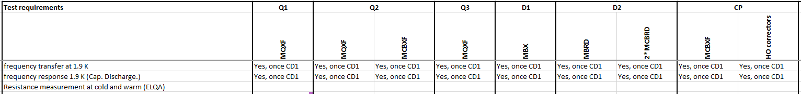
Warm and cold reference measurements
For trouble shooting after non-conformities, it is important to have reference data.
Impedance measurements and capacitive discharge are important to find interturn short for example.
ELQA requests wire resistance measurements at cold for reference to future trouble shooting.
Impedance measurements : 2 hours
Capacitive discharge: 2 hours
Wire resistance measurements: 3 hours

Slide 18
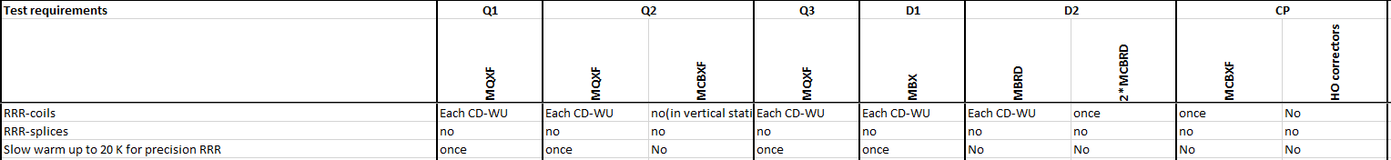
RRR measurements
RRR (warm and cold coil resistance) is useful for protection studies (CLIQ and QH) and important when there is a QH failure. Resistance measurement during cool down for coils.
Slow warm up to 20 K (takes 6 hours additional) for MQXF magnets needed once to have a precision measurement of Resistance at 20 K.
Q1, Q3: : Once a precision measurement, continuous R recording during warm up and cool down.
Q2 –MQXF : Once a precision measurement, continuous R recording during warm up and cool down.
Q2 – MCBXF : Not required, should be available from stand alone test.
D1 – MBXF : Not required, should be available from KEK test
D2 – MBRD : Once a precision measurement at 10 K, continuous R recording during warm up and cool down.
D2 – MCBRD : Not required, should be available from IHEP tests
CP – MCBXF : Not required, should be available from Upsala tests
CP – HO correctors: Not required, should be available from INFN tests
Recording during normal WU-CD: no additional time.
Precision measurement: 4-6 days.

Slide 19
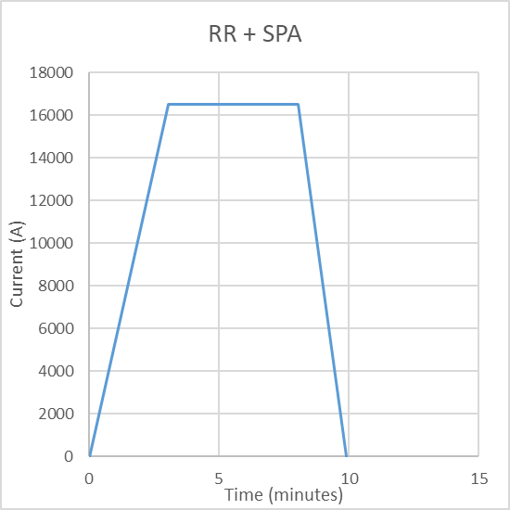
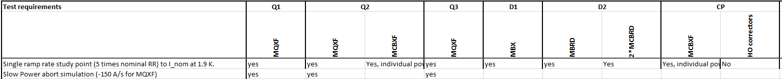
Ramp rate
10 minutes of test, no quench.
Full ramp rate studies needed for magnets with issues.
For series magnet, a single ramp to nominal current at 5 times nominal ramp rate can show margin in ramp rate. This is 80 A/s for MQXF magnets.
Slow Power Abort test is required because it reflects the case when installed in HLC. (-150 A/s for MQXF)
Q1, Q3: : Once – at nominal, ramp up at 80 A/s, ramp down at 150 A/s
Q2 –MQXF : Once – at nominal, ramp up at 80 A/s, ramp down at 150 A/s
Q2 – MCBXF : Once, only in individual powering.
D1 – MBXF : Once – at nominal, ramp up at … A/s, ramp down at … A/s
D2 – MBRD : Once – at nominal, ramp up at … A/s, ramp down at …. A/s
D2 – MCBRD : Once – at nominal, ramp up at … A/s, ramp down at …. A/s
CP – MCBXF : Once, only in individual powering.
CP – HO correctors: Not required
Required test.
About 1 hour including preparations if no quench.
Check PC capacity to ramp fast!!

Slide 20
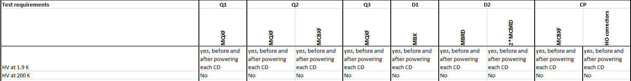
HV insulation test
In air at 300 K before first and after last CD.
At 1.9 K before powering and after powering during each cool down. (not at 4.5 K).
200/100 K tests were performed to qualify/disqualify certain heater/coil insulation schemes in 11T and MQXF.
Not needed for series magnets?? (1 day additional test time).
Note: To optimize time efficiency, the HV test after powering could be performed just before the last quench (saves 3-4 hours for recovery).
100 K HV test: 1 day additional test time.
1.9 K HV tests are required.

Slide 21
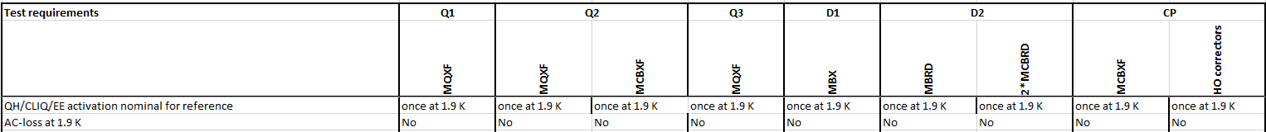
Protection studies
Fire nominal protection at nominal current for all magnets one time. This is to have the reference data for protection and check if it is all OK. (depending on the circuit this includes EE, QH and CLIQ)
QH/CLIQ firing at nominal for main circuits: about 3 hours.
EE for corrector circuits: about 1 hour per circuit.
AC loss
Not included. Studied in prototypes.
AC loss: about 4 hours.

