Slide 1
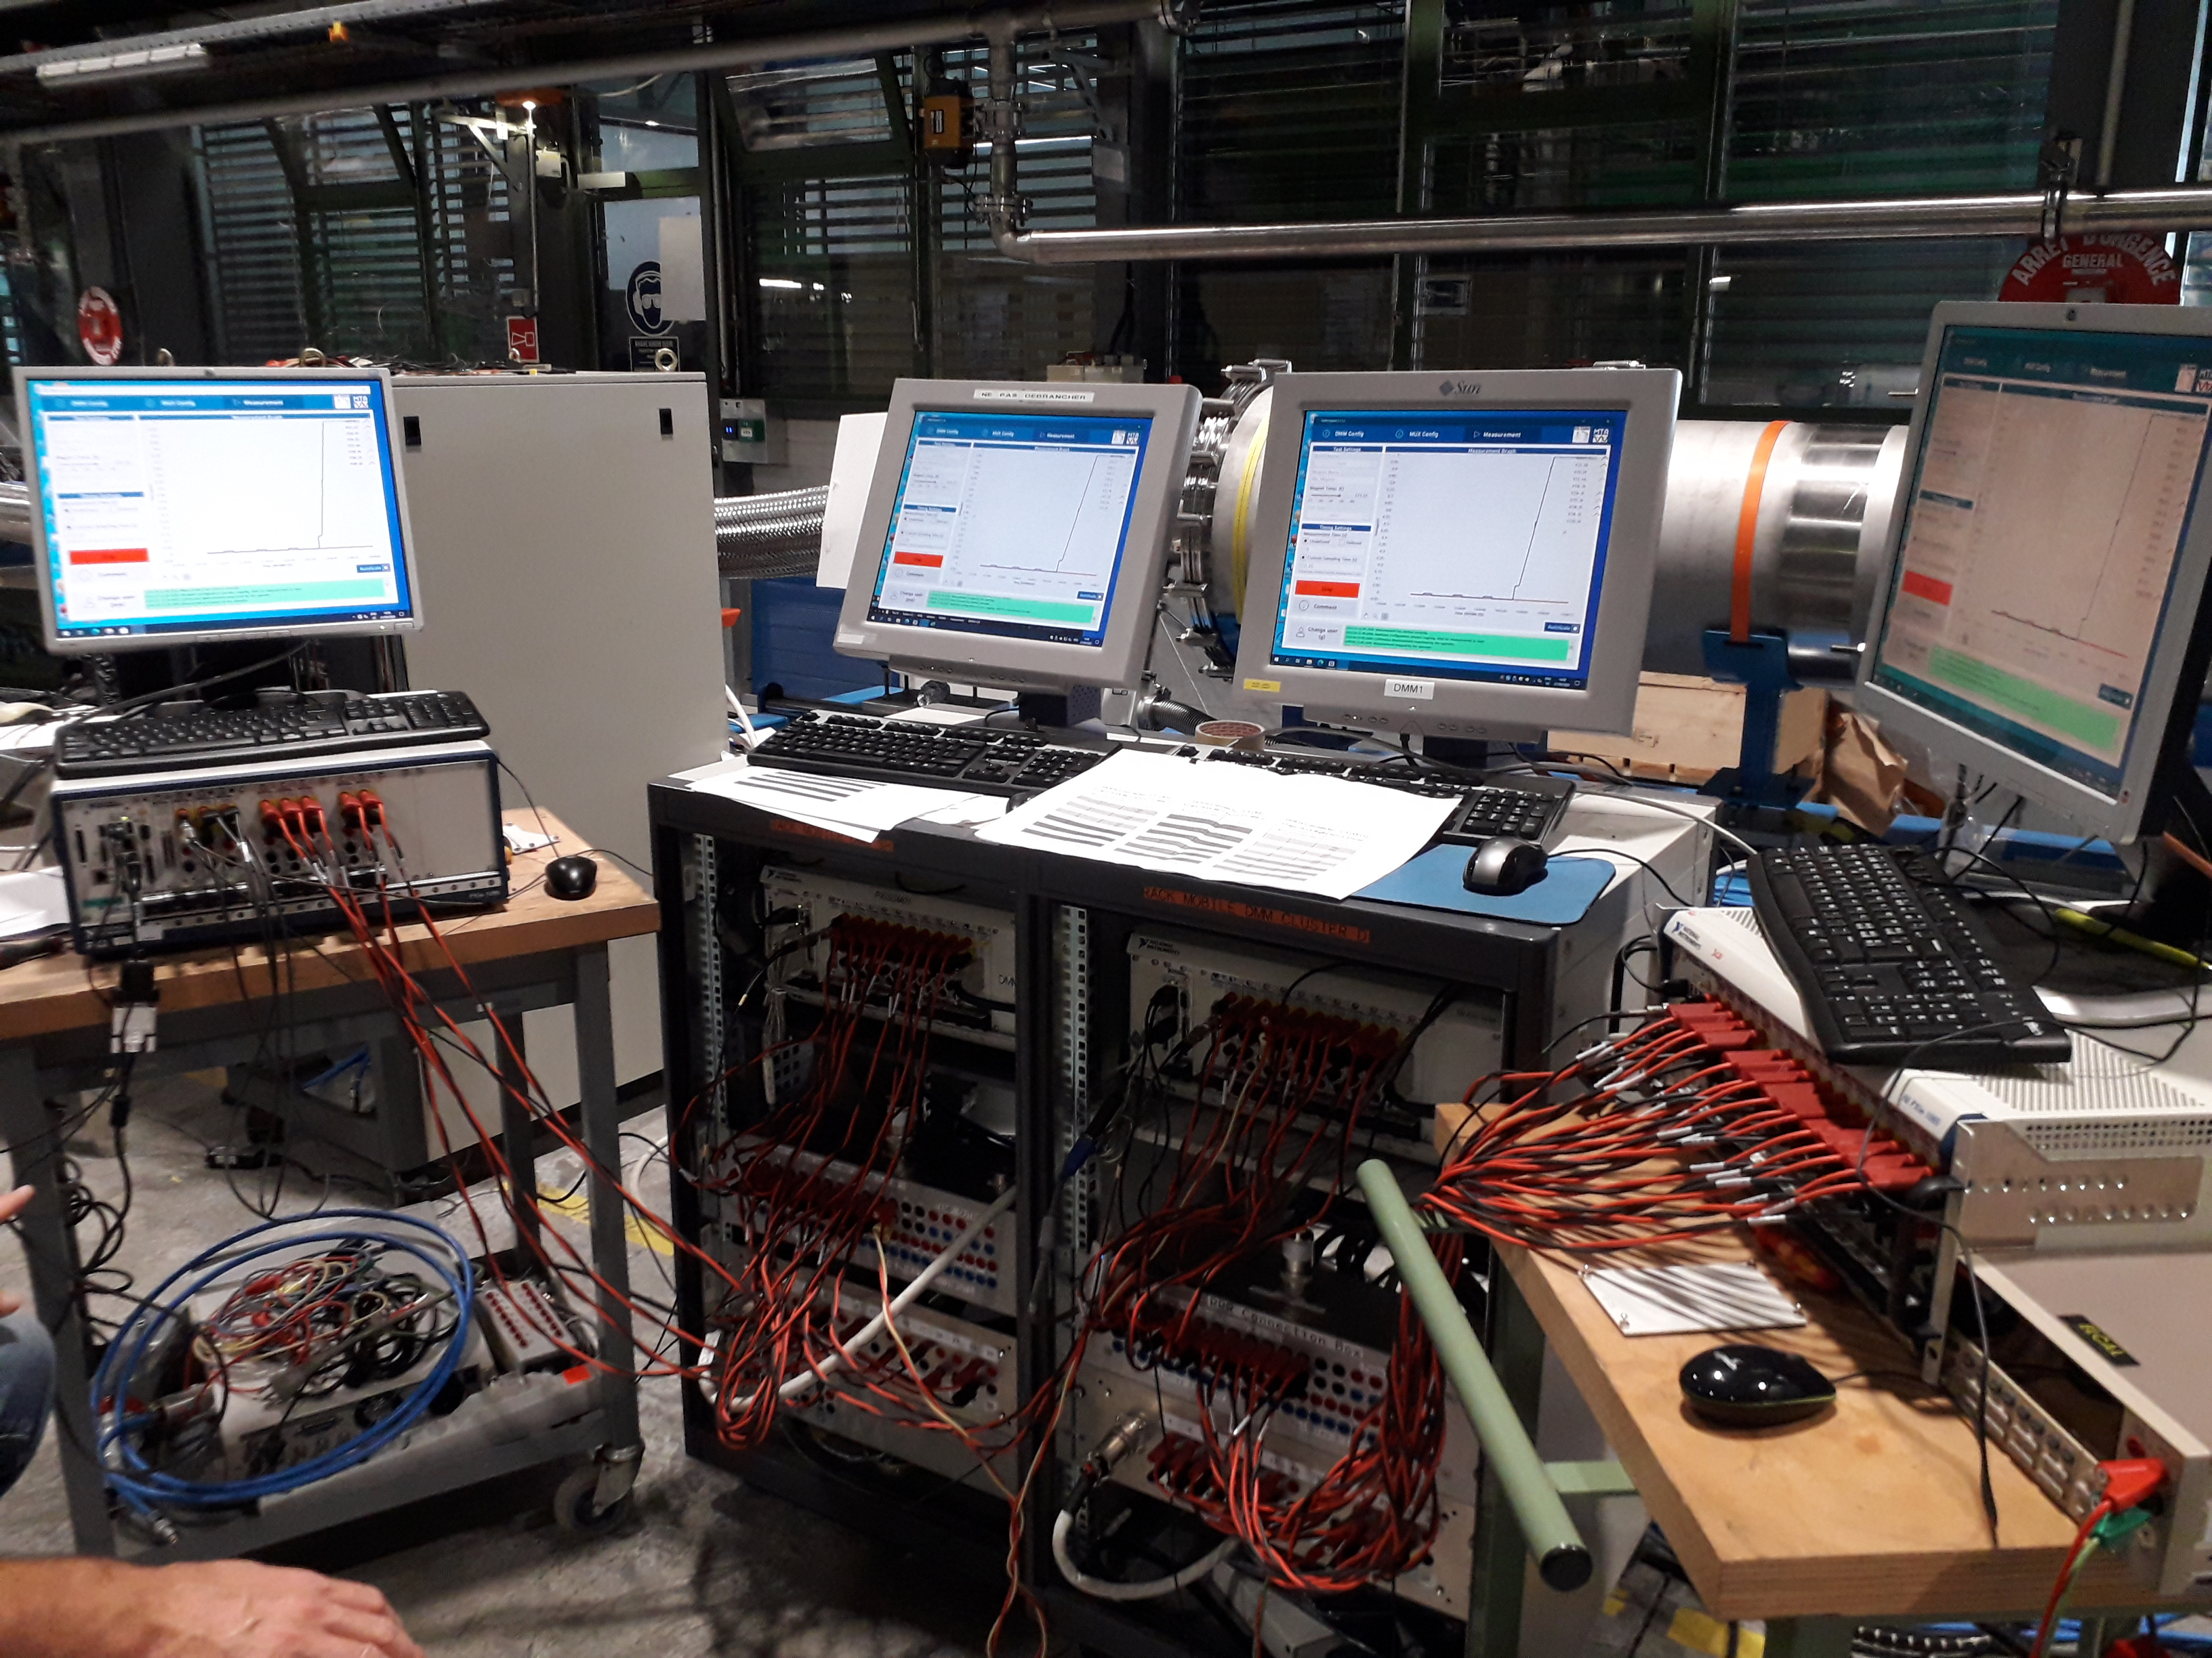
DMM Hybrid
Improvements and validation process

Slide 2
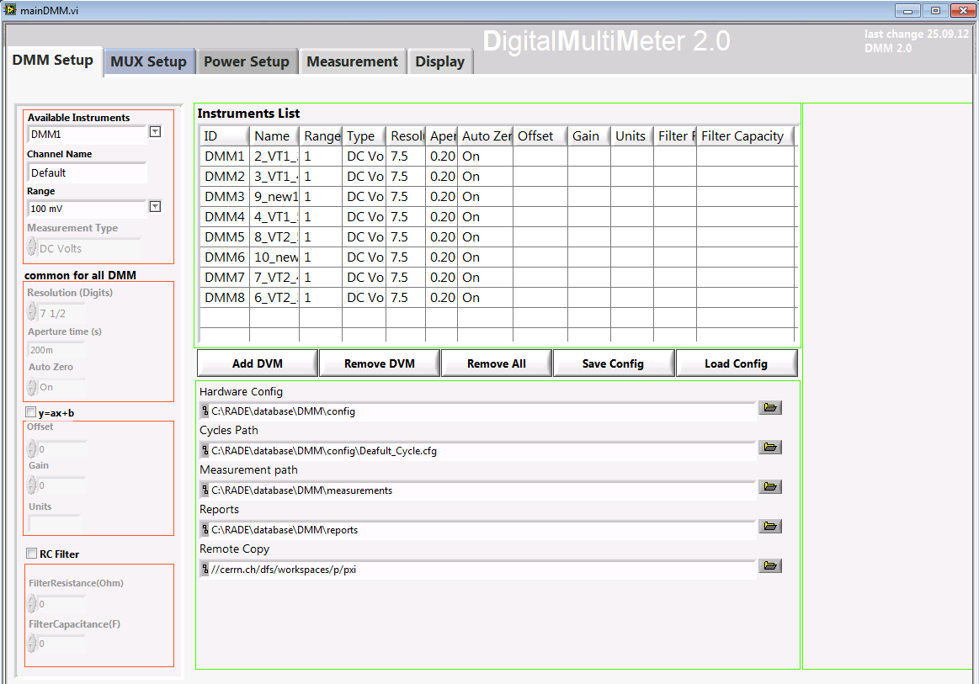
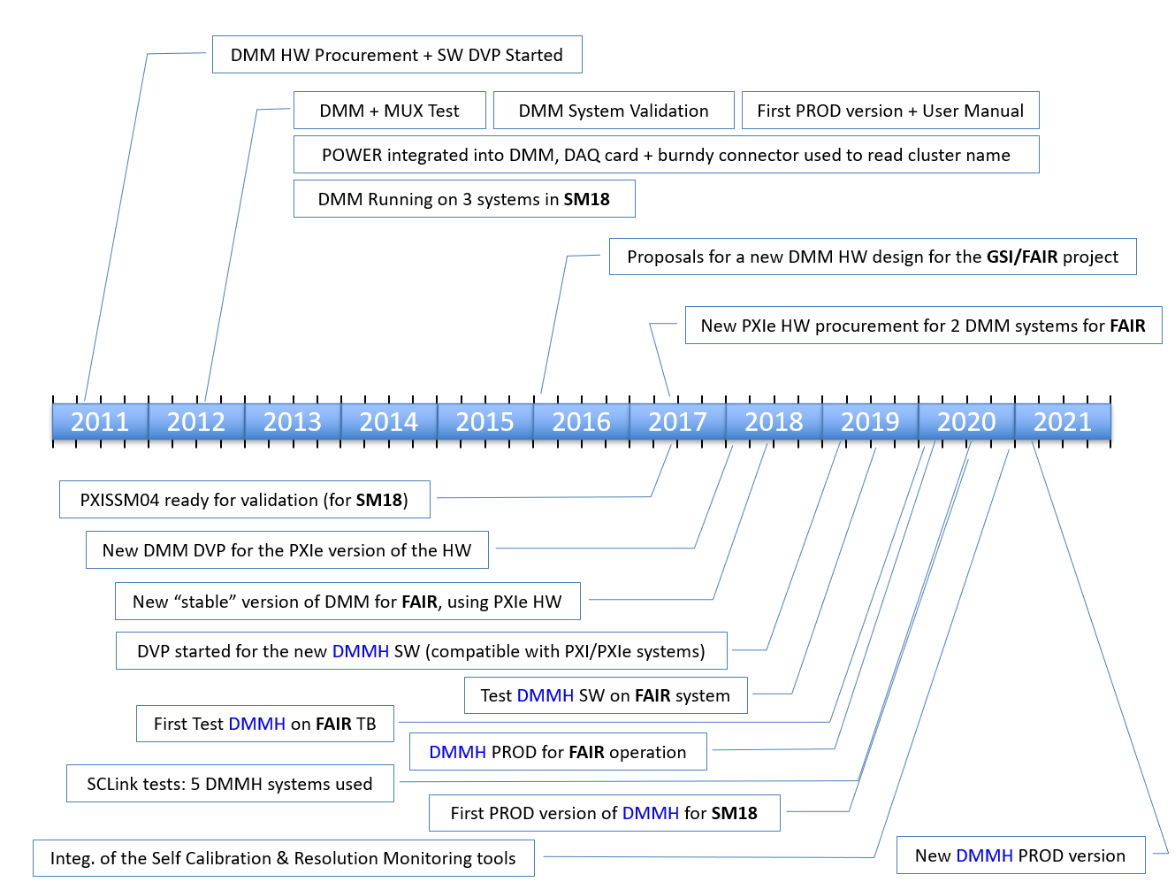
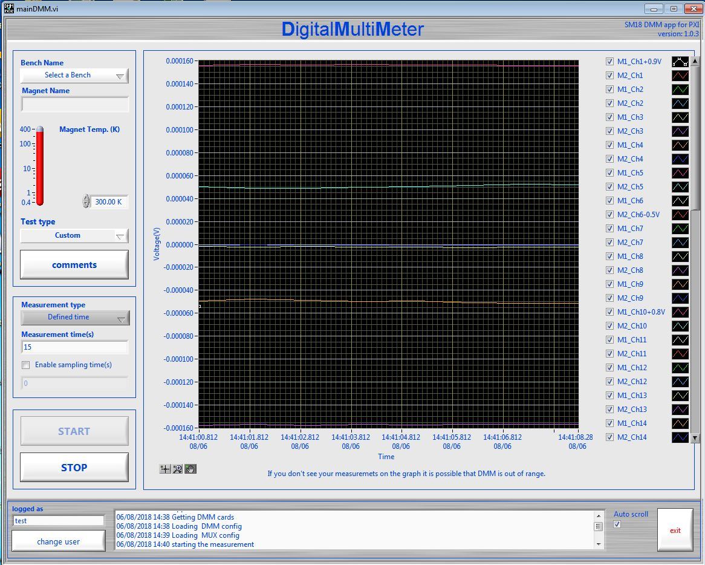
DMM Project Timeline
DMM PXI Ver. 2012
DMM PXIe Ver. 2018

Slide 3
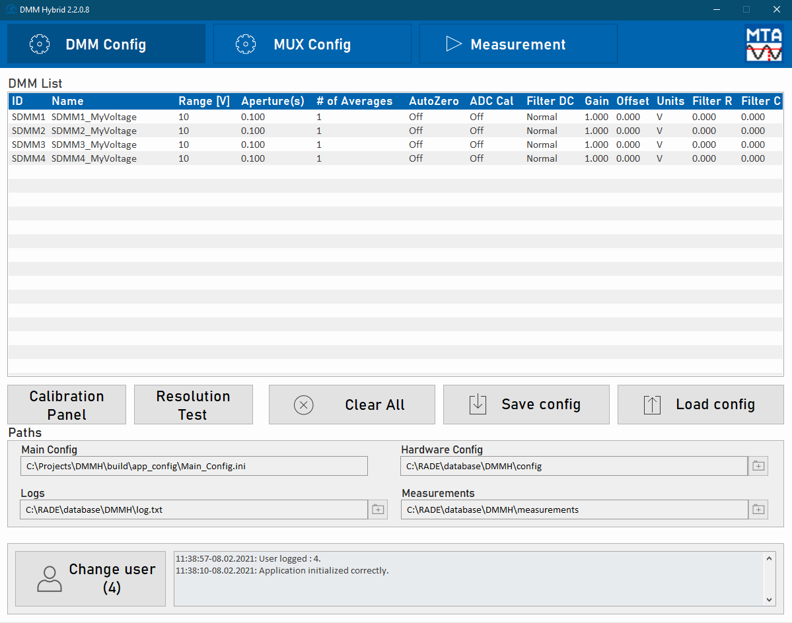
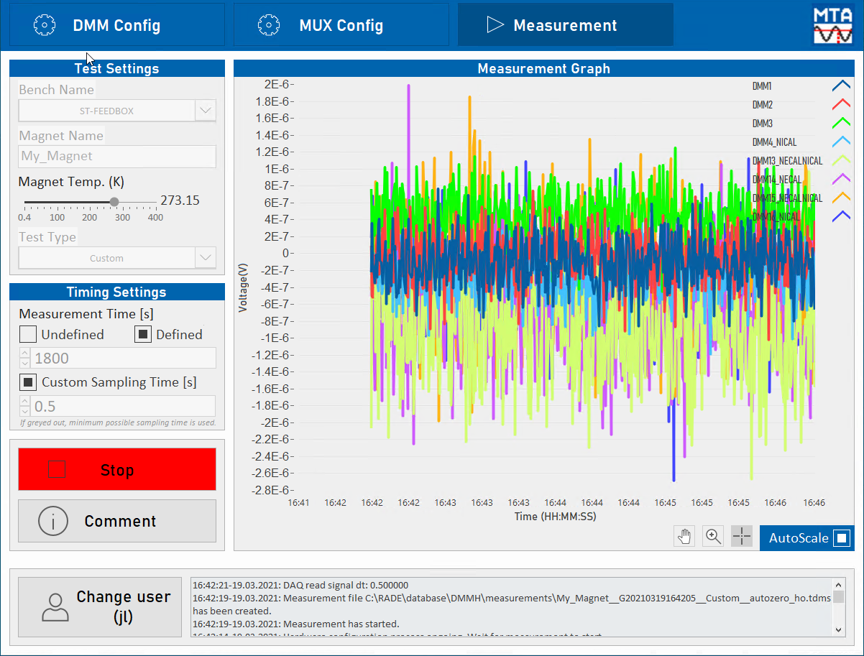
DMM Hybrid traits
One application reused for two systems (PXI and PXIe)
*240k CHF of equipment to be reused in combination with new PXIe hardware
Hardware abstraction layer prepared for future expansion
Efficient data storage using *.TDMS format (better compatibility with DIAdem)
Better resource management with multithreading and data referencing
Hardware triggering for better synchronization and timestamping
Calibration status interface
Logs and measurement files contain more debug information
Reworked UI for easier use

Slide 4
Validation process
Long time measurements:
  26.01 – 29.01 Sampling 1.5s, 8 channels = 12MB
  18.02 – 22.02 Sampling 0.1s, 6 channels = 211MB
Short measurements
  18.03 10min Sampling 0.0024s, 12 channels = 28MB
Tested mobile racks
  pxissm03 12 PXI-4071
  pxissm07 12 PXIe-4081 4 PXI-4071
Test focus
  External and Self-Calibration impact in short circuit configuration
  # of Averages, AutoZero, ADC Calibration, DC Noise Rejection impact in short circuit configuration

Slide 5

Effective Resolution
$$Effective Resolution=0.52 ∗PtP Gaussian Noise$$
$$Effective Number of Digits=\log_{10}(\frac{total range}{resolution at that range})$$

Slide 6
Effective Resolution
NI PXIe-4081
*With AutoZero On, ADC Calibration On, DC Noise Rejection High-Order
Range | Aperture Time | # of Averages | Theoretical Resolution | Noise P-P | Effective Resolution | Effective # of Digits
+/- 0.1V | 100ms | 1 | 10nV | 600nV | 312nV | 5.80
+/- 1V | 100ms | 1 | 50nV | 600nV | 312nV | 6.80
+/- 10V | 100ms | 1 | 500nV | 3uV | 1.56uV | 7.10
NI PXI-4071
Range | Aperture Time | # of Averages | Theoretical Resolution | Noise P-P | Effective Resolution | Effective # of Digits
+/- 0.1V | 100ms | 1 | 10nV | 675nV | 351nV | 5.76
+/- 1V | 100ms | 1 | 50nV | 900nV | 468nV | 6.63
+/- 10V | 100ms | 1 | 500nV | 4.5uV | 2.34uV | 6.93

Slide 7
Effective Resolution
NI PXIe-4081
*With AutoZero On, ADC Calibration On, DC Noise Rejection High-Order
Range | Aperture Time | # of Averages | Theoretical Resolution | Noise P-P | Effective Resolution | Effective # of Digits
+/- 0.1V | 100ms | 4 | 10nV | 320nV | 166nV | 6.08
+/- 1V | 100ms | 4 | 50nV | 320nV | 166nV | 7.08
+/- 10V | 100ms | 4 | 500nV | 1.6uV | 832nV | 7.38
NI PXI-4071
Range | Aperture Time | # of Averages | Theoretical Resolution | Noise P-P | Effective Resolution | Effective # of Digits
+/- 0.1V | 100ms | 4 | 10nV | 360nV | 187nV | 6.03
+/- 1V | 100ms | 4 | 50nV | 480nV | 250nV | 6.90
+/- 10V | 100ms | 4 | 500nV | 2.4uV | 1.25uV | 7.20

Slide 8
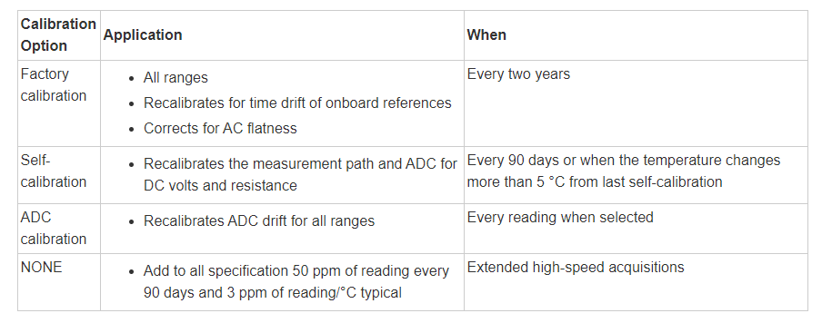
Accuracy and calibration
For maximum accuracy, NI recommends self-calibrating once every 24 hours or when the temperature changes by more than ±1 °C on the NI 4081 and NI 4071 and more than ±5 °C on the NI 4070/4072. Otherwise, NI recommends running self-calibration every 90 days.

Slide 9
Accuracy and calibration
Self-Calibration in details:
Self-calibration corrects for all DCV gain and offset errors within the DMM using a precision, high-stability internal voltage reference, which has an outstanding temperature coefficient and time drift.
Self-calibration also accounts for all resistance, source, and gain errors.
In resistance, all errors are corrected to a single internal 10 kΩ aerospace grade, high-stability foil resistor, which is stable to within 0.8 ppm/°C over the full operating range.
During self-calibration, the internal circuitry is automatically disconnected from the input. Therefore, for the majority of applications, users do not need to disconnect the input signals during self-calibration.
*However, excessive signal levels (>30 VDC, >30 VACrms, >20 kHz) at the input terminals of the NI 4070/4071/4072 generate a self-calibration error.
For optimum reliability, avoid application of current to the Amps terminals or signals of >30 V to the Volts Input terminals during self-calibration.

Slide 10
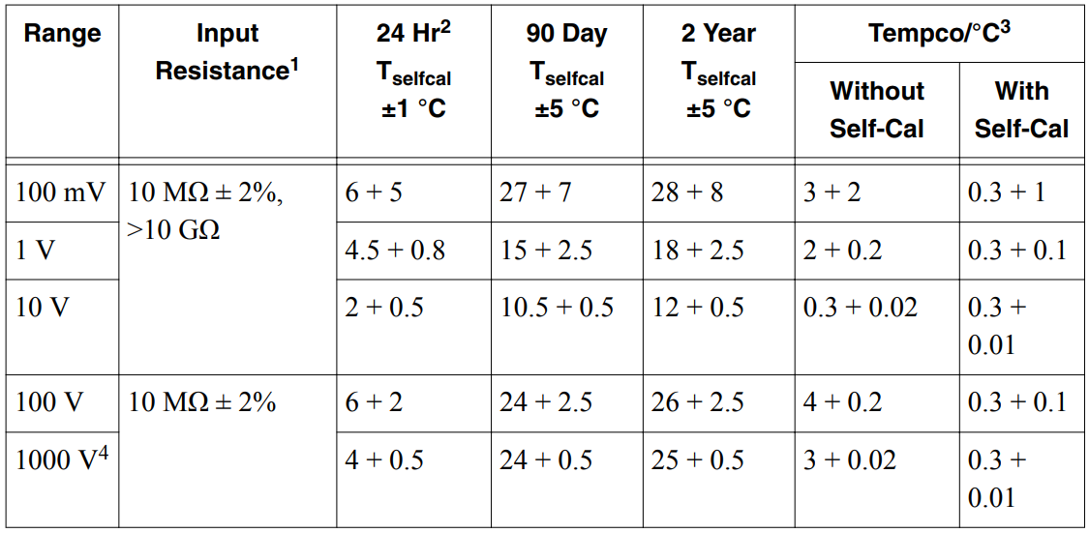

Accuracy and calibration
$$\text{Accuracy}\text{ = }\text{±}\text{(}\text{ppm} \text{of} \text{reading}\text{ + }\text{ppm} \text{of} \text{range}\text{)}$$
All DC voltage accuracy specifications apply to apertures of ≥100 ms, with Auto Zero and ADC calibration enabled. (Table applies to PXIe-4081)

Slide 11
Accuracy and calibration
NI PXIe-4081
Range | Signal | 24H T_{selfcal} ± 1°C | 90D T_{selfcal} ± 5°C | 90D T_{selfcal} ± 15°C | 2Y T_{selfcal} ± 5°C | 2Y T_{selfcal} ± 15°C
0.1V | 0.05V | 0.8uV | 2.05uV | 5.5uV | 2.2uV | 5.7uV
1V | 0.5V | 3.05uV | 10uV | 22uV | 11.5uV | 23.5uV
10V | 5V | 15uV | 57.5uV | 74.5uV | 65uV | 82uV
NI PXI-4071
Range | Signal | 24H T_{selfcal} ± 1°C | 90D T_{selfcal} ± 5°C | 90D T_{selfcal} ± 15°C | 2Y T_{selfcal} ± 5°C | 2Y T_{selfcal} ± 15°C
0.1V | 0.05V | 0.71uV | 2.41uV | 5.91uV | 2.56uV | 6.06uV
1V | 0.5V | 2.88uV | 9.88uV | 21.88uV | 11.88uV | 23.88uV
10V | 5V | 15.38uV | 70.38uV | 87.38uV | 80.38uV | 97.38uV

Slide 12
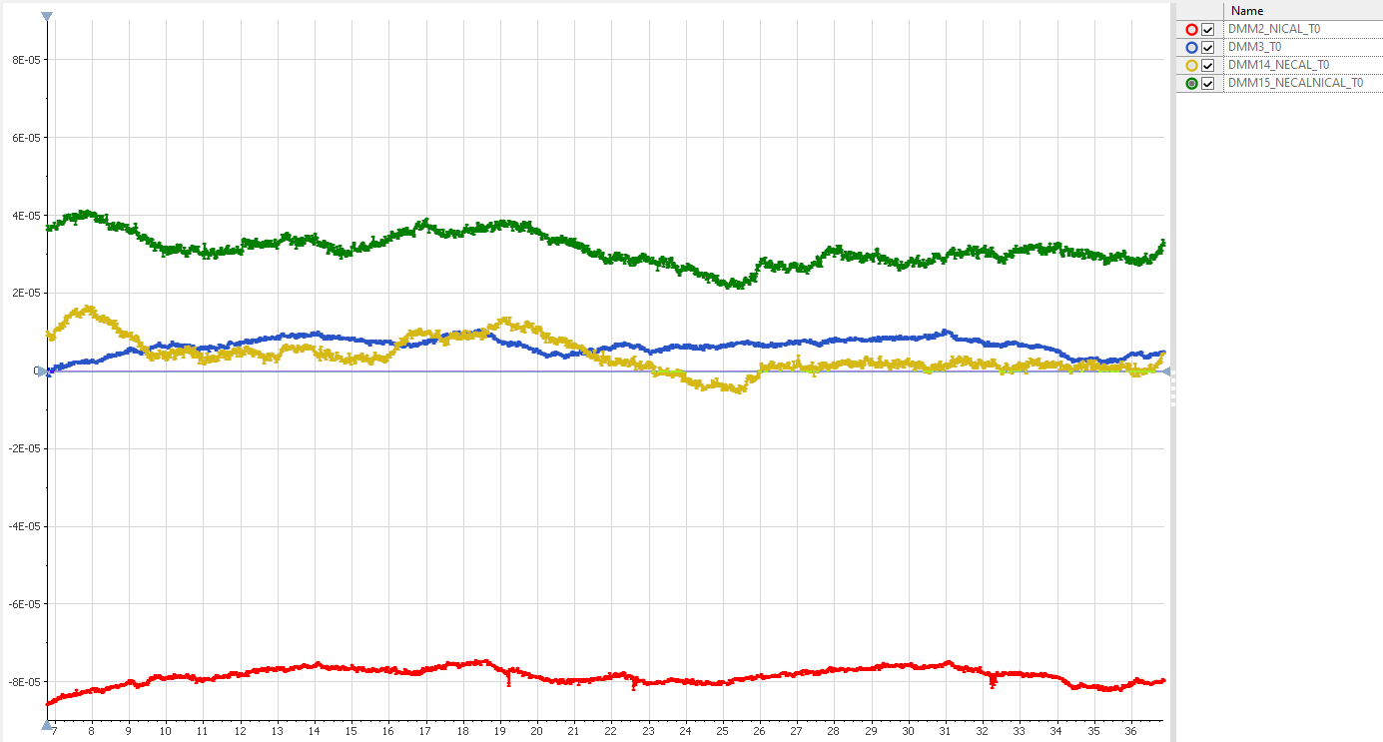
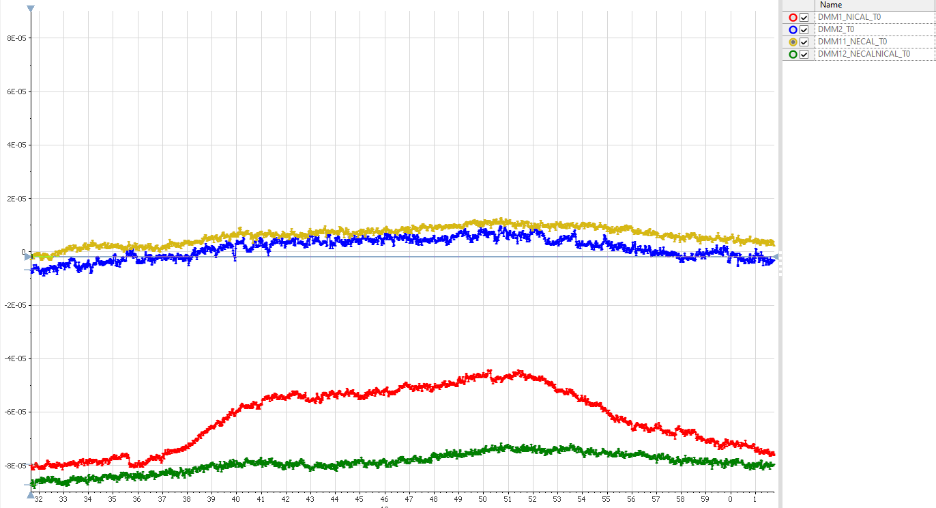
Calibration impact – raw config
PXISSM07
PXISSM03
Calibration status | Average | StdDev
Calibrated (B) | 6.53E-06 | 2.07E-06
Only Self-Calibration (O) | 4.02E-06 | 4.40E-06
Only Ext. Calibration (R) | -7.83E-05 | 2.08E-06
Non-Calibrated (G) | 3.14E-05 | 3.94E-06
Calibration status | Average | StdDev
Calibrated (B) | 1.45E-06 | 3.92E-06
Only Self-Calibration (O) | 6.29E-06 | 3.29E-06
Only Ext. Calibration (R) | -6.20E-05 | 1.13E-05
Non-Calibrated (G) | -7.89E-05 | 3.60E-06

Slide 13
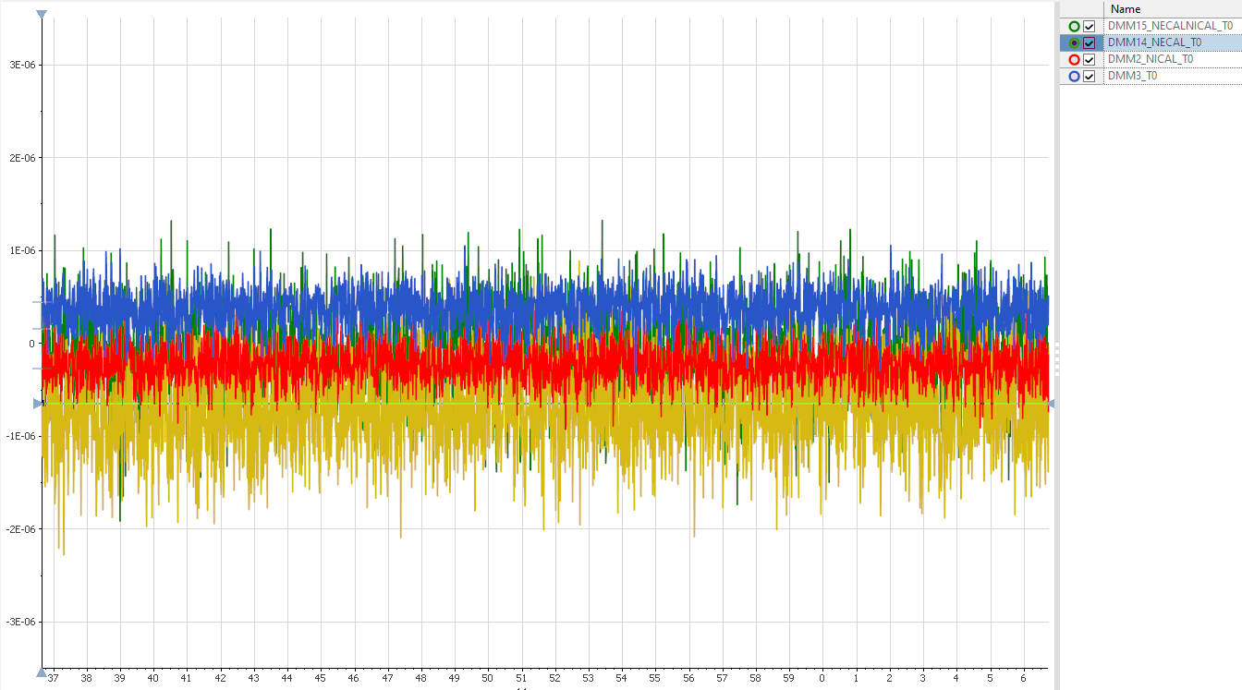
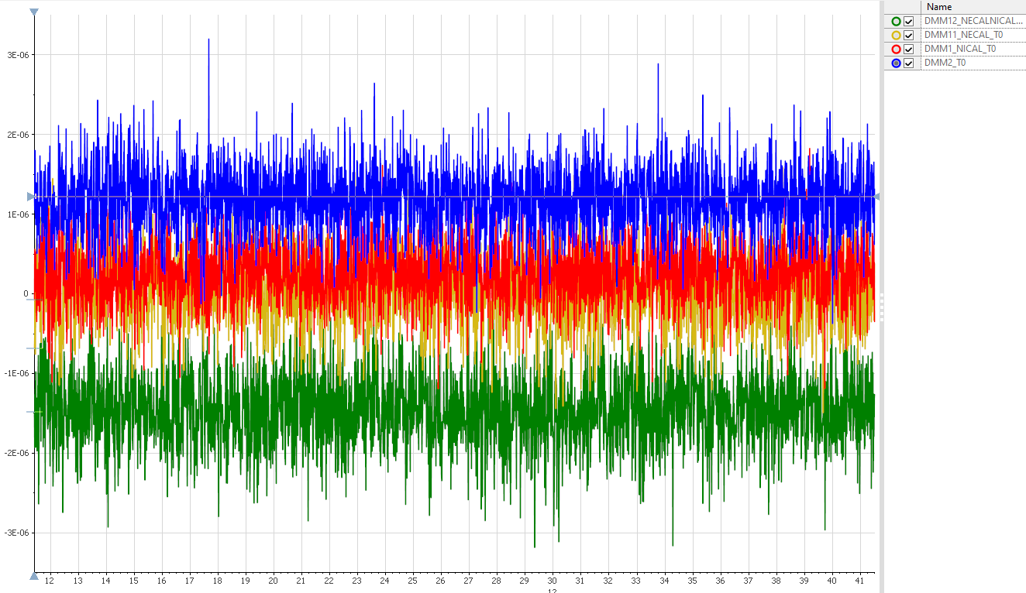
Calibration impact – best possible config
PXISSM07
PXISSM03
Calibration status | Average | StdDev
Calibrated (B) | 3.81E-07 | 2.00E-07
Only Self-Calibration (O) | -7.37E-07 | 4.54E-07
Only Ext. Calibration (R) | -2.30E-07 | 2.01E-07
Non-Calibrated (G) | -1.16E-07 | 4.78E-07
Calibration status | Average | StdDev
Calibrated (B) | 1.19E-06 | 4.19E-07
Only Self-Calibration (O) | 8.03E-08 | 4.64E-07
Only Ext. Calibration (R) | 2.69E-07 | 4.01E-07
Non-Calibrated (G) | -1.45E-06 | 4.71E-06

Slide 14
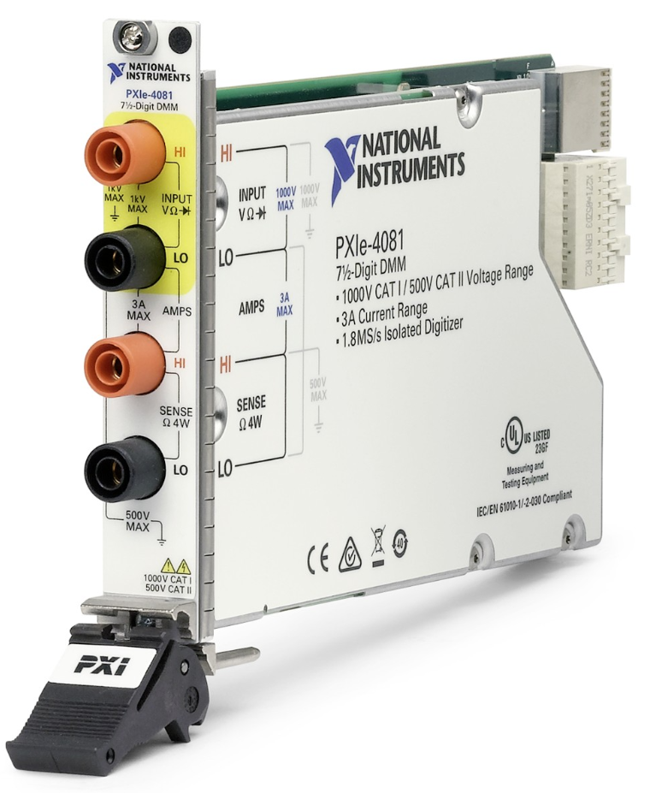
AutoZero
Auto Zero is a method used to compensate for internal DMM offsets.
When enabled, the internal DMM input is connected to LO terminal.
Thus, any offsets in the measurement path or ADC are measured. The subsequent “real” measurement, has AutoZero value subtracted from it.
This parameter increases the measurement resolution by compensating internal DMM offsets. AutoZero adds around 63 milliseconds per sample.

Slide 15
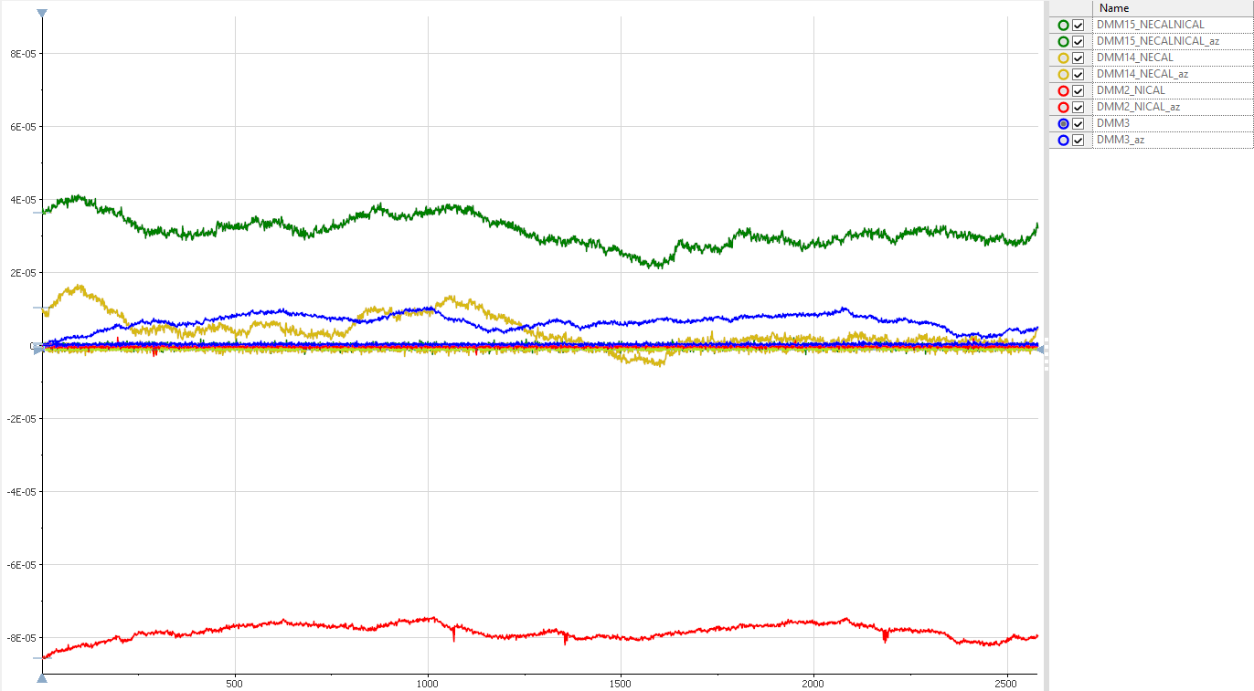
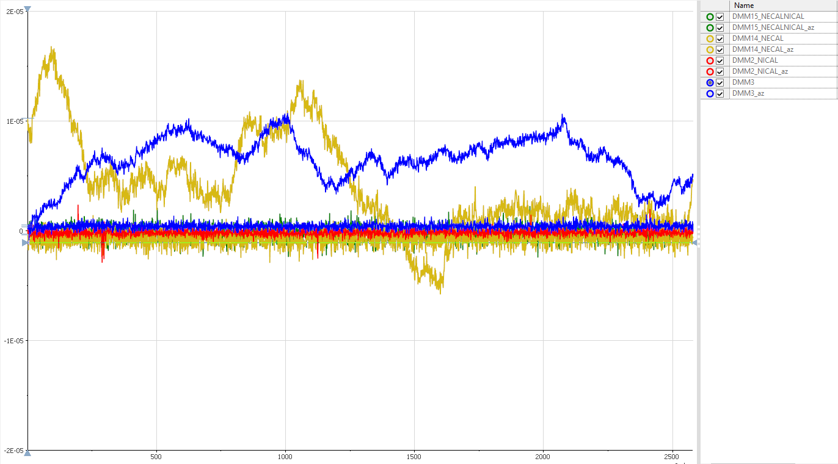
AutoZero impact (PXISSM07)
Noisy curve = raw config
Flat curve = AutoZero
Zoom
Calibration status | Average | StdDev | Average (AutoZero) | StdDev (AutoZero)
Calibrated (B) | 6.53E-06 | 2.07E-06 | 4.39E-07 | 2.58E-07
Only Self-Calibration (O) | 4.02E-06 | 4.40E-06 | -7.52E-07 | 6.08E-07
Only Ext. Calibration (R) | -7.83E-05 | 2.08E-06 | -1.55E-07 | 2.93E-07
Non-Calibrated (G) | 3.14E-05 | 3.94E-06 | -2.05E-07 | 6.50E-07

Slide 16
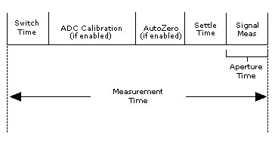
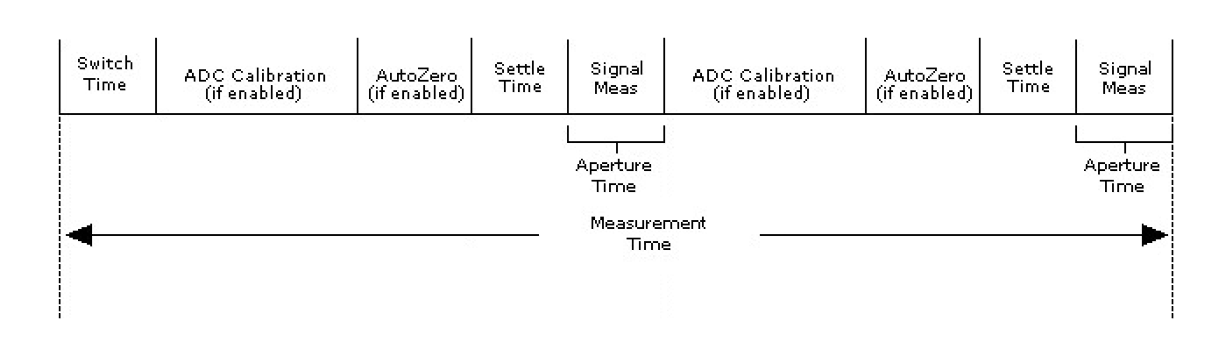
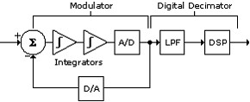
Averaging
Specifies the number of Aperture Times to perform in one sample measurement.
NI DMM will perform AutoZero(if enabled), ADC Calibration(if enabled) and Settling before each Aperture Time.
Because of that, average of 4 points acquired with Aperture Time = 100ms should have better accuracy/precision than 1 point acquired with Aperture Time = 400ms.
*Aperture Time is the period during which the ADC is reading the input signal. In other words it is integration time of the signal
Number of Averages = 1
Number of Averages = 2

Slide 17
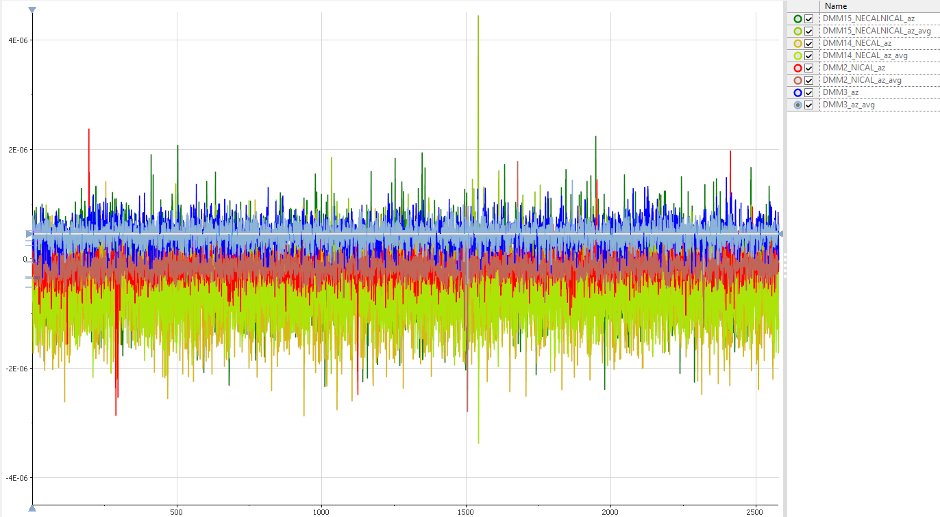
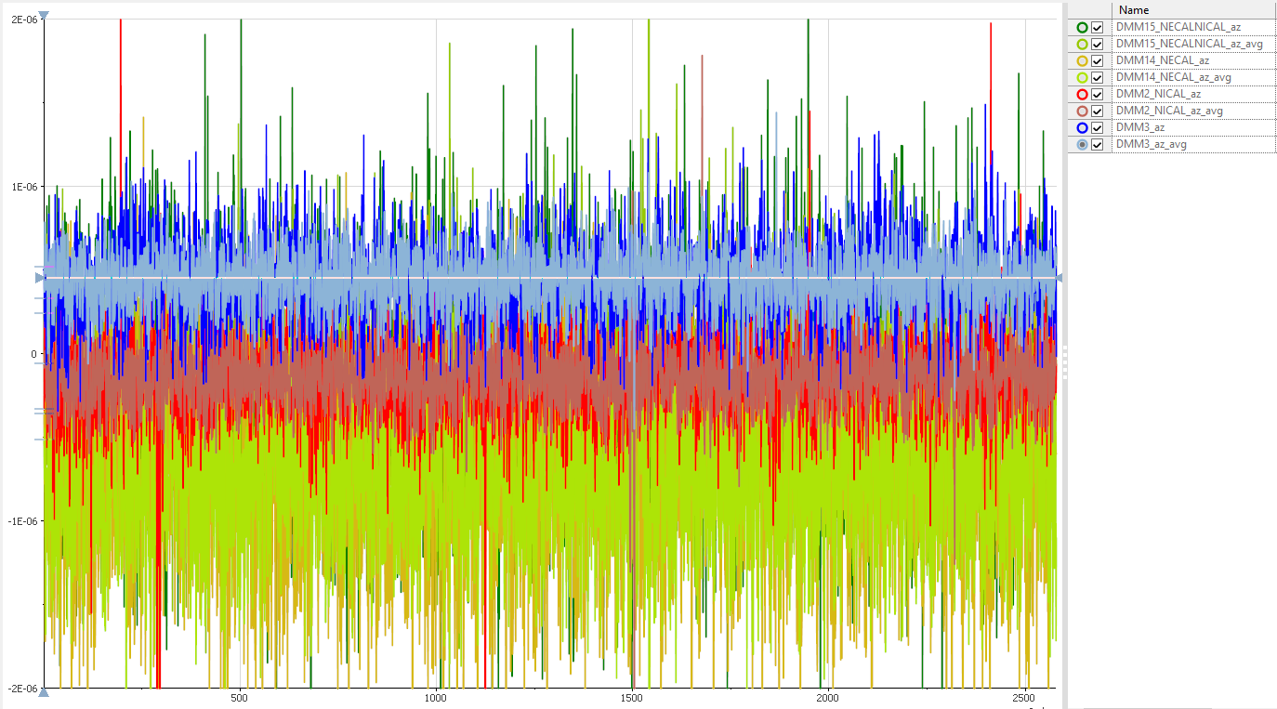
Averaging impact (PXISSM07)
Dark color = AZ
Bright color = AZ+AVG
Zoom
Calibration status | Average (AZ) | StdDev(AZ) | Average (AZ+2Avg) | StdDev (AZ+2Avg)
Calibrated (B) | 4.39E-07 | 2.58E-07 | 4.48E-07 | 1.75E-07
Only Self-Calibration (O) | -7.52E-07 | 6.08E-07 | -7.30E-07 | 4.52E-07
Only Ext. Calibration (R) | -1.55E-07 | 2.93E-07 | -1.34E-07 | 1.92E-07
Non-Calibrated (G) | -2.05E-07 | 6.50E-07 | -1.87E-07 | 4.81E-07

Slide 18
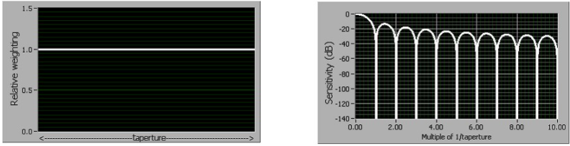
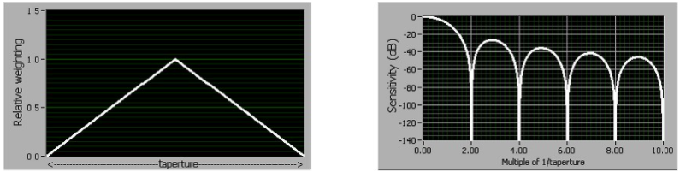
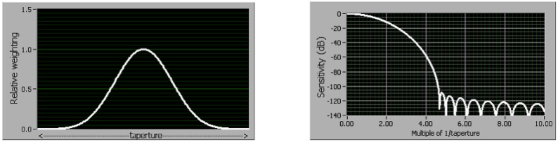
Filtering (DC Noise Rejection)
Each DC reading returned by the NI DMM is actually the mathematical result (integration) of multiple high-speed samples.
By adjusting the relative weighting of those samples, you can adjust the sensitivity to different interfering frequencies.
Three different weightings are available – normal, second-order, and high-order.

Slide 19
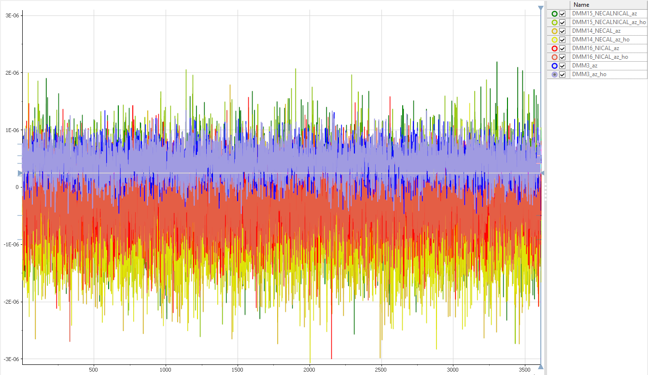
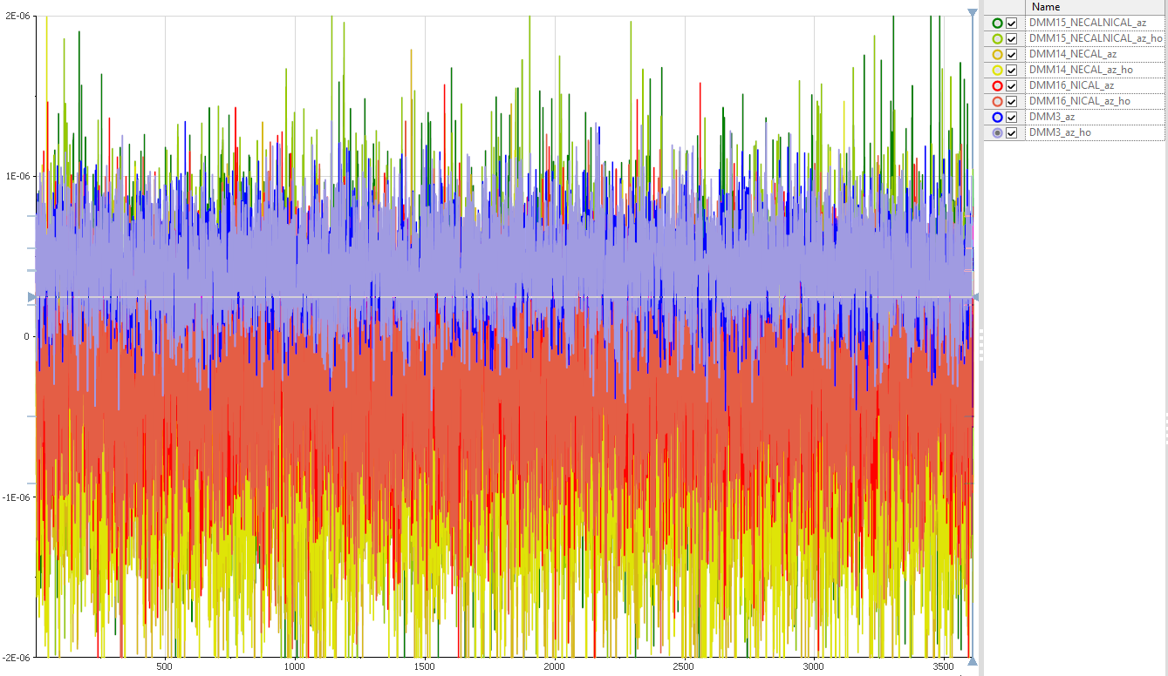
High-Order Filtering impact (PXISSM07)
Zoom
Calibration status | Average (AZ) | StdDev(AZ) | Average (AZ+H-O F) | StdDev (AZ+H-O F)
Calibrated (B) | 4.32E-07 | 2.60E-07 | 4.31E-07 | 2.89E-07
Only Self-Calibration (O) | -7.13E-07 | 5.97E-07 | -7.36E-07 | 6.02E-07
Only Ext. Calibration (R) | -2.68E-07 | 5.18E-07 | -2.97E-07 | 5.07E-07
Non-Calibrated (G) | -2.12E-07 | 6.71E-07 | -2.39E-07 | 6.65E-07

Slide 20
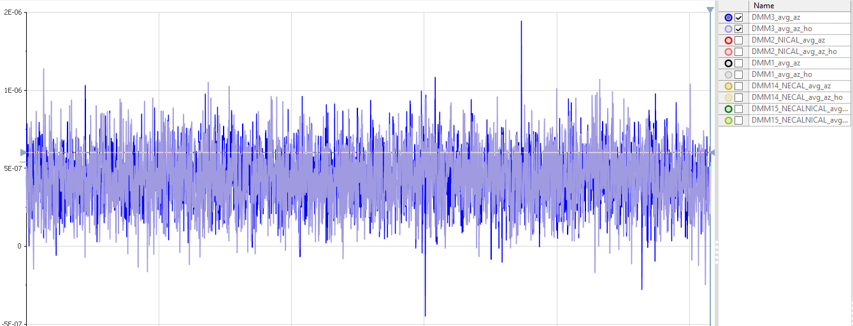
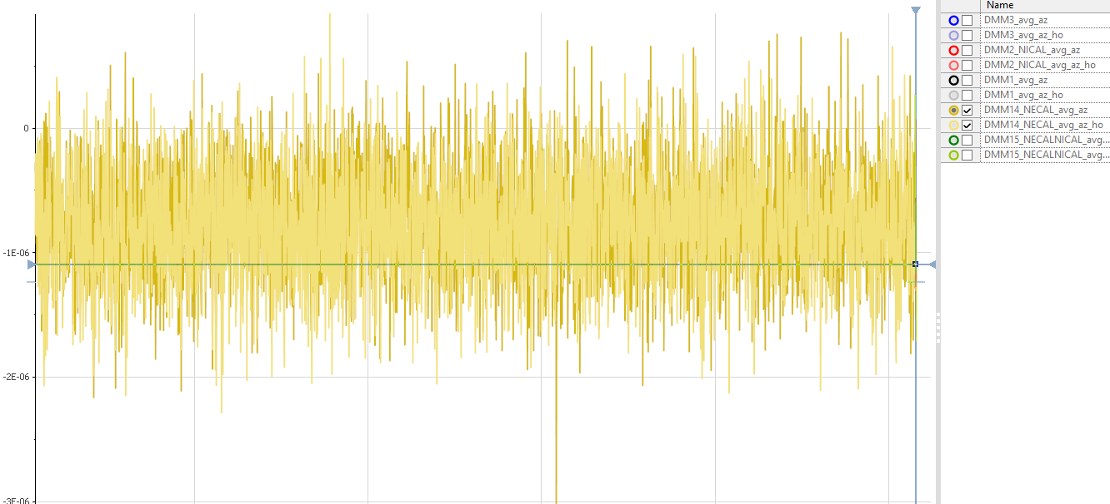
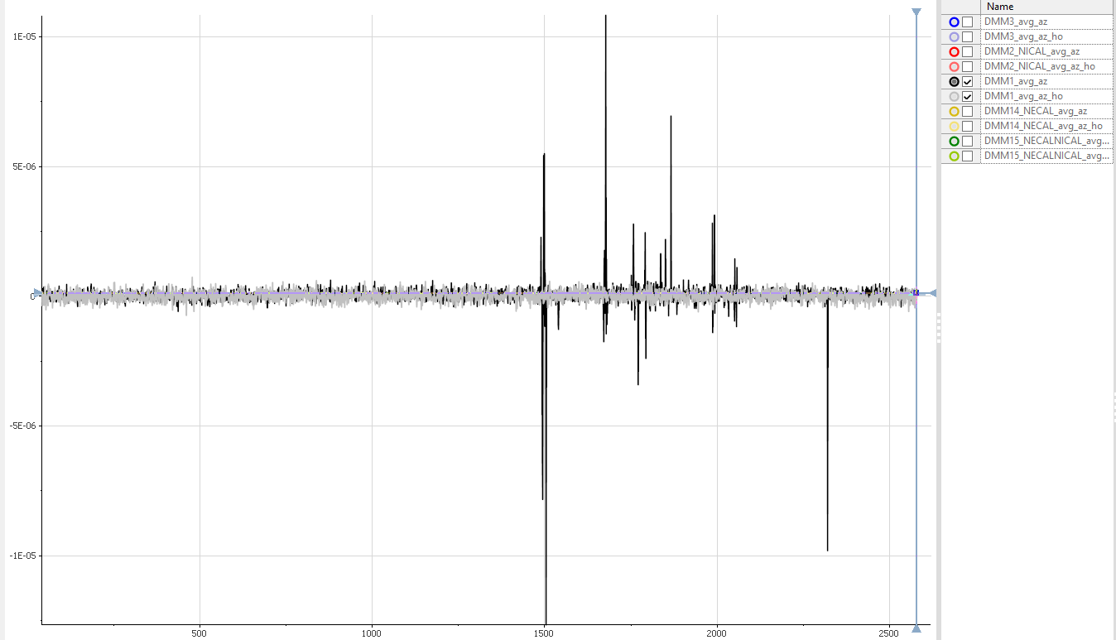
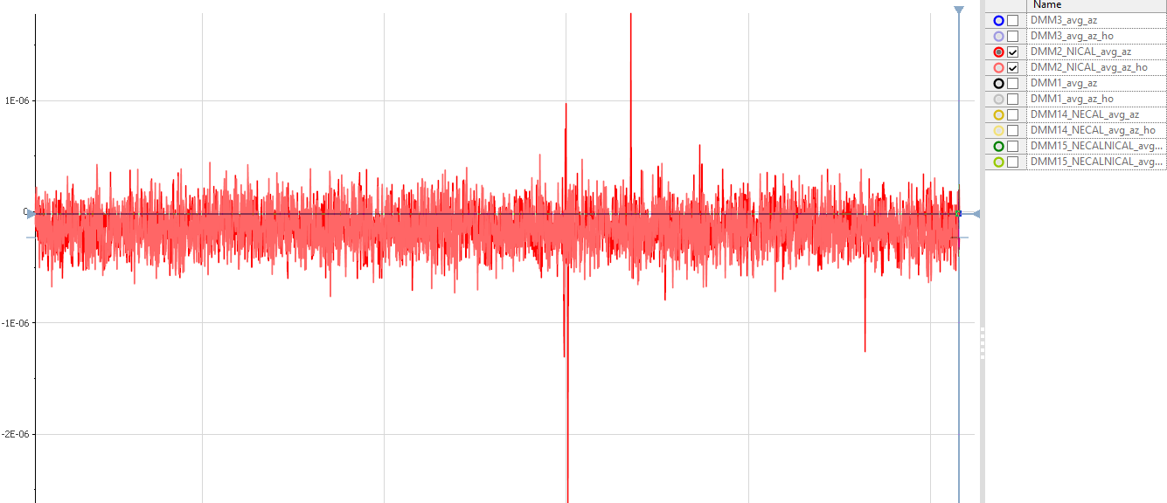
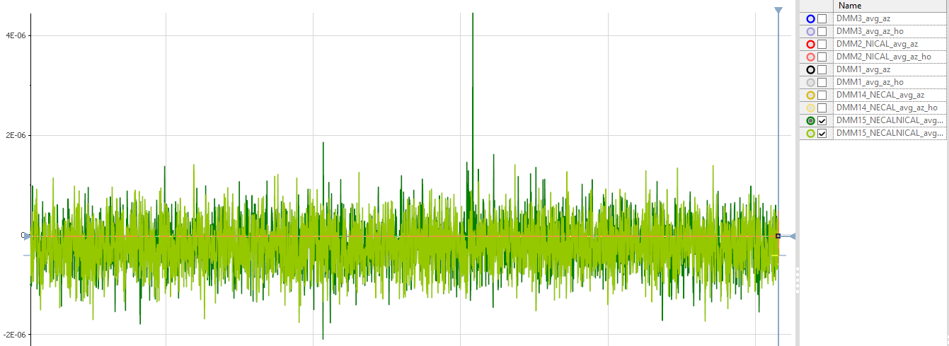
High-Order Filtering impact (PXISSM07)
Calibration status | Average (AZ+2Avg) | StdDev(AZ+2Avg) | Average (AZ+2Avg+HO) | StdDev (AZ+2Avg+HO)
Calibrated (B) | 4.48E-07 | 1.75E-07 | 4.37E-07 | 1.97E-07
Only Self-Calibration (O) | -7.30E-07 | 4.52E-07 | -7.80E-07 | 4.55E-07
Only Ext. Calibration (R) | -1.34E-07 | 1.92E-07 | -1.47E-07 | 1.95E-07
Non-Calibrated (G) | -1.87E-07 | 4.81E-07 | -2.19E-07 | 4.90E-07

Slide 21
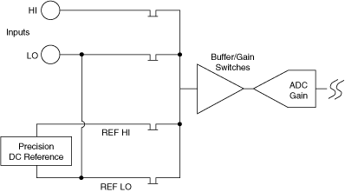
ADC Calibration
ADC Calibration is a method used to compensate for an internal DMM gain error and allows you to appropriately trade off measurement speed for long-term accuracy.
When ADC calibration is enabled, every measurement cycle includes an additional phase for acquiring the value of the high-precision on-board reference voltage.
ADC gain drift is normalized to the input signal, and the ADC gain drift is removed in the resulting mathematical calculation on every measurement.
Input is disconnected from the ADC and the precision DC reference is measured.
This measurement consists of an ADC calibration Auto Zero (REF LO) and an ADC calibration HI (REF HI). The normalized value of the reference voltage is calculated from Vref = REF HI–REF LO.

Slide 22
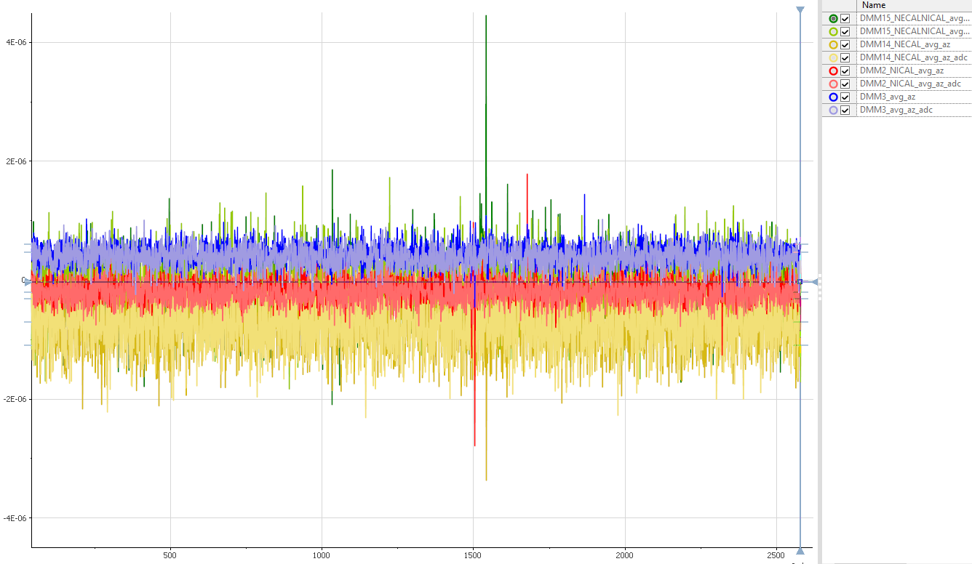
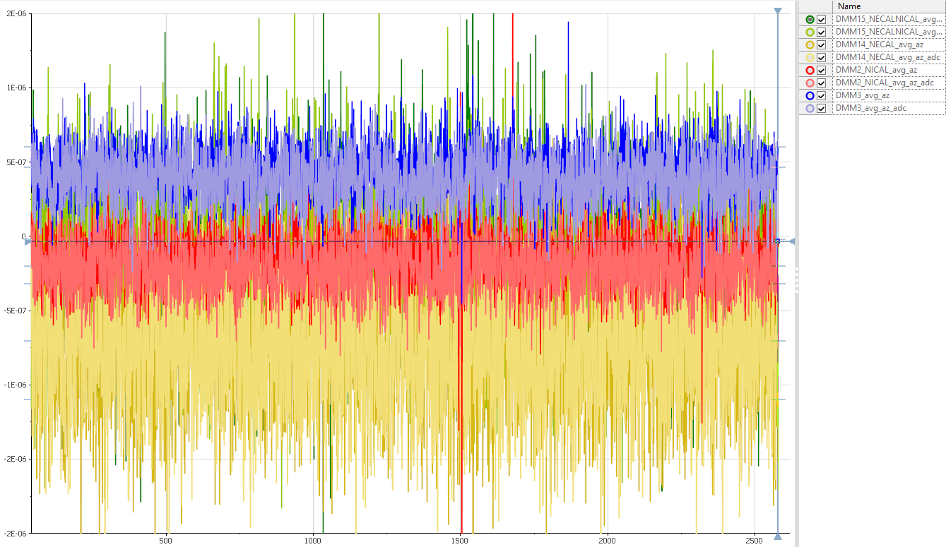
ADC Calibration impact (PXISSM07)
Zoom
Calibration status | Average (AZ+2Avg) | StdDev(AZ+2Avg) | Average (AZ+2Avg+ADC) | StdDev (AZ+2Avg+ADC)
Calibrated (B) | 4.48E-07 | 1.75E-07 | 3.86E-07 | 1.78E-07
Only Self-Calibration (O) | -7.30E-07 | 4.52E-07 | -7.47E-07 | 4.34E-07
Only Ext. Calibration (R) | -1.34E-07 | 1.92E-07 | -2.12E-07 | 1.81E-07
Non-Calibrated (G) | -1.87E-07 | 4.81E-07 | -1.17E-07 | 4.86E-07

Slide 23
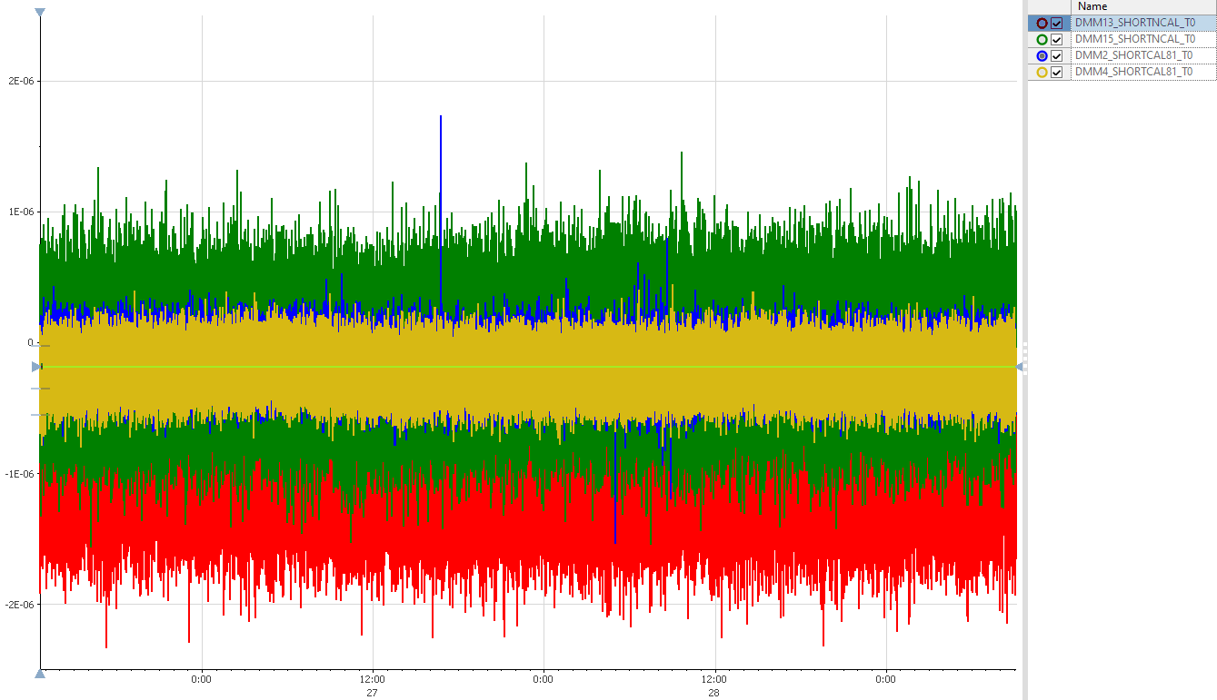
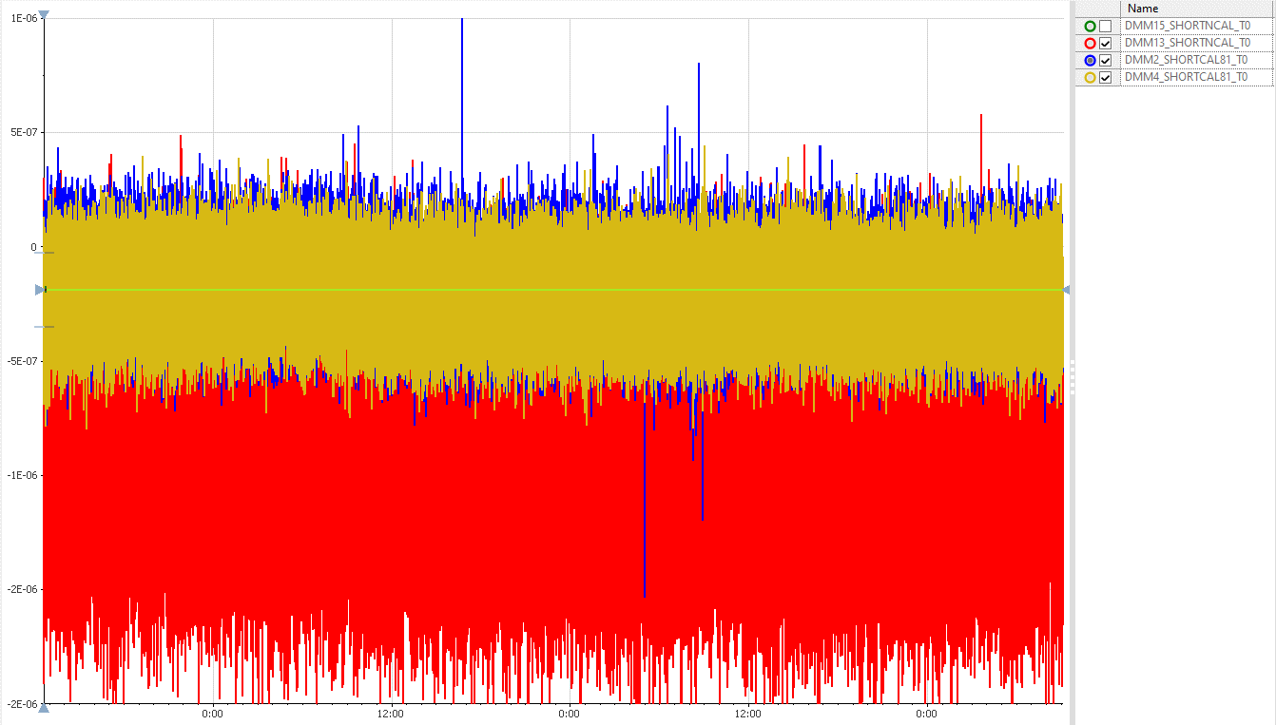
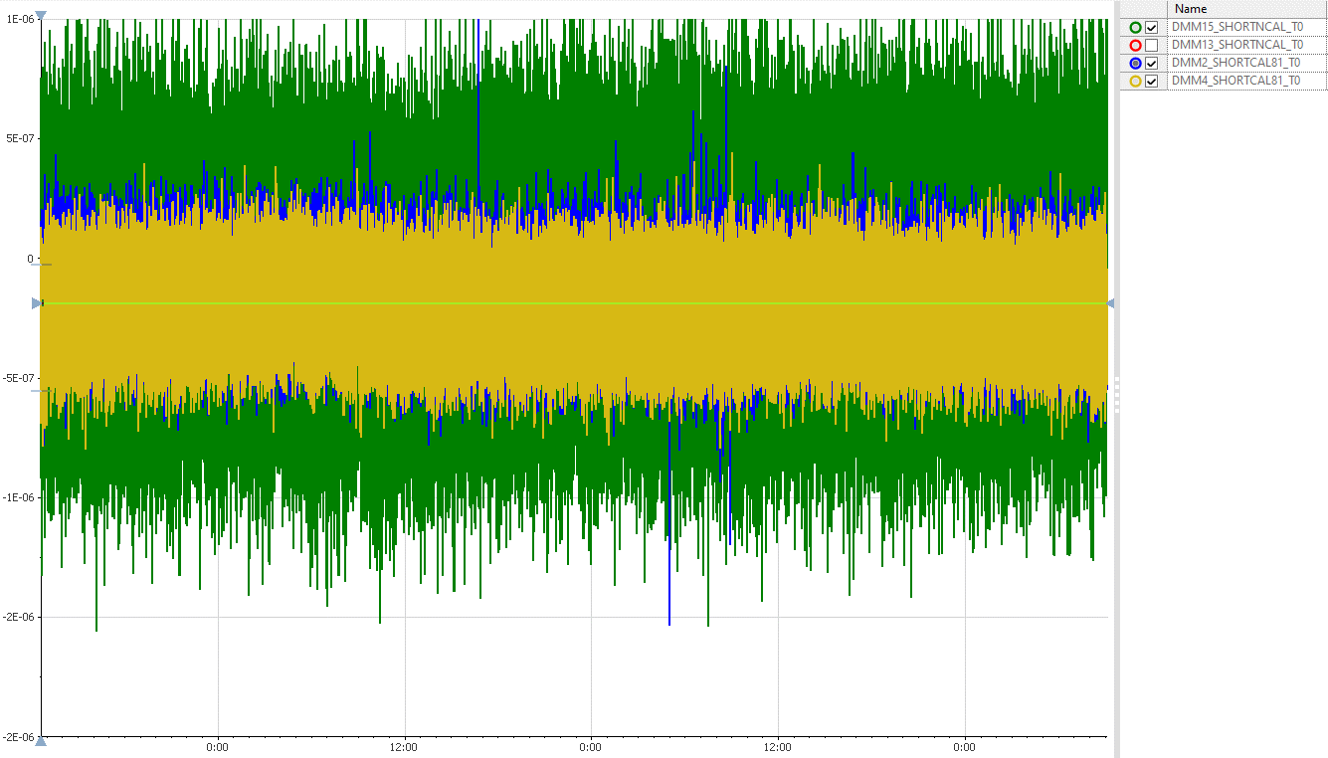
Long time measurement (PXISSM07 for 68.5 hours)
Green hidden
Red hidden
*With 4 Averages, AutoZero On, ADC Calibration On, DC Noise Rejection High-Order
**No missed samples, no missed timestamps
Calibration status | Average | StdDev
Calibrated PXIe-4081(B) | -1.70E-07 | 1.44E-07
Calibrated PXIe-4081(O) | -2.10E-07 | 1.38E-07
Only Self-Calibrated PXI-4071(R) | -8.89E-07 | 3.29E-07
Only Self-Calibrated PXI-4071 (G) | -1.05E-07 | 3.43E-07

Slide 24
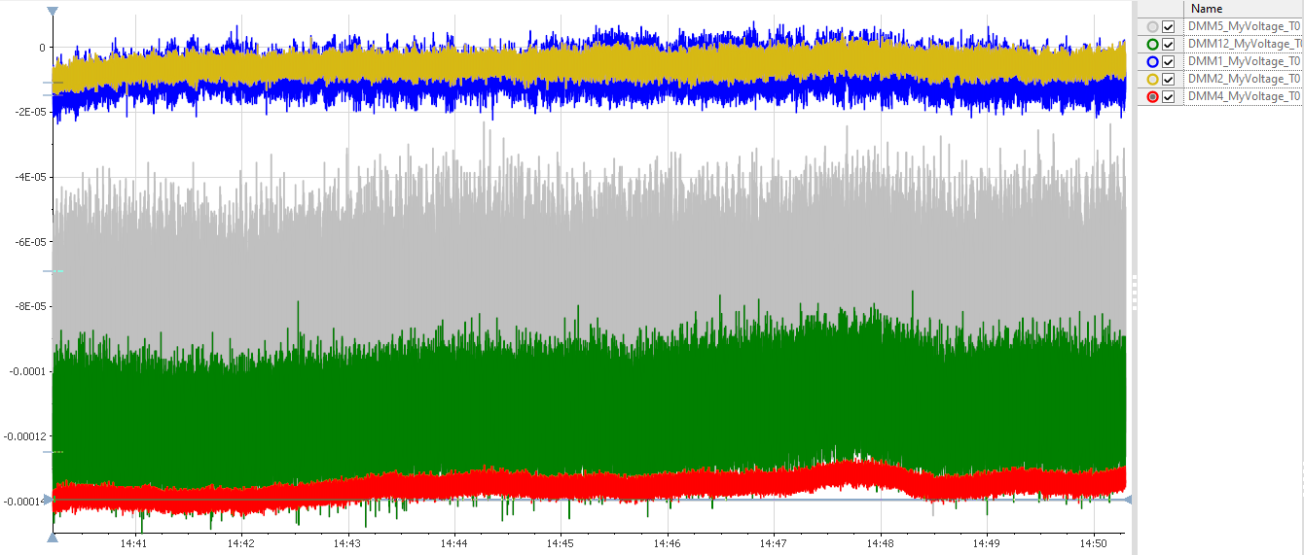
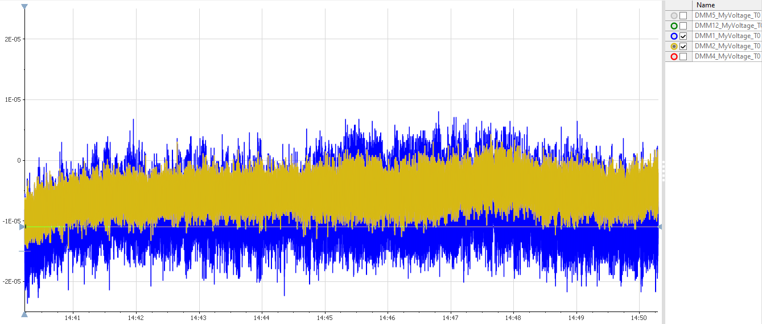
High freq. (PXISSM07 ~1kHz for 10min)
Zoom
*Raw config (Aperture = 1ms) to achieve low sampling time
Calibration status | Average | StdDev
1 day since Self-Calibration(B) | -8.07E-06 | 3.00E-06
1 day since Self-Calibration(O) | -5.41E-06 | 1.84E-06
1.5 month since Self-Calibration(R) | -1.36E-4 | 2.59E-06
1.5 month since Self-Calibration(Gray) | -8.37E-05 | 1.60E-05
1.5 month since Self-Calibration(Green) | -1.13E-4 | 8.46E-06

Slide 25
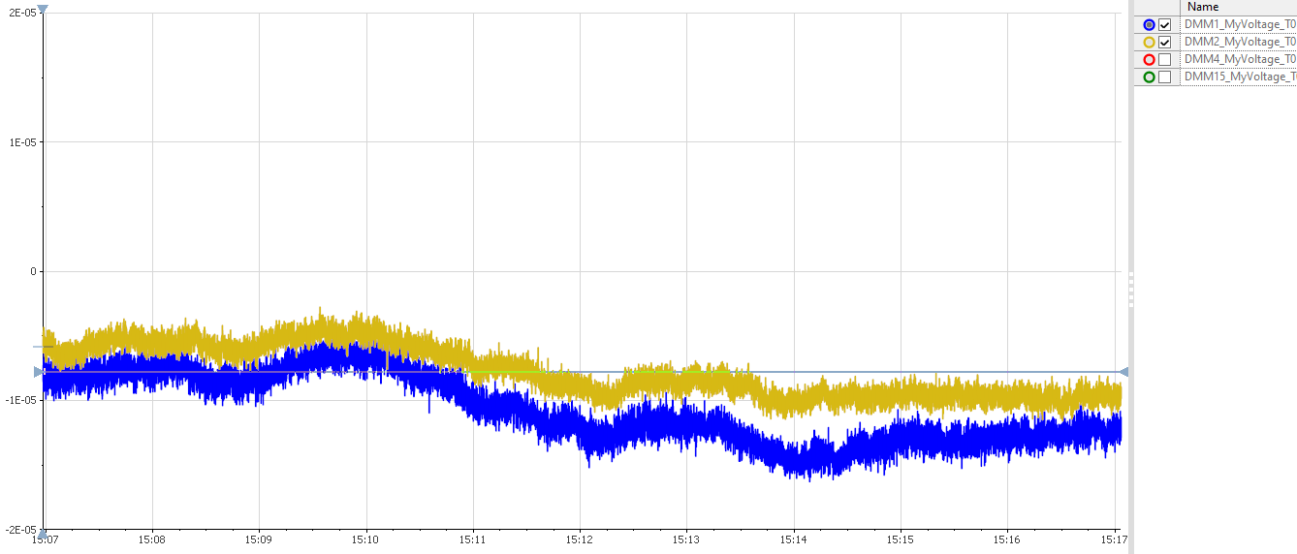
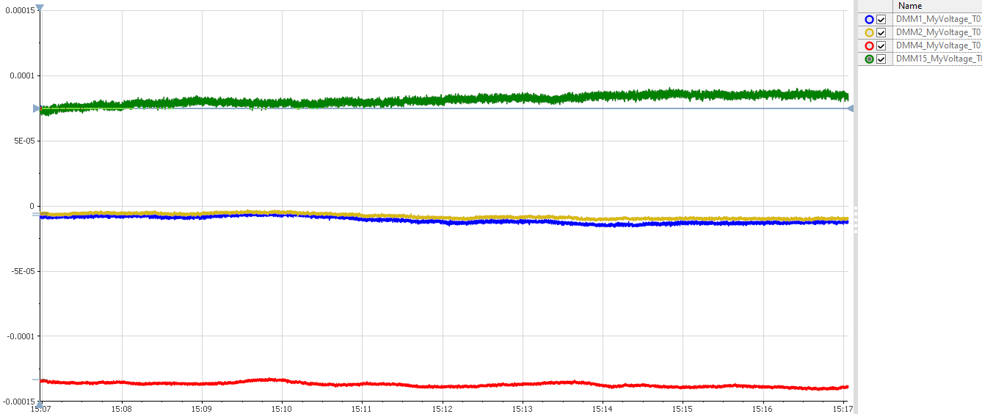
High freq. (PXISSM07 ~100Hz for 10min)
Zoom
*Raw config (Aperture = 10ms)to achieve low sampling time
Calibration status | Average | StdDev
1 day since Self-Calibration(B) | -1.07E-05 | 2.64E-06
1 day since Self-Calibration(O) | -7.73E-06 | 1.97E-06
1.5 month since Self-Calibration(R) | -1.37E-4 | 1.66E-06
1.5 month since Self-Calibration(Green) | 8.15E-05 | 3.50E-06

Slide 26
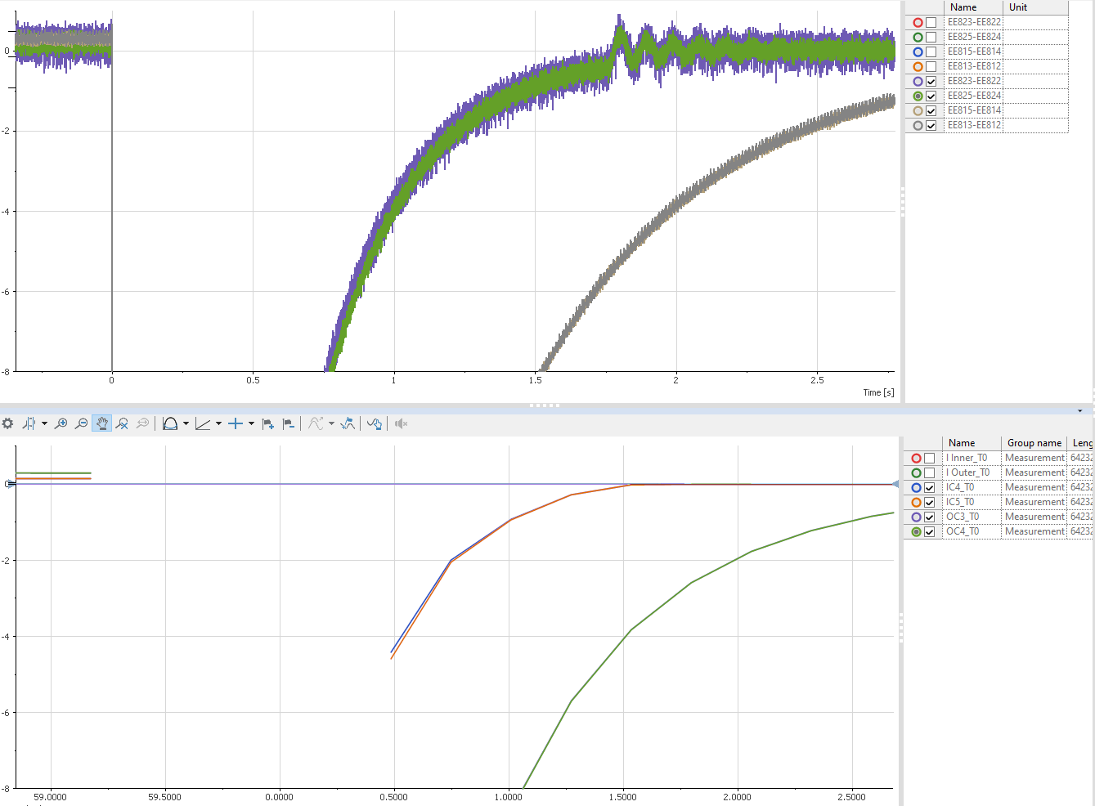
Comparison with DAQ
DAQ
Data points missing due to overrange/underrange.
(NI DMM range configured to 10V)
Ranges: 0.1V, 1V, 10V, 100V
Occurs above 105% of the range.
Above/below 105%, NI-DMM returns NaN.
Range: 1000V
Occurs above 105% of the range.
Above 105%, NI-DMM returns readings (not NaN) and the IVI overrange warning, even though the readings are not guaranteed within specifications.
DMM

Slide 27
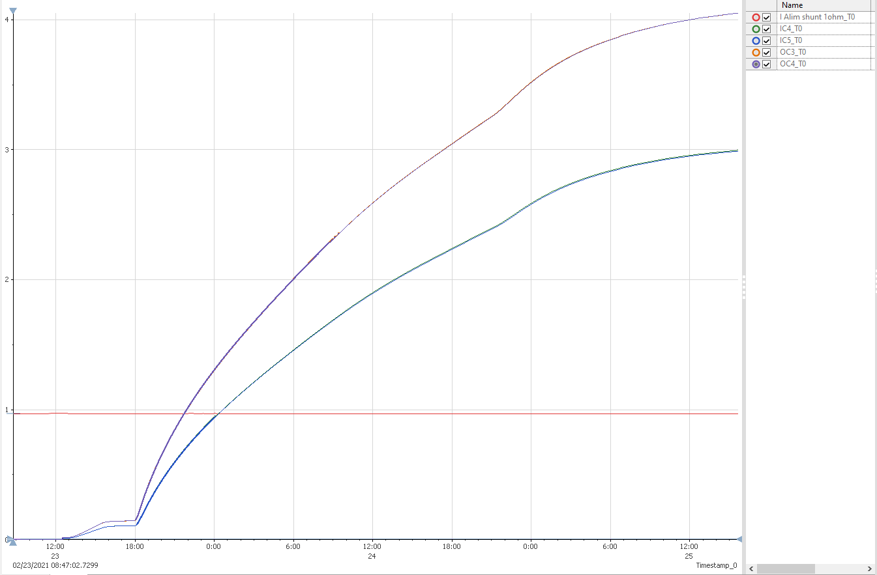
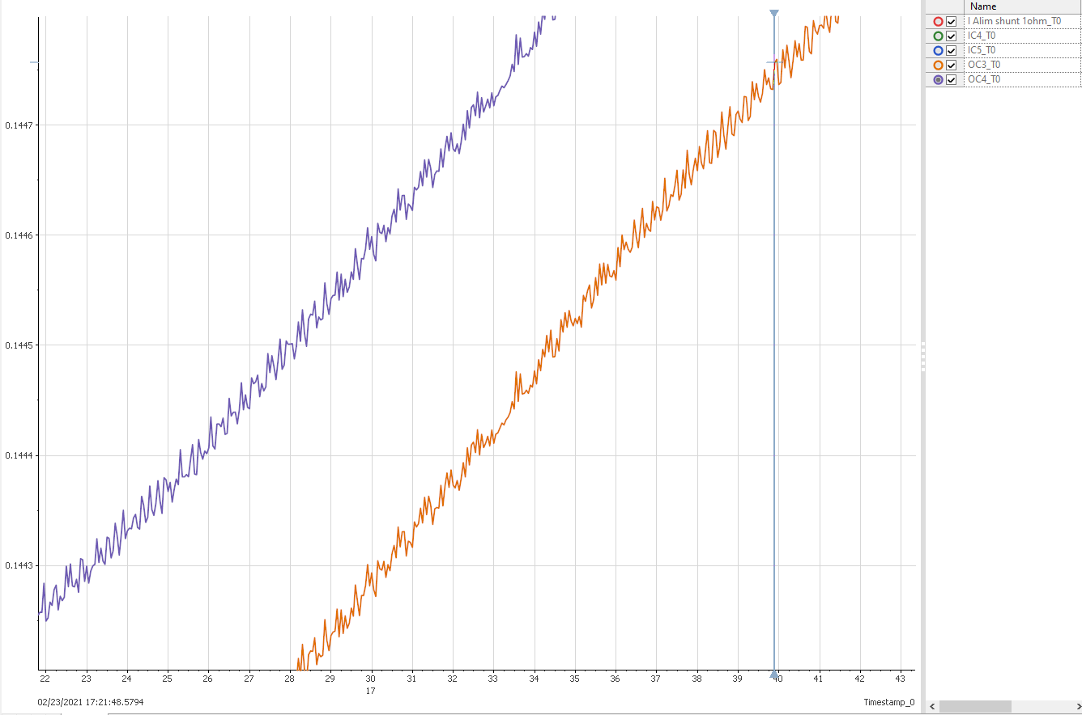
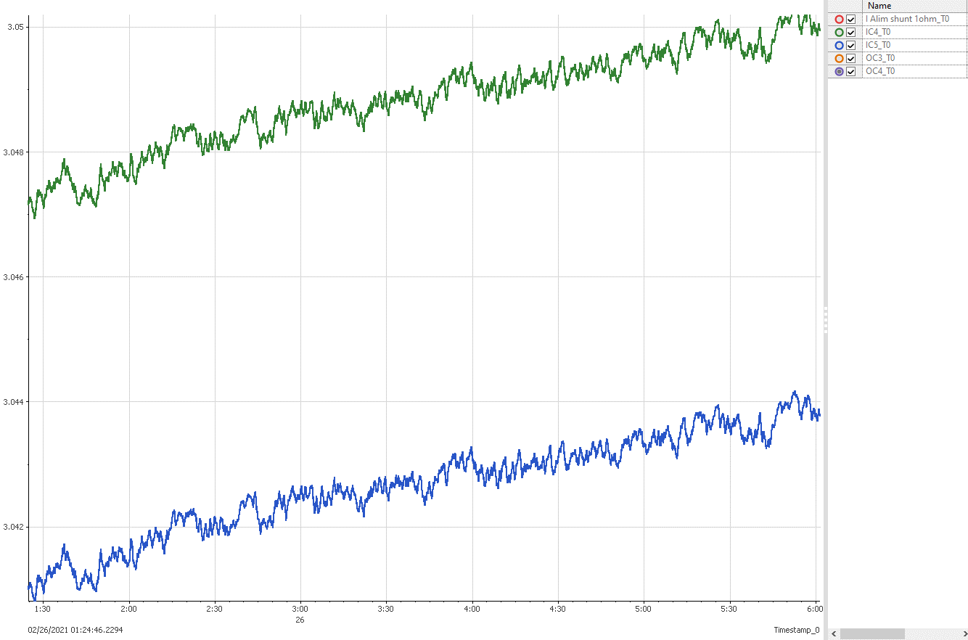
RRR Example
Performed on 23.02.2021
Aperture Time = 0.2s
# of Averages = 1
AutoZero = On
ADC Calibration = Off
DC Noise Rejection = Normal
Sampling Time = 3s
! Might benefit from using better parameters as timing is not a constraint here.
Measurement with 4 averages of 0.1s Aperture, AutoZero ON, ADC Calibration ON should take less than 1.2s while assuring 7.5-digit resolution.
Zoom
Zoom

Slide 28
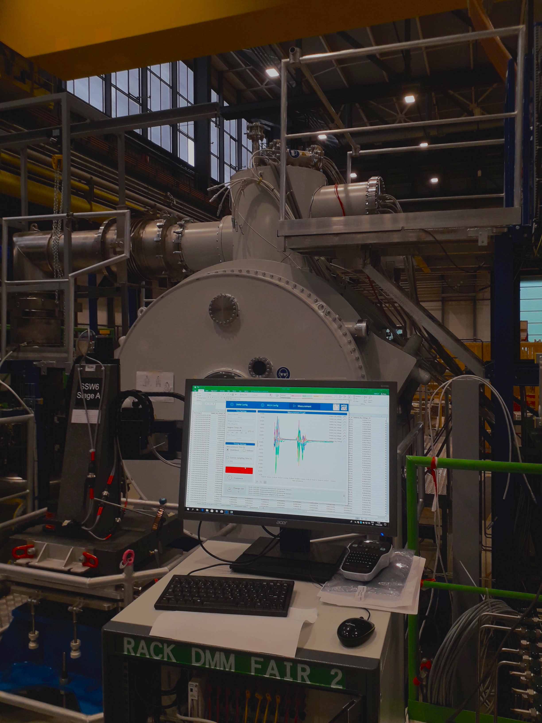
Plans/Ideas for improvements
Generate even more debug data.
Start measurement synchronously on multiple mobile racks.
Notify the user about new application version on startup.
Continue to eliminate any bugs/problems recognized by operators.

