Slide 1
Results from the MBPL Measurements in NA64
Melvin Liebsch, Jens Kaeske and Thomas Zickler

Slide 2
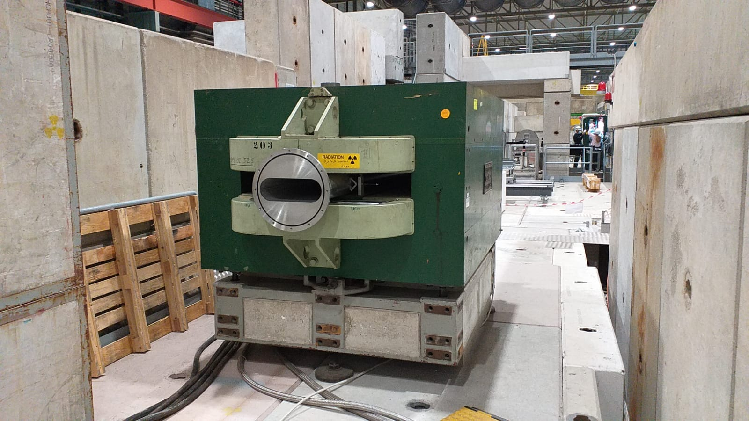
Magnetic Measurement Request
Two bending dipole magnets in the north area
Magnets are equipped with a vacuum chamber with unknown properties
Permeability of vacuum chamber is to be characterized
Domain inside the chamber is to be mapped
Requested accuracy in the % range

Slide 3
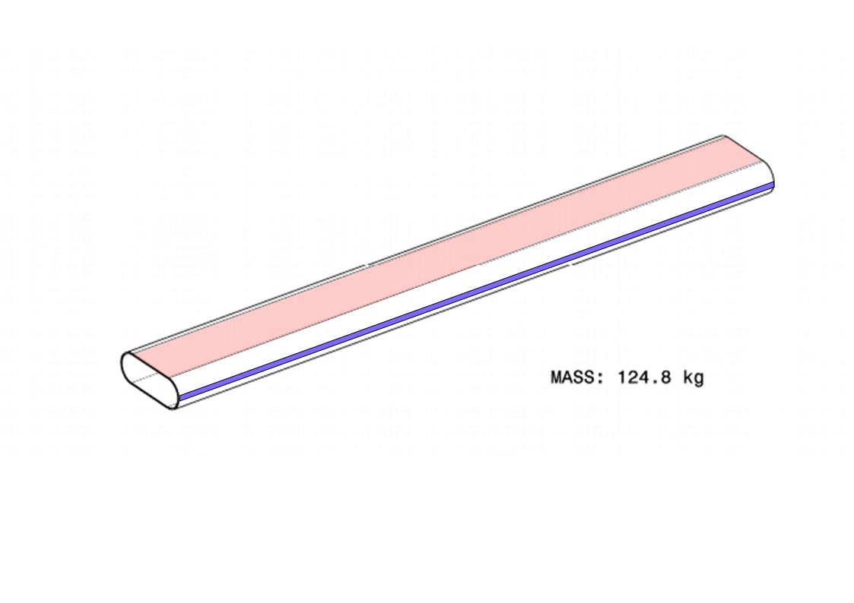
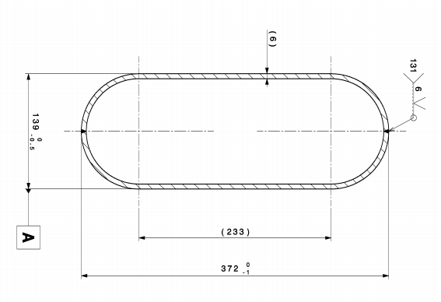
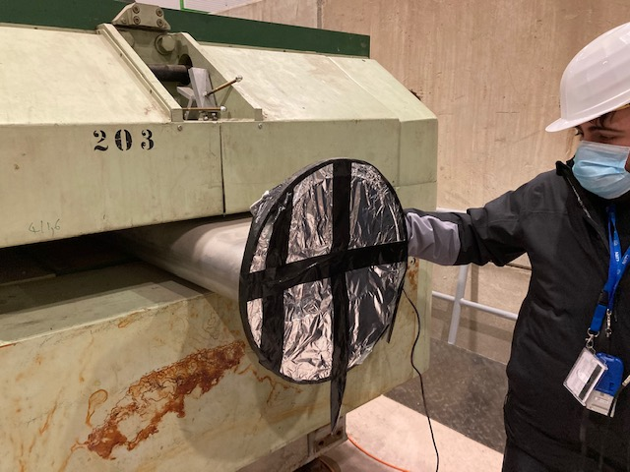


The Vacuum Chamber
Stainless seel type: 304L
Two welding seams along the chambers length
$μ_{r}$ = 1.07 +/- 0.01
$μ_{r}$ = 1.07 +/- 0.01
Permeability was measured with a FOERSTER Magnetoscop
Thanks to Mariano for the permeability measurements!

Slide 4
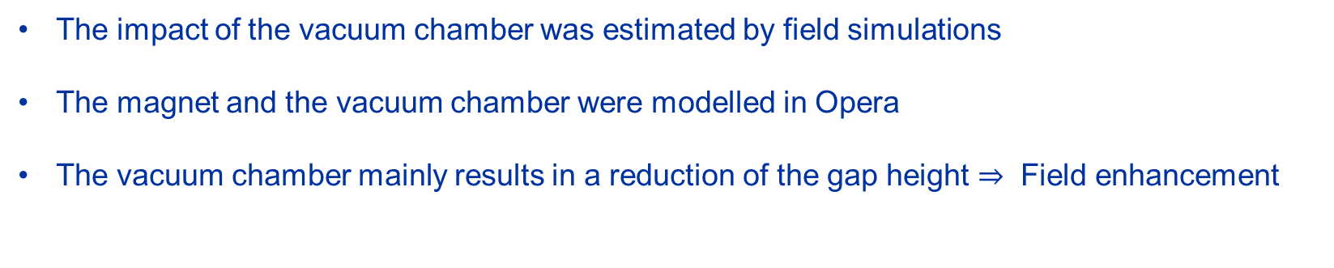
Field Simulations
The impact of the vacuum chamber was estimated by field simulations
The magnet and the vacuum chamber were modelled in Opera
The vacuum chamber mainly results in a reduction of the gap height $⇒$ Field enhancement
Thanks Thomas for these simulations!

Slide 5
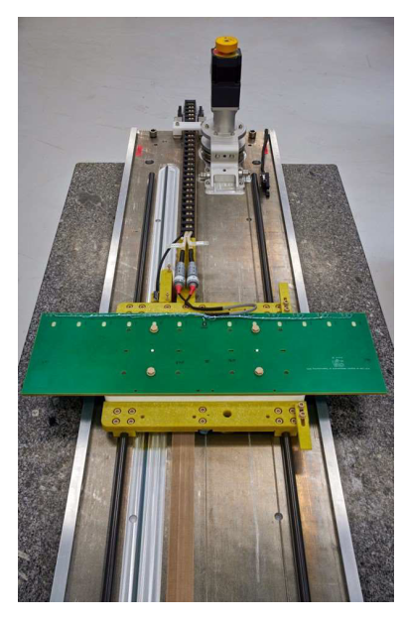
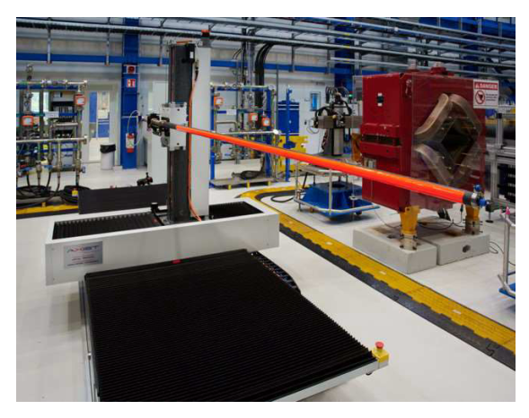
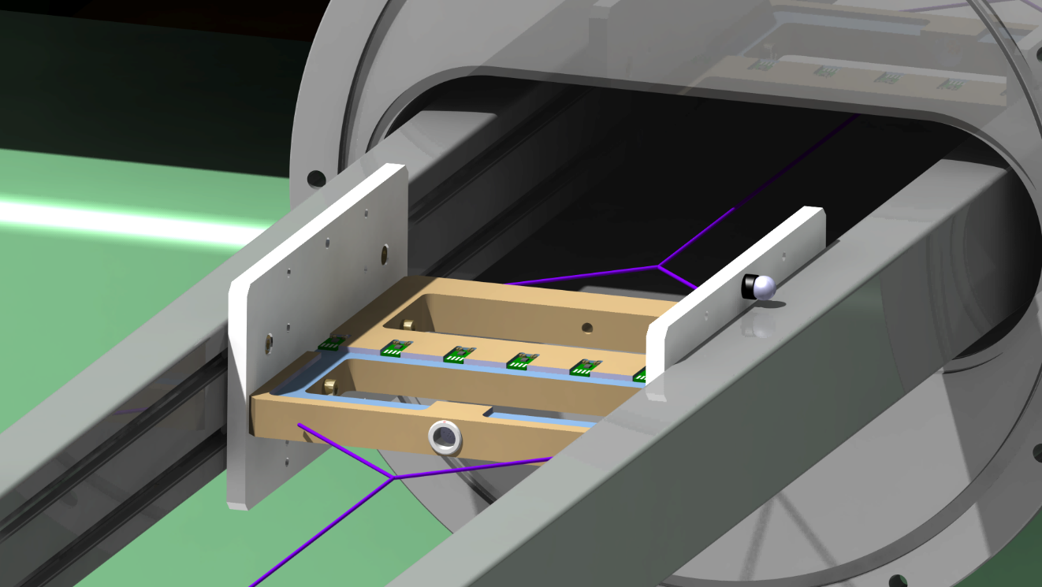
Magnetic Field Maps
Constraints:
  3D mapper is occupied to set up the FAIR measurements
  Translating Fluxmeter does not fit in the vacuum chamber
  Time: Measurements needed to be performed in March 2021
Solution:
The Hall probe array
Thanks to Jens for his work on the development of this system!

Slide 6
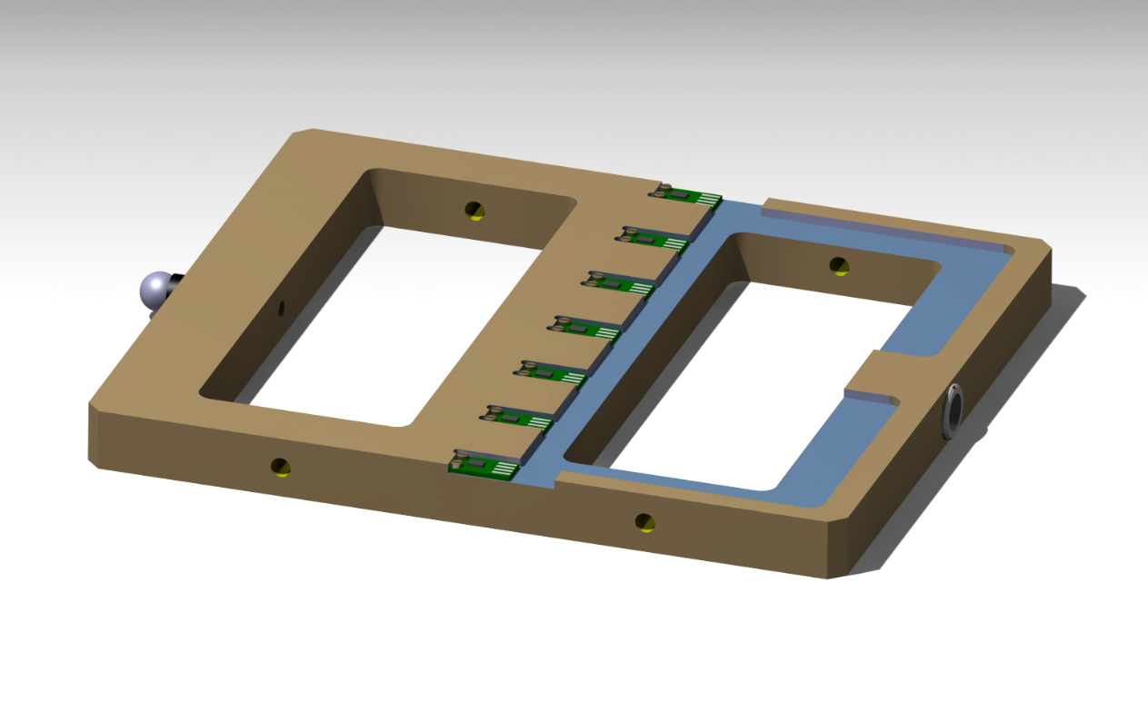
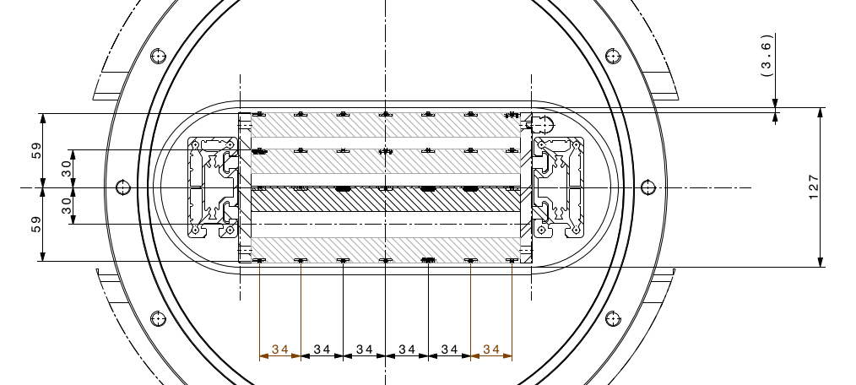
The System in a Nutshell
7 Hall probes
Asensor HE244
Guiding rails 2 mm sag over 5 m
Sled
Retroreflector
Rods pulling the sled
Field can be mapped on 5 vertical positions

Slide 7
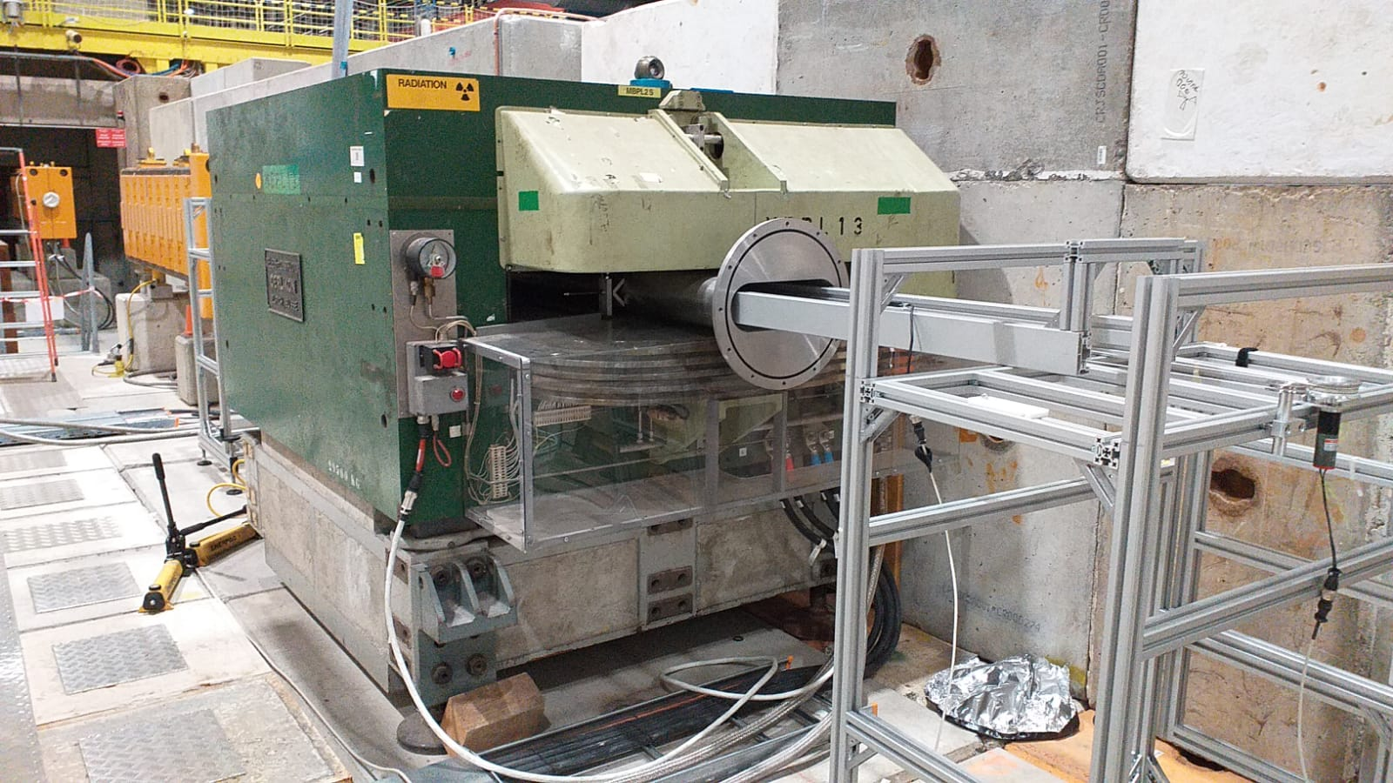
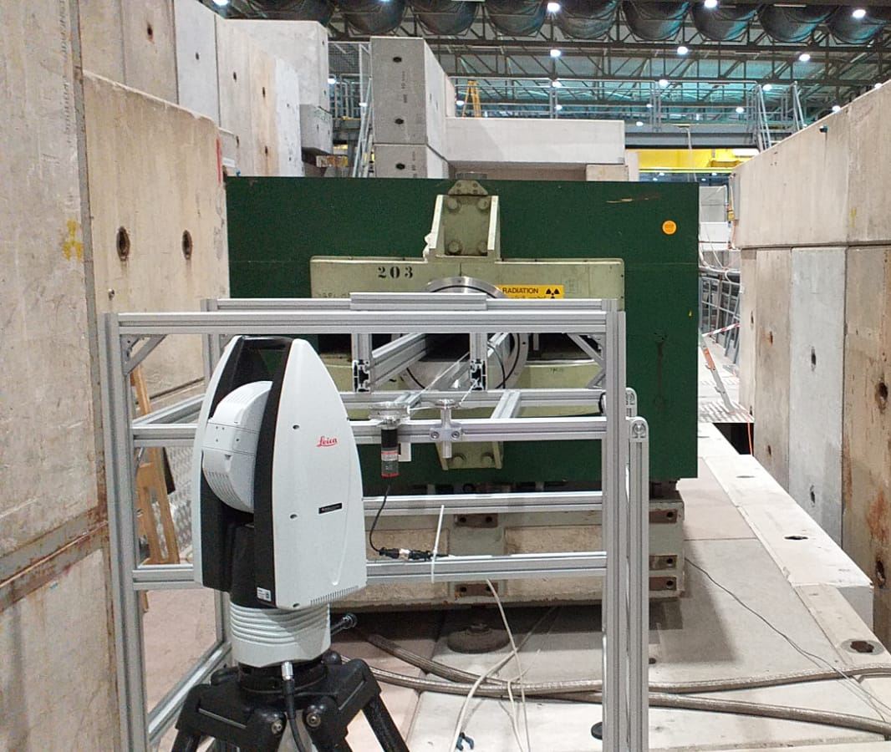
The System in a Nutshell
Leica Laser Tracker
Motor
Support

Slide 8
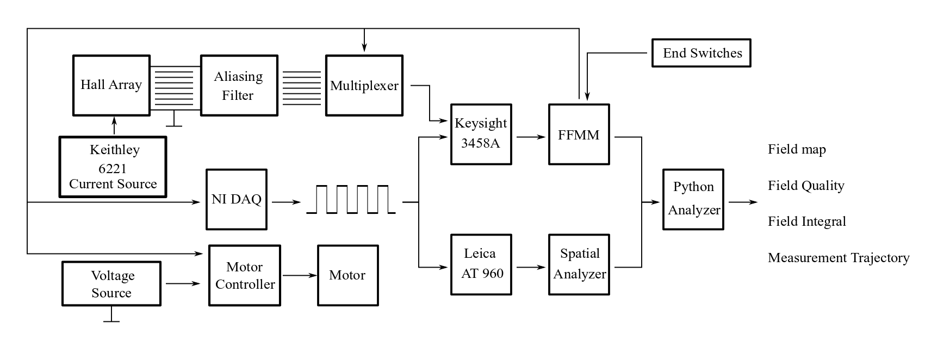
The System in a Nutshell

Slide 9
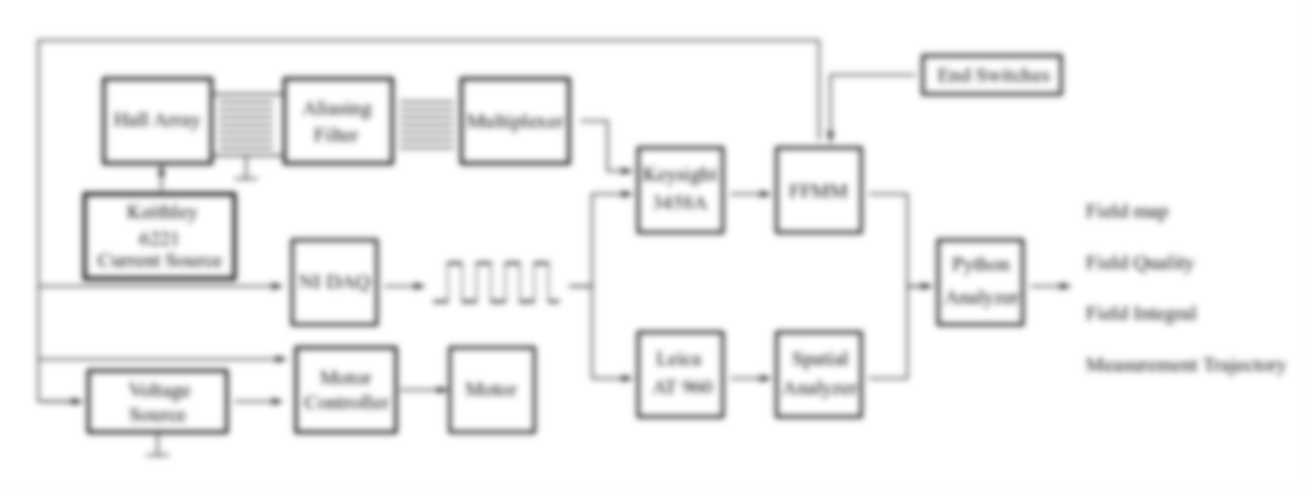

Sources of Noise
Aliasing Filter with 2 kHz corner frequency
Keithley introduced noise at 8 kHz

Slide 10
Sources of Noise
Signal cable was shielded to motor ground
The motor was is a large noise contributor

Slide 11
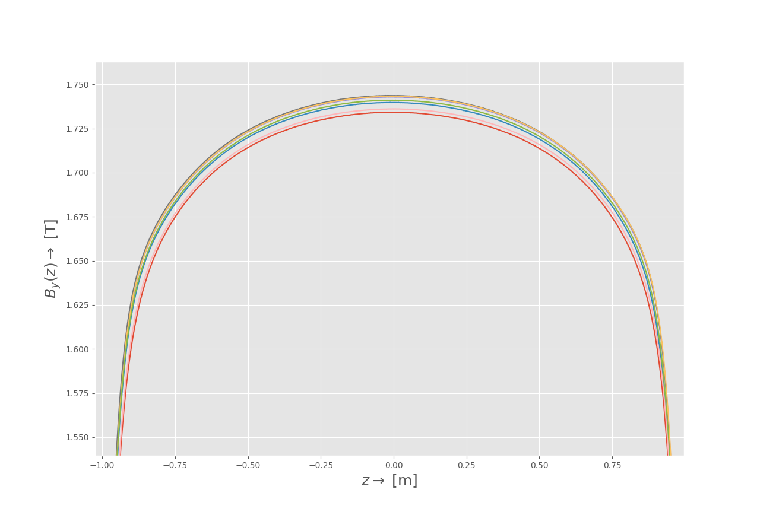
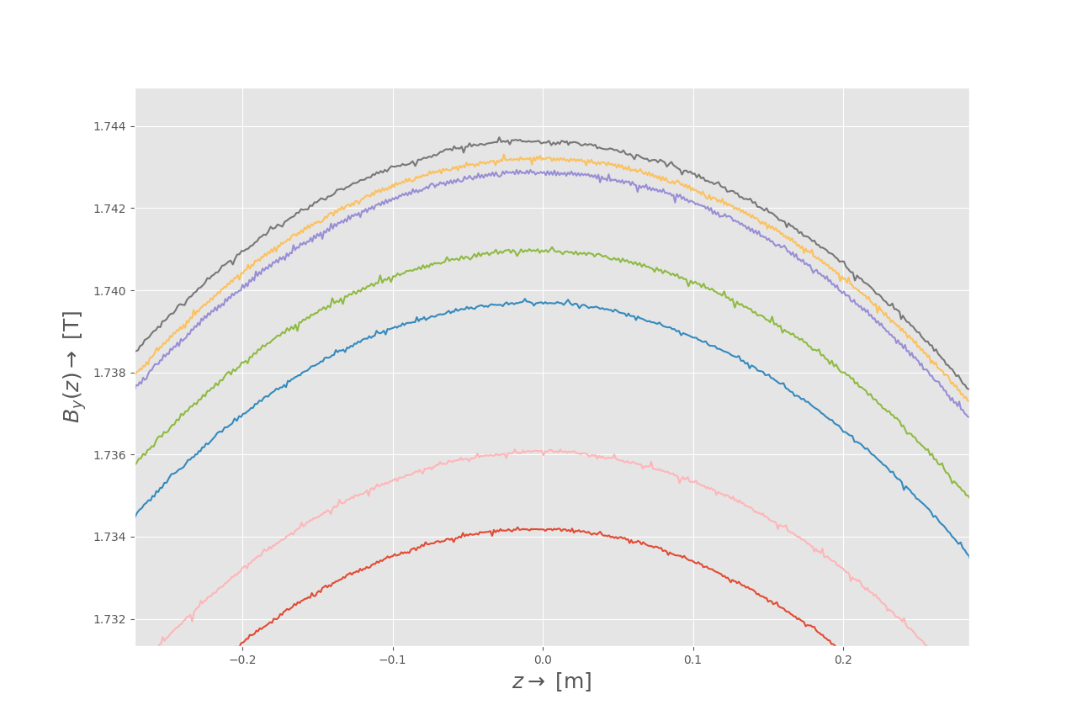
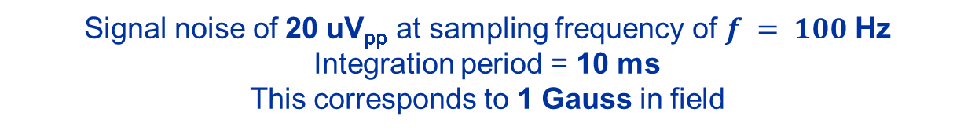
Sources of Noise
Signal noise of 20 uV_{pp} at sampling frequency of $f = 100$ Hz
Integration period = 10 ms
This corresponds to 1 Gauss in field

Slide 12
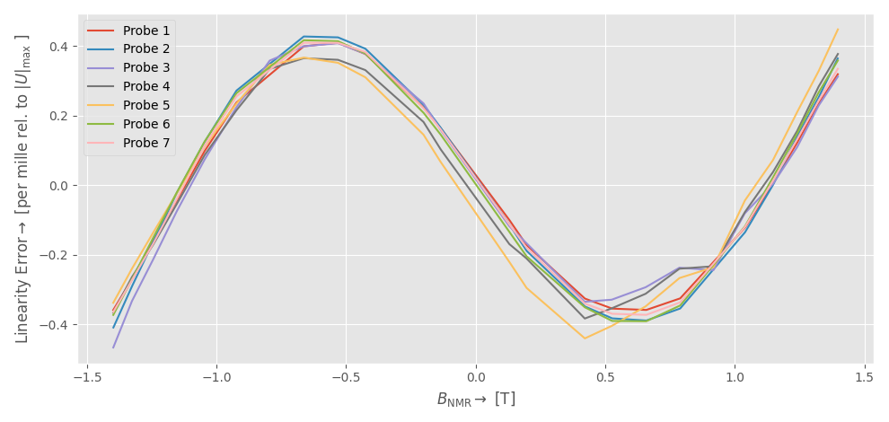
Calibration
Hall probes were calibrated between +/- 1.4 T in 311
The linearity error in this range is below 5 units of 10 000

Slide 13
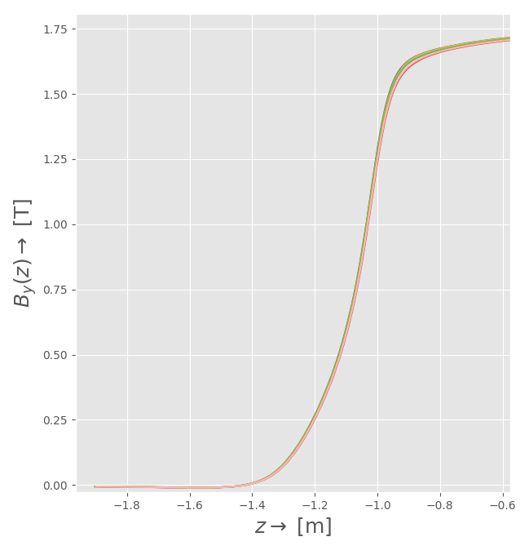
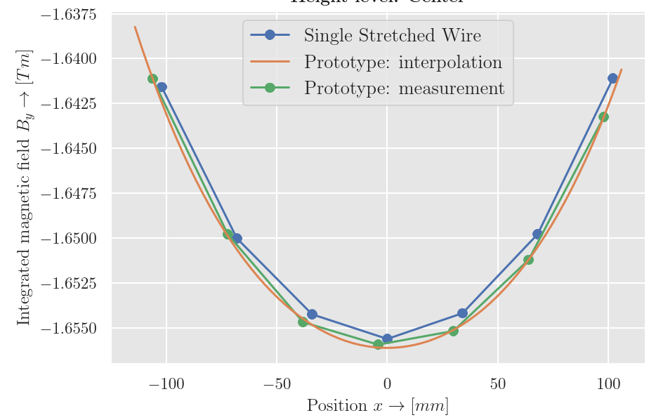
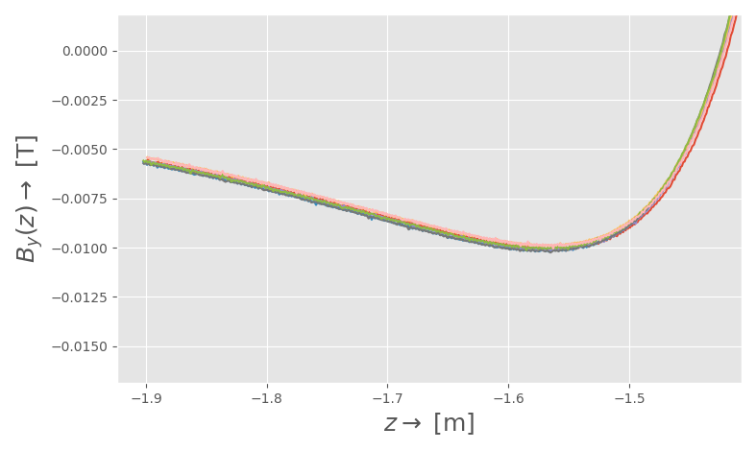
Verification in 311
System was used to measure the „Panzer“ in 311
A comparison to the SSW integral measurement was made
Why do the Hall probes see more field?
15 mTm
We are missing some of the field!

Slide 14
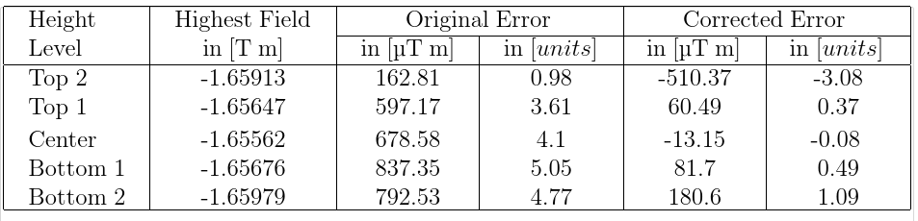
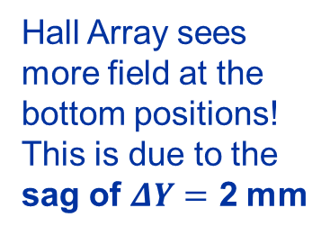
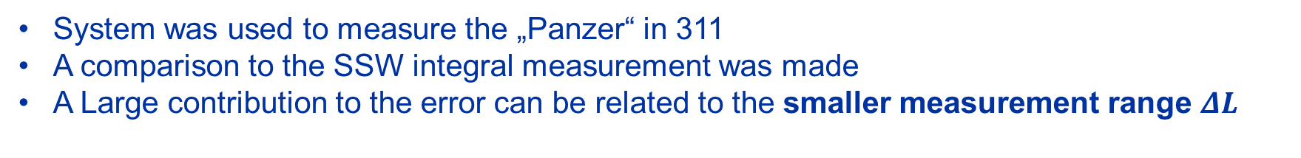



Verification in 311
System was used to measure the „Panzer“ in 311
A comparison to the SSW integral measurement was made
A Large contribution to the error can be related to the smaller measurement range $ΔL$
$$ΔL$$
$$ΔL$$
wire
$$ΔY$$
Hall Array
Hall Array sees more field at the bottom positions!
This is due to the sag of $ΔY=$ 2 mm

Slide 15
Measurements in 887

Slide 16
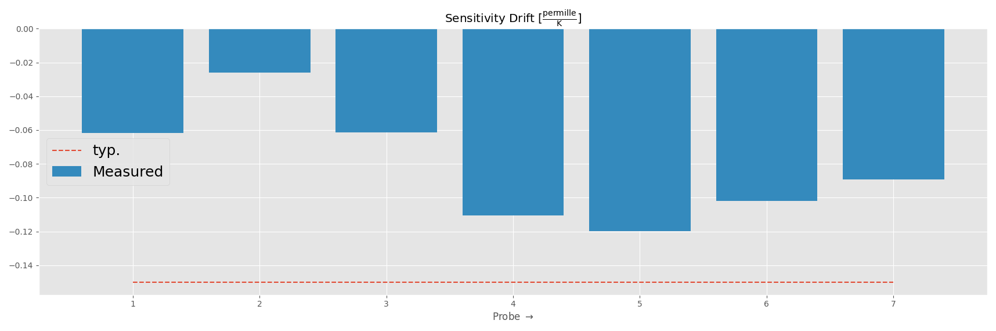
Temperature Dependency
The calibration was performed in the controlled environment in 311 T = 23 °C
At 887 the temperature is much lower T = 18.5 °C
We have to recalibrate the sensitivity!
Typical value given in the datasheet

Slide 17
Magnet Cycles
830 A
100 A

Slide 18
Magnet Cycles
1
2
3
4
5
6
7
830 A
100 A

Slide 19
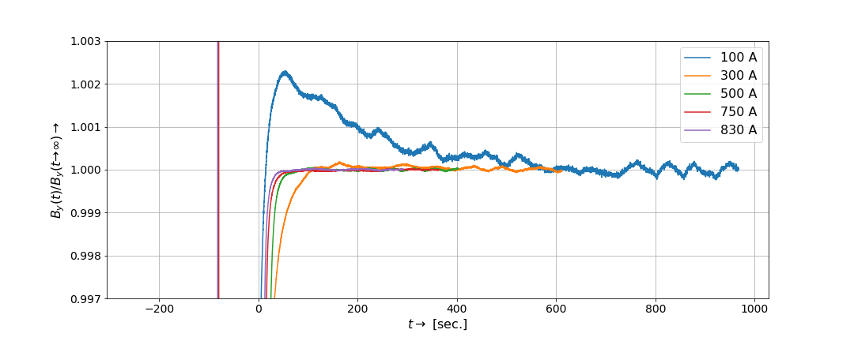
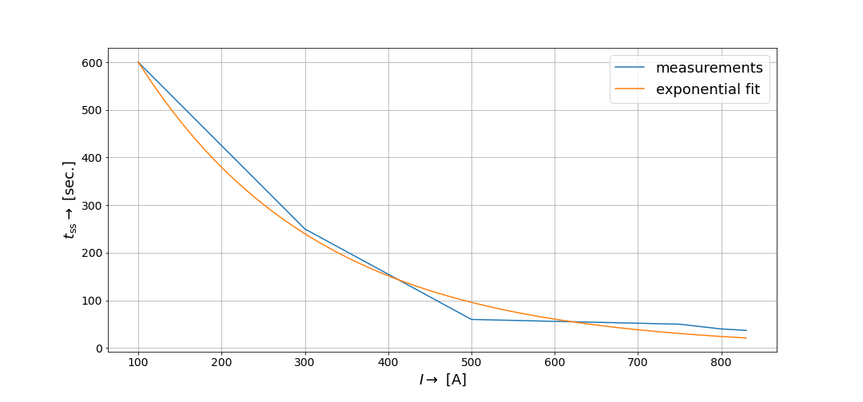
Transient Effects
The yoke is bulk $→$ Eddy currents with large time constants
Probe in the magnet center
Ramping to requested currents
How long you need to wait until decay?
We are at the moment preparing for another measurement of this type separating ramp up and down

Slide 20
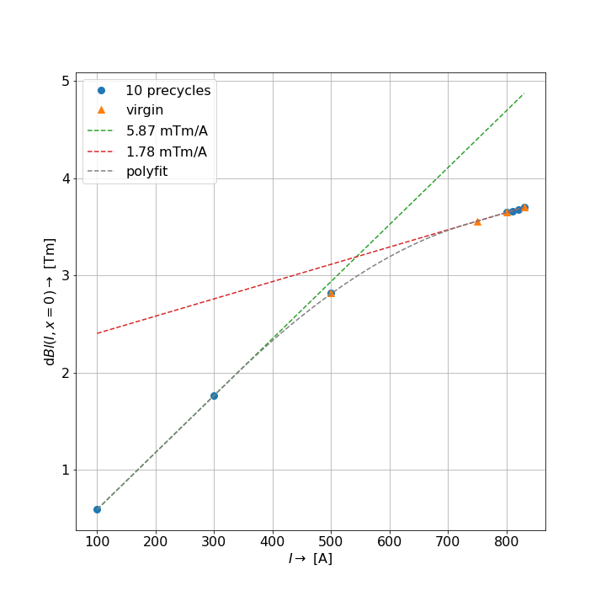
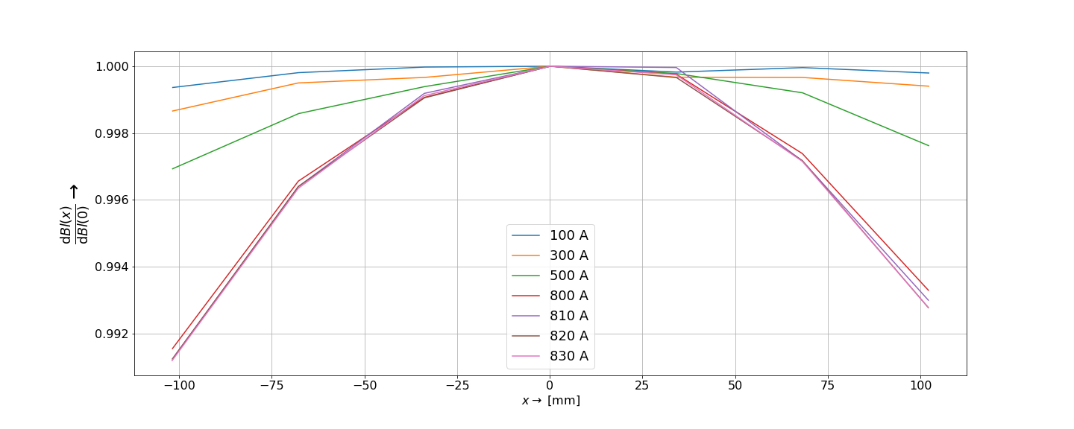
Field Integrals
x coordinate wrt to chamber center. Magnet is misaligned wrt chamber!
magnetic center [mm] | des. mech. center [mm]
-4.6479 | -4.702
B(I)
Coincidence within 50 um!

Slide 21
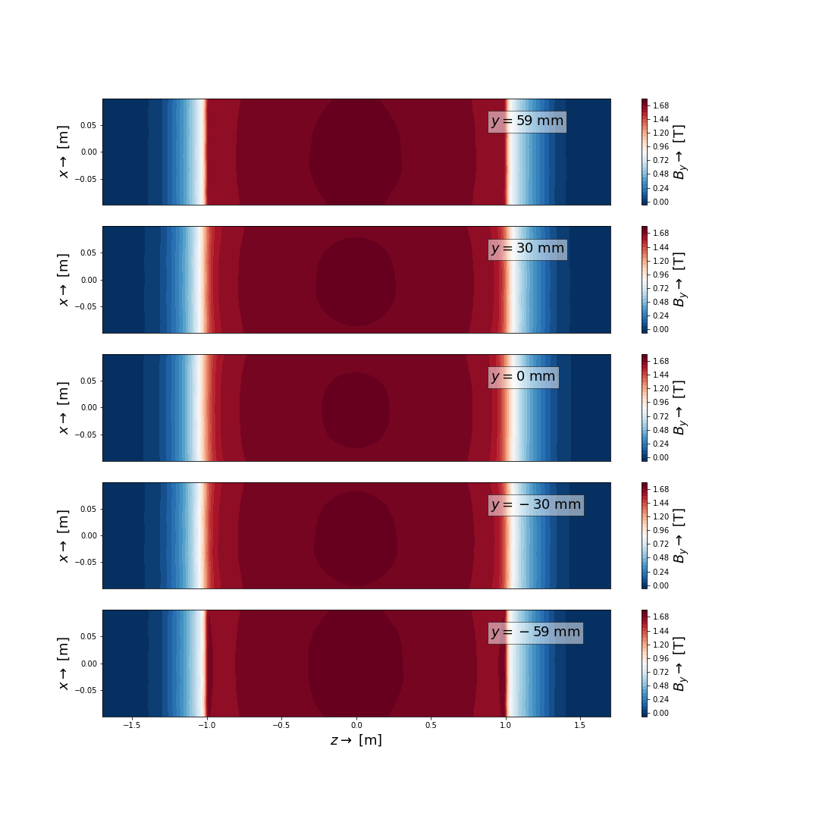
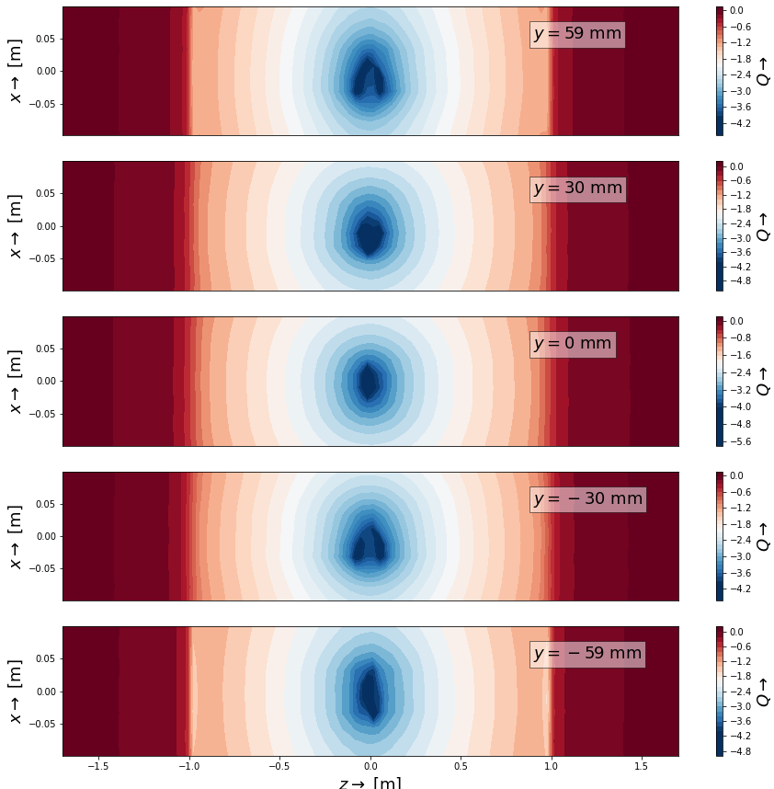
Field Profiles Field Quality

Slide 22
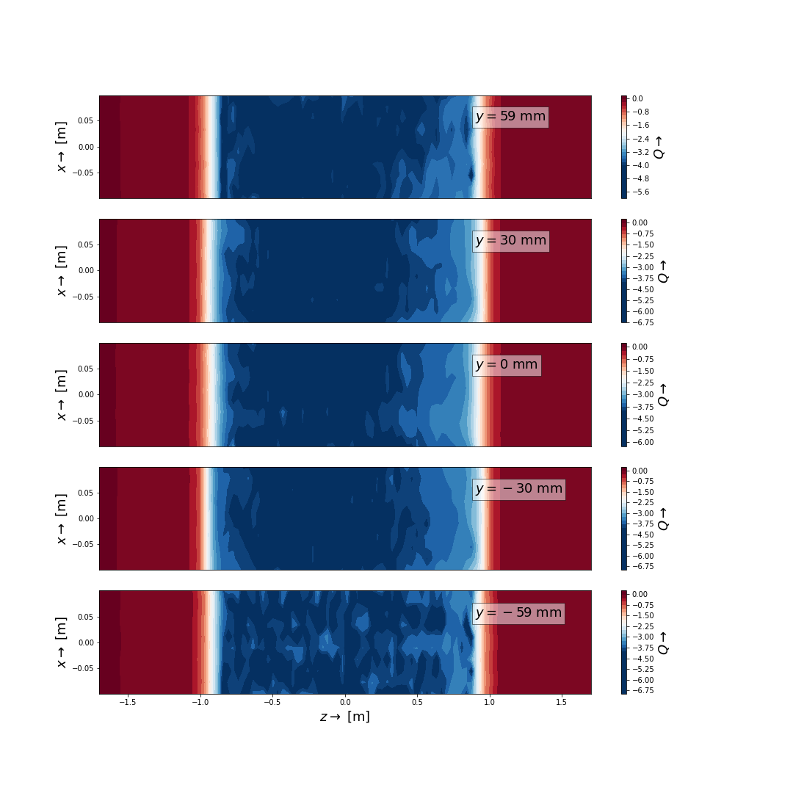
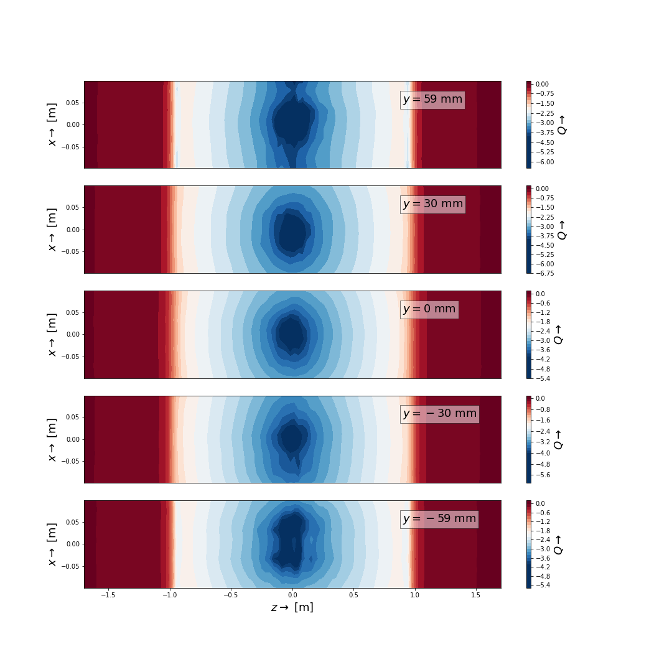
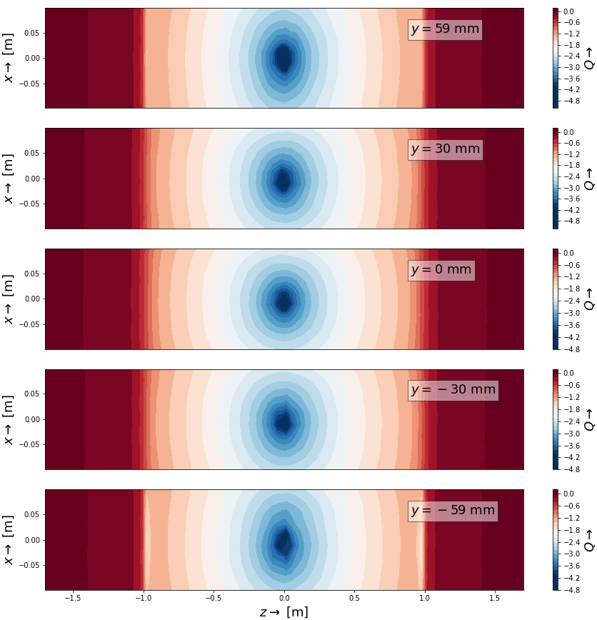
Measurements done for 2 magnets at 7 current levels
300 A
500 A
800 A

Slide 23
Conclusion
Measurement request satisfied
Total costs of new components < 10 000 CHF
Possible Improvements:
Instrumental amplifiers to get single ended signals for all Hall probes → parallel acquisition with DAQ
Controlling the Leica from FFMM
Mechanism to pull back the cable
7x faster
Full automation

Slide 24
Acknowledgements
The whole project was finished within 3 months.
Mainly because of the help of the 311 team!
Special thanks to:
Dmitry for the design
Nini for machining
Fatia for electronics and cabling
Richard for manufacturing the Hall probe array
Guy for building the Leica trigger box

