Slide 1
EP-nu Meeting
4/2/2021

Slide 2
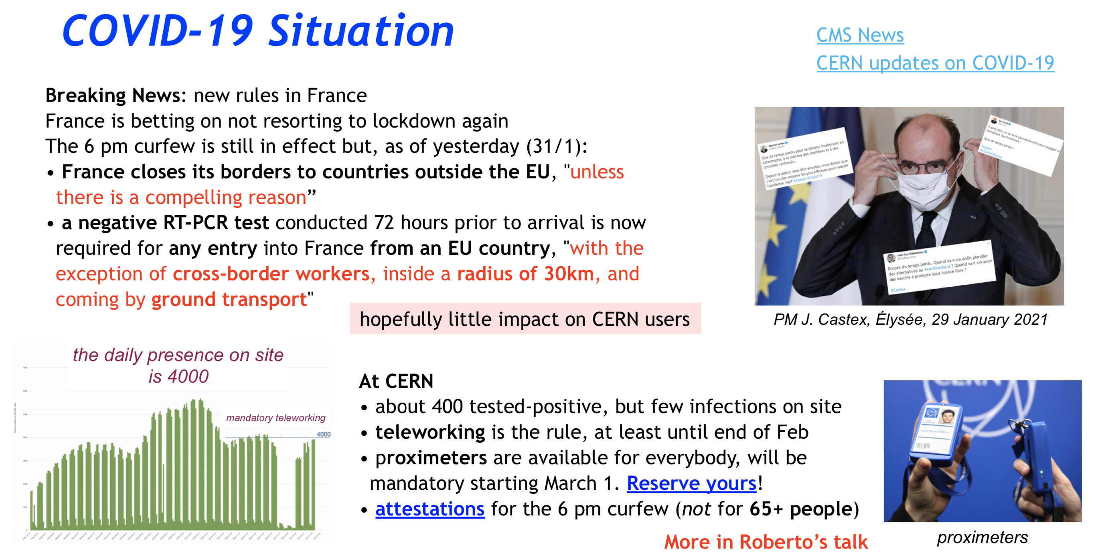
From the CMS meeting om Monday

Slide 3
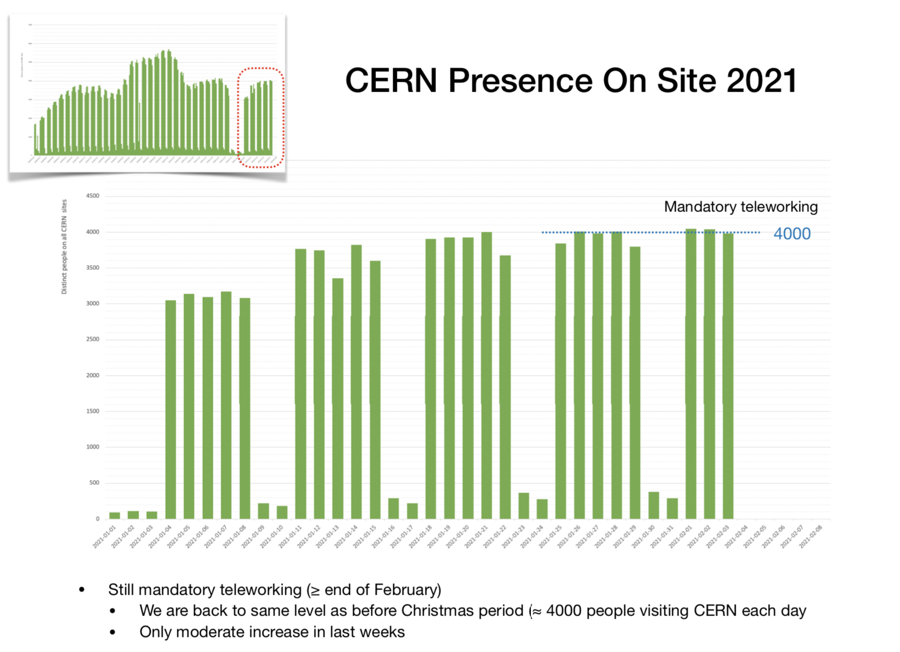

Slide 4
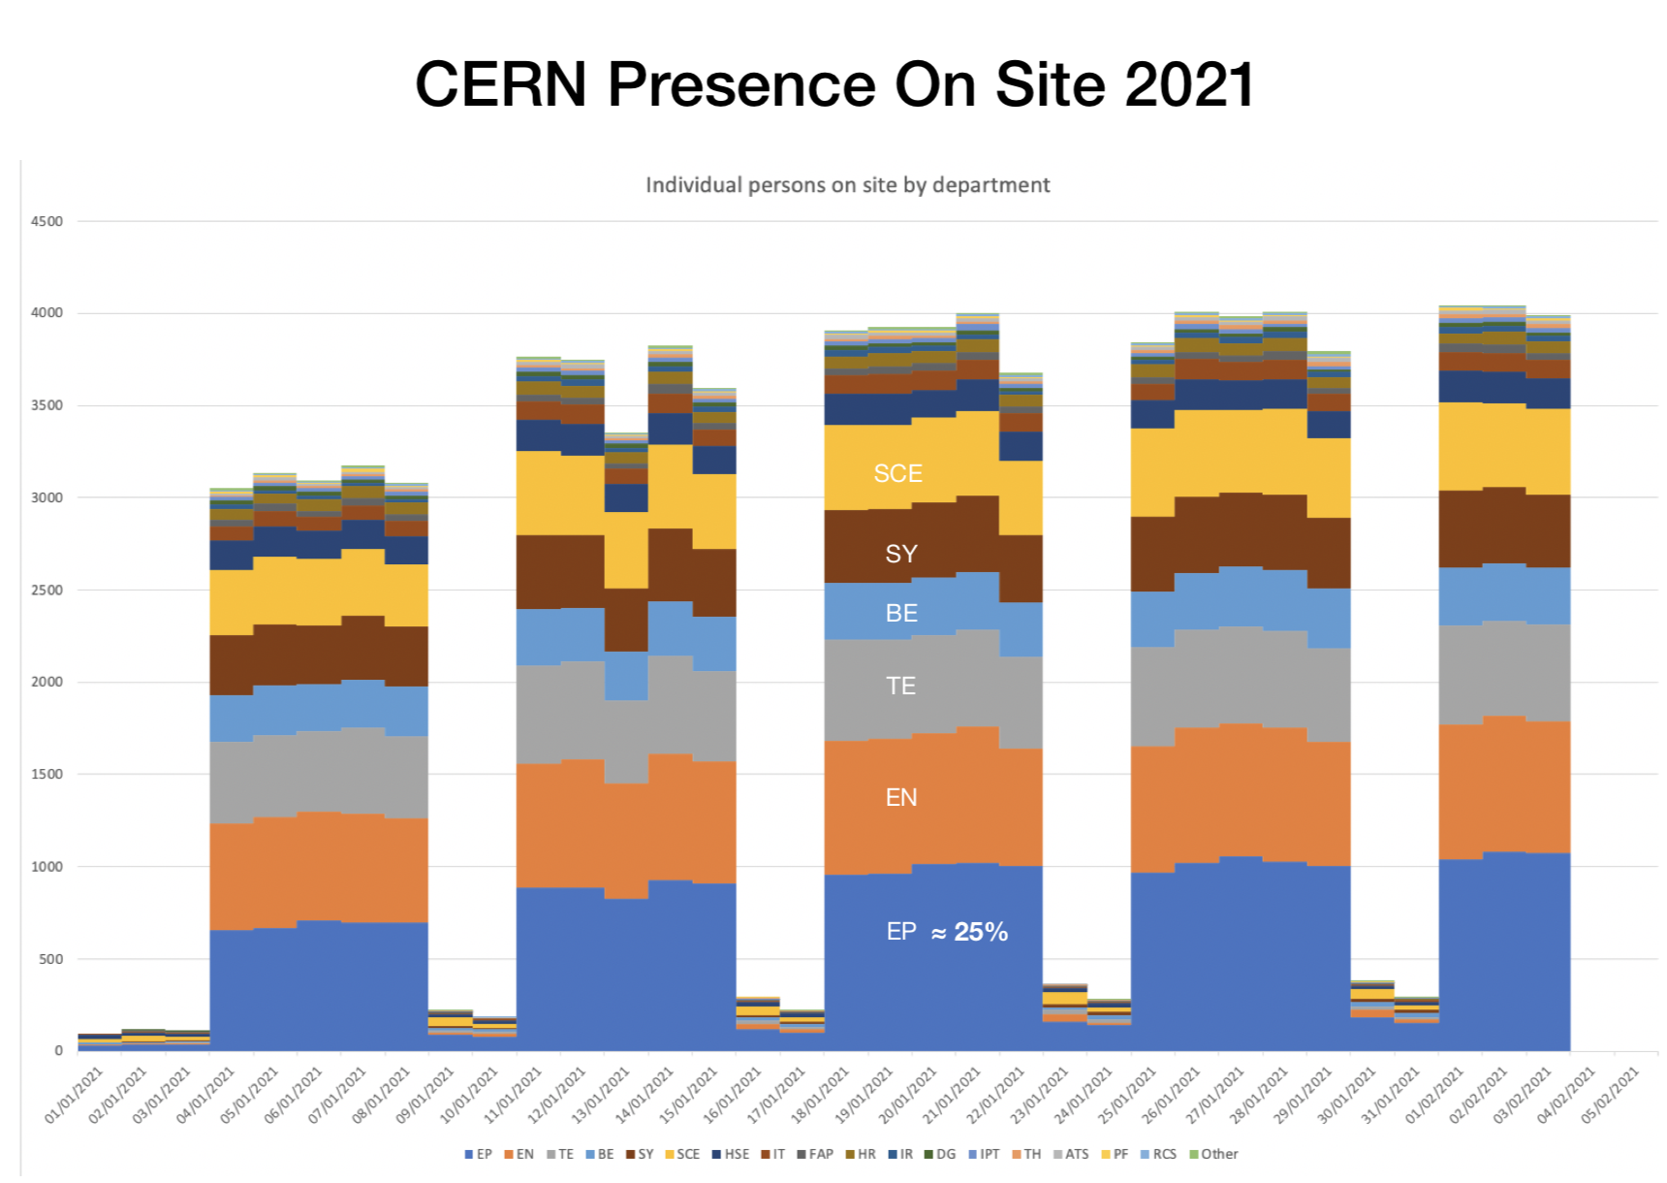

Slide 5
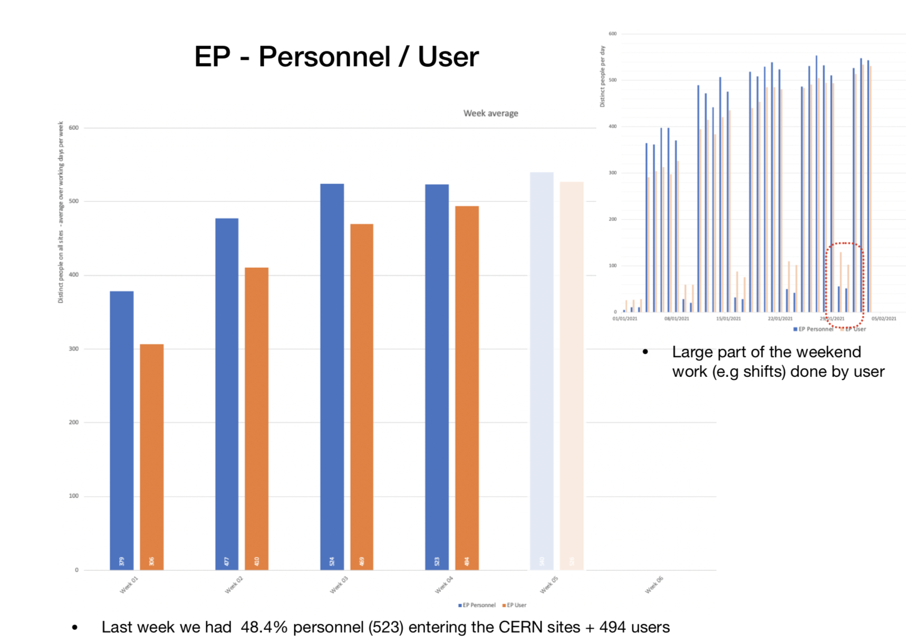

Slide 6
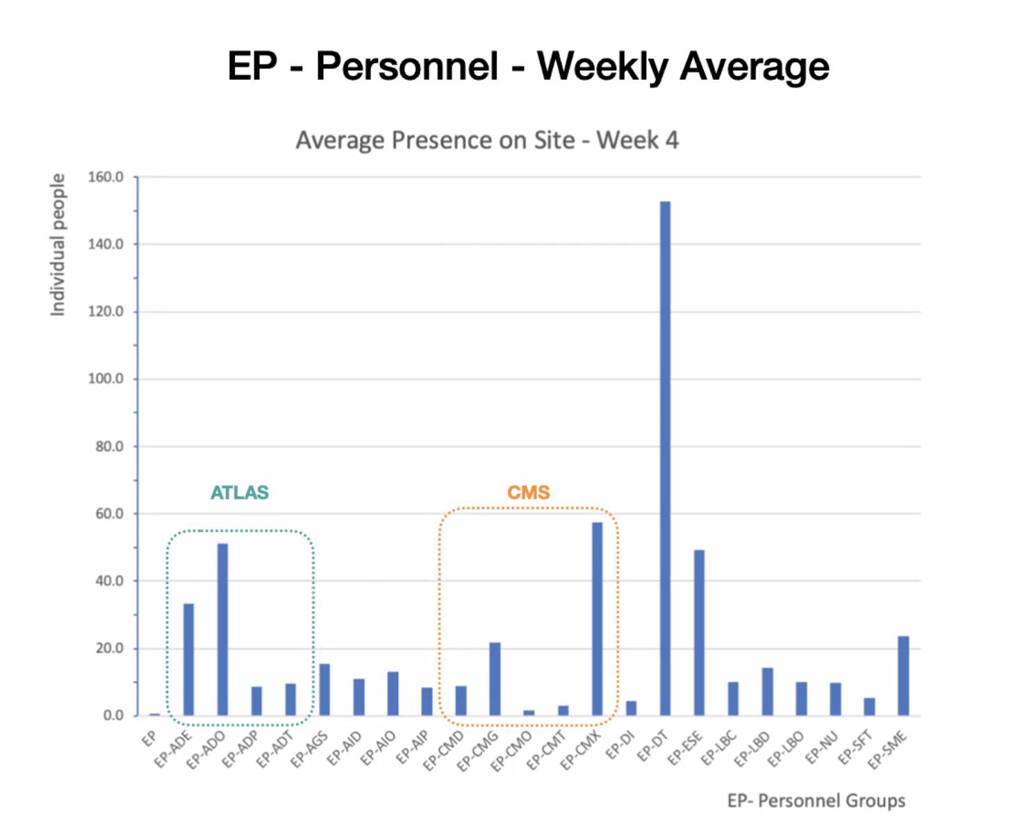

Slide 7
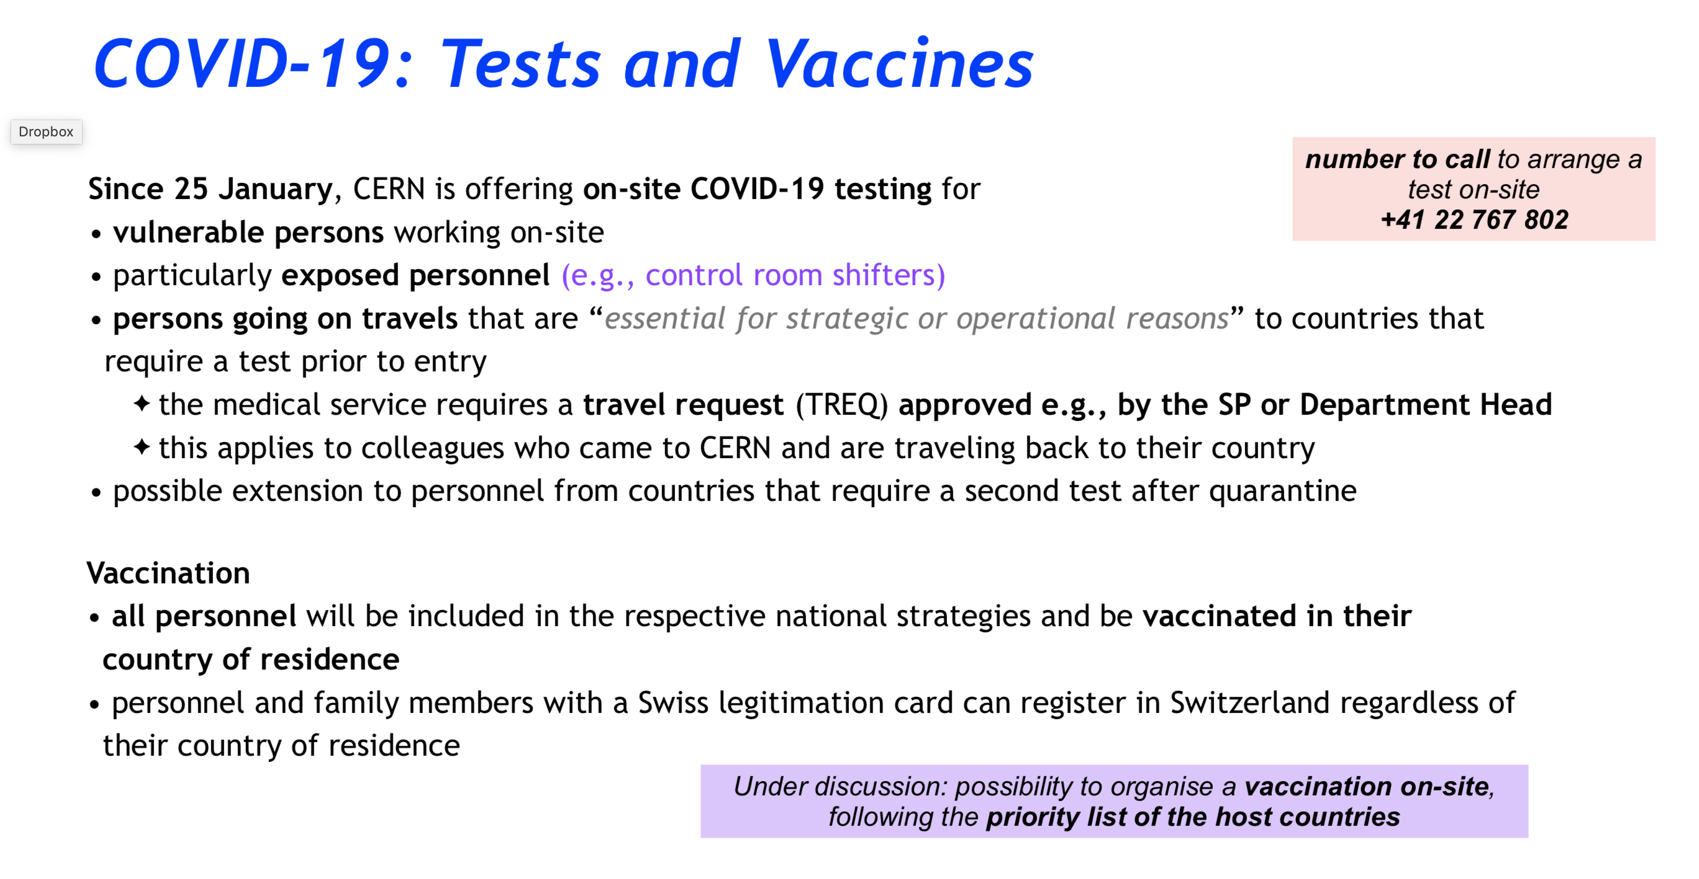

Slide 8
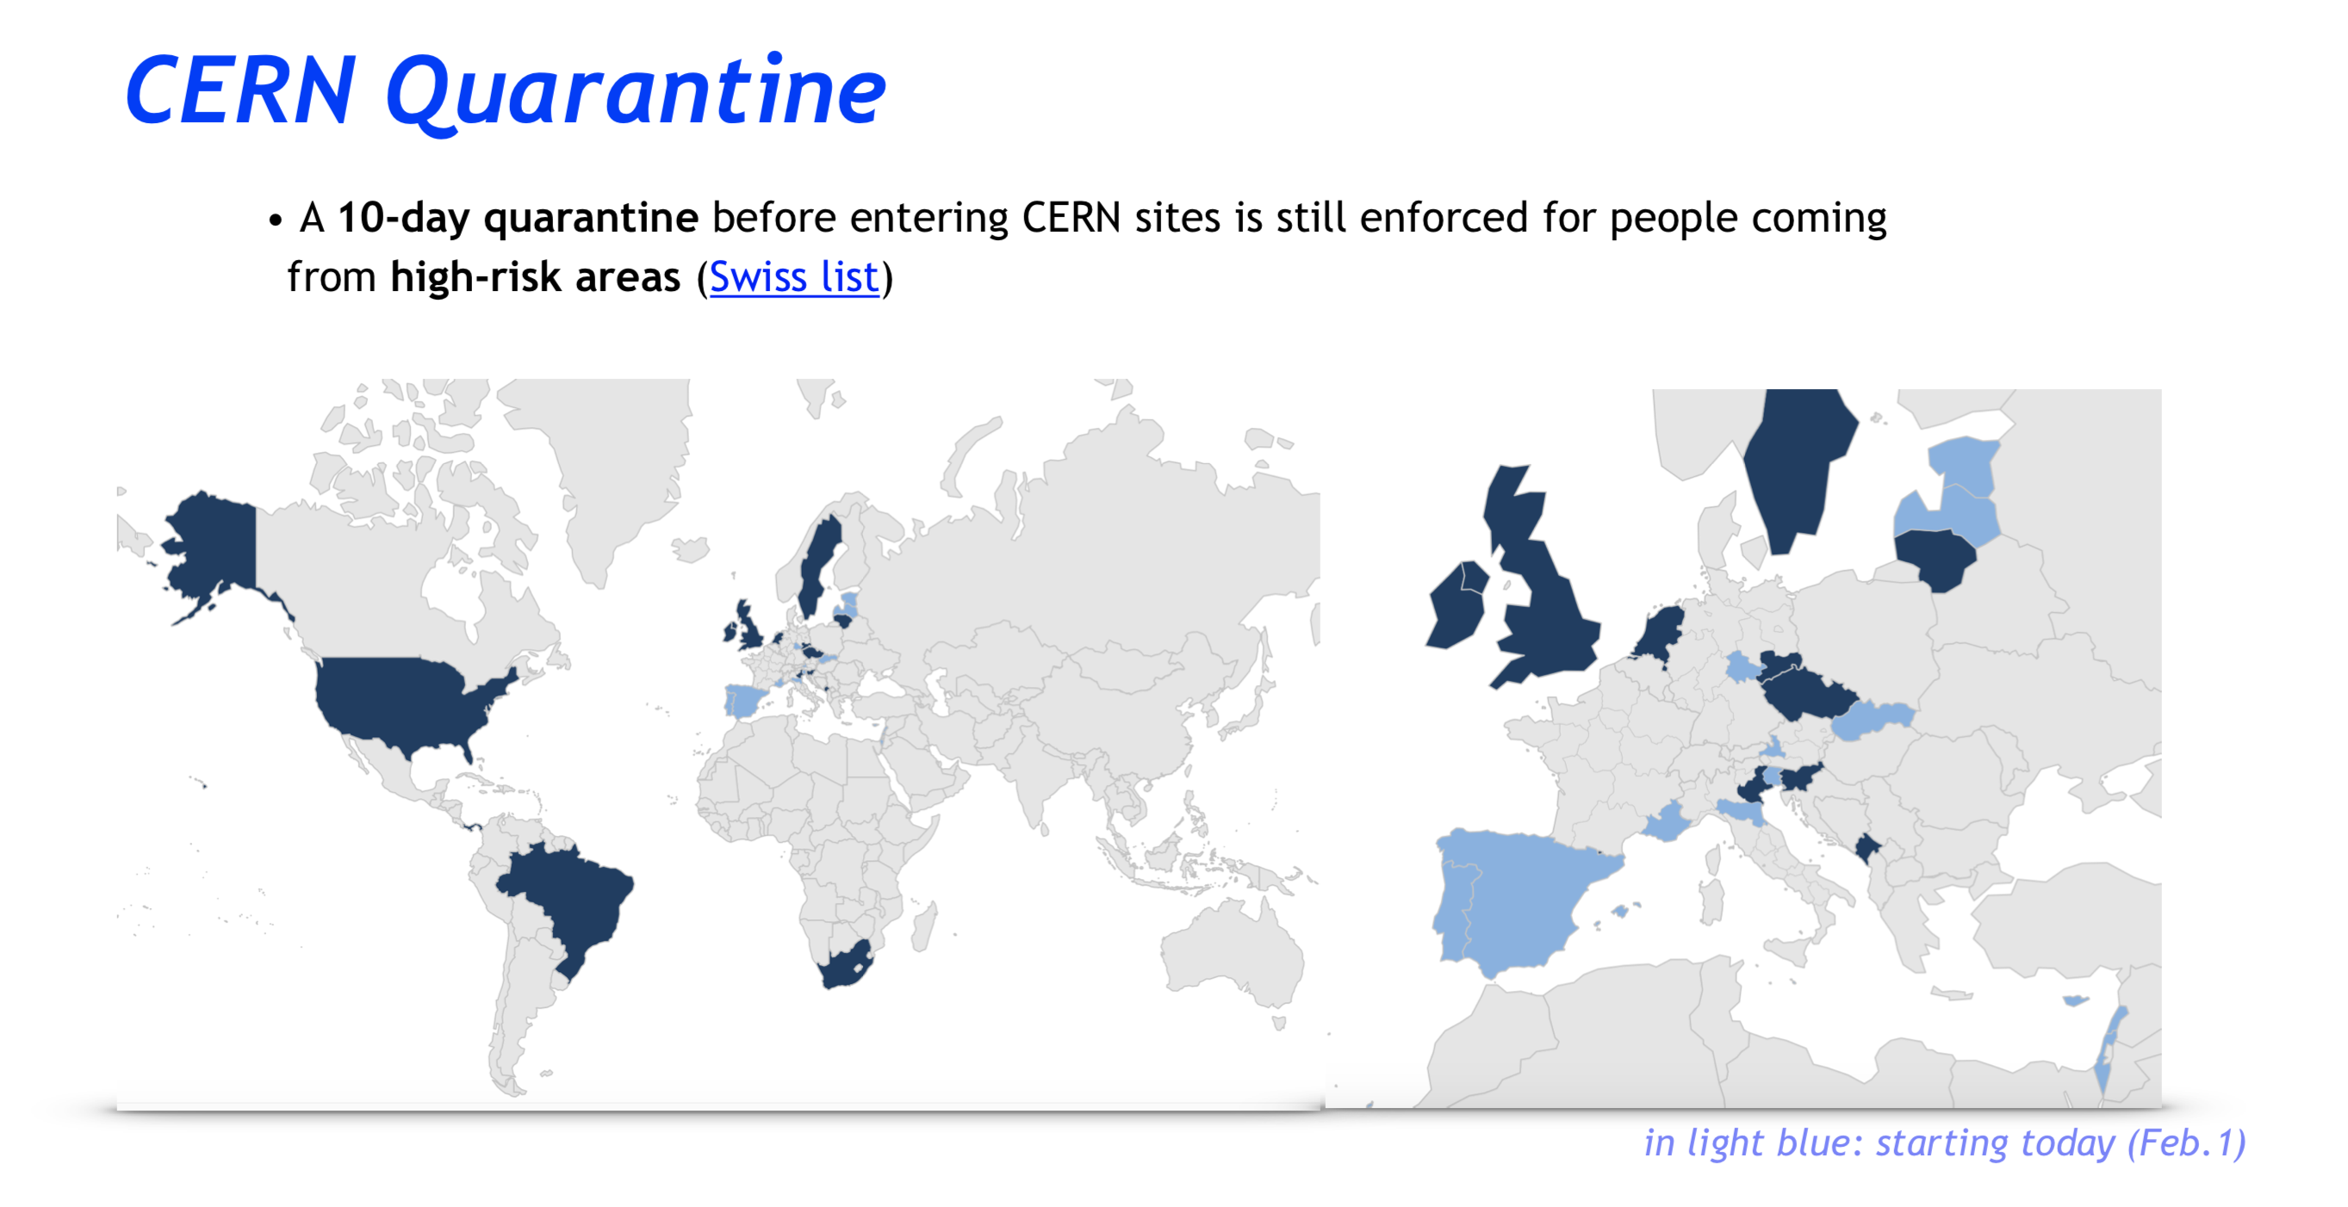

Slide 9
DUNE Outreach
Dune is collecting self-made videos it should be only 1 person telling in 3 minutes about 3 points:
Introducing him/herself and the position at CERN
Introducing CERN as an institution and location
Explaining how is CERN contributing to DUNE
Nothing too formal or fancy, just a simple phone video/selfie – it’s for general public so no need to go too much into details
Volunteers?

